Slide 1
Lunar calibration for forthcoming instrument: Himawari-8/AHI
Masaya Takahashi
Japan Meteorological Agency

Slide 2
Contents
Introduction
Himawari-8/AHI radiometric calibration plan
Lunar calibration
Summary and future plans

Slide 3
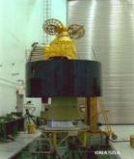
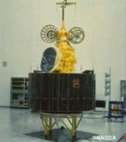
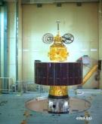
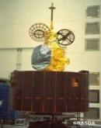
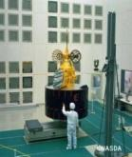
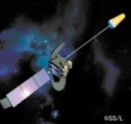
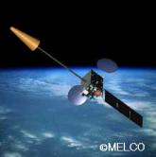
JMA geostationary (GEO) satellites
GMS (Geostationary Meteorological Satellite)
GMS
GMS-2
GMS-3
GMS-4
GMS-5
(GOES-9)
(Himawari)
(Himawari-2)
(Himawari-3)
(Himawari-4)
(Himawari-5)
Back-up operation of GMS-5 w/ GOES-9 by NOAA/NESDIS:
2003/05/22-2005/06/28
Satellite | Operation period
GMS | 1978 – 1981
GMS-2 | 1981 – 1984
GMS-3 | 1984 – 1989
GMS-4 | 1989 – 1995
GMS-5 | 1995 – 2003
GOES-9 | 2003 – 2005
MTSAT-1R | 2005 – 2010
MTSAT-2 | 2010 – 2015
Himawari-8 | 2015 – 2022
Himawari-9 | 2022 – 2029
ⒸNASDA
ⒸNASDA
ⒸNASDA
ⒸNASDA
ⒸNASDA
Jul 1977
Aug 1981
Aug 1984
Sep 1989
Mar 1995
MTSAT (Multi-functional Transport SATellite )
MTSAT-1R
MTSAT-2
(Himawari-6)
(Himawari-7)
Himawari
Himawari-8
Himawari-9
launched on
7 Oct. 2014!
ⒸSS/L
ⒸMELCO
2014
2016
Feb 2005
Feb 2006

Slide 4
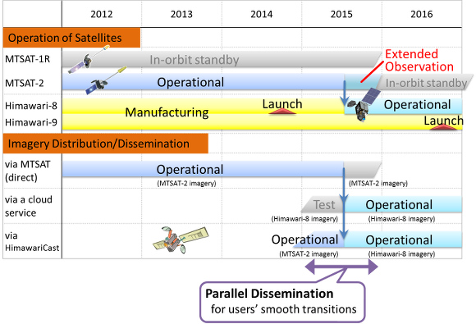
Data distribution/dissemination schedule

Slide 5
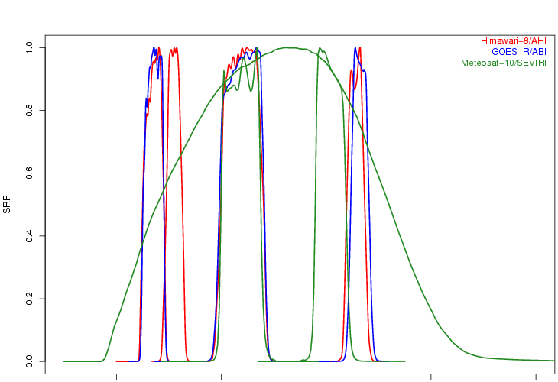
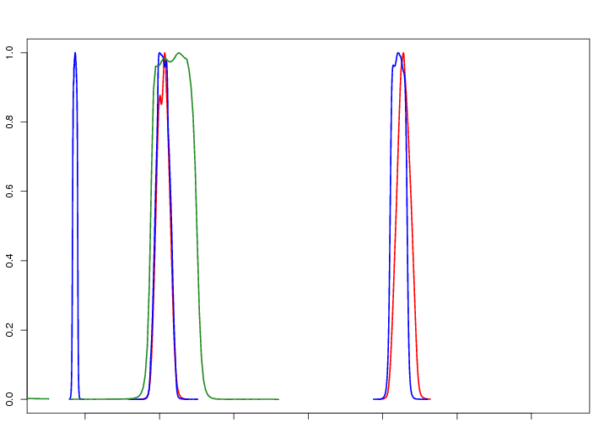
Himawari-8/AHI VIS/NIR bands
AHI VIS/NIR spec.
Band | Central Wavelength [μm] | Spatial Resolution [km] | # of detectors (*) | Levels of digital count [bit]
1 | 0.47 | 1 | 676 (3) | 11
2 | 0.51 | 1 | 676 (3) | 11
3 | 0.64 | 0.5 | 1460 (3) | 11
4 | 0.86 | 1 | 676 (6) | 11
5 | 1.6 | 2 | 372 (6) | 11
6 | 2.3 | 2 | 372 (6) | 11
Himawari-8/AHI
GOES-R/ABI
Meteosat-10/SEVIRI
0.4 0.6 0.8 1.0 1.2 1.4 1.6 1.8 2.0 2.2 2.4 [µm]

Slide 6
Himawari-8/9 AHI observations in 10 minutes time frame
These “super-rapidscan”s (every 30 seconds)
will also be used for the lunar observations
Full Disk Observation
every 10 min.
Region 1
(NE Japan)
Every 2.5 min.
Region 2
(SW Japan)
Every 2.5 min.
Region 3
(Target Area)
Every 2.5 min.
Region 4
(Landmark Area)
Every 30 sec.
Region 5
(Landmark Area)
Every 30 sec.

Slide 7
Himawari-8/AHI radiometric calibration/comparison
Band | Central Wavelength [µm] | Solar Diffuser | Black Body | GSICS (IR) | GSICS (DCC) | GSICS (Moon) | Vicarious method (RTM) | Ray matching | GEO-GEO
1 | 0.47 | Y |  |  | Y | Y | Y | (Y) | (Y)
2 | 0.51 | Y |  |  | Y | Y | Y | (Y) | (Y)
3 | 0.64 | Y |  |  | Y | Y | Y | (Y) | (Y)
4 | 0.86 | Y |  |  | Y | Y | Y | Y | (Y)
5 | 1.6 | Y |  |  | Y? | Y | Y | Y | (Y)
6 | 2.3 | Y |  |  | Y? | Y | Y | Y | (Y)
7 | 3.9 |  | Y | Y |  |  | (Y) | (Y) | (Y)
8 | 6.2 |  | Y | Y |  |  | (Y) | (Y) | (Y)
9 | 6.9 |  | Y | Y |  |  | (Y) | (Y) | (Y)
10 | 7.3 |  | Y | Y |  |  | (Y) | (Y) | (Y)
11 | 8.6 |  | Y | Y |  |  | (Y) | (Y) | (Y)
12 | 9.6 |  | Y | Y |  |  | (Y) | (Y) | (Y)
13 | 10.4 |  | Y | Y |  |  | (Y) | (Y) | (Y)
14 | 11.2 |  | Y | Y |  |  | (Y) | (Y) | (Y)
15 | 12.4 |  | Y | Y |  |  | (Y) | (Y) | (Y)
16 | 13.3 |  | Y | Y |  |  | (Y) | (Y) | (Y)

Slide 8
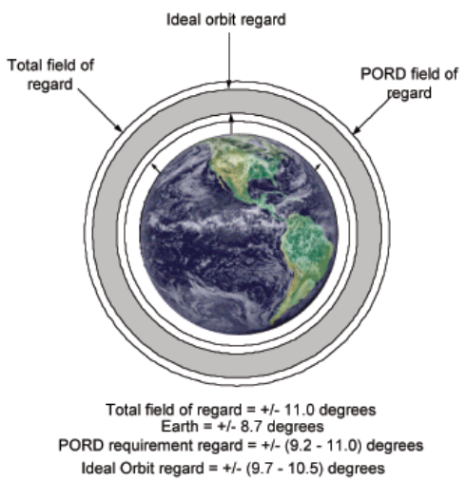
AHI VIS/NIR spec.
Himawari-8/AHI
lunar calibration
Band | Central Wavelength [μm] | Spatial Resolution [km] | # of detectors (*) | Levels of DC [bit]
1 | 0.47 | 1 | 676 (3) | 11
2 | 0.51 | 1 | 676 (3) | 11
3 | 0.64 | 0.5 | 1460 (3) | 11
4 | 0.86 | 1 | 676 (6) | 11
5 | 1.6 | 2 | 372 (6) | 11
6 | 2.3 | 2 | 372 (6) | 11
The Moon acquisition: super-rapidscan / 30 sec
Performed based on the Moon position prediction
~100 lunar observations / month are expected
One swath for the Moon observation
Commissioning phase: Dec. 2014-
Lunar observation netCDF
Will be shared within the community
ABI FoR (similar to AHI)
Observation domain of super-rapidscan
Moon
Targeting observation size: ~0.8 x 1.6 [deg]
Moon apparent diameter: ~0.5 [deg]
Gounder et. Al (2008): https://ams.confex.com/ams/88Annual/techprogram/paper_136061.htm

Slide 9
Summary and future plans
Himawari-8: launched on 7 October, 2014
Operation will start in July 2015
Lunar observation by AHI (Advanced Himawari Imager)
Scheduled lunar observation based on the prediction of the Moon position
Super-rapidscan mode (1 Obs. / 30 sec) is used
AHI lunar calibration
GIRO will be applied to 3 VIS and 3 NIR bands
Combination of multiple calibration methods (DCC, desert, …)
Will be discussed/developed within the GSCIS framework
Meteorological Satellite Center of JMA: http://www.jma-net.go.jp/msc/en/
Satellite Program Division of JMA: http://www.jma.go.jp/jma/jma-eng/satellite/index.html

Slide 10
Thank you for your attention

