Slide 1
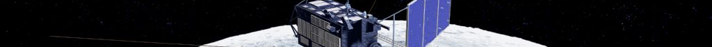
Lunar Reflectance model developed from SELENE/SP data for Lunar Calibration
Toru Kouyama
Supported by SELENE/SP Team
HISUI calibration WG

Slide 2
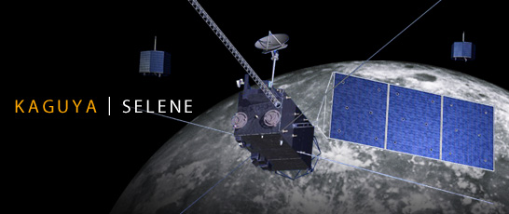
SELENE(KAGUYA) and SP
SELENE:
Polar orbit (non sun-synchronous)
Altitude: 100 km
Grand track repeat cycle: ~ 30 days
Mission period: 2007 – 2009 (1.5 years)
Observation with various solar incident angle condition.

Slide 3
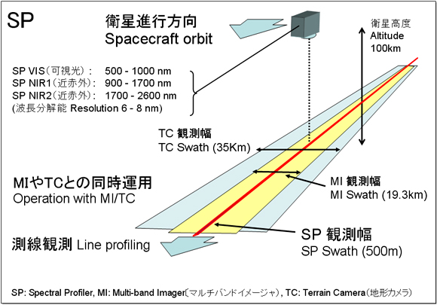
SELENE(KAGUYA) and SP
SP: Spectral Profiler
Sensor type: Spectrometer
Spectral range:
500-2600 nm
Spectral resolution:
6 nm (VNIR 520-960 nm)
8 nm (NIR-SWIR > 900 nm)
Observation swath
500 m

Slide 4
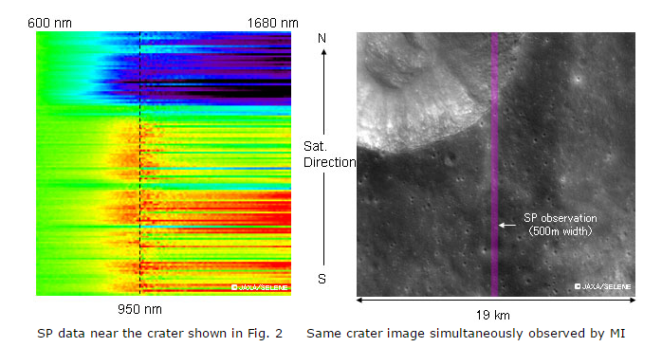
SELENE(KAGUYA) and SP
SP: Spectral Profiler
http://global.jaxa.jp/press/2007/12/20071214_kaguya_e.html

Slide 5
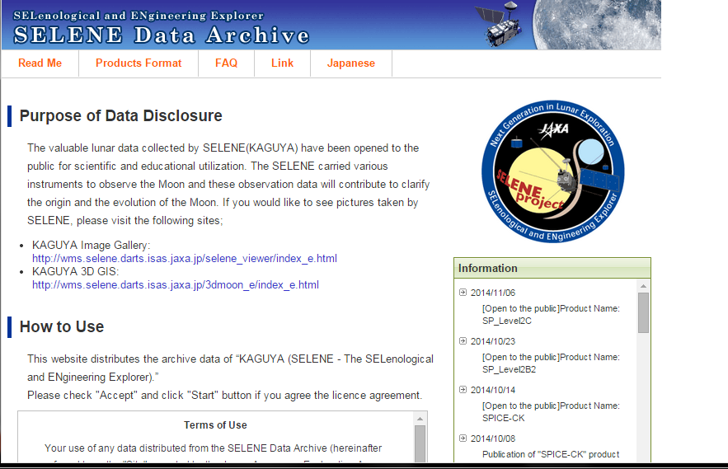
SELENE(KAGUYA) and SP
http://l2db.selene.darts.isas.jaxa.jp/index.html.en
At this time, SP Lunar reflectance model has not been distributed from this archive.

Slide 6
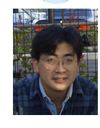
Key persons
PI
松永恒雄
Tsuneo Matsunaga
横田康弘
Yoshihiro Yokota
Yokota et al., 2011,Icarus, 215, 639-660:
Lunar photometric properties at wavelengths 0.5–1.6 lm acquired by SELENE
Spectral Profiler and their dependency on local albedo and latitudinal zones

Slide 7
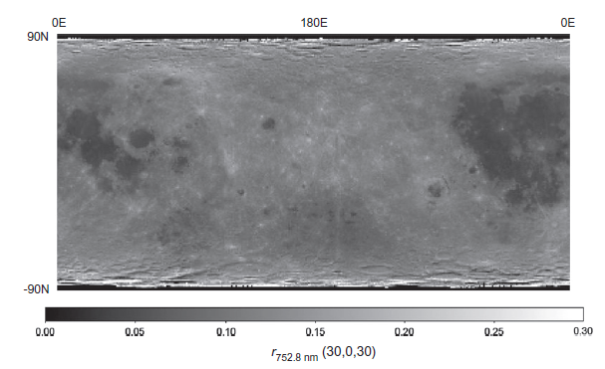
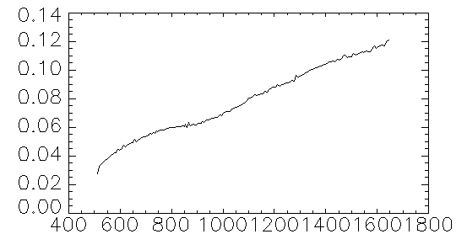
SELENE/SP
Lunar Reflectance map
Spectral range:
512 – 1650 nm (160 channels)
Δλ = 6 nm(VNIR) & 8 nm (SWIR)
1˚ x 1˚ resolution: published
0.5˚ x 0.5˚: to be published
[Yokota et al., 2011]
0.5x0.5: Corresponding to ~40 μrad resolution viewing from Earth
@ nadir
Hyper spectral reflectance map
Reflectance
Also including the lunar surface photometric properties depending on incident, emission and phase angles.
Wavelength [nm]
Newkur data

Slide 8
Model equations
After Yokota et al., 2011, Eq (11)
Reflectance to be calculated
i: incident angle
e: emission angle
α: phase angle
X_{L}: Lunar lambert function
Correction terms for Limb darkening effect
f: Empirical function of phase angle dependencies
B: Shadow hiding opposition effect
P: Regolith phase function
h, c, g, B₀: Model coefficients
Notes:
c₁=-0.019, c₂=0.242x10⁻³, c₃=-1.46x10⁻⁶

Slide 9
Model equations
After Yokota et al., 2011, Eq (11)
Reflectance to be calculated
i: incident angle
e: emission angle
α: phase angle
X_{L}: Lunar lambert function
Correction terms for Limb darkening effect
f: Empirical function of phase angle dependencies
B: Shadow hiding opposition effect
P: Regolith phase function
h, c, g, B₀: Model coefficients
High land, mare and medium albedo

Slide 10
Model equations
After Yokota et al., 2011, Eq (11)
Reflectance to be calculated
i: incident angle
e: emission angle
α: phase angle
X_{L}: Lunar lambert function
Correction terms for Limb darkening effect
f: Empirical function of phase angle dependencies
B: Shadow hiding opposition effect
P: Regolith phase function
h, c, g, B₀: Model coefficients

Slide 11
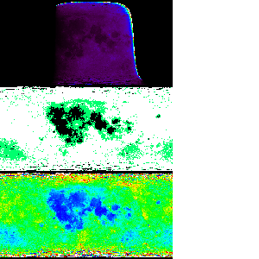
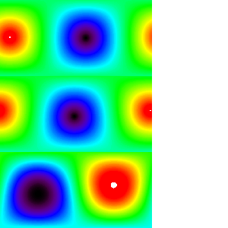
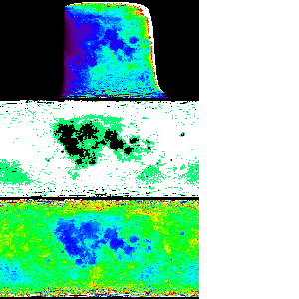
Estimation of Lunar radiance
Input geometry data
Incident angle
Reflectance map (30,0,30)
Emission angle
+ Solar Irradiance model
Phase angle at observation timing
Lunar radiance map at the observation time
Highland, mare and middle albedo region map

Slide 12
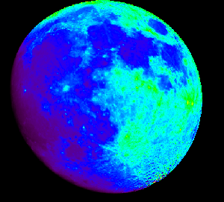
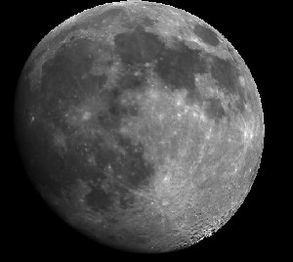
Simulated hyperspectral images
SRF convolution
Simulated band image

Slide 13
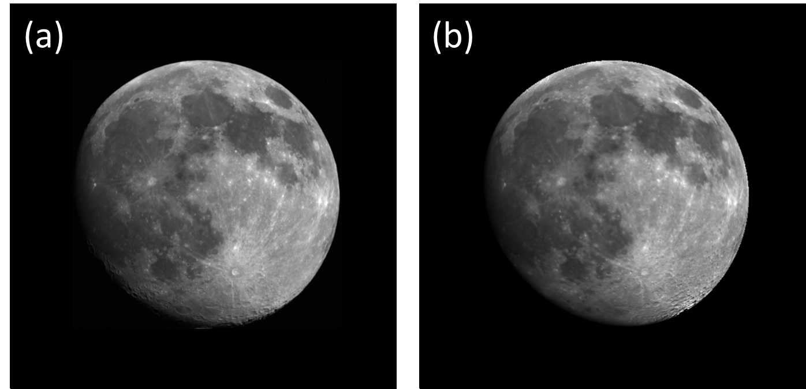
Observed
ASTER/Band 2 (660 nm)
April 14, 2003
Simulated

Slide 14
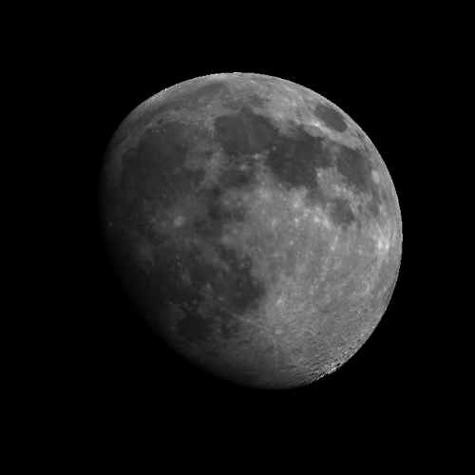
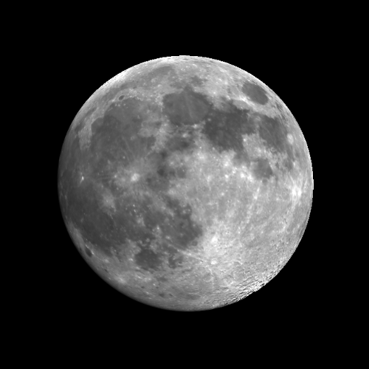
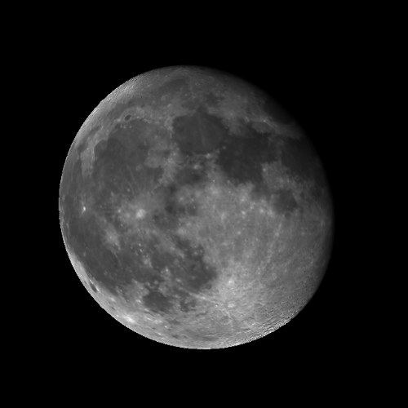
Simulating Moon observations
April 13, 2003
April 15
April 18

Slide 15
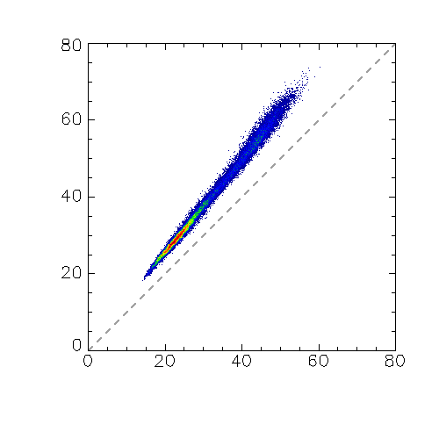
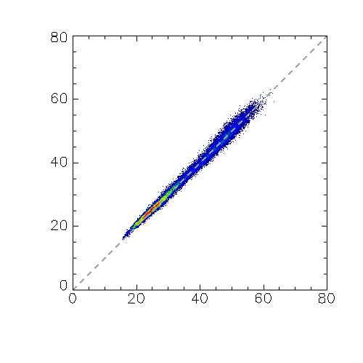
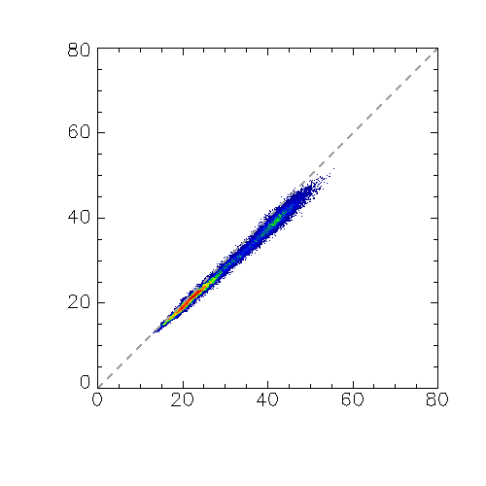
Brightness Comparison: ASTER vs SELENE/SP
Band 1
Band 2
Band 3N
Observed radiance
(W/m²/μm/str)
Frequency
Simulated radiance (W/m²/μm/str)
 | Band 1 | Band 2 | Band 3
Observed / Simulated (= Bias) | 1.20 | 1.01 | 0.95
Correlation Coefficient | 0.992 | 0.993 | 0.993
Standard deviation | 0.03 | 0.03 | 0.04
Standard error | 0.0002 | 0.0002 | 0.0002

Slide 16
Known problems
Large bias
Worse model accuracy in high emission angle and high latitude regions
ASTER
Model
In SP observation, emission angle was basically ~0 degree because of nadir viewing.
Yokota recommends using only the region where emission angle is less than 45 degrees.
This model requires estimating where each pixel looks at on the moon surface (= LOS ray tracing).
=> Pixel registration error should be considered.

Slide 17
Summary
Lunar reflectance model based on SELENE/SP hyper-spectral data has been developed. Using the model, we can simulate/predict any moon observation.
This model describes surface contrast and phase angle dependencies well.
=> The model can be used for evaluating relative degradations of sensors.
Large brightness bias exits.
Some limitations (emission angle and latitude dependences, etc..) should be considered.
Collaboration of ROLO/GIRO is very important
phase angle dependence, bias, etc..

Slide 20
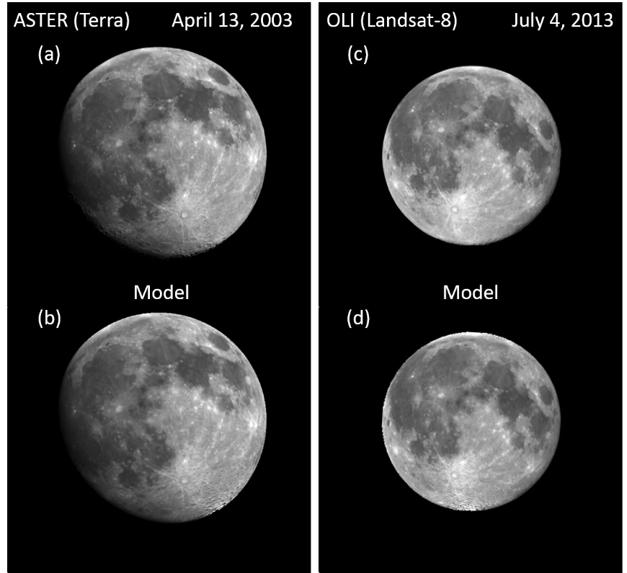
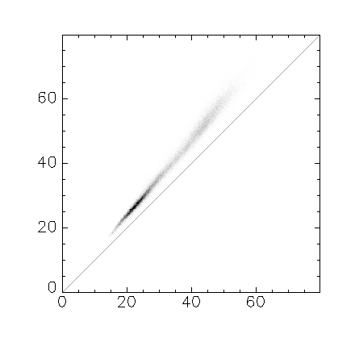
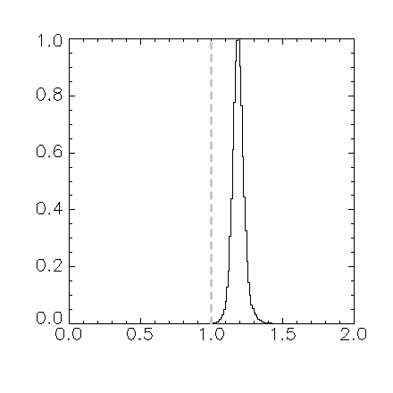
ASTER@2003.04.14 vs Model (SELENE/SP)
ASTER (Band 1) Large bias
Observed radiance (W m⁻² str⁻¹ μm⁻¹)
Relative Frequency
Modeled radiance (W m⁻² str⁻¹ μm⁻¹)
Observed / Model
Mean (Obseｒved/Model) = 1.20
SD = 0.04
SE (= SD/√Number of pixels used) = 0.0002

Slide 21
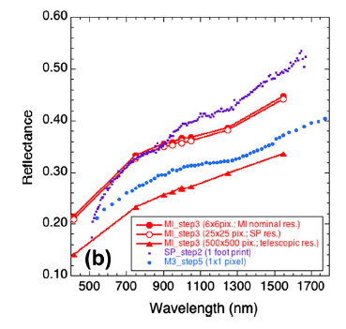
SP’s reflectance
In shorter wavelength region, SP tends to describe Moon reflectance darker than other sensors
(Ohtake et al., 2010 & 2013)
Ohtake,M. et al., Deriving the Absolute Reflectance of Lunar Surface Using SELENE (Kaguya) Multiband Imager Data, 2010, Space Sci. Rev., 154, 57-77
Ohtake,M. et al., One Moon, Many Measurements 3: Spectral reflectance, 2013, Icarus., 226, 364-374

Slide 22
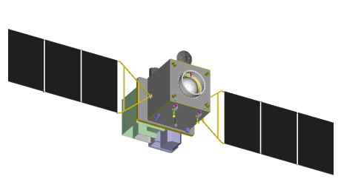
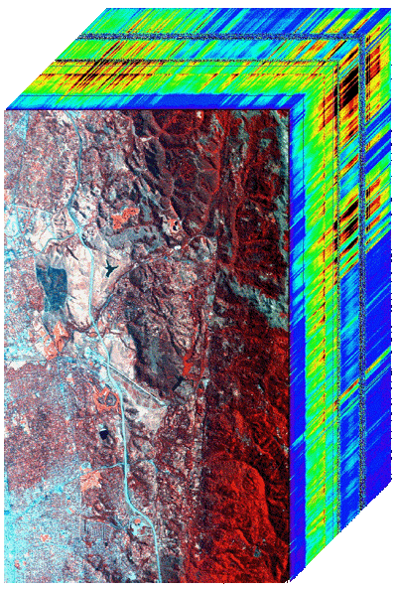
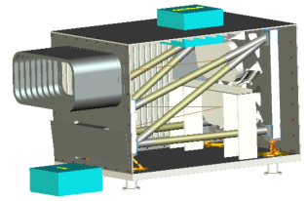
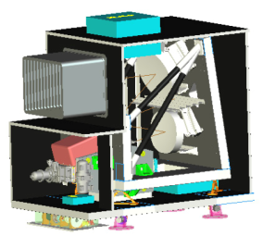
ALOS-3
(JAXA)
Panchromatic
Stereo Camera
HISUI
Multispectral Imager
Hyperspectral Imager
Hyperspectral
Image “Cube”
The hyperspectral imager:
Contiguous and high resolution spectral information from visible to short-wave IR
The multispectral imager:
4 Bands observation with a high spatial resolution by a wide swath

Slide 23
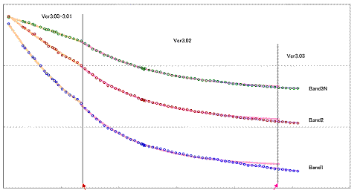
1.0
0.9
Band 3
0.8
Band 2
Band 1
0.7
0
Day since launch
3000

Slide 24
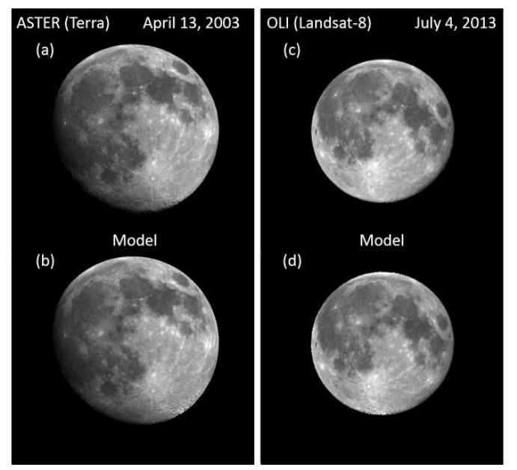
[Kouyama et al., 2014, LPSC]

Slide 25
Simulating Moon observations
April 13, 2003
April 15
April 18

Slide 26
Model equations
i: incident, e: emission, α: phase anlge
F_{sun}: Sun light Flux (W/m²/um)
S: SRF
r: reflectance using i=30, e=0, α=30 as the basis condition [Yokota et al.,2011] (11)
From SP model
X_{L}: Empirical function of sun-light scattering
f: Empirical function of phase angle dependencies

Slide 27
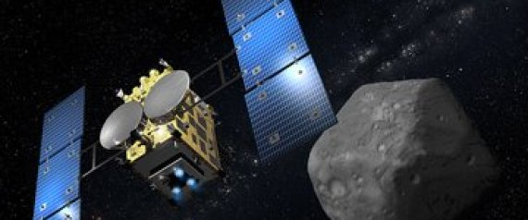
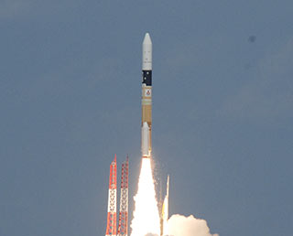
Hayabusa-2
Japanese satellite for exploring a small asteroid
Successfully launched Yesterday !

