Slide 1
Sno Prediction and Unit testing
MaNIK BALI
NOAA/NESDIS/STAR

Slide 2
Contents
Introduction
SNO Code Input and Output
SNO Prediction Algorithm
Unit Testing Method
Conclusions.

Slide 3
Introduction
Simultaneous Nadir overpass algorithm produces collocation between two instruments.
This algorithm lies at the heart of the Classical GSICS product generation.
Accuracy and precision of this code is critical to instrument monitoring, anomaly detection and correction.
There is a need to have SNO prediction:
  Would help in speeding up code
  Would help in Validating
There is a need to have a unit testing suite for the SNO algorithm.
  Aim is to detect and remove logical and programmatically errors

Slide 4
SNO Code Input and Outputs
Input -Level -1B, Sat-1 Sat-2
Output- Collocation data

Slide 5
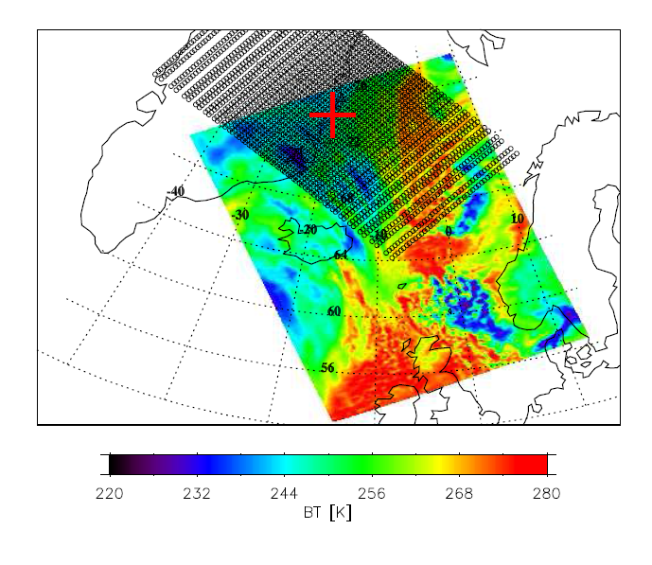
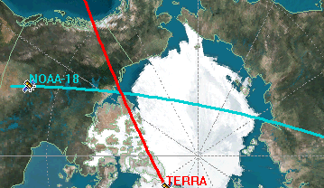
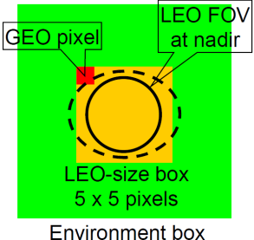
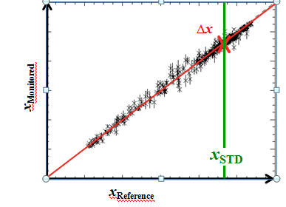
GSICS Comparison method
Simultaneous Nadir Overpass
Step 1. Identification of Collocated Pixels that satisfy GSICS selection criterion.
Step 2. Selection of pixels for inter- comparison
………………………………………Selection Criterion……………………………………………………
GSICS collocated pixel selection criterion
Time difference of observations < 5 Min
Atmospheric path diff Δsec(sat. zenith angle) < 0.01
Uniformity Constraint
STD (GEO pixels within LEO FOV) < 0.01 K (yellow in figure below).
STD (GEO pixels around the LEO pixel) < 1 K (Green in figure below). One reference (say IASI) instrument footprint is compare with the averaged value of the GOES pixels falling into that IASI footprint ( see below).
GSICS Product
Regression coefficients
Step 3. Convolution and Comparison
Final Result
Correction Formula
To be applied on Monitored Instrument
R is the Hyperspectral Radiance
S is the spectral response function
L is the IASI convolved radiance
V is the wavenumber

Slide 6
SNO algorithm
Top Level
Read in a single Sat 1 L1B and time overlapping Sat 2 L1b file/s
Convert pixel location to spherical coordinates
Matchup
Call MATCH_PIX
Pick overlapping grid boxes
Call FIND_COLLOCATION
Call Read_Param
Call SELECT_NEARBY
Loop over Sat 1 pixels inside the box, apply thresholds ,get edges of Sat 1 pixel and identify collocated pixels
Check for if scanlines overlap in time
No
STOP/
Loop to next input file
Mask_Update
Gross_test
Mask out invalid pixels
Maskout edges
Store information about each Sat 1 pixel and its collocated pixel in a collocation structure
YES
Check if 1x1 lat/lon grids of Sat 1 and Sat 2 overlap
Write the collocation structure to a file
STOP/Loop to next input file
Predicts the grid space-time cube in which SNO are most likely to be found Algorithm. Curtesy Jon Mittaz
This leads to a smaller search loop thereby considerably reducing the SNO execution time.

Slide 7
Unit Testing is a series of tests at times using test data sets
TEST 1
Sat 1 Vs Sat 1 inter- comparision
Should produce 1 collocation for each pixel.

Slide 8
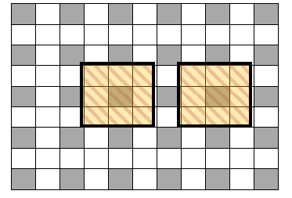
TEST 2
te Data
Should produce 1 collocation for each pixel.
Simulate data which is similar to real life scenario and number of collocated
pixels are predetermined
Sat-1: Is the gridded AATSR L1B
Sat-2: Is produced by ignoring every alternate pixel of Sat-1
Resulting data set has pixels that are large enough to collocate with exactly 3x3 AATSR L1B pixels.
Helps in detecting logical errors in SNO algorithm

Slide 9
Conclusion
A SNO Prediction Algorithm suggested by Jonathan Mittaz has been shared with the GSICS.
Implemented this algorithm in IR and MW inter- comparisions: Step gives high speed up to the SNO code particularly when data sets are large.
A Unit Testing suite for GSICS SNO –baseline algorithm has been presented here.
This suite uses a two step process to test the SNO code for logical accuracy.
Suite has been used at NOAA for SNO code of GEO-LEO and LEO-LEO algorithm and helped to detect and remove key errors.

Slide 10
THANK YOU

