Slide 1
GSICS Procedure for Product Acceptance (GPPA)
Fuzhong Weng and Bob Iacovazzi, Jr.
GSICS Coordination Center

Slide 2
Outline
GPPA Fundamental Capabilities
The Four GPPA Phases
Current Status and Future Plans
Get More Information About the GPPA
GPPA - How You the Data User Can Help
Summary

Slide 3
Fundamental Capabilities of GPPA …
The GPPA is the:
Inter-calibration product developers pathway to obtain a GSICS “Stamp of Approval” for a potential product
GSICS governing body’s reference for judging product fitness
GSICS data users’ window to product quality and “fitness for purpose”
The GPPA defines and documents:
Scope of product within the GSICS product portfolio
Theoretical basis, and implementation and distribution strategy, of product
Product Quality (uncertainty, quality indicators, etc)
Four Product Phases:
Submission Phase
Demonstration Phase
Pre-operational Phase
Operational Phase

Slide 4
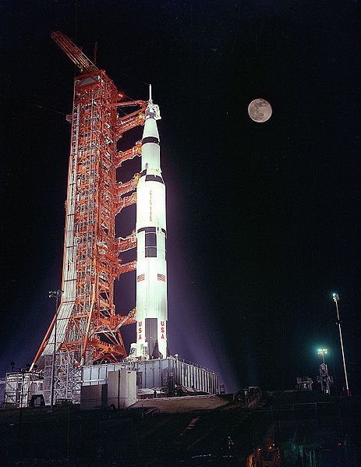
GPPA: Submission Phase
Entry Criteria:
The initial GSICS Product Acceptance Form (GPAF) sections outlining product name, POC, brief description, and relevance to GSICS are complete
Preliminary algorithm theoretical basis document (ATBD) is drafted
These items submitted to the GCC
Maximum Time Period: 90 Days
Milestones:
Submit sample product files that adhere to GSICS file and parameter naming conventions

Slide 5
GPPA: Demonstration Phase
Entry Criteria : Product in GSICS scope, founding concepts are clear, and meets GSICS data format/content guidelines.
Data Status: Data released to GSICS members and potential users.
Maximum Time Period: 365 Days
Milestones:
Arrange for routine product upload to a GSICS data server and agree on file retention policy.
Obtain GSICS users’ feedback
Accepted baseline versions of four documents critical to product quality assurance –
Algorithm Theoretical Basis Document
Document describing product traceability to community or SI standards
Product supporting radiative transfer model and cal/val supporting measurements description
Product quality indicator description and justification
Affirmative decision regarding continuance of product within the GPPA process

Slide 6
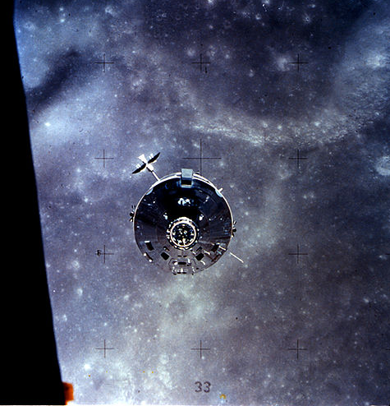
GPPA: Pre-operational Phase
Entry Criteria: Product has developed and understood methodology, software, supporting models and measurements, uncertainty, quality indicator, and traceability to a community or SI standard.
Data Status: Data released to public with disclaimer.
Maximum Time Period: 180 Days
Milestones:
Executive Panel review of the GSICS Product Acceptance Team recommendations.
Accepted Baseline documents associated with product data stewardship in an operational environment:
product version control plan
operations and distribution plan
data users’ guide

Slide 7
GPPA: Operational Phase
Entry Criteria:
In addition to its PP attributes, the Product has developed and understood generation, distribution, version control and archive strategies. It also has an available User’s Guide. At this point, Product is fully accepted and maintained within GSICS.
Data Status: Data released to public.
Milestones:
Product logs and usage reports
Updated documentation/software as necessary
Periodic reviews

Slide 8
GPPA: Current Status and Future Plans
Current Status …
Three Potential Products in Demonstration Phase
GSICS Correction for EUMETSAT SEVIRI IR Channels based on IASI
GSICS Correction for GOES and MTSAT Imager IR Channels based on AIRS and IASI
One Potential Product in Submission Phase
Patmos-X AVHRR solar reflective channel corrections based on MODIS
In the Next Year …
All Four of These Potential Products in Pre-Operational Phase or Beyond
New Potential Product Submissions
GSICS Correction for CMA VISSR IR Channels based on IASI
GSICS Correction for EUMETSAT SEVIRI, MTSAT Imager and GOES Imager solar reflective channels based on MODIS
GSICS Correction for MSU/AMSU-A data based on simultaneous nadir overpasses

Slide 9
GPPA Information Links
GSICS Wiki:
Up-to-date GPPA Workflow, Documents and Forms
(http://www.star.nesdis.noaa.gov/smcd/GCC/qa-gppa.php)
GSICS Coordination Center Web Site:
GPPA Overview
Links to GPPA Information archived on GSICS Wiki
(https://cs.star.nesdis.noaa.gov/GSICS/GppaWorkflow soon to be https://gsics.nesdis.noaa.gov/GSICS/GppaWorkflow)

Slide 10
GPPA: Product User Review
An integral part of the GPPA during demonstration phase is to obtain feedback about the potential product from you … GSICS Data Users.
Basically, the information that we are looking for if you are requested to review a product is:
1. If you are able to review and test products, GSICS needs feedback on:
a. Product accessibility, availability, and ease of product data access
b. Suitability and impacts of the product to your work (is it accurate, stable enough, etc?)
c. Product reliability
2. If you can review, but not test, products. We need your assessment of product implementation feasibility. Also, give us the following feedback regarding why you cannot test the product.
3. If you can neither review nor test the product, please let us know why not.

Slide 11
Summary
At GSICS, we require that product providers conform to product quality assurance standards, defined within the earth-observation community, …
so you, the data users, don’t have to struggle to apply inter-calibration data products for your activities.

