Slide 1
Impact of GSICS Correction for GOES imager and sounder
Cloud Top Height GSICS Correction
S. Ackerman, M. Gunshor and T. Schmit
CIMSS, APSB
University of Wisconsin-Madison
In the spirit of workshops to share, discuss, be transparent; and southern Spain
1

Slide 2
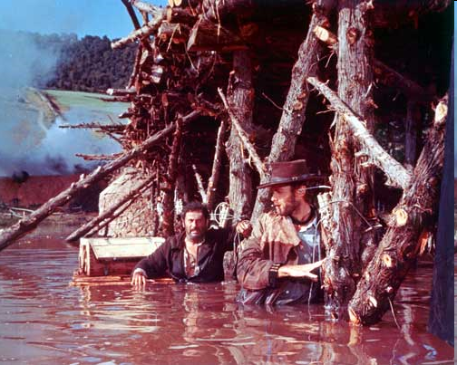
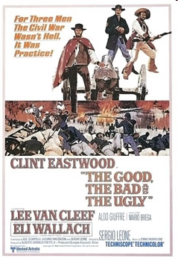
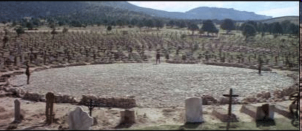

The plot revolves around three gunslingers competing to find a fortune in buried Confederate gold amid the violent chaos of gunfights, hangings, American Civil War battles and prison camps
Filmed in Spain
Theme Song
2

Slide 3

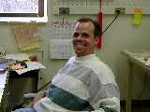

Impact of GSICS Correction for GOES imager and sounder
Cloud Top Height GSICS Correction
The Good…
The Bad…
The Ugly…

Slide 4
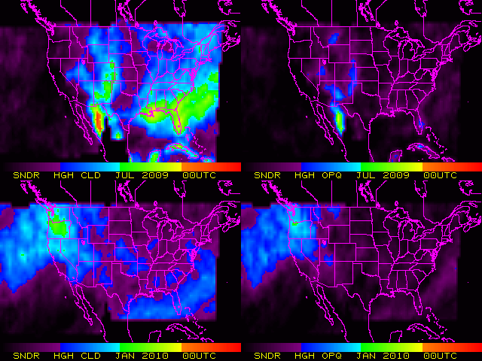

… the gold…
July 2009
Diurnal variation of High Cloud for two months
January 2100

Slide 5
GEO-IASI Results (CIMSS method)
Imager: |  | GOES-10 | GOES-11 | GOES-12 | GOES-13 | MET-9
Shortwave Window | N | 269 | 268 | 261 | 44 | -
 | ΔT (K) | 0.05 | -0.03 | -0.2 | -0.3 | -
 | STD (K) | 0.92 | 0.62 | 1.26 | 0.8 | -
Water Vapor | N | 310 | 280 | 340 | 97 | 46
 | ΔT (K) | 0.7 | 0.4 | -0.1 | 0.1 | -0.4
 | STD (K) | 0.39 | 0.32 | 0.50 | 0.22 | 0.4
IR Window | N | 356 | 280 | 340 | 92 | 46
 | ΔT (K) | -0.1 | -0.01 | -0.05 | 0.16 | 0.1
 | STD (K) | 0.94 | 0.69 | 1.14 | 0.52 | 0.9
“Dirty” Window | N | 347 | 278 | - | - | 46
 | ΔT (K) | 0.06 | -0.04 | - | - | 0.3
 | STD (K) | 0.97 | 0.71 | - | - | 0.9
CO₂ | N | - | - | 341 | 93 | 46
 | ΔT (K) | - | - | -0.9 | -0.1 | -0.7
 | STD (K) | - | - | 0.9 | 0.43 | 0.7
GOES: May 2007 through October 2009
MET-9: Jan through Apr 2009
MET-9 “Water Vapor” band results here are for the 6.2um
The MET-9 shortwave window SRF extends to shorter wavelengths than IASI, making comparison difficult
We have the entire MET-8 and MET-9 dataset stored at SSEC/CIMSS as well as IASI in native format; these are the results available from prior analysis
The Point is: We are experienced users of intercalibration methods….

Slide 6
Using the GSICS Correction
GOES Sounder Products
Currently GOES Sounder bias corrections are done two different ways, both suboptimal
Simple Bias: Radiosondes as “truth”
  0 and 12 UTC only
  Over land only
  Requires forward model calculation (hence uncertainty)
  5 predictors
Complex Bias: NWP-based “truth”
  Still need a forward model
  NWP is just a model, not a perfect predictor of atmospheric conditions.
  26 predictors
6

Slide 7
GSICS Sounder Correction
A case study using CTP at CIMSS
Cloud Top Pressure (CTP) Case Study for 7 Sep 2010 (18:01 UTC) for the GOES-11 Sounder
Currently simple bias corrections (K) are applied to each sounder band used in this product (from historic radiosonde)
  A bias correction normally consists of just a brightness temperature bias to be added to (or subtracted from) the measured brightness temperature
Fred and Fangfang at NOAA-NESDIS provided the GSICS coefficients in temperature instead of radiance.
  We expected a single number, a bias, similar to the values shown in the time series plots on GSICS web pages.
  We received a file with a slope and an offset for 231 days covering 27Dec2009 – 14Aug2010 (we applied the mean slope and offset to our data).
  Tb_{GSICS} = Tb_{GOES} /slope - offset/slope
7

Slide 8
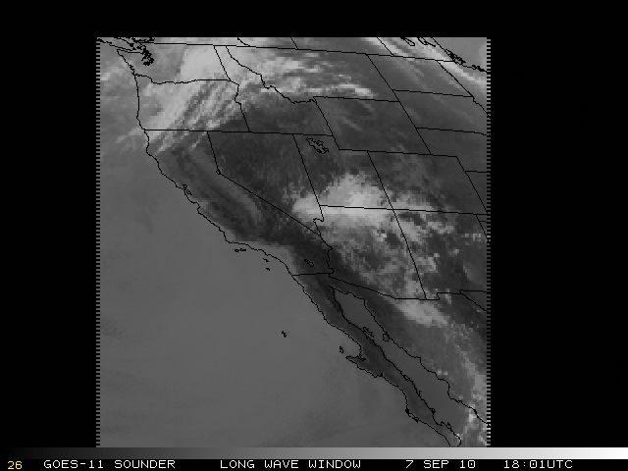
8

Slide 9
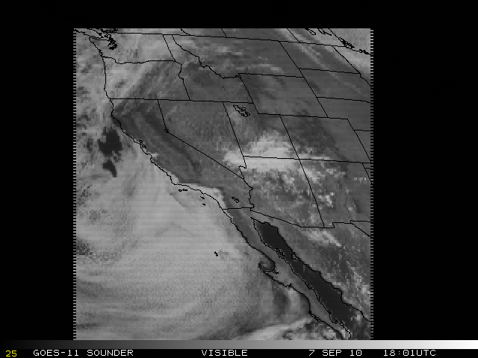
9

Slide 10
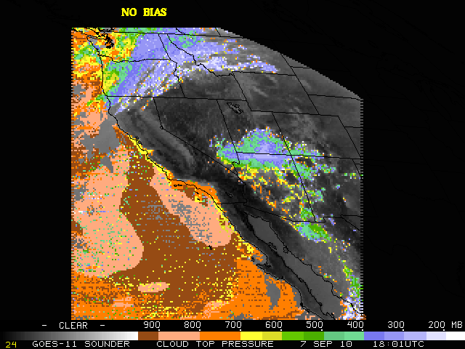
NO BIAS
CO2 Slicking Cloud Top Pressure
10

Slide 11
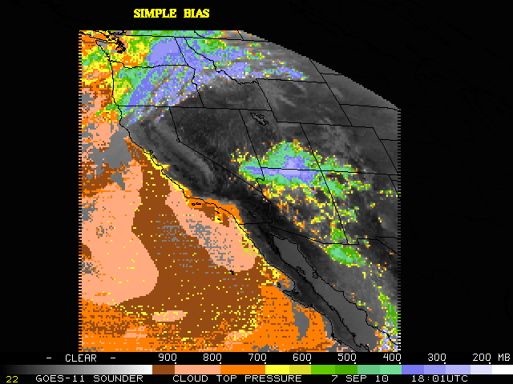
SIMPLE BIAS
11
Notes:
Flipping between this slide and the previous one with “no bias” – you can see why we want a bias. A lot of what looks to be noise, especially in the clouds over the Pacific, seems to go away with a bias correction added.
11

Slide 12
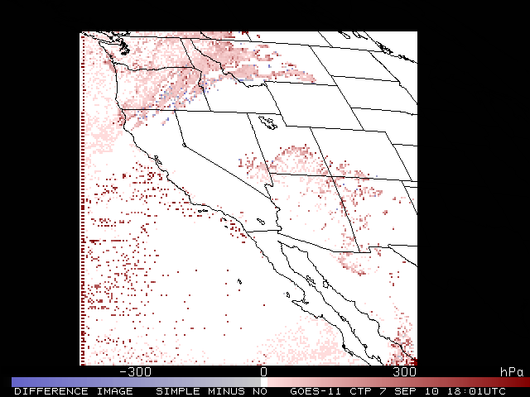
SIMPLE – NO BIAS

Slide 13
13

Slide 14

14
Notes:
Flipping between the simple bias and this GSICS bias shows that with the GSICS bias some of the high clouds (north, southeast portions of the image) get higher(from green to blue, from blue to white) and some of the lower clouds (Pacific) get lower. (from yellow to orange) What we like seeing here is that it appears that the GSICS bias takes out even more of the noise! We’ve only looked at this one case, but so far we’re impressed… and we’re not even sure we’re applying it in the most ideal way.
14

Slide 15
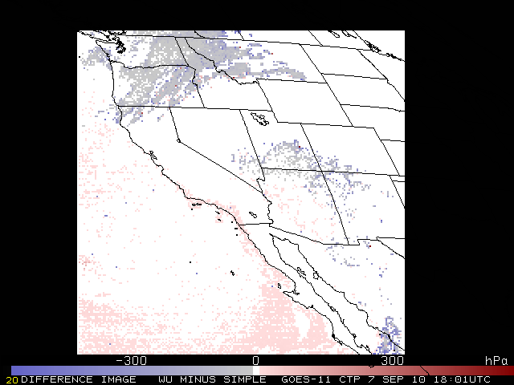

Slide 16
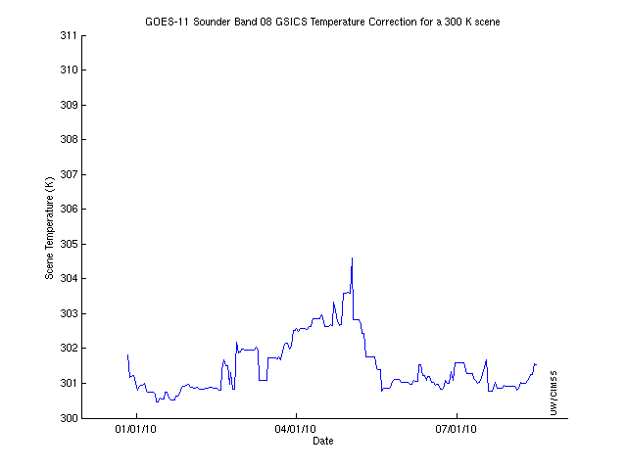
GOES-11 Sounder Band-8 GSIC Temperature Correction
CIMSS calc-obs:
Mean = 0.51 K
Rmsd = 0.52 K
N=41,206 during this time period
calc = forward model calculated using RAOB profiles over CONUS
obs = GOES-11 observed
Scene Temperature (K)
DATE
The difference between the GSICS calculated Tbs and 300 K:
  Tb_{GSICS} = Tb_{GOES} /slope - offset/slope where Tb_{GOES} = 300 K
The min is 0.47778
The max is 4.5895
The mean is 1.4691
The standard deviation is 0.7736
16

Slide 17
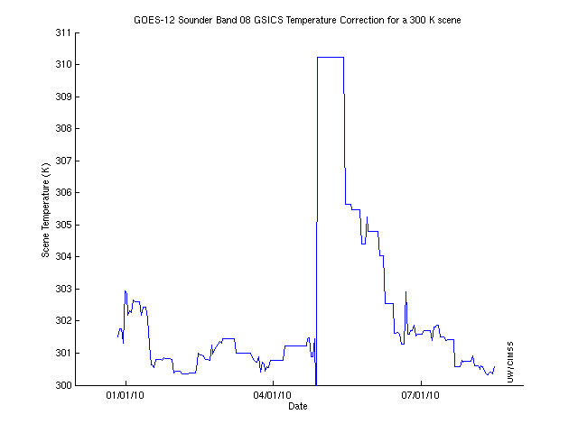
GOES-12 Sounder Band-8 GSIC Temperature Correction
Scene Temperature (K)
DATE
The difference between the GSICS calculated Tbs and 300 K:
  Tb_{GSICS} = Tb_{GOES} /slope - offset/slope where Tb_{GOES} = 300 K
The min is -0.25372
The max is 10.2172
The mean is 2.2466
The standard deviation is 2.6032
17

Slide 18

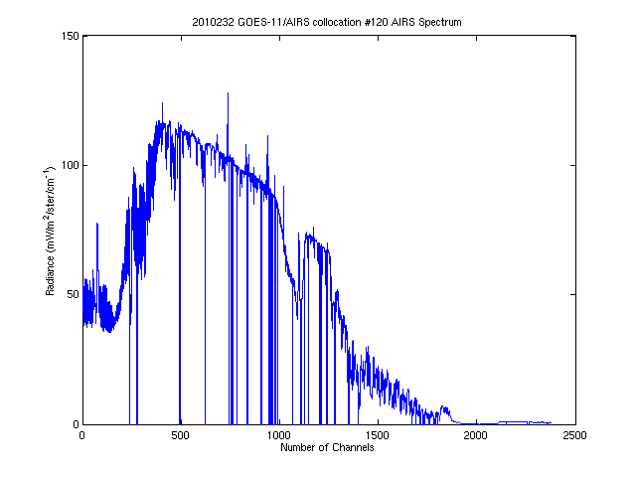
In search of treasure
Can detector-level coefficients be generated?
  The sounder especially is susceptible to striping in various bands (true of all GOES) which affects products (you can see it in the CTP images in parts of the Pacific).
The average correction, not just individually for 231 days
Which channels are used
in the convolution?
18

Slide 19
Summary
Theme Song
Back to the movie theme analogy
GSICS and CIMSS
One of us has the name of the cemetery, the other the name of the grave…
CIMSS and NOAA need to make sure that CIMSS is generating the output that NOAA wants

Slide 20
Status Report
Post-Processing GOES vs AIRS using the GSICS Method at CIMSS
20

Slide 21
Status Report:
Post-processing GOES vs AIRS GSICS Method at CIMSS
Goal:
  Process the historical GOES vs AIRS record using the GSICS (NOAA) GEO-LEO method.
    GOES Imagers only at this point.
    Will likely start with GOES-10 per Fred’s request.
Future Goals:
  Expand to include GOES Sounders, IASI and other (non-GOES) GEOs
21

Slide 22
Status Report:
Post-processing GOES vs AIRS GSICS Method at CIMSS
Goal:
  Process the historical GOES vs AIRS record using the GSICS (NOAA) GEO-LEO method.
    GOES Imagers only at this point.
    Will likely start with GOES-10 per Fred’s request.
Future Goals:
  Expand to include GOES Sounders, IASI and other (non-GOES) GEOs
22

Slide 23
Status of the code
The NOAA-NESDIS version of the GSICS code has been installed at CIMSS
  Mixture of Fortran and IDL
  Created a script to gather the GOES data and AIRS data and put it on the machine running the comparison code. (The comparison code expects local data).
  Modified most of the hard-wiring in the McIDAS and IDL programs so that the programs can find the data. Code was somewhat specialized, hardwired directory structures, etc.
  Needed to modify the scripts to access local data archives of AIRS, IASI, GOES, METEOSAT, MTSAT, FY2, etc.
  The output file labels the program version as 2.2
23

Slide 24
Status of the code
Successful Case Study
  Day 2010232
  AIRS vs GOES-11 netCDF output generated
  Compared multiple variables in the netCDF output files such as GOES radiances, convolved AIRS radiances, Mean GEO radiance within LEO field of view, etc and found either no differences or differences we believe are just due to machine precision (on the order of 10⁻⁶).
    We had to first make sure we were only comparing the same subset of GOES data – 3,228 collocations
  We believe we can be confident moving forward that we are generating outputs that match that of the NOAA version of the algorithm.
24

Slide 25
Work to be done
The NOAA version of the ATBD on the GSICS Wiki is not descriptive enough.
  https://cs.star.nesdis.noaa.gov/GSICS/AtbdCentral
  Is this the latest version?
There is not a good description of each variable in the output file in the ATBD.
  It is not immediately apparent which variables are actually used in the GEO-LEO differences.
  Is the ATBD for intercalibrators or users? There should be a FAQ or ATBD for users that helps them use the output files.
Getting familiar with the output:
  Is there other code to generate the slope and offset for the day?
  Generation of a temperature bias for the day.
  How are the data quality controlled.
  Are bad AIRS channels filtered out by the convolution? Bad channels are in the output file.
  Is there a way to know which AIRS channels were used?
  How similar are these output files to those generated by other GSICS members?
  Do they follow CF file format conventions where possible?
CIMSS and NOAA need to make sure that CIMSS is generating the output that NOAA wants
  1 file per day? Slopes and offsets? Monthly means?
  CIMSS also would like to be able to generate all of the outputs (slope/offset, etc), regardless.
25

Slide 26
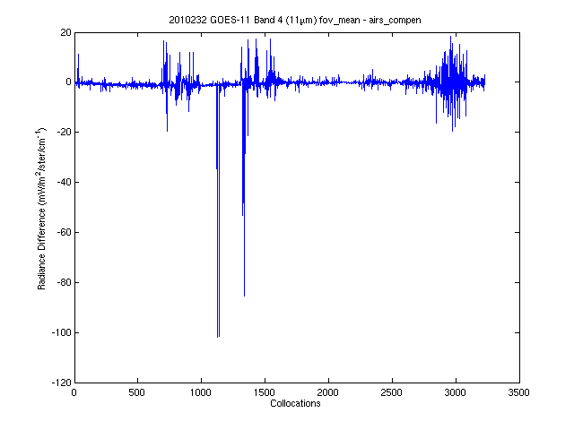
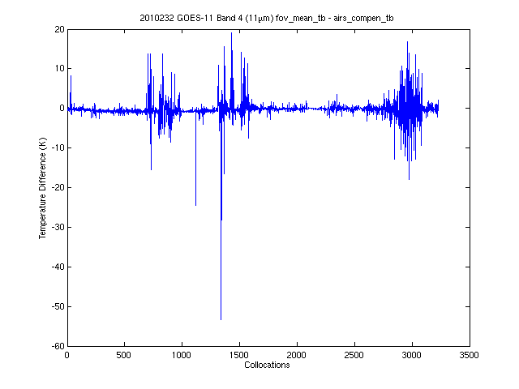
Quality Control
IR Window (11um) Band GOES-AIRS
Fov_mean – airs_compen
(Radiances)
Fov_mean – airs_compen
(converted to temperature)
One day, 3228 collocations.
26
Notes:
Why such a big difference during the same day? From about collocation #2700 to nearly the end the differences go haywire, in stark contrast to collocations 2000 through 2500. Is this something that the GSICS team understands or is this something we should be investigating? I don’t believe anything that is more than 2 K different for this band, but how are we sorting these data later to avoid the turkeys? Are we actually comparing the right variables from the output file?
26

Slide 27
Quality Control
Bad AIRS channels?
Which channels are used in the convolution? There are many channels with “missing” radiances, but there are some that just have small (below zero) radiances, and some that appear to have “popping”. This would be easier to investigate if there were wavenumbers to go with the AIRS radiances in the output files
27

Slide 28
Intercalibration at CIMSS
CIMSS and EUMETSAT are partners in the Global Space-Based Inter-Calibration System (GSICS) – organized through the WMO
  Mission: Assure high-quality, inter-calibrated measurements from the international constellation of operational satellites to support the GEOSS goal of increasing the accuracy and interoperability of environmental products and applications for societal benefit.
  The primary activity currently is intercalibrating the world’s Geostationary Imagers using IASI and AIRS.
The traditional CIMSS method varies from the GSICS method, but the results are comparable:
  CIMSS compares an area at GEO nadir, spatial averages to mitigate FOV differences; GSICS is pixel to pixel, filters for spatial scene uniformity; both use similar convolution methods.
  GSICS generates calibration coefficients based on temperature differences with IASI, similar in function to bias corrections.

Slide 29
Running the GSICS method at CIMSS
Goal:
  Process the historical GOES vs AIRS record using the GSICS (@NOAA) GEO-LEO method.
  In the next year we will expand to include IASI and Meteosat
  Compare CIMSS method and GSICS method results and approaches

