Slide 1
Inter-Sensor Comparison for Soumi NPP CrIS
Likun Wang¹, Yong Han^{2*}, Denis Tremblay³, Fuzhong Weng², and Mitch Goldberg⁴
1. CICS/ESSIC/University of Maryland, College Park, MD; wlikun@umd.edu
2. NOAA/NESDIS/STAR, College Park, MD
3. Earth Resources Technology, Inc., Laurel, MD
4. NOAA/NESDIS/JPSS Program Office, Greenbelt, MD
* CrIS SDR Team Lead
2013 GSICS User Workshop, 8 April 2013,College Park, MD

Slide 2
Motivation
Hyperspectral IR sounders have served as benchmark measurements for the GSICS community.
Polar orbiting sensor: HIRS, AVHRR, AATSR
Geostationary : Imagers and Sounders
With more hyperspectral IR sounders on-orbit, are there any radiometric and spectral differences among them?
Now: AIRS →Metop-A/IASI → NPP/CrIS → Metop-B/IASI
Future: JPSS-1/CrIS and MetOp-C/IASI ….
If so, we need to understand the root causes of the differences based on sensor physics.
Benefit for each sensor’s calibration
Basis for climate data records

Slide 3
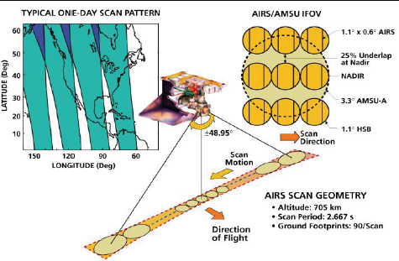
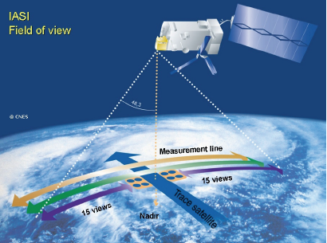
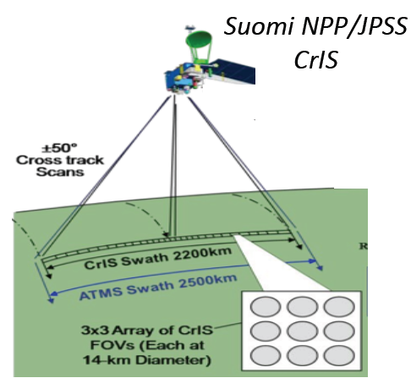
Instrument and Spectral Characteristics
Spectral Coverage and Resolution of
AIRS, IASI, and CrIS
IASI-A: 2006
IASI-B:2012
From Hank Revercomb

Slide 4
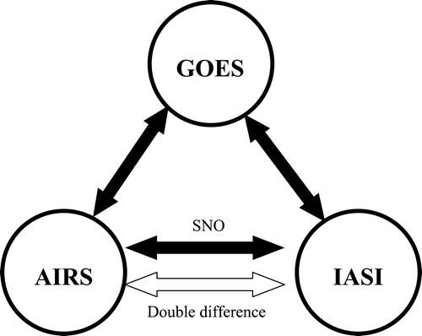
Approach
Direct comparison
CrIS versus IASI/AIRS
Indirect comparison:
Through the third sensor, CrIS-VIIRS versus IASI-VIIRS
Objectives
Reduce uncertainties caused by the methodology
Identify the differences at the sensor calibration level
Understanding the root causes of these differences
VIIRS
CrIS

Slide 5
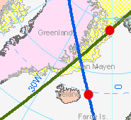
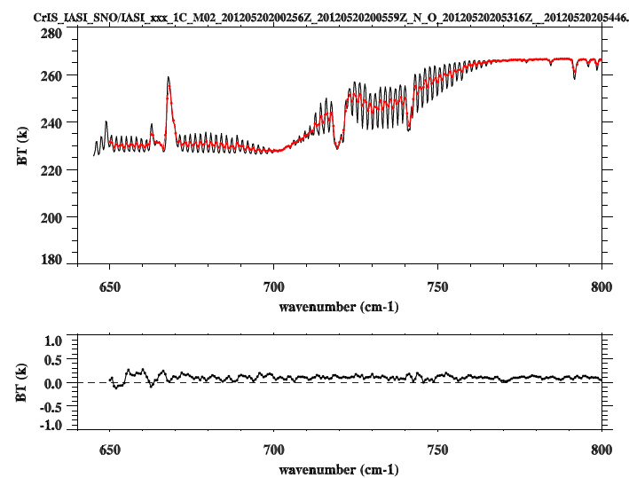
Simultaneous Nadir Overpass (SNO)
CrIS
Time Difference: <= 120 Sec
FOV distance difference: <=(12+14)/4.0 km = 6.5 km
Angle Difference: ABS(cos(a1)/cos(a2)-1) <= 0.01
IASI
From Changyong Cao
All data are from IDPS.
Only nadir and uniform scenes were selected.
Using the same collocation algorithms to collocate CrIS/IASI with VIIRS.

Slide 6
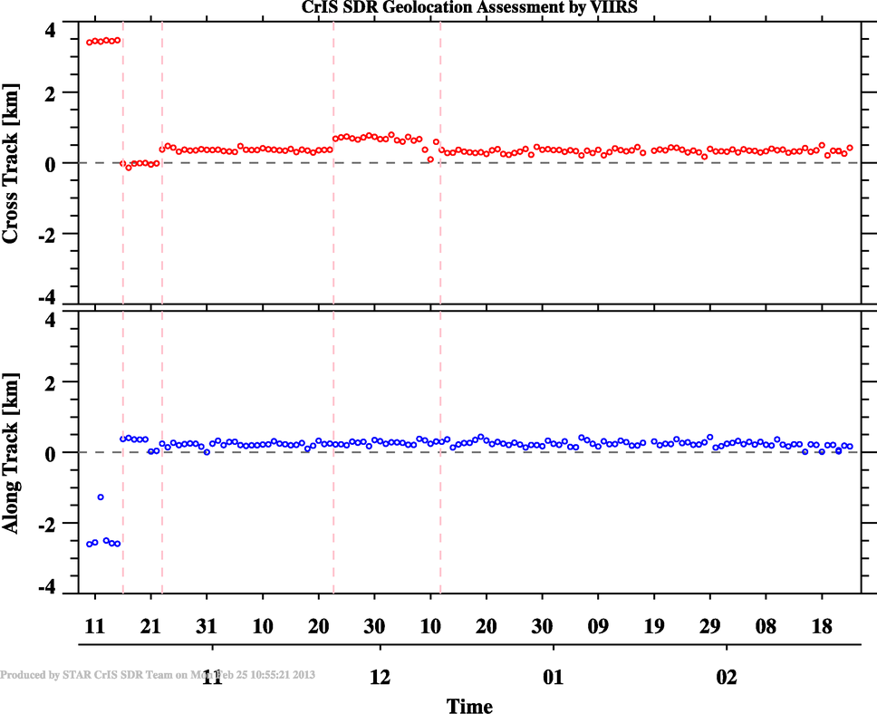
Collocating CrIS/IASI with VIIRS: Accurately computing FOV Shape
Satellite Direction
VIIRS Scan Direction
CrIS Scan Direction
M6.3x released, code bugs were fixed
The method based on the algorithm
can detect the VIIRS geolocation errors
EP V35 Upload
VIIRS Geolocation errors

Slide 7
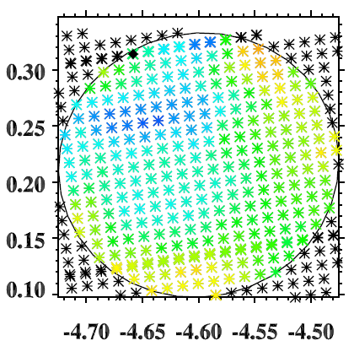
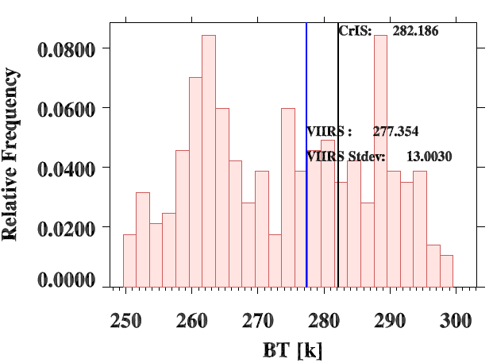
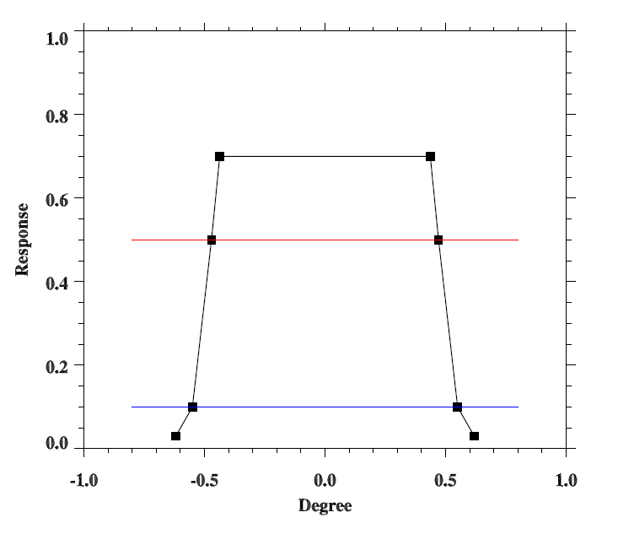
Collocate VIIRS with CrIS/IASI
VIIRS Pixels
CrIS FOV footprint
CrIS/IASI FOV Spatial Response
50%
Histogram of VIIRS M16 radiances in CrIS FOV

Slide 8
Scene Uniformity Effects

Slide 9
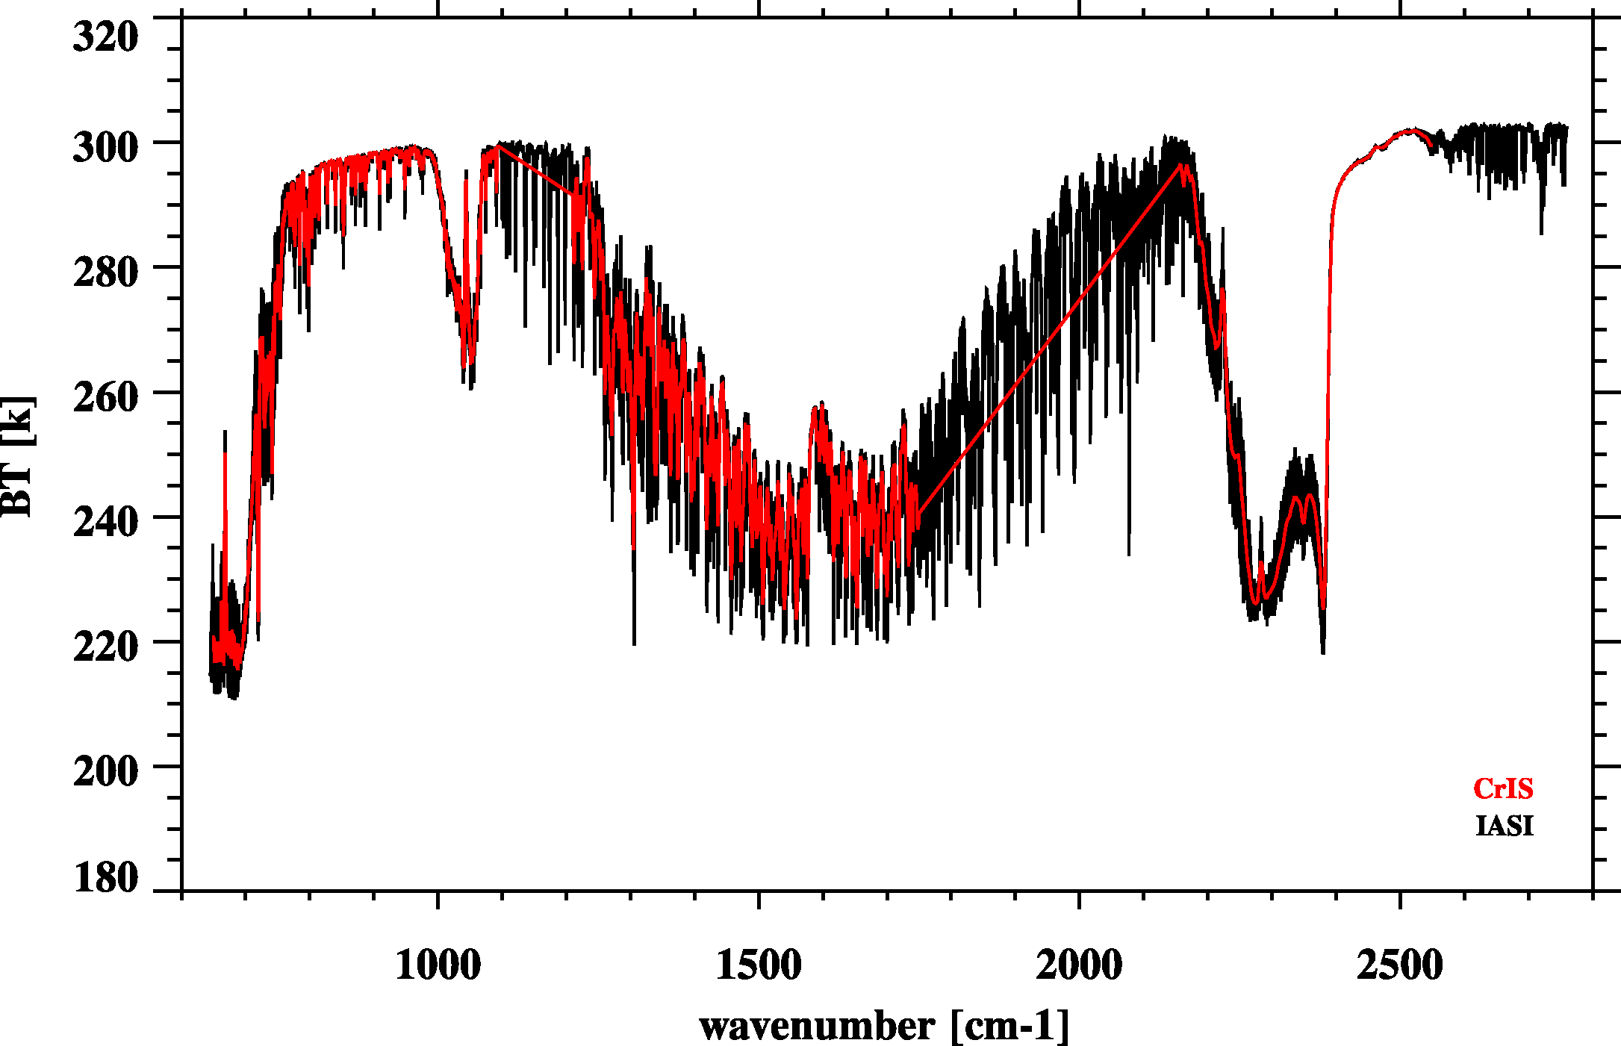
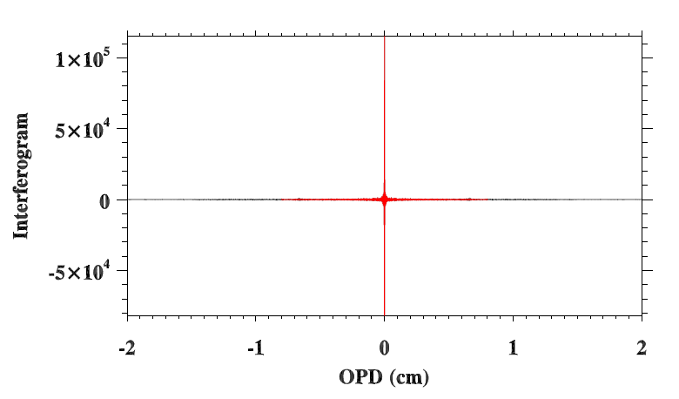
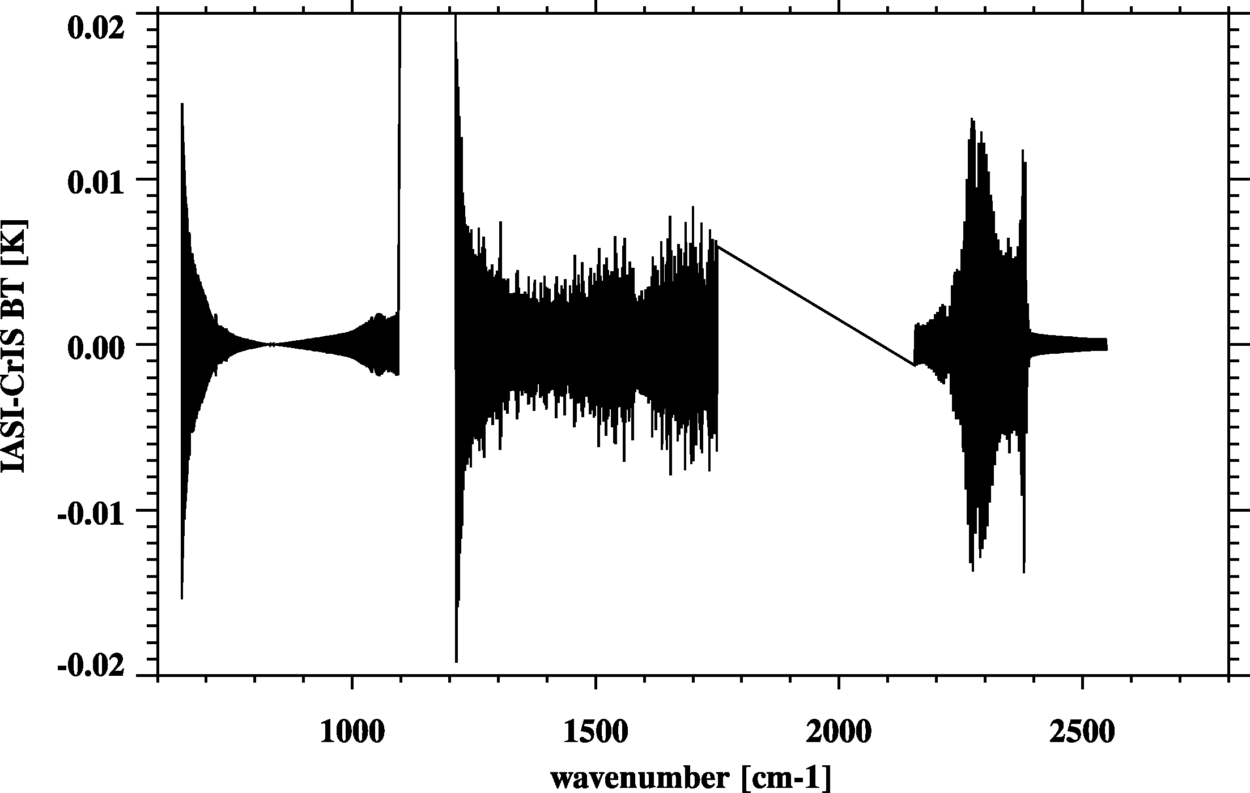
Resample IASI to CrIS
Fourier Transform
De-Apodization
2) Truncation
3) Apodization
CrIS – IASI
Re-sampling error very small
Inverse Fourier Transform

Slide 10
IASI and CrIS SNO Spectra
Metop-A IASI and CrIS
Metop-B IASI/ and CrIS
North (339)
North (153)
Average Spectra
South (431)
South (133)
SNOs in 10/2012, 12/2012, and 02/2013
SNOs in 03/2013

Slide 11
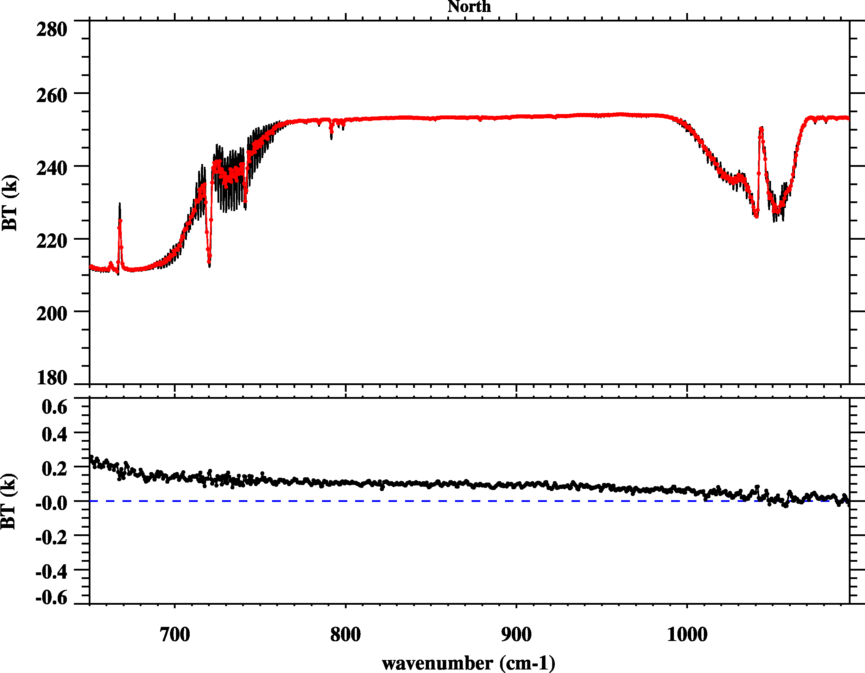
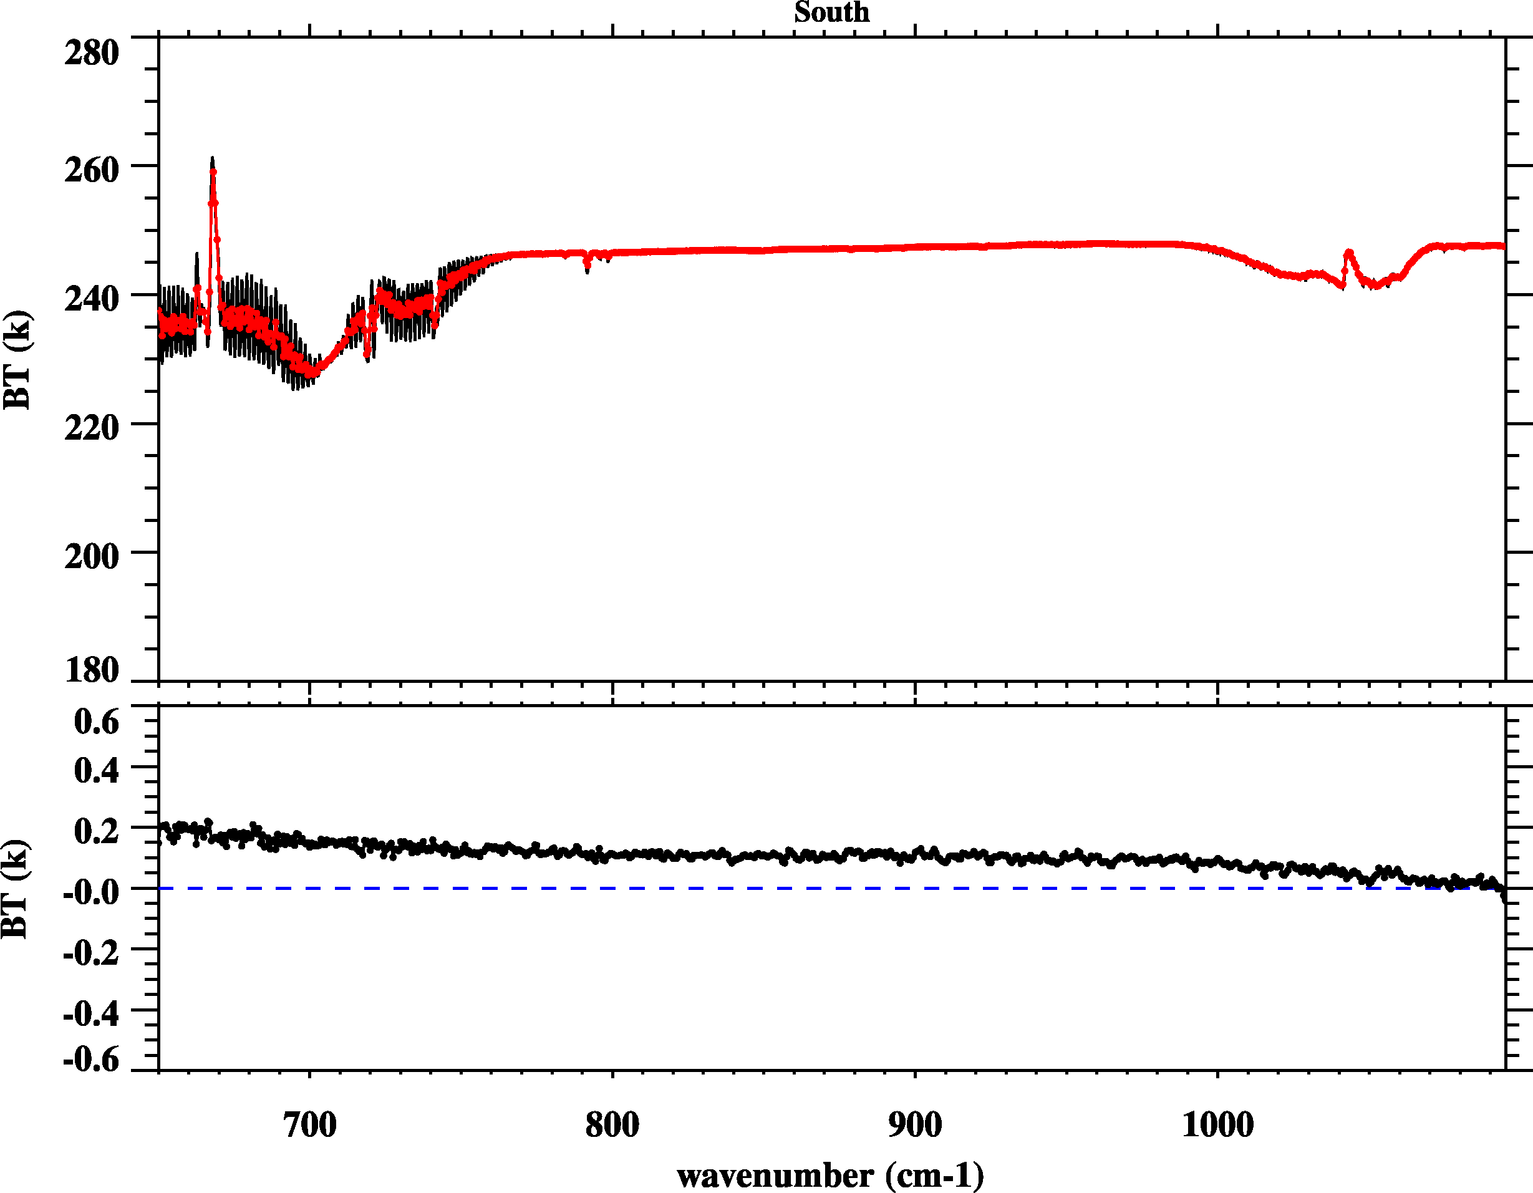
CrIS vs. IASI: CrIS Band 1
North Pole
South Pole
CrIS
IASI
Metop-A
IASI
CrIS-IASI
North Pole
South Pole
Metop-B
IASI

Slide 12
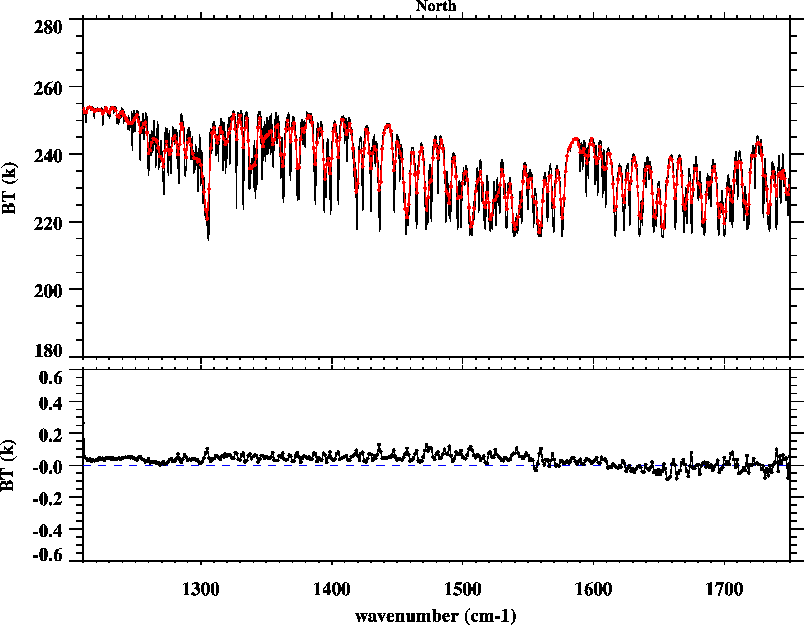
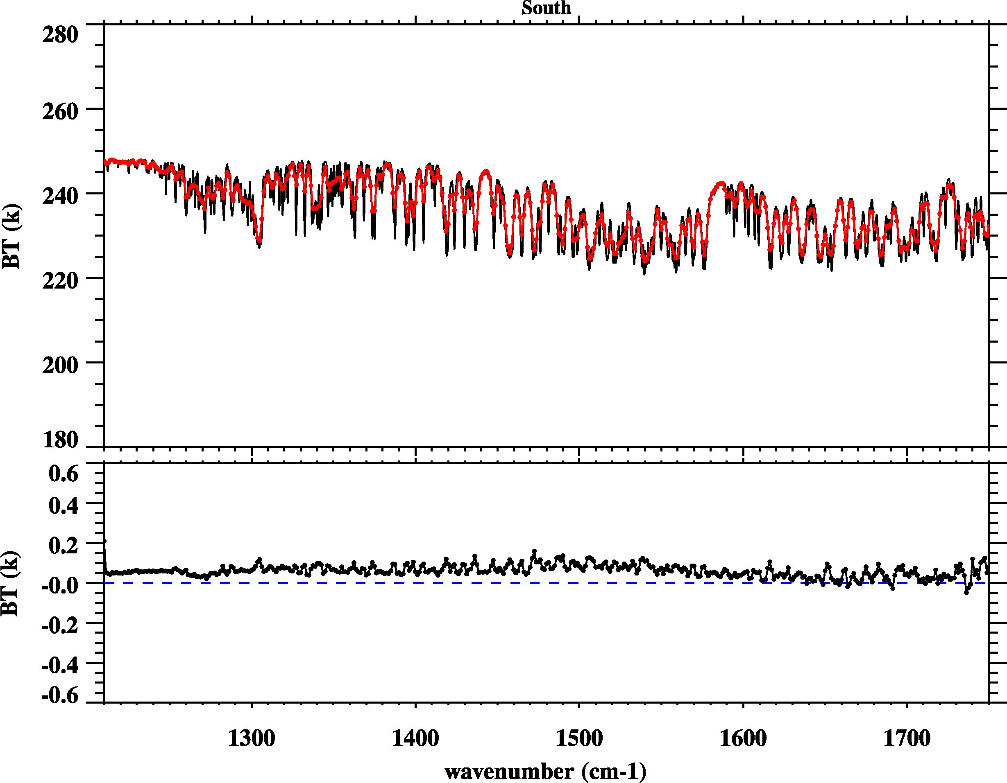
CrIS vs. IASI: CrIS Band 2
North Pole
South Pole
CrIS
IASI
Metop-A
CrIS-IASI
North Pole
South Pole
Metop-B

Slide 13
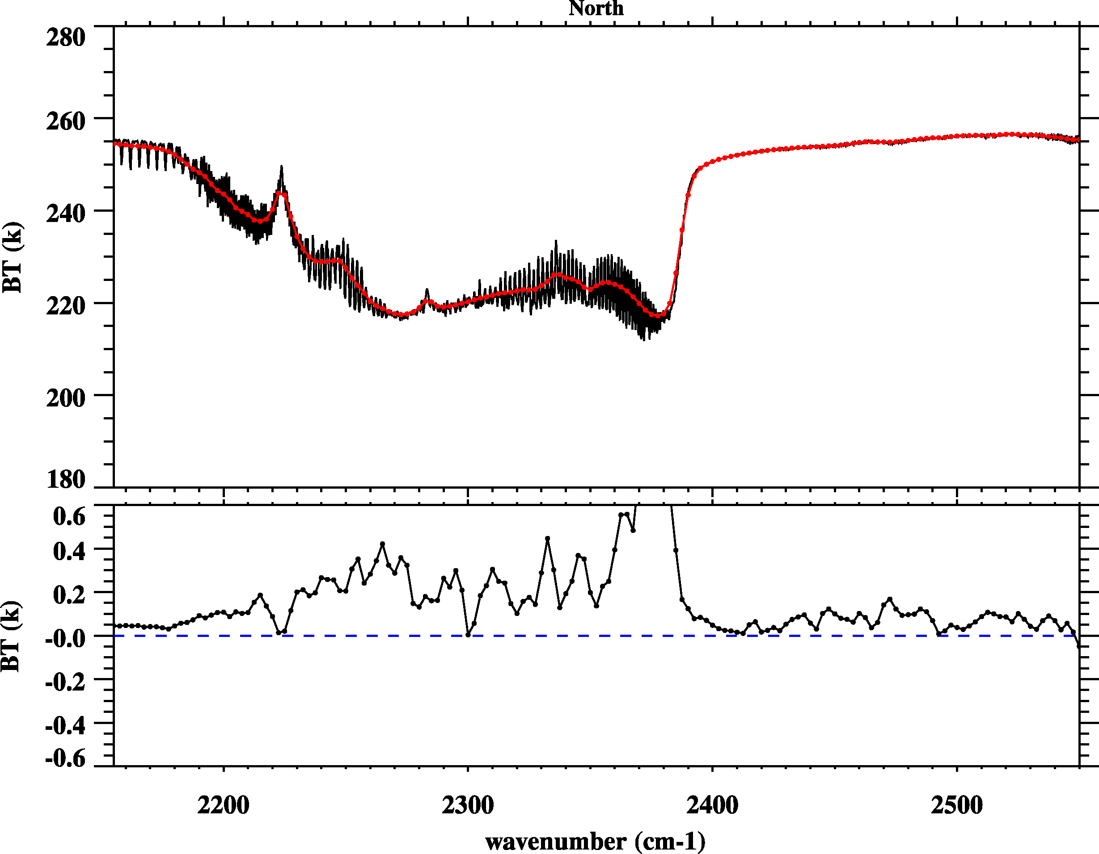
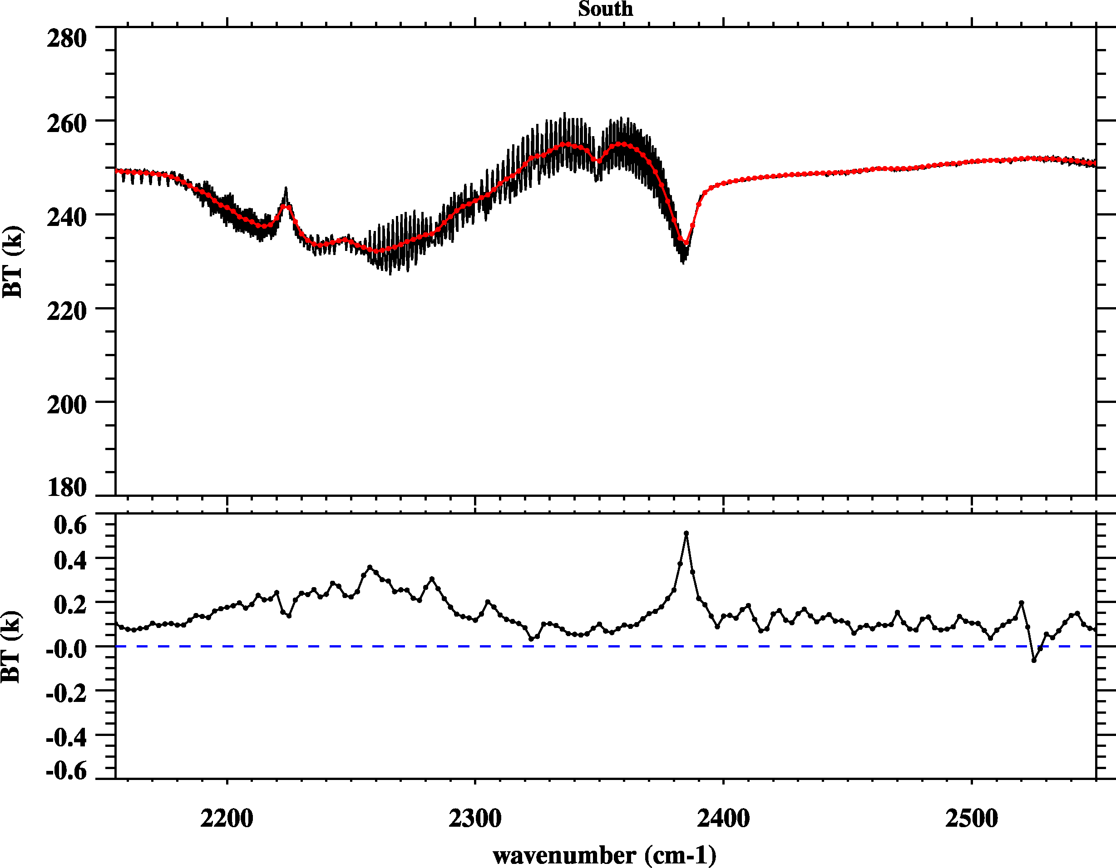
CrIS vs. IASI: CrIS Band 3
North Pole
South Pole
IASI
CrIS
Metop-A
CrIS-IASI
Metop-B

Slide 14
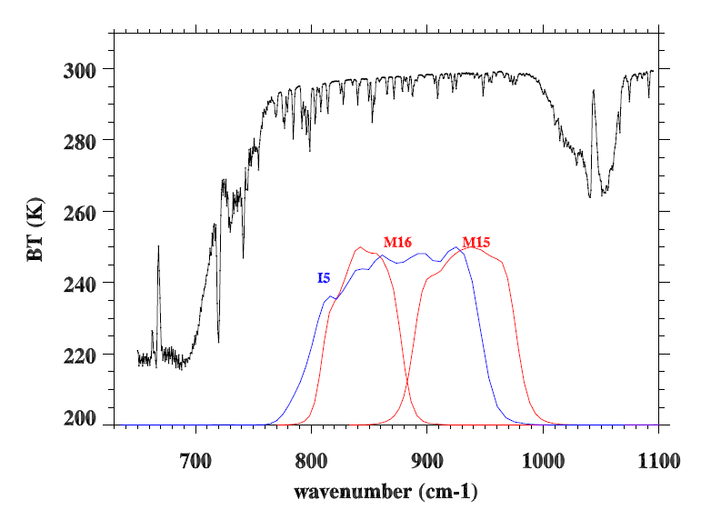
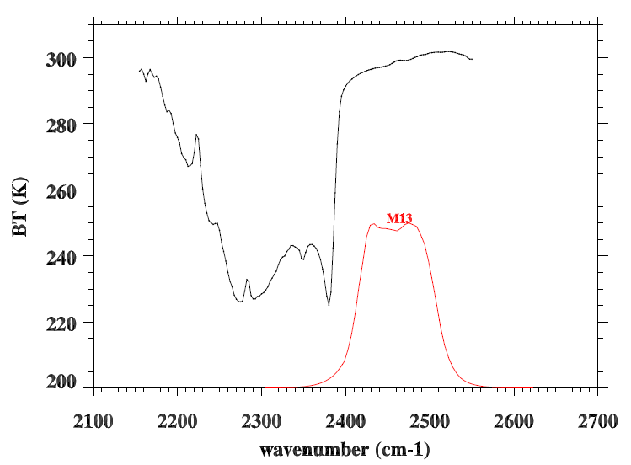
How about CrIS/IASI versus VIIRS?
CrIS/IASI spectra are overlapped with VIIRS SRFs for M13, M15, and M16, and I5
12.0 µm
10.8 µm
4.05 µm

Slide 15
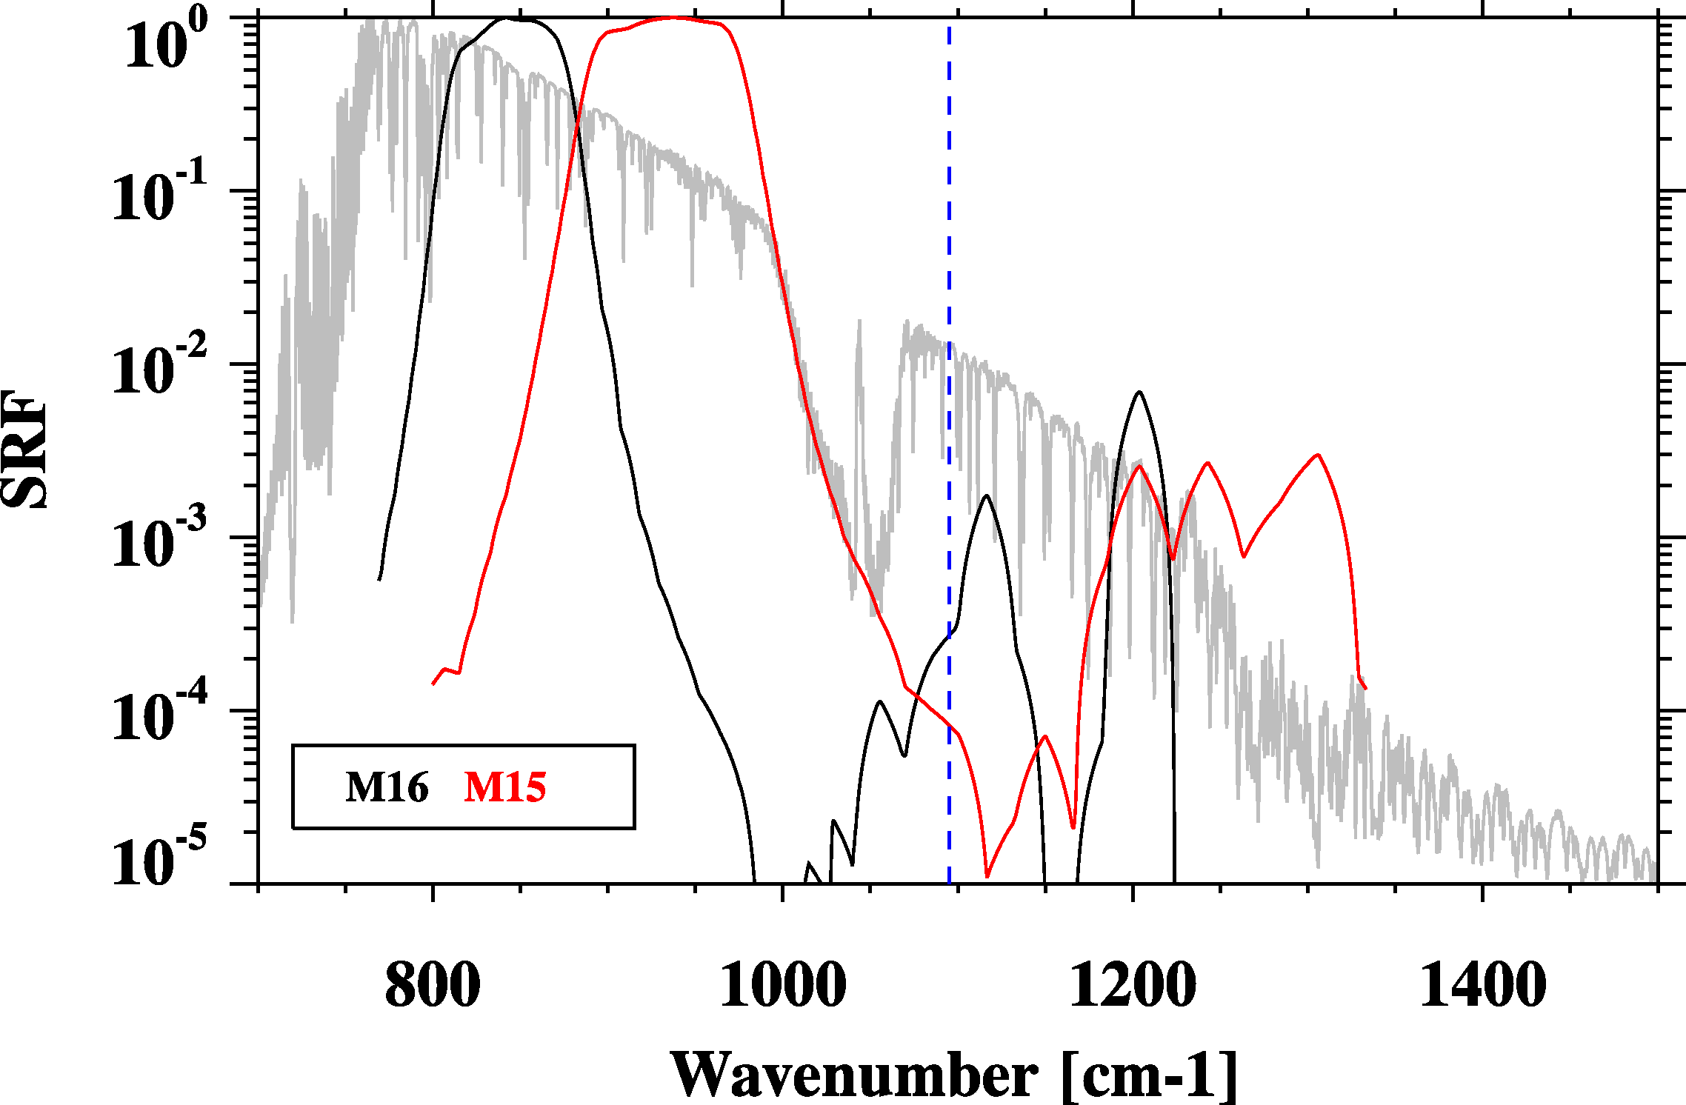
Be careful for out-of-band response!
CrIS Band 1 end point
Center wavenumber and band correction coefficients are calculated using the above SRFs.

Slide 16
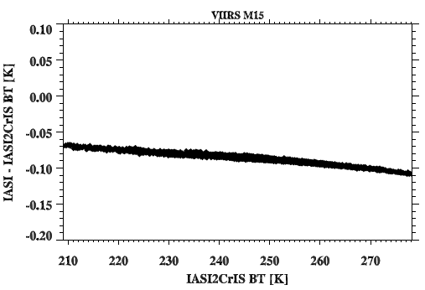
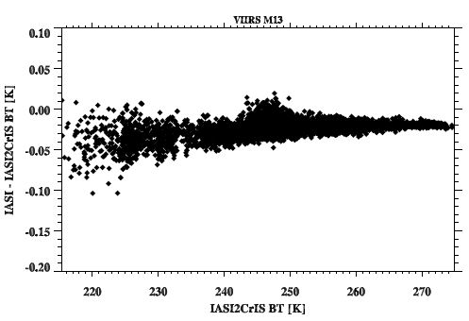
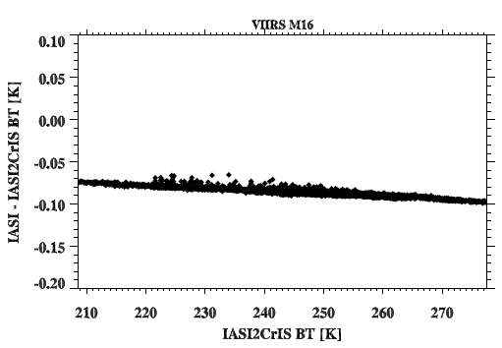
OOB effects in BTs
IASI-IASI2CrIS vs. IASI2CrIS
M15
M15
M13
M16
M16
This relationship is used to compensate
CrIS convolution results.

Slide 17
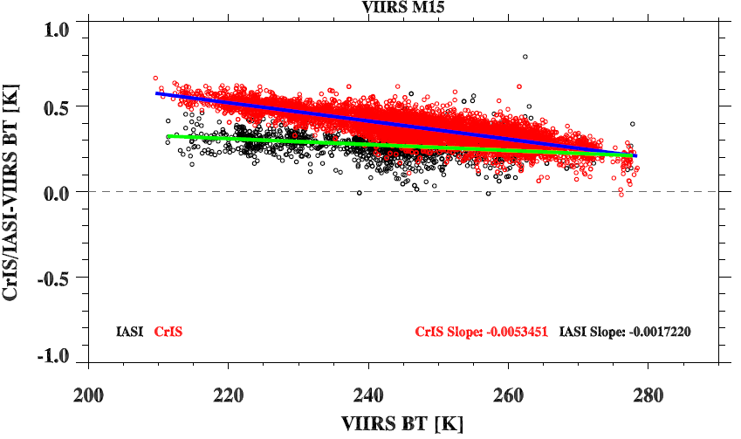
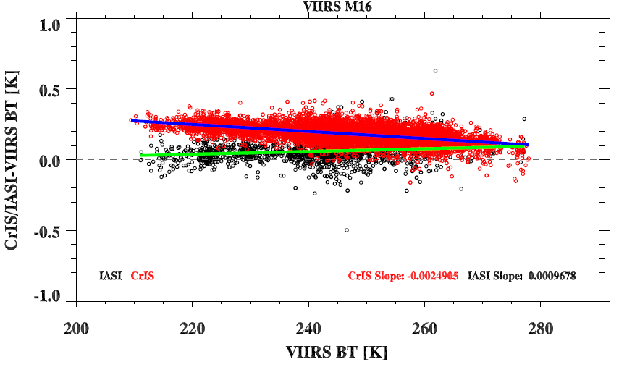
CrIS/IASI versus VIIRS
M15
M16
CrIS-VIIRS
IASI-VIIRS
Metop-A
M15
M16
Metop-B
Notes:
CrIS is warmer than all the sensors, Band 15 have more large scene-dependence than M16
IASI seems close to VIIRS and doesn’t show scene dependence bias.
CrIS and IASI

Slide 18
Conclusion Remarks
Inter-comparison of CrIS with IASI indicate that the consistency between CrIS and IASI is around 0.1-0.2 K at most spectral regions.
Given current consistency level (0.1-0.2K), it is very hard to find the root causes of the differences. However, in order to generate long-term climate data records, some issues still need further investigation:
CrIS is warmer than IASI at the longwave band, especially for cold scenes
CrIS-VIIRS scene-dependent features at M15
Spectral inconsistency for shortwave sharp transition regions between CrIS and IASI
Investigation is now undergoing to understand these differneces.

Slide 19
Thank you

Slide 20
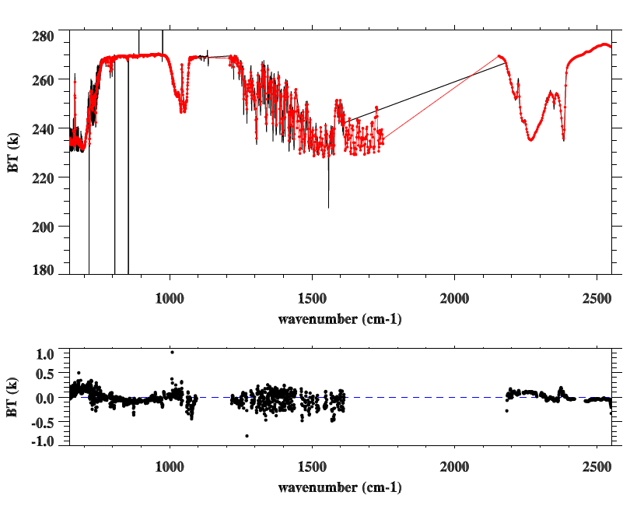
AIRS vs. CrIS
: North Pole SNOs
CrIS
AIRS
CrIS-AIRS

