Slide 1
ICVS Calibration and Processing Flow on S-NPP VIIRS
8/11/2016
Taeyoung (Jason) Choi, Ninghai Sun, Fuzhong Weng, Wanchun Chen, Lori Brown
NOAA STAR JPSS 2016 Annual Science Meeting ⋅ 8-12 August 2016 ⋅ NCWCP ⋅ College Park, MD

Slide 2
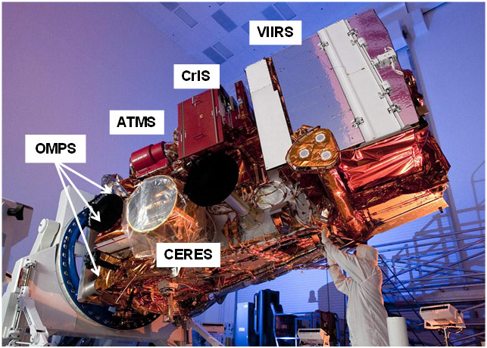
Introduction
The Suomi National Polar-orbiting Partnership (S-NPP)
Visible Infrared Imaging Radiometer Suite (VIIRS)
Descriptions of S-NPP VIIRS
  A whiskbroom scanning radiometer
  Sun synchronous orbit
  Field of view of 112.56⁰
  Nominal altitude of 829 km
  A large scan coverage of 3060 km
  Equator crossing local time of approximately 13:30 pm
  22 spectral bands
From ICVS webpage http://www.star.nesdis.noaa.gov/icvs/index.php

Slide 3
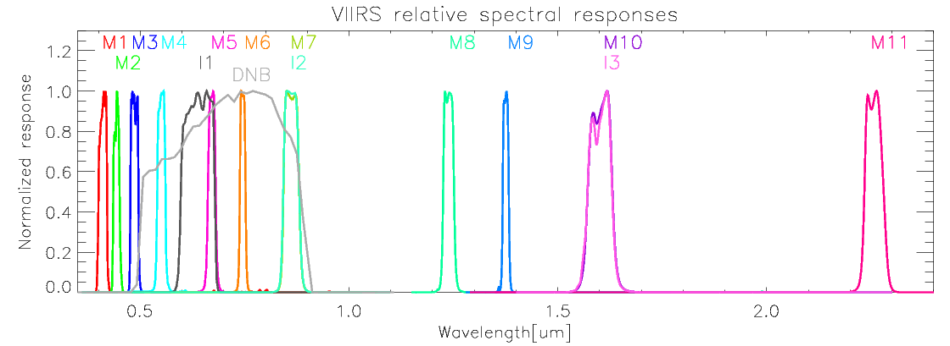
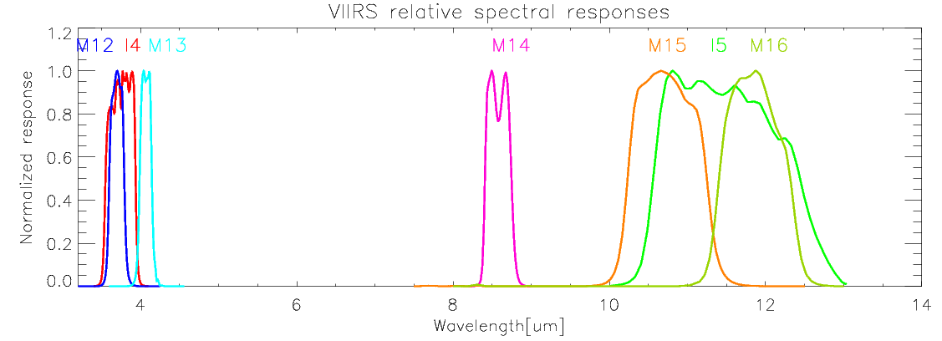
Introduction
Spectral Responses of the VIIRIS Bands

Slide 4
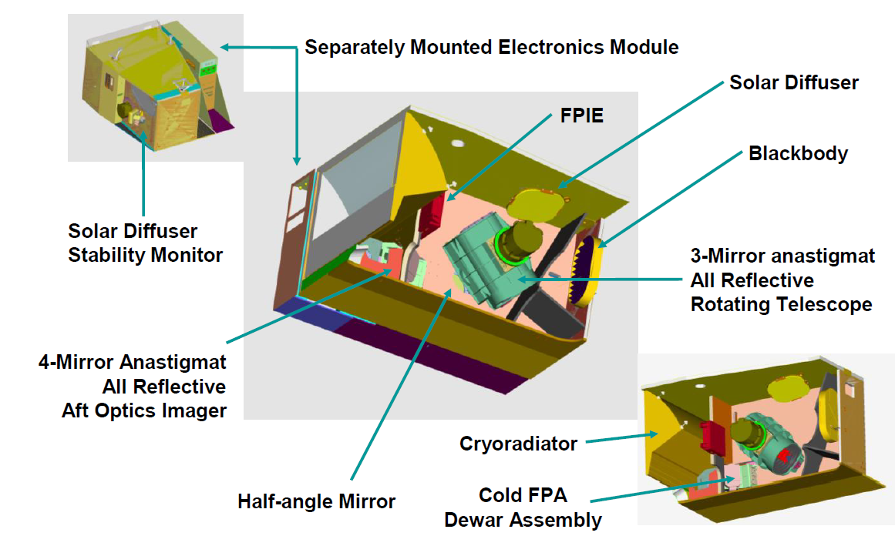
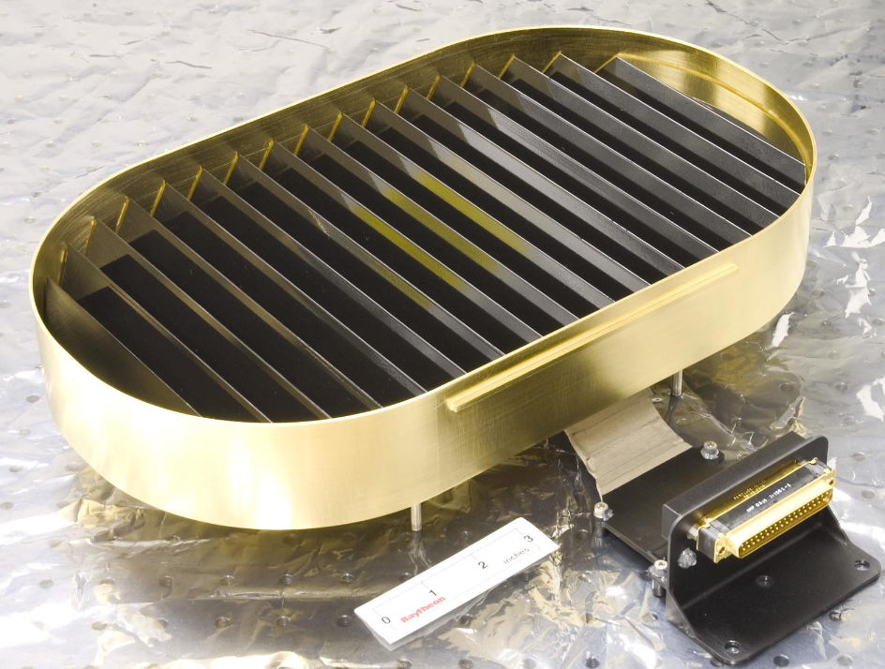
Introduction
Focal Plane Interface Electronics
Blackbody
From VIIRS Radiometric ATBD.

Slide 5
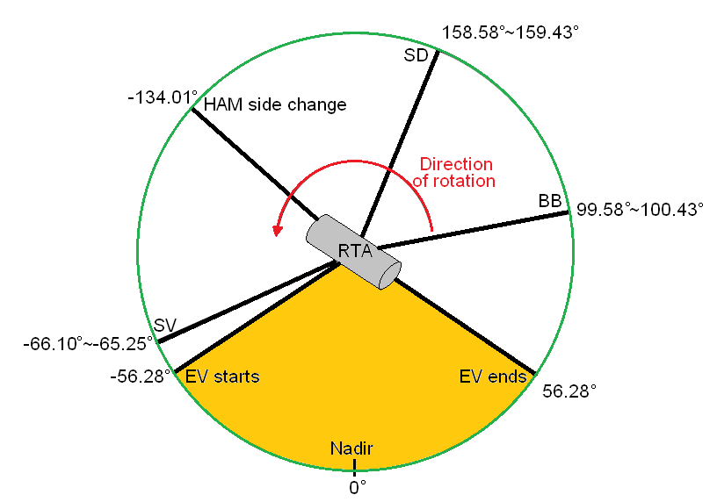
Introduction
SD
Rotating Telescope Assembly (RTA) scan over four data sectors
EV = Earth View, the main data sector (±56° off nadir).
BB = Blackbody; used for TEB Cal.
SD = Solar Diffuser view; used for RSB Cal.
SV = Space View; used for bias removal → Moon observed at this position.
2.5 ms for SV scan
BB
SV
EV
1.7793 s/scan

Slide 6
Introduction
Parameters | Descriptions | Dimensions | Usage
Global Image | Global true color image and single band image | 38 | VIIRS Imagery/Products
Quality Flag Image | Global Quality Flag Images | 22 | VIIRS QF Check
RSB & TEB H / F –factors | RSB Calibration Coefficients including Lunar Cal. | 66 | Calibration Monitoring
DNB Gain, Bias, Gain Ratio | DNB Calibration Coefficients | 18 | DNB Cal. Monitoring
Telemetry/Temperature | BB, RTA, cavity, HAM, FPA, cooler, Mainframe, Circuit Card Assembly, instrument current/voltage | 41 | Instrument Healthy status
SD Counts | VIIRS observation DN of Solar diffuser for band I1~I3, M1~M11, DNB over band average | 14 bands | Degradation trending
SD NE∆N | Noise NE∆N for SD signal of solar bands | 14 bands | SNR trending
SD Counts | VIIRS observation DN of Solar diffuser I1~I3, M1~M11, DNB over detector average | 14 bands *32d | degradation for Detector uniform
SDSM signal | SDSM signal of SD and Sun in every orbit | 8 bands | SD trending
SV Counts | VIIRS observation Space view DN for 22 bands | 22 bands | Background signal trending
SV NE∆N | Dark Noise NE∆N for Space view signal | 22 bands | Dark noise signal
BB Counts | VIIRS observation Blackbody DN for 22 bands | 22 bands | IR gain derivation
BB NE∆N | Noise NE∆N for black body signal | 22 bands | IR NEDT derivation
IR NE∆T | Noise equivalent temperature for IR bands M4, M5, M12-M16 | 7 IR bands | IR bands noise
Alaska Images | Automatically Animated Images over Alaska | 12 bands | Alaska Weather Monitoring
RTA & HAM No-Sync | Checks Synchronization between RTA and HAM | 1 | Auto notification
* 351 trending plots are generated in near real time (+80 trending plots added since last year)

Slide 7
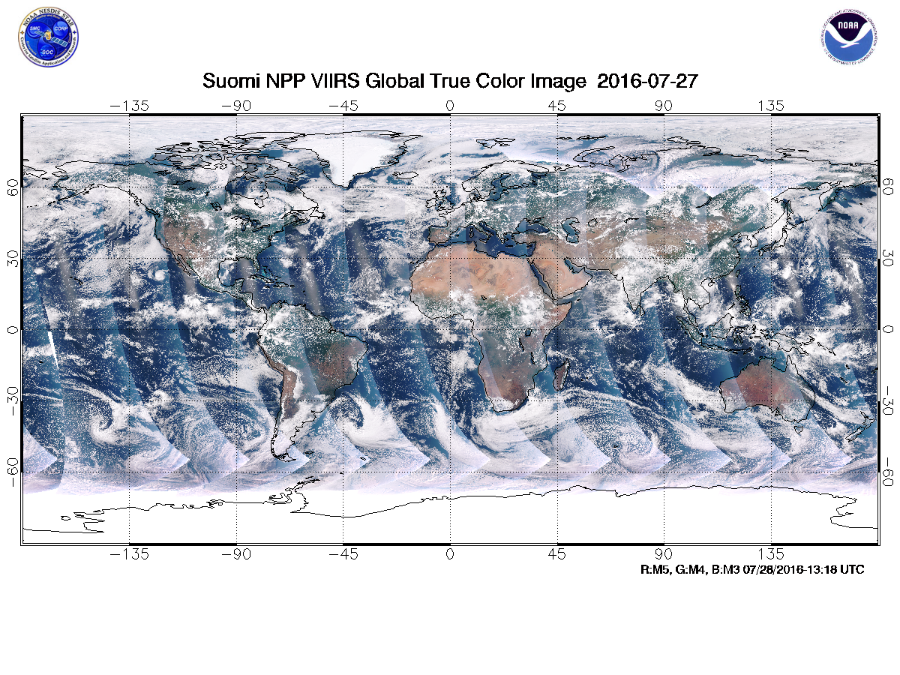
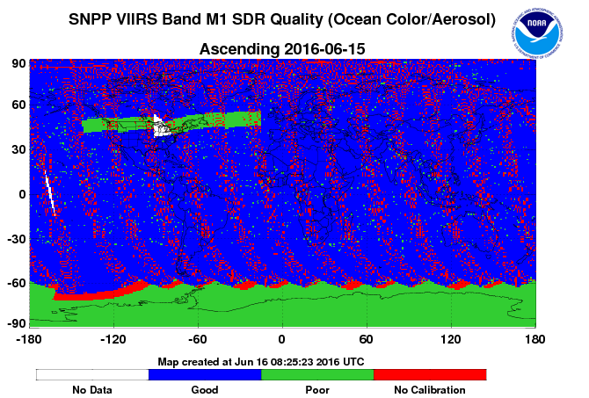
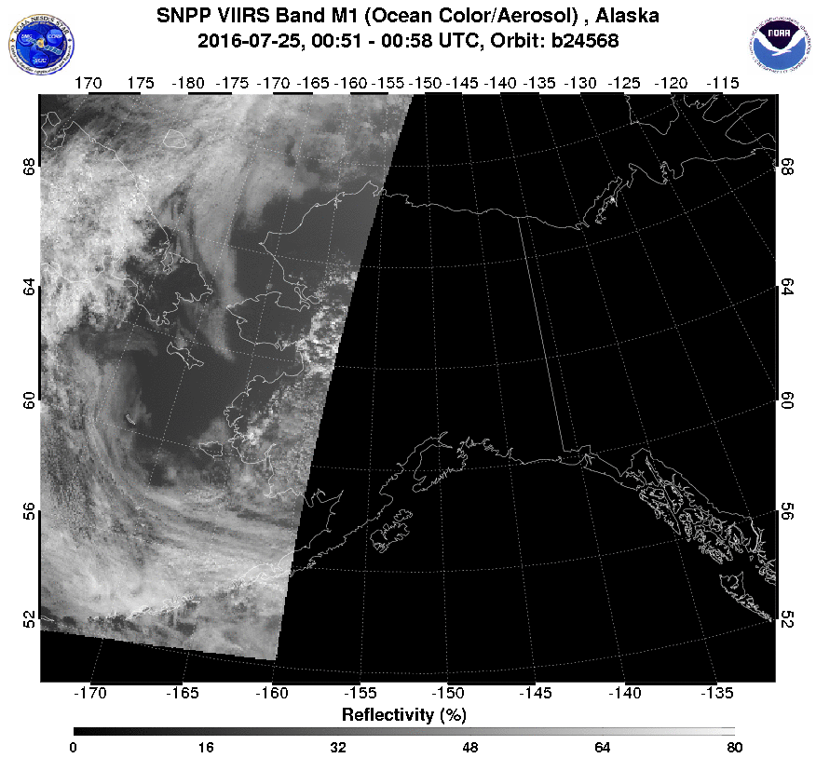
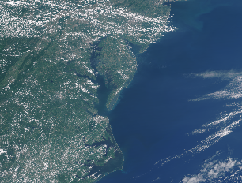
STAR ICVS VIIRS Processing Flow
VIIRS Image Processing Flow
True color / Single band image generation
38 images
Image processing code
SDR Quality Flag Image
1013 Granules/day
Geo I band
Geo M band
Geo DNB
SDR I1~I5
SDR M1~M16
540GB/day
22 images
Alaska Image Generation
12 images
High Resolution Image Generation
52 images

Slide 8
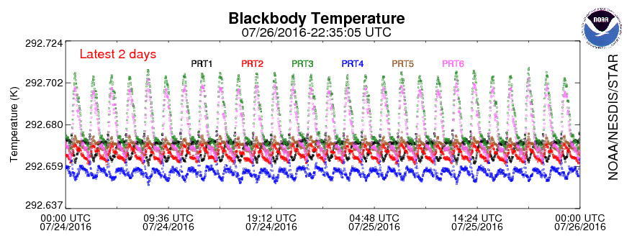
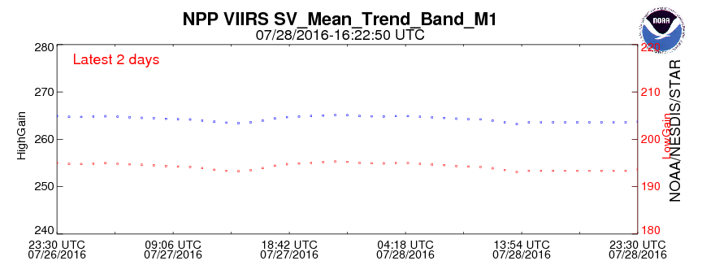
STAR ICVS VIIRS Processing Flow
VIIRS On-board Calibrator Processing Flow
ICVS OBCIP Code
1013 Granules/day
OBCIP
18GB/day
Daily parameter processing
Daily accumulated HDF file
Long-term parameter processing
Long-term accumulated HDF file
Trending plot generation
212 Calibration Trending Plots
End

Slide 9
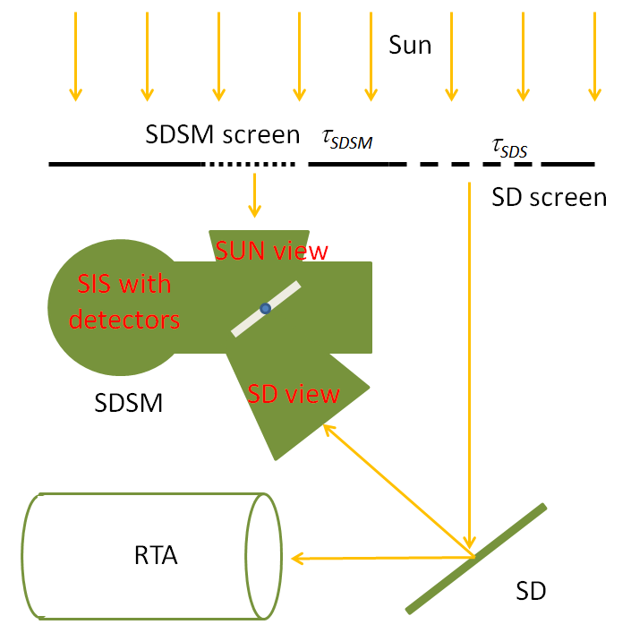
STAR ICVS VIIRS Processing Flow
VIIRS Reflective Solar Band Calibration Processing Flow
  Sources of calibration :
  Solar Diffuser (SD) and SD Stability Monitor (SDSM)

Slide 10
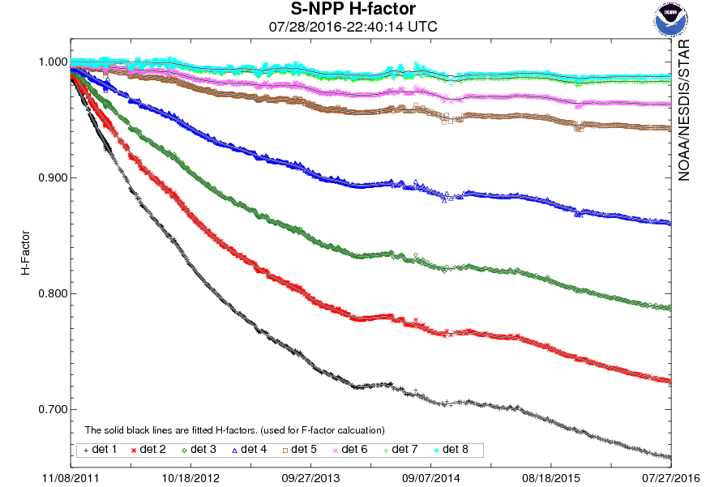
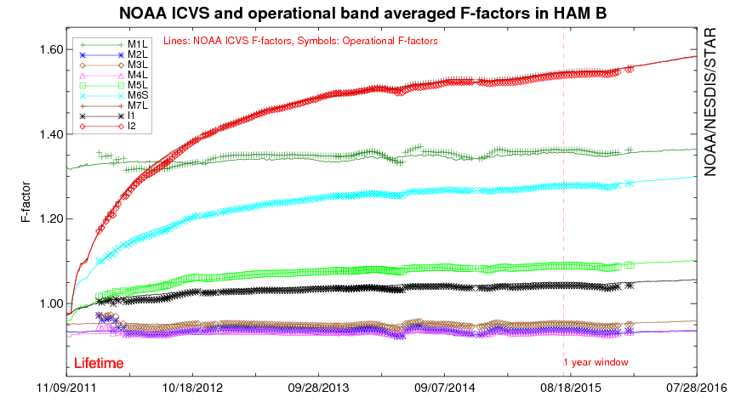
STAR ICVS VIIRS Processing Flow
VIIRS RSB Calibration Processing Flow
RSB Cal. Start
1013 Granules/day
OBCIP
18GB/day
Detect SD/SDSM active OBCIP granules
14 or 15 OBCIP files / day
SD/SDSM active OBCIP file list
H-factor, SD response, Sun response, etc.
9 trending plots
Calculate SD degradation (H-factor)
Calculate F-factor
TEB calibration
End
F-factors and comparison plots.
Detector dependent plots

Slide 11
STAR ICVS VIIRS Processing Flow
Thermal Emissive Band Calibration:
  Source of calibration: Blackbody (BB) and SV
BB Image is taken from http://digitalcommons.usu.edu/cgi/viewcontent.cgi?article=1011&context=calcon
Background Term
Blackbody
Blackbody Reflection

Slide 12
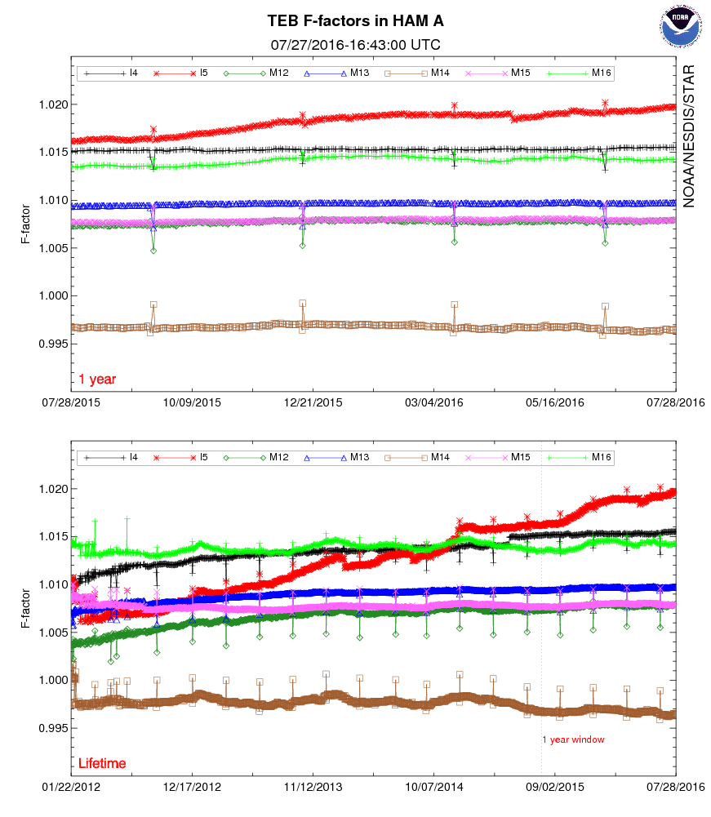
STAR ICVS VIIRS Processing Flow
VIIRS TEB Calibration Processing Flow
SD/SDSM active OBCIP file list from the RSB Cal.
TEB Cal. Start
Get SD/SDSM active OBCIP files
1013 Granules/day
OBCIP
18GB/day
1-year and lifetime TEB F-factor trending plots.
Calculate TEB-factor
End

Slide 13
STAR ICVS VIIRS Processing Flow
VIIRS Day-Night-Band (DNB) Calibration
  DNB calibration is similar to RSB calibration.
  DNB has 3 gain states and 32 aggregations zones.
    Low Gain State (LGS), Mid Gain State (MGS), High Gain State (HGS).
  The calibration coefficient is calculated in LGS and transferred to MGS and HGS by ratio LUTs.
  RTA degradation model (by Tungsten contamination) is applied.
1013
Granules/day
OBCIP
18GB/day
SD/SDSM active OBCIP file list from the RSB Cal.
TEB Cal. Start
Get SD/SDSM active OBCIP files
From RTA degradation model,
Calculate new spectral response
Calculate new Esun, BRDF, and H-factor
Calculate DNB LGS gain
in 32 aggregation zones.
18 DNB Cal. Trending Plots
End

Slide 14
Summary
VIIRS imagery processing provides near real-time band images and quality flag information.
Recently ICVS team added high resolution VIIRS image page including global and polar regions.
OBCIP processing unit provides basic instrument status.
  Temperatures, SD, SDSM, SV, and BB counts.
RSB, TEB, and DNB processing units generate calibration coefficients and related trending plots.
Sensor performance can be validated by comparing to the operational calibration coefficient.
ICVS calibration results also supports future reprocessing.
Current S-NPP ICVS processing unit will be applied to J1 VIIRS.

