Slide 1
NOAA Integrated Calibration and Validation System (ICVS)
Alerts, Events, and Monitoring
Ninghai Sun, Xin Jin, Jason Choi, Ellen Liang, Wanchun Chen, Fuzhong Weng
NOAA/NESDIS/STAR

Slide 2
Outline
Introduction to STAR ICVS
Objectives
Services
IT Infrastructure
Processing Flowchart
Major Accomplishments
New Trending Products
Improvements of Existing Products
Useful Near Real Time Anomaly Alert
Summary & Future Plans
ICVS improvement and implementation plan
JPSS Readiness

Slide 3
Benefits of STAR ICVS System
Provide near real time and long term spacecraft and instrument health status and performance monitoring
Provide near real time and long term SDR/EDR data product quality monitoring
Provide real time support for sensor calibration activities and instrument anomaly troubleshooting
Provide quick and preliminary estimate of satellite data impact in NWP applications
Ensure the integrity of the climate data records from broader satellite instruments

Slide 4
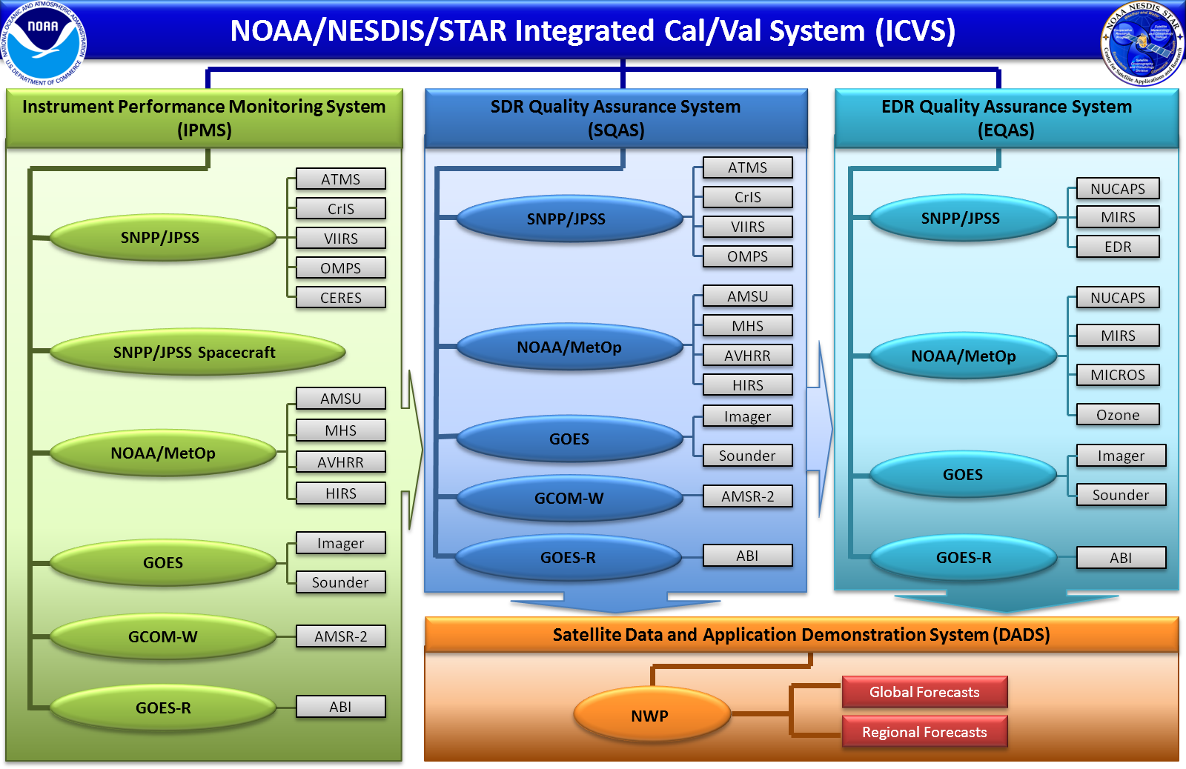
STAR ICVS Structure
Notes:
To meet the requirements of ICVS mentioned in the previous slide, we build up the system following the structure
Green: instrument level health status monitoring
Blue: satellite sensor data product quality monitoring
Cyan: environmental data product generation and monitoring
Orange: Numerical weather prediction model demonstration on satellite data product applications (global vs regional models)
ICVS is more than just monitoring system, it is also a calibration system. Any anomaly detected in instrument and data will be notified to calibration teams automatically for analysis and troubleshooting. Calibration impacts will be also evaluated by ICVS.

Slide 5
Services
NOAA ICVS provides the following services
Monitors over 400 parameters for 28 instruments onboard NOAA/METOP/SNPP satellites
Monitors and trends the SNPP spacecraft parameters , supporting NASA flight team
Monitors the instrument performance through trending the instrument house-keeping and telemetry parameters
Detects the anomaly events and automatically sends the warning messages to NOAA satellite operators, NASA instrument scientists, and senior program managers
Characterizes the sounder SDR data quality with respect to the numerical weather prediction model (NWP) simulations
Provides NWP users and remote sensing communities on the instrument noises for their real-time applications (e.g. error covariance in data assimilation)
Generates high resolution geostationary/polar-orbiting satellite images
4246 all instrument status and data quality trending figures generated in near real time
Supports Suomi NPP life cycle reprocessing by operating SDR processing packages

Slide 6
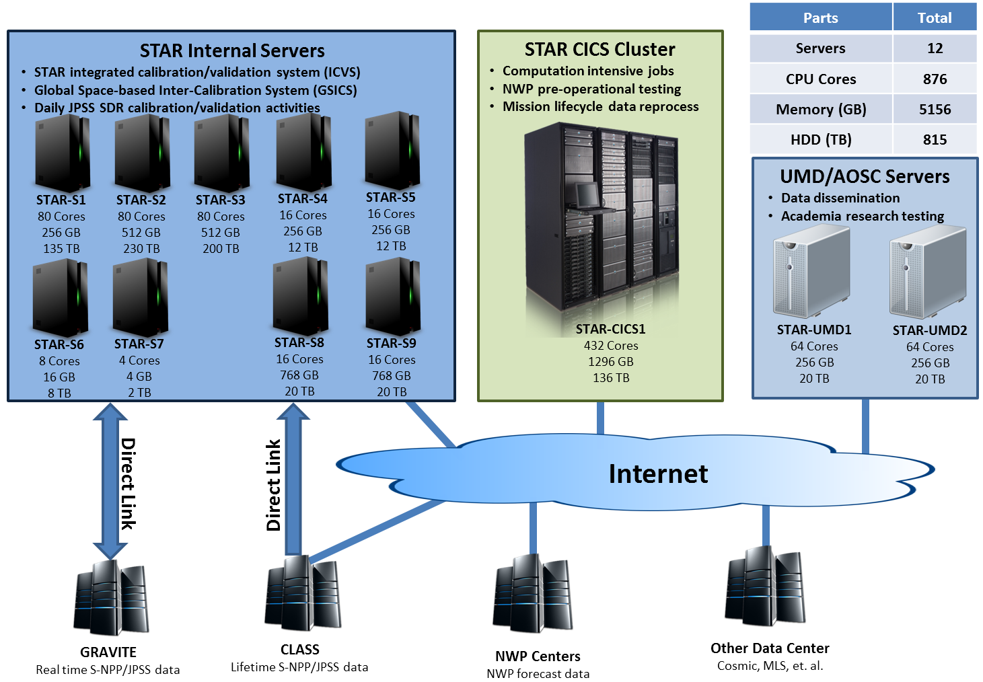
STAR ICVS IT Infrastructure
Notes:
To support the daily processing activities of four modules in the previous slide, we build up the IT infrastructure shown in this slide.
Blue: STAR internal SDR calibration servers
Green: Cluster super computer for NWP demonstration and mission lifecycle data reprocessing
Blue (right): Small group of server located in university for research and algorithm testing
STAR Internal servers are directly connected to GRAVITE and CLASS for real time satellite data access. Other connections through internet to NWP centers and international data centers can provide ancillary data for data quality monitoring

Slide 7
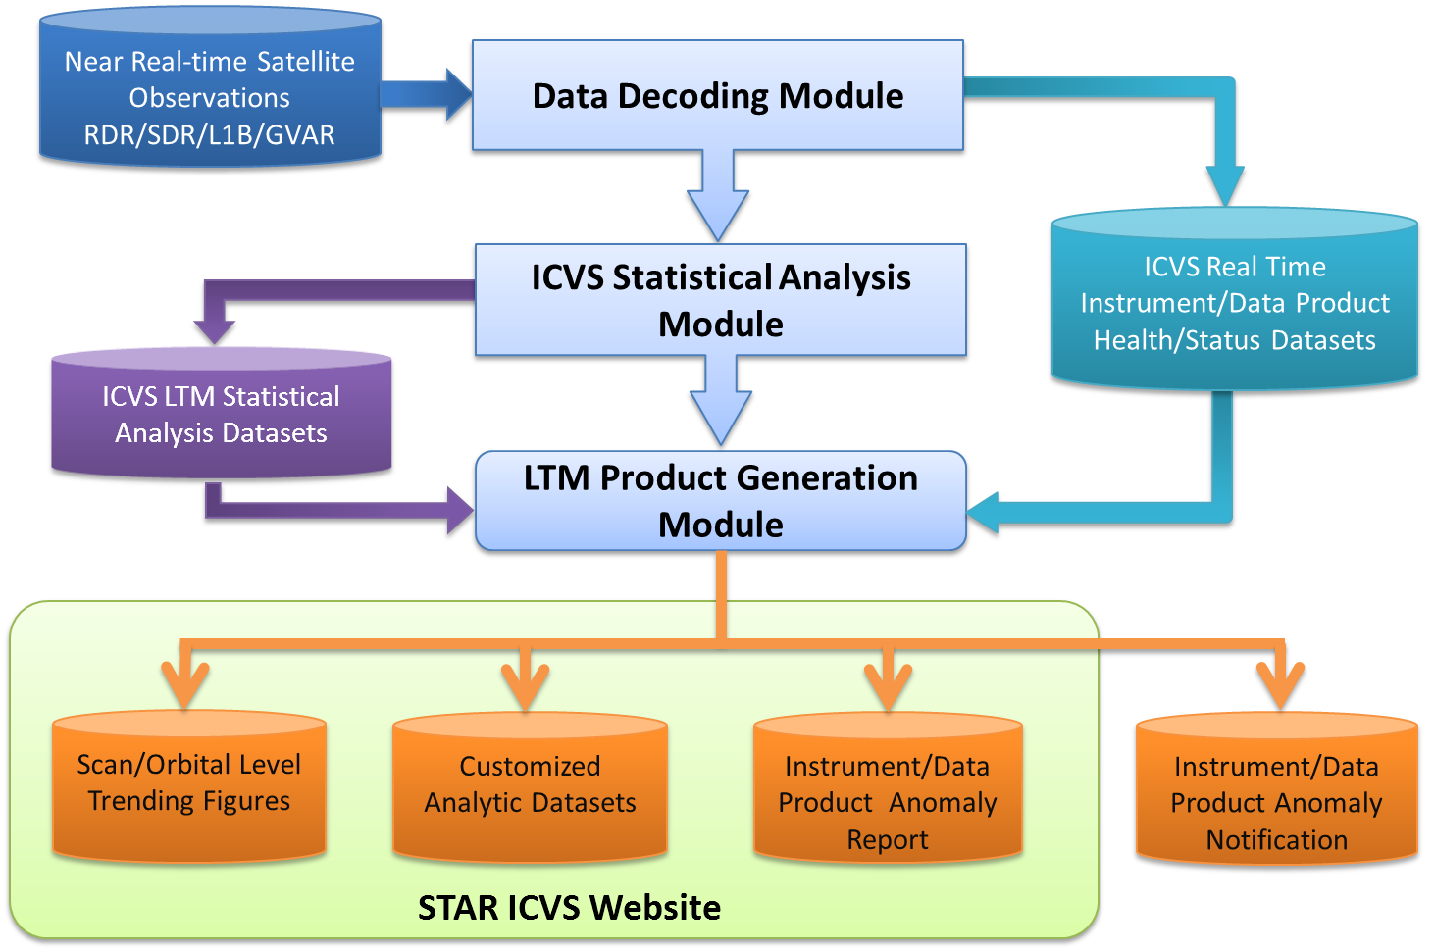
STAR ICVS Data Processing Flowchart
Notes:
To realize the real-time monitoring and long term trending of satellite operational status and data product quality functions, the ICVS data processing software packages are designed following this working flowchart.
Emphasize customized data for NASA Flight project for instrument health status analysis and automatic anomaly warning notification capability
All intermediate and lifetime statistic data are updated and saved for future additional analysis

Slide 8
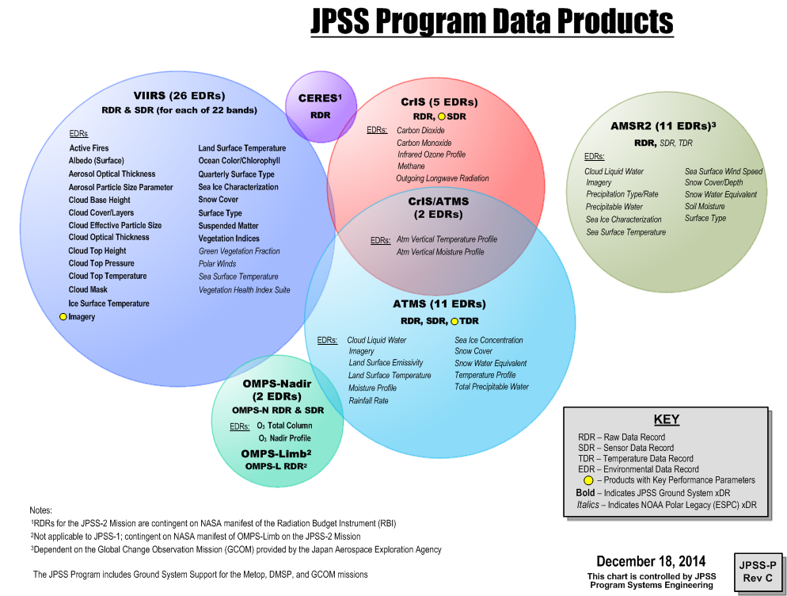
JPSS Data Products

Slide 9
STAR ICVS Event Log
Suomi NPP instrument event log is now available in STAR ICVS website provided by Cole Rossiter

Slide 10
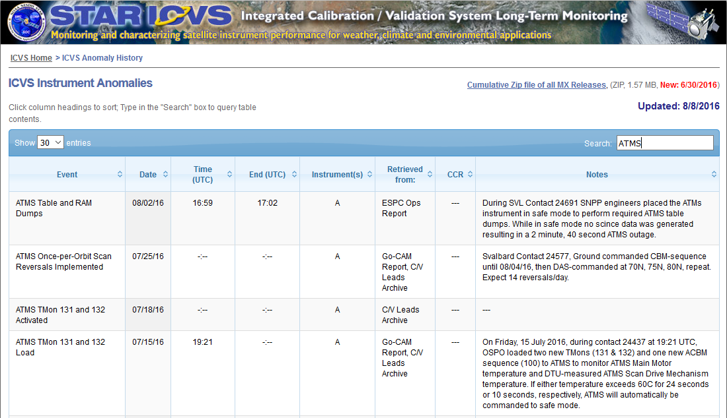
STAR ICVS Event Log
Suomi NPP instrument event log is now available in STAR ICVS website provided by Cole Rossiter

Slide 11
Major Performance Indicator
STAR ICVS-LTM system uses the following equation to calculation S-NPP ATMS channel sensitivity (NE∆T)
Where,
M is the number of scans for orbital NE∆T calculation
N is the number of warm count readings used in calculation
C is the warm count readings for each scan
G is the calibration gain of each scan
Tian, Miao, Xiaolei Zou, and Fuzhong Weng. "Use of Allan Deviation for Characterizing Satellite Microwave Sounder Noise Equivalent Differential Temperature (NEDT)." Geoscience and Remote Sensing Letters, IEEE 12.12 (2015): 2477-2480.
Chen, Yong, Fuzhong Weng, and Yong Han. "SI traceable algorithm for characterizing hyperspectral infrared sounder CrIS noise." Applied optics 54.26 (2015): 7889-7894.

Slide 12
Major Performance Indicator

Slide 13
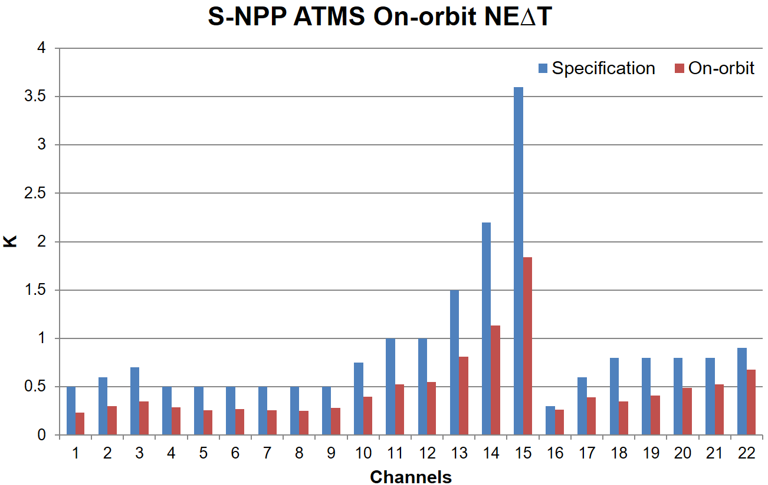
Major Performance Indicator

Slide 14
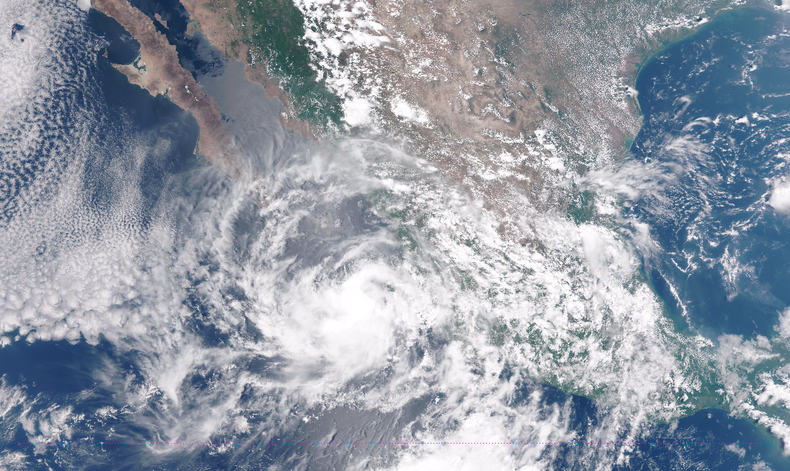
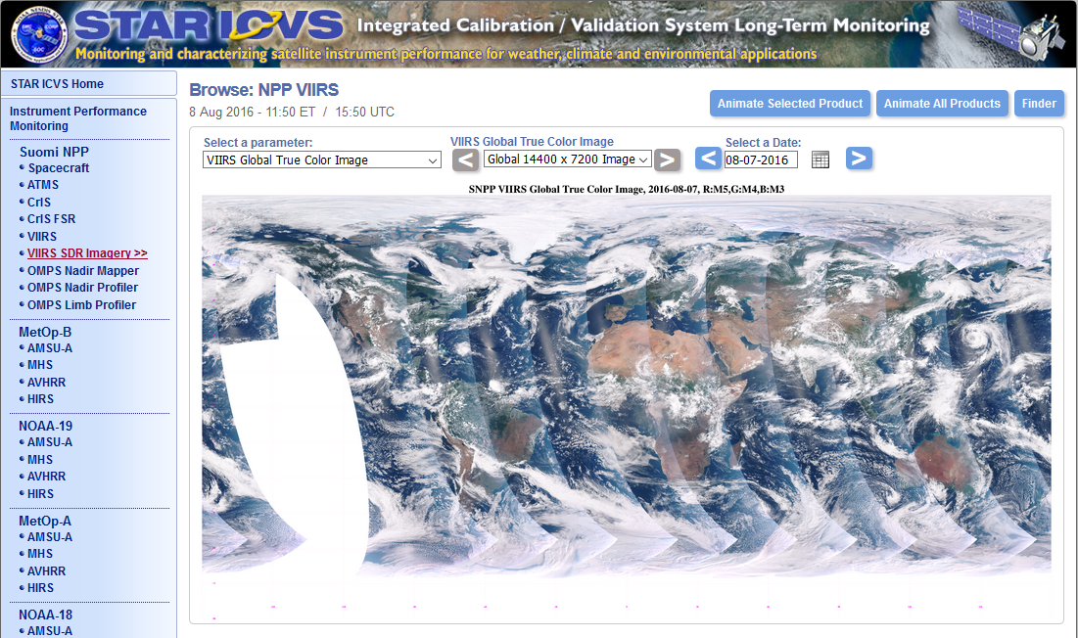
ICVS New Products

Slide 15
ICVS New Products
Super typhoon Nepartak from July 5 to 8, 2016 UTC

Slide 16
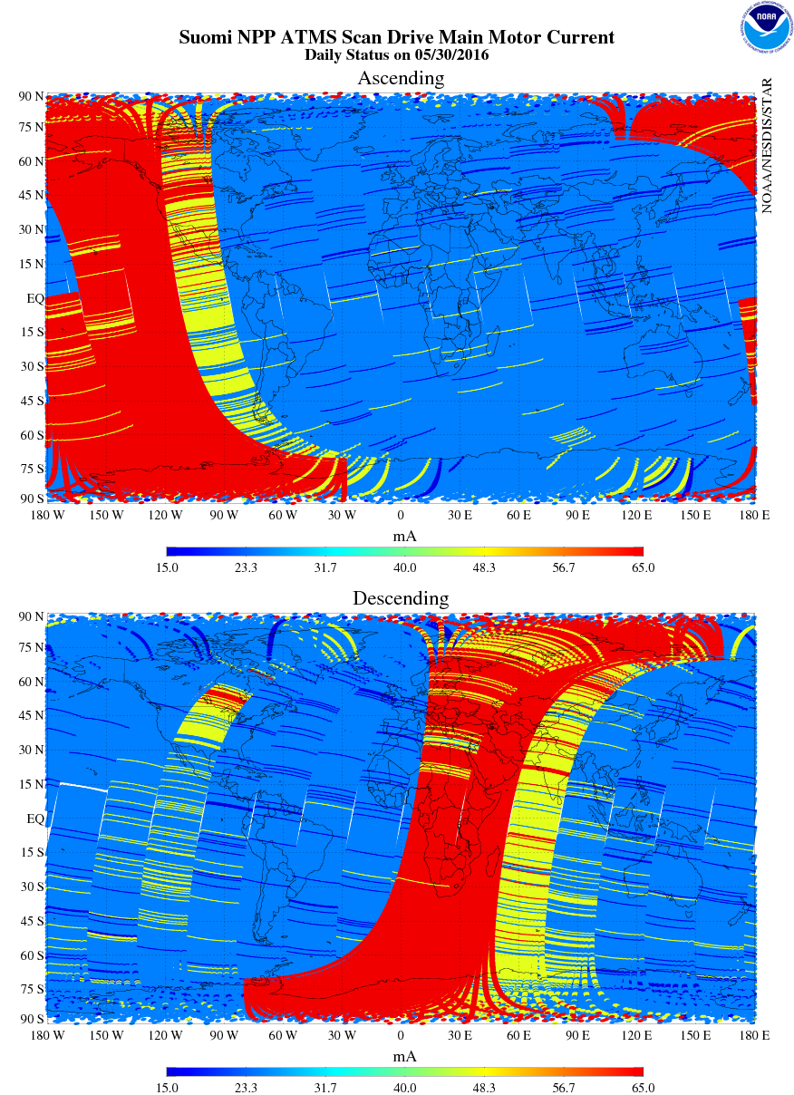
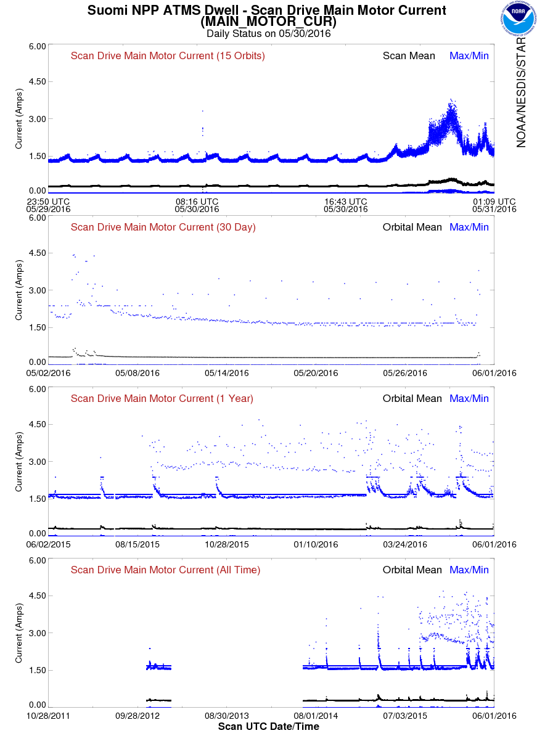
S-NPP Anomaly Alert

Slide 17
S-NPP ATMS Status

Slide 18
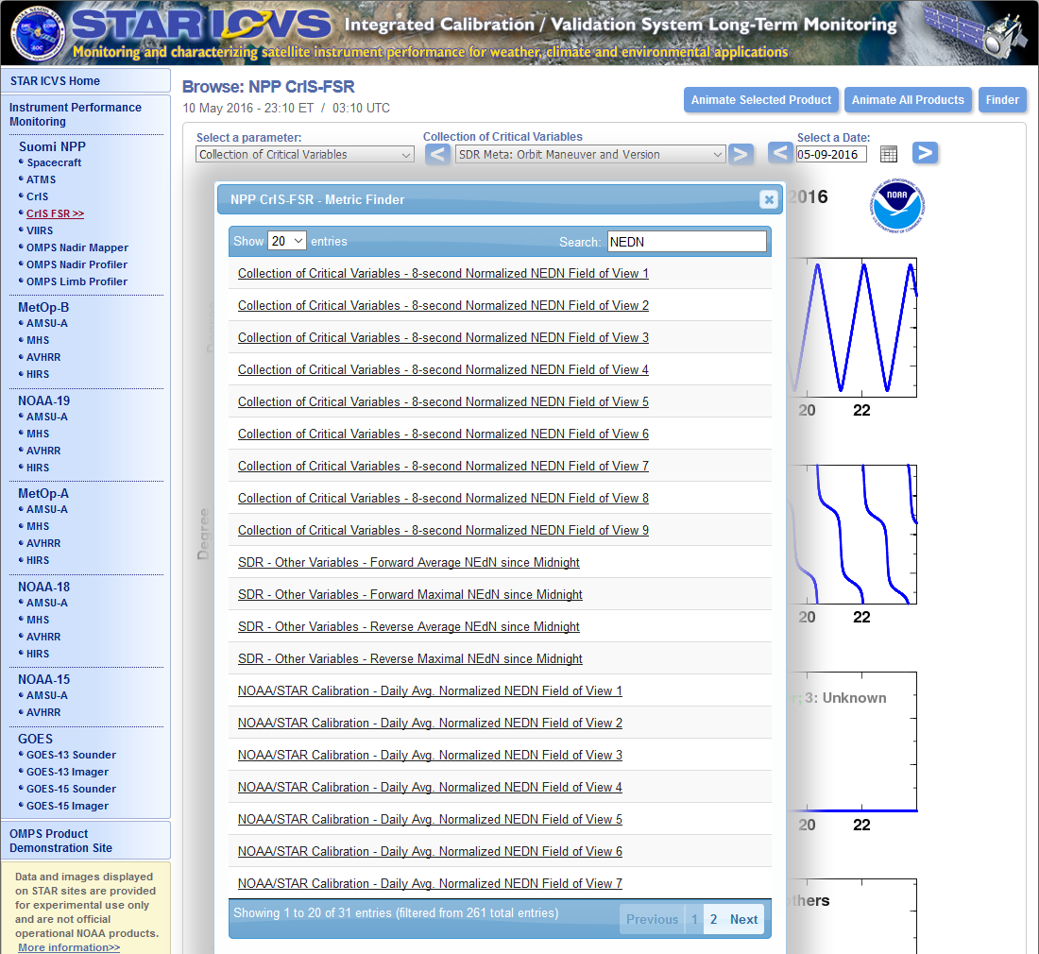
Improved Website

Slide 19
Summary & Future Plan
STAR ICVS is not only just instrument status monitoring system but also a calibration testing and quality evaluation testbed
STAR ICVS keeps providing near real time and long term trending of NOAA instrument and automatically sending warning messages when anomaly is detected
STAR ICVS will keep supporting NESDIS 24/7 operational missions
New functions and parameters are being added to ICVS to provide users better understanding of NOAA satellites/instruments operational status and support on calibration activities, as well as improving user experience by updating STAR ICVS website
STAR ICVS has supported JPSS-1 pre-launch calibration activities and is ready for JPSS-1 post-launch instrument monitoring and calibration activities

