Slide 1

Stability and Interconsistency of Passive Microwave Products for Weather and Climate Users
John Forsythe, CIRA
August 11, 2016
Presentation to Global Space-Based Inter-Calibration System (GSICS) Users Workshop

Slide 2
Outline
Differences in needs of weather and climate users
Blended hydrometeorological products for forecasters (Total and Layered Precipitable Water)
Total Precipitable Water Climate Record (NVAP-M)
Connections to GSICS

Slide 3
Weather and Climate Users of Water Vapor Products have Different Needs
Weather | Climate
Retrieval algorithms can be updated frequently | Need constant retrieval algorithm though time
Introduce new sensors as soon as practical | New sensors might cause discontinuities in existing records
Polar orbiters in equally spaced orbits desirable | Overlapping sensors in some orbit (e.g. NASA A-Train) desirable for intercomparison
Accuracy less important, images which represent gradients and moisture flow are key. | Absolute accuracy and precision are critical for things like reanalysis/model comparison and trend analysis
Latency of less than a few hours required | Latency not a key issue

Slide 4
Part 1: Weather

Slide 5
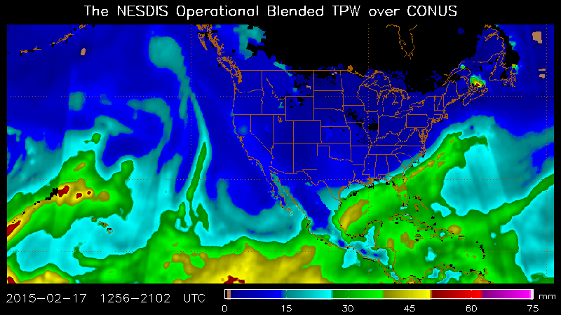
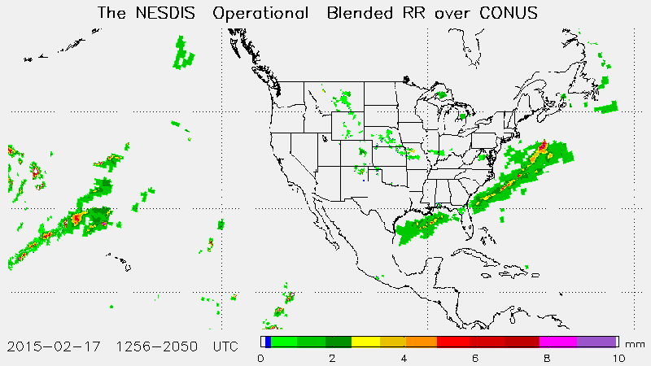
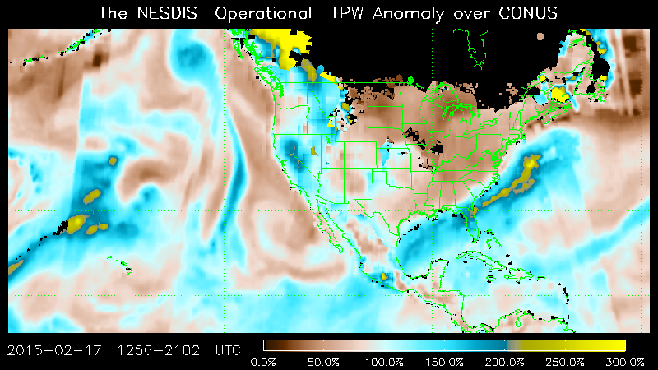
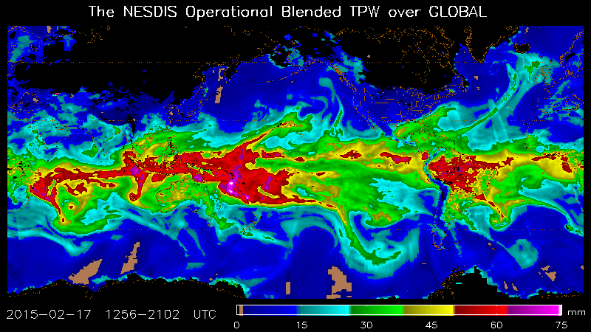
Operational NOAA Blended TPW, TPW Anomaly and Rain Rate show forecasters where the action is. Layer Precipitable Water (LPW) non-operational but being used by national centers.
Near-global, from 71° S to 71°N
Moisture and rainfall can be tracked for extreme precipitation events
Produced every hour. Mostly from NOAA MiRS retrievals (Boukabara et al.). Surface GPS and GOES Sounder also used near CONUS.
Blended TPW
http://www.ospo.noaa.gov/Products/bTPW/index.html
Blended Rain Rate
Blended TPW Near-Global View
TPW Anomaly (% of normal)

Slide 6
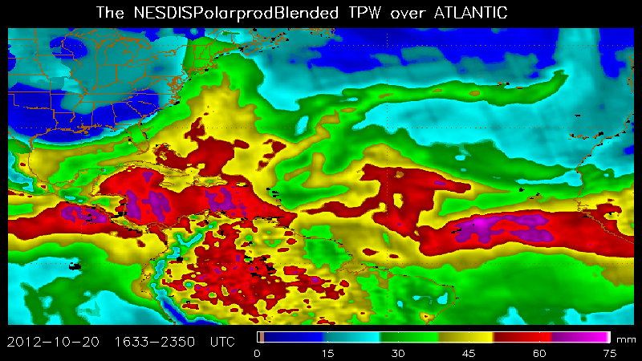
Blended Products from Polar Satellites Allow Forecasters to Track Moisture Flow
Ten Day Animation of Blended TPW during Hurricane Sandy (2012)

Slide 7
  Frequent updates on intercalibration and sensor biases to NOAA MiRS group essential for quality near-realtime products.
  Science Issue
  Forecasters are faced with an overwhelming variety of satellite data for analysis.
  Blended products - merging multiple sensors into one product - consolidate this data into easy-to-use observational products.
  How do we merge disparate sensors in space, time, and algorithm to create a seamless blended product? How do we know it’s helping forecasters? Can we feed back anomalies to algorithm developers to inform efforts like GSICS?

Slide 8
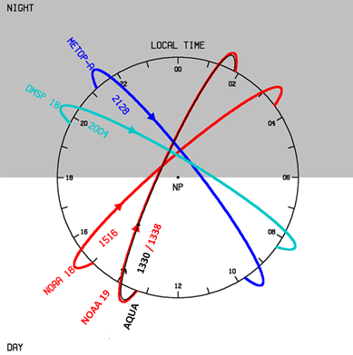
“Clock Diagrams” show local time sampling of polar sensors used
Current configuration for Layer Precipitable Water:
Periods of high sampling and no sampling
S-NPP
Older satellites play a valuable role in extending temporal sampling

Slide 9
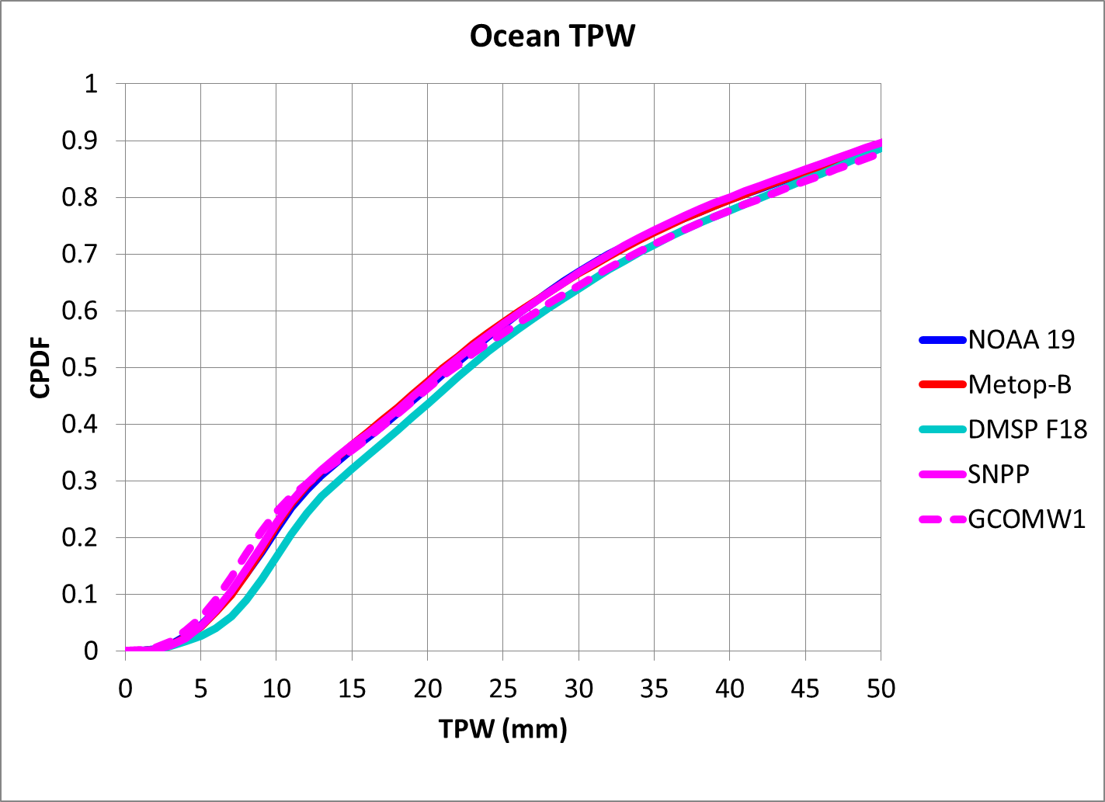
February 14, 2016

Slide 10
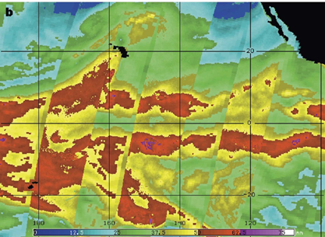
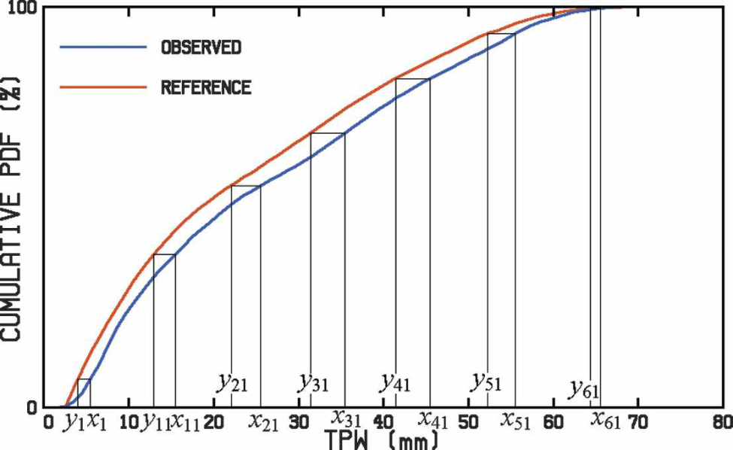
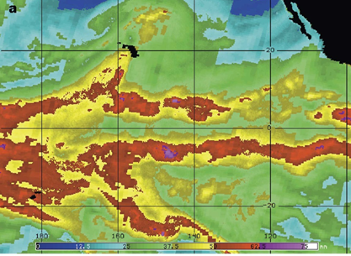
Removing Artifacts Which Distract Forecasters
Before Histogram Matching
5-day scan angle-dependent histogram matching is applied to the NOAA operational blended Total Precipitable Water vapor product (over ocean).
SNPP MiRS V11 is current reference product. Makes the other sensors look more like it.
After Histogram Matching
Seams mitigated
TPW example of histogram matching
Kidder and Jones, J. Atmos Ocean. Tech. 2007

Slide 11
Adding the Vertical Dimension to Water Vapor
CIRA and NASA completed an initial demonstration of a near-realtime Layer Precipitable Water (LPW) product (4 layers; every 3 hours) in 2013. Science development continuing under JPSS Proving Ground.
NASA AIRS and six MiRS sounding spacecraft used (NOAA-18/19,Metop-A/B, DMSP F18, S-NPP)
Forecast applications include moisture flow for heavy precipitation, tropical cyclone genesis and intensification
Further details in Forsythe, J. M., S. Q. Kidder, K. K. Fuell, A. LeRoy, G. J. Jedlovec, and A. S. Jones, 2015: A multisensor, blended, layered water vapor product for weather analysis and forecasting. J. Operational Meteor., 3, 41-58.

Slide 12
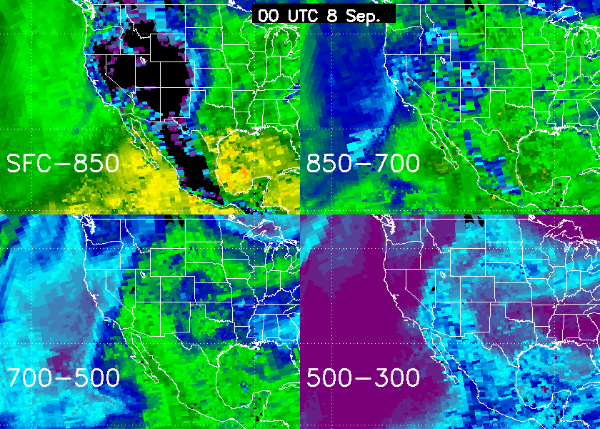

Four-layer LPW leading up to the Colorado Front Range floods in September 2013

Slide 13
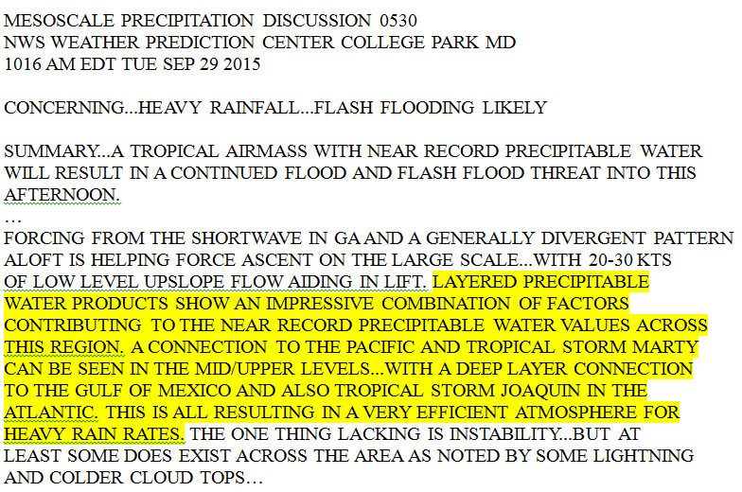
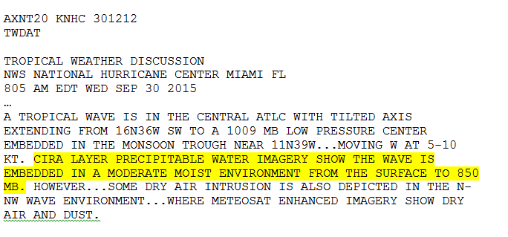
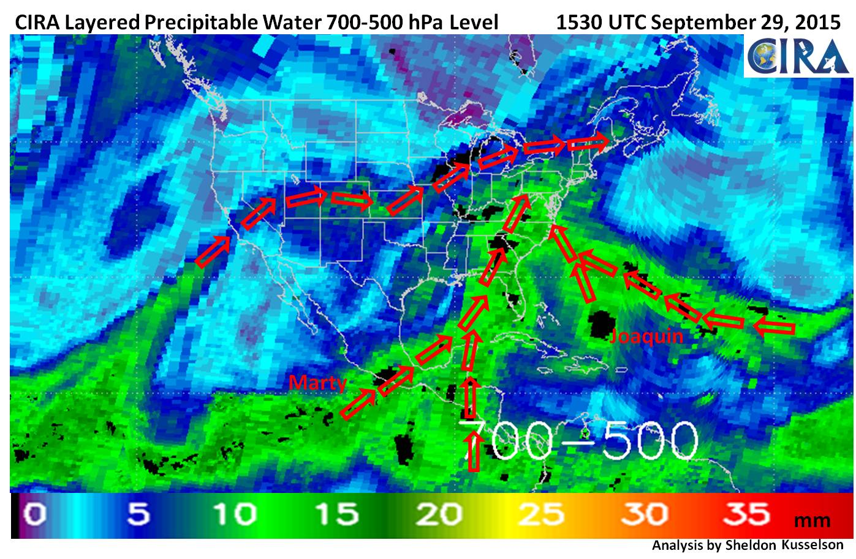
Delivering Existing Layer Precipitable Water Product to National Centers
Example NHC usage of LPW
Example NOAA WPC usage of LPW for flooding in New England
Five streams of moisture fuel flooding in SC

Slide 14
Part 2: Climate
Featuring the NASA Water Vapor-MEaSUREs Global Total and Layered Water Vapor Record (1988-2009)

Slide 15
1987 1989 1991 1993 1995 1997 1999 2001 2003 2005 2007 2009
More confidence in later period due to increased observations

Slide 16
SSM/I is the backbone sensor of NVAP-M; efforts in Intercalibration have paid off
SSM/I L1C intercalibrated Brightness Temperatures (Sapiano, Berg et al)
Reynolds 1º SST and sea ice data
Extinction coefficient tables
ECMWF lapse rate and scale height climatology
SSM/I Retrieval Data Flow for NVAP-M
Pixel level total precipitable water, cloud liquid water, surface wind speed and retrieval diagnostics over ocean
Elsaesser and Kummerow (2008) Optimal Estimation Retrieval. Updated by Duncan and Kummerow (2016)
At the time of NVAP-M production (2012), we did not judge the 183 GHz radiance record (AMSU-B, SSM/T-2) to be sufficiently intercalibrated to consider for this climate record.

Slide 17
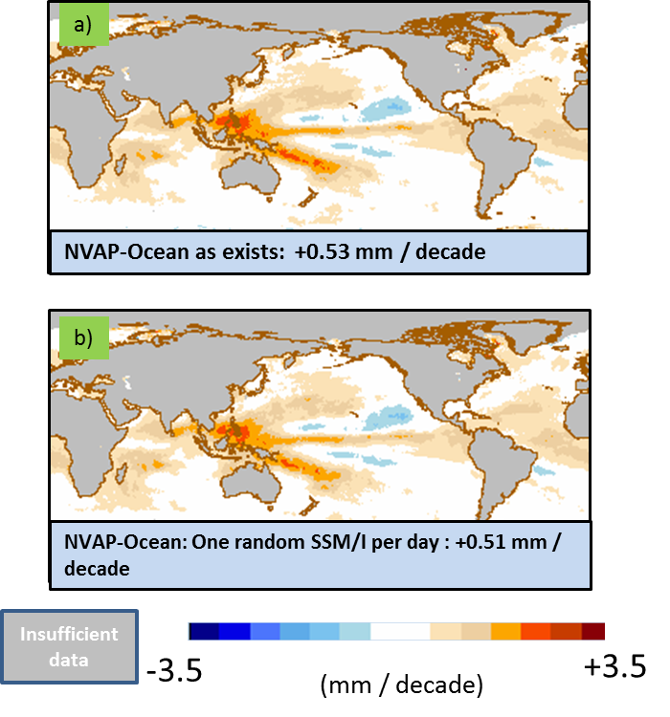
TPW Trend in NVAP-M Ocean (1988 – 2009 data)

Slide 18
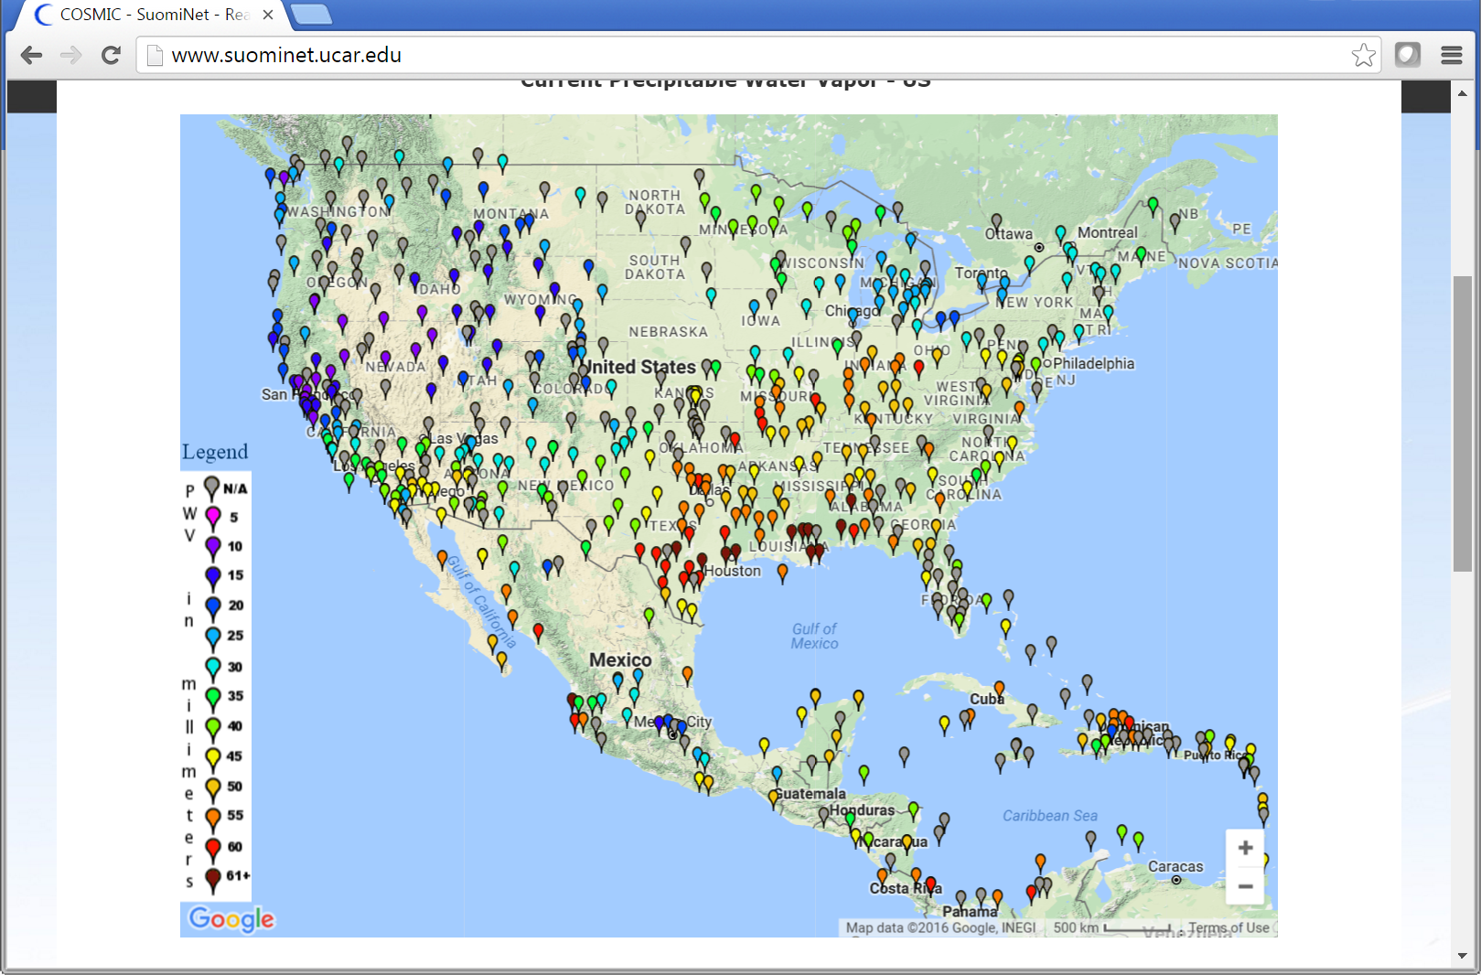
Surface GPS sites measure TPW every half hour within better than 2 mm or 5%, we consider them as the best validation source
A few offshore sites on oil rigs, useful for ocean algorithm validation
Suominet GPS TPW, 1900 UTC July 28, 2016

Slide 19
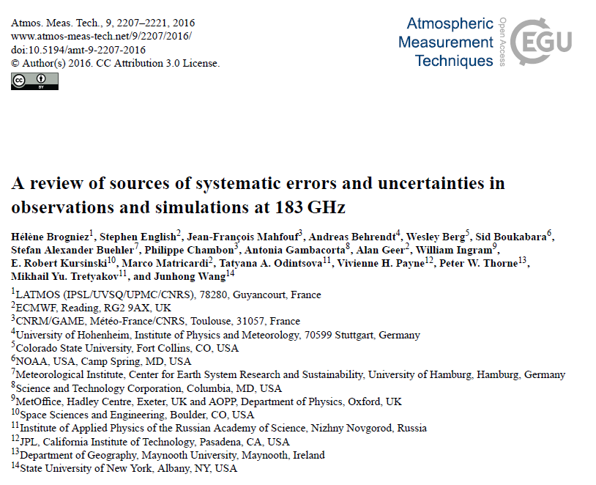
2015 workshop on 183 GHz uncertainties
Recent sensor radiances compare to < 1 K
Spectroscopy and cloud clearing likely causing observed up to 3 K differences
Opportunities exist to add passive microwave water vapor profile to climate record

Slide 20
  Needs From and Feedback To GSICS
  NOAA MiRS team continue to receive updated Level 1 radiance regularly so that Level 2 products and blended products have artifacts minimized.
  SSM/I L1C radiance intercalibration very useful for climate, allows trend studies.
  183 GHz record in particular is important for weather applications, and for climate records of water vapor (upper tropospheric moisture feedback). Noted inconsistencies among measurements / RTM’s at 183 GHz (Brogniez et al. 2016)
  “Image validation” from near-realtime weather is a useful form of determining product quality throughout all seasons and weather regimes. For example, a MiRS cold land TPW artifact was noticed and reported.

Slide 21
Backup Slides

Slide 22
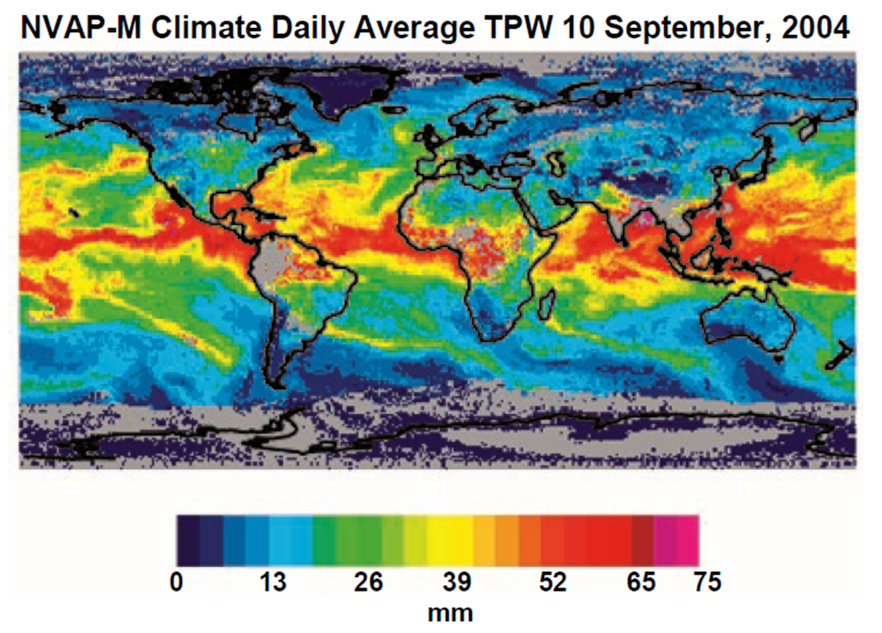
NASA Water Vapor Project – MEaSUREs
Reanalysis, extension (1988-2009) and replacement of the heritage NVAP (1988-2001) dataset
Global (land and ocean) data designed for weather, climate and hydrology users
Total (TPW) and layered (LPW) precipitable water
Removes time-dependent biases caused by dataset and algorithm changes incurred during multi-phase processing.
  Focus on consistent data inputs and peer reviewed processing algorithms through time.
Back-propagation of modern observations through the entire data period.
  Collaboration with AIRS water vapor project at NASA JPL. (E. Fetzer et al.)
Highly model-independent
Available at NASA Langley Atmospheric Science Data Center (ASDC): https://eosweb.larc.nasa.gov/project/nvap/nvap-m_table
Similar in concept to GPCP, ISCCP, but with three products: Climate, Weather, Ocean.
> 300 withdrawals by over 150 different users of the dataset from the NASA Langley Atmospheric Science Data Center and over 25 refereed papers since release in 2013
Vonder Haar et al. 2012: Weather and climate analyses using improved global water vapor observations. Geophys. Res. Lett., 39, L15802. doi:10.1029/2012GL052094.
“NVAP-M” refers to the new NVAP-MEaSUREs data set. “Heritage NVAP” refers to the existing dataset described by Randel et al., 1996

Slide 23
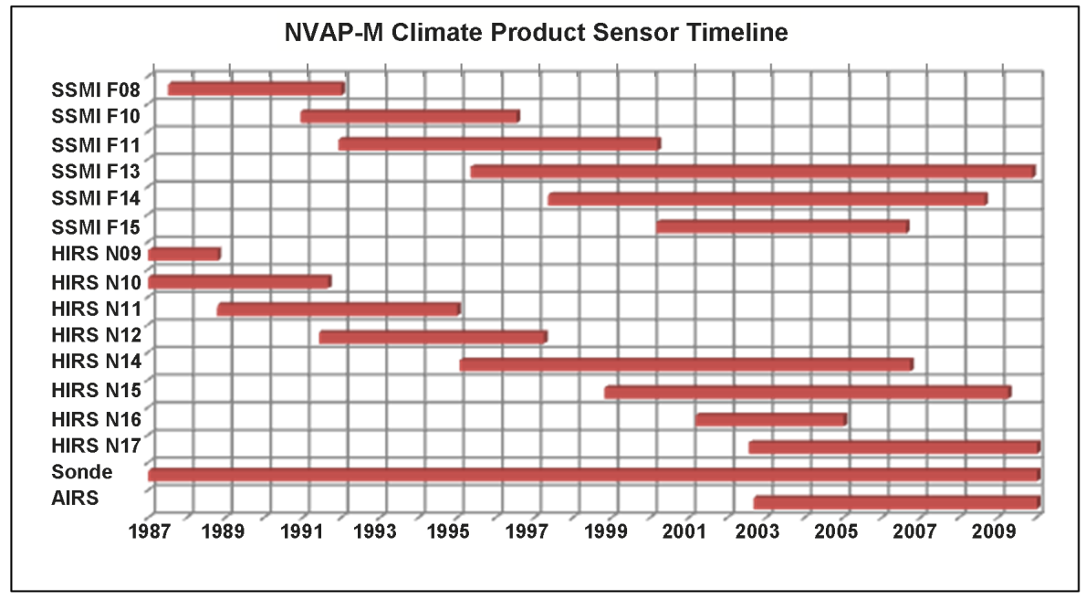
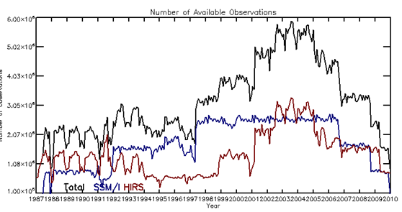
The challenge of creating a multisensor, multidecadal, global water vapor climate record
Sensors preferentially sample ocean or clear regions.
6 X 10⁶
Total
Number of Observations
SSM/I (ocean only)
HIRS (clear only)
1 X 10⁶

Slide 24
Creating the Product
LPW Product is created from NOAA Microwave Integrated Retrieval System (MIRS) soundings, and NASA AIRS soundings.
Retrievals are independent of dynamic NWP models, allowing comparison
Produced every 3 hours and mapped onto a 16 km resolution Mercator projection.
Four layers created (sfc-850,850-700,700-500,500-300 hPa)
NASA AIRS and Six MIRS sounding spacecraft currently used (NOAA-18/19,Metop-A/B, DMSP F18, Suomi-NPP).

Slide 25
Strengths of surface-based TPW from GPS:
Low-cost
All weather
High temporal resolution (~ 20 minute, 24 h / day)
Accuracy
Untapped networks for seismology/volcanology exist
A few very dense networks (Japanese GEONET ~ 800 stations)
Limitations:
Sparse spatial coverage (centered on developed world, few ocean sites).
Climate record begins in 1995 at ~ 100 sites.

Slide 26
Blended, layered water vapor products fill a void in observations

Slide 27
“…This is likely our most highly analyzed product in AWIPS during the monsoonal surges. The associated percent of normal graphics are also very useful” (NWS Albuquerque, NM)
“…This has been a fantastic product for monitoring trends since observation coverage from RAOB and aircraft over Mexico and Gulf of Mexico is poor.” (NWS San Antonio, TX)

Slide 28
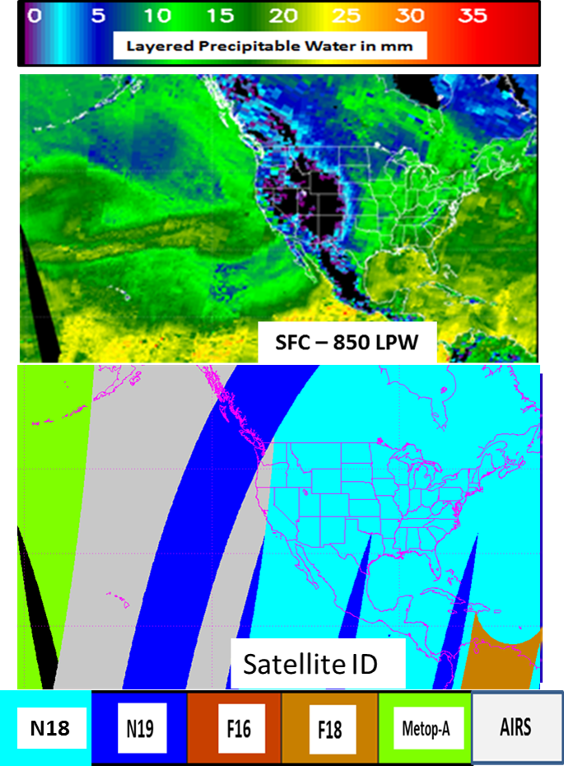
Passive microwave sensors allow a multitude of atmospheric and surface variables to be observed.
Key sensor in climate record of:
Precipitation
Sea ice
Water vapor
Ocean winds

Slide 29
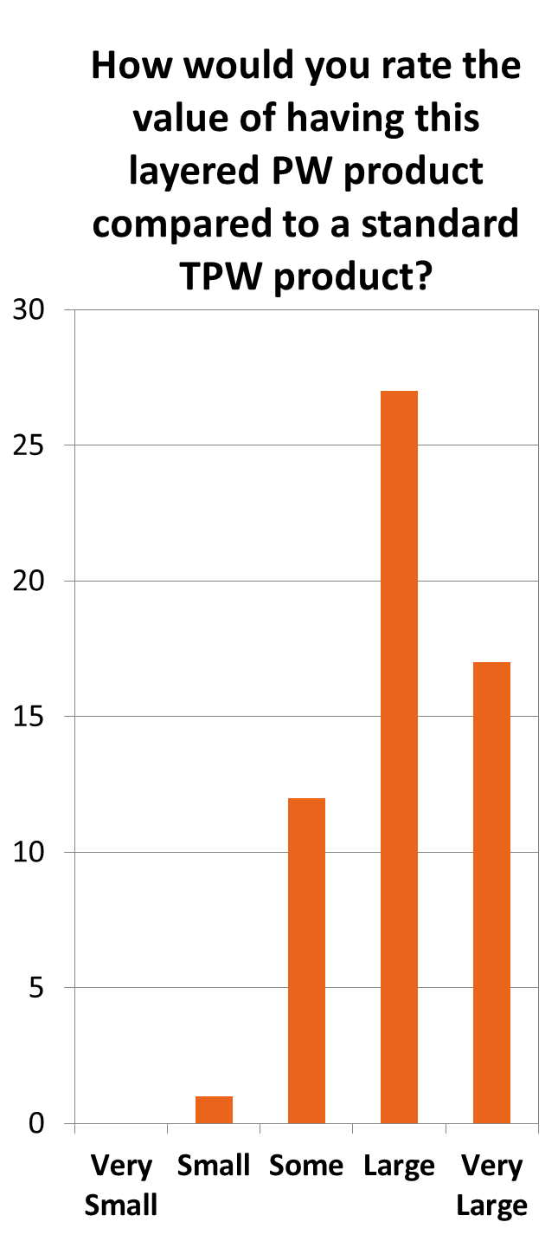

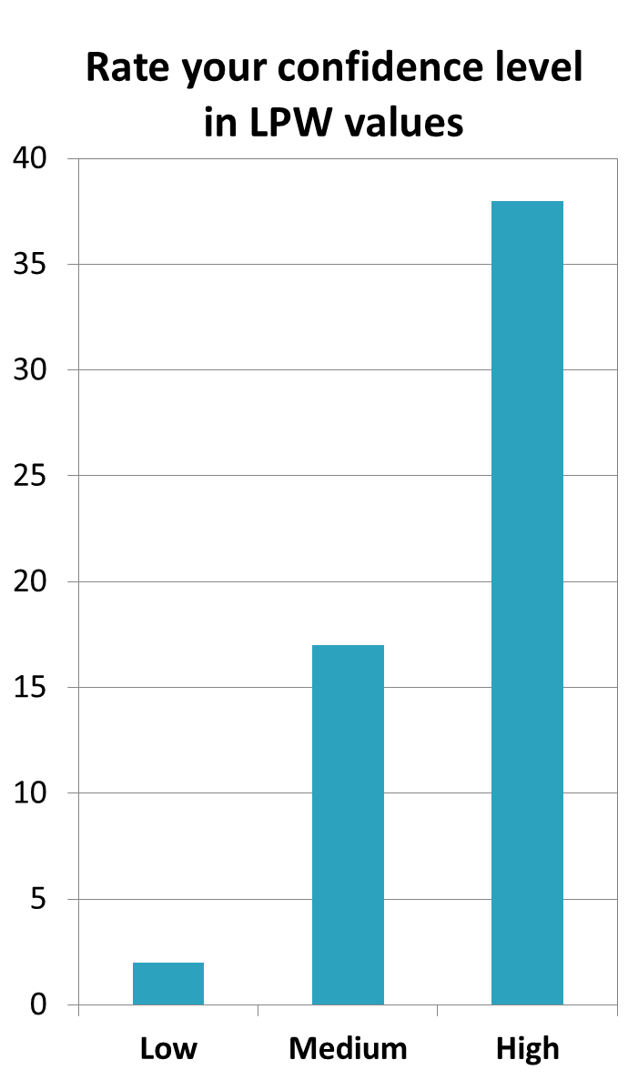
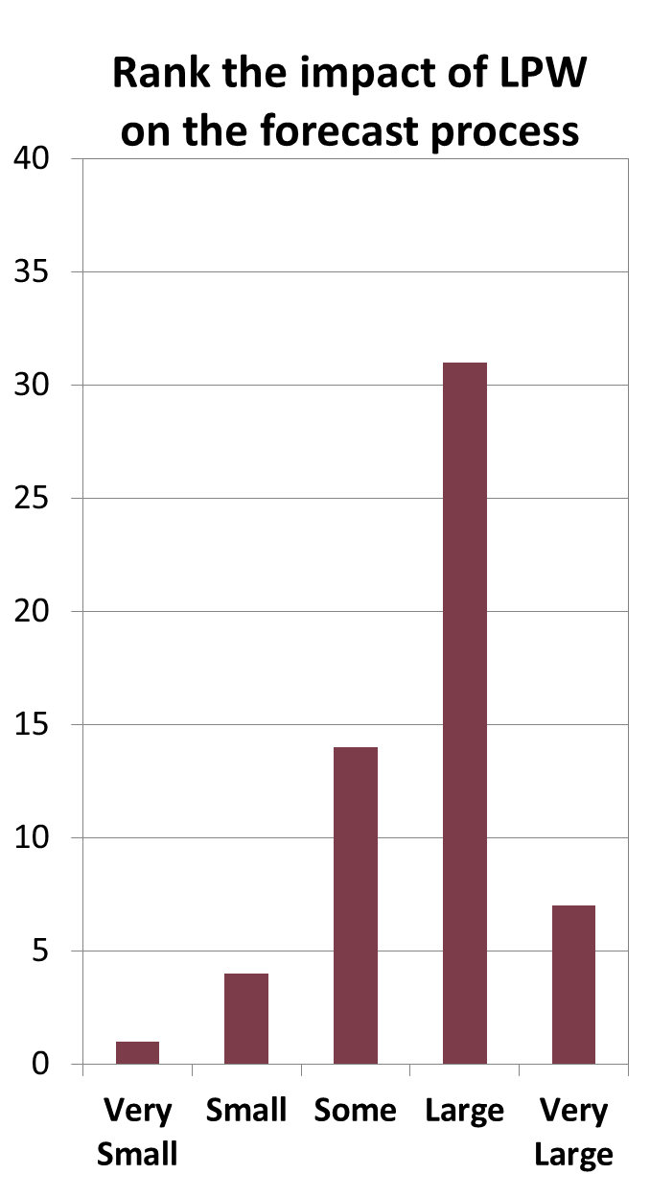
NASA-led NWS forecaster survey of Alaska and Puerto Rico NWS offices during 2013 demonstration of Layered Precipitable Water

Slide 30
Spacecraft and instruments used in blended TPW and Rain Rate:
Suomi-NPP
NOAA-15, NOAA-16, NOAA-17, NOAA-18, NOAA-19 (AMSU/MHS)
Metop-A, Metop-B (AMSU/MHS)
DMSP F18 (SSMIS)
Surface-based GPS TPW
GOES-W & E Sounder TPW
Major source of retrievals from polar spacecraft is the NOAA Microwave Integrated Retrieval System (MiRS)
Currently merging 10 polar orbiters
New satellites are demonstrated at CIRA and added to operations

Slide 31
NVAP-M: A Three-Tiered Product Approach
Heritage NVAP begun in early 1990’s was “one size fits all” approach.
NVAP-Weather
Used for weather case studies on timescales of days to weeks
SSM/I Level 1 C intercalibrated radiances HIRS cloud cleared radiances Radiosonde, GPS since 1997 AIRS Level 3 TPW and Layered PW
Maximizes spatial and temporal coverage Not driven by reduction of time-dependent biases
4x daily ½ degree resolution TPW and layered precipitable water surface to 700 hPa 700 to 500 hPa 500 to 300 hPa < 300 hPa.
NVAP-Climate
Used for studies of climate change and interannual variability
SSM/I Level 1 C intercalibrated radiances HIRS cloud cleared radiances, + AIRS since 2002 Radiosonde
Consistent inputs through time. Consistent, high quality retrievals. Less emphasis on spatial and temporal coverage
Daily 1-degree resolution TPW layered precipitable water surface to 700 hPa 700 to 500 hPa 500 to 300 hPa < 300 hPa
NVAP-Ocean
SSM/I-only.
Supplemental Fields
Data source code (DSC) map, indicating the sources used in each grid box .

Slide 32
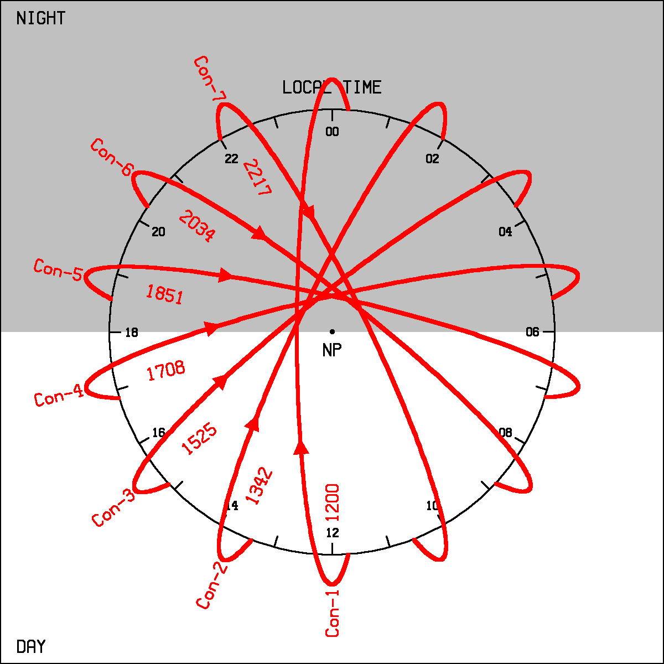
“Clock Diagrams” show local time sampling of polar sensors used
Current configuration for Layer Precipitable Water:
Periods of high sampling and no sampling
Conceptual future system for blended products: Two satellites in 7 orbital planes would provide hourly sampling globally.
S-NPP
Older satellites play a valuable role in extending temporal sampling

Slide 33
  Summary
  Blended products have proven to be successful at leveraging NOAA investments, particularly polar orbiter data, to add an observations-based, time-resolved view of weather that complements model fields.
  Weather and climate uses of the same products benefit both. For instance, seasonal biases have been noted in weather products which are reported to developers.
  Microwave Imager climate records (i.e. SSM/I) have benefited greatly from intercalibration efforts
  Microwave sounder radiance record (183 GHz) is making progress but needs more exploration
  “Image validation” is a useful form of determining product quality from a weather-oriented product.
  CIRA makes new and experimental products available on it’s website, with feedback from NWS forecasters.

Slide 34
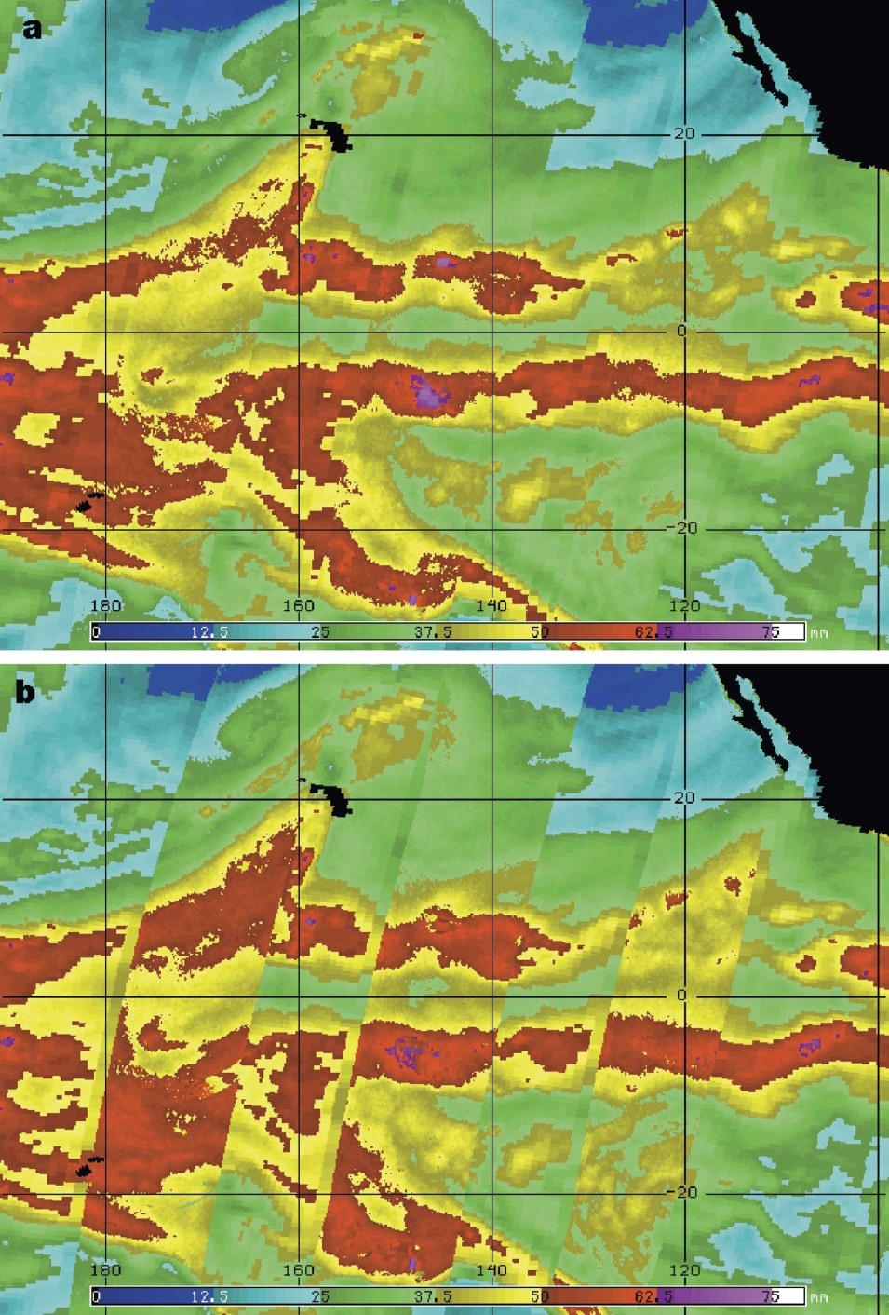
Removing Artifacts Which Distract Forecasters
5-day scan angle-dependent histogram matching is applied to the NOAA operational blended Total Precipitable Water vapor product (over ocean).
SNPP MiRS V11 is current reference product. Makes the other sensors look more like it.
After Histogram Matching
Before Histogram Matching
Seams mitigated
TPW example of histogram matching
Kidder and Jones, J. Atmos Ocean. Tech. 2007

