Slide 1
PATMOS-x solar reflectance channel calibration – use of global mean reflectance
Andrew Heidinger
NOAA/NESDIS/STAR@CIMSS
JPSS Cloud Team Lead

Slide 2
Outline
Analysis of Global Mean Reflectance from MODIS AQUA
Application to VIIRS M5 comparisons
Application to AVHRR Ch1
PATMOS-x Calibration Update

Slide 3
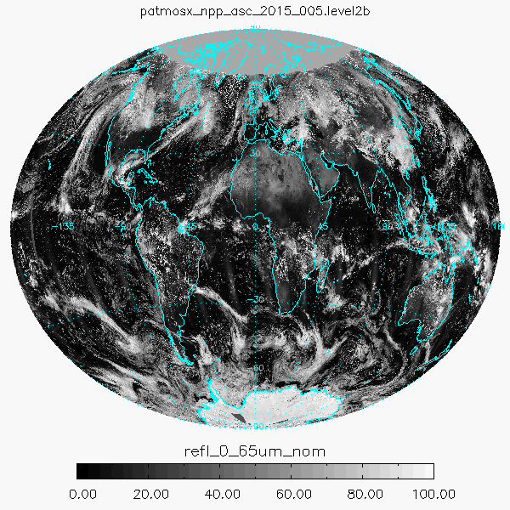
Why Do This
NCEI asked the PATMOS-x team to monitor the calibration of the AVHRR.
While doing this we noted it was very stable and decided to pursue it as another calibration data source.
It has the benefit of
available every day in real-time
Independent of atmospheric correction, angular adjustments and cloud mask.
Could be important for the pre-EOS AVHRR data.

Slide 4
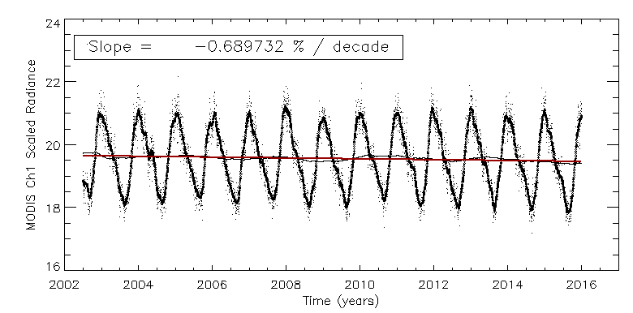
Stability of the Global Reflectance for AQUA/MODIS Ch1
So over 15 years, MODIS AQUA dropped about 1%.

Slide 5
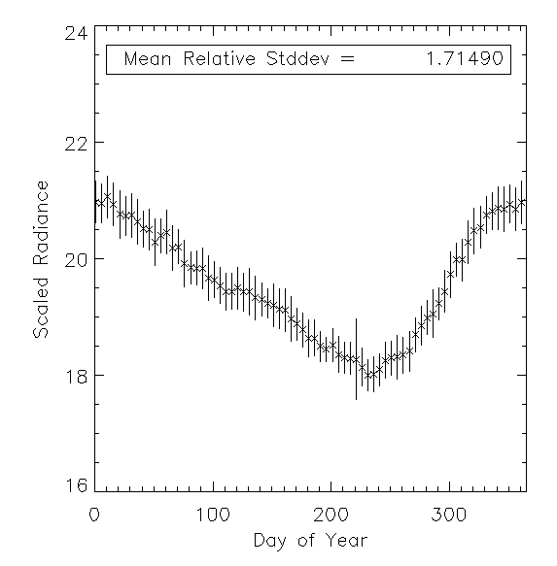
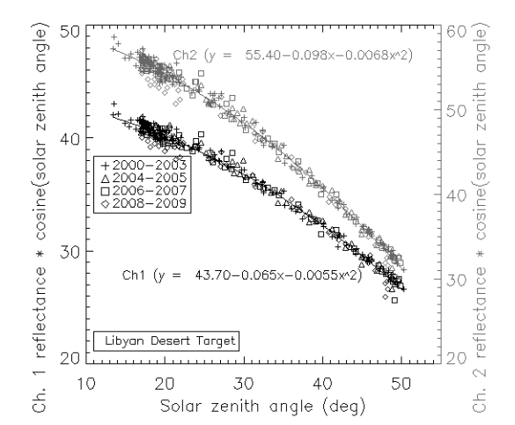
Stability of the Annual Cycle in Global Mean Reflectance
Variability of Global Mean Reflectance is comparable to that scene with clear-sky stable targets.

Slide 6
Application VIIRS

Slide 7
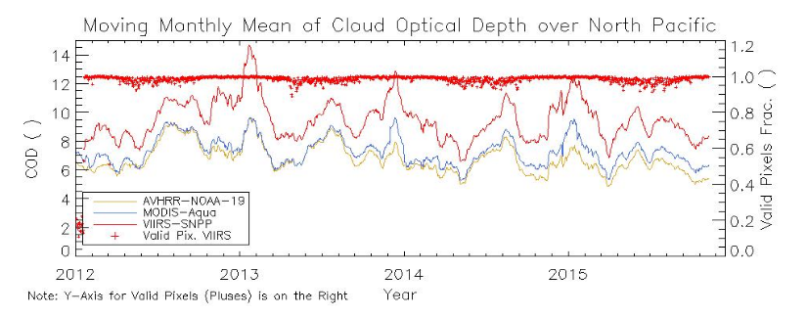
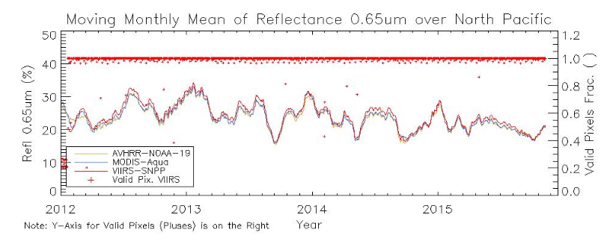
VIIRS M5 Issues
We continually see the cloud optical depths being higher from VIIRS than MODIS. (Both derived from NOAA Enterprise Algorithms).
Similar difference to that seen on Sunny Sun-Mack’s poster (CERES-VIIRS).
Cloud optical depth is highly non-linear with reflectance and calibration errors.
We think a 2-3% error accounts for this difference.

Slide 8
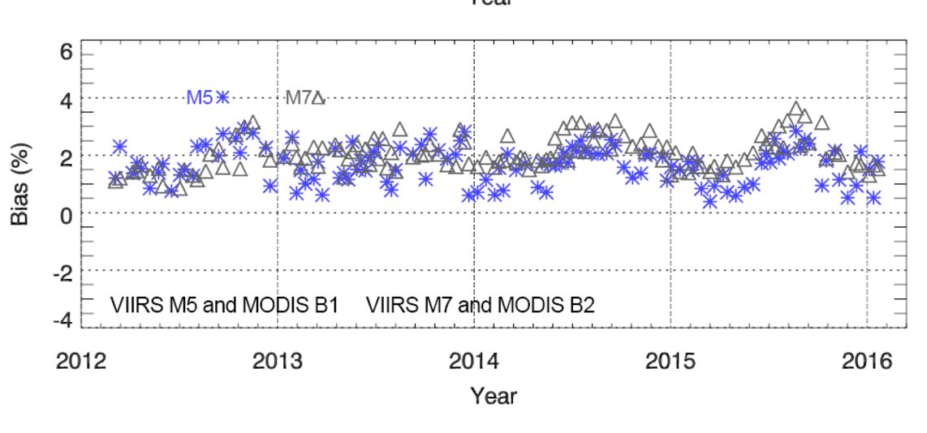
STAR ICVS VIIRS M5 and M7 Bias
These results are after the adjustment for spectral response differences

Slide 9
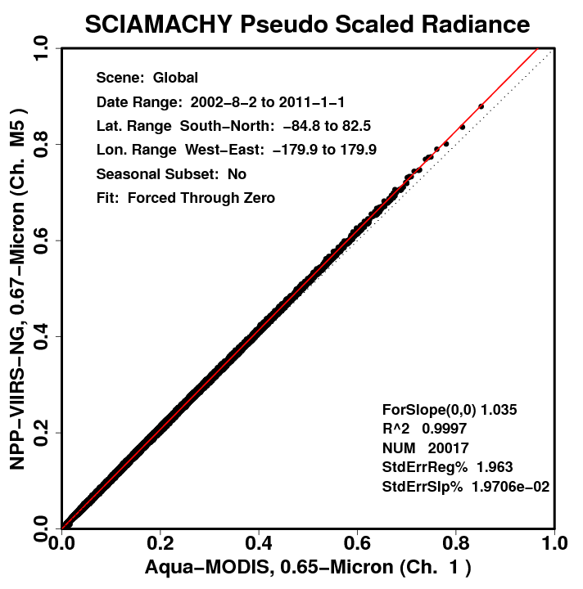
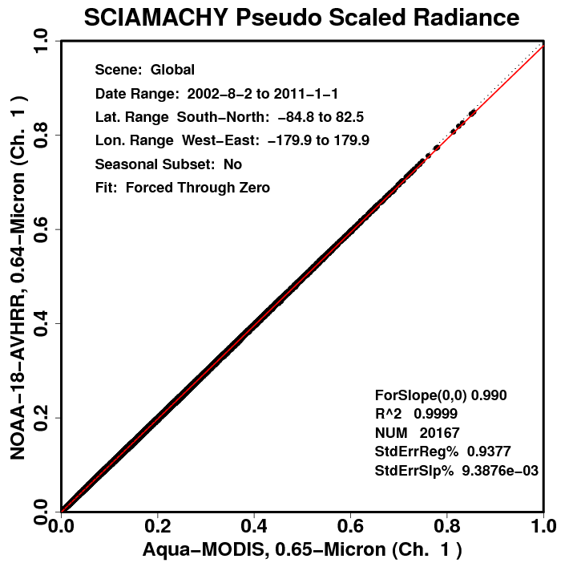
Spectral Conversion from MODIS Ch1 to VIIRS M5 and AVHRR Ch1
NASA Langley (Ben Scarino) runs a very nice site where SCHIMACHY-derived spectral conversions are available for many sensors and many surface regions including global. These plots are from that site.
Based on SCHIMACHY, VIIRS M5 should be 3.5% larger then MODIS Ch1 for a global mean reflectance
Based on SCHIMACHY, AVHRR Ch1 should be 1% smaller then MODIS Ch1 for a global mean reflectance

Slide 10
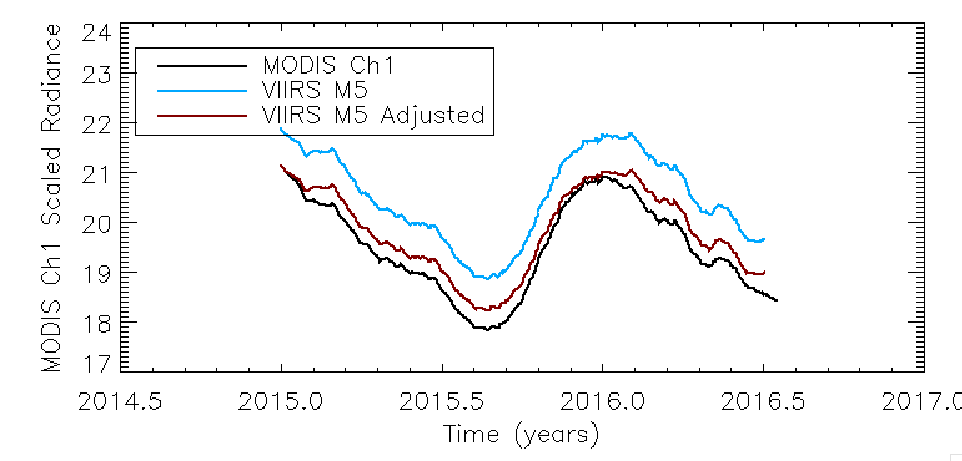
Applying Global Reflectance Analysis to VIIRS M5.
VIIRS M5 after adjustment is 1.5% higher than MODIS Ch1
Very similar to STAR ICVS value
More than the computed degradation in MODIS Ch 1 (1%)
Less than we expected from the cloud optical depth analysis (2%)

Slide 11
Application AVHRR Solar Channels

Slide 12
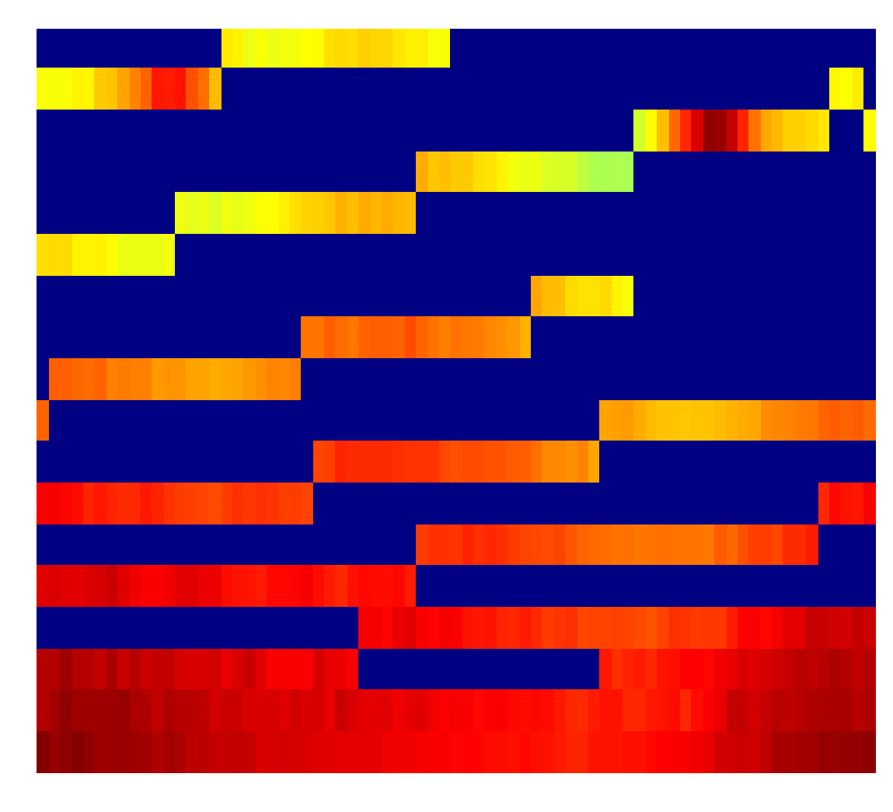
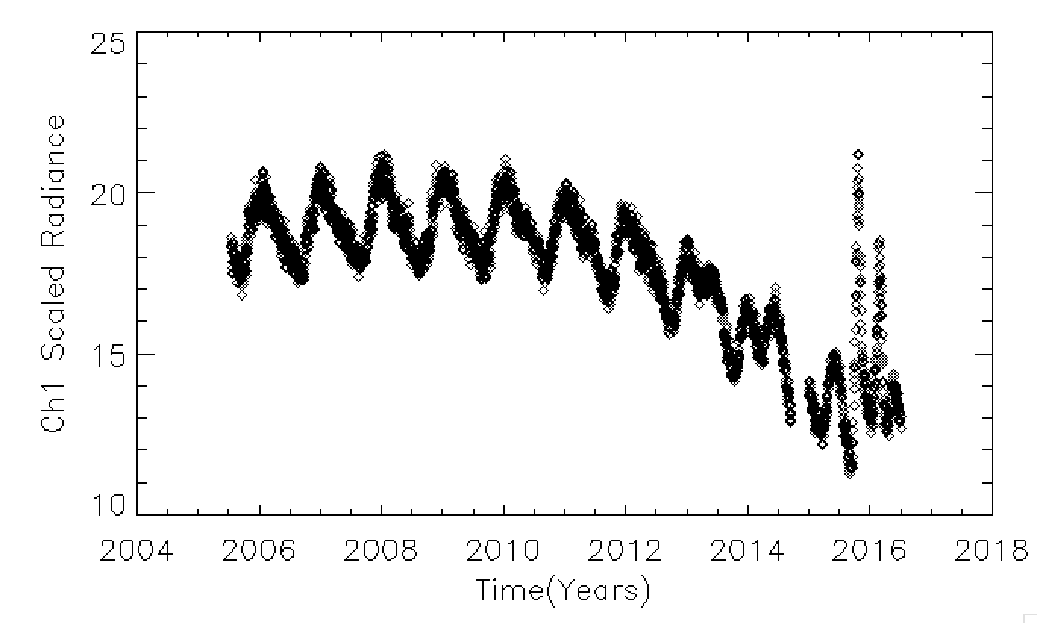
Application to AVHRR for Inclusion in PATMOS-x
NOAA-18 AVHRR CH 1
Time of Day (13:30 – 18:00 Z)
Since NOAA-18 has drifted so far, can we use it as a reference for the other AVHRR sensors?
Day of Year (1 – 365)

Slide 13
Method for Application AVHRR
Compute mean global count from any AVHRR
Compute mean global scaled radiance from the NOAA-18 table for a given day-of-year and the equator crossing time.
Generate a calibration slope.

Slide 14
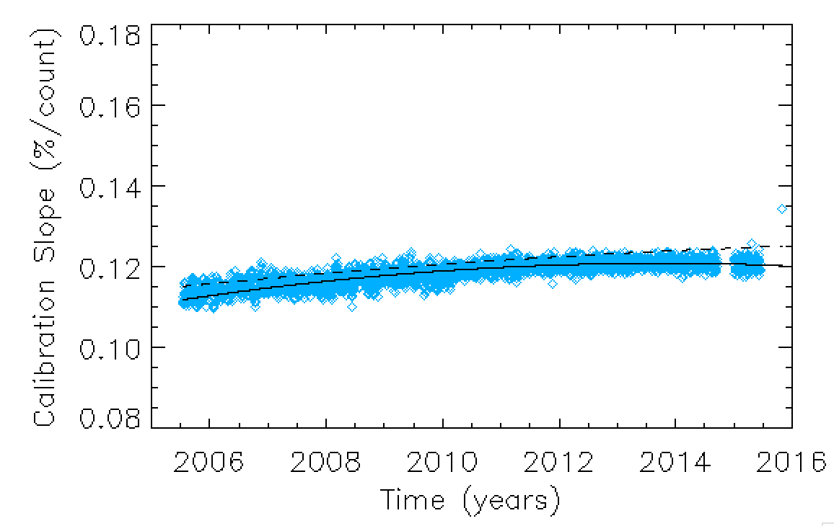
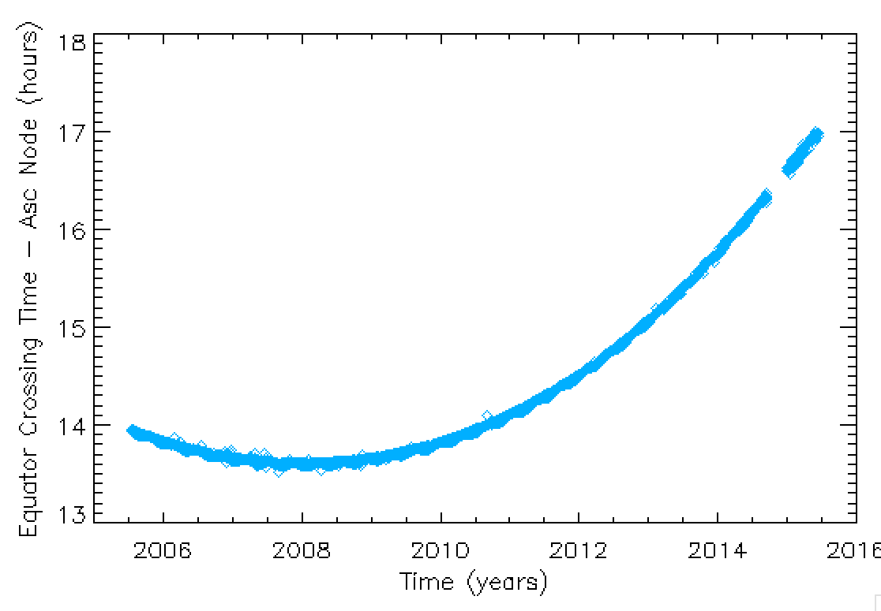
NOAA-18 Ch1 Results
Since NOAA-18 is the reference, we expect NOAA-18 to agree perfectly with the PATMOS-x calibration.
Local equator crossing time
mitram
Blue dots are calibration slopes from the technique
patmos-x

Slide 15
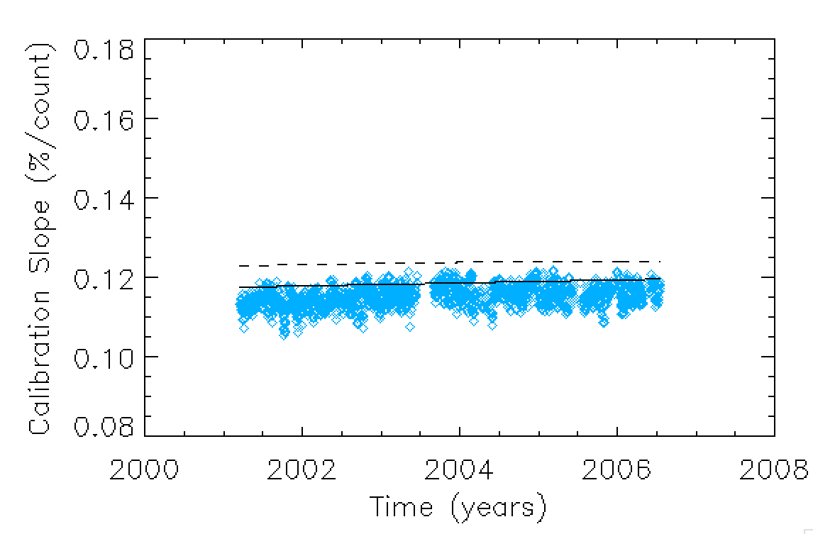
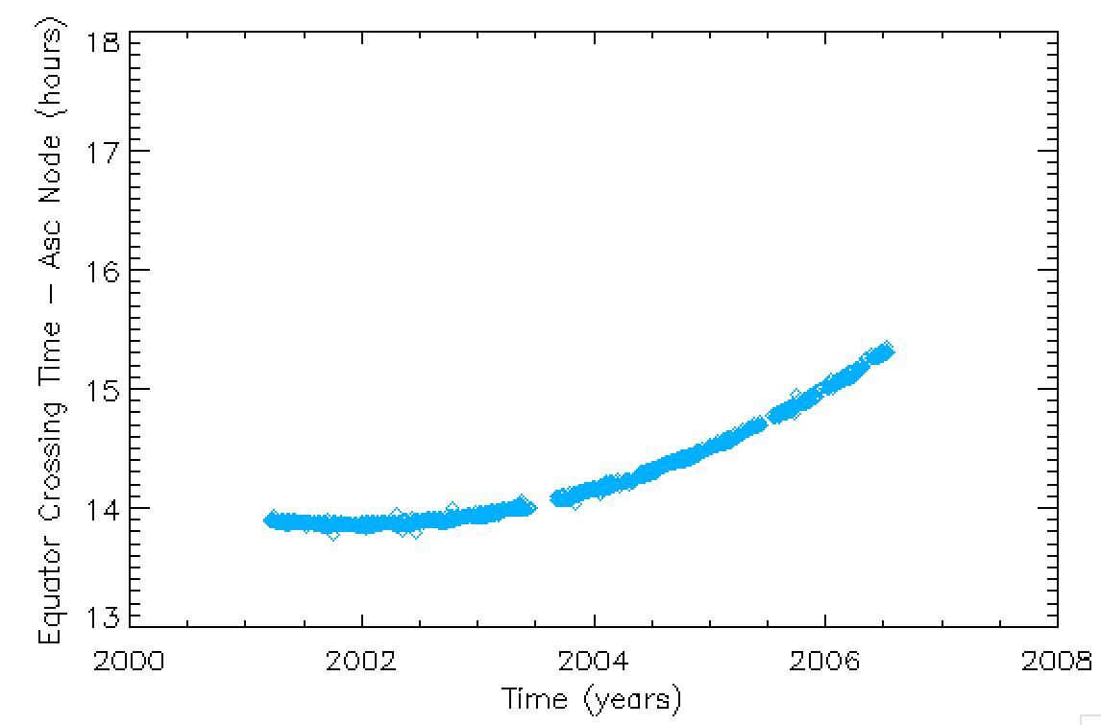
Application to NOAA-16 Ch1
Method appears to work well with NOAA-16 over its 2 hours of drift from 2001 to 2007.

Slide 16
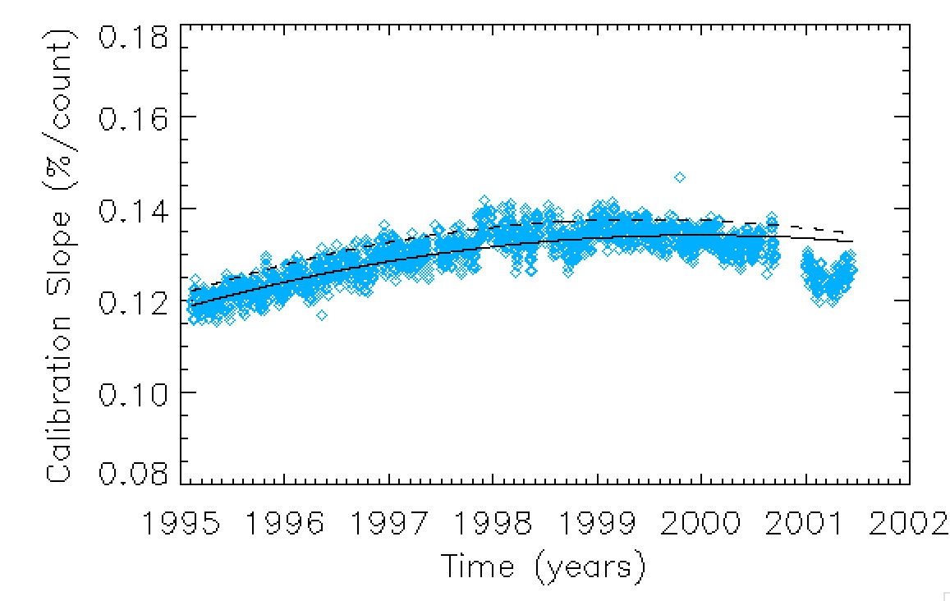
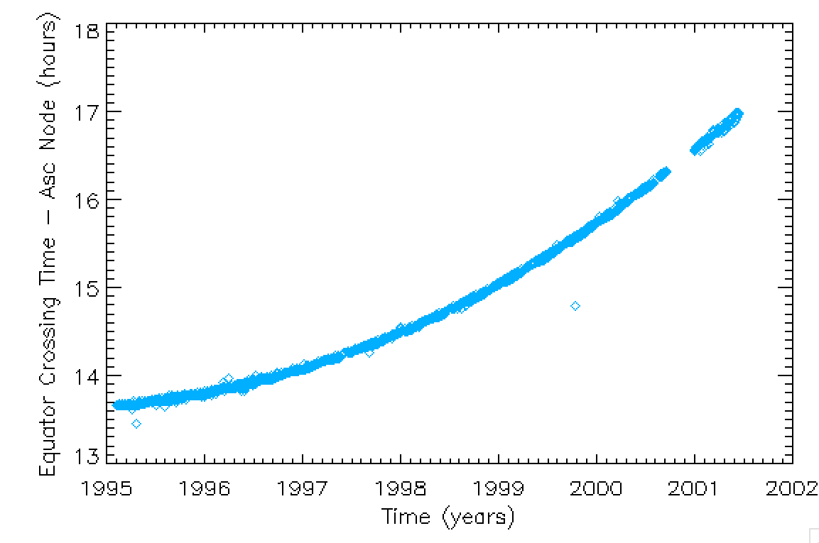
Application to NOAA-14 Ch1
Issues arise after 2000 when the drift exceeds 3 hours.

Slide 17
Conclusions
Mean global reflectance from a sun-synchronous polar orbiter is very stable. Warrants a look as a GSICS monitoring tool.
We can use this to compare MODIS and VIIRS. VIIRS M5 appears to be 1.5% too high.
Our optical depth analysis indicated VIIRS M5 is 2% too high relative to MODIS AQUA Ch1.
Long term analysis shows MODIS AQUA Ch1 gradually dropped 1%.
Application to AVHRR, which drifts, also shows promise.
PATMOS-x would like to use this as an independent monitoring tool and may use it in the calibration.
PATMOS-x owes an AVHRR calibration update to NCEI in September.

Slide 18
