Slide 1
An Introduction to the CLARREO Reflected Solar Instrument and Reference Intercalibration Strategy
David Young, Kurt Thome
Constantine Lukashin,
Carlos Roithmayr, Paul Speth,
Bruce Wielicki

Slide 2

Decadal Survey defines CLARREO
NOAA CLARREO
CERES (Clouds and Earth’s Radiative Energy System)
TSIS (Total Solar Irradiance Sensor)
NASA CLARREO
Solar reflected spectra: SI traceable relative uncertainty of 0.3% (k=2)
Infrared emitted spectra: SI traceable uncertainty of 0.1K (k=3)
Global Navigational Satellite System Radio Occultation: SI traceable uncertainty of 0.1K (k=3).
CLARREO is a Cornerstone of the Climate Observing System

Slide 3

CLARREO Science Objectives
Societal Benefits
Enable knowledgeable policy decisions based on internationally acknowledged climate measurements and models through:
- Observation of high accuracy long-term climate change trends
- Use the long term climate change observations to test and improve climate forecasts.
Science Objectives
Make highly accurate and SI-traceable decadal change observations sensitive to the most critical but least understood climate radiative forcings, responses, and feedbacks
- Infrared spectra to infer temperature and water vapor feedbacks, cloud feedbacks, and decadal change of temperature profiles, water vapor profiles, clouds, and greenhouse gas radiative effects
- GNSS-RO to infer decadal change of temperature profiles
- Solar reflected spectra to infer cloud feedbacks, snow/ice albedo feedbacks, and decadal change of clouds, radiative fluxes, aerosols, snow cover, sea ice, land use
- Serve as an in-orbit standard to provide Reference Intercalibration for broadband CERES, and operational sounders (CrIS, IASI)
A Mission with Decadal Change Accuracy Traceable to SI Standards

Slide 4
Tracing CLARREO Decadal Change
Science Objectives to Mission Requirements
CLARREO will create benchmark climate data records using two complementary approaches
  Benchmarks using only CLARREO data
  Benchmarks using CLARREO for reference calibration of operational sensors
These two approaches provide a robust test of the CLARREO data records
  Analogous to using independent measurements and analysis in metrology
Climate benchmarks require
  Accuracy for decadal trend detection
  Unbiased sampling of the climate system
  Information content sufficient for trend detection and attribution
CLARREO is a Climate Benchmarking Mission

Slide 5
Revised CLARREO Baseline Mission Concept
PRELIMINARY
  CLARREO comprises two phases, with launches in 2017 (“CLARREO-1”) and 2020 (“CLARREO-2”)
  Mission Concept Strategies:
    Each spectrometer will fly on a separate observatory
    Observatories will be configured around a small, common spacecraft bus to reduce cost
    Observatories will be compatible with multiple launch vehicles (Falcon 1e, Athena, Taurus XL, Minotaur IV)
  2017 Launch:
    One observatory with either the infrared or the reflected solar spectrometer, plus GNSS-RO
    Polar orbits (90° inclination) at 609 km altitude
  2020 Launches:
    Two observatories launched individually, one with the infrared spectrometer and one with the reflected solar spectrometer (both with GNSS-RO)
    Polar orbits (90° inclination) at 609 km altitude
CLARREO is ready to move to Phase A in 2011

Slide 6
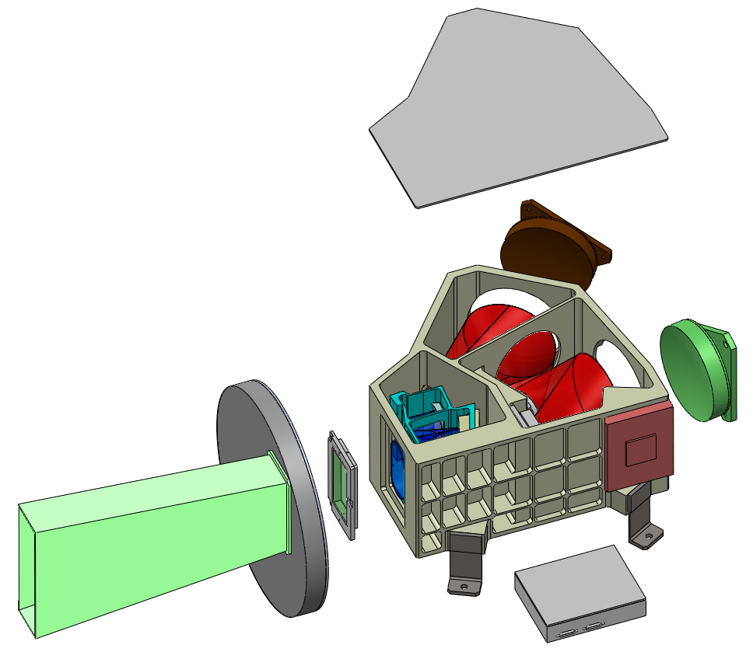
Sensor overview
Reflected Solar Spectrometer
Instrument Description:
  Pushbroom hyperspectral imagers with high spatial and spectral resolution for SI traceable direct and reflected solar irradiance measurements
  Calibration of detectors obtained through precision apertures and neutral density filters rotated via filter wheels
  Field of regard (FOR) needed for Solar-Lunar Calibrations, Inter-calibrations, and Benchmarking achieved with a spacecraft provided two-axis gimbal
Characteristics:
  Spectral Range: 320 to 2300 nm
  Spectral Sampling: 4 nm
  Spectral Resolution: 8 nm
  Swath Width: ~100 km from 600 km orbit
  Pointing Stability: ~ 34 arc sec
Baseline Instrument Package:
  Two Spectrometers, Mounting Plate, Electronics, and Thermal Radiators
  Instrument Dimension: ~20x25x30 cm³
  Data Rate:
    Benchmarking: ~932 kbps/orbit
    Intercalibration: ~36.7 Mbps/orbit
    Solar-Lunar Calibration: ~7.6 Mbps/week

Slide 7
Operating Modes
Reflectance retrieval, calibration and inter-calibration requirements lead to three basic operating modes
  Solar Calibration
  Nadir Data Collection
  Inter-calibration of LEO/GEO assets (avg. 2x per orbit)
Verification of calibration drives the need for Lunar Views
Three basic operating modes for RSS instrument

Slide 8
Calibration Approach
Characterize the sensor to SI-traceable, absolute radiometric quantities during prelaunch calibration
    Watt
    Irradiance mode
    Radiance mode
Determine geometric factors for conversion to reflectance
  On-orbit calibration “validates” the prelaunch calibration
  Solar and lunar views used to determine temporal changes
Key is to ensure prelaunch calibration simulates on-orbit sources
  Absolute irradiance calibration for solar view
  Simulated geometry of solar and lunar views for stray light
Successful transfer to orbit achieved when sensor behavior can be accurately predicted
Simulating and predicting on-orbit sources is basis of calibration

Slide 9
Calibration Overview
* Measurements to achieve SI traceability for transfer to orbit

Slide 10
CLARREO Reference Inter-calibration Uncertainty: Reflected Solar Spectra
Studies conducted during Pre-Phase A have determined the ability of CLARREO to serve as a reference calibrator of operational sensors at decadal change accuracy.
Demonstrated using SCHIAMACHY data to simulate CLARREO spectra. Determined the ability to distinguish and correct for changes in
  Gain and Offset
    Reference Inter-calibration of VIIRS narrowband leads to spectral sampling requirement of 4 nm and spectral resolution of 8nm.
  Gain Nonlinearity
  Spectral shape
    Reference Inter-calibration of CERES broadband leads to spectral range requirement: 320 nm to 2300 nm
  Polarization Sensitivity
    Polarization sensitivity requirement for CLARREO RS spectrometer is less than 0.25% (k=2)
    Scene dependent PARASOL spectral polarization data used to demonstrate intercalibration.
Demonstrated requirement of angle matching to 1 degree, time matching to 5min, spatial averaging to 10km scale with 1km pointing knowledge (Wielicki et al. 2008).
Demonstrated that any of the 90, 83, or 74 degree orbit inclinations have sufficient sampling for RS Reference intercalibration as long as either a gimball or spacecraft pointing system is capable of matching viewing zenith/azimuth/solar zenith with 1.5 degree/second motion.
CLARREO can provide RS reference intercalibration for CERES, VIIRS

Slide 11
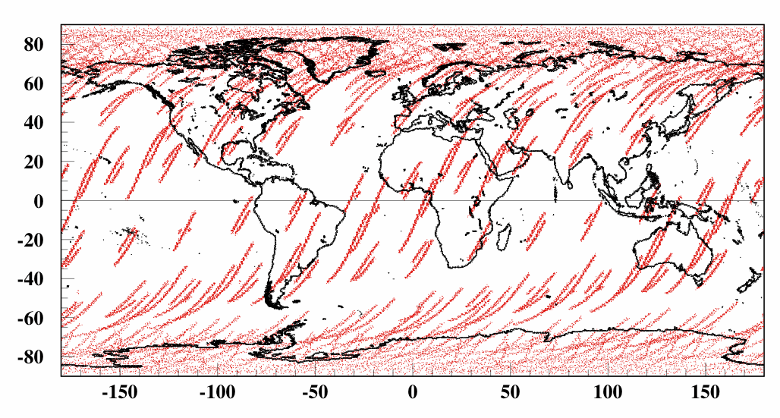
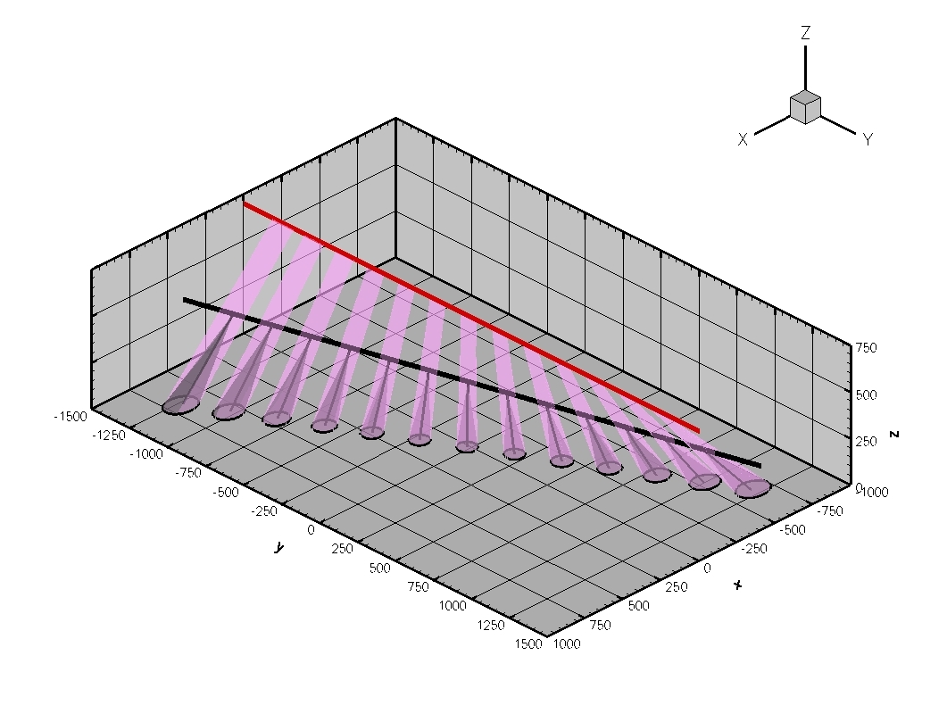
CLARREO Reference Inter-calibration
Orbit crossing with JPSS orbit over 365 days
One CLARREO Observatory in 90º orbit
Goal:
  Time/space/angle matching to obtain ensemble of
  samples with matching noise ≤ 1%.
Matching requirements:
  5 min within NPOESS passing
  Viewing Zenith Angle match of < 1.4°
  10 km spatial averaging
Notes:
One CLARREO observatory at 90 deg orbit. Simulation start is Autumn Equinox. Target: JPSS SSO orbit at 833 km altitude.

Slide 12
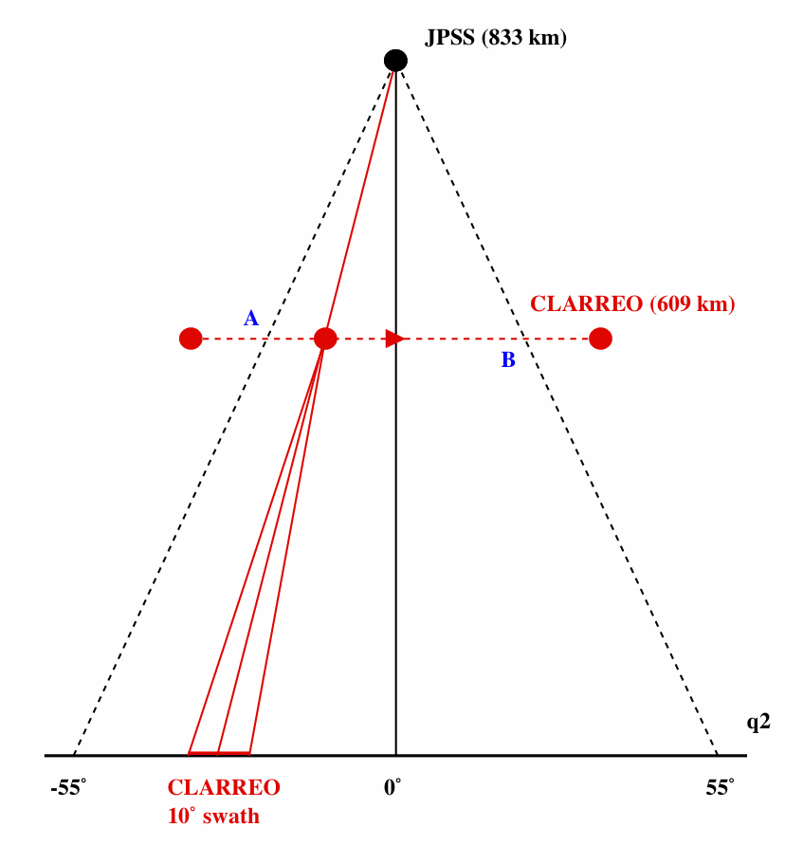
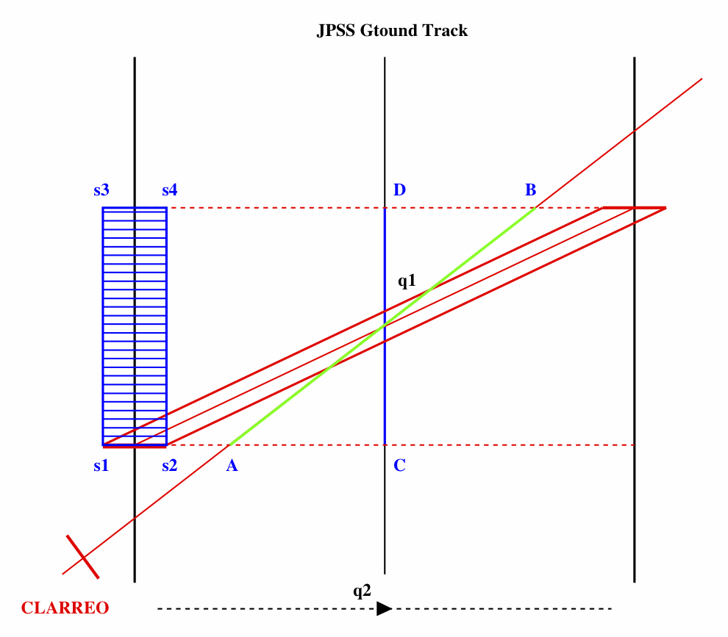
CLARREO Reference Inter-calibration
Sampling Estimates
Projection in JPSS cross-track plane
Top view
Note: All matched data (red parallelogram) is aligned with
JPSS cross-track direction
Notes:
Simulation performed for the latest gimbal option 3 (nadir deck, azimuth and elevation degrees of freedom). Two CLARREO observatories at 90 deg orbits 6 hours apart. Simulation start is Autumn Equinox. One target for both CLARREO observatories: NPOESS SSO orbit at 833 km altitude.

Slide 13
CLARREO RS Reference Inter-Calibration Goals
Goals are set at noise level ≈ 1% (sources: instrument + data matching)
RI error ≤ 0.3% (k=2) over auto-correlation time period (18 months)
1) CLARREO Inter-Calibration Goals: CERES
Parameter | Time scale | Variable | Accuracy, k=2 (%)
Offset | monthly | All Data | ≤ 1.2
Gain | monthly | All Data | ≤ 1.2
SRF Degradation | seasonally | Scene Type (clr.o) | ≤ 0.5
Non-Linearity | Validation Annually, Accuracy 0.3% (k=2)
Sensitivity to DOP | Not Sensitive, Validation Annually, Accuracy 0.3% (k=2)
2) CLARREO Inter-Calibration Goals: VIIRS
Parameter | Time scale | Variable | Accuracy, k=2 (%)
Baseline Offset | monthly | VZA(7), DOP, HAM | ≤ 1.2
Baseline Gain | monthly | VZA(7), DOP, HAM | ≤ 1.2
Sensitivity to DOP | seasonally | VZA(7), DOP, χ (6), HAM | ≤ 0.5
SRF CW Shift | Validation Annually, Accuracy 0.3% (k=2)
Non-Linearity | Validation Annually, Accuracy 0.3% (k=2)

Slide 14
CLARREO RI Required Sampling: Monthly
N Samples CERES | N Samples VIIRS | RI Errors, k=2 (%)
16,000 | 448,000 | 0.11
8,000 | 224,000 | 0.15
4,000 | 112,000 | 0.21
2,000 | 56,000 | 0.3
1,000 | 28,000 | 0.42
500 | 14,000 | 0.6
250 | 7,000 | 0.85
125 | 3,500 | 1.2
CERES RI: All collected data together.
For VIIRS/AVHRR RI: Factor 2 for DOP ≤ 0.05 (670 nm), factor 7 for VZA, and
factor 2 for HAM (half angle mirror) sides. Total = factor 28.

Slide 15
CLARREO RI Required Sampling: Seasonally
N Samples (CERES) | N Samples (VIIRS) | RI Errors, k=2 (%)
320,000 | 20.0 M | 0.11
160,000 | 10.0 M | 0.15
80,000 | 5.0 M | 0.21
40,000 | 2.5 M | 0.3
20,000 | 1.25 M | 0.42
10,000 | 0.6 M | 0.6
5,000 | 0.3 M | 0.85
2,500 | 0.15 M | 1.2
CERES RI: Factor of 20 for clear-sky ocean (5% of global sampling).
For VIIRS/AVHRR RI: 10 for DOP = 0.2 - 0.3 (670 nm), 7 for VZA, 9 for χ,
and factor of 2 for HAM side. Total = factor of 1,260.

Slide 16
CLARREO Reference Inter-calibration
Monthly RI sampling with CERES and VIIRS on JPSS
One CLARREO Observatory in Polar Orbit
 | Month | N Samples CERES | RI Error k=2 (%) | N Samples VIIRS | RI Error k=2 (%)
1 | September | 48.5 K | ≤ 0.1 | 6.1 M | ≤ 0.1
2 | October | 1.4 K | 0.42 | 0.18 M | 0.15
3 | November | 0.3 K | 0.85 | 0.09 M | 0.2
4 | December | 3.1 K | 0.3 | 0.54 M | 0.1
5 | January | 16.8 K | 0.1 | 2.2 M | ≤ 0.1
6 | February | 54.1 K | ≤ 0.1 | 6.7 M | ≤ 0.1
7 | March | 57.1 K | ≤ 0.1 | 7.1 M | ≤ 0.1
8 | April | 14.5 K | 0.1 | 1.9 M | ≤ 0.1
9 | May | 2.9 K | 0.3 | 0.53 M | 0.1
10 | June | 2.9 K | 0.3 | 0.52 M | 0.1
11 | July | 6.2 K | 0.2 | 0.85 M | ≤ 0.1
12 | August | 34.8 K | ≤ 0.1 | 4.4 M | ≤ 0.1

Slide 17
CLARREO Reference Inter-calibration
Seasonal RI sampling with CERES and VIIRS on JPSS
One CLARREO Observatory in Polar Orbit
Seasonal RI sampling for CERES:
Seasonal RI sampling for VIIRS:
Season | N Samples | RI Errors, k=2 (%)
S1 | 50 K | 0.3
S2 | 74 K | 0.2
S3 | 73 K | 0.2
S4 | 43 K | 0.3
Season | N Samples | RI Errors, k=2 (%)
S1 | 6.3 M | 0.2
S2 | 9.4 M | 0.15
S3 | 9.5 M | 0.15
S4 | 5.7 M | 0.2
One observatory CLARREO Reference Inter-calibration sampling is satisfactory for CERES and VIIRS on JPSS for meeting all monthly and seasonal goals.

Slide 18
Summary
CLARREO budget for radiometric accuracy at 0.3% (2σ) must be met. Major contributions are from:
  CLARREO/TSIS error, ≤ 0.15% (2σ);
  CLARREO RS error due to polarization, ≤ 0.15% (2σ);
  CLARREO RS error due to calibration & stability, ≤ 0.15% (2σ);
  Data matching noise & instrument noise, ≤ 0.15% (2σ);
2-D data matching (azimuth and elevation) is required: constant in azimuth and varying in elevation within matching tent.
  Pointing knowledge ≤ 0.1º.
For mission baseline all reference inter-calibration goals are feasible from sampling point of view. CLARREO RS instrument in polar 90º orbit provides adequate sampling monthly, seasonally and annually for inter-calibration of cross-track sensors on JPSS.
Polarization Distribution Models are required for inter-calibration sensor sensitivity to polarization, and further its stand-alone operation.
  A global all-sky set of models should be build for DOP and polarization angle χ .

Slide 19
Backups

Slide 20
CLARREO Mission Status
The importance of high-accuracy, SI- traceable climate observations has been recognized by the National Acedemy of Science and now by NASA and the current US administration.
CLARREO budget guidance calls for an initial launch target of 2017, second launch in 2020.
Level 1and 2 requirements are set – generated by science team based mission studies (model and observational) over the past 2 years.
Working closely with NIST on CLARREO metrology, SI traceability
  We understand the fundamental connection between the climate science and metrology for this type of measurement
  Working to extend standards where necessary (e.g. >15μm IR, >1600nm RS).
CLARREO is working with the UK – agreement with NCEO, key contacts Nigel Fox (Solar Reflected), John Harries (IR).
NASA ROSES Science Definition Team (SDT) announcement for proposals just released (March 2010). International proposals encouraged for collaboration
Mission Concept Review tentatively planned for October 2010
CLARREO ready to move into phase A

Slide 21
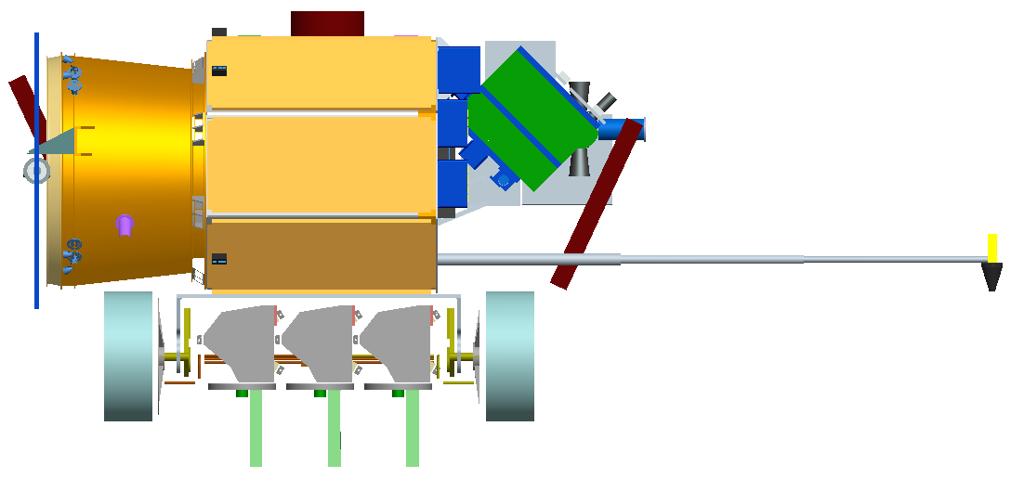
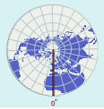
Original CLARREO Baseline Mission Concept
GNSS-RO
Antenna
S/C Bus
IR Spectrometer
CBE Mass: 814 kg
OA Power: 691 W
~ ¼ the mass and
~ 1/7th the power of
the Aqua spacecraft
GNSS-RO
Antenna
Nadir
  Two identical observatories
  Two orthogonal 609 km polar orbits (90º inclination)
  3-year design life with spacecraft consumables to extend to a 5-year mission
  Instrument payload
        IR FTS spectrometer
        Reflected solar spectrometer suite
        GNSS RO
        Extensive on-orbit calibration verification
Reflected Solar Spectrometer
2 - 90 degree polar orbits
- 6hrs apart local equator
crossing time
- Samples full diurnal
cycle once per 3 months. - Precise repeat each year.
- Observes equator to pole.

Slide 22
CLARREO Accuracy Requirements
CLARREO instrument absolute accuracy requirements are derived consistent with the goal of achieving accuracy within 20% of a perfect climate observing system, and time to detect trends within 15% of a perfect observing system.
0.1K (k=3) for the IR spectra absolute accuracy required. Driven by natural variability of IR spectra.
0.3% (k=2) for the RS spectra (nadir reflectance) is required. Driven by natural variability of cloud radiative forcing, cloud fraction, cloud optical depth, particle size.
0.03% (k=2) refractivity, consistent with an accuracy of 0.1K (k=3) for temperature profile. Accuracy is for 5km to 20km altitudes.
Achieving SI traceable observations with absolute accuracy at these decadal change levels enables the CLARREO mission to uniquely survive even short gaps in the climate record. Overlap becomes very important for a continuous climate record, but a gap does not break the climate record and cause a "restart".
Instrument Absolute Accuracy set for < 20% Trend Accuracy Degradation

Slide 23
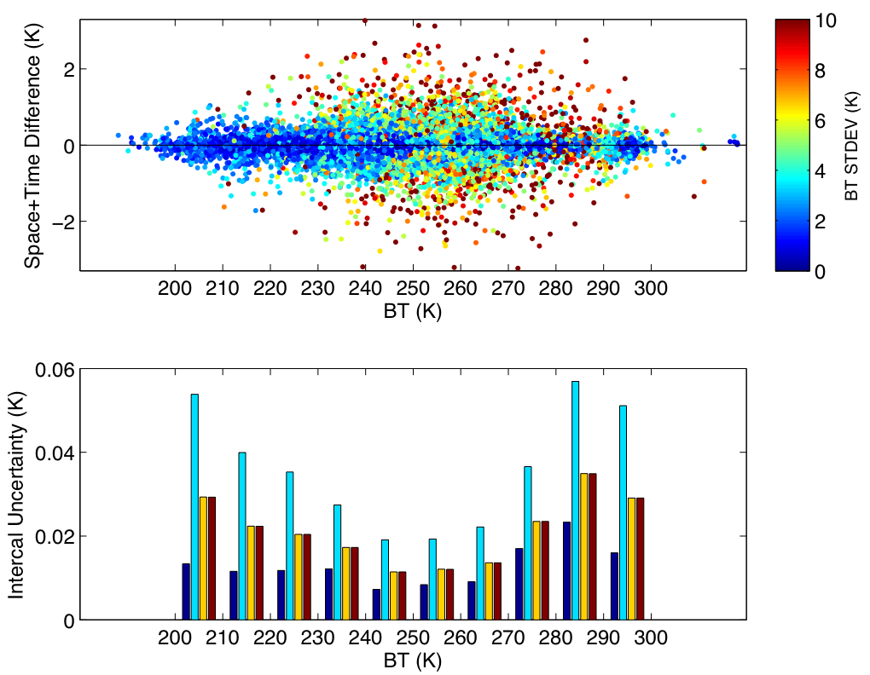
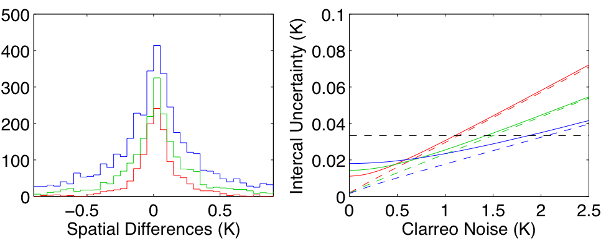
CLARREO Reference Inter-calibration Uncertainty: IR spectra
Studies have answered outstanding questions concerning the accuracy of using CLARREO as a reference calibrator of operational IR sensors
Nadir-only viewing provides sufficient sampling for IR intercalibration of gain, offset, and response nonlinearities.
Sampling time and FOV will determine integration time for reference calibration
Conclusion: The inter-calibration goal of 0.1K (3-σ) for decadal change can be accomplished for a range of CLARREO FOV sizes 25km or larger.
Conclusion: Instrument nonlinearities can be investigated using yearly averages for single channels or monthly using spectral averaging
Holz et al., 2009
Holz et al., 2009
100km (14s), 1276 pts, STDEV = 0.214 K spatial sampling noise
50 km (8s), 2286 pts, STDEV = 0.460 K spatial sampling noise
25 km (4s), 4474 pts, STDEV = 0.918 K spatial sampling noise
CLARREO can provide IR reference intercalibration for CrIS, IASI, VIIRS, CERES

Slide 24
Presentation Outline
Reference Inter-calibration method
CLARREO reference inter-calibration goals
- radiometric accuracy (level-1 product)
- inter-calibration of broadband instrument (CERES)
- inter-calibration of an imager (VIIRS)
Simulations of orbit crossing with JPSS
Reference Inter-calibration sampling estimates with
- JPSS/VIIRS (cross-track)
- JPSS/CERES (cross-track)
Example: Reference inter-calibration of CERES spectral response function
Empirical Polarization Distribution Models (PDM)
Recommendation for mission requirements

Slide 25
CLARREO Reflected Solar
Science Implementation Strategy
  CLARREO will create benchmark climate data records using two complementary approaches
    Benchmarks using only CLARREO data: spectral optimal fingerprinting
    Benchmarks using CLARREO for reference inter-calibration of operational sensors
  CLARREO Inter-calibration will be used to determine and correct operational sensors for:
    Detector offset and gain
    Spectral response function degradation or shift
    Non-linearity
    Sensitivity to polarization

Slide 26
Acknowledgment for Data
Used in Reference Inter-Calibration simulation
SCIAMACHY Level-1 spectral radiance data obtained from ESA. Used to simulate CLARREO spectral radiances, CERES broadband and VIIRS narrowband radiances, 250 – 1750 nm wavelength range, seasonal months 2003 – 2007.
CERES/MODIS/Terra SSF data used to provide scene description for SCIAMACHY field-of-view (5 locations per FOV).
POLDER-3/PARASOL Level-1 data obtained from CNES, France. Used to simulate distributions of observed polarization for inter-calibration sampling, development of polarization models.
POLDER-3/PARASOL Level-2 Clouds data obtained from ICARE, France. Used for scene description of the polarization data.
CERES/MODIS/Aqua SSF data used to simulate scene type distributions within reference inter-calibration sampling.
Notes:
This is a list of data used in simulations and data sources. Technically speaking, we have to acknowledge ESA, CNES, and ICARE in every publication.

Slide 27
CLARREO RI Sampling: Error Scaling
Assuming 1% space/time/angles data matching (Wielicki et al., IGARSS 2008), only linear case differences with CLARREO (offset and gain only), the reference inter-calibration error can be scaled as sqrt(N) as number of samples changes.
N Samples | RI Error (%, k=2)
16,000 | 0.11
8,000 | 0.15
4,000 | 0.21
2,000 | 0.3
1,000 | 0.42
500 | 0.6
250 | 0.85
125 | 1.2
⬅ From simulation using
SCIAMACHY spectral data
(clear-sky ocean case)

Slide 28
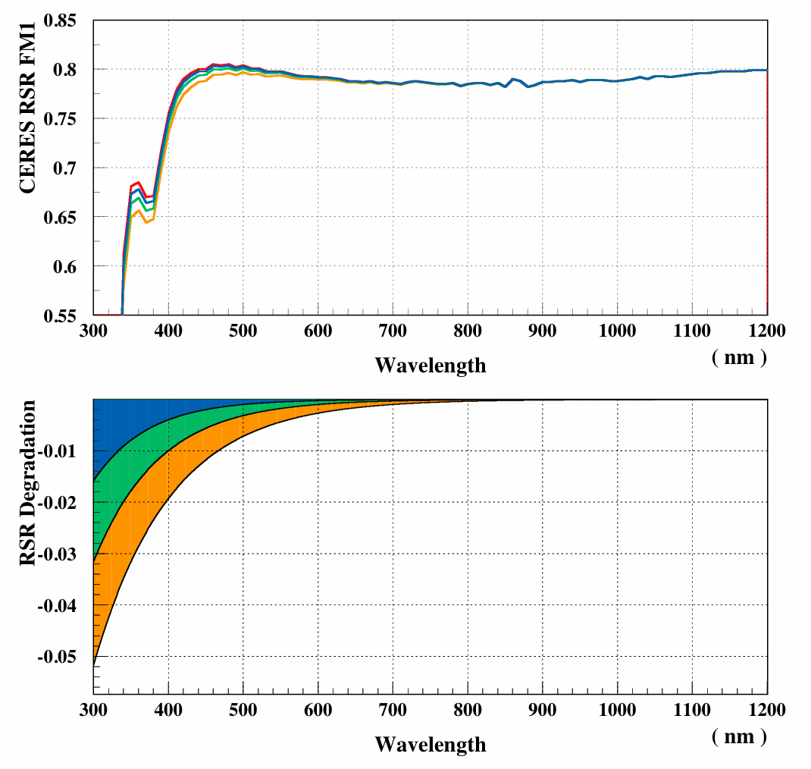
Example: CERES SR Degradation Test (1)
(SCIAMACHY spectral data used)
Plots:
Top: CERES FM1 pre-launch SR and 3 cases of degraded SR.
Bottom: Amount of degradation
D(λ) = 1 – exp(-αλ)
α = 13.8155 (D=0.999 @ λ=0.5 μm)
α = 11.5129 (D=0.999 @ λ=0.6 μm)
α = 9.8155 (D=0.999 @ λ=0.7 μm)
Notes:
Example of the inter-calibration of CERES spectral response function. Point out that essentially the same approach was used by CERES Instrument group to correct response function of instrument in RAPS mode. To make simulation example, we used alpha=9.8. This amount of degradation we see in CERES/Terra instruments after the first year of operation (both instruments switched between cross-track and RAPS). So, CERES signal is simulated with degraded response function and CLARREO signal is generated using start of the mission response function.

Slide 29
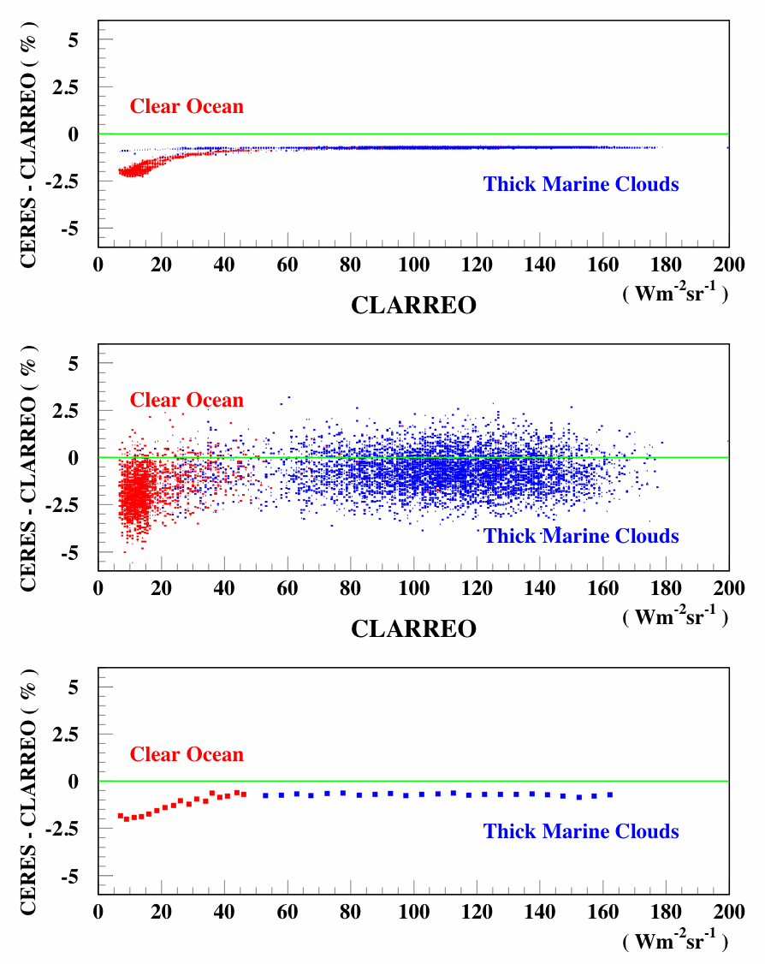
Example: CERES RSR Degradation Test (2) clear ocean (N = 1800) and marine clouds scenes (N = 7000)
CERES RSR Degradation:
α = 9.8155 (D=0.999 @ λ=0.7 μm)
Plots:
Top: CERES – CLARREO difference versus CLARREO signals (%).
Middle: CERES – CLARREO difference versus CLARREO signals (%) with 1% matching noise.
Bottom: Relative difference between
CLARREO and CERES signals with noise
reduced by averaging.
FIT RESULTS:
Scene | OFFSET (Wm⁻²sr⁻¹) | GAIN (%)
CLRO | -0.183 ± 0.028 | -0.31 ± 0.18
MCLD | 0.021 ± 0.108 | -0.73 ± 0.10
* CLRO: Offset error (2σ) = 0.21%
* MCLD: Offset error (2σ) = 0.10%
Notes:
The top plot shows simulated signature for CERES response function degradation without data matching noise. The middle plot shows the same data but with added 1% matching noise (the signature is visually blurred). The plot at the bottom shows the means averages of the difference, the essential signature remains. The table shows parameters of linear fit (offset and gain difference) performed after noise reduction. The goal is to find CERES response function for which offset and gain difference equal zero. Inter-calibration accuracy is defined by CLARREO accuracy and uncertainties of the fit shown in the table and below (2 sigma).

Slide 30
Polarization Distribution Models (1)
Motivation for PDM: Information on polarization state of reflected light is required for inter-calibration of sensor sensitivity to polarization and further its stand-alone operation.
- Inter-calibration of sensitivity to polarization is derivation of polarization dependent correction to instrument baseline effective gain !
Empirical Polarization Distribution Models (PDM):
- Development Approach: Approach is similar to development of CERES/TRMM empirical Anisotropy Distribution Models (ADMs).
- PDM Purpose: To provide polarization information (DOP & χ or U
and Q) as function of physical parameters and geometry of viewed scene for both - CLARREO and inter-calibrated sensor (on NPP,
JPSS, Metop).
- PDM Development: PARASOL data, RT calculations and APS
data (validation). Amount of data required = at least 1 year.
Prototype PDMs: Built as all-sky global set using 12 days
of POLDER-3/PARASOL Level-1 and Level-2 data (day per month).
Stratification parameters: IGBP surface type, cloud fraction, wind speed for clear ocean, cloud phase, cloud optical depth, and all viewing geometry angles (SZA, VZA, RAZ).

Slide 31
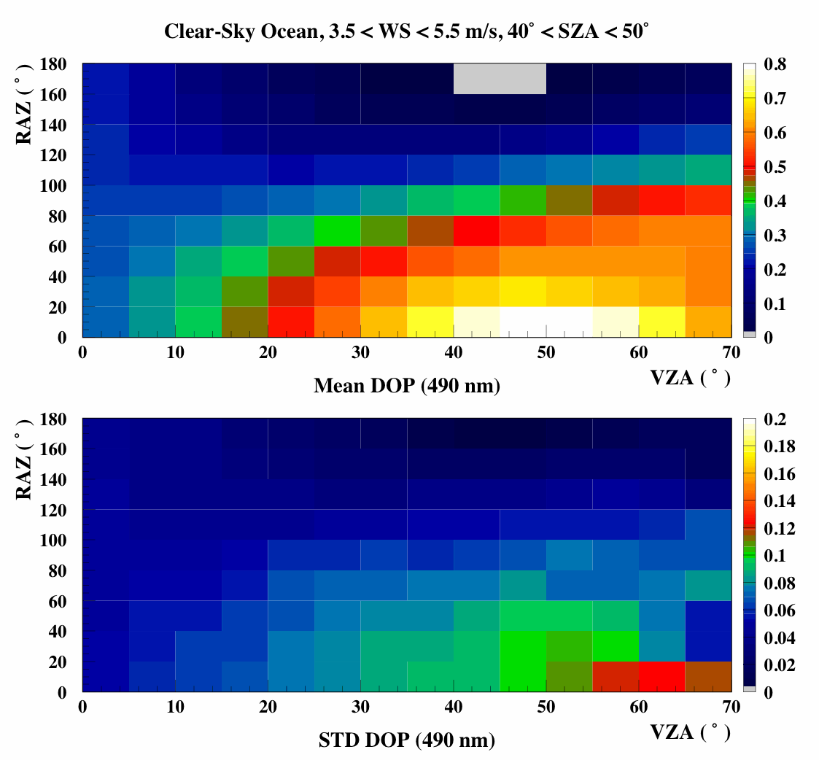
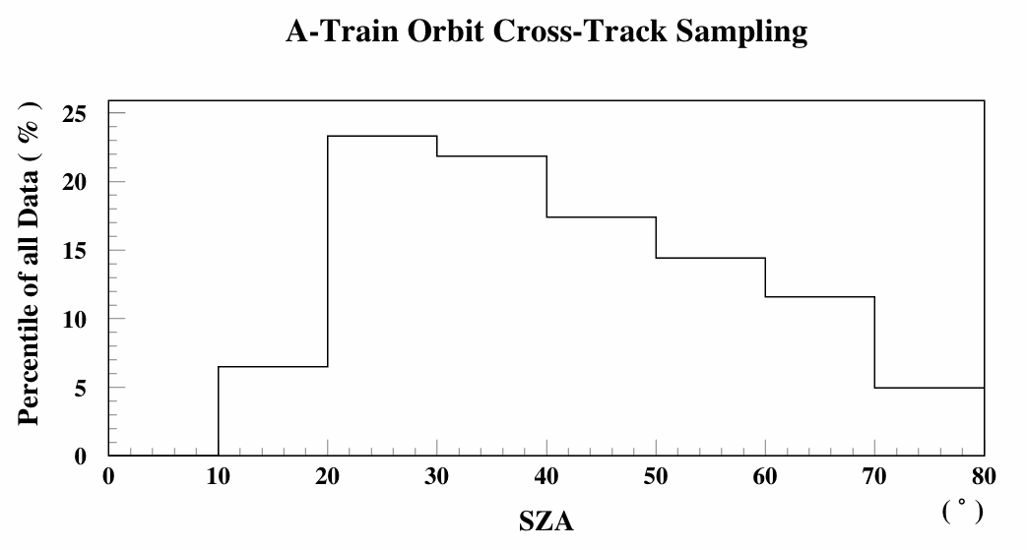
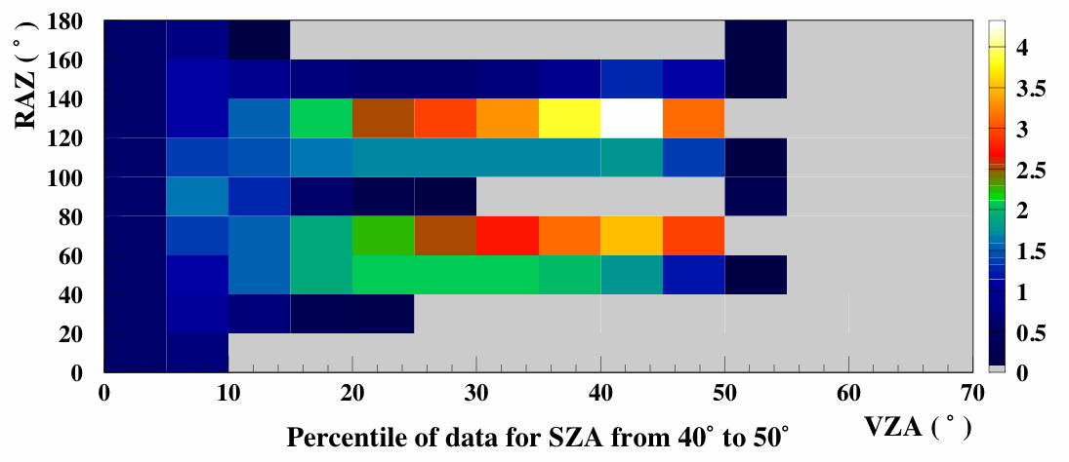
Polarization Distribution Models (2)
Example: clear-sky ocean
Prototype PDM and its STD, PARASOL
Data (12 days of 2006, 1 per month):
A-Train Orbit Cross-Track Sampling
(PARASOL 12 days of 2006):
Notes:
Example of prototype PDM and its STD: clear-sky ocean for SZA from 40 to 50 degs and wind speed from 3.5 to 5.5 m/ (left plots). Plots on the right show simulated sampling for cross-track instrument in 1:30 pm SSO (NPOESS). Top left plot shows fraction of data for certain SZA ranges, for example percentile of data for SZA from 40 to 50 degs is about 18%. The bottom right plot shows percentile distribution of this 18% in RAZ and VZA: it demonstrates that cross-track instrument on NPOESS samples clear-sky ocean mostly with low polarization (samples away from principal plane).

Slide 32
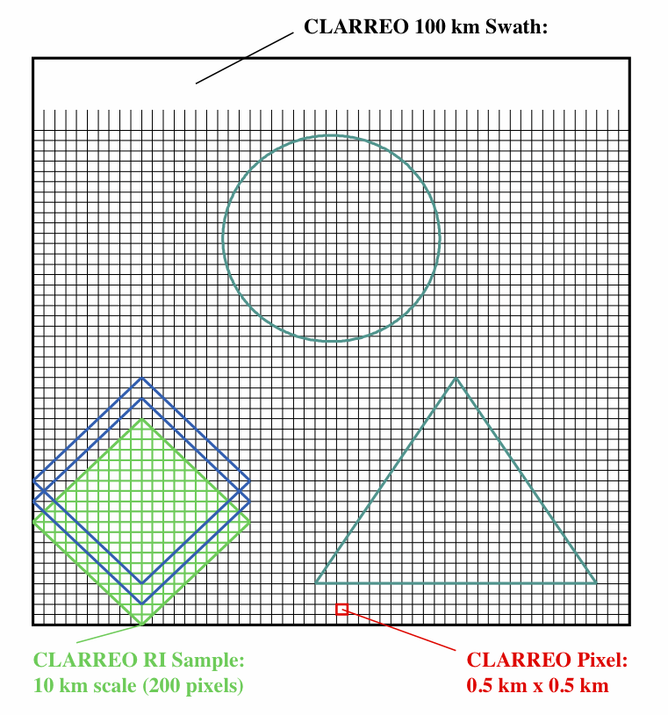
Reference Inter-calibration Sampling
CLARREO RS Inter-Calibration Event:
orbits crossing of CLARREO with sensor
to be calibrated that allows time/angle/
space matched inter-calibration.
CLARREO RS Swath: 100 km
CLARREO RS Inter-Calibration Sample:
area of 10 km scale (for reduction
of spatial matching noise to 1%).
(Wielicki et al., IGARSS 2008)
CLARREO RS Pixel:
0.5×0.5 km observed area (65% of signal).

Slide 33
Sampling Estimates and Restrictions
Sampling for AVHRR/VIIRS is nadir equivalent 10×10 km area in angular space,
1º CLARREO elevation angle. To estimate number of samples with independent
spatial noise 1 km shift (0.1º in elevation angle ) is required from one sample to
the next in both spatial directions (along CLARREO frame and along ground
track). With CLARREO spatial resolution of 0.5×0.5 km the 1 km shift ensures
that only 2 boundary pixels are common.
- This approach of forming a CLARREO/VIIRS RI sample does not allow inter-
calibration on detector-by-detector basis. Relative calibration (flat-fielding)
is required using VIIRS data alone.
For CERES sampling is estimated taking into account CERES FOV size of 25 km
at nadir (from JPSS orbit, 2.5º in CLARREO elevation angle), and data acquisition
rate 330/180 = 1.8 footprints per degree of scan angle every 3.3 seconds.
Restrictions:
SZA < 75º;
CLARREO effective swath > 10 km in VIIRS case, and > 25 km in CERES case.
VZA difference < 1.4º.

