Slide 1
Some Issues of Traceability to Reference Instrument
Fred Wu
GRWG Web Meeting

Slide 2
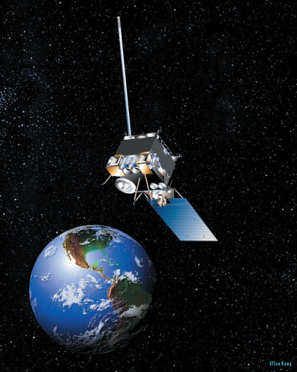
Concept of Inter-Calibration
“It’s 3.14159”
“OK – my 2.71828 should be 3.14159”

Slide 3
Concept of Inter-Calibration
“It’s 3.14159”
“OK – my 2.71828 should be 3.14159”
But there is more to it …

Slide 4
Collocated in Space
GEO FOV, may be square or overlapping
Non-uniform features
LEO FOV, relative to GEO FOV
Collocation FOV, may depend on GEO and LEO FOVs
Collocation environment, may depend on time window and wind speed
Notes:
Basic requirement is to average the 3-by-3 GEO FOV for comparison with LEO FOV. But environment stdv matters.

Slide 5
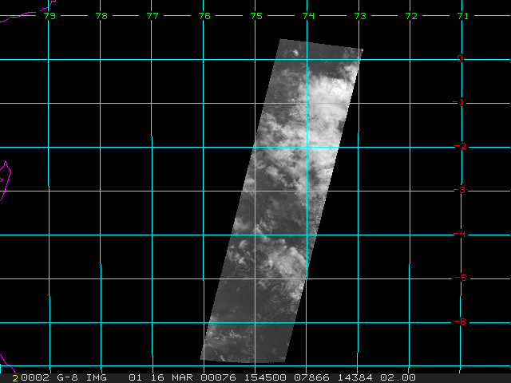
Concurrent in Time

Slide 6
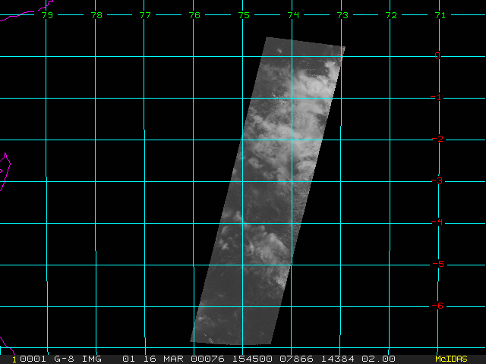
Concurrent in Time

Slide 7
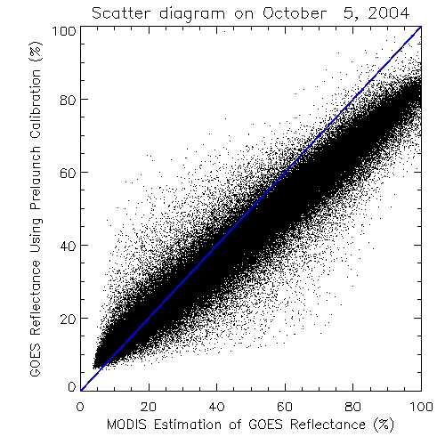
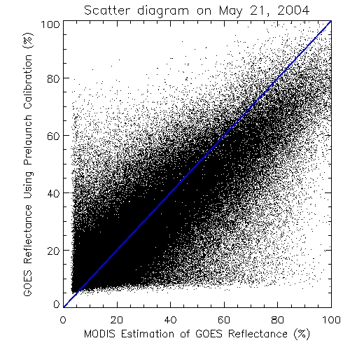
Concurrent in Time

Slide 8
Matched in Spectrum
GOES is brighter than MODIS for dark scenes

Slide 9
Matched in Spectrum

Slide 10
Matched in Spectrum

Slide 11
Aligned in View Geometry
No illustration yet

Slide 12
Summary
The followings are required to transfer calibration of reference instrument to instrument-under-test:
Collocated in space
Concurrent in time
Matched in spectrum
Aligned in view geometry
…
Traceability is the uncertainty in each of them and their impacts on how well the target radiances are known

