Slide 1
Simultaneous Nadir Overpass Analysis of Advanced Microwave Sounding Unit Series-A (AMSU-A)
Bob Iacovazzi, Jr., Changyong Cao, Sid-Ahmed Boukabara and Fuzhong Weng
NOAA GSICS Processing and Research Center
October 12, 2010

Slide 2
Outline
SNO Background
SNO cross comparison between AMSU-A instruments
SNO cross comparison between AMSU-A and MSU instruments

Slide 3
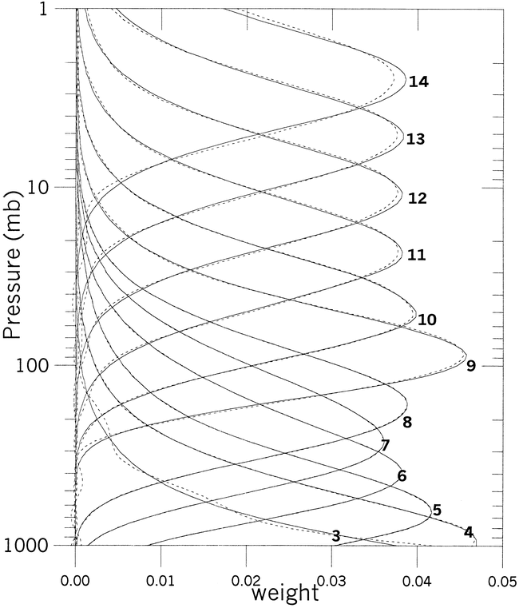
Advanced Microwave Sounding Unit-A (AMSU-A) Instrument Characteristics
Frequencies: 15 Channels @ 24, 31, 50-57, and 89 GHz
BlackBody
Deep Space
Antenna
During each eight second in-orbit scan line, the AMSU-A views three different types of targets:
30 Earth view (EV) positions,
2 views of the internal warm target (~300K), and
2 views of cold space (~2.73K).
Goldberg et al., 2000: J. Applied Met., 40, 70-83.
EV-1 (~-48.3 Deg)
EV-30 (~+48.3 Deg)
~ 50 km Footprint Near-Nadir
~ 150 km Limb Footprint @ Limb

Slide 4
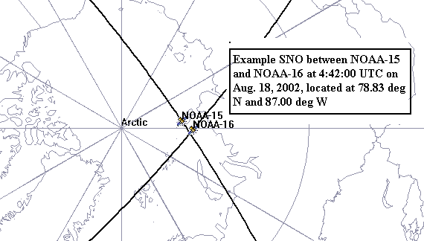
Typical Simultaneous Nadir Overpass (SNO)
Cao et. al., J. Atmos. Ocn. Tech., 2004

Slide 5
AMSU-A SNO Dataset Collocation
150 km
Satellite 2 Footprints
SNO
200 km
Satellite 1 Footprints
50km

Slide 6
Operational AMSU-A SNO Ensemble Dataset
Time Period: May 21, 2005 to July 31, 2006
Locations: Typically Around 80⁰ North and South
SNO Time Threshold: 30 Seconds
Number of SNOs:
 | Aqua/ N15 | Aqua/ N16 | Aqua/ N18 | N15/ N16 | N15/ N18 | N16/ N18
Northern Hemisphere (NH) | 63 | 57 | 58 | 57 | 60 | 54
Southern Hemisphere (SH) | 65 | 53 | 55 | 55 | 57 | 54
Globe | 128 | 110 | 113 | 112 | 117 | 108

Slide 7
AMSU-A SNO Uncertainty Relative to NEDT
Avg. Percentage of SNO Bias Variance due to NEDT

Slide 8
Aqua and N15 AMSU-A Individual SNO
Mean Bias Time Series

Slide 9
POES and Aqua AMSU-A SNO-ensemble Mean Biases and 99% Confidence Intervals

Slide 10
Estimated and Observed and AMSU-A SNO biases using Aqua/AMSU-A as a Calibration Transfer Radiometer

Slide 11
Channel aggregated SNO biases for AMSU-A1-1 and AMSU-A1-2 subunits

Slide 12
AMSU-A SNO Mean Bias Uncertainties
for Different Collocation and QA Schemes

Slide 13
Microwave Sounding Unit (MSU) and Advanced MSU Series-A (AMSU-A) Comparison
Ch # | Ch f (GHz) | # Bands | Nominal Bandwidth (GHz) | Nominal Beamwidth (degrees) | ΝΕΔΤ (K) (Spec.) | Nadir Polar-ization | Subunit
MSU 1 | 50.30 | 1 | 0.20 | 7.5 | 0.30 | V | N/A
AMSU 3 | 50.30 | 1 | 0.18 | 3.3 | 0.40 | V | A1-2
MSU 2 | 53.74 | 1 | 0.20 | 7.5 | 0.30 | H | N/A
AMSU 5 | 53.596 0.115 | 2 | 0.17 | 3.3 | 0.25 | H | A1-2
MSU 3 | 54.96 | 1 | 0.20 | 7.5 | 0.30 | V | N/A
AMSU 7 | 54.94 | 1 | 0.40 | 3.3 | 0.25 | V | A1-1
MSU 4 | 57.95 | 1 | 0.20 | 7.5 | 0.30 | H | N/A
AMSU 9 | 57.29 | 1 | 0.33 | 3.3 | 0.25 | H | A1-1
Note: H indicates horizontal and V indicate vertical polarization

Slide 14
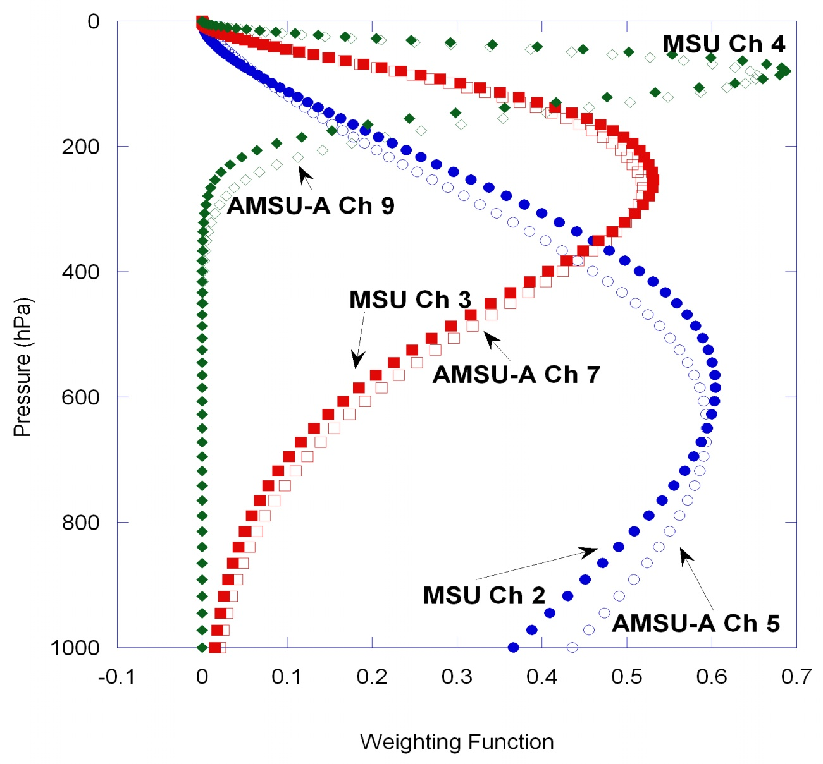
Microwave Sounding Unit (MSU) and Advanced MSU Series-A (AMSU-A) Comparison

Slide 15
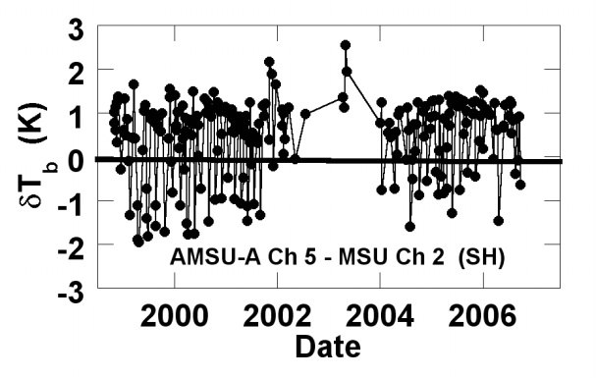
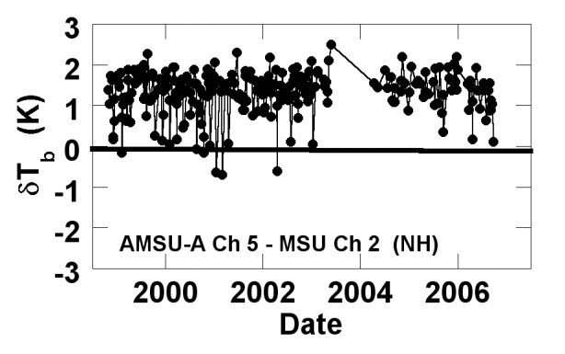
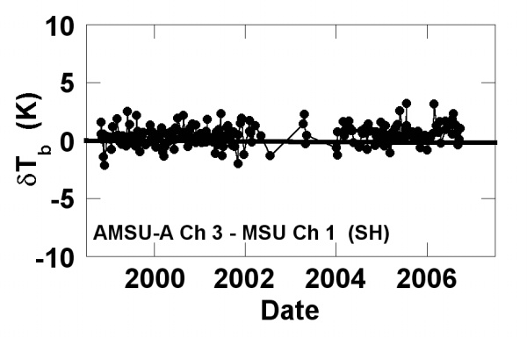
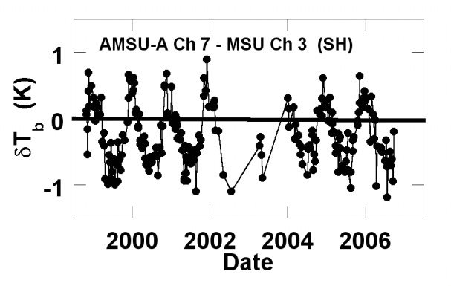
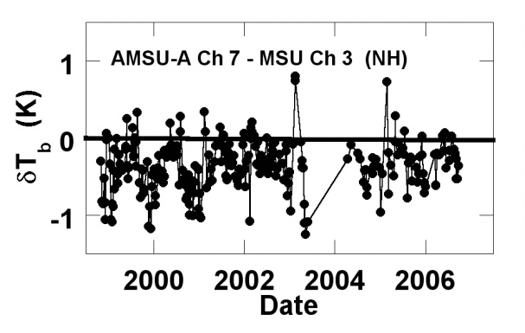
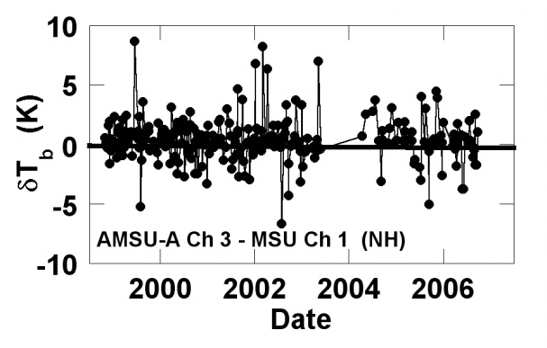
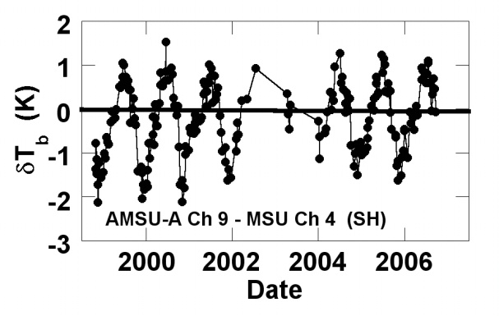
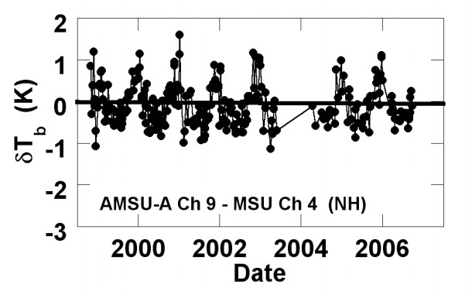
NOAA-14 MSU and NOAA-15 AMSU-A Tb Biases
Estimated from Raw Data (Oct. 1998 – Sept. 2006)
South Hemisphere
North Hemisphere
AMSU-A 3 - MSU 1
AMSU-A 5 - MSU 2
South Hemisphere
AMSU-A 7 - MSU 3
North Hemisphere
AMSU-A 9 - MSU 4

Slide 16
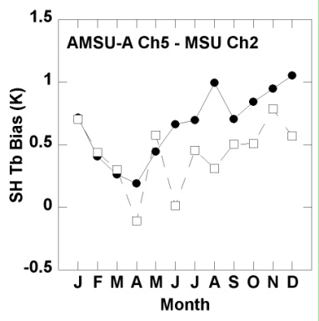
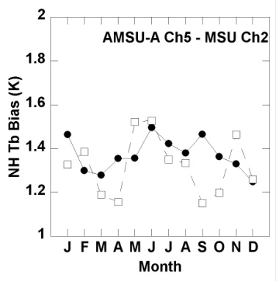
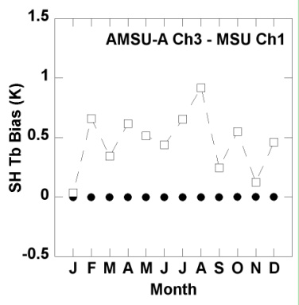
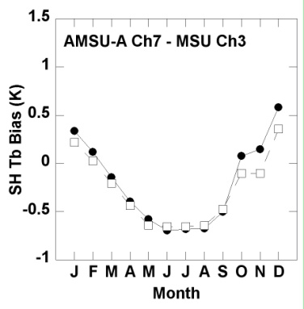
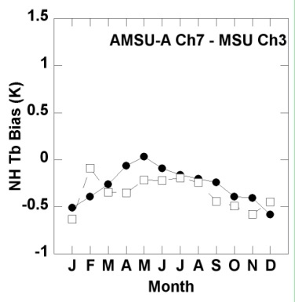
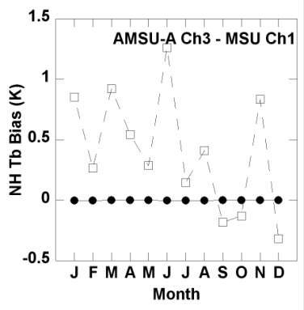
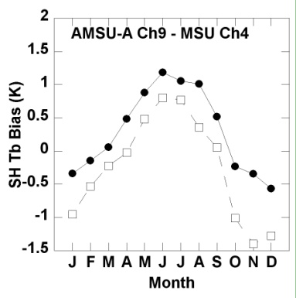
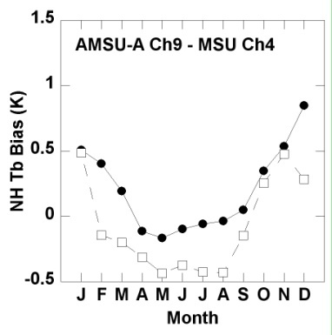
NOAA-14 MSU and NOAA-15 AMSU-A Tb Biases
Projected from MIRS/CRTM for 2007 (MSU/AMSU-A center frequency and band width differences only) and Raw Data for 1998-2006
South Hemisphere
North Hemisphere
AMSU-A 3 - MSU 1
South Hemisphere
AMSU-A 5 - MSU 2
AMSU-A 7 - MSU 3
North Hemisphere
AMSU-A 9 - MSU 4

Slide 17
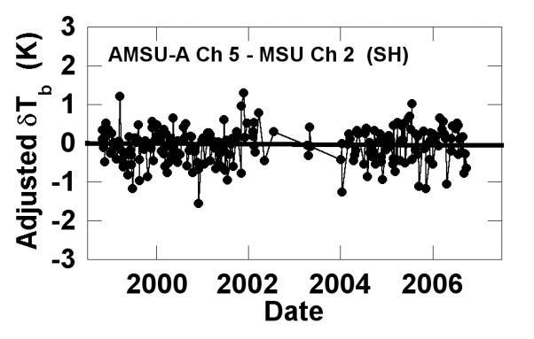
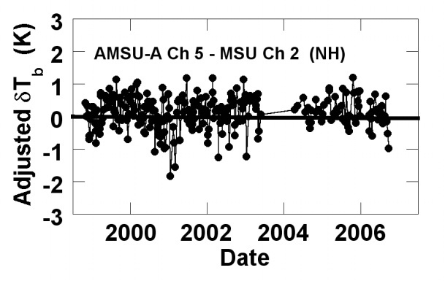
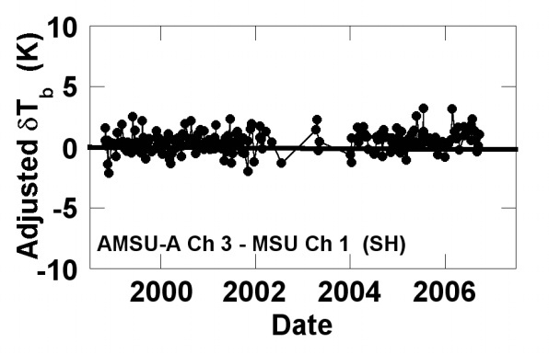
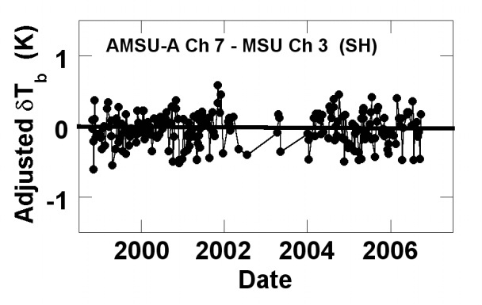
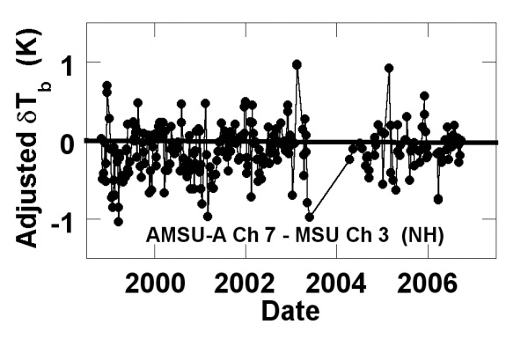
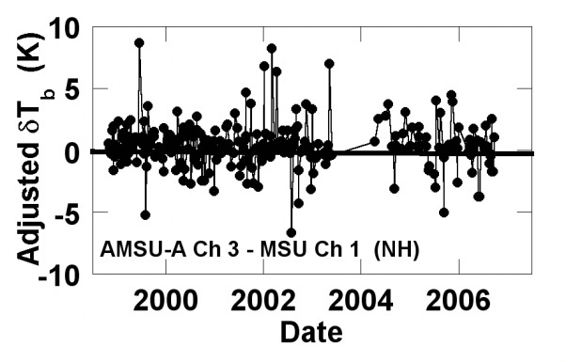
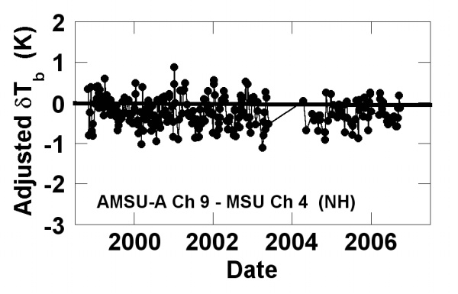
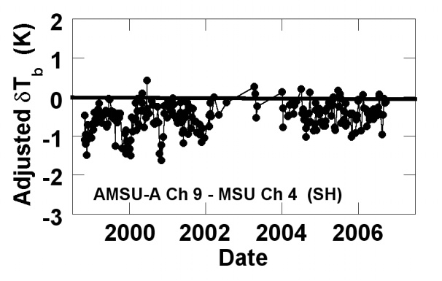
NOAA-14 MSU and NOAA-15 AMSU-A Tb Biases
Estimated after MIRS/CRTM Adjustments to Raw Data
South Hemisphere
North Hemisphere
AMSU-A 3 - MSU 1
South Hemisphere
AMSU-A 5 - MSU 2
AMSU-A 7 - MSU 3
North Hemisphere
AMSU-A 9 - MSU 4

Slide 18
References
Iacovazzi, R. A., Jr., C. Cao, and S. Boukabara, 2009: Analysis of Polar-orbiting Operational Environmental Satellite NOAA-14 MSU and NOAA-15 AMSU-A relative measurement biases for climate change detection, J. Geophys. Res., 114, D09107, doi:10.1029/2008JD011588.
Iacovazzi, Jr., R. A., C. Cao, 2008: Reducing uncertainties of SNO-estimated inter-satellite AMSU-A brightness temperature biases for surface-sensitive channels. J. Atmos. and Oceanic Tech., 25, 1048-1054.
Iacovazzi Jr., R. and C. Cao, 2007: Quantifying EOS-Aqua and NOAA POES AMSU-A Brightness Temperature Biases for Weather and Climate Applications Utilizing the SNO Method. J. Atmos. and Ocn. Tech., 24, 1895-1909.
AMSU-A SNO Analysis
https://cs.star.nesdis.noaa.gov/GPRC/LeoLeoMicroSounder

