Slide 1
Road to Pre-Operational Phase for GEO-LEO IR Products
Fuzhong Weng and Bob Iacovazzi, Jr.
GSICS Coordination Center
January 18, 2011

Slide 2
Outline
GSICS Procedure for Product Acceptance (GPPA) Fundamental Capabilities
The Four GPPA Phases
GPPA Current Status
Road to GPPA Pre-operational Phase
GPPA Impediments
Pep Talk and Future plans

Slide 3
Fundamental Capabilities of GPPA …
The GPPA is the GSICS:
Product developers pathway to obtain a “Stamp of Approval” for a potential product
Data users window to GSICS product quality and “fitness for purpose”
Governing body reference for judging GSICS product fitness
The GPPA defines and documents:
Scope of product within the GSICS product portfolio
Theoretical basis, and implementation and distribution strategy, of product
Product Quality (uncertainty, quality indicators, etc)
Four Product Phases:
Submission Phase
Demonstration Phase
Pre-operational Phase
Operational Phase

Slide 4
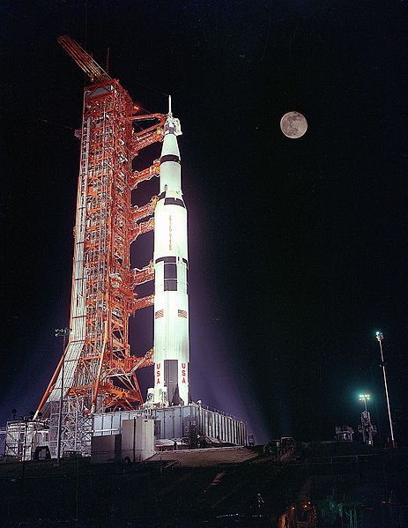
GPPA: Submission Phase
Phase Goals: Product
GSICS Product Acceptance Form (GPAF) is satisfactory,
Data files conform to GSICS file and parameter naming and format standards,
Verified to be within GSICS scope, and
Theoretical basis is understood at a high-level.
Maximum Time Period: 90 Days
Milestones: The following are submitted by the product provider to the GCC and approved by the GSICS Product Acceptance Team (GPAT)
GPAF sections that detail product name, POC, brief description, and relevance to GSICS.
Preliminary version of the product algorithm theoretical basis document (ATBD)
Sample product files that adhere to GSICS file and parameter naming conventions

Slide 5
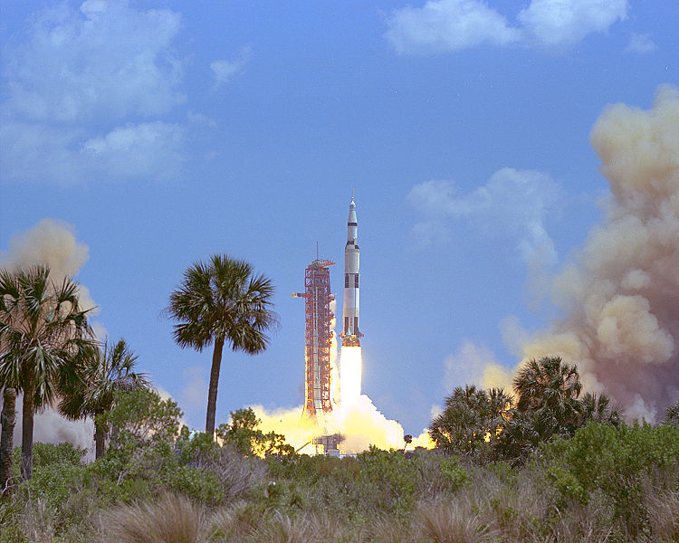
GPPA: Demonstration Phase
Phase Goals: Product
Founding concepts, supporting models and measurements, and implementation are documented and fully understood,
Traceability (or lack thereof) to SI-standards is documented,
Quality Indicator is documented and well-defined,
Tested and reviewed by potential product users, and
Data released to GSICS members and potential users.
Maximum Time Period: 365 Days
Milestones: The following are submitted to, or arranged in coordination with, the GCC by the product provider and approved by the GPAT
Routine product upload to a GSICS data server and agree on file retention policy.
GSICS product users feedback regarding product usefulness
Baseline versions of four documents critical to product quality assurance –
Algorithm Theoretical Basis Document,
Document describing product traceability to standards
Product supporting radiative transfer model and cal/val supporting measurements description
Product quality indicator description and justification
Affirmative decision regarding continuance of product within the GPPA process

Slide 6
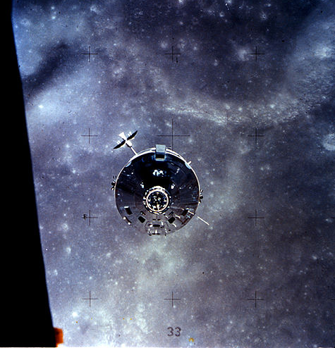
GPPA: Pre-operational Phase
Phase Goals: Product
Generation, distribution, version control and archive strategies are fully documented and implemented.
Users’ Guide with clear implementation instructions made available to data users,
Data released to public with disclaimer.
Maximum Time Period: 180 Days
Milestones:
Executive Panel review and approval of GPAT recommendations.
Documents associated with product data stewardship in an operational environment:
product version control plan,
operations and distribution plan, and
data user's guide
are submitted by the product provider and approved by the GPAT.

Slide 7
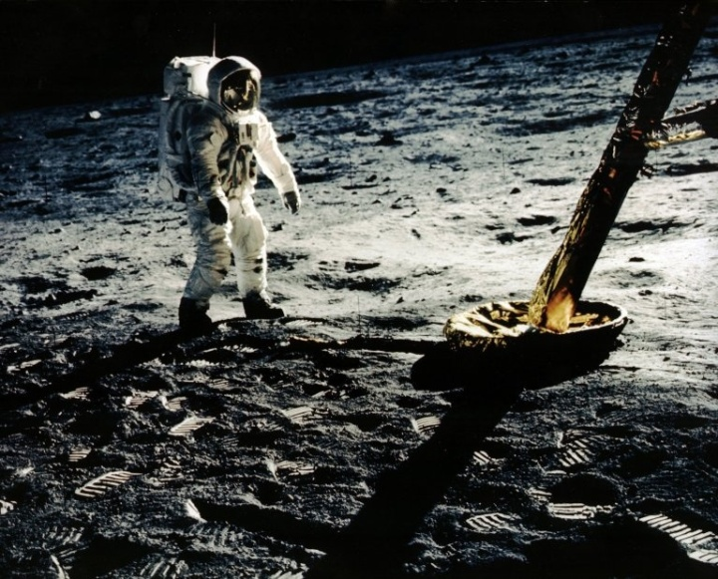
GPPA: Operational Phase
Goal:
Product is fully accepted and maintained within GSICS and distributed to the public.
Maximum Time Period: Periodic Reviews
Milestones: The following are made available by the product provider to the GCC and the GPAT for periodic inspection and review
Product logs and usage reports
Updated documentation/software as necessary

Slide 8
GPPA: Current Status
Four Potential Products in Demonstration Phase
GSICS Correction for EUMETSAT SEVIRI IR Channels based on IASI
GSICS Correction for GOES and MTSAT Imager IR Channels based on AIRS and IASI
Patmos-X AVHRR solar reflective channel corrections based on MODIS

Slide 9
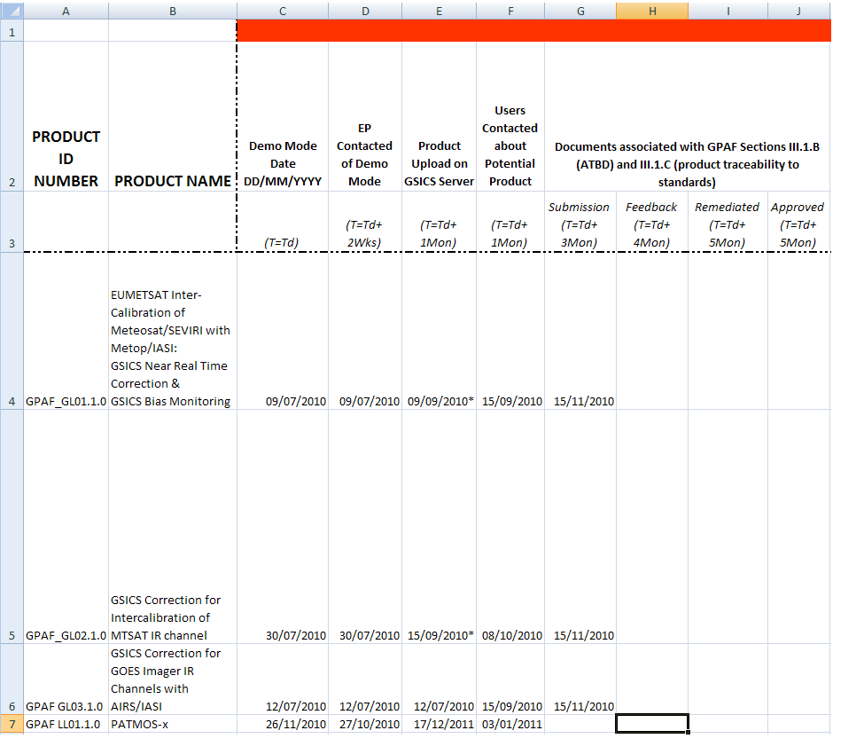
GPPA: Current Status
GPPA Tracker Demo Phase Page: Information Updated 03/01/2011
Feedback from GSICS Product Acceptance Team is overdue

Slide 10
GPPA: Road to Pre-Operational Phase
Examine the submitted documents (ATBD and product traceability to standards)
Who: GPAT and product users
Due: One month after GCC received the documents
Remediate any document issues according to the GPAT and user feedback
Who: Product provider, GCC Director
Due: One month after receiving GPAT feedback
Complete documents associated with GPAF Sections III.2.A (radiative transfer models) and III.2.B (cal/val supporting measurements)
Who: Product provider
Due: Six months after entering the Demonstration phase
Collect and disseminate user feedback regarding product's data usability and format
Who: Product users, GCC Director
Due: Six months after entering the Demonstration phase
Examine the submitted documents (radiative transfer models and cal/val supporting measurements).
Who: GPAT
Due: One month after GCC received the documents
Remediate any document or data issues according to the GPAT and user feedback
Who: Product provider, GCC Director
Due: One month after receiving GPAT feedback

Slide 11
GPPA: Impediments to Pre-Operational Phase
Little input regarding GEO-LEO IR Product Algorithm Theoretical Basis Document or Traceability to Standards Statement
Many GEO-LEO IR algorithms have changed since product submission.

Slide 12
GPPA: Road to Pre-Operational Phase
Examine the submitted documents (ATBD and product traceability to standards)
Who: GPAT and product users
Due: One month after GCC received the documents
Remediate any document issues according to the GPAT and user feedback
Who: Product provider, GCC Director
Due: One month after receiving GPAT feedback
Complete documents associated with GPAF Sections III.2.A (radiative transfer models) and III.2.B (cal/val supporting measurements)
Who: Product provider
Due: Six months after entering the Demonstration phase
Collect and disseminate user feedback regarding product's data usability and format
Who: Product users, GCC Director
Due: Six months after entering the Demonstration phase
Examine the submitted documents (radiative transfer models and cal/val supporting measurements).
Who: GPAT
Due: One month after GCC received the documents
Remediate any document or data issues according to the GPAT and user feedback
Who: Product provider, GCC Director
Due: One month after receiving GPAT feedback

Slide 13
GPPA: Road to Pre-Operational Phase
Examine the submitted documents (ATBD and product traceability to standards)
Who: GPAT and product users
Due: One month after GCC received the documents
Remediate any document issues according to the GPAT and user feedback
Who: Product provider, GCC Director
Due: One month after receiving GPAT feedback
Complete documents associated with GPAF Sections III.2.A (radiative transfer models) and III.2.B (cal/val supporting measurements)
Who: Product provider
Due: Six months after entering the Demonstration phase
Collect and disseminate user feedback regarding product's data usability and format
Who: Product users, GCC Director
Due: Six months after entering the Demonstration phase
Examine the submitted documents (radiative transfer models and cal/val supporting measurements).
Who: GPAT
Due: One month after GCC received the documents
Remediate any document or data issues according to the GPAT and user feedback
Who: Product provider, GCC Director
Due: One month after receiving GPAT feedback

Slide 14
GPPA: Road to Pre-Operational Phase
Examine the submitted documents (ATBD and product traceability to standards)
Who: GPAT and product users
Due: One month after GCC received the documents
Remediate any document issues according to the GPAT and user feedback
Who: Product provider, GCC Director
Due: One month after receiving GPAT feedback
Complete documents associated with GPAF Sections III.2.A (radiative transfer models) and III.2.B (cal/val supporting measurements)
Who: Product provider
Due: Six months after entering the Demonstration phase
Collect and disseminate user feedback regarding product's data usability and format
Who: Product users, GCC Director
Due: Six months after entering the Demonstration phase
Examine the submitted documents (radiative transfer models and cal/val supporting measurements).
Who: GPAT
Due: One month after GCC received the documents
Remediate any document or data issues according to the GPAT and user feedback
Who: Product provider, GCC Director
Due: One month after receiving GPAT feedback

Slide 15
GPPA: Impediments to Pre-Operational Phase
Little interim input from product testers

Slide 16
GPPA: Road to Pre-Operational Phase
Examine the submitted documents (ATBD and product traceability to standards)
Who: GPAT and product users
Due: One month after GCC received the documents
Remediate any document issues according to the GPAT and user feedback
Who: Product provider, GCC Director
Due: One month after receiving GPAT feedback
Complete documents associated with GPAF Sections III.2.A (radiative transfer models) and III.2.B (cal/val supporting measurements)
Who: Product provider
Due: Six months after entering the Demonstration phase
Collect and disseminate user feedback regarding product's data usability and format
Who: Product users, GCC Director
Due: Six months after entering the Demonstration phase
Examine the submitted documents (radiative transfer models and cal/val supporting measurements).
Who: GPAT
Due: One month after GCC received the documents
Remediate any document or data issues according to the GPAT and user feedback
Who: Product provider, GCC Director
Due: One month after receiving GPAT feedback

Slide 17
GPPA: Road to Pre-Operational Phase
Examine the submitted documents (ATBD and product traceability to standards)
Who: GPAT and product users
Due: One month after GCC received the documents
Remediate any document issues according to the GPAT and user feedback
Who: Product provider, GCC Director
Due: One month after receiving GPAT feedback
Complete documents associated with GPAF Sections III.2.A (radiative transfer models) and III.2.B (cal/val supporting measurements)
Who: Product provider
Due: Six months after entering the Demonstration phase
Collect and disseminate user feedback regarding product's data usability and format
Who: Product users, GCC Director
Due: Six months after entering the Demonstration phase
Examine the submitted documents (radiative transfer models and cal/val supporting measurements).
Who: GPAT
Due: One month after GCC received the documents
Remediate any document or data issues according to the GPAT and user feedback
Who: Product provider, GCC Director
Due: One month after receiving GPAT feedback

Slide 18
GSICS Procedure for Product Acceptance (GPPA): Pep Talk
The GPPA is designed to provide a clear statement of inter-calibration product quality to the operational and research weather satellite data user communities.
Such a procedure - involving rigorous inspection, review, verification and testing associated with satellite inter-calibration methods, and their implementation, results and impacts - is ultimately essential for the "G" in GSICS to represent the "Global" service that it proclaims.
Please remain committed to the GPPA process, as it becomes important in building trust between GSICS product producers and their data users.

Slide 19
GPPA: Future Plans
In the Next Year …
All Four Current Potential Products in Pre-Operational Phase
New Potential Product Submissions
GSICS Correction for CMA VISSR IR Channels based on IASI
GSICS Correction for EUMETSAT SEVIRI, MTSAT Imager and GOES Imager solar reflective channels based on MODIS
GSICS Correction for MSU/AMSU-A data based on SNO

Slide 20
GPPA Information Links
GSICS Wiki:
Up-to-date GPPA Workflow, Documents and Forms
(http://www.star.nesdis.noaa.gov/smcd/GCC/qa-gppa.php)
GSICS Coordination Center Web Site:
GPPA Overview
Links to GPPA Information archived on GSICS Wiki
(https://gsics.nesdis.noaa.gov/wiki/Development/GppaWorkflow)

