Slide 1
GSICS Coordination Center Update
Fuzhong Weng and Bob Iacovazzi, Jr.
GSICS Coordination Center
Joint GDWG-V and GRWG-VI Meeting
March 22, 2011

Slide 2
Outline
GCC Progress Since February 2010
GEO-LEO Baseline Algorithm Implementation
NOAA GPRC / GCC Web Site Segregation
GSICS Quarterly
GSICS Implementation Plan
Product Quality Assurance Activities
GSICS Procedure for Product Acceptance Implementation (see presentation later today)
Meeting Support
GSICS Operations Plan Updates: Unfulfilled GSICS Action Items and Recommendations
GCC Near-term Goals for 2011

Slide 3
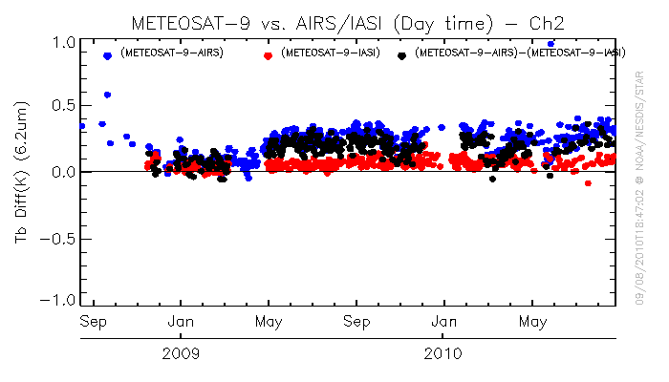
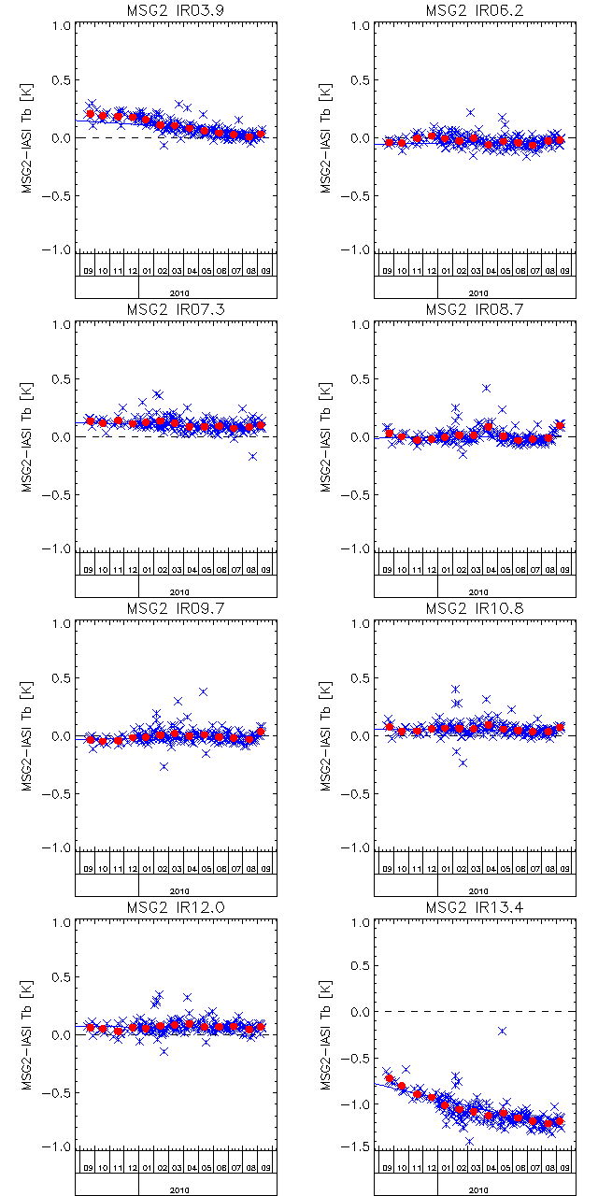
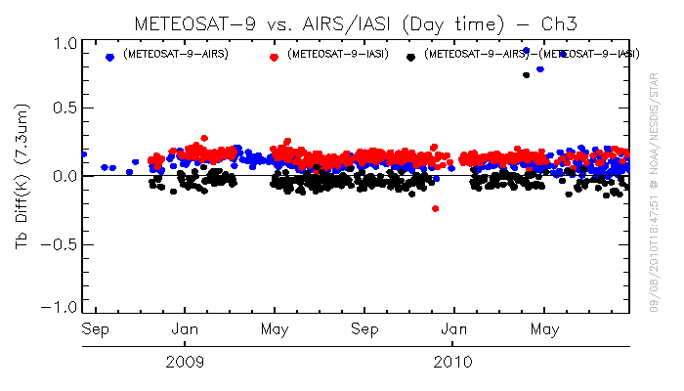
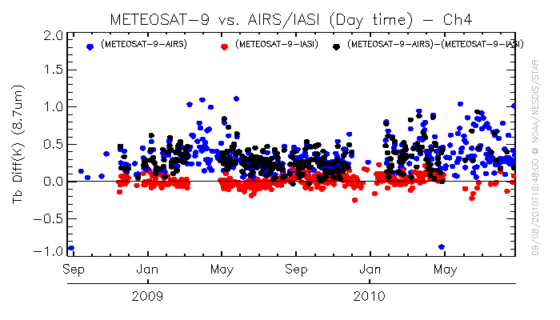
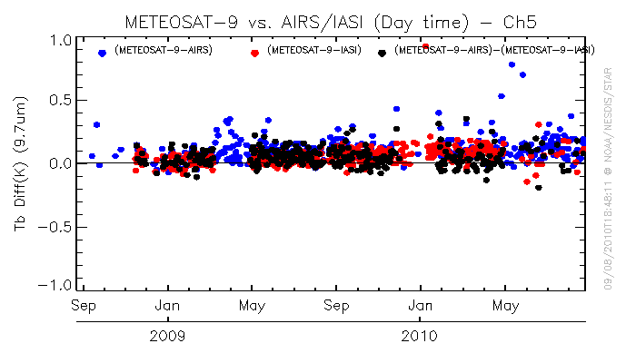
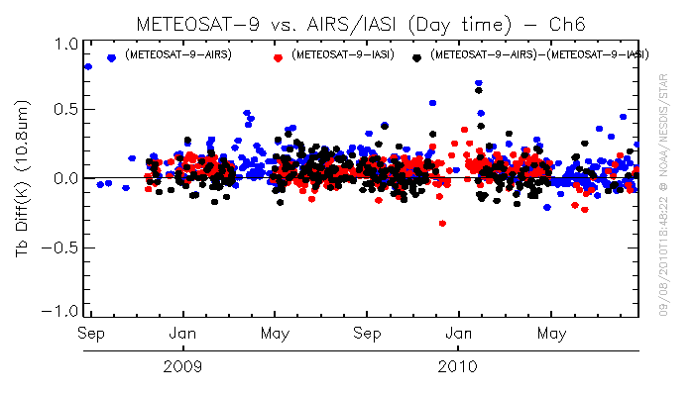
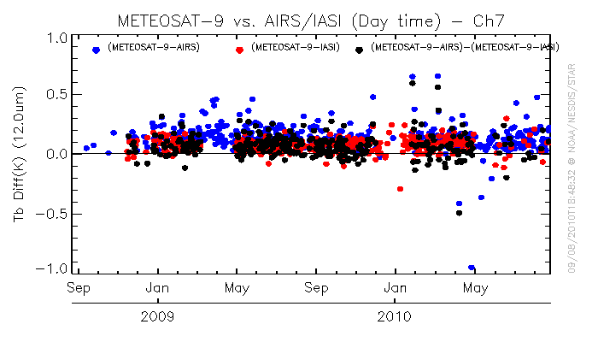
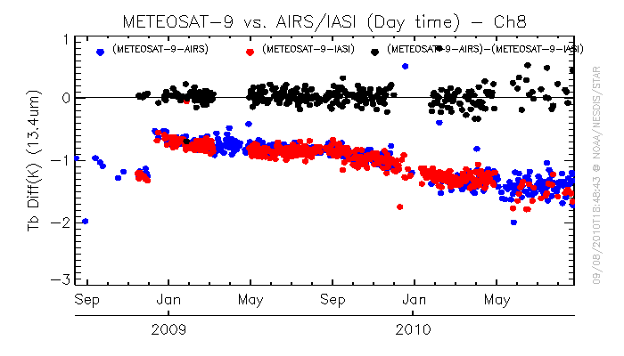
GEO-LEO Baseline Algorithm Implementation Tb Bias for Meteosat-9
http://www.eumetsat.int/Home/Main/DataProducts/Calibration/Inter-calibration/GSCISMeteosatIRInter-calibration/
Baseline Algorithm Results
In general, baseline and operational algorithm results agree well in the Tb bias changing patterns and magnitude
Difference in Ch13.4µm Tb bias magnitude may mainly come from the difference of mean homo. scenes vs. standard scene Tb biases
Homogeneous Scenes
Standard Scenes

Slide 4
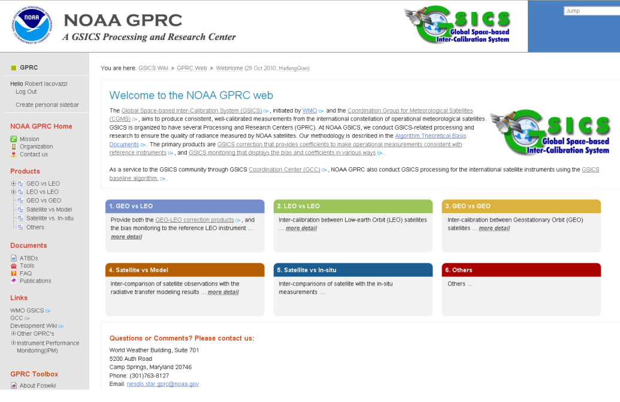
NOAA GSICS Web Site Separated into GCC and NOAA GPRC Sites
Ported over GCC appropriate content from old GSICS web site hosted on the NOAA/STAR web server to new web page templates that conform to current NOAA/STAR organization web standards
Created new content for web meetings and presentations
Updated all pages (removing NOAA GSICS Processing and Research Center (GPRC) relevant information)
Assisted in porting of NOAA/GPRC relevant information to new NOAA/GPRC dedicated web site
Coordinated development of new GSICS banner and logo
New NOAA/GPRC Web Site: https://gsics.nesdis.noaa.gov/wiki/GPRC/WebHome
New NOAA/GCC Web Site: http://www.star.nesdis.noaa.gov/smcd/GCC/index.php

Slide 5
GSICS Quarterly Newsletter
All GSICS Quarterly Volume 4 issues are complete
Created an Associate Editor position, held by Gordana Sindic-Rancic of GCC, to assist in editing newsletter articles
Teamwork between contributing authors and the GQ Chief Editor, Associate Editor, and Press Correspondents (Tim Hewison [Europe] and Yuan Li [Asia]) has helped make the newsletter successful
At least 30 new names gathered during the GSICS 2nd Users Workshop added to the distribution list

Slide 6
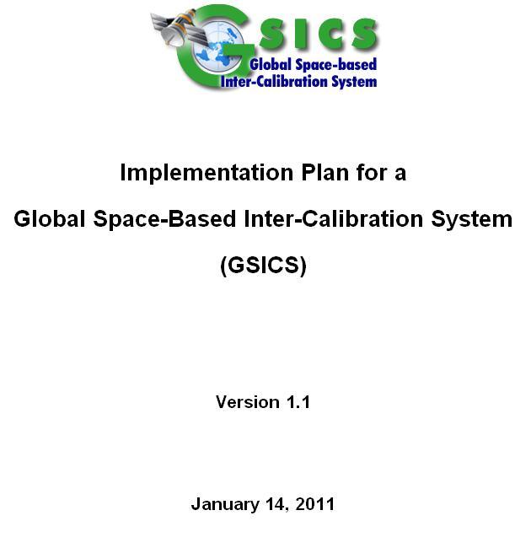
Revision of GSICS Implementation Plan
Made changes to objective and overall approach to more clearly state GSICS goals. In particular, added statements regarding:
GSICS encouragement of establishing well-characterized intrinsic standard vicarious calibration targets and/or instruments with on-orbit SI-traceable calibration sources
Strong dependence of GSICS activities on state-of-the-art telecommunications
Updated roles and responsibilities of GSICS Coordination Center to reflect actual charter
Made significant changes and edits to Executive Summary, Background, Inter-calibration activity, Pre-launch calibration, and Earth-based reference sites
Under review by WMO

Slide 7
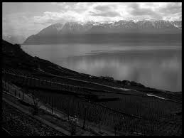
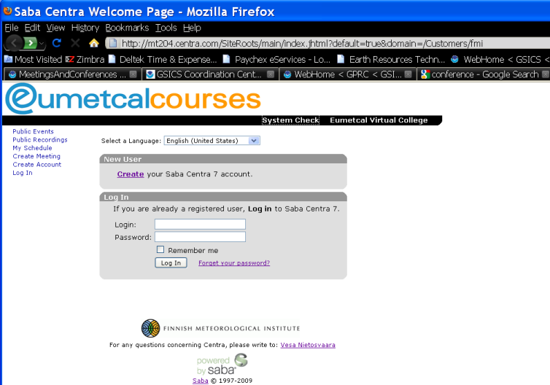
Meeting Support
GSICS Meetings
GSICS Second Users’ Workshop – September 2010, Cordoba, Spain (Brief report to be given in the next presentation)
GSICS Executive Panel VIII – April 2010, Geneva, Switzerland
GSICS Executive Panel IX – November 2010, Jeju Island, South Korea
Centra web meetings hosted by EUMETSAT: Two meetings of the GSICS Microwave Sub-Group and several GRWG/GDWG meetings

Slide 8
Meeting Support
GSICS-Related Meetings
The Global Precipitation Measurement Cross-Calibration Meeting and NOAA Climate Data Record Workshop – March 2011

Slide 9
NOAA Workshop on CDRs from Satellite Passive Microwave Sounders – AMSU/MHS/SSMTS
March 2-3, 2011 College Park, MD
Over 30 participants from NOAA, NASA, EUMETSAT, and academia
Meeting held consecutively with NASA GPM Intersatellite Calibration (“X-Cal”) Working Group
Lead by T. Wilheit - main focus is MW imagers, but have interest in AMSU/MHS
GSICS participates in X-Cal
February 2011 ______

Slide 10
NOAA Workshop on CDRs from Satellite Passive Microwave Sounders – AMSU/MHS/SSMTS
Some take-away points from workshop:
Major issues to contend with on AMSU-A, -B, and MHS:
Across scan bias (esp. AMSU-A)
Can characterize via CRTM over clear, ocean backgrounds
Can also attempt vicarious calibration over warm and cold targets
Intersatellite bias
Viable methods include SNO and vicarious calibration
RFI on AMSU-B
Geolocation
Orbital decay
Satellite drift
Learned that there is not necessarily “one best method” to solve a particular issue
Need to develop synergies with:
EUMETSAT Climate-SAF
Existing NOAA CDR efforts (AMSU Sounding Channels)
GPM X-Cal
February 2011 ______

Slide 11
GSICS Operations Plan Updates: Unfulfilled Actions and Recommendations
GDWG04_07 (Evaluation of WMO GSICS Web Site) - All
GDWG03_16 and GDWG04_03R (GSICS Portal) - GDWG
GDWG04_11 (Action Tracker) - NOAA and EUMETSAT
GDWG04_12 (GSICS Help Desk) - GDWG
GDWG04_14 (Product Quality Indicators) - GCC-NOAA
GDWG04_04 (Filenaming convention: Confirm originator codes) - GDWG
GDWG04_13 GRWG05_15 (Gathering Instrument Information )
GDWG04_11R (Instrument Monitoring Web Site) - GCC + GDWG

Slide 12
GSICS Operations Plan Updates: Unfulfilled Actions and Recommendations
GRWG05_08 (Investigation into adding GEO data to SADE database) - All GPRCs
EP08_02 (Result display harmonization) - JMA and GCC
EP08_12 (Vocabulary and guide on uncertainty) - NIST
EP09_01 (ISRO and the GCC to coordinate for the implementation of GEO-to-LEO algorithms by ISRO.) - ISRO and GCC
GRWG05_10 (SEVIRI Data Transfer) - EUMETSAT and CNES
GRWG05_11 (Moon calibration method review) - NOAA
EP03_06 (Presentation about absolute microwave calibration) - GCC

Slide 13
Near-term 2011 Goals
Implement Procedure for Product Acceptance (see presentation later today)
GSICS Implementation Plan
Finish revision of the Plan
GSICS Baseline Algorithm
Continue to coordinate efforts to establish the GSICS baseline algorithm at NOAA GPRC
GSICS Quarterly
Continue to create and distribute this important link to the GSICS community
Update GSICS Operations Plan
Meeting Support
Joint Meeting, QA4EO Workshop, GSICS 3rd Users Workshop and GSICS Web Meetings

