Slide 1
GSICS Collaboration Servers a Vehicle for International Collaboration Status 2011
Peter Miu
EUMETSAT

Slide 2
GSICS Collaboration Servers: A Reminder
What are the GSICS Collaboration Servers?
The servers are Individually known as Data and Product Servers.
They provide a set of services for the GSICS user community to support data exchange and access to derived products used in the calibration of satellite data.
Who has implemented one of these servers?
EUMETSAT has a fully operational server, receiving comparable satellite data sets from EUMETSAT. Demonstration GSICS products from EUMETSAT and JMA are on the server for validation by experts in the GSICS community.
NOAA has implemented a GSICS server where demonstration GSICS products are available from the GOES, TIROS, NOAA & EPS satellites.
JMA and CMA have indicated a commitment to implementing their own GSICS servers to be part of the GSICS collaboration servers network.

Slide 3
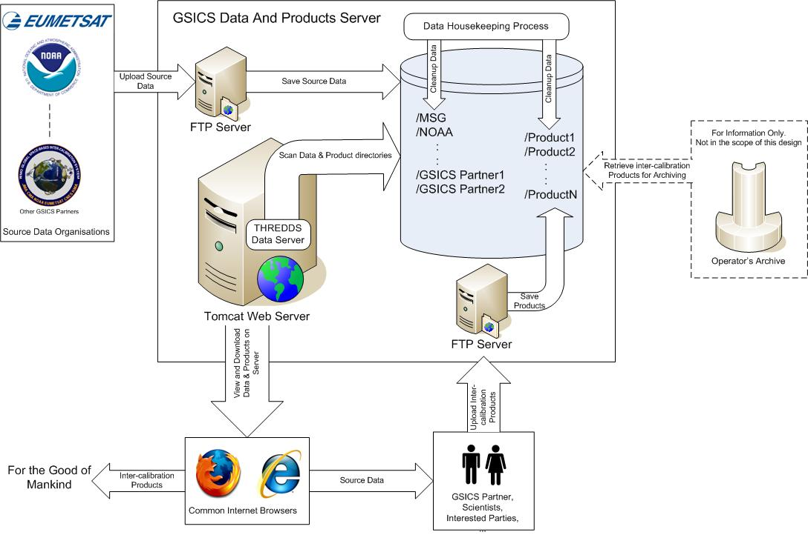
GSICS Data and Products Server: High Level Design
GEO-AIRS/IASI is one of many
GSICS supports inter-calibration on other orbits, for other instruments, in other spectral regions
All are similar in some ways
Each pair is unique in some ways
Instrument characteristics
Agency priority
Hierarchical Structure
General ATBD
Purpose, Options, Selection, Implementation
Details for individual pairs on http://www.star.nesdis.noaa.gov/smcd/spb/calibration/icvs/GSICS/index.php

Slide 4
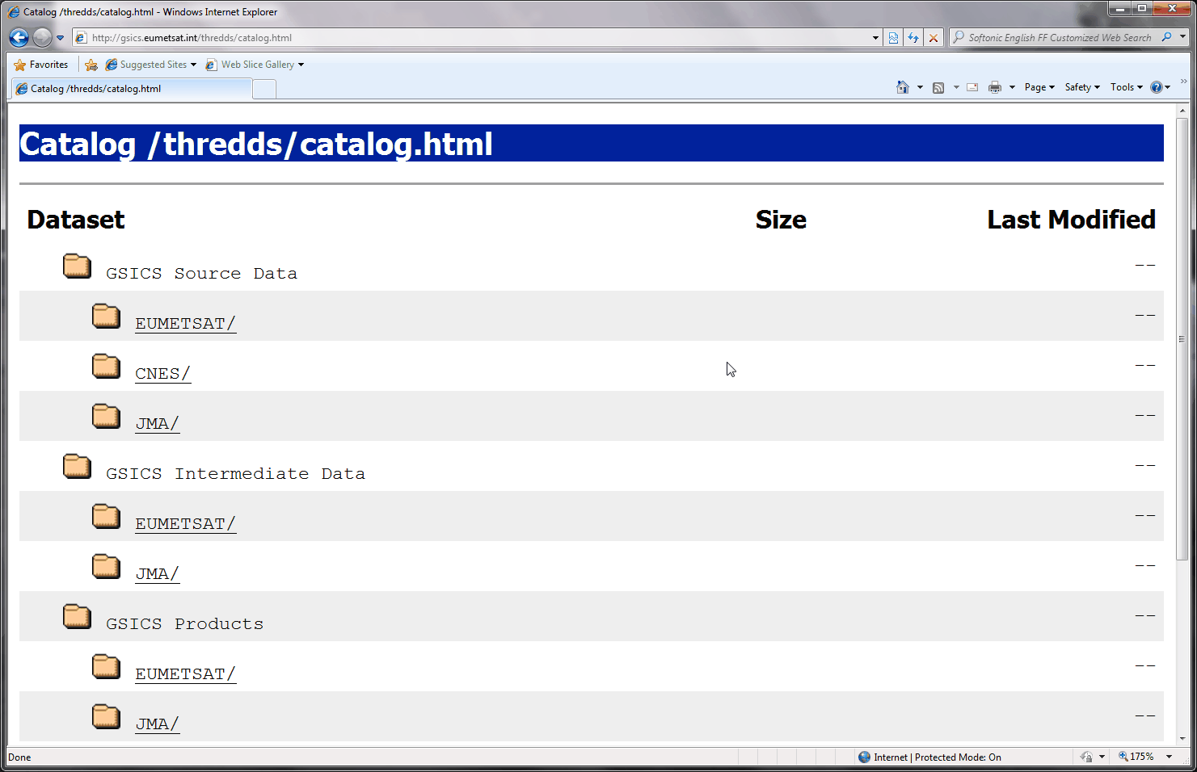
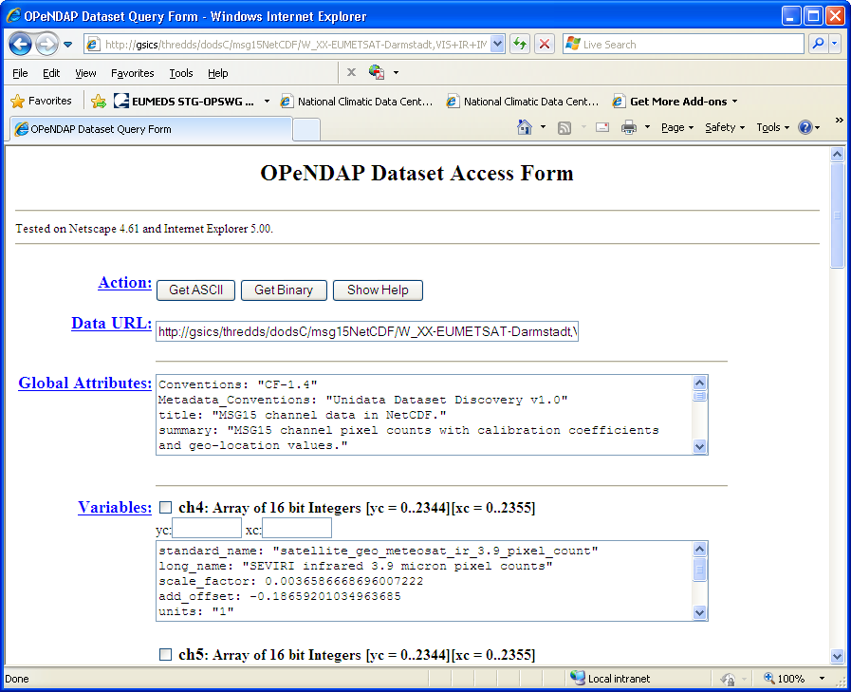
GSICS Data and Products Server: Operations and Services Overview
Catalogue generation using THREDDS (Freeware from Unidata)
Server’s directory structure and files are scanned when users click on
the THREDDS directory tree.
Metadata for the directory or
the file is then displayed.
THREDDS Download Services
HTTP download service
FTP download service
Uploads to the Server
FTP upload via specific GPRC
user accounts.
Organisation of the uploaded
files are based on their
WMO filenames
File contents access using OpenDAP
Contents can be examined in ASCII
Contents can be examined in Binary
Notes:
OGC WMS as planned future service, to generate “on demand” common bias monitoring for different satellites

Slide 5
GSICS Data and Products Server: Operational Aspects
Servers Documentation
GSICS Data and Products Server User Guide.
GSICS Data Management Server Operations Service Specification (and supporting documentation) Action GDWG 03_22.
Definition of netCDF formats for Source Data Sets.
Proposed netCDF formats for GSICS products (TBW).
The use of agreed WMO GTS File Naming Convention
The convention clearly identifies the origin and content of all GSICS source data sets and products.
Organisation of the source data sets and products can be performed using these agreed names for ease of access by the users (see next slide).
GSICS Source Data Sets and Products are in netCDF file format
File contents are accessible via APIs.
Developers/users do not require knowledge of the underlying structures.
Additions and subtractions of variables to/from the netCDF file does not affect existing applications.
Freely available tools exist to examine and work with netCDF files.
Notes:
On the mandatory metadata:
Global attributes: support easy “downstream” applications of data (e.g. Visualisation)
variable attributes: especially for consistency and quality purposes

Slide 6
GSICS Data and Products Server: Operational Aspects
The use of agreed variable metadata
The Climate and Forecast (CF) metadata convention has been chosen to identify GSICS data variables and units. This convention is designed to promote the processing and the sharing of files created with the netCDF API i.e. netCDF users and applications can understand how to work with the data stored in the variables.
GSICS variable metadata follows the CF metadata convention but some GSICS specific metadata have been identified to address deficiencies in the convention.
In this week’s GDWG breakout sessions, a list of agreed GSICS variable metadata is expected to be finalised into a recommendation.
GSICS specific variable metadata shall be re-worked for general use and submitted to the CF metadata conventions committee for inclusion into the CF metadata convention.
The advantage of this is users of the convention can develop applications to work with the GSICS data as well as use the GSICS variable metadata for their data description needs.
All developers and users of the GSICS should be aware of these operational aspects

Slide 7
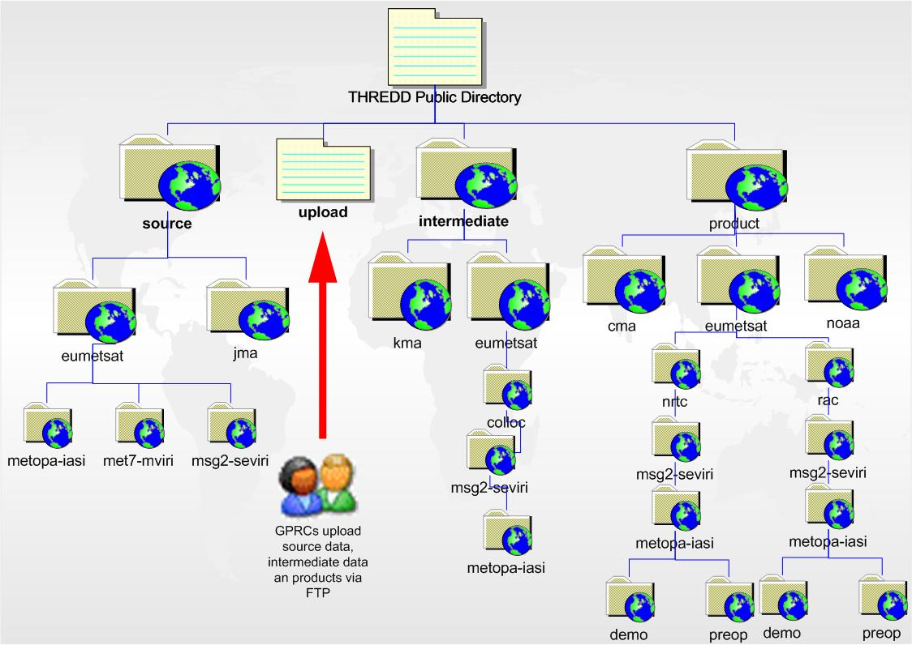
GSICS Data and Products Server Organisation of Data and Products
Notes:
Directory structure:
Source intermediate product + upload (uploaded files are sorted by there WMO GTS filename in the correct directory -> wrong filenames are discarded
Product tree structure
Which GPRC
Which calibration mode
Which monitored instrument
Which reference instrument
Maturity level of product
Lowest level in tree is the distribution mode (demo – preoperational, operational) -> follow the general product release cycle and shows the “maturity” of the product

Slide 8
GSICS Data and Products Server Source Data and Products
Comparable Source Data Sets available on the EUMETSAT Data and Products Server:
Monitoring Meteosat MVIRI Instrument: MFG15 netCDF
Monitoring Meteosat SEVIRI Instrument: MSG15 netCDF
Reference EPS IASI Instrument: IASI1c netCDF
First demonstration ‘Near Real Time Correction’ (NRTC) and ‘Re-analysis Correction’ (RAC) products available:
MFG15 and IASI1c NRTC and RAC (replacement) products.
MSG15 and IASI1c NRTC and RAC (replacement) products .
MTSAT2 Imager with IASI 1c and AQUA AIRS RAC products.
GOES Imager and IASI1c NRTC and RAC (replacement) products.
GOES Sounder and IASI1c NRTC and RAC (replacement) products.
TIROS-N AVHRR and MODIS RAC product
NOAA AVHRR and MODIS RAC products
EPS AVHRR and MODIS RAC product
Source Data Sets and Intermediate Data should be available in order to facilitate cooperation in validation of the GSICS products using different Algorithm Theatrical Baseline Documents (ATBDs)..

Slide 9
Data and Products Servers: The Future
Implementation and full operations of further Data and Products Servers. Ideally, a server should be available in America, Europe and Asia.
Uploading of source data sets and intermediate data to support the validation of GSICS Products.
For data redundancy, a mechanism is needed to transfer data between existing collaboration servers.
Further work in the definition of WMO filenames and variable metadata for future GSICS source data sets and products.
Porting of the netCDF data sets from version 3 to version 4.
Analyse how to improve the servers’ services in terms of their operation (e.g. OGC WMS / WCS to improve visualisation of the data, automated data downloads, etc.).
Notes:
Further support to the GRWG in creating GSICS correction products - in the past e.g. included defining version numbers, defining the distribution (release) modes
Automated processes: e.g. retrieval of time series from server

Slide 10
End of Presentation Thank you for your attention
GSICS website
http://gsics.wmo.int
GSICS Collaboration Servers
http://gsics.eumetsat.int
http://gsics.nesdis.noaa.gov:8080/thredds
GSICS Developers’ References Website
https://cs.star.nesdis.noaa.gov/GSICS/WebHome

