Slide 1
Migration to Operational Phase for GEO-LEO IR Products
Fuzhong Weng and Bob Iacovazzi, Jr.
GSICS Coordination Center
Joint GDWG-V and GRWG-VI Meeting
March 22, 2011

Slide 2
Outline
GSICS Procedure for Product Acceptance (GPPA) Fundamental Capabilities
GPPA Evolution
GPPA Current Status
Road to GPPA Operational Phase
GPPA Impediments
Pep Talk and Future Plans

Slide 3
Fundamental Capabilities of GPPA …
The GPPA is the GSICS:
Product developers’ pathway to obtain a “stamp of approval” for a potential product
Data users’ window to GSICS product quality and “fitness for purpose”
Governing body reference for judging GSICS product fitness
The GPPA defines and documents:
Scope of product within the GSICS product portfolio
Theoretical basis, and implementation and distribution strategy, of product
Product quality (e.g. uncertainty, quality indicators, etc.)
Four Product Phases:
Submission Phase
Demonstration Phase
Pre-operational Phase
Operational Phase

Slide 4
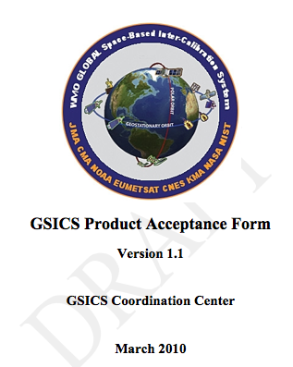
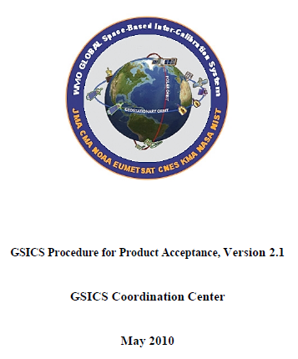
GSICS Procedure for Product Acceptance (GPPA) - Evolution
GSICS Procedure for Product Acceptance (GPPA) was deemed impractical due to upfront requirements that were too strict
Recommendations regarding the GPPA and GPAF were offered by members of both working groups at joint face-to-face and web meetings of the GRWG and GDWG, as well as a web meeting of the GRWG
This led to the following updates:
Revised GPPA document
Revised GPAF
Creation of an online workflow to help clarify expectations of the acceptance procedure
Creation of a Product Acceptance Tracking Spreadsheet

Slide 5
GSICS Procedure for Product Acceptance (GPPA) - The GPERF
Created the GSICS Product External Review Form (GPERF)
The GPERF is given during the GPPA demonstration phase to potential users of a given product
As the potential users review and/or test the inter-calibration product, their findings can be captured on the form
Questions within the form focus on the following product characteristics:
Clarity, utility, and reproducibility of method
Accessibility, availability, and ease of use of data
Suitability and reliability in application
Impacts to data user products

Slide 6
GSICS Procedure for Product Acceptance (GPPA) - Current Product Status
Progress of Potential Products in Demonstration Phase
GL01.1.0 - GSICS Correction for EUMETSAT SEVIRI IR Channels based on IASI
GL02.1.0 - GSICS Correction for MTSAT Imager IR Channels based on AIRS and IASI
GL03.1.0 - GSICS Correction for GOES Imager IR Channels based on AIRS and IASI
Achieved flow of near-real time data to GSICS Collaboration Server at EUMETSAT
Under testing by three or more potential users of product
ATBD and Traceability to SI Standards documents were accepted as of March 3, 2011
LL01.1.0 - Patmos-X AVHRR solar reflective channel corrections based on MODIS
Achieved flow of near-real time data to GSICS Collaboration Server at EUMETSAT
Under testing by three or more potential users of product
Submitted ATBD and Traceability to SI Standards documents

Slide 7
GPPA: Road to Pre-Operational Phase
Complete documents associated with GPAF Sections III.2.A (radiative transfer models) and III.2.B (cal/val supporting measurements)
Collect and disseminate user feedback regarding product's data usability and format
Examine and remediate the submitted documents (radiative transfer models and cal/val supporting measurements)
Who: Product provider
Due: March 2011
Who: Product users and GCC Director
Due: April 2011
Who: GPAT, product provider, and GCC Director
Due: May 2011

Slide 8
GPPA: Road to Pre-Operational Phase
Complete documents associated with GPAF Sections III.2.A (radiative transfer models) and III.2.B (cal/val supporting measurements)
Collect and disseminate user feedback regarding product's data usability and format
Examine and remediate the submitted documents (radiative transfer models and cal/val supporting measurements)
Who: Product provider
Due: March 2011
Who: Product users and GCC Director
Due: April 2011
Who: GPAT, product provider, and GCC Director
Due: May 2011

Slide 9
GPPA: Impediments to Pre-Operational Phase
Little interim input from product testers

Slide 10
GPPA: Road to Pre-Operational Phase
Complete documents associated with GPAF Sections III.2.A (radiative transfer models) and III.2.B (cal/val supporting measurements)
Collect and disseminate user feedback regarding product's data usability and format
Examine and remediate the submitted documents (radiative transfer models and cal/val supporting measurements)
Who: Product provider
Due: March 2011
Who: Product users and GCC Director
Due: April 2011
Who: GPAT, product provider, and GCC Director
Due: May 2011

Slide 11
GPPA: Road to Pre-Operational Phase
[Major milestone] Make a consensus decision whether or not to continue the product acceptance process
Complete and submit Section III.3.A (product quality) of the GPAF and submit the product quality document
Examine and remediate the submitted product quality document
Who: GPAT and Executive Panel
Due: May 2011
Who: Product provider and GCC Director
Due: May 2011
Who: GPAT, product provider, and GCC Director
Due: July-August 2011

Slide 12
GPPA: Road to Pre-Operational Phase
[Major milestone] Make a consensus decision whether or not to continue the product acceptance process
Complete and submit Section III.3.A (product quality) of the GPAF and submit the product quality document
Examine and remediate the submitted product quality document
Who: GPAT and Executive Panel
Due: May 2011
Who: Product provider and GCC Director
Due: May 2011
Who: GPAT, product provider, and GCC Director
Due: July-August 2011

Slide 13
GPPA: Road to Pre-Operational Phase
[Major milestone] Make a consensus decision whether or not to continue the product acceptance process
Complete and submit Section III.3.A (product quality) of the GPAF and submit the product quality document
Examine and remediate the submitted product quality document
Who: Product provider
Due: May 2011
Who: Product users and GCC Director
Due: May 2011
Who: GPAT, product provider, and GCC Director
Due: July-August 2011

Slide 14
GPPA: Road to Pre-Operational Phase
Enter Pre-Operational Phase – July-August 2011

Slide 15
GPPA: Road to Operational Phase
Obtain product feedback from the Executive Panel and remediate product based on this feedback
Complete documents associated with GPAF Sections III.2.C (analysis software documentation), III.2.D (product version control plan), III.3.B (operations and distribution plan), and III.3.C (data user's guide), and submit the documents to the GCC
Examine and remediate the submitted documents (product version control plan, operations and distribution plan, and data user's guide)
Who: Product provider
Due: November 2011
Who: Product users and GCC Director
Due: December 2011
Who: GPAT, product provider, and GCC Director
Due: February-March 2012

Slide 16
GPPA: Road to Operational Phase
Obtain product feedback from the Executive Panel and remediate product based on this feedback
Complete documents associated with GPAF Sections III.2.C (analysis software documentation), III.2.D (product version control plan), III.3.B (operations and distribution plan), and III.3.C (data user's guide), and submit the documents to the GCC
Examine and remediate the submitted documents (product version control plan, operations and distribution plan, and data user's guide)
Who: Product provider
Due: November 2011
Who: Product users and GCC Director
Due: December 2011
Who: GPAT, product provider, and GCC Director
Due: February-March 2012

Slide 17
GPPA: Road to Operational Phase
Obtain product feedback from the Executive Panel and remediate product based on this feedback
Complete documents associated with GPAF Sections III.2.C (analysis software documentation), III.2.D (product version control plan), III.3.B (operations and distribution plan), and III.3.C (data user's guide), and submit the documents to the GCC
Examine and remediate the submitted documents (product version control plan, operations and distribution plan, and data user's guide)
Who: Product provider
Due: November 2011
Who: Product users and GCC Director
Due: December 2011
Who: GPAT, product provider, and GCC Director
Due: February-March 2012

Slide 18
GPPA: Road to Pre-Operational Phase
Enter Operational Phase - February-March 2012

Slide 19
GSICS Procedure for Product Acceptance (GPPA) - Pep Talk
The GPPA is designed to provide a clear statement of inter-calibration product quality to the operational and research weather satellite data user communities.
Such a procedure - involving rigorous inspection, review, verification, and testing associated with satellite inter-calibration methods, and their implementation, results and impacts - is ultimately essential for the "G" in GSICS to represent the "Global" service that it proclaims.
Please remain committed to the GPPA process, as it becomes important in building trust between GSICS product producers and their data users.

Slide 20
GPPA: Future Plans
In the Next Year …
All Four Current Potential Products in Pre-Operational Phase
New Potential Product Submissions:
GSICS Correction for CMA VISSR IR channels based on IASI
GSICS Correction for EUMETSAT SEVIRI, MTSAT Imager and GOES Imager solar reflective channels based on MODIS
GSICS Correction for MSU/AMSU-A data based on SNO

Slide 21
GPPA Information Links
GSICS Wiki:
Up-to-date GPPA workflow, documents and forms
(http://www.star.nesdis.noaa.gov/smcd/GCC/qa-gppa.php)
GSICS Coordination Center Web Site:
GPPA Overview
Links to GPPA information archived on GSICS Wiki
(https://gsics.nesdis.noaa.gov/wiki/Development/GppaWorkflow)

Slide 22
Backup Slides

Slide 23
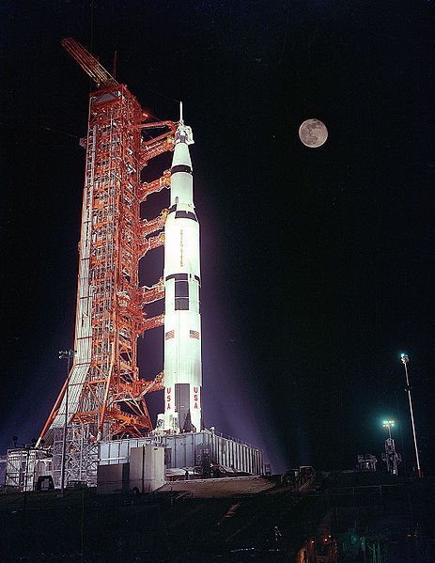
GPPA: Submission Phase
Phase Goals: Product
GSICS Product Acceptance Form (GPAF) is satisfactory,
Data files conform to GSICS file and parameter naming and format standards,
Verified to be within GSICS scope, and
Theoretical basis is understood at a high level.
Maximum Time Period: 90 days
Milestones: The following are submitted by the product provider to the GCC and approved by the GSICS Product Acceptance Team (GPAT)
GPAF sections that detail product name, POC, brief description, and relevance to GSICS
Preliminary version of the product algorithm theoretical basis document (ATBD)
Sample product files that adhere to GSICS file and parameter-naming conventions

Slide 24
GPPA: Demonstration Phase
Phase Goals: Product
Founding concepts, supporting models and measurements, and implementation are documented and fully understood,
Traceability (or lack thereof) to SI standards is documented,
Quality Indicator is documented and well-defined,
Tested and reviewed by potential product users, and
Data released to GSICS members and potential users.
Maximum Time Period: 365 days
Milestones: The following are submitted to, or arranged in coordination with, the GCC by the product provider and approved by the GPAT
Routine product upload to a GSICS data server and agree on file retention policy
GSICS product users’ feedback regarding product usefulness
Baseline versions of four documents critical to product quality assurance –
Algorithm Theoretical Basis Document
Document describing product traceability to standards
Product supporting radiative transfer model and cal/val supporting measurements description
Product quality indicator description and justification
Affirmative decision regarding continuance of product within the GPPA process

Slide 25
GPPA: Pre-operational Phase
Phase Goals: Product
Generation, distribution, version control, and archive strategies are fully documented and implemented.
Users’ Guide with clear implementation instructions made available to data users.
Data released to public with disclaimer.
Maximum Time Period: 180 days
Milestones:
Executive Panel review and approval of GPAT recommendations
Documents associated with product data stewardship in an operational environment:
product version control plan,
operations and distribution plan, and
data user's guide
are submitted by the product provider and approved by the GPAT.

Slide 26
GPPA: Operational Phase
Goal:
Product is fully accepted and maintained within GSICS and distributed to the public.
Maximum Time Period: Periodic Reviews
Milestones: The following are made available by the product provider to the GCC and the GPAT for periodic inspection and review:
Product logs and usage reports
Updated documentation/software as necessary

