Slide 1
Joint meeting of GRWG and GDWG, 22-26 March, Daejeon, Korea
KMA’s Activities of GSICS
Korea Meteorological Administration
National Meteorological Satellite Center

Slide 2
Current GSICS Activity of KMA
IR inter-calibration system for GEO with MODIS
Test using MTSAT-1R data: ~2010
COMS data: 2011~
GEO-LEO IR radiation Calibration with AIRS/IASI
MTSAT-1R data during 2009-2010
COMS data from Jan 2011~
VI vicarious Calibration
Desert Target: 2011~
Deep Convective Cloud: 2011~
Notes:
This is current GSICS activity of KMA. Implement IR inter-calibration system for COMS with MODIS. Test with MTSAT-1R data instead of COMS. Installation of GSICS GEO-LEO AIRS IR radiation calibration Software. Test with MTSAT-1R data during 2007.

Slide 3
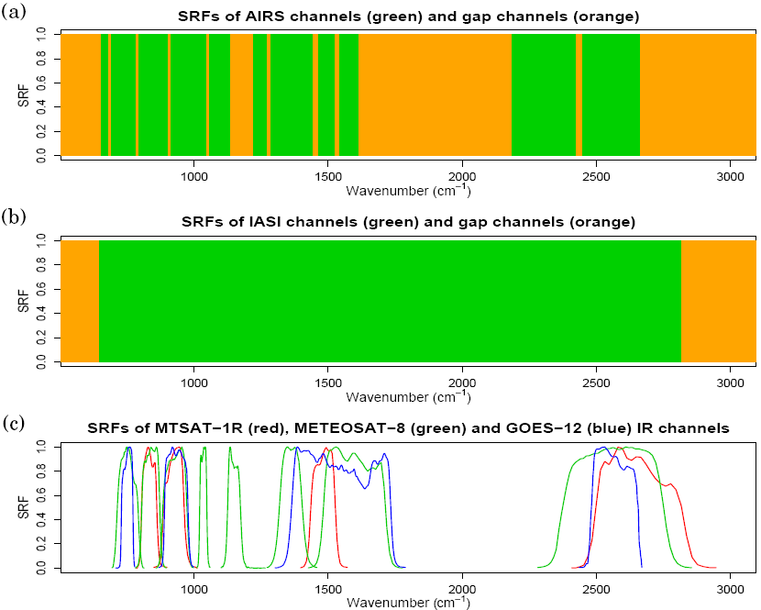
GEO(COMS) vs. LEO(AIRS) IR Calibration
Spectral filling method
Convolution method
Linear interpolation using only US profile
Proposed by NESDIS
Constraint method
Least square method using 8-profile
Proposed by JMA
COLLOCATED IN SPACE
COLLOCATED IN TIME
ALIGNED IN LINE-OF-SIGHT
UNIFORM ENVIRONMENT
LEO: AIRS
Missing channel
NORMAL GEO FOV
LEO: IASI
Valid channel
SPATIAL AVERAGING
GEO:
COMS
SPECTRAL FILLING

Slide 4
GEO(COMS) vs. LEO(AIRS) constraint method (1/3)

Slide 5
GEO(COMS) vs. LEO(AIRS) constraint method (2/3)

Slide 6
GEO(COMS) vs. LEO(AIRS) constraint method (3/3)

Slide 7
TB vs. ΔTB(COMS – AIRS) (1/3)

Slide 8
TB vs. ΔTB(COMS – AIRS) (2/3)

Slide 9
TB vs. ΔTB(COMS – AIRS) (3/3)

Slide 10
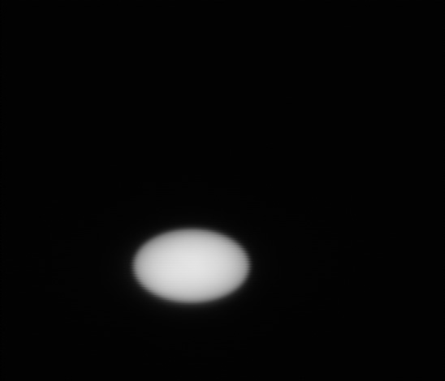
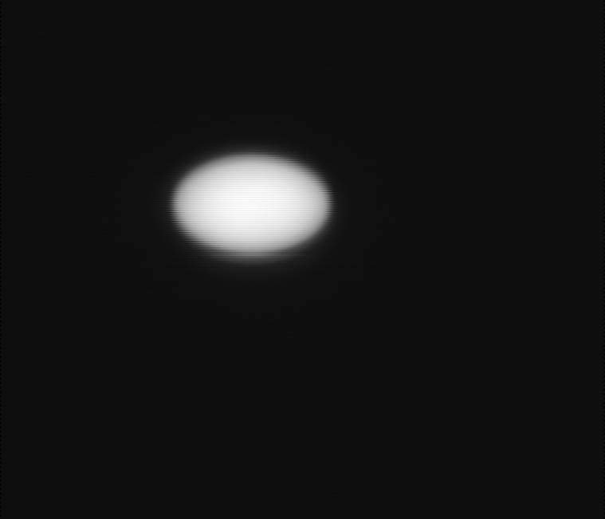
Albedo Monitor for COMS VI channel
August 25th (Mirror N1)
August 13th (Mirror N2)
A degradation rate = 0.1%/day (0.5% accuracy)
* The linear fit of the average among all VIS detectors

Slide 11
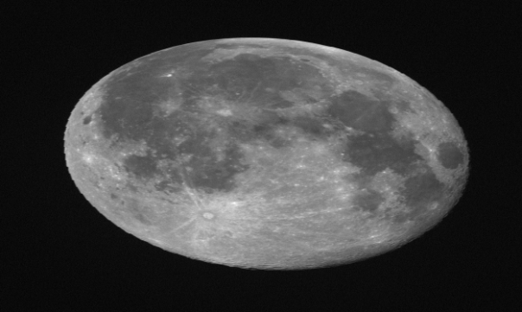
Moon Calibration of COMS visible (1/2)
To measure the total degradation of the instrument visible channel
Comparison between the Moon signal and ROLO model of USGS – as a Function of Phase angle(Sun-Moon-Earth)
Imager Response
Where
is the Moon irradiance as measured by the Imager
is the Moon irradiance computed from the ROLO model,
under the same conditions

Slide 12
Moon Calibration of COMS visible (2/2)
k(t_{ref}) : k value at last valid reference
Mean Moon Slope Factor Trend = 2.9%
* Monthly averaged value over 5 months

Slide 13
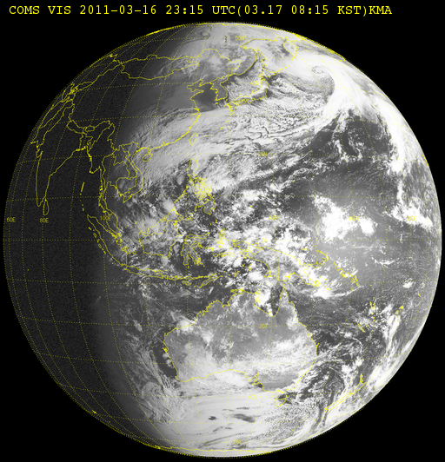
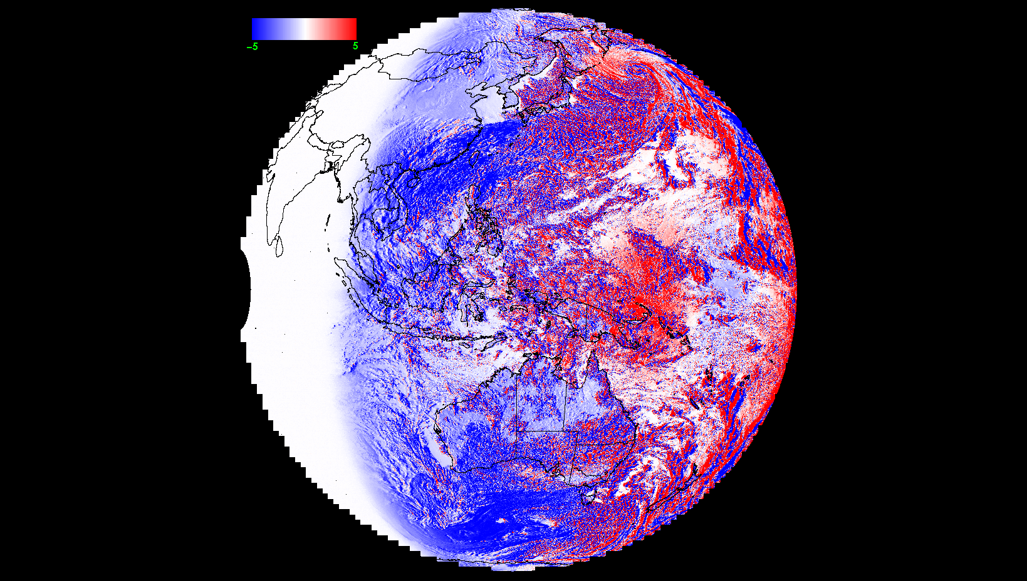
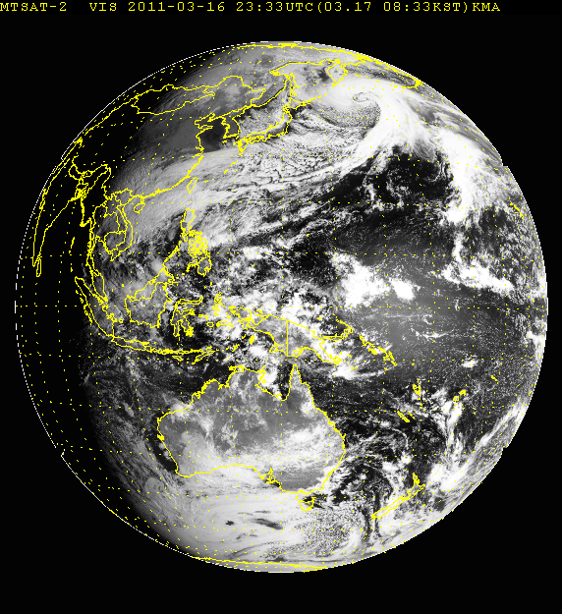
COMS vs. MTSAT-2 [Visible]
COMS 2011. 0316. 2315 - MTSAT2 2011. 0316. 2333
~ -0.5%
~ -1.5%

Slide 14
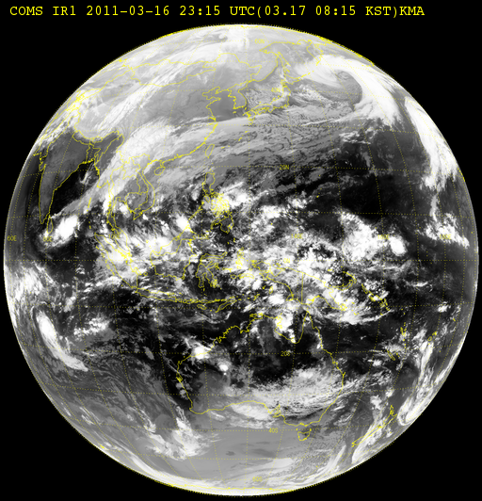
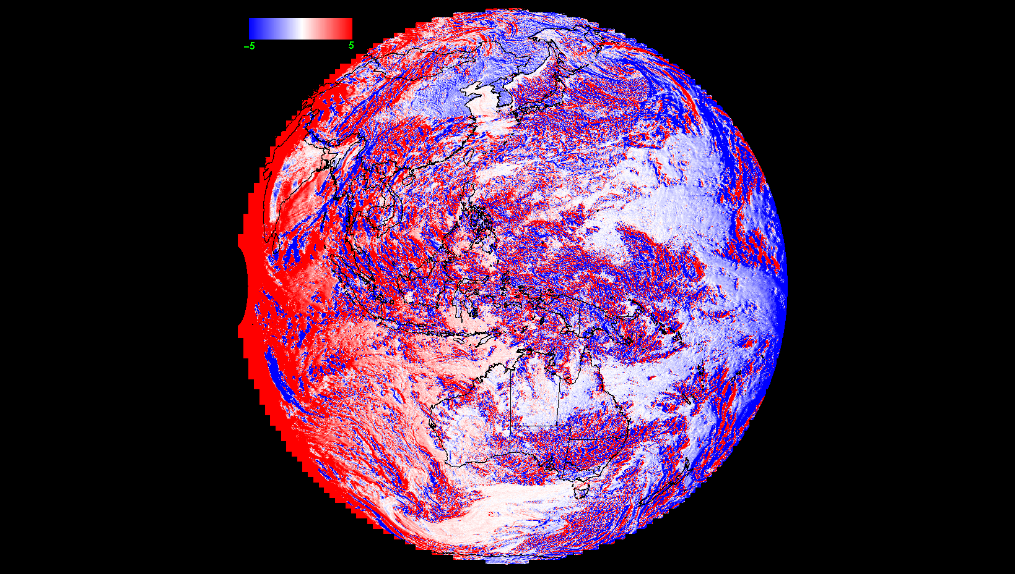
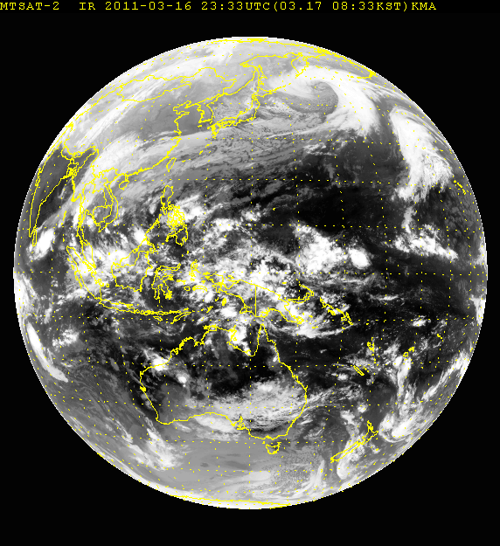
COMS vs. MTSAT-1R [IR1]
COMS 2011. 0316. 2315 - MTSAT2 2011. 0316. 2333
~ -2.5K

Slide 15
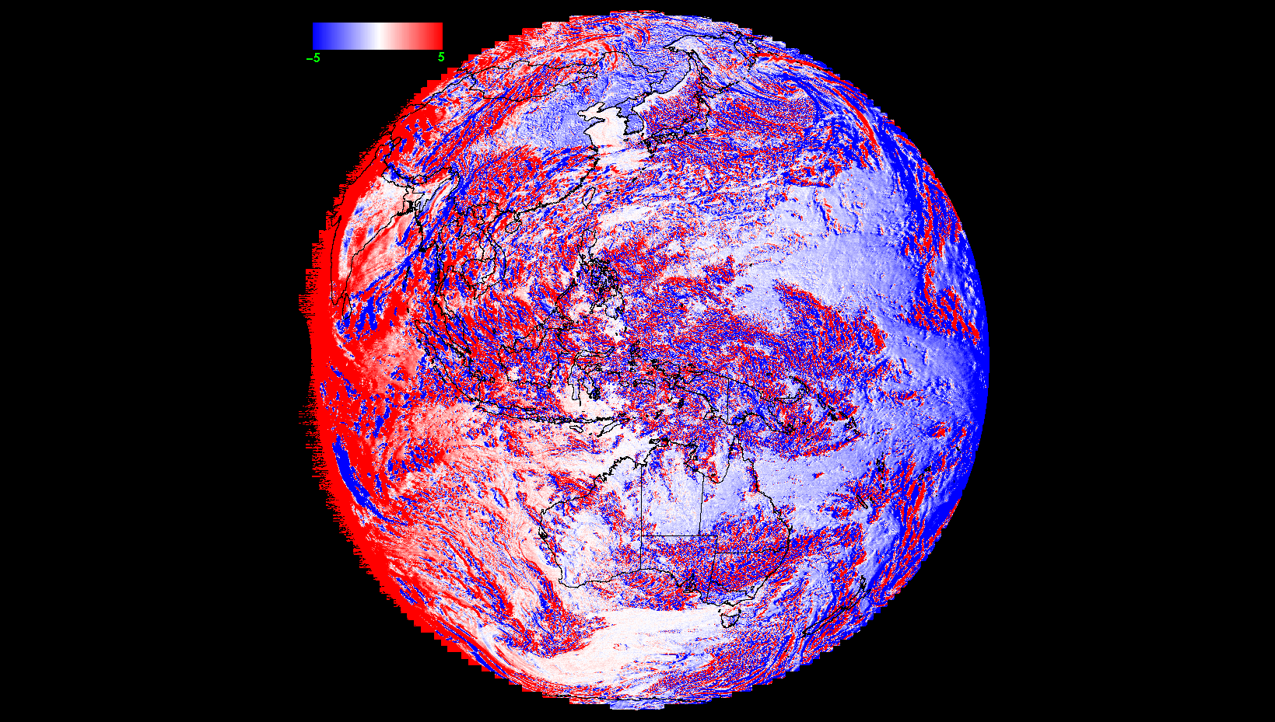
COMS vs. MTSAT-1R [IR2]
COMS 2011. 0316. 2315 - MTSAT2 2011. 0316. 2333
~ -2.5K

Slide 16
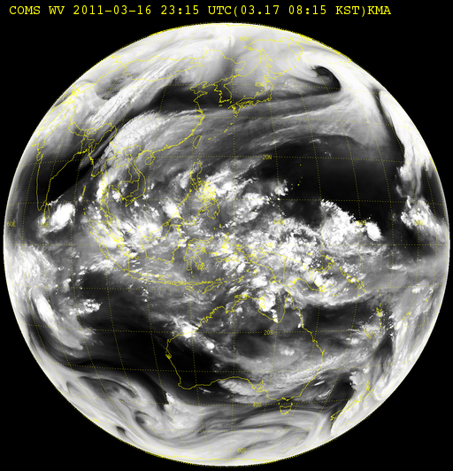
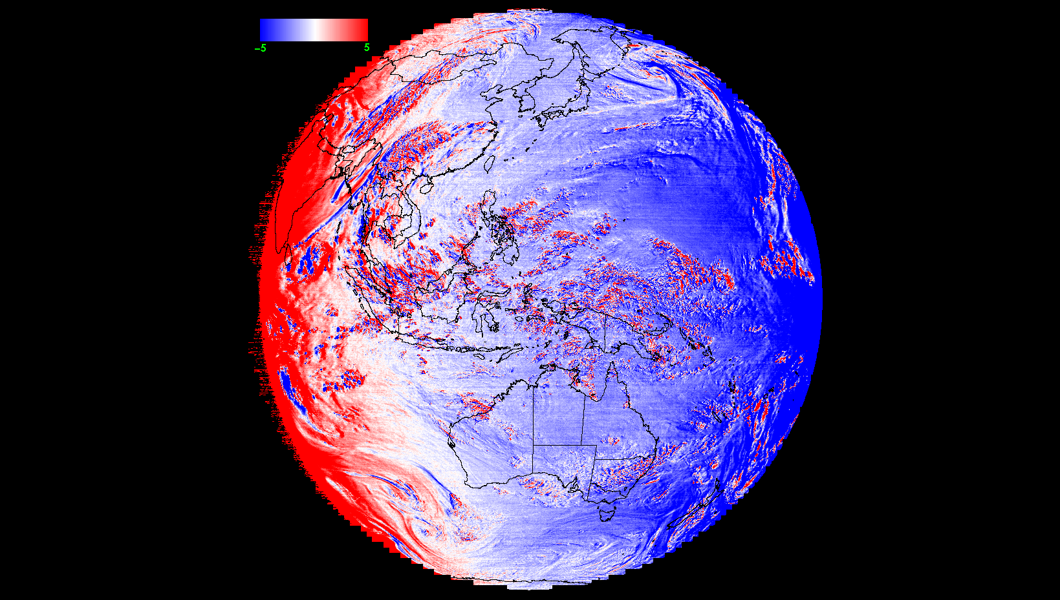
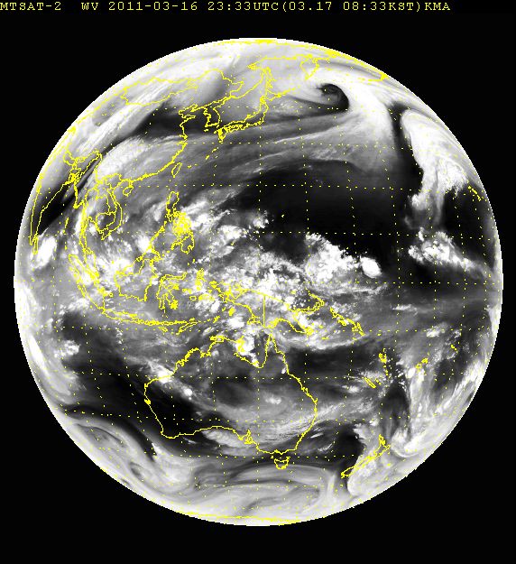
COMS vs. MTSAT-1R [WV]
COMS 2011. 0316. 2315 - MTSAT2 2011. 0316. 2333
~ -1.5K

Slide 17
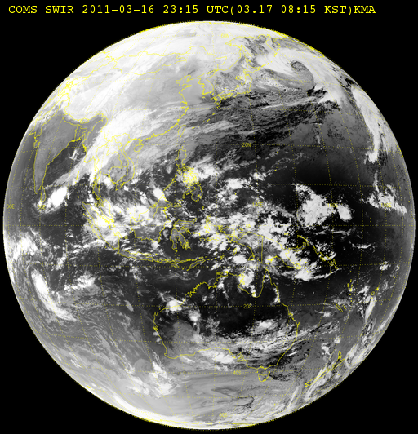
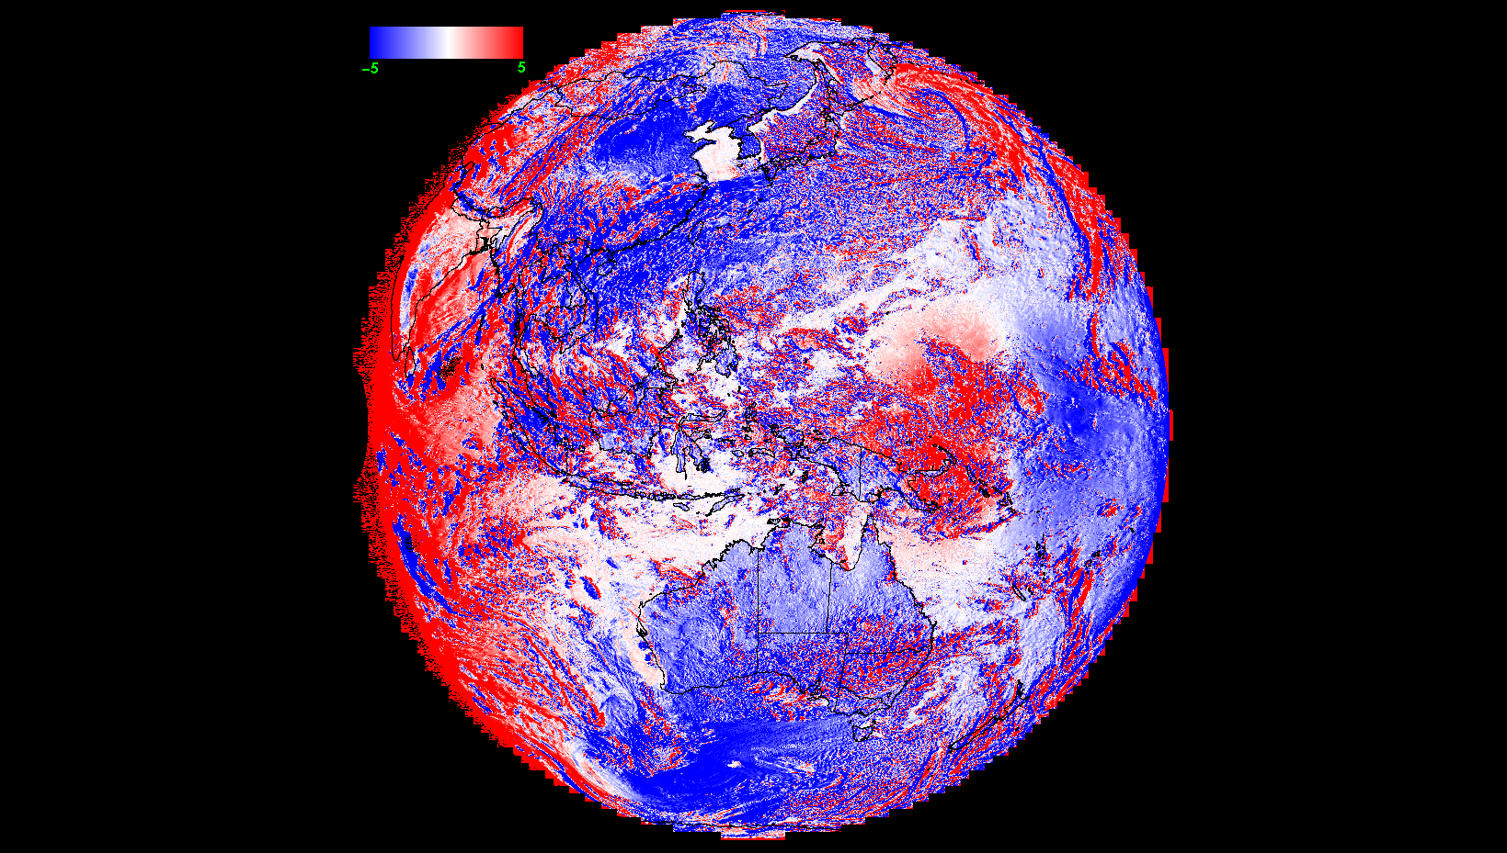
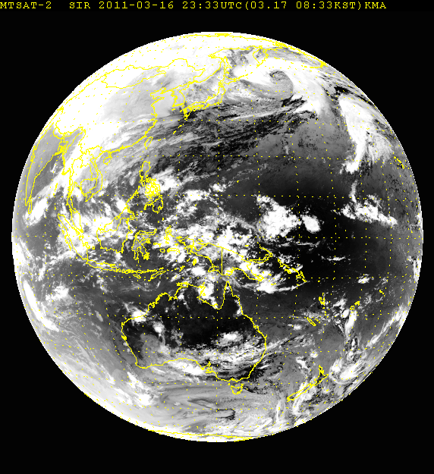
COMS vs. MTSAT-1R [SWIR]
COMS 2011. 0316. 2315 - MTSAT2 2011. 0316. 2333
~ -5.0K

Slide 18
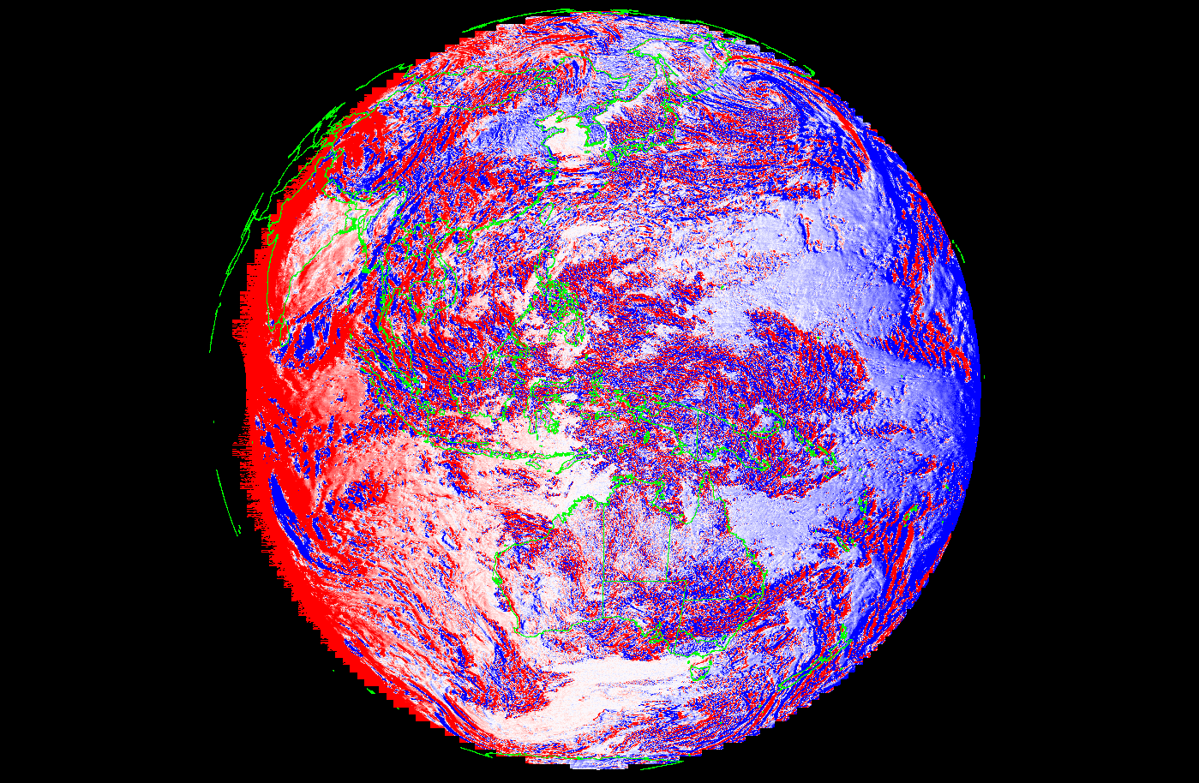
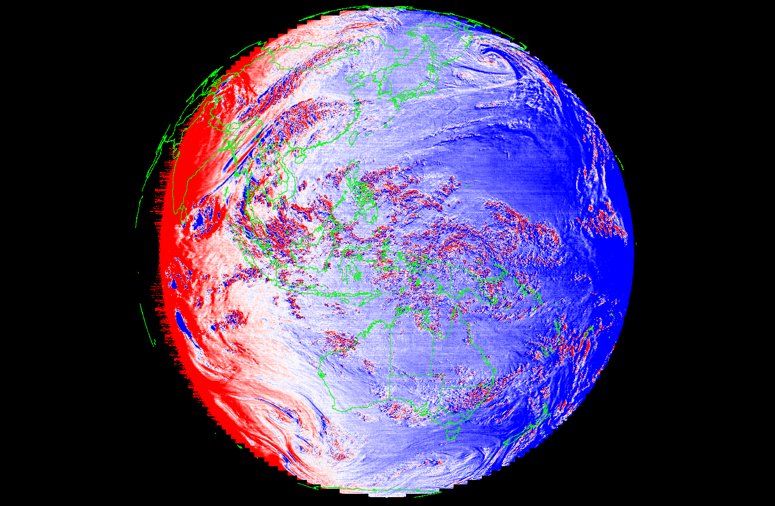
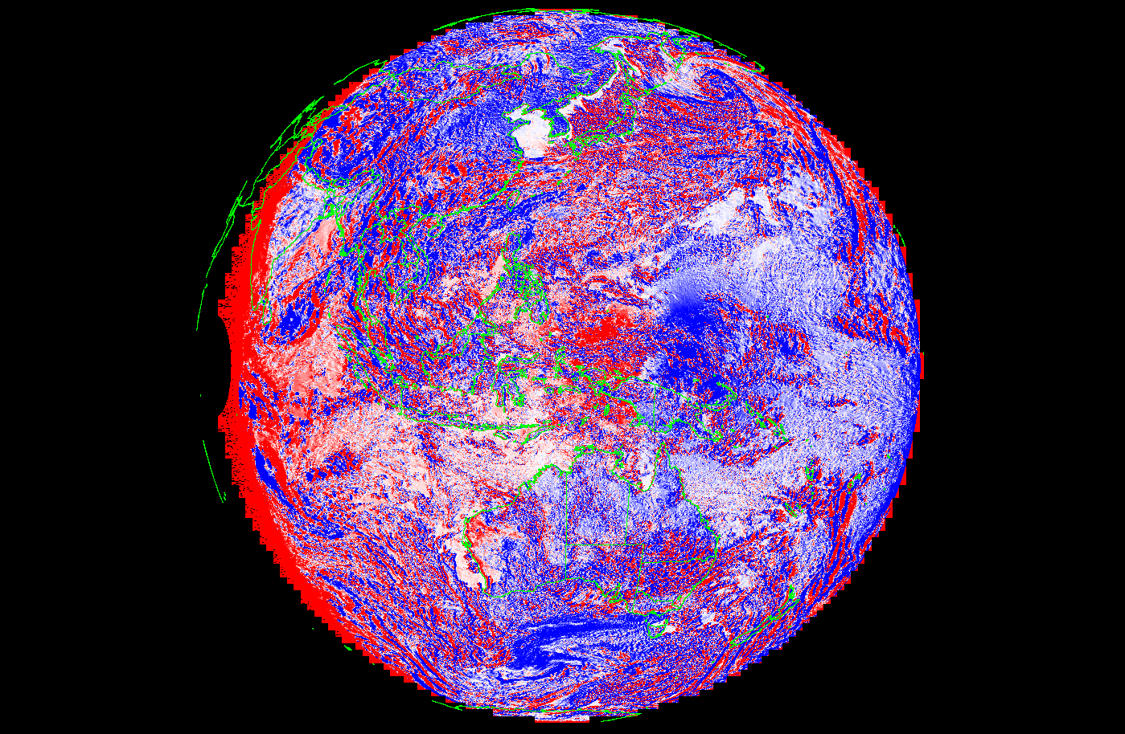
IR1
0215 UTC
IR2
WV
2011 0316
SWIR

Slide 19
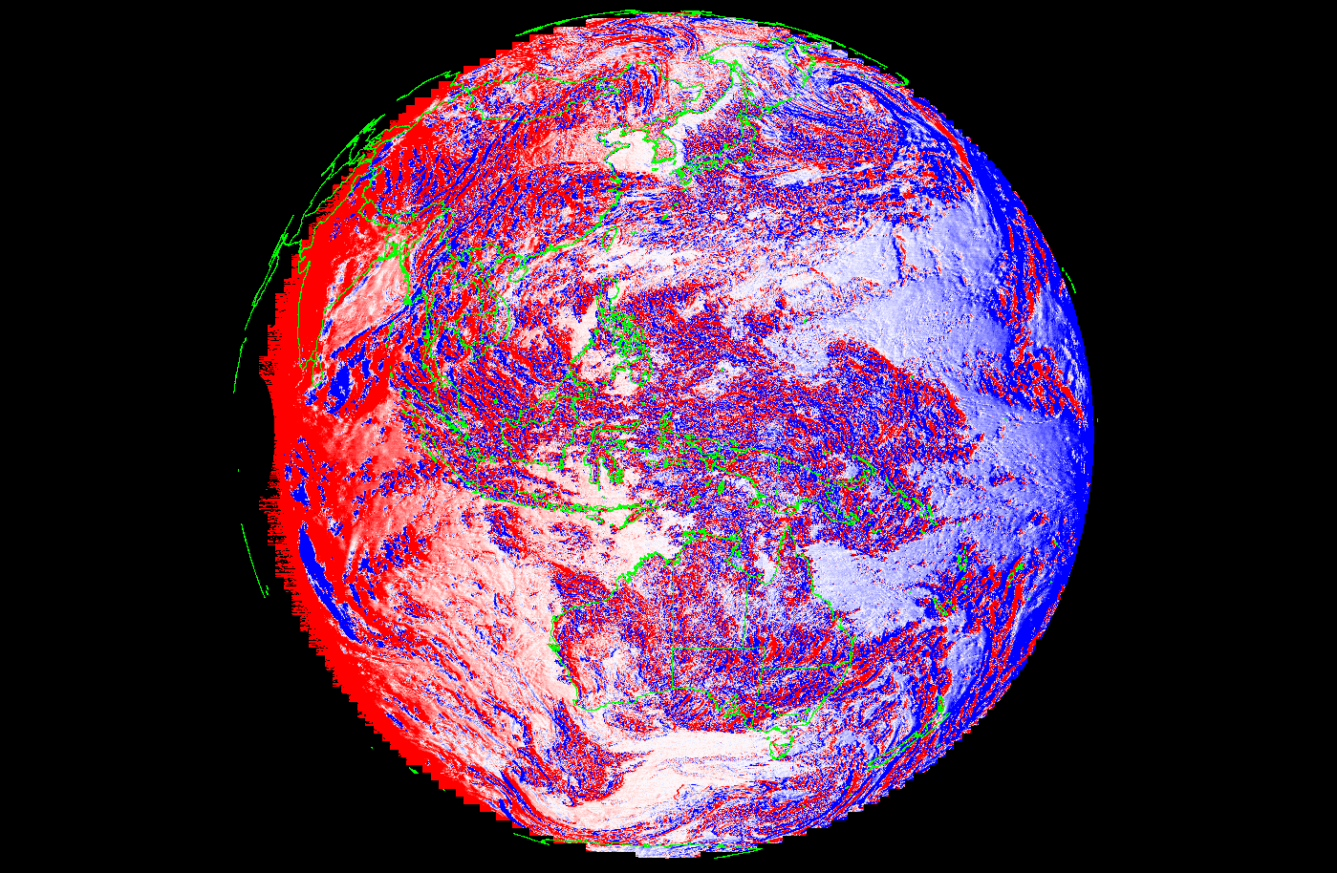
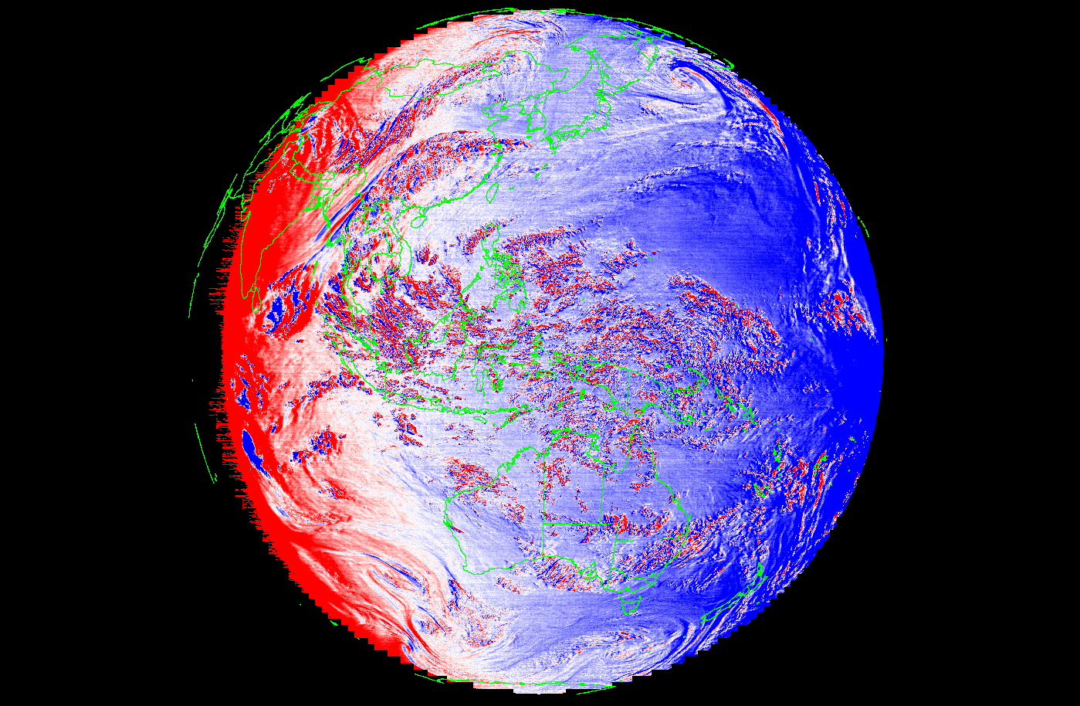
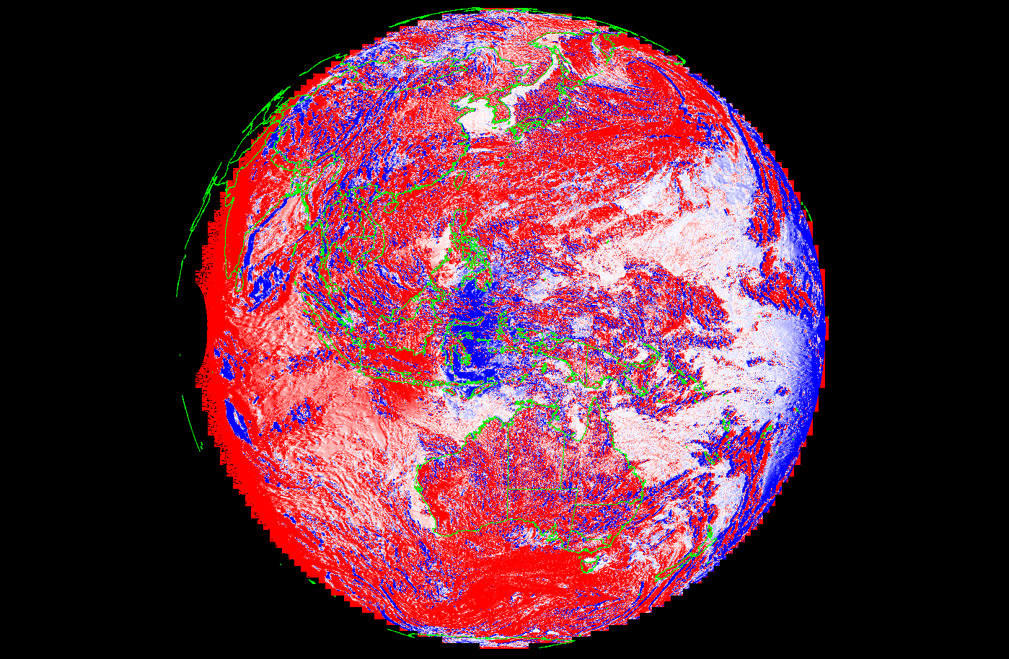
IR1
0515 UTC
IR2
WV
2011 0316
SWIR

Slide 20
고맙습니다 Thank you

