Slide 1
Potential of Sun-Glint Observations from 3.9 μm to Calibrate 0.65 μm reflectance observations.
Andrew Heidinger, Xiangqian (Fred) Wu
NOAA/NESDIS Center for Satellite Applications and Research
Annual GRWG+GDWG Meeting at Daejeon, South Korea, 2011

Slide 2
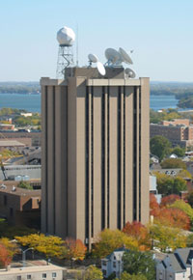
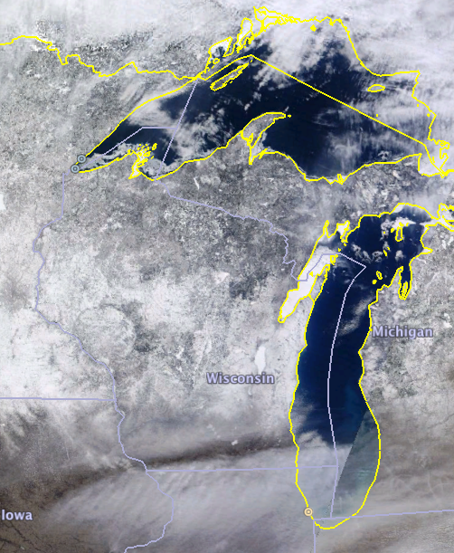
Hello from Madison, Wisconsin, USA!
my office
Madison

Slide 3
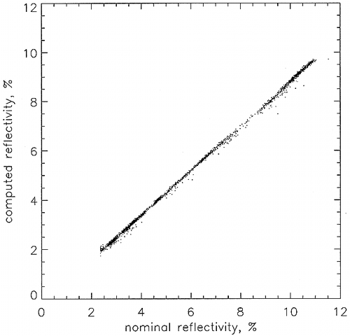
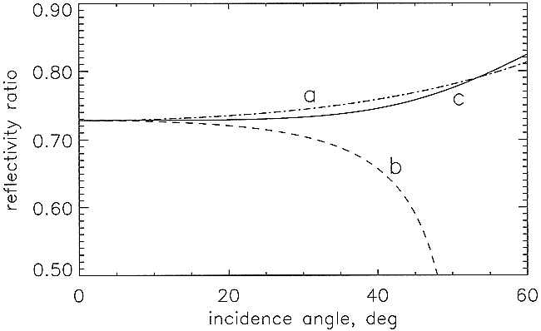
Past Uses of Sun Glint for Calibration
KAUFMAN Y. J.. and HOLBEN. B. N., 1993. Calibration of the AVHRR visible and near-IR bands by atmospheric scattering, ocean glint and desert reflection. International Journal of Remote Sensing, 14. 11-52.
Závody, A. M., P. D. Watts, D. L. Smith, C. T. Mutlow, 1998: A Novel Method for Calibrating the ATSR-2 1.6-μm Channel Using Simultaneous Measurements Made in the 3.7-μm Channel in Sun Glint. J. Atmos. Oceanic Technol., 15, 1243–1252.
Predicted vs Observed 1.6 μm reflectance
1.6/3.9 μm reflectance ratio

Slide 4
Motivation for Trying with 3.9 μm channel on Geostationary Imagers
Current geostationary imagers have channels located near 0.65 and 3.9 μm.
NOAA especially has flown Geo imagers with these channels since 1980.
While 0.65 μm channels have no on-board calibration, 3.9 μm channels do have on-board calibration accurate enough for SST retrievals.
Solar glint represents a common phenomenon that is radiometrically stable.
For these reasons, a study into the efficacy of this method to complement the other methods is warranted.

Slide 5
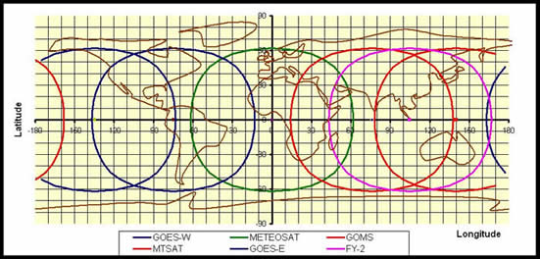
Sun Glint in Current Geo Domains
5 of the 6 geo imagers in above figure see glint at nadir. COMS also sees glint at nadir.

Slide 6
Data Used in this Study
GOES-11 Imager data from 2006-2010
Processed through the PATMOS-x system.
PATMOS-x is a cloud climatology system that can process AVHRR, GOES and MODIS data.
Results are compared to NESDIS Operational GOES-11 calibration from http://www.star.nesdis.noaa.gov/smcd/spb/fwu/homepage/GOES_Imager_Vis_OpCal.php
Only data from solstice periods (March and September) are used. This is where glint is near the equator.
Only data from 21:00 UTC are used. This is where glint is near the sub-satellite point of GOES-11.
These constraints were applied for convenience – it is not obvious that glint needs to be at nadir.
NCEP Reanalysis and OISST v2 used for ancillary data in PATMOS-x.

Slide 7
Assumptions of this Method
Sun-glint is a radiometrically stable target.
The relationship between the 0.65 μm and 3.9 μm reflectance is constant and predictable.
MODIS provides the needed reference.

Slide 8
Atmospheric Correction
We apply atmospheric correction to the 0.65 μm counts, 0.65 μm reflectance and 3.9 μm reflectance.
3.9 μm atmospheric correction derived from fast IR model used in PATMOS-x.
0.65 μm atmospheric correction derived based on TPW, Ozone and Rayleigh Scattering. Regressions generated from MODTRAN4.
0.65 μm counts correctly by multiplying by ratio of TOA and atmospherically corrected 0.65 μm reflectance.

Slide 9
Computation of 3.9 μm Reflectance
I_{obs} = 3.9 μm observed radiance atmospherically corrected.
I_{emission} = 3.9 μm estimated radiance due to emission only using atmospherically corrected 11 μm brightness temperature inserted into 3.9 μm Planck Equation.
μ_{o} = solar zenith angle cosine
F_{o} = in-band solar energy

Slide 10
Accuracy of 3.9μm Observations
GOES-13 Science Test – BAMS (2010)– Authors Don Hillger and Tim Schmit (NOAA).

Slide 11
Error in 3.9 μm Reflectance as a function of Radiometric Accuracy @300K
The 3.9 μm reflectance uncertainty is a function of both the 3.9 and the 11 μm calibration error.
If we add the 0.2 K and -0.1 K Mean Biases for GOES-13 3.9 and 11 μm channels from the Hiller&Schmit BAMS paper, this translates to an error of <4 % in the 3.9 μm reflectance.

Slide 12
Identification of Sun Glint in GOES-11

Slide 13
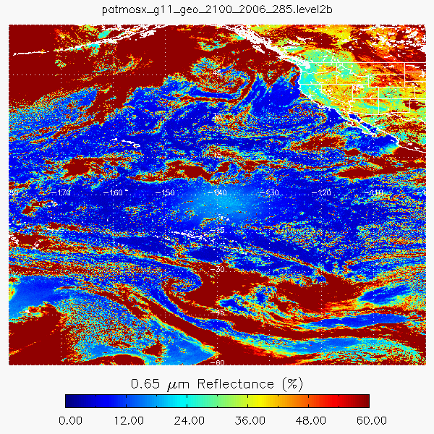
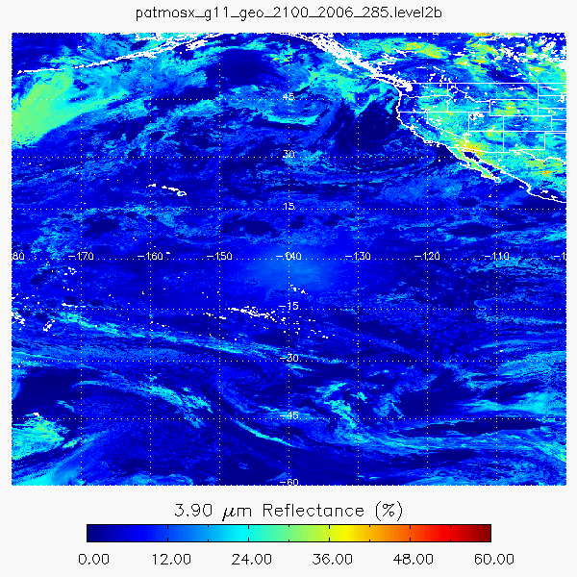
Observations of 0.65μm and 3.9 μm Reflectance from GOES-11
cloudy reflectance is not correlated – ice clouds are dark in 3.9μm, water clouds are bright.
Glint appears as relatively brightness regions in both spectral regions.

Slide 14
Identification of Sun Glint
We employed a compositing strategy over all images in the selected region for each period (March and September)
3.9 μm Reflectance > 3.9 μm Reflectance of the Composite Imager
3.9 μm brightness temperature < 320 K (Avoid Saturation)
11 μm brightness temperature > 280 K
Bayesian cloud probability < 0.5
Glint angle < 40º
Sensor Zenith < 30º (MODIS Only)

Slide 15
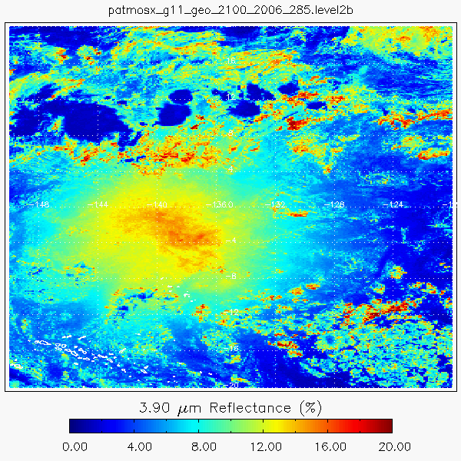
Example of Image Compositing for GOES-11 September 2008.
Raw Data
Final Composite

Slide 16
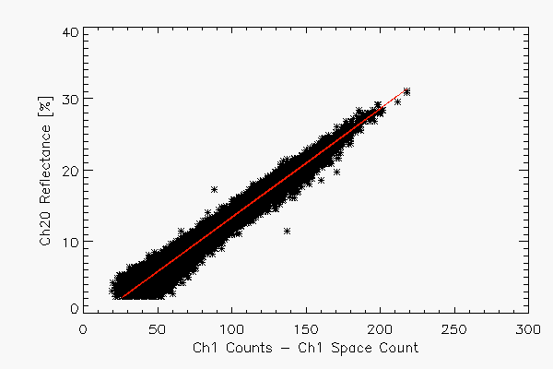
Correlation of 0.65 μm Counts and 3.9 μm Reflectance for GOES-11 Image Composites
March 2007
Correlation = 0.99

Slide 17
Estimation of Reference Relationship of 0.65 and 3.9 μm Reflectance from AQUA/MODIS

Slide 18
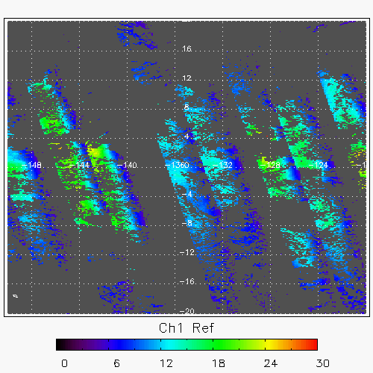
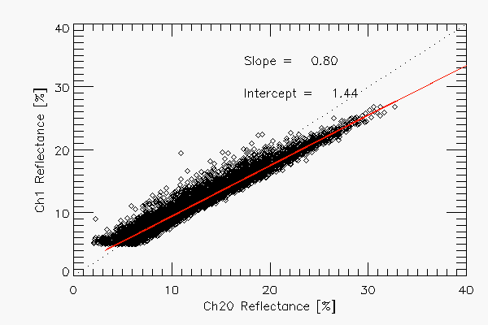
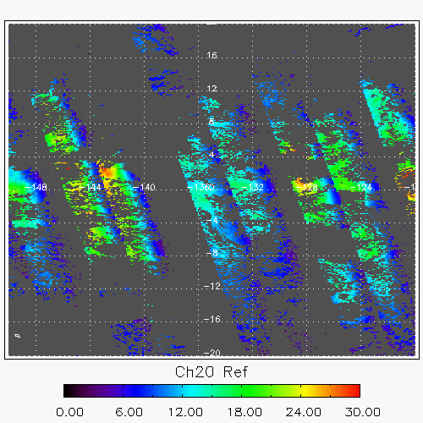
Estimation of the Relationship Between 0.65 and 3.9 μm Reflectances in Sun-Glint.
0.65 μm Reflectance
0.65 μm Reflectance
3.9 μm Reflectance
3.9 μm Reflectance
We assume MODIS is well calibrated. ATSR is another source of this data

Slide 19
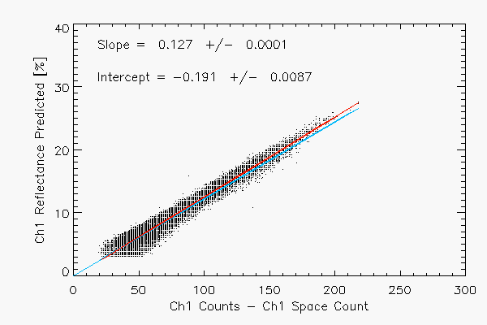
Summary of Methodology to Compute Calibration Slope from Sun-Glint Obs.
GOES-11 Observations of 3.9 μm Reflectance and 0.65 μm Counts
3.9 μm Reflectance
0.65 μm Counts
Relationship between Estimated 0.65 μm
Reflectance and 0.65 μm Counts
MODIS derived relationship between 3.9 μm
Reflectance and 0.65 μm Reflectance
calibration
slope

Slide 20
Comparison to NESDIS Operational Calibration Slopes
Mean difference is roughly 5%
This magnitude of difference is no larger than spread seen in various AVHRR 0.65 μm calibrations.
Obvious seasonality in the results – atmospheric correction?

Slide 21
Conclusions
Sun Glint does appear have a good potential to provide another source of calibration data to complement other methods.
This preliminary analysis generated calibration slopes that agreed to within 5% of NESDIS Operational calibration slopes.
Future Work
Explore direct modeling of glint as done in ATSR work to separate from MODIS dependency.
PATMOS-x atmospheric correction is probably not accurate enough. Should explore use of NOAA CRTM for this purpose.
Abandon compositing and pursue methods that work on all relevant images instantaneously. Availability of glint observations every day is a big advantage of this technique.

