Slide 1
SPIE Asia Pacific Remote Sensing, Incheon, South Korea, 11-14 October 2010
Assessment of the calibration performance of satellite visible channels using cloud targets: Application to Meteosat-8/9 and MTSAT-1R
Seung-Hee Ham and B.J. Sohn Seoul National University, Korea
Atmos. Chem. Phys., 10, 11131–11149, 2010
Notes:
1

Slide 2
Three Calibration Methods
Method 1: Ray-Matching Technique
Meteosat-8/9 and MTSAT-1R visible channels are inter-calibrated using collocated and ray-matched MODIS 0.646-μm measurements.
Method 2: Use of MODIS cloud products as inputs to RTM
Meteosat-8/9 and MTSAT-1R visible channel reflectances are simulated using collocated MODIS-derived cloud parameters.
Method 3: Use of deep convective clouds (DCCs)
Meteosat-8/9 and MTSAT-1R visible channel reflectances are simulated for optically thick cloud targets.
2

Slide 3
Method 1: Ray-Matching Technique
MODIS 0.646-μm Reflectance
SEVIRI 0.640-μm Reflectance
0.5°х 0.5°Grid Format
0.5°х 0.5° Grid Format
Matching Time & Location
∆Time ≤ 5 minutes
Ray-matching
∆(Viewing zenith angle; VZA) ≤ 5°
∆(Viewing azimuth angle; VAA) ≤ 15°
VZA ≤ 40°, SZA ≤ 40°
Land Mask
Ocean only
Spectral correction
MODIS-Equivalent
SEVIRI Reflectance
Inter-Satellite Calibration
“Reference”
3

Slide 4
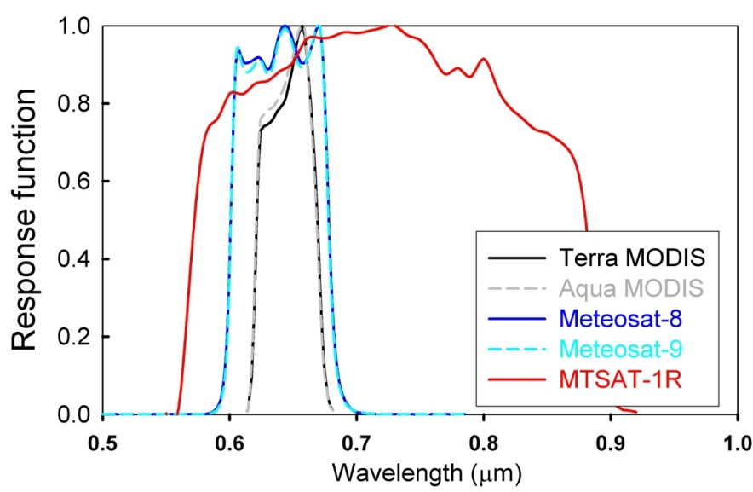
Sensor Response Function
● Due to different spectral regions, measured reflectances by MODIS, Meteosat-8/9, and MTSAT-1R may be different.
● Therefore, spectral correction is achieved before comparing two channels (MODIS vs. Meteosat, or MODIS vs. MTSAT-1R).
4

Slide 5
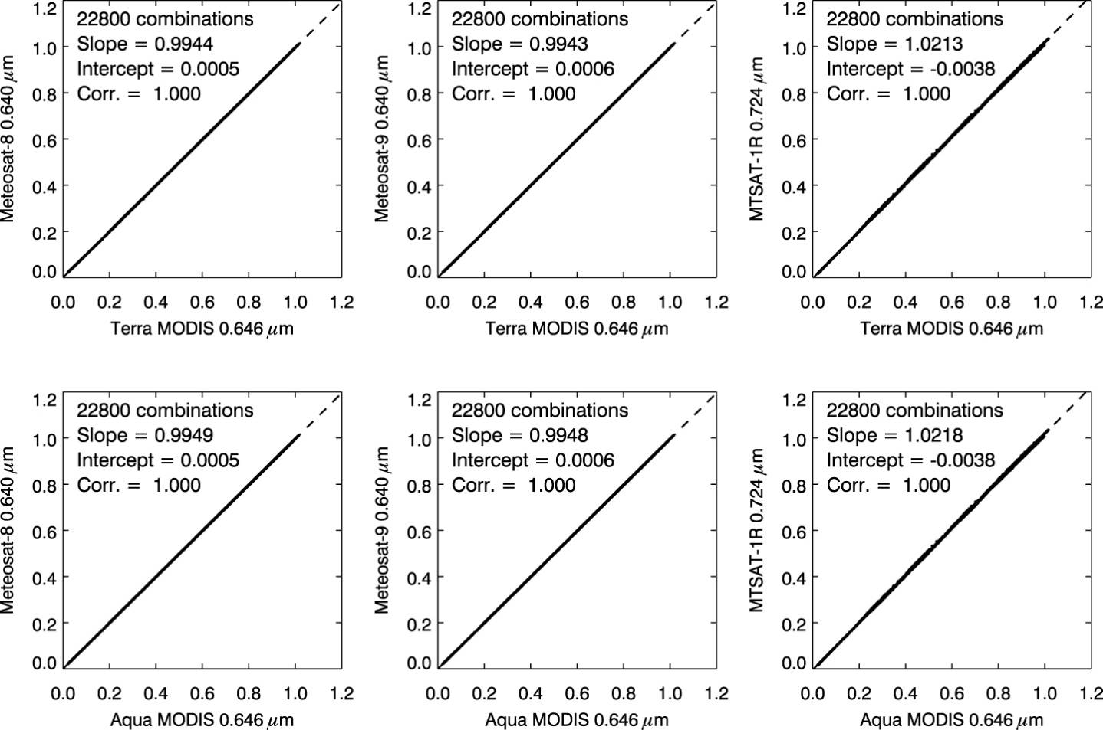
Spectral Correction between Two Channels
Radiative simulation is performed to obtain relation between two channels.
- Cloud phase = ice (Baum) and water (Mie)
- Cloud particle size (r_{e}) = 10, 20, and 30 μm
- Cloud optical thickness (COT) = 0 to 100
- Solar zenith angle (SZA) = 0 to 40°
- Viewing zenith angle (VZA) = 0 to 40°
- Relative azimuth angles (RAA) = 0 to 180°
“Various inputs”
Relation between two channel reflectances
Conversion Equation
R_{MET8} = 0.9944 R_{TERRA} + 0.0005
R_{MET8} = 0.9949 R_{AQUA} + 0.0005
R_{MET9} = 0.9943 R_{TERRA} + 0.0006
R_{MET9} = 0.9948 R_{AQUA} + 0.0006
R_{MTSAT} = 1.0213 R_{TERRA} – 0.0038
R_{MTSAT} = 1.0218 R_{AQUA} – 0.0038
5

Slide 6
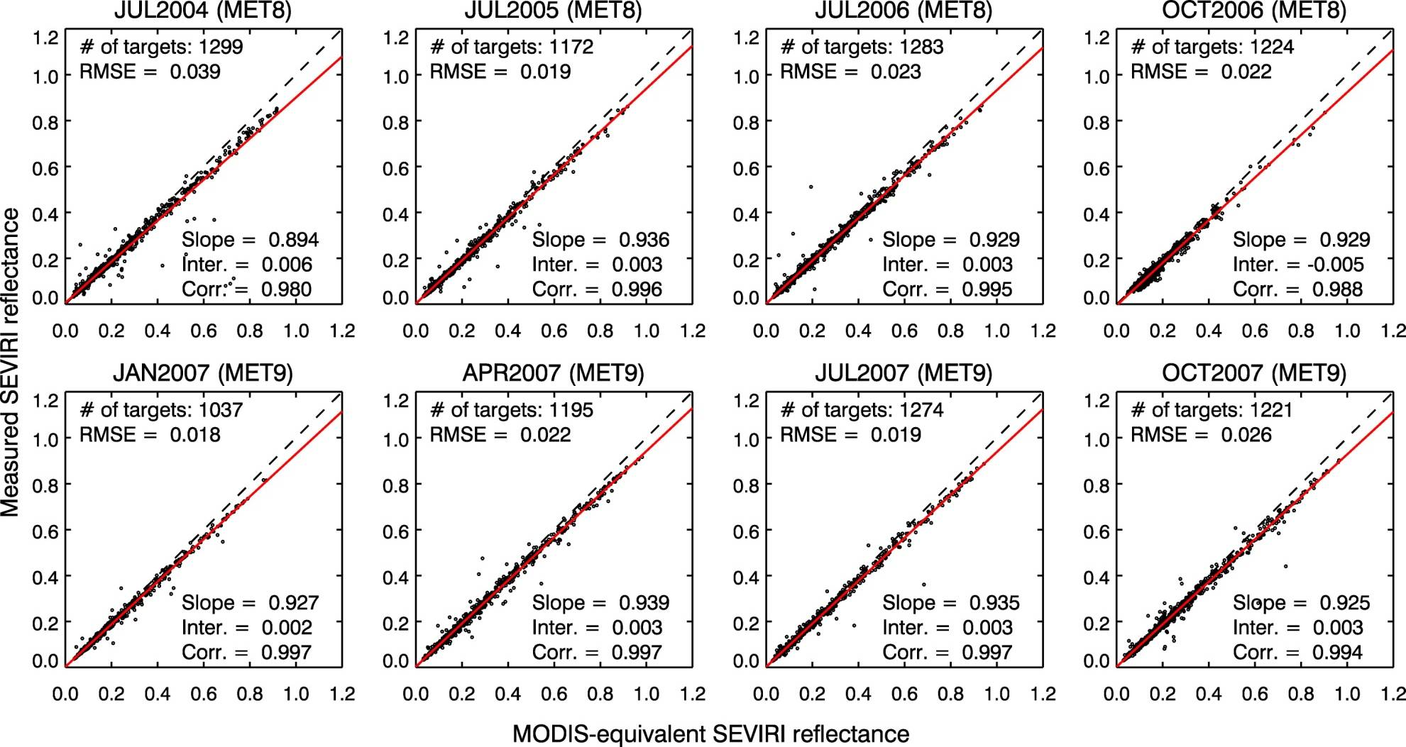
Results of Meteosat-8/9 from Method 1
Regression slope = 0.93–0.94, Intercept < 0.01
➔ “6–7%” of low bias of SEVIRI measurements
6~7% bias
Convert MODIS-measured reflectance into SEVIRI channel reflectance
6

Slide 7
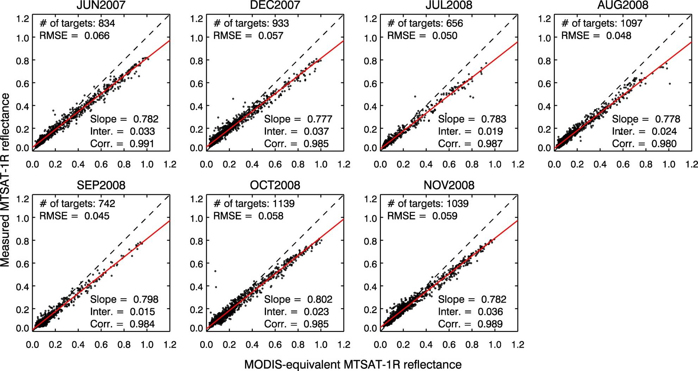
Results of MTSAT-1R from Method 1
Measurement biases are shown to depend on reflectance magnitude. (+5% at reflectance=0.1, –20% at reflectance=1)
Considerable regression offset implies that incorrect space count may be currently used in MTSAT-R calibration.
Negative bias
Positive bias
Large scattered patterns are due to problems in scan method?
7

Slide 8
Method 2: Use of MODIS Cloud Products
MODIS
Cloud Products
SEVIRI 0.640-μm Reflectance
0.5°х 0.5°Grid Format
0.5°х 0.5° Grid Format
Matching Time & Location
∆Time ≤ 5 minutes
Thresholds of Cloud Targets
Over ocean regions
Overcast clouds
5 ≤ Cloud optical thickness (COT)
RTM Inputs
Surface – Ocean BRDF
Atmosphere – Tropical profile
Cloud – MODIS COT, particle size (r_{e}), Cloud altitude Mie scattering model for CTT ≥ 273 K
Baum scattering model for CTT ≤ 227 K
3D Radiative
Effects
Simulated Reflectance
Using SBDART
Examining SEVIRI Measurements
“Reference”
8

Slide 9
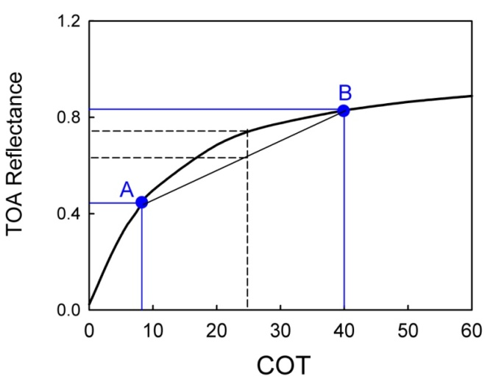
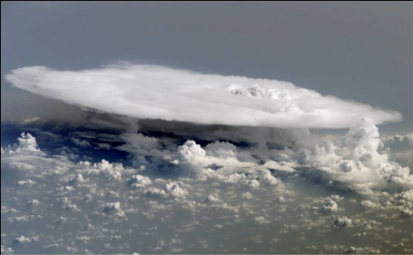
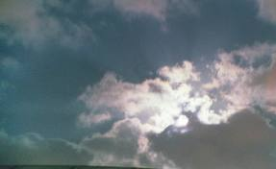
3D Radiative Effects in Cloud Simulation
Two types of simulation biases associated with 3D effects
(1) Plane-parallel homogeneous (PPH) bias
The bias occurred by ignoring horizontal (subgrid) variation
(2) Independent column approximation (ICA) bias
The bias occurred by neglecting horizontal radiative interaction (e.g., cloud shadow, cloud illumination)
R_{PPH}
R_{ICA}
Columnar reflectance cannot be computed alone because the reflectance is influenced by surrounding columns due to radiative interaction (e.g., cloud shadow or illumination).
Cloud shadow
Cloud illumination
9

Slide 10
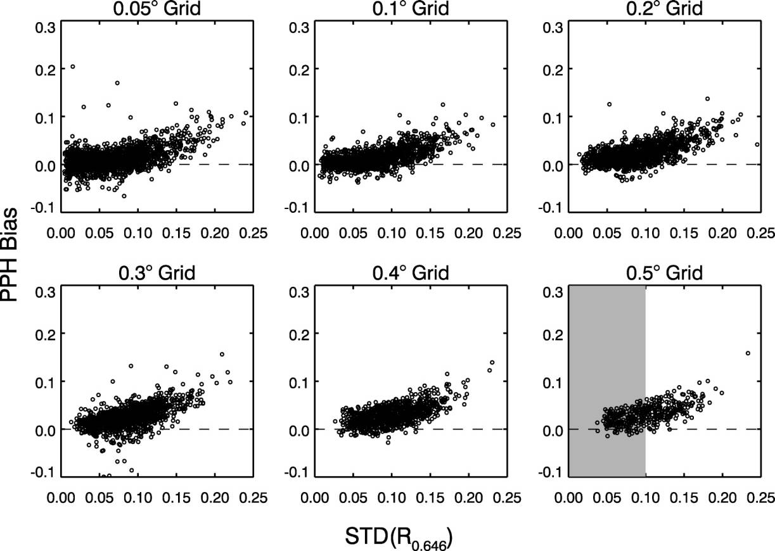
Plane-Parallel Homogeneous (PPH) Bias
Homogenous clouds
“Subgrid variability”
● PPH bias increases with grid size and subgrid variability.
● To minimize PPH bias, homogeneous cloud targets are used by applying STD(R_{0.6}) ≤ 0.1.
● Lognormal (LN)-ICA method (Oreopoulos and Davies, 1998) is adopted to resolve subgrid variability.
Numerical integration of subgrid reflectance
LN function to describe COT distribution
10

Slide 11
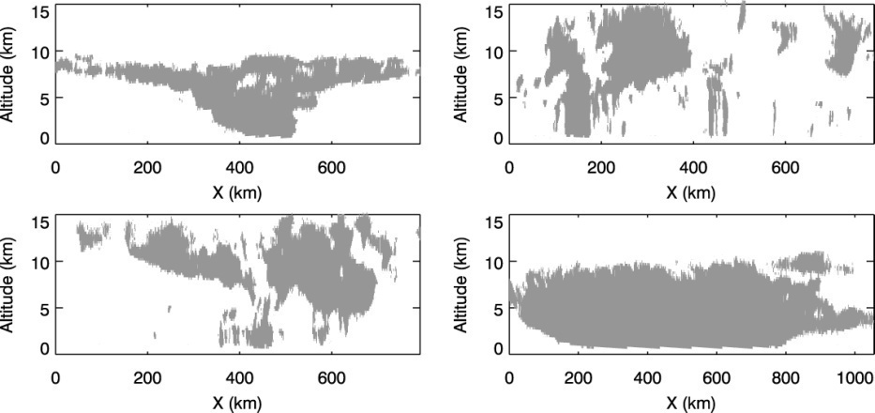
Independent Column Approximation (ICA) Bias
Case study for quantifying ICA bias
Cloud vertical structures are described from CloudSat measurements
For the given cloud shapes, full 3D modeling (which considers cloud shadow-illumination) and ICA modeling (which ignores radiative interaction) are performed.
By comparing ICA modeling results with full 3D modeling results, ICA bias can be estimated.
Four chosen cases among CloudSat measurements
CS1
CS2
CS3
ICA bias for CS1, CS2, CS3, and CS4
CS4
11

Slide 12
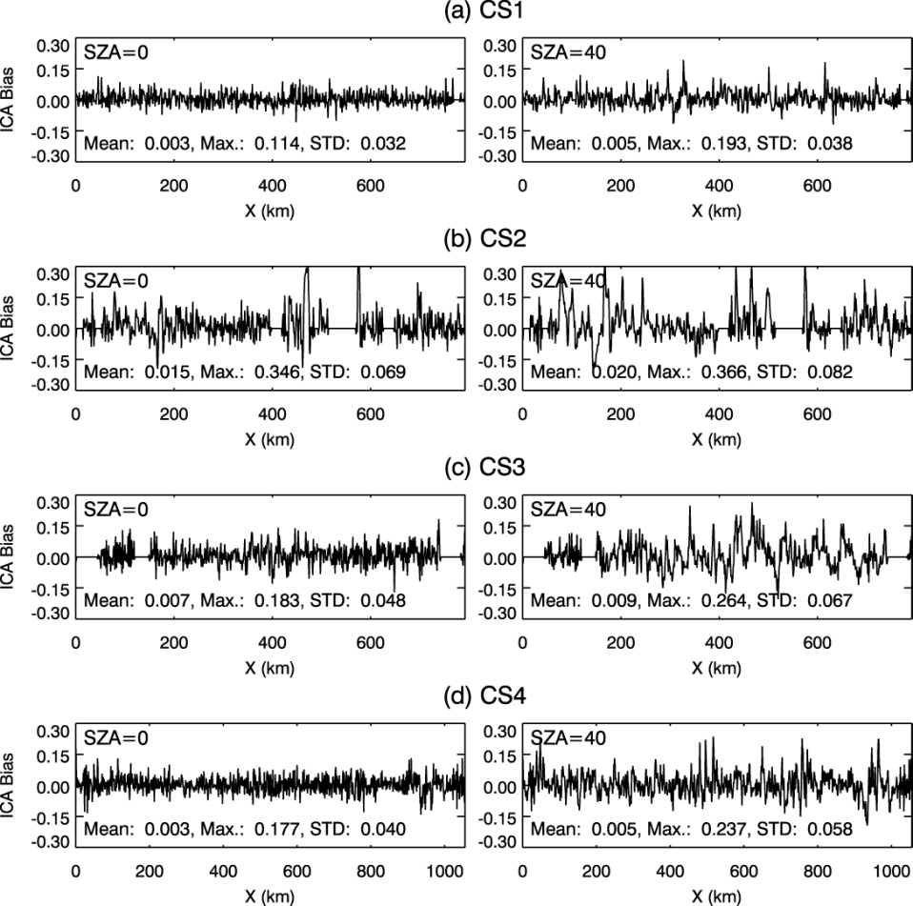
Independent Column Approximation (ICA) Bias
Estimated ICA biases of four CloudSat cases with two SZAs (0 and 40°)
From the case study, we can minimize ICA bias in the calibration by
● Choosing cases with small SZA (≤ 40°) because the fluctuation of ICA bias increases with SZA.
● Taking spatial or temporal average because ICA bias is randomly distributed (i.e. their spatial mean is always close to zero regardless of case and SZA).
● Using homogeneous cloud targets only because large-scale homogeneous clouds (CS1 and CS4) represent smaller fluctuation of ICA biases compared to small-scale multilayered clouds (CS2 and CS3).
STD(R_{0.6}) ≤ 0.1
12

Slide 13
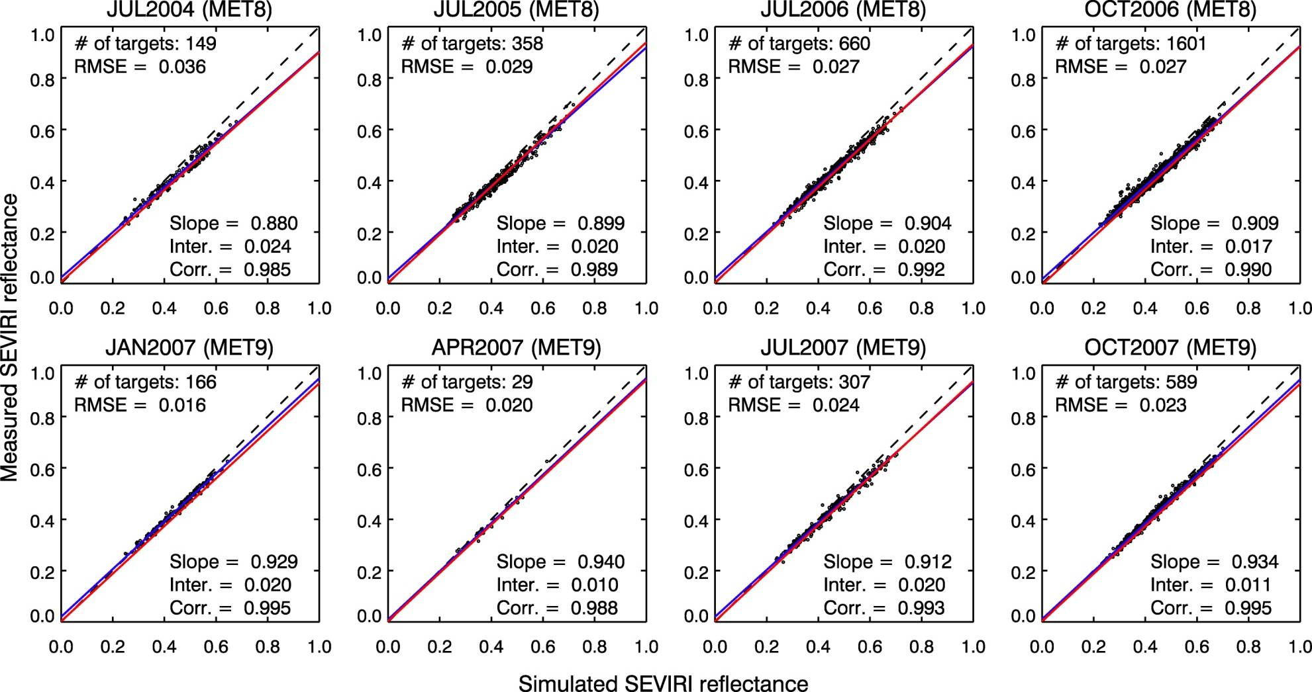
Results of Meteosat-8/9 from Method 2
Regression results from Methods 1 and 2 are similar.
➔ “6–7%” of low bias of SEVIRI measurements
——— Regression from Method 1 ——— Regression from Method 2
6~7% bias
13

Slide 14
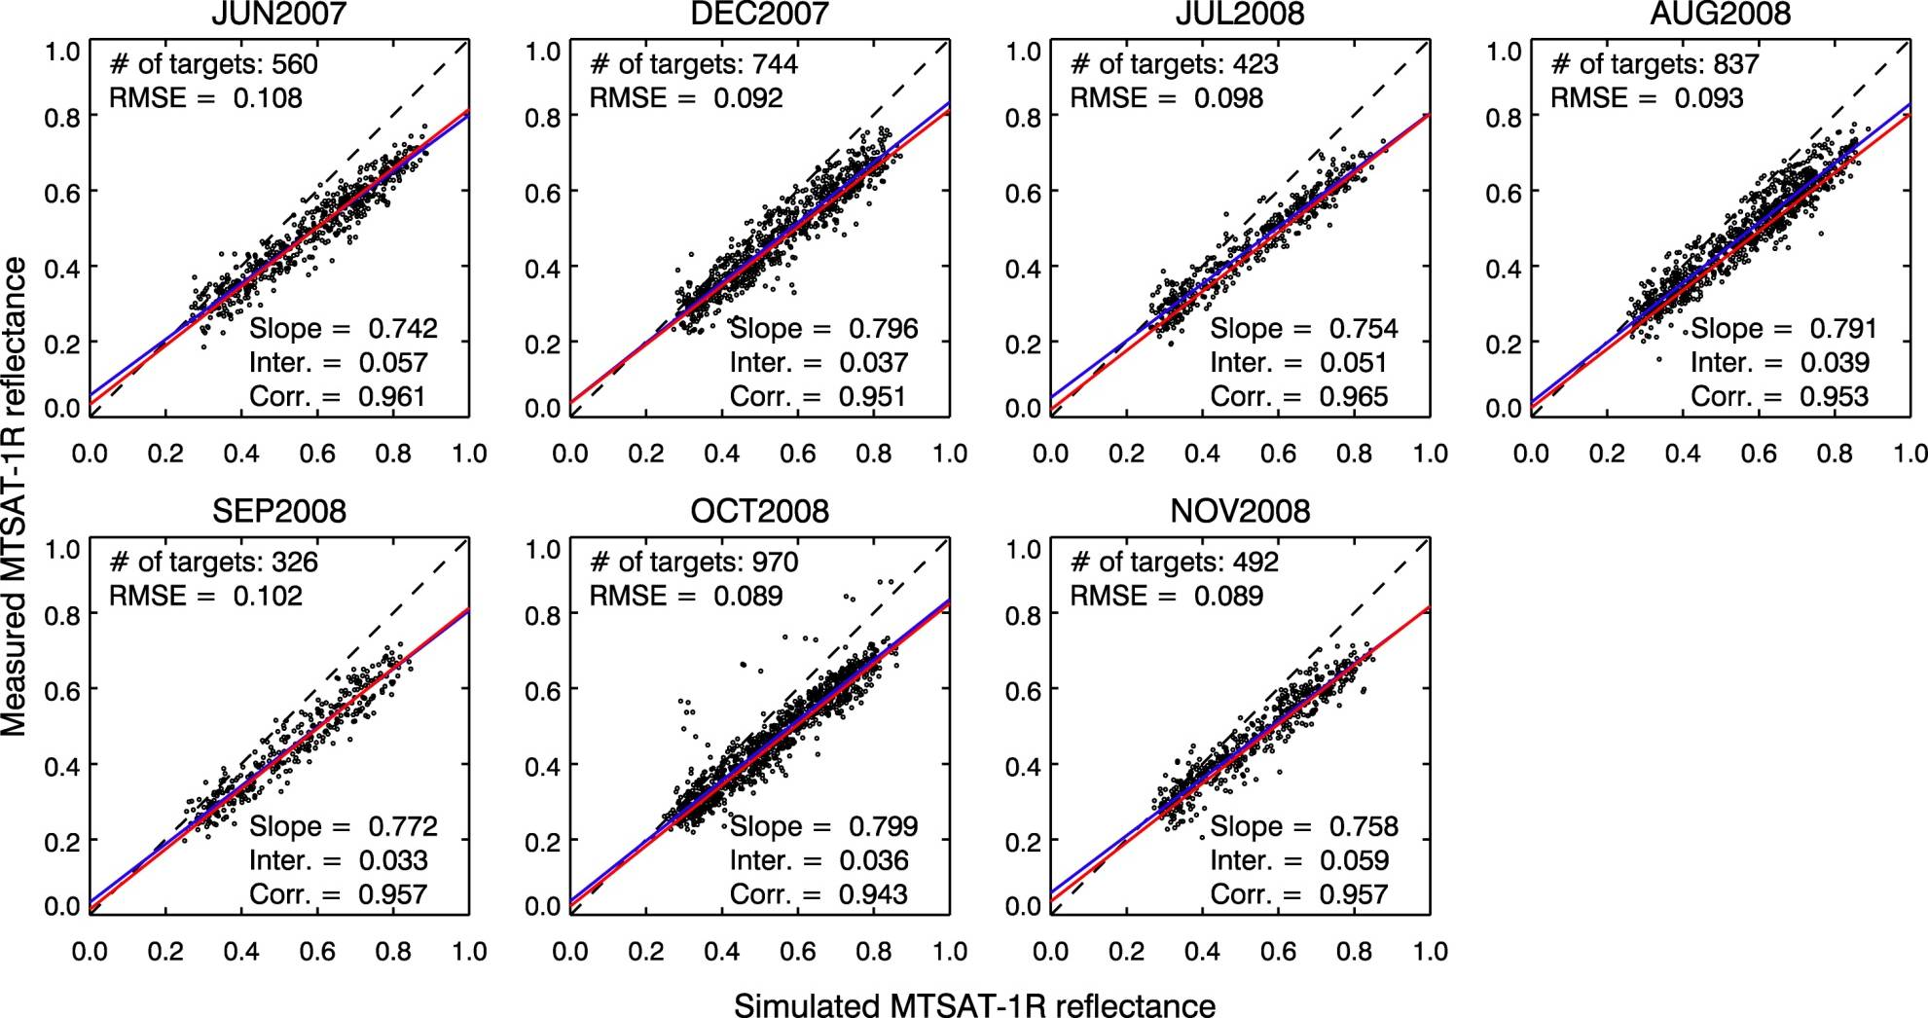
Results of MTSAT-1R from Method 2
——— Regression from Method 1 ——— Regression from Method 2
Negative bias
Positive bias
14

Slide 15
Method 3: Use of DCCs
SEVIRI 0.640-μm Reflectance and
11-μm Brightness Temperature
3D Effects
PPH bias
Can be ignored because of small pixel size, and almost linearity of reflectance w.r.t. COT for optically thick clouds (COT > 100).
ICA bias
Can be minimized from temporal averaging (daily mean) and two homogeneity checks. .
Thresholds of DCCs
TB₁₁ ≤ 190 K
STD(TB₁₁) ≤ 1 K
STD(R_{0.6})/Mean(R_{0.6}) ≤ 0.03
Investigating Optical Properties of DCCs with MODIS Data
RTM Inputs
Surface – Ocean BRDF
Atmosphere – Tropical profile
Cloud properties
COT = 200, particle size (r_{e}) = 20 μm
Baum scattering model
3D Radiative
Effects
Simulated Reflectance
Using SBDART
Examining SEVIRI Measurements
“Reference”
15

Slide 16
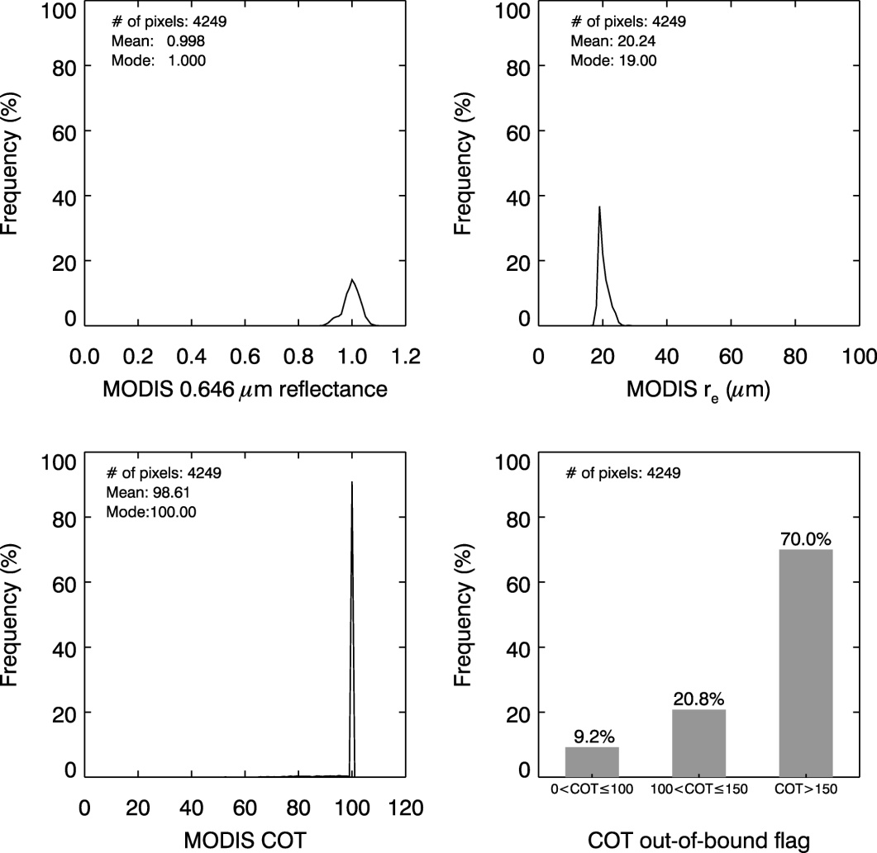
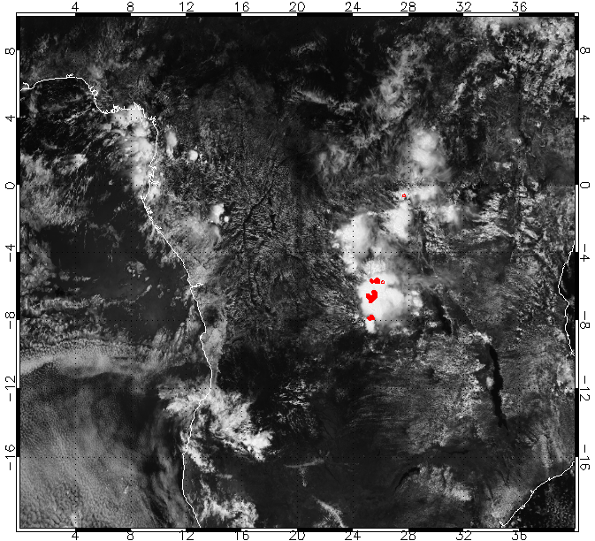
Optical Properties of DCC Targets
(1) Cold cloud condition to select clouds overshooting tropopause layer
DCC Properties from MODIS products
TB₁₁: Brightness Temp. at 11-μm band
(2) Homogeneity checks to exclude cloud boundary pixels
r_{e}≈20μm
R_{0.6}: Visible reflectance
Chosen DCC Targets
TB₁₁ ≤ 190K
COT≥100
➔ For the simulation, optical properties of DCC targets are assumed as COT = 200 and r_{e} = 20 μm.
16

Slide 17
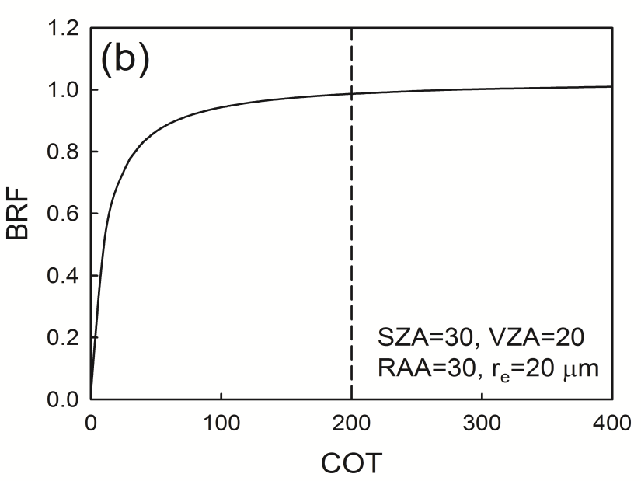
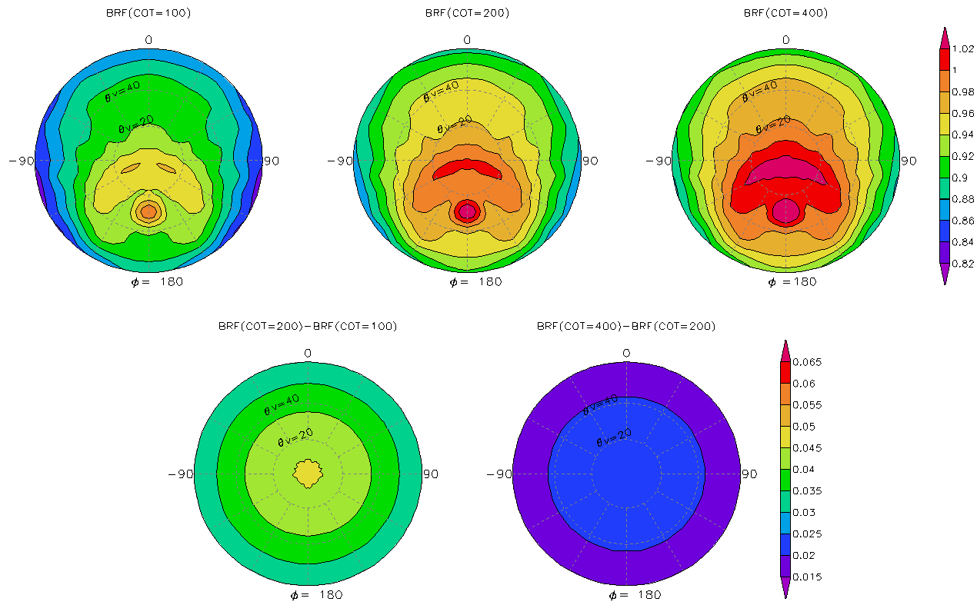
Sensitivity of Input Parameters
to DCC Simulation
DCC targets
COT=100
COT=200
COT=400
Diff. <5%
Diff. <5%
Simulation uncertainty by each RTM input parameter
Input Parameters |  | Surface Reflectance | Atmospheric Profiles | AOT at 0.55 μm | Cloud Properties
 |  |  |  |  | COT at 0.646 μm | Effective Radius | CTH | Cloud Depth
Reference Value |  | Oceanic BRDF | Tropic | 0 | 200 | 20 μm | 15 km | 14 km
Input Range |  | 0 – 0.4 | MLS | 0 – 3 | 100 – 400 | 10 – 30 μm | 12 – 18 km | 10 – 14 km
Maximum Uncertainty (%) | SZA = 0° | 0.09% | 1.29% | 0.14% | 4.79% | 1.64% | 0.15% | 0.24%
 | SZA = 40° | 0.08% | 1.30% | 0.13% | 4.41% | 3.02% | 0.21% | 0.23%
~5% of simulation error by fixing cloud parameters
17

Slide 18
Terra
Aqua

Slide 19
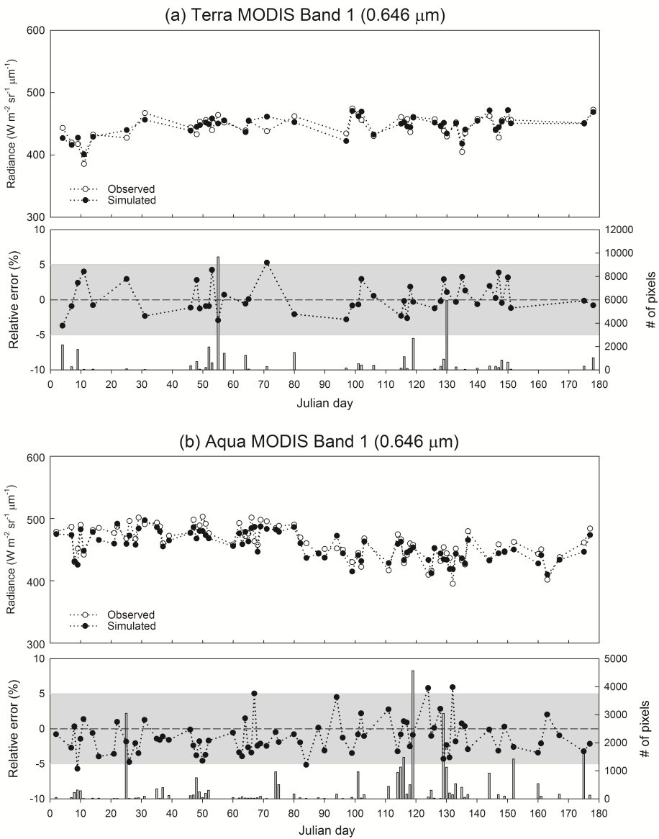
Evaluation of Method 3 by Applying to Well-Calibrated MODIS Visible Channel
The accuracy of Method 3 seems to be better than 5%.
19

Slide 20
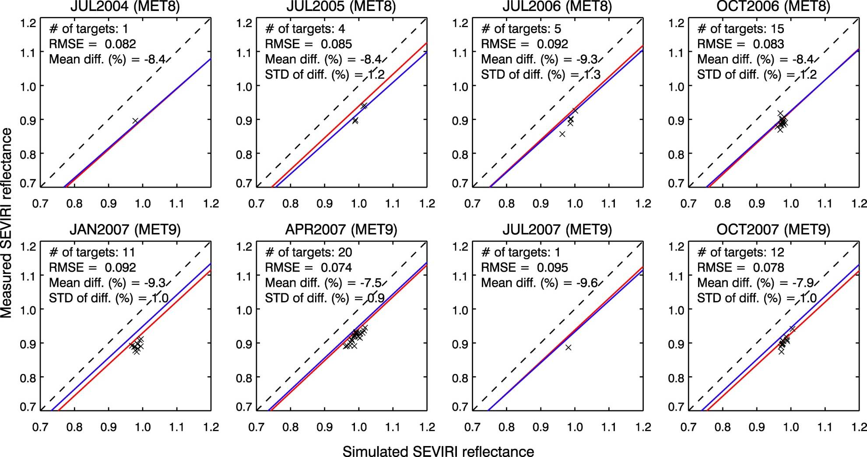
Results of Meteosat-8/9 from Method 3
Method 3 produces different results compared to Method 1 or 2.
The degree of discrepancy is “2 ~ 3%.”
———Method 1 ———Method 2 X Method 3
20

Slide 21
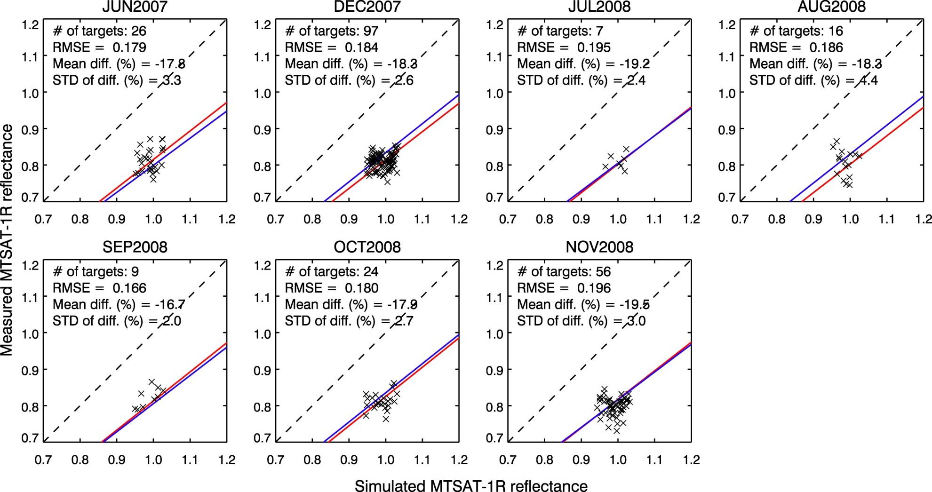
Results of MTSAT-1R from Method 3
Methods 1, 2, and 3 are shown to produce consistent results.
———Method 1 ———Method 2 X Method 3
21

Slide 22
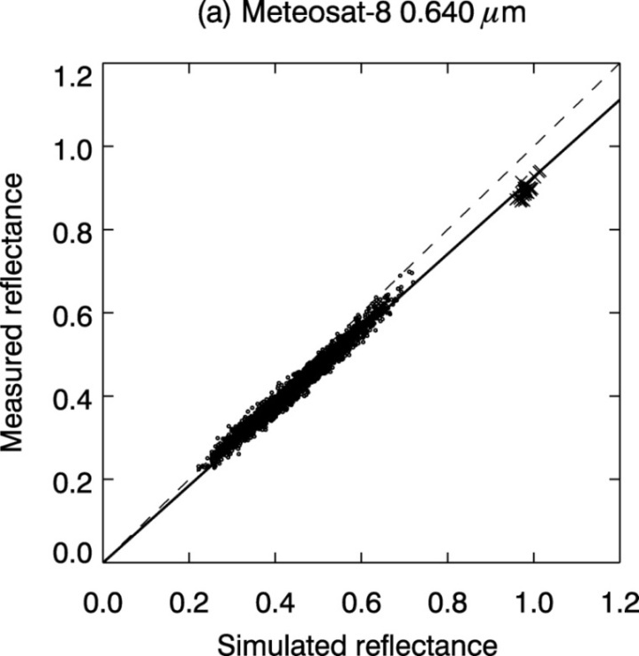
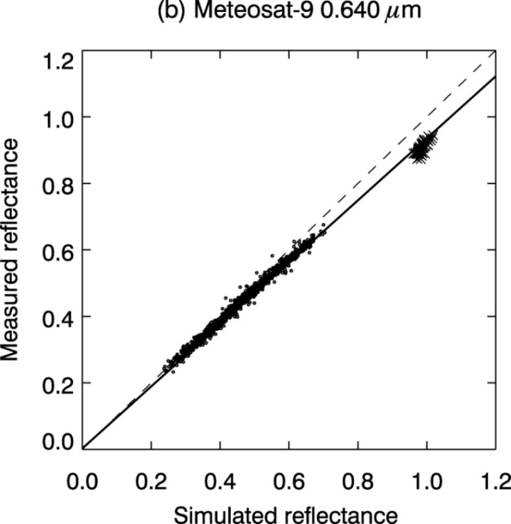
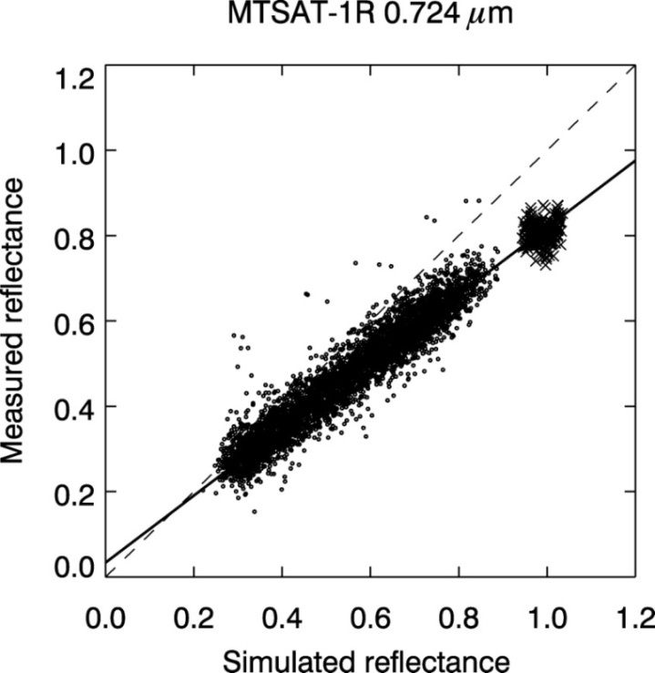
Summary of Three Calibration Results of Meteosat-8/9
and MTSAT-1R Visible Channels
–– Method 1: Inter-calibration
Method 2: Calibration using MODIS cloud products
× Method 3: Calibration using DCC targets ---- One-to-one match
All three methods generally show good agreement, with less than 3% differences.
When high reflectances are absent in inter-calibration, Method 2 and Method 3 can be used for improvement of calibration accuracy.

Slide 23
Conclusions
Reference
reflectance
Reference
reflectance
Measured reflectance
SEVIRI Reflectance
•
MTSAT-1R Reflectance
17~19%
Measured reflectance
Method 3
•
6~7%
Method 3
Method 1 &
Method 2
Methods 1 &
Method 2
SEVIRI Digital Count
MTSAT-1R Digital Count
Meteosat-8/9 SEVIRI 0.640-μm channel measurements are underestimated by 6–7%, and larger measurement biases are expected at the high end.
Consistent results of MTSAT-1R 0.724-μm channel are derived from three methods; i.e. MTSAT-1R measurements is positively biased at near-zero reflectances, while the bias is negative up to –20% at the bright side. Update of correct space offset count is required.
23

Slide 24
Thank you
Notes:
24

