Slide 1
Midnight calibration errors on MTSAT-2
Japan Meteorological Agency
Meteorological Satellite Center
Arata OKUYAMA
26 Jul. 2011 GSICS GRWG Web meeting

Slide 2
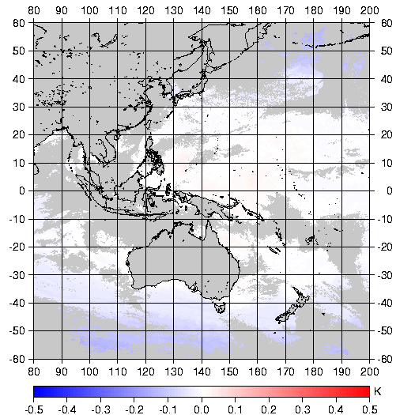
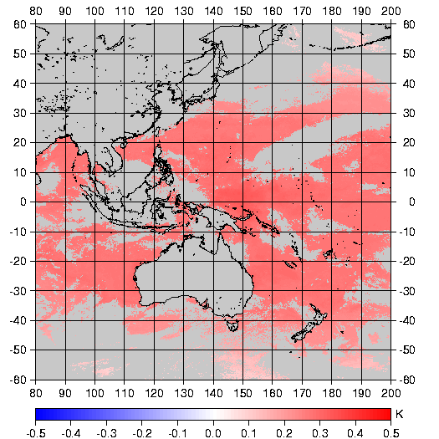
Experiment on SST
MTSAT-2 IR images contain midnight calibration error, which becomes large during eclipse seasons (right charts)
To use GSICS correction, SST parameters should be tuned again. Otherwise, significant biases would be appeared. (bottom chart)
If diurnal bias information is obtained from GSICS, better SST product would be expected
MTSAT 12um – AIRS Asc.(13:30)
GSICS Correction
SST(GSICS) – SST(Original)
MTSAT 12um – AIRS Dec.(01:30)
8 January 2011
1 March 2011
MTSAT 12um – AIRS (All orbits)
Jul 2010
Jun 2011

Slide 3
Quoted from 10th GSICS EXP meeting presentation by NOAA

Slide 4
MTSAT-2 Brightness temperature differences
3.8um(IR4)
6.8um(IR3)
10.8um(IR1)
12.0um(IR2)
2011
Jan
Feb
Mar
Apr
May
Jun
2010Jul
Aug
Sep
Oct
Nov
MTSAT-2 had no data. MTSAT-1R was operational
Dec
30 minutes mean brightness temperature differences between MTSAT-2 and LEO versus UTC for each MTSAT-2 channel. Vertical lines shows standard error of the brightness temperatures in each 30 mins bin. The red color indicates that differences are with respect to IASI and black color indicates that differences are with respect to AIRS. A vertical black line on 15 UTC means MTSAT-2 midnight.
Notes:
Operational observation was performed by MTSAT-1R on November 2010, because of ground system maintenance and trouble.

Slide 5
TBB difference comparison
 | MTSAT-2 | GOES-11
Peak season of the midnight effect | 3.8um : Apr. and Aug. | 3.9um : Mar. and Sep.
 | 6.8um : none | 6.7um : none
 | 10.8um : Feb. ? | 11.0um : Apr. or May ?
 | 12.0um : Oct. and Feb. | 12.0um : Apr. or May ?
Amplitudes at peak season | 3.8um : ~ +1.5 K | 3.9um : ~ +1.0 K
 | 6.8um : ~ -0.5 K | 6.7um : ~ -0.5 K
 | 10.8um : ~ +/-0.5 K | 11.0um : ~ -1.2 K
 | 12.0um : ~ +1.3 K | 12.0um : ~ -1.2 K
Variation for time of day | limited on specific times | more gradual
GOES-11 and MTSAT-2 have ITT imager.
Notes:
Peak seasons are similar, but signs are opposite on IR window channels.

Slide 6
Discussion
GSICS Correction considering midnight effect?
One Correction per day (current style)
Midnight effect is not distinguished.
One Correction per each LEO satellite, each orbit
Day and night time data can be separated.
Diurnal cycle correction
Is it feasible ?
The midnight error should be mentioned on ATBD quality check section.

