Slide 2
Collocation Criteria for FY-2C/D
Input data – Mcidas AREA data
Spatial collocation – the center of LEO pixel should be within the GEO FOV
Time difference - 15 minutes
Viewing alignment - abs(cos(leo_zen)/cos(geo_zen)) < 1%
Target area - 3x3 pixels
Environmental area – 7 x 7 pixels

Slide 3
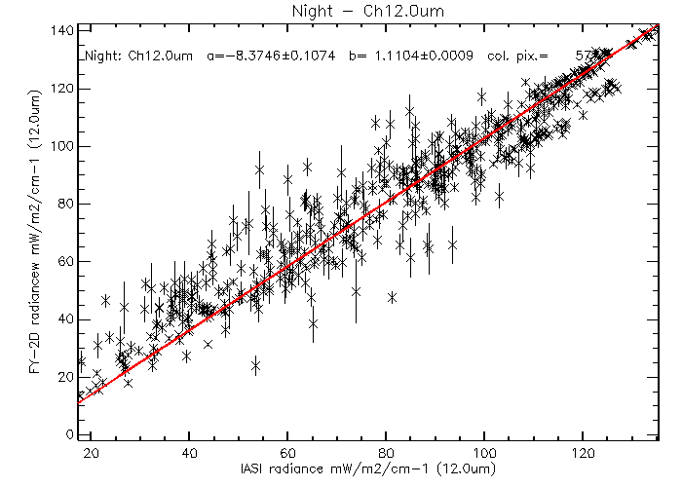
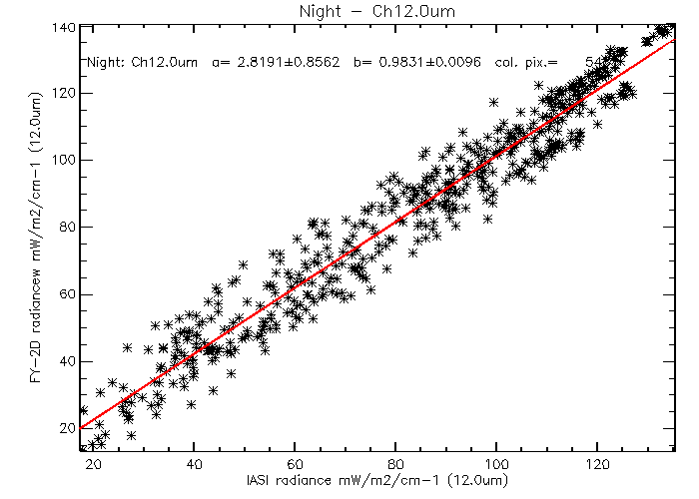
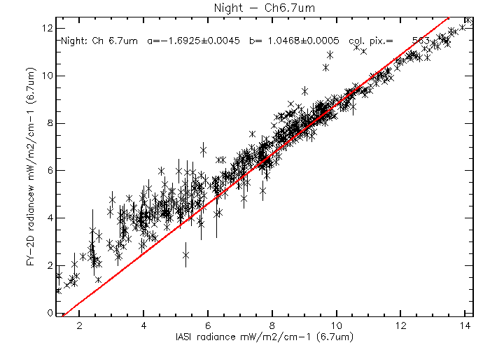
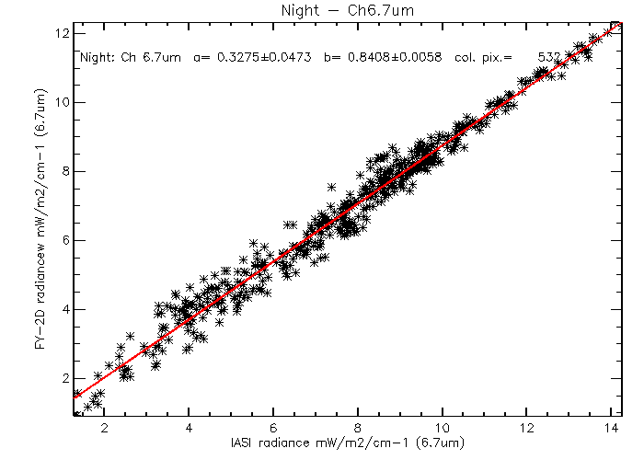
Issue with Linear Regression
Recursive filtering:
Stray-light
Homogeneous scenes

Slide 4
Homogeneous
Standard deviation of FOV radiance / mean of FOV radiance < 0.05
Standard deviation of ENV radiance / mean of ENV radiance < 0.05

Slide 5
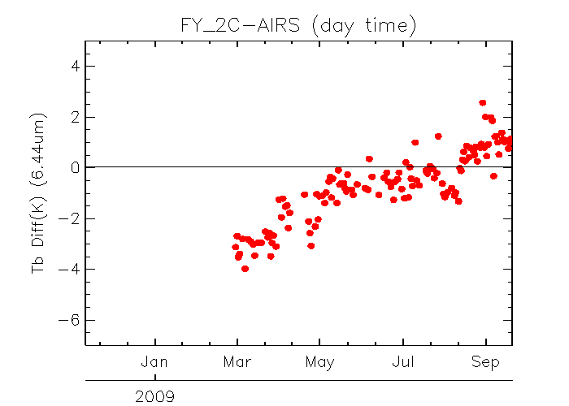
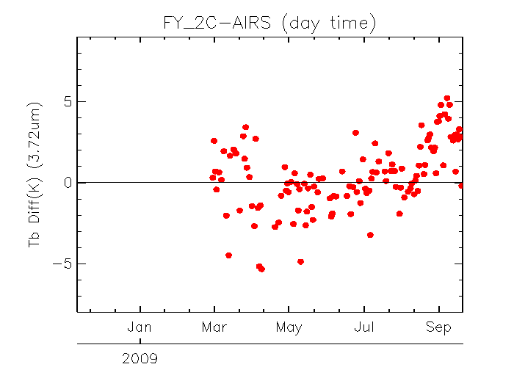
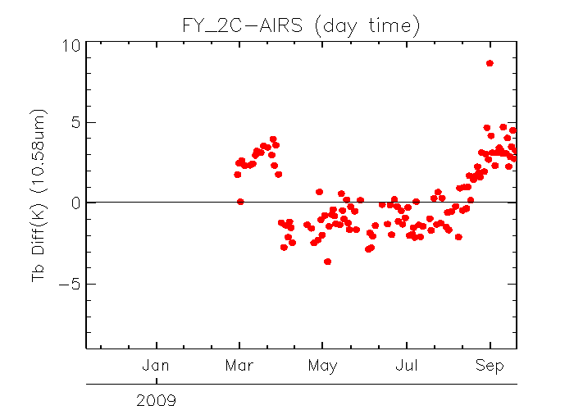
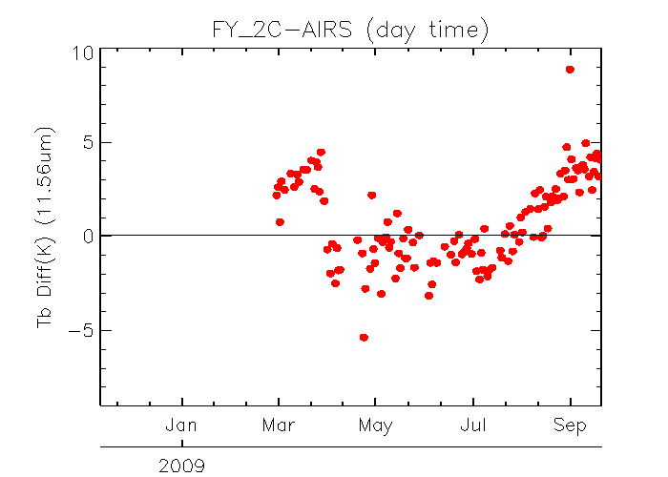
Time-series FY-2C vs. AIRS (day-time)

Slide 6
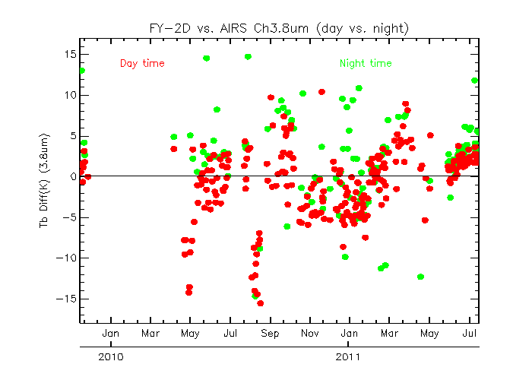
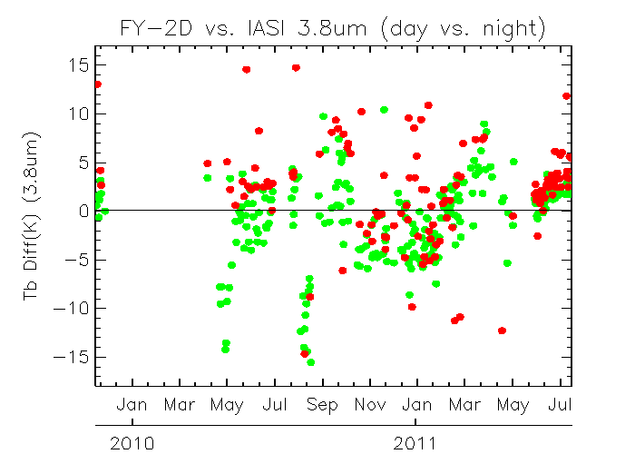
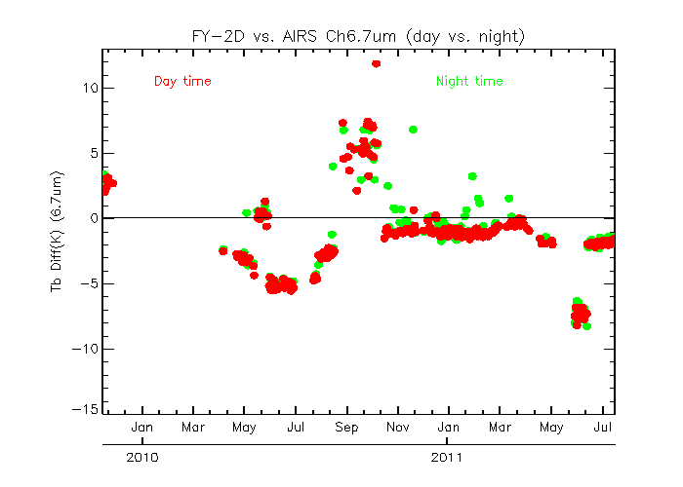
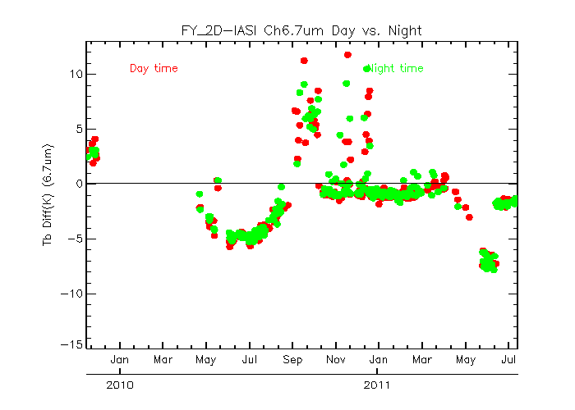
Time-series of FY-2D Tb bias to AIRS/IASI

Slide 7
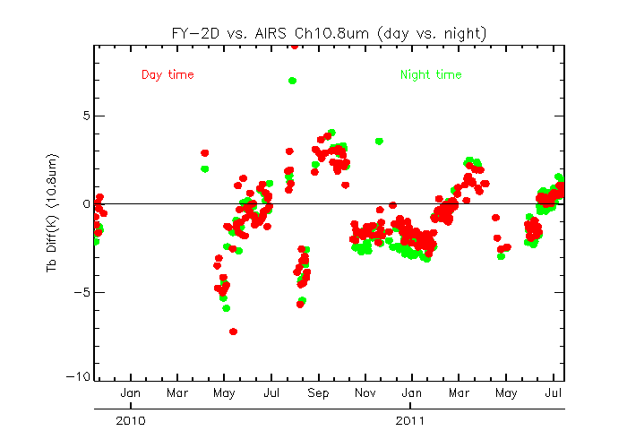
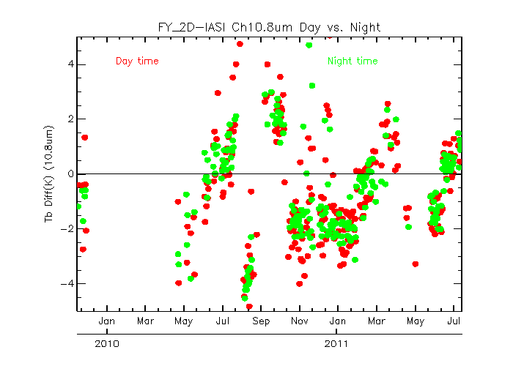
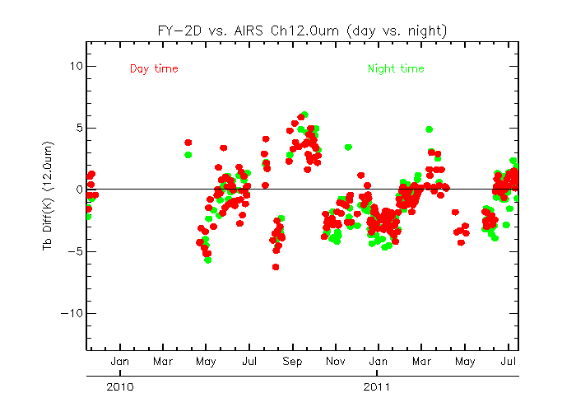
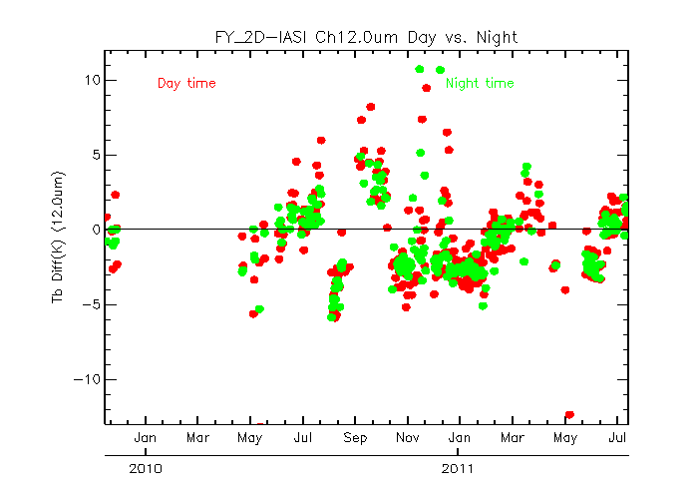
Time-series of FY-2D Tb bias to AIRS/IASI

Slide 8
Summary
FY-2C/D may need to apply some filtering algorithm to remove the homogenous collocated outliers
FY-2C/D experience strong seasonal calibration variations.
Diurnal variation seems to relatively small, compared to seasonal variation.

