Slide 1
GOES Imager IR Midnight Calibration Anomaly and Correction
Fangfang Yu, Xiangqian Wu, M. K. Rama Varma Raja and Haifeng Qian

Slide 2
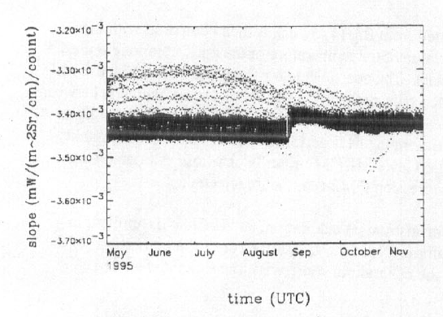
Midnight calibration anomaly and correction
Causes of Midnight calibration anomaly (Johnson et al. 1996)
Extra radiation reflected by the non-unity emissivity of BB to the detectors, when the instrument is viewing the BB.
Scattered solar radiation contamination at space view
Most pronounced at pre-eclipse and post-eclipse around the equinox.
Current operational remedy: midnight blackbody calibration correction (MBCC) (Johnson et al. 1996, Weinreb and Han 2003)
non-perfect BB effect
Contaminated SPLK effect
Figure. Original calibration slopes of GOES-8 Imager Ch2 (from Johnson et al. 1996)

Slide 3
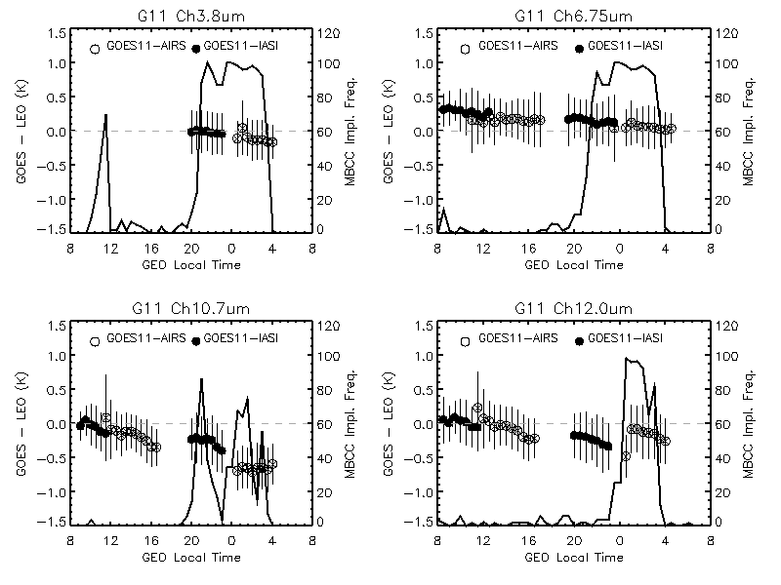
Diurnal Cal. Variation and MBCC Calibration Evaluation
Time dependent Tb bias and the standard deviation (at 30 minute time bin), as well the onset frequency of MBCC application for the winter of 2008.
(Yu et al. 2011)

Slide 4
MBCC correction residual
Impact of one of MBCC slopes on the diurnal calibration variations, calculated using Equation 9. (mean Tb 1:30pm – Tb 1:30am). The results with high frequency of MBCC onset (>80%) are in bold-italic font.
Channel name | GOES11 - AIRS |  | GOES12 -AIRS
 | Winter | Summer | Winter | Summer
Ch3 | 0.12 | 0.13 | - | -
Ch4 | - | 0.49 | - | 0.48
Ch5 | 0.13 | -
Ch6 |  |  | 0.04 | -0.11
Efficiently and sufficiently applied at Ch2
When sufficiently applied, it can work efficiently at Ch3, Ch5 and Ch6 to reduce the Tb bias to less than 0.15K
Even sufficiently applied, it works less efficiently at Ch4 with residual (mean Tb difference to the day-time data) of 0.5K bias.
(Yu et al. 2011)

Slide 5
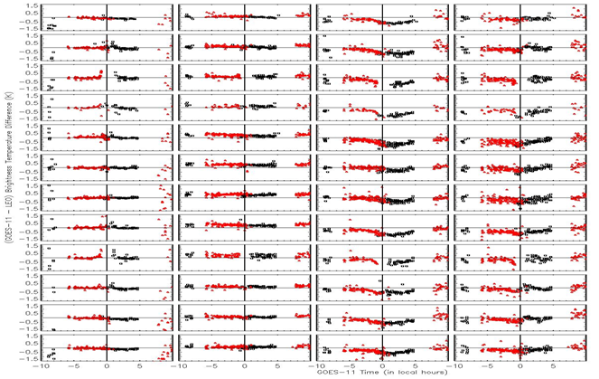
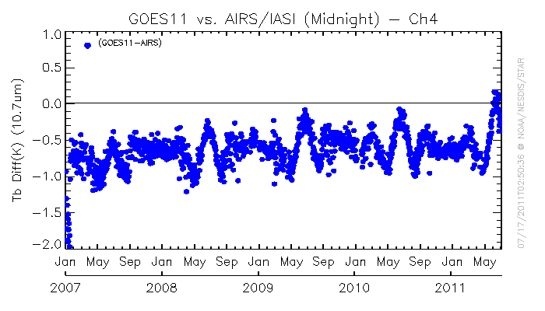
Time-dependent correction during the midnight effect time
Calibration uncertainty
Duration and amplitude vary at different IR channel
Depends on the frequency of MBCC application
Change with seasons
Has seasonal long-term trending
Time-series of Tb bias to AIRS at midnight time for GOES-11 Ch4
Evaluation of MBCC performance for each channel and in each month for GOES-11

Slide 6
Time-dependent correction during the midnight effect time
Look up table for each month
Binned at 30-minute interval: BB calibration interval
Mean and standard deviation of the mean monthly Tb bias to AIRS/IASI at each half-hour bin.
Linear calibration coefficients (a and b) at each half-hour bin
Statistically at least 150 collocation pairs is needed to get reliable coefficients.

Slide 7
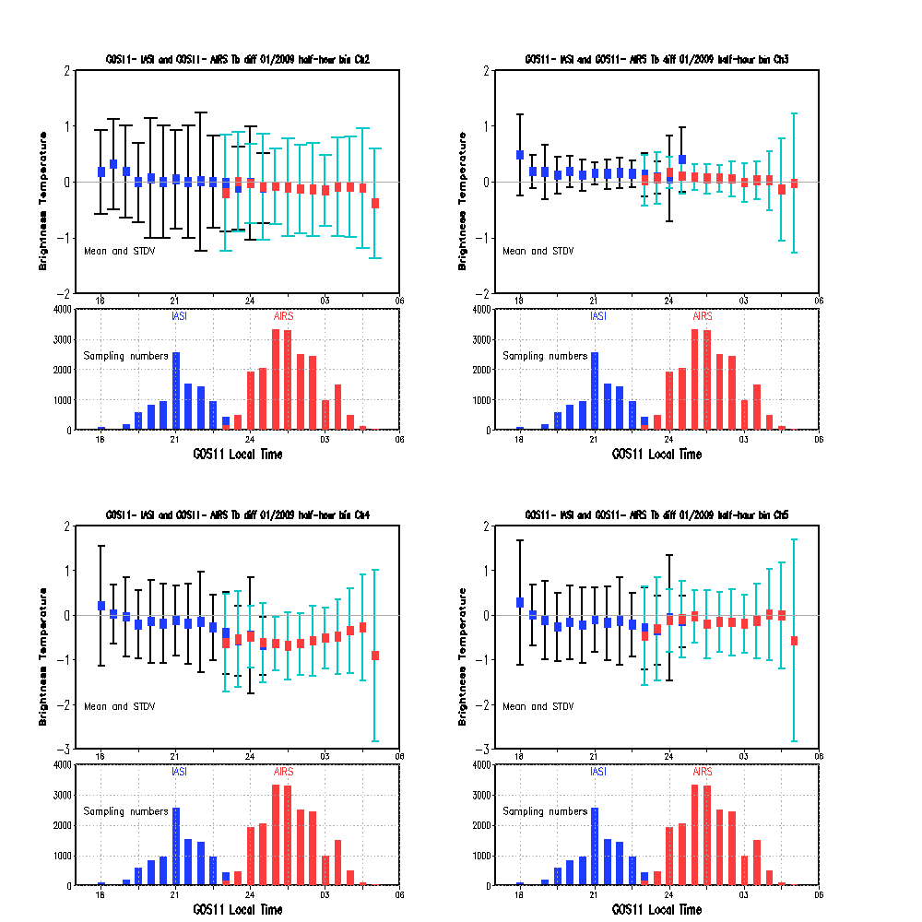

Slide 8
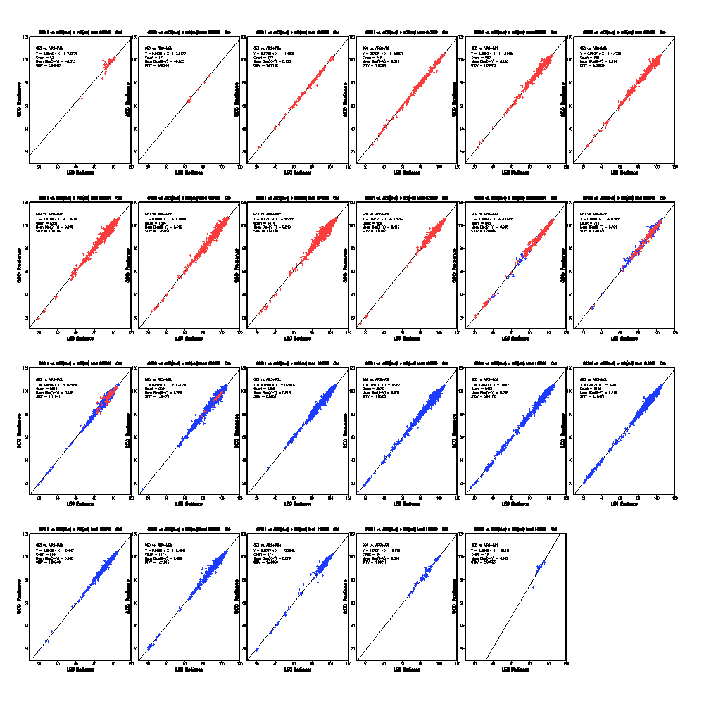
18:00
18:30
19:00
19:30
20:00
20:30
21:00
21:30
22:00
22:30
23:00
23:30
00:00
00:30
01:00
01:30
02:00
02:30
GOES-11 Ch4
03:00
03:30
04:00
04:30
05:00

Slide 9
Summary
The MBCC works sufficiently at most IR channels except Ch4 when sufficiently applied, However,
Only Ch2 is always sufficiently applied
Large residual still remains at Ch4, even sufficiently applied
The duration and amplitude of midnight calibration anomaly vary at different seasons at different IR channels
Seasonal long-term trending
Use the time-dependent correction (e.g. LUT table) derived from one month night-time collocation data
binned at half-hour time interval: coincidently with BB calibration and MBCC application intervals
Duration: ~10pm – ~04am
Mean Tb bias/standard deviation and linear regression coefficients

