Slide 1
Diurnal Cycles and Midnight Calibration Correction
NOAA GPRC
Fangfang Yu, Xiangqian Wu and Haifeng Qian

Slide 2
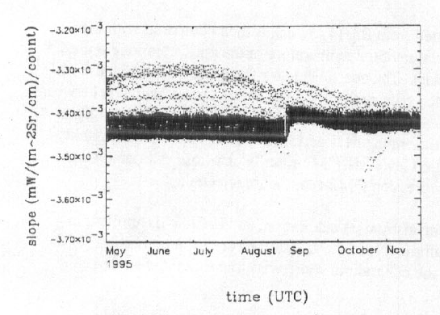
Midnight calibration anomaly and correction
Causes of Midnight calibration anomaly (Johnson et al. 1996)
Extra radiation reflected by the non-unity emissivity of BB to the detectors, when the instrument is viewing the BB.
Scattered solar radiation contamination at space view
Most pronounced at pre-eclipse and post-eclipse around the equinox.
Current operational remedy: midnight blackbody calibration correction (MBCC) (Johnson et al. 1996, Weinreb and Han 2003)
non-perfect BB effect
Contaminated SPLK effect
Figure. Original calibration slopes of GOES-8 Imager Ch2 (from Johnson et al. 1996)

Slide 3
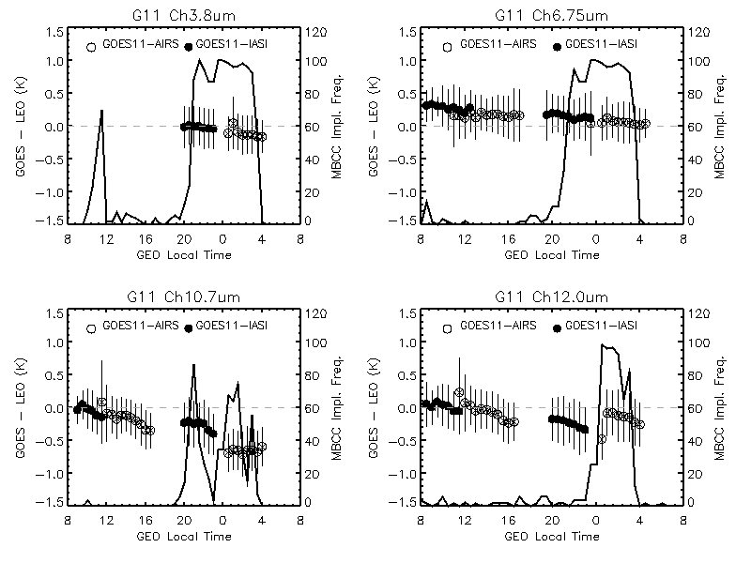
Diurnal Cal. Variation and MBCC Calibration Evaluation
Time dependent Tb bias and the standard deviation (at 30 minute time bin), as well the onset frequency of MBCC application for the winter of 2008.
(Yu et al. 2011)

Slide 4
MBCC correction residual
Impact of one of MBCC slopes on the diurnal calibration variations, calculated using Equation 9. (mean Tb 1:30pm – Tb 1:30am). The results with high frequency of MBCC onset (>80%) are in bold-italic font.
Channel name | GOES11 - AIRS |  | GOES12 -AIRS
 | Winter | Summer | Winter | Summer
Ch3 | 0.12 | 0.13 | - | -
Ch4 | - | 0.49 | - | 0.48
Ch5 | 0.13 | -
Ch6 |  |  | 0.04 | -0.11
Efficiently and sufficiently applied at Ch2
When sufficiently applied, it can work efficiently at Ch3, Ch5 and Ch6 to reduce the Tb bias to less than 0.15K
Even sufficiently applied, it works less efficiently at Ch4 with residual (mean Tb difference to the day-time data) of 0.5K bias.
(Yu et al. 2011)

Slide 5
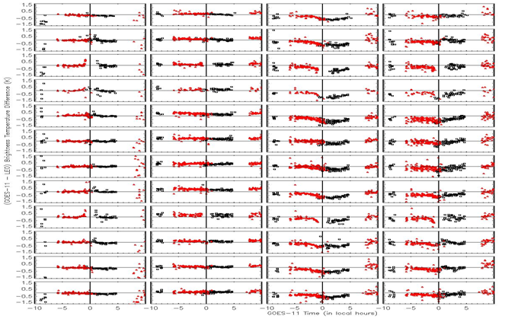
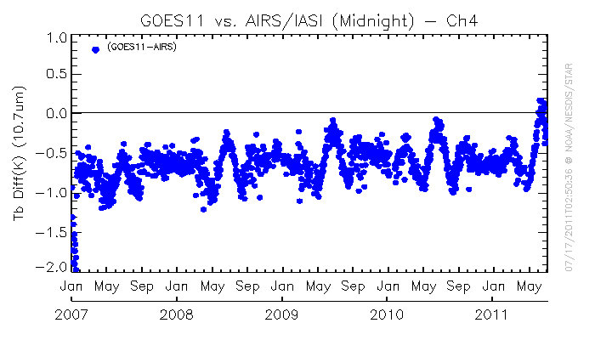
Time-dependent correction during the midnight effect time
Calibration uncertainty
Duration and amplitude vary at different IR channel
Depends on the frequency of MBCC application
Change with seasons
Has seasonal long-term trending
Time-series of Tb bias to AIRS at midnight time for GOES-11 Ch4
Evaluation of MBCC performance for each channel and in each month for GOES-11

Slide 6
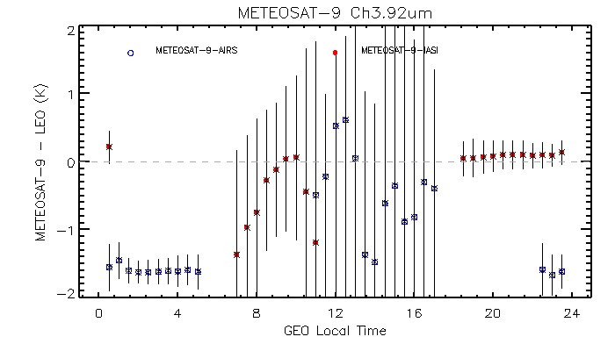
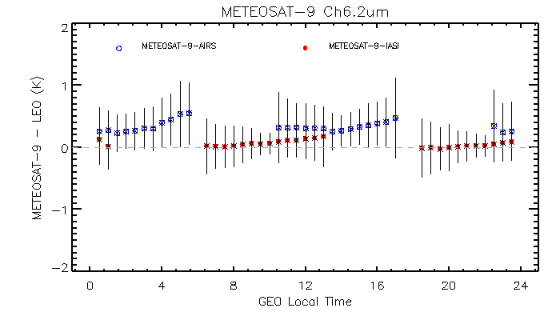
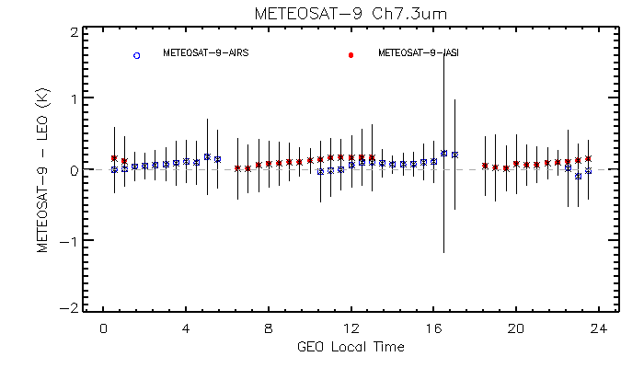
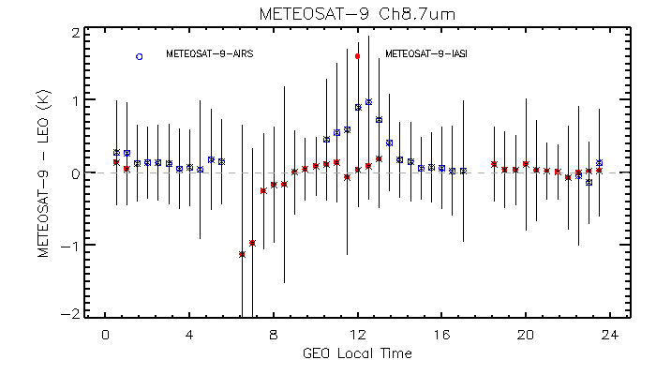
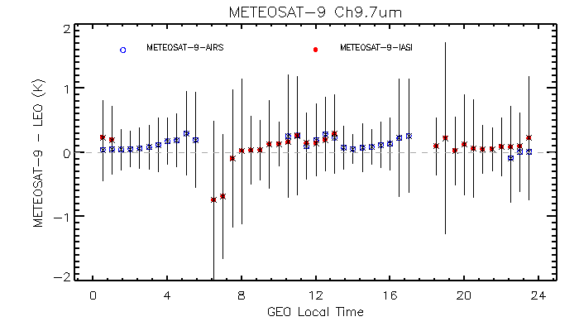
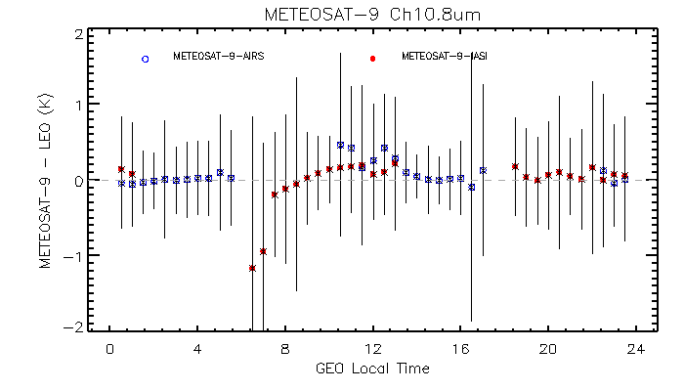
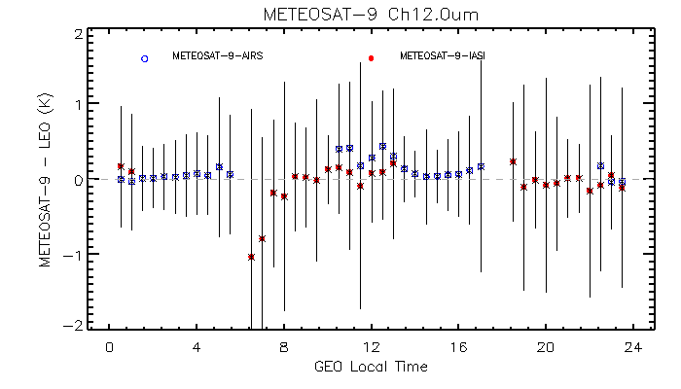
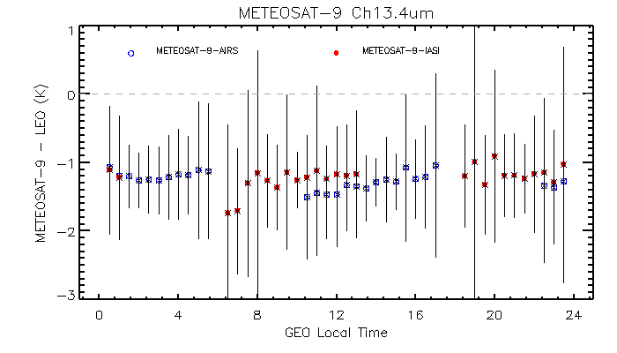
Diurnal Cycle – MET-9
No gap-filling applied

Slide 7
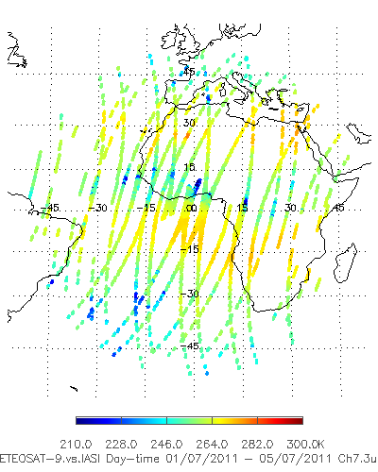
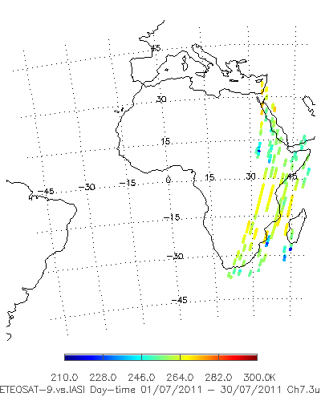
Spatial Distr. Of Coll. Scenes
Day-time
Local Satellite Time: 5:00-7:00
Need more investigation for the root cause of ~6:00 anomaly

Slide 8
MTSAT-2

Slide 9
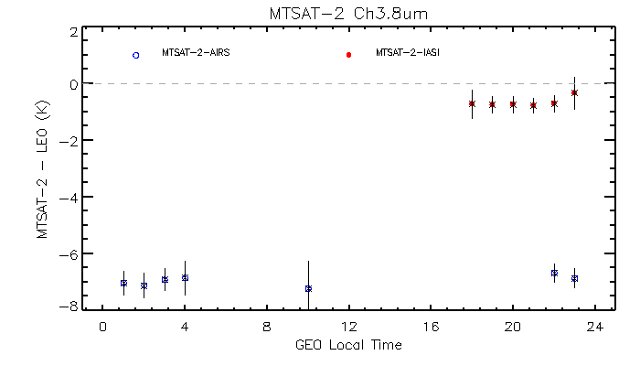
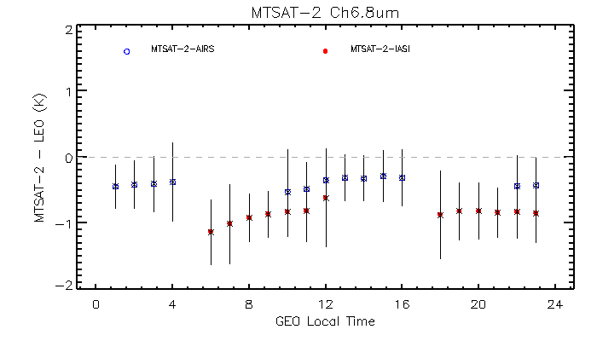
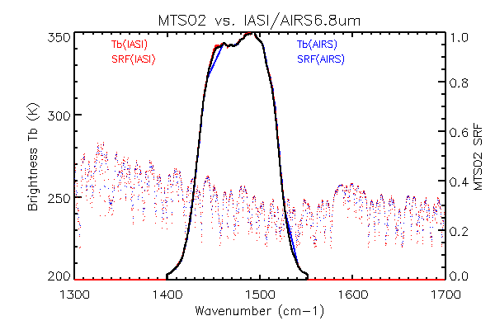
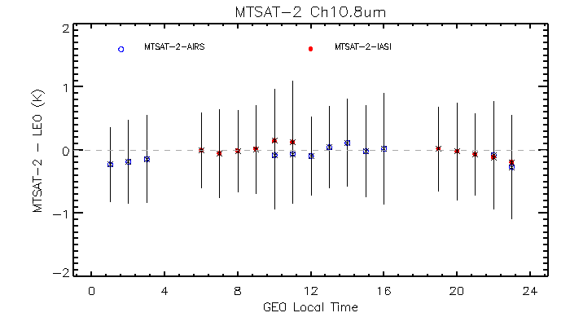
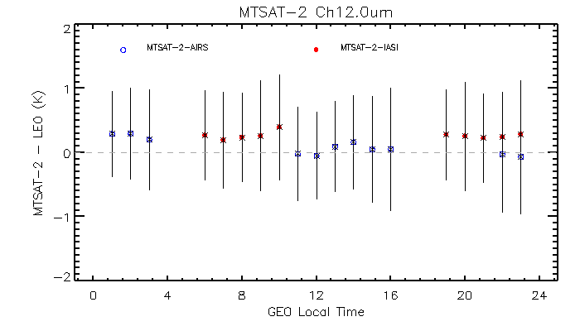
No gap filling method applied
Different SRF applied for AIRS/IASI spectral transform
Gap filling for the missing AIRS spectra
Difference in the AIRS and IASI calibration
Uncertainty in collocation(?)

Slide 10
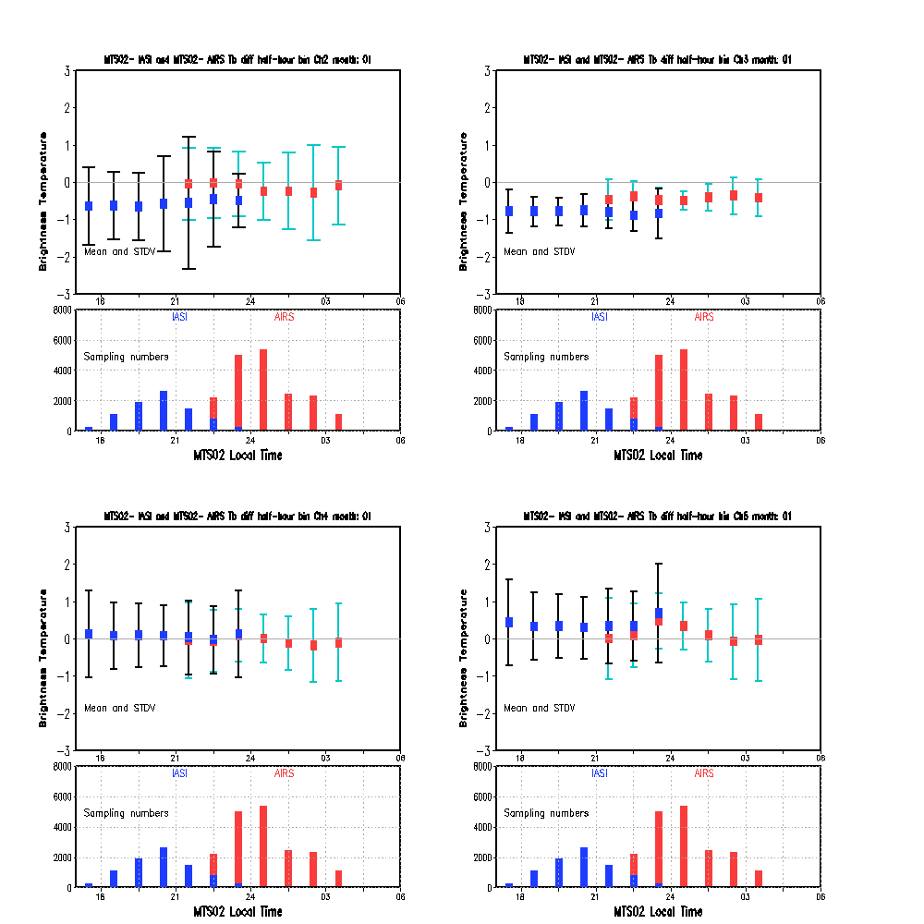
MTS02 : Jan

Slide 11
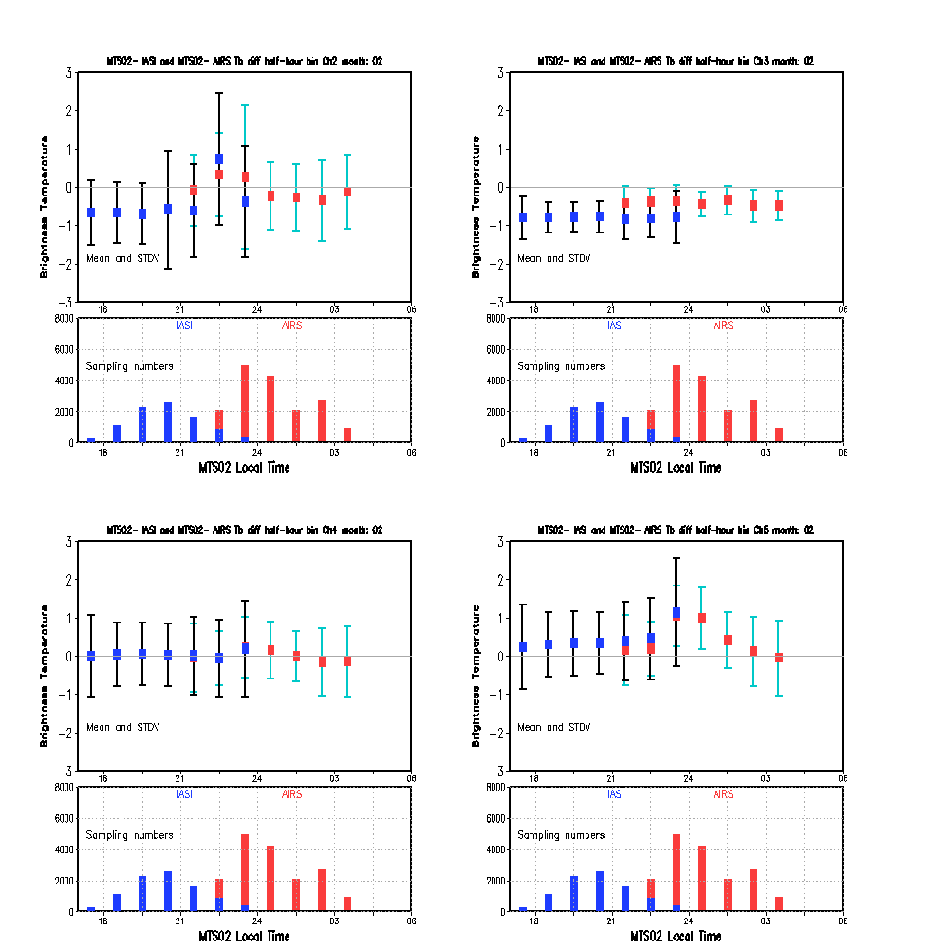
MTS02 : Feb

Slide 12
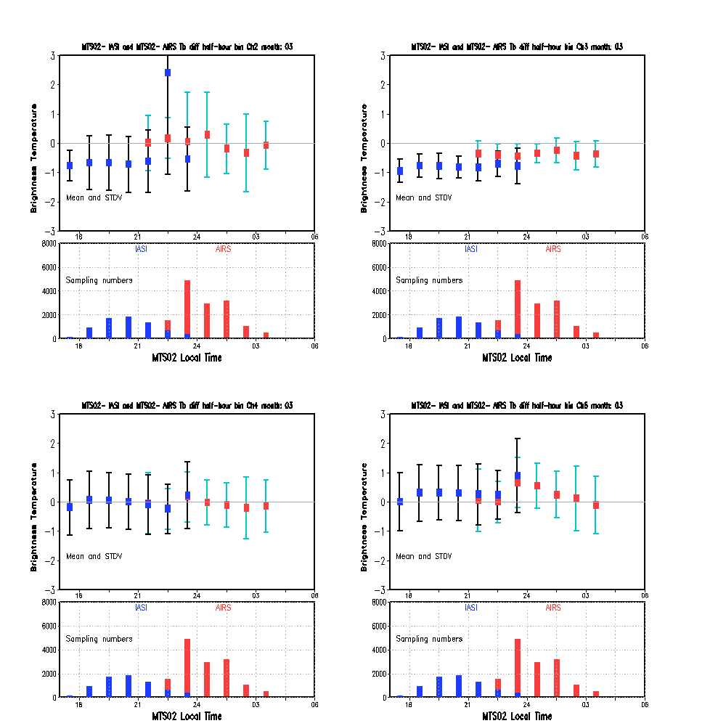
MTS02 : Mar

Slide 13
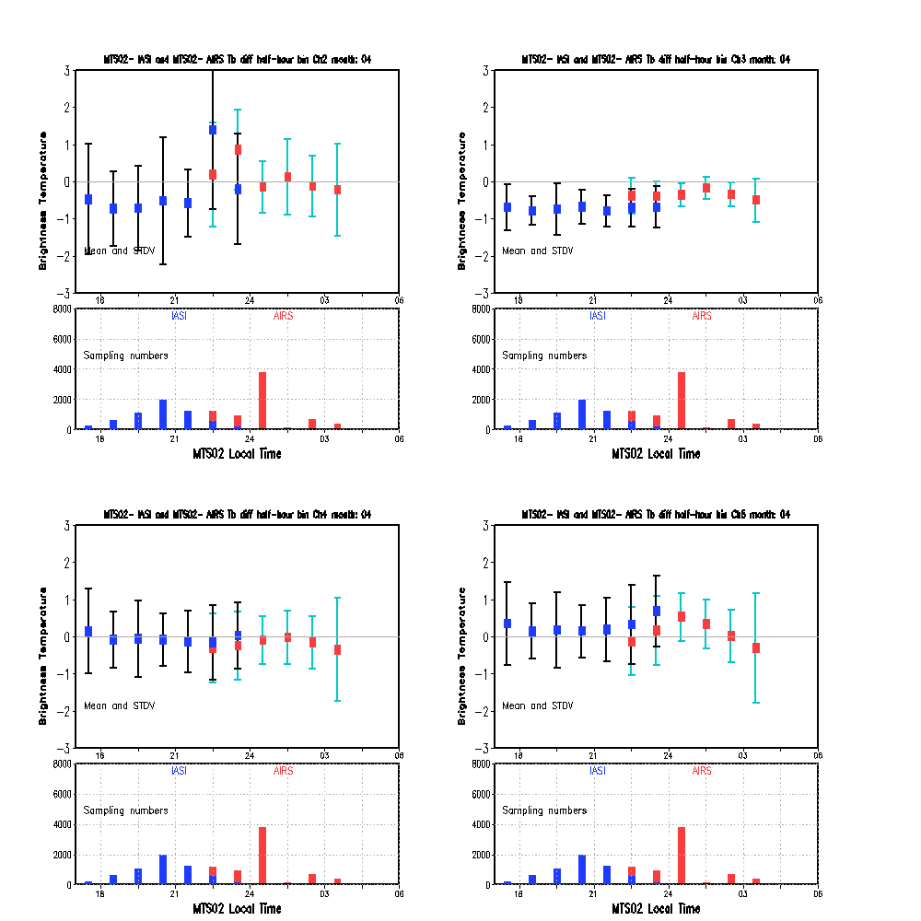
MTS02 : Apr

Slide 14
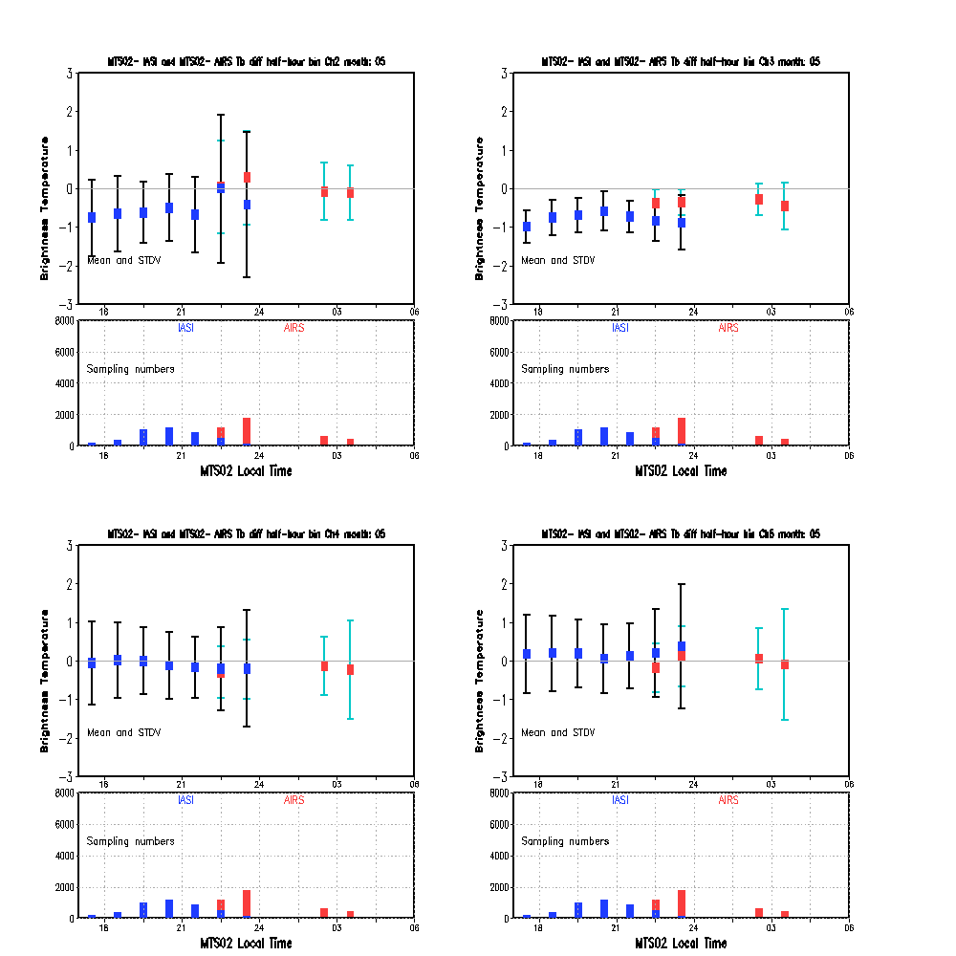
MTS02 : May

Slide 15
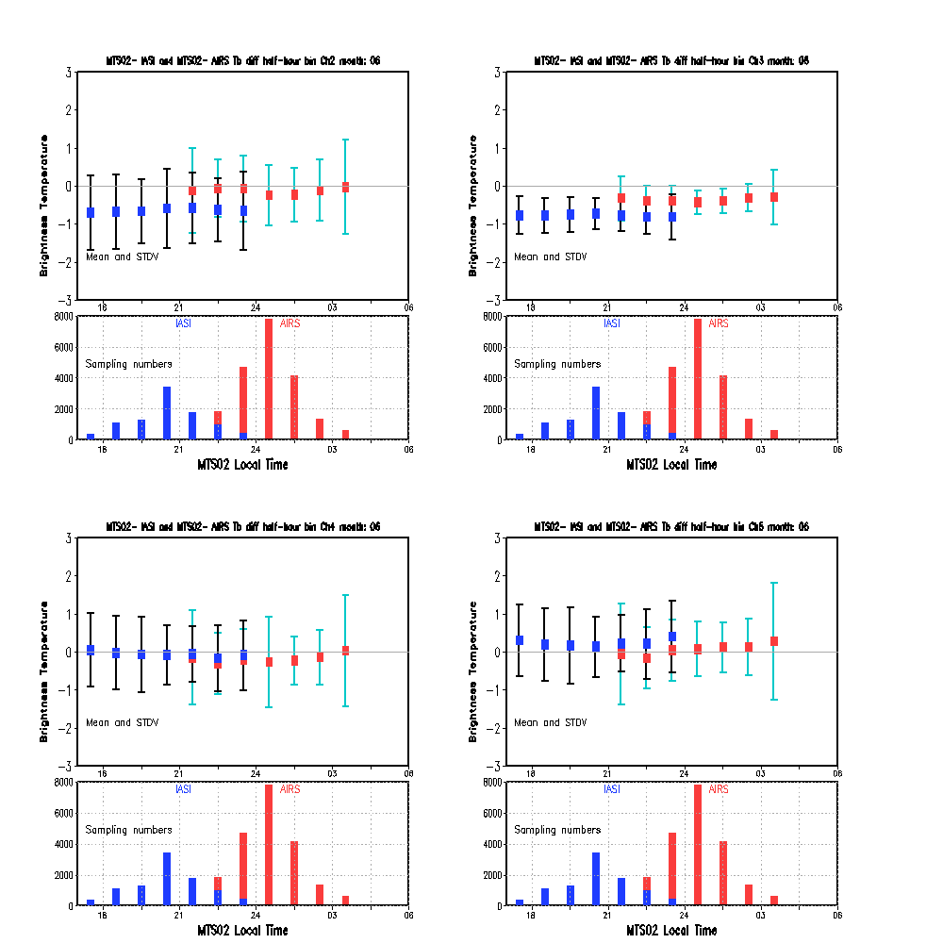
MTS02 : Jun

Slide 16
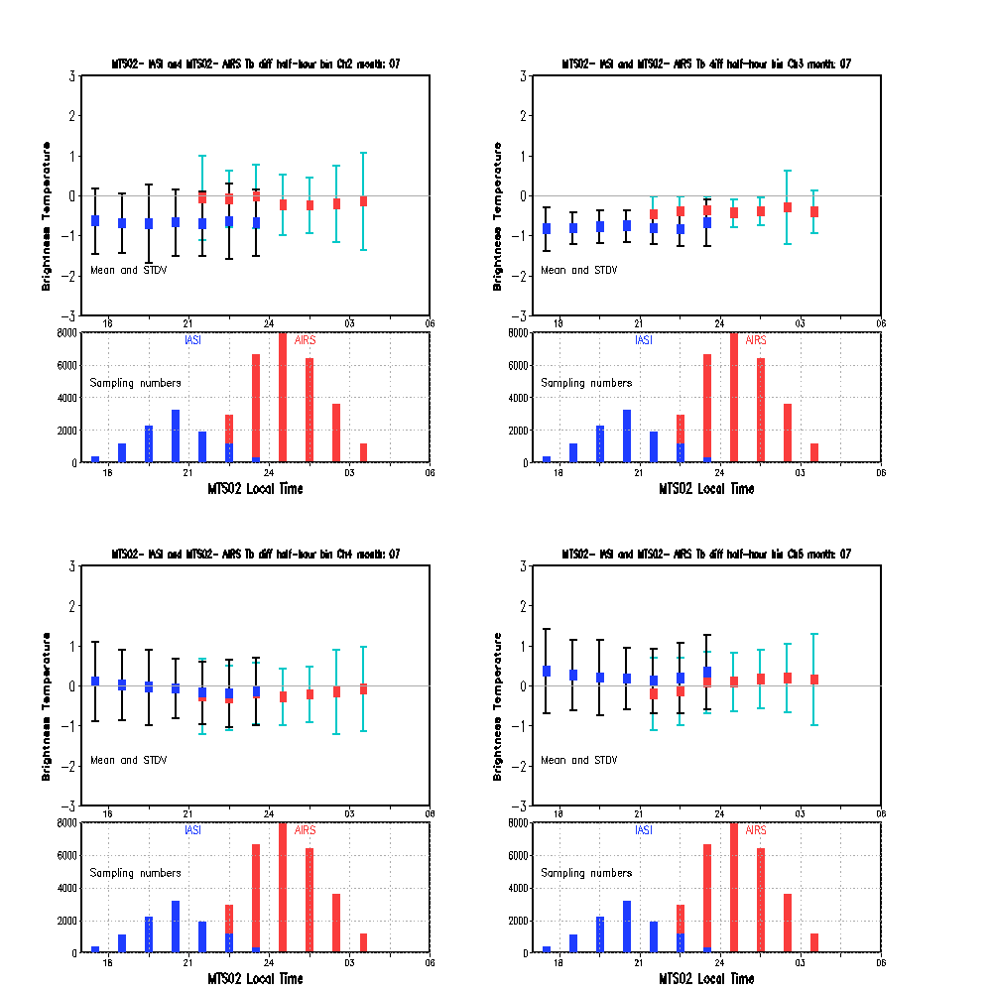
MTS02 : Jul

Slide 17
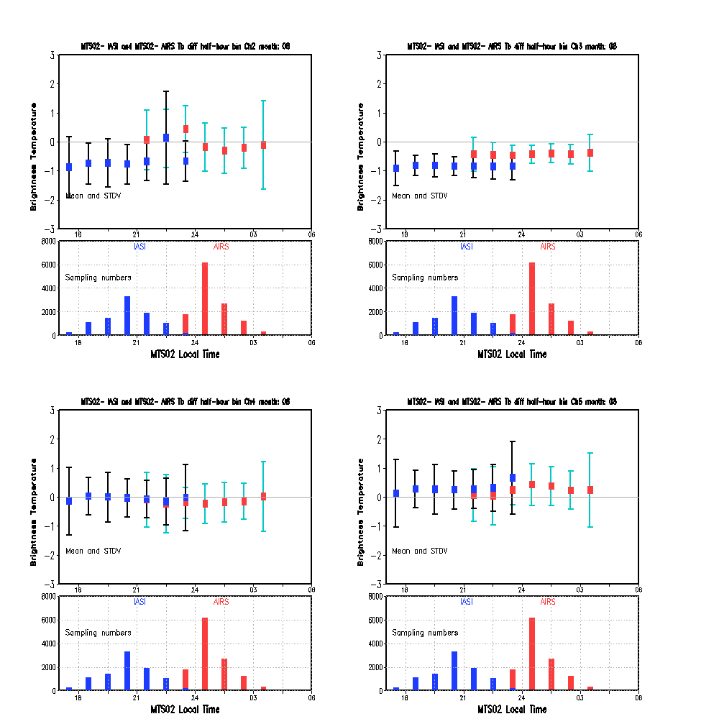
Ch1
MTS02 : Aug

Slide 18
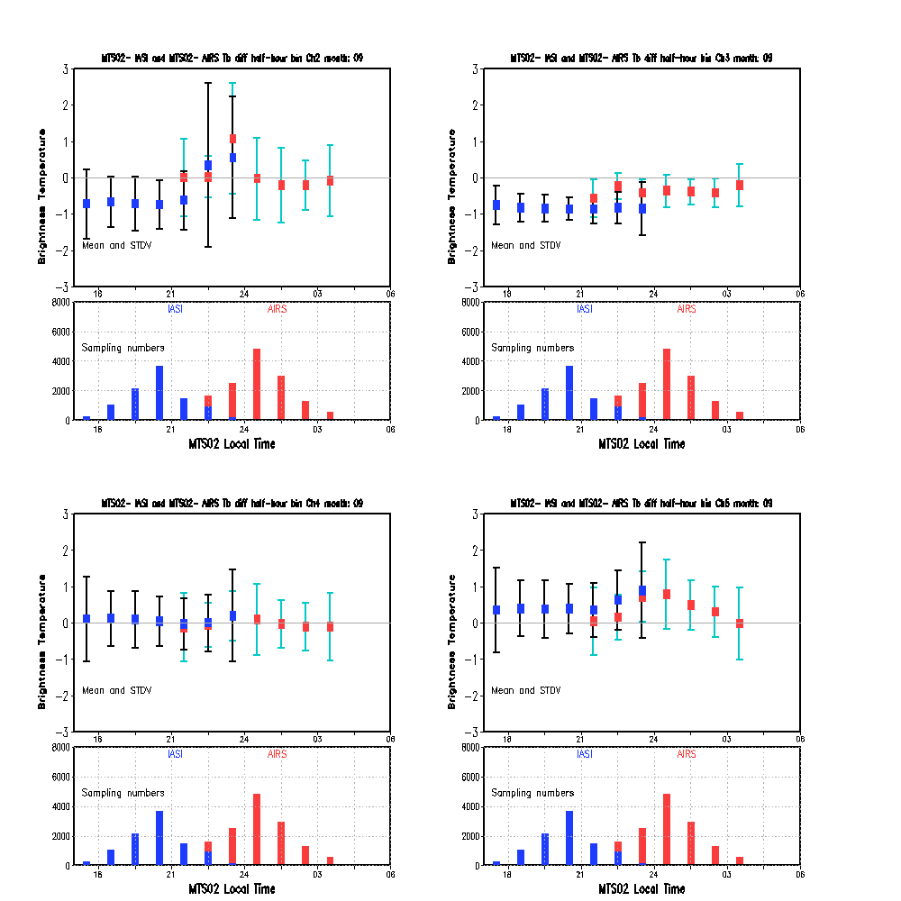
MTS02 : Sep

Slide 19
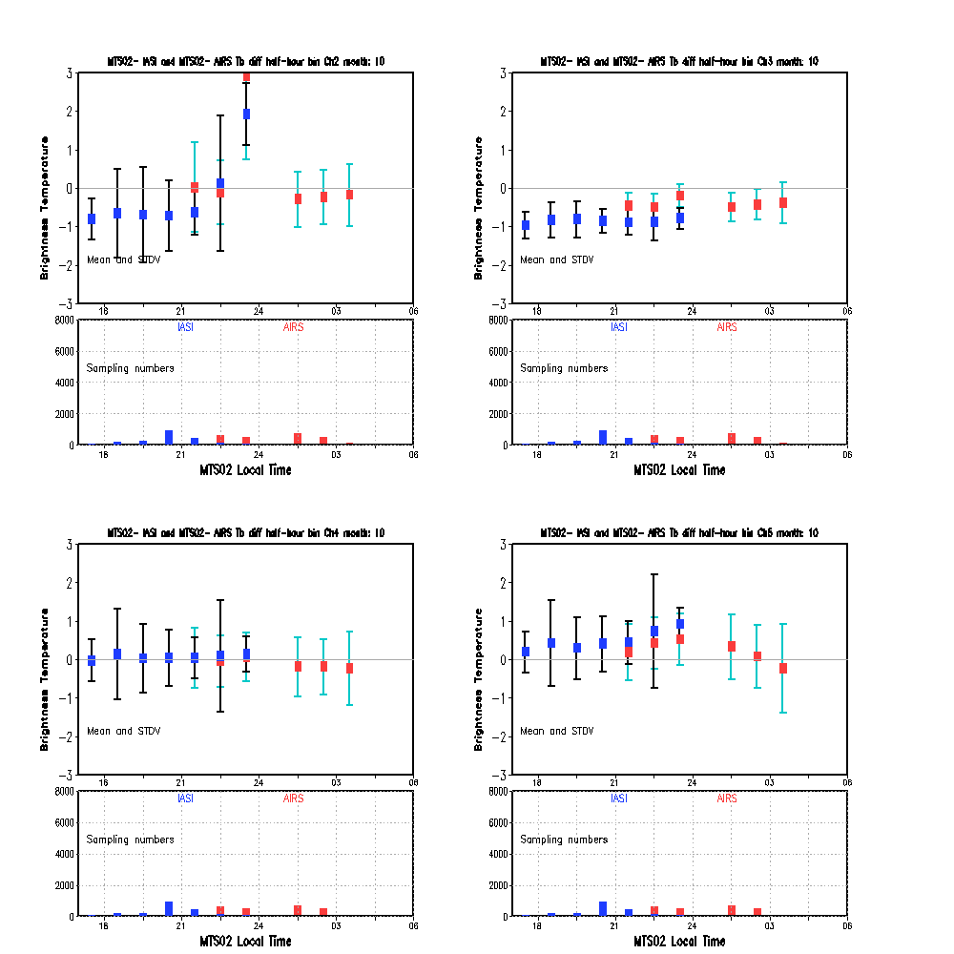
MTS02 : Oct

Slide 20
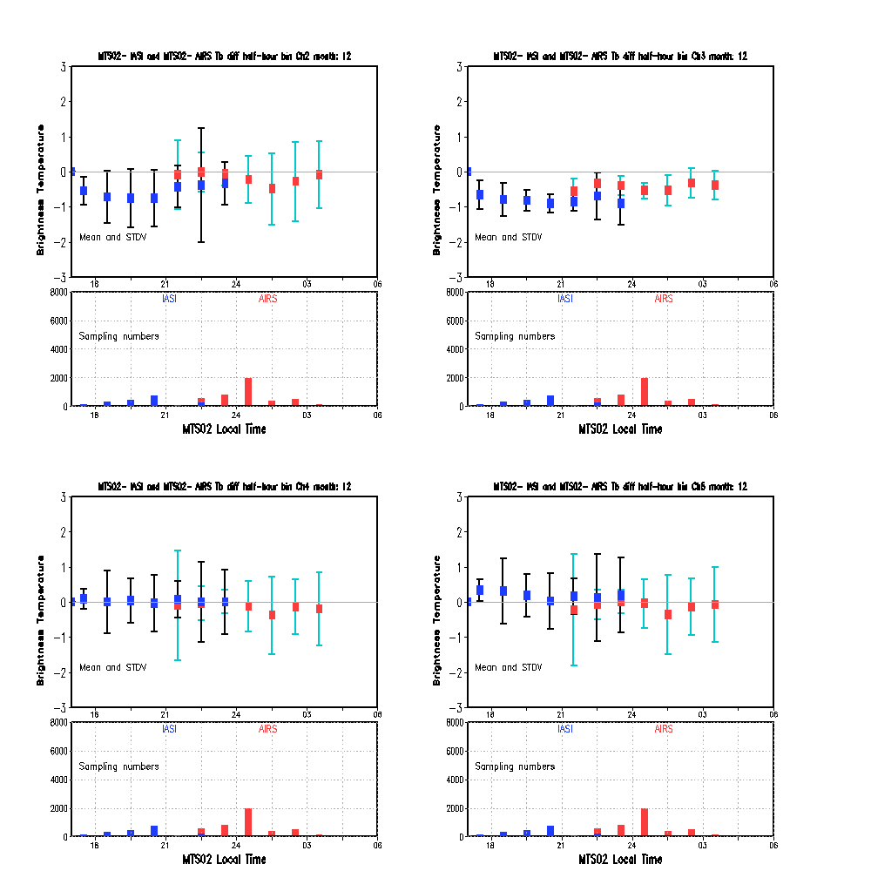
MTS02 : Dec

Slide 21
Time-dependent GSICS Correction
If the diurnal variation is caused by the instrument calibration, then
Fundamental correction with physical models
Empirical correction
Look-up table at time bin
Large uncertainty for the extreme Tb scenes
Regression correction at time bin
LEO overpass time interval (1 hour) vs. BB calibration time interval (30 minutes).
Need sufficient of collocation pixel number for the all-sky correction at each time bin
Delta correction
Use SNO and double-difference to transfer the AIRS correction to IASI with uncertainty analysis.

Slide 22
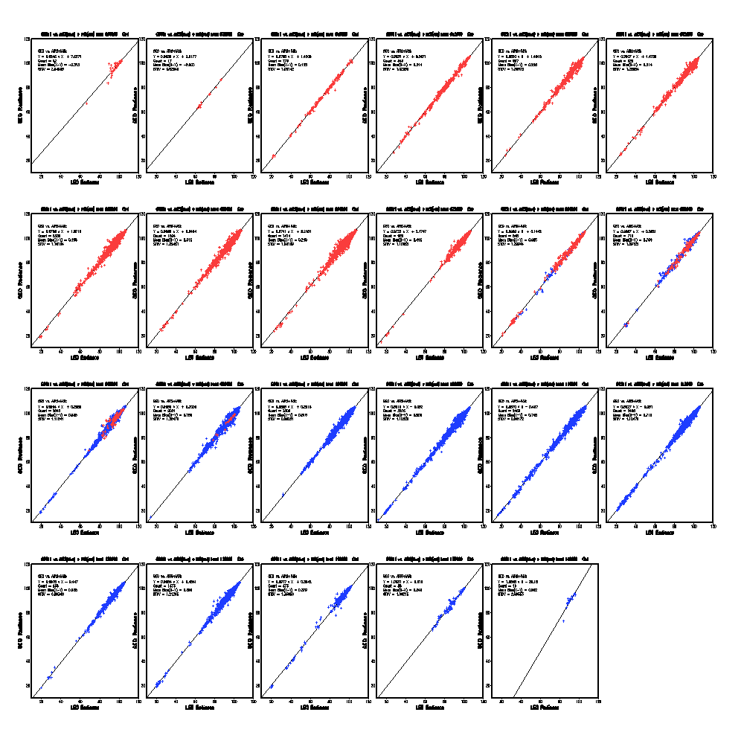
18:00
18:30
19:00
19:30
20:00
20:30
21:00
21:30
22:00
22:30
23:00
23:30
00:00
00:30
01:00
01:30
02:00
02:30
GOES-11 Ch4
03:00
03:30
04:00
04:30
05:00

