Slide 1
Handling Dependencies in the (Current) GSICS Corrections
Tim Hewison
EUMETSAT
August 2011

Slide 2
Assumptions in GSICS Corrections
Underlying assumptions of current GSICS Correction:
Stable with time
over smoothing period
Linear radiance-dependence
With variable offset term
Insensitive to all other variables
Lat, Lon, Incidence Angle, Time of Day, phase of moon, price of cheese…
Applicable over full range of conditions
Although only derived over a limited range of above variables

Slide 3
Check assumptions
Apply GSICS Correction to monitored instrument’s data
To remove radiance-dependence
Compare corrected radiances with reference instrument’s
Perform regression against the following variables:
Latitude, Longitude, Incidence Angle, Relative Azimuth Angle, Solar Zenith and Azimuth Angles
Over full validity range of GSICS Correction
E.g. Night-time only
Calculate statistical significance of results

Slide 4
Revise form of GSICS Correction
For any variables that have significant dependencies, consider:
including this variable as an additional predictor in GSICS Correction
limiting range of applicability of GSICS Correction
increasing stated uncertainties to include variability (if still within acceptable limits)
For any variables that have non-significant dependencies:
Remove any non-significant terms? (e.g. offset)
Repeat process of checking residual dependences

Slide 5
Investigate and Correct or Increase Uncertainty
If we choose not to change form of GSICS Correction:
For any variables that have significant dependencies, consider:
These are mostly instrument effects
And should be dealt with at root cause level
Before inter-calibration
By inter-action with instrument engineers/operators
Re-check validity of GSICS Correction after any changes
Then
We need to inflate the uncertainty estimates to account for additional bias variability caused by these effects

Slide 6
Significance of Slope & Offset terms of GSICS Correction

Slide 7
Approximating System response by a Linear GSICS Correction
Possible causes of non-zero offset term include:
Obscured space view
SRF errors
Inaccurate compensation for scan mirror reflectivity
Detector non-linearity
Contamination of optical elements (e.g. By water ice build-up)
Most could be manifested as a non-linear response of the system
although its response could still appear to be linear over the range of radiances covered by the collocations used to derive the GSICS Correction.
Using a linear regression of the collocated radiances would introduce a non-zero offset term.
All could potentially change with time.
Hence even if we force the offset term to zero, we should periodically perform a full linear regression to check the real offset has not changed.

Slide 8
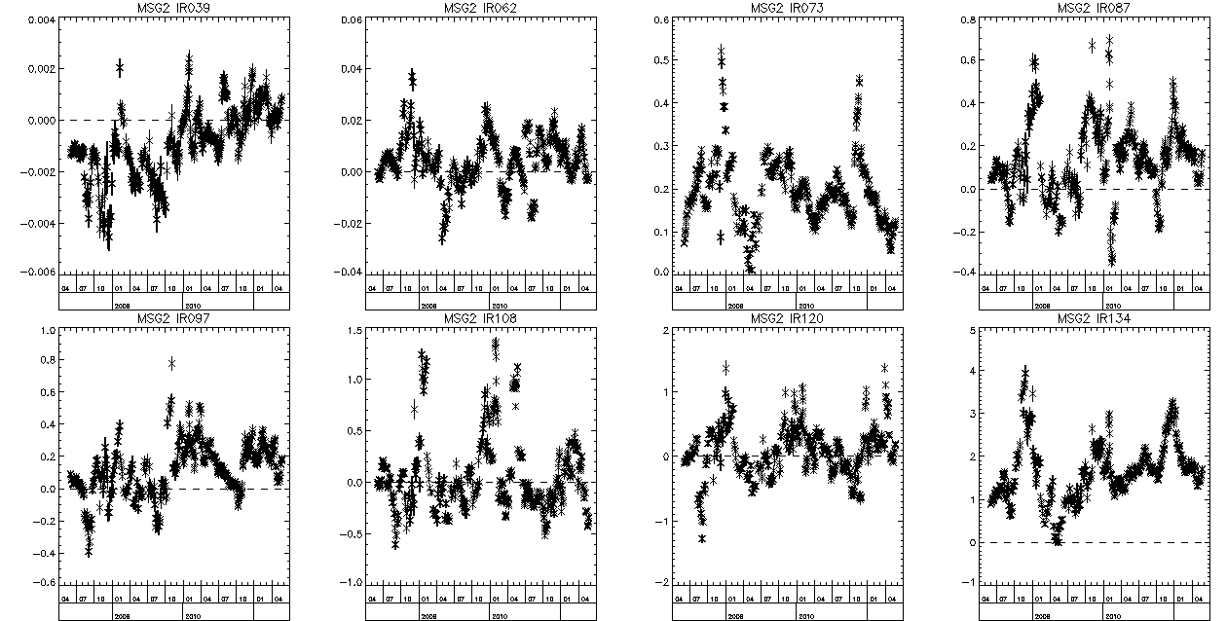
SEVIRI-IASI Regression Offset Term
Time Series of offset term of GSICS Correction for Meteosat-9 IR channels
Significantly non-zero terms for IR13.4, IR7.3 and IR3.9
n.b. Correlation between window channels and weak seasonal cycle ~±0.2K p-p

Slide 9
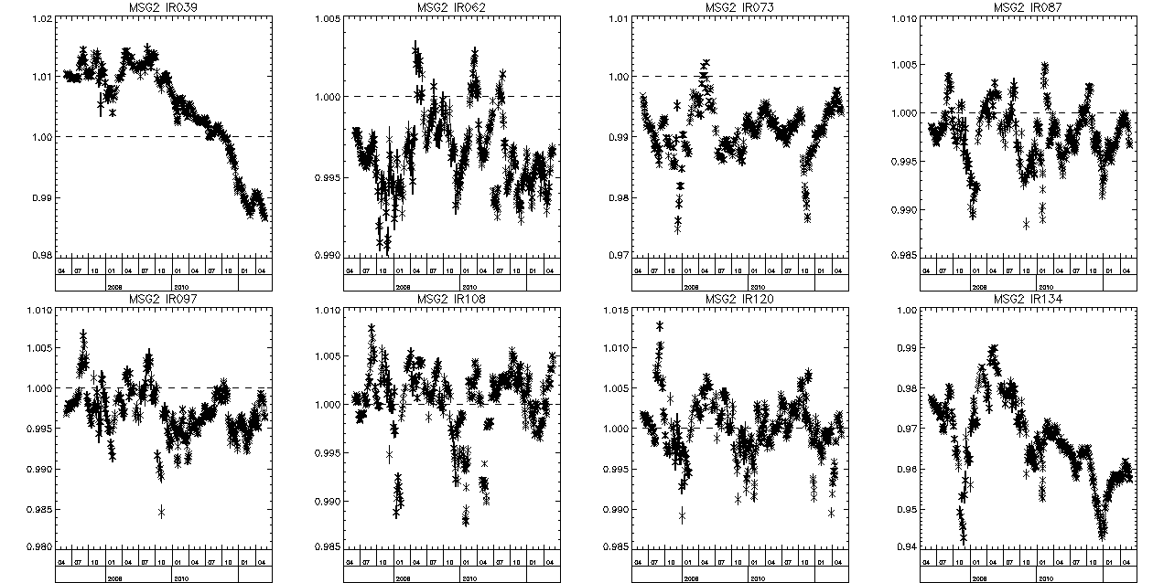
SEVIRI-IASI Regression Slope Term
Time Series of offset term of GSICS Correction for Meteosat-9 IR channels
Significantly not one terms for IR13.4, IR7.3, IR6.2 and IR3.9
n.b. Correlation between window channels and weak seasonal cycle ~±0.003 p-p

Slide 10
So, What should we do?
If we can show the offset term of a GSICS Correction is insignificant, then should we fix the offset term to zero?
If we can show the slope term is not significantly different from 1, then should we fix that too?
In both cases we can keep the same form of GSICS Correction,
just fix these terms to 0/1 and their uncertainties to the limit of detection.
Either by adding heavily weighted point at (0,0)
or calculating weighted average of radiance ratios
If we do, then we need to build checks into the ATBD to ensure these terms stay insignificant
and if not, that they are re-introduced into the correction manually.
How could we do that? E.g. Calculate deviations outside uncertainty limits. Uncertainty need to be limited manually – e.g. at quantisation/noise level?

Slide 11
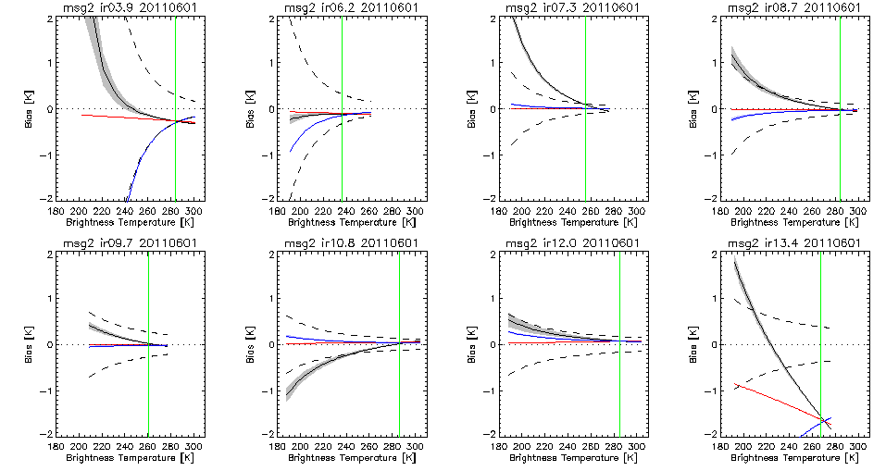
What happens if we force OFFSET=0?
Significant Offset
Significant Offset
Black - with grey 1-sigma shading = GSICS Correction, based on weighted linear regression
Red - with 1-sigma shading = Fixing OFFSET=0 in weighted regression (weighted ratio)
Blue - with 1-sigma shading = Fixing SLOPE=1 in weighted regression (weighted difference)
Black dashed lines = Radiometric Noise Level, NE∆T(Tb)
Green - Standard Radiance Scenes

Slide 12
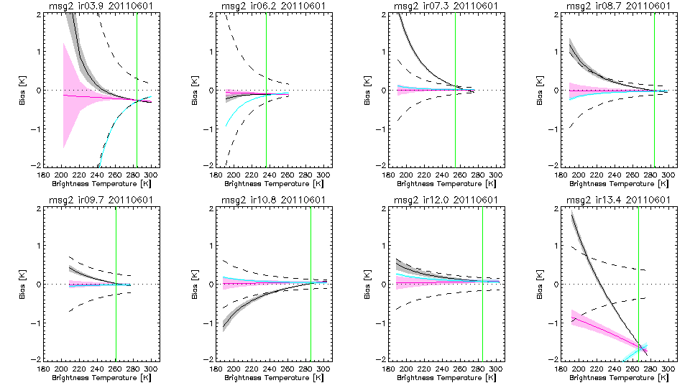
What happens if we force OFFSET=0?
Significant Offset
Significant Offset
Black - with grey 1-sigma shading = GSICS Correction, based on weighted linear regression
Red - with 1-sigma shading = Fixing OFFSET=0 in weighted regression (weighted ratio)
Blue - with 1-sigma shading = Fixing SLOPE=1 in weighted regression (weighted difference)
Black dashed lines = Radiometric Noise Level, NE∆T(Tb)
Green - Standard Radiance Scenes

Slide 13
Outcome
Uncertainties are smaller for warm scenes with OFFSET=0 or SLOPE=1
as expected as there are more degrees of freedom to fit the data
But especially at low scene radiances,
which is not surprising, as this is why I did it!
Obviously the biases tend to zero at low scene radiances when fixing OFFSET=0
Tend to weighted regression values for scenes typical tropical clear sky radiances
The biases are surprisingly linear with scene Tb for OFFSET=0
Could estimate bias at any scene Tb by scaling standard scene bias linearly with Tb
(and the same for its uncertainty)
GSICS Correction is comparable to radiometric noise for most channels
Correction < Noise for warm scenes for all, except IR13.4
Correction > Noise for cold scenes in IR13.4, IR7.3, IR8.7 and IR10.8 (IR13.4, IR7.3 have significant offset terms)
So although it adds noise, users would only notice in climate averages (but these are still important applications we should cater for)

Slide 14
Discussion
If we find significant sensitivities, Should we add these as predictors in GSICS Correction?
How?
If terms of GSICS Correction are not significant, Should we fix these?
e.g. OFFSET=0, SLOPE=1
Or some other value?
Do we need different versions of GSICS Correction?
e.g. for different applications
Role of Baseline

