Slide 1
Why and How to Fix Slope & Offset terms of GSICS Correction
Tim Hewison
EUMETSAT
August 2011

Slide 2
Approximating System response by a Linear GSICS Correction
Possible causes of non-zero offset term include:
Obscured space view
SRF errors
Inaccurate compensation for scan mirror reflectivity
Detector non-linearity
Contamination of optical elements (e.g. By water ice build-up)
Most could be manifested as a non-linear response of the system
although its response could still appear to be linear over the range of radiances covered by the collocations used to derive the GSICS Correction.
Using a linear regression of the collocated radiances would introduce a non-zero offset term.
All could potentially change with time.
Hence even if we force the offset term to zero, we should periodically perform a full linear regression to check the real offset has not changed.

Slide 3
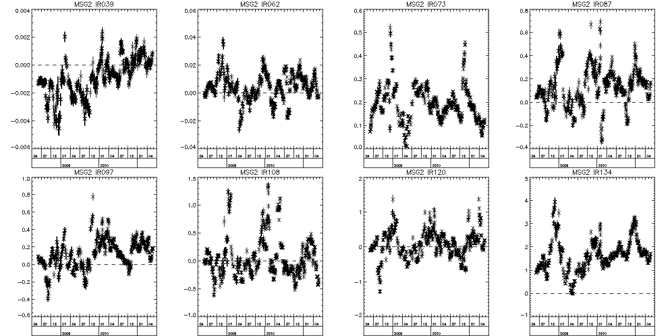
SEVIRI-IASI Regression Offset Term
Time Series of offset term of GSICS Correction for Meteosat-9 IR channels
Significantly non-zero terms for IR13.4, IR7.3 and IR3.9
n.b. Correlation between window channels and weak seasonal cycle ~±0.2K p-p

Slide 4
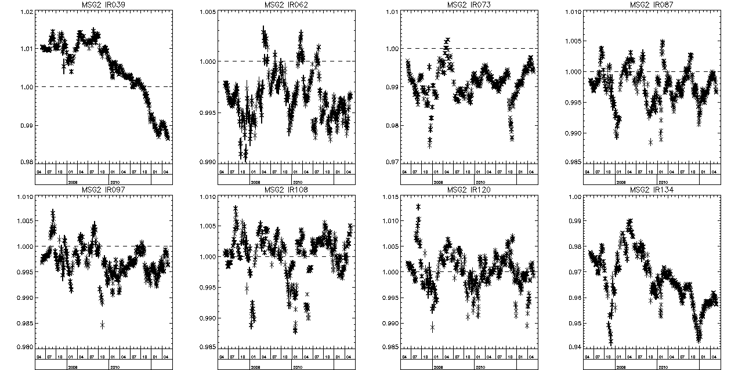
SEVIRI-IASI Regression Slope Term
Time Series of offset term of GSICS Correction for Meteosat-9 IR channels
Significantly not one terms for IR13.4, IR7.3, IR6.2 and IR3.9
n.b. Correlation between window channels and weak seasonal cycle ~±0.003 p-p

Slide 5
So, What should we do?
If we can show the offset term of a GSICS Correction is insignificant, then should we fix the offset term to zero?
If we can show the slope term is not significantly different from 1, then should we fix that too?
In both cases we can keep the same form of GSICS Correction,
just fix these terms to 0/1 and their uncertainties to the limit of detection.
Either by adding heavily weighted point at (0,0)
or calculating weighted average of radiance ratios
If we do, then we need to build checks into the ATBD to ensure these terms stay insignificant
and if not, that they are re-introduced into the correction manually.
How could we do that? E.g. Calculate deviations outside uncertainty limits. Uncertainty need to be limited manually – e.g. at quantisation/noise level?

Slide 6
Are Offset Variations Instrumental?
Do instrument variations introduce some observed variability in GSICS Correction?
If so, they may be “real” variations in calibration
Should be kept
If not, they may be artefacts of inter-calibration process
Could be discarded
Although offset variations are correlated between channels, they are uncorrelated with T_{bb}
=> Introduced by inter-calibration?
Tim Series of Offset term of GSICS Correction for IR10.8 channel of Meteosat-9 (black) and Blackbody temperature (red)

Slide 7
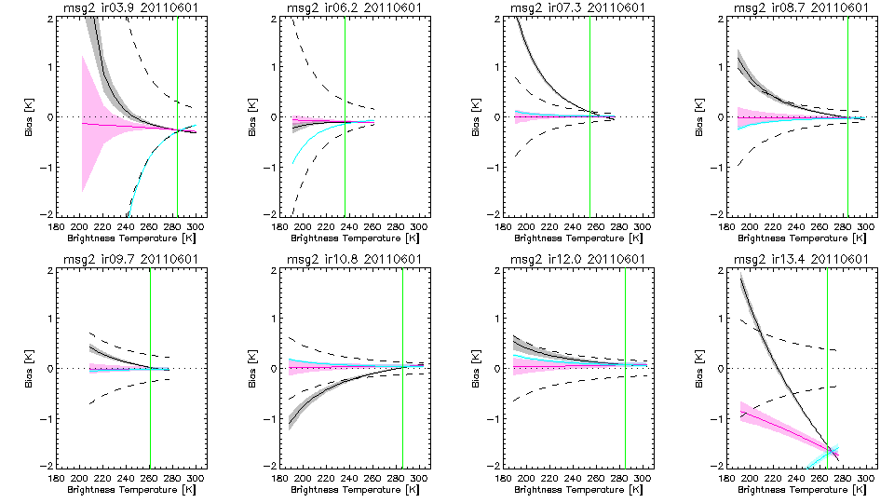
What happens if we force OFFSET=0?
Significant Offset
Significant Offset
Black - with grey 1-sigma shading = GSICS Correction, based on weighted linear regression
Red - with 1-sigma shading = Fixing OFFSET=0 in weighted regression (weighted ratio)
Blue - with 1-sigma shading = Fixing SLOPE=1 in weighted regression (weighted difference)
Black dashed lines = Radiometric Noise Level, NE∆T(Tb)
Green - Standard Radiance Scenes

Slide 8
Outcome
Uncertainties are smaller for warm scenes with OFFSET=0 or SLOPE=1
as expected as there are more degrees of freedom to fit the data
But especially at low scene radiances,
which is not surprising, as this is why I did it!
Obviously the biases tend to zero at low scene radiances when fixing OFFSET=0
Tend to weighted regression values for scenes typical tropical clear sky radiances
The biases are surprisingly linear with scene Tb for OFFSET=0
Could estimate bias at any scene Tb by scaling standard scene bias linearly with Tb
(and the same for its uncertainty)
GSICS Correction is comparable to radiometric noise for most channels
Correction < Noise for warm scenes for all, except IR13.4
Correction > Noise for cold scenes in IR13.4, IR7.3, IR8.7 and IR10.8 (IR13.4, IR7.3 have significant offset terms)
So although it adds noise, users would only notice in climate averages (but these are still important applications we should cater for)

Slide 9
Discussion
If terms of GSICS Correction are not significant, Should we fix these?
e.g. OFFSET=0, SLOPE=1 - Or some other value?
How?

