Slide 1
Preliminary Results of the use of GOME-2 data in the GOES Imager Visible Calibration
Xiangqian Wu¹, Haifeng Qian², and Fangfang Yu³
1: NOAA/NESDIS/STAR
2: IMSG @ NOAA/NESDIS/STAR
3: ERT, Inc. @ NOAA/NESDIS/STAR

Slide 2
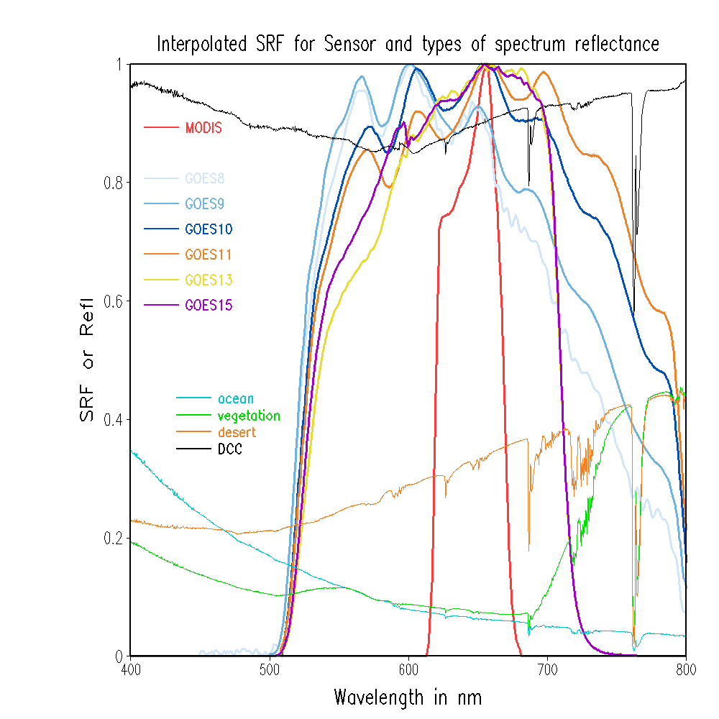
GOES/MODIS SRFs and spectral refl
GOES10/GOES12
GOES14/GOES15

Slide 3
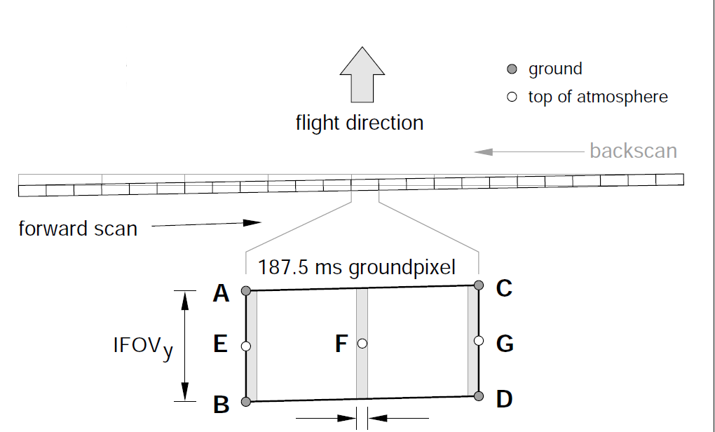
GOME2 scan line pattern (one mode)
2
3
25
80km
GOME-2 Band 3 & Band 4 (391-798nm)
Normal scan mode with 80km x 40km spatial resolution
24 near nadir GOME-2 pixels used
40km

Slide 4
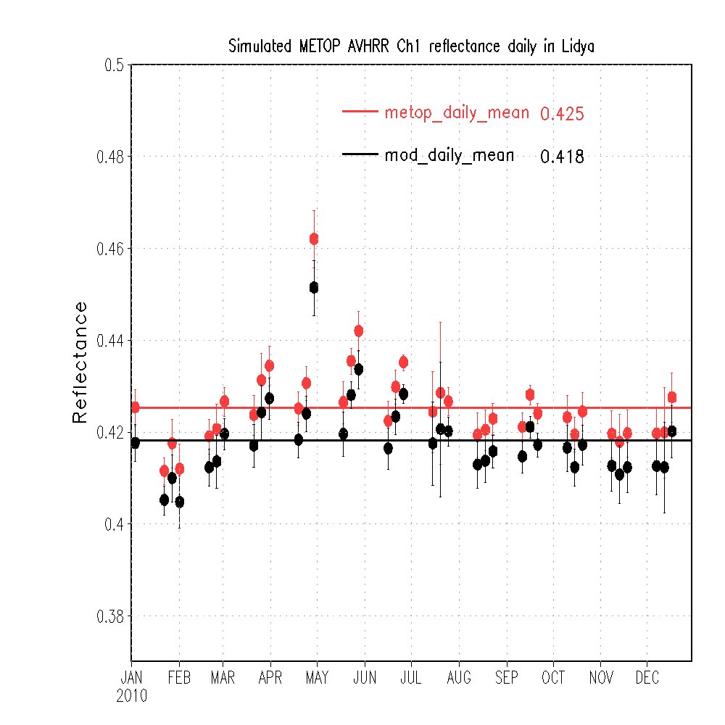
GOME-2 Simulated Reflectance in Libya Desert
Reference reflectance for the METOP AVHRR Ch1 operational calibration is 0.378
Simulated METOP Band 1 refl with GOME-2: 0.425
Simulated MODIS Band 1 refl. with GOME-2: 0.418
About 1.6% radiometric calibration difference due to SRF
GOEM-2 data shows seasonal variations
Monthly mean and the standard deviation of MODIS band 1 and GOME-2 simulated MODIS reflectance at Libyan desert in 2010.

Slide 5
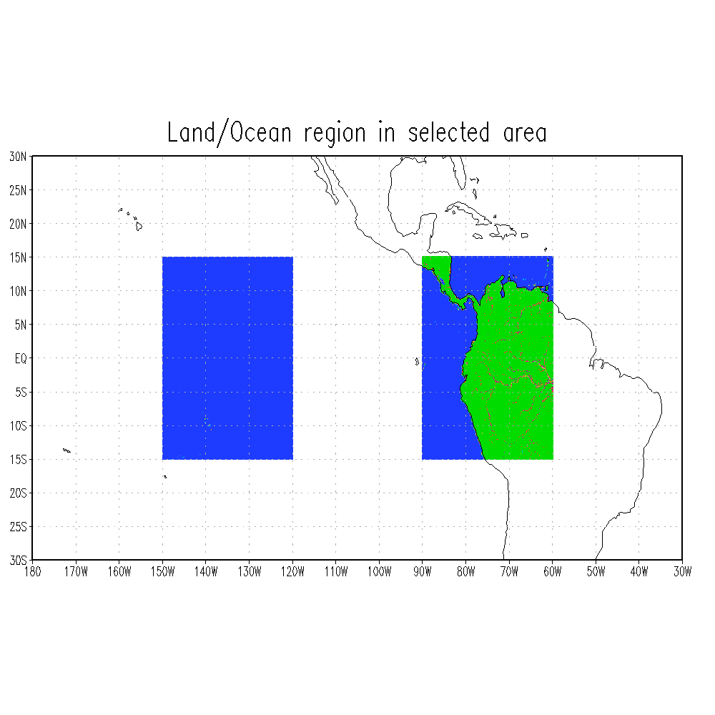
GOES-East/West
GOES-West
GOES-East

Slide 6
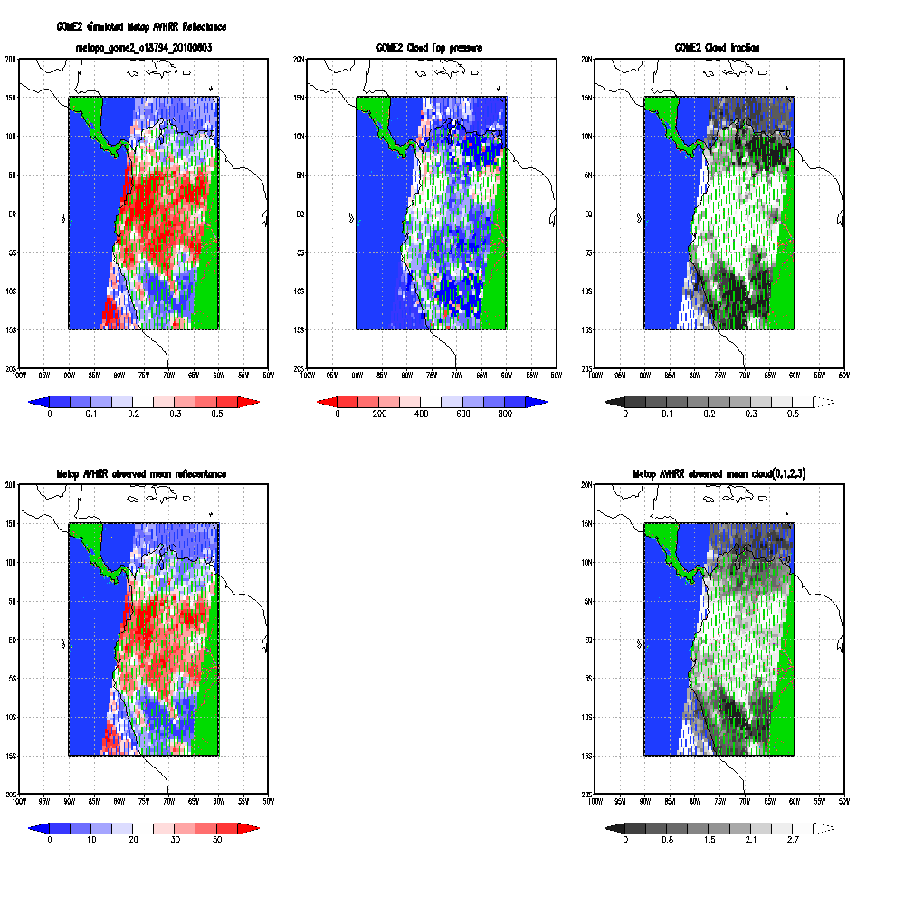
GOME2 simulated reflectance GOME2 Top Pressure GOME2 cloud fraction
Example comparison of reflectance/cloud in GOME2-AVHRR collocation
AVHRR obs mean reflectance
AVHRR obs mean cloud

Slide 7
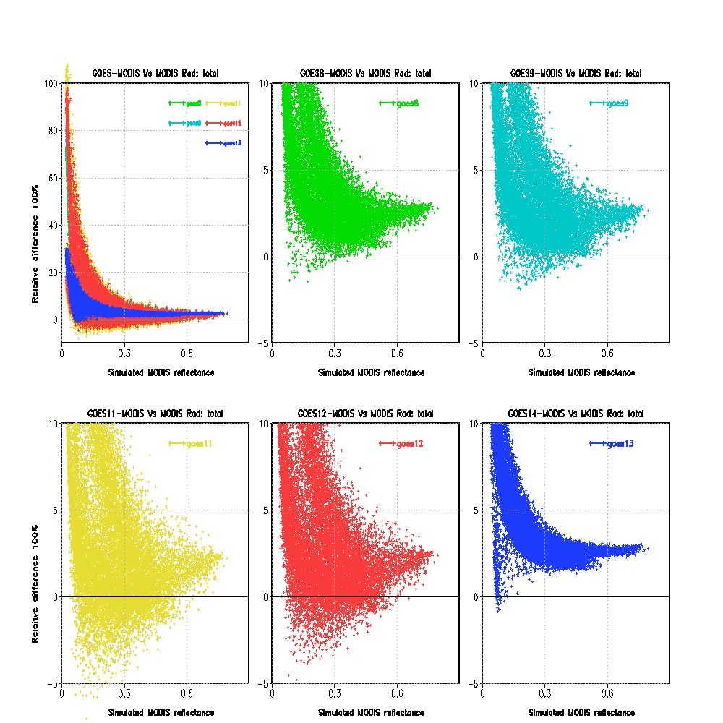
Simulated (GOES – MODIS) vs MODIS

Slide 8
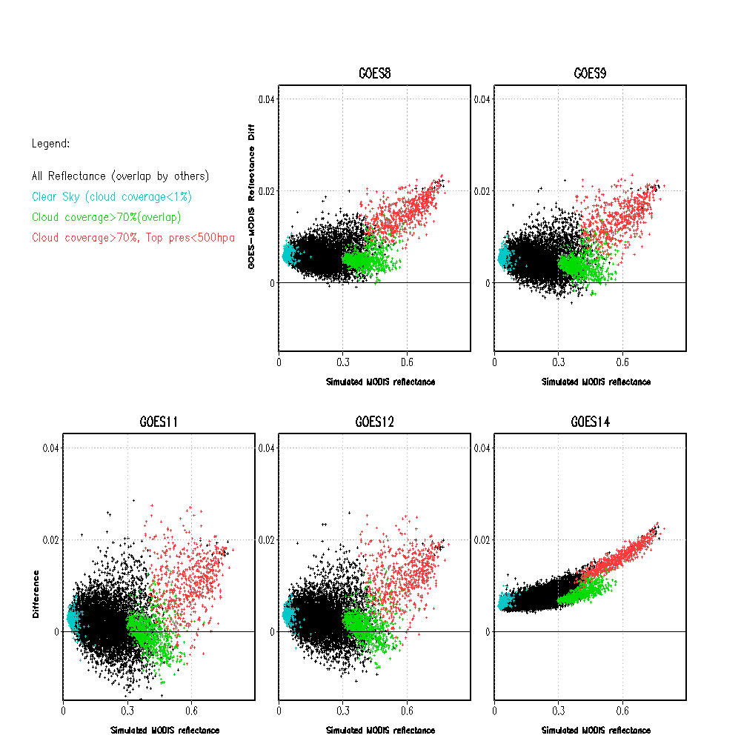
Spectral Characterization of Different Cloud Types
Collocated Metop-A AVHRR and GOME-2 data
Difference in GOES and MODIS (Band1) SRFs causes relative reflectance difference patterns at different cloud types
Differences are well behaved for GOES-14
Work is undergoing to use DCC as the reference for the spectral calibration traceability to MODIS
SRFs of GOES-8 thru 15 and MODIS band 1, together with the spectra of DCC, desert, ocean and green vegetation.
Difference between the simulated GOES and MODIS reflectance for GOES-East over different cloud types.

Slide 9
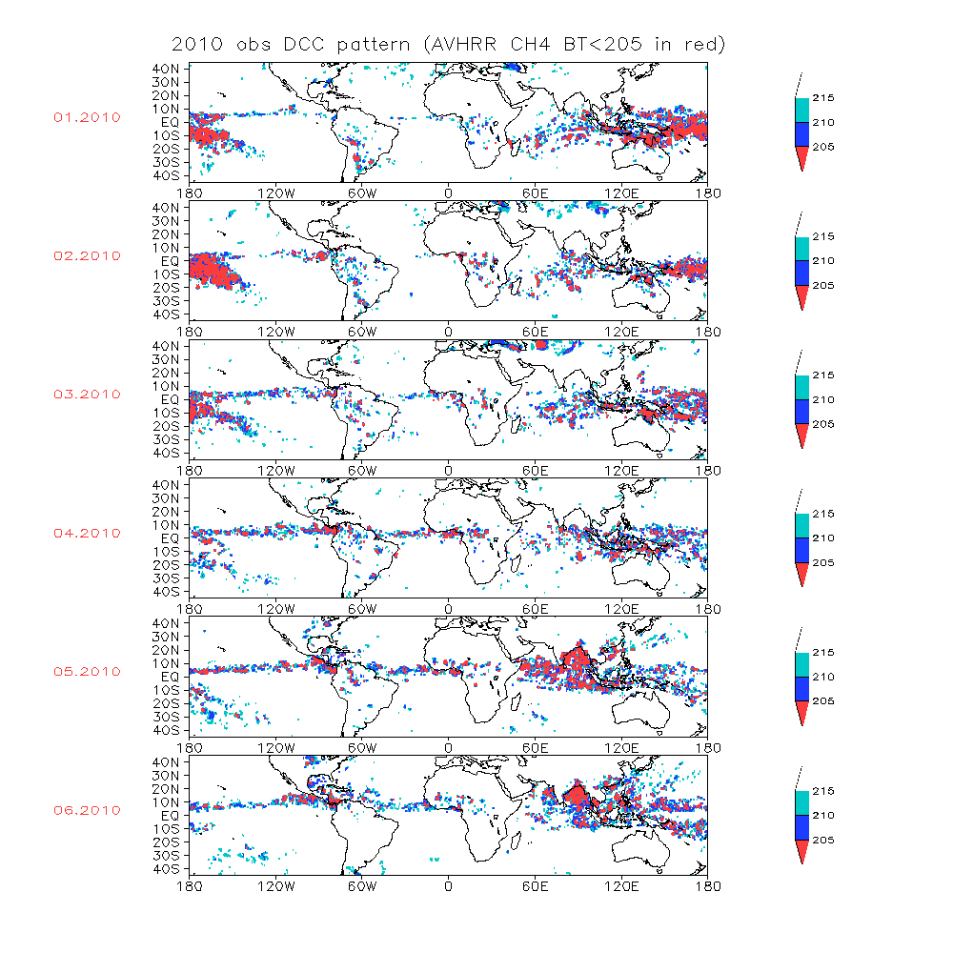
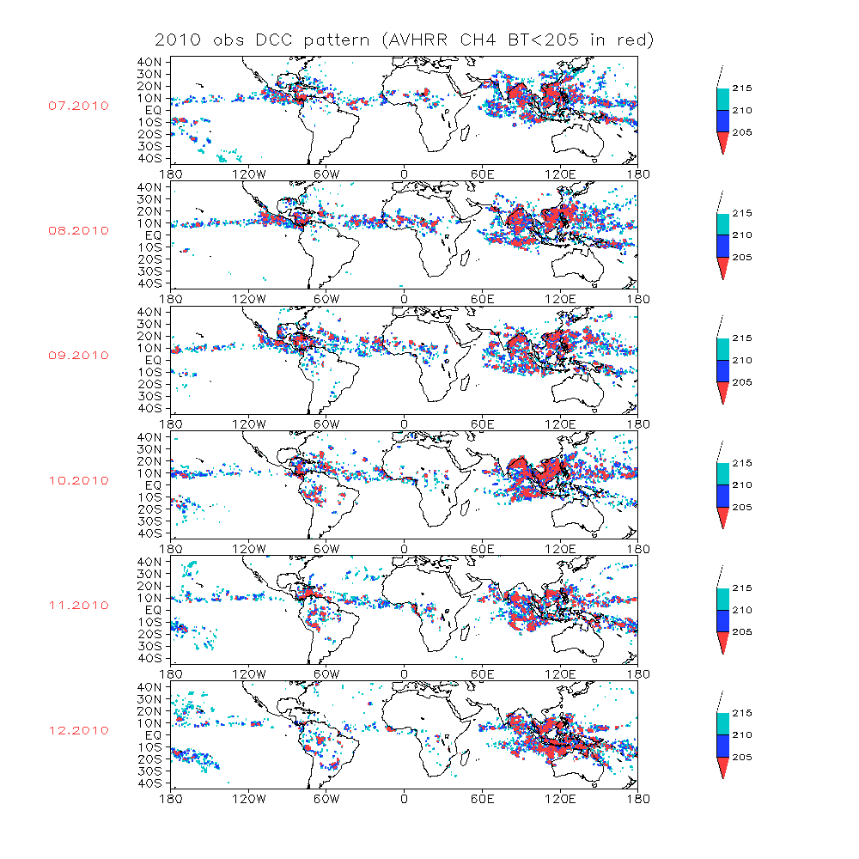
DCC Spatial & Temporal Distribution
Deep Convective Cloud (DCC) is identified with Metop-A AVHRR data
Most DCC are distributed at the eastern Hemisphere, especially over the Pacific Ocean
GOES-East will observe much more DCC pixels in summer than winter
Jan
Jul
Feb
Aug
Mar
Sep
Apr
Oct
May
Nov
Jun
Dec

Slide 10
Conclusion
Hyper-spectral GOME-2 observation is reliable for the use in the GOES Imager Visible Calibration;
Deep Convective Cloud (DCC) identified with Metop-A AVHRR data shows spatial seasonal patterns.
Under bright clouds, the impact of different sensor spectrum response function (SRF) on the GOES/MODIS calibration tends to be stable.
Next step is to use DCC to quantify the impact.

