Slide 1
GOES Lunar Calibration
Comparison of GOES lunar calibration vs. other vicarious calibration methods

Slide 2
Lunar Calibration of GOES Visible Channel
X. Wu F. Yu T. Stone G. Rancic M. Grotenhuis
NOAA ERT, Inc USGS IMGS ERT, Inc
- Based on the presentations in SPIE’06 and Calcon’06

Slide 3
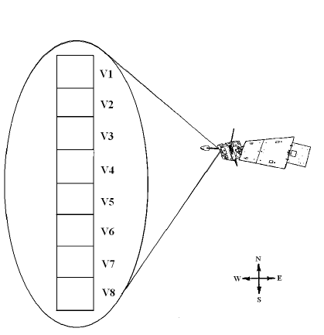
GOES Imager Visible Channel
Linear array of 8 detectors
IGFOV = 28 µrad
Only one calibration source: space clamp
Scan the field of regard (FOV) back and forth
Multiple scan modes

Slide 4
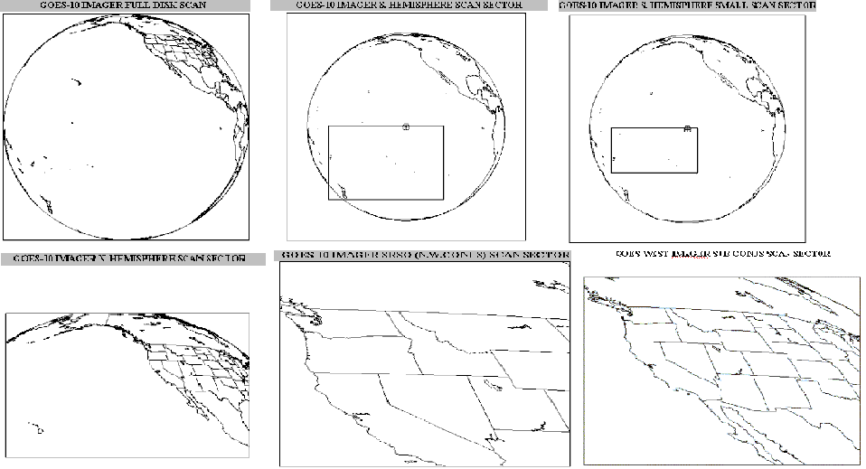
GOES-10 (GOES West) Scan Modes

Slide 5
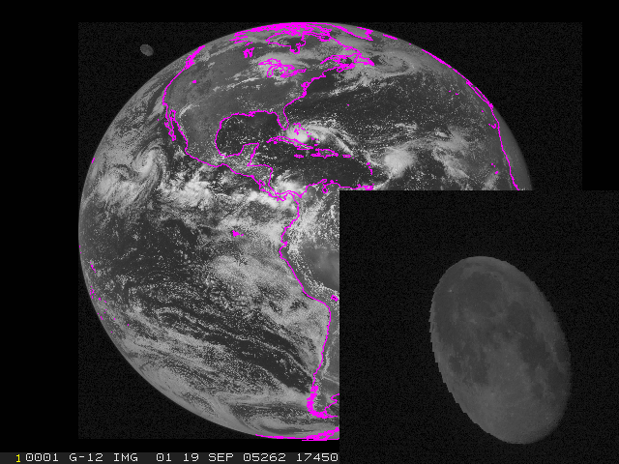
Good Data

Slide 6
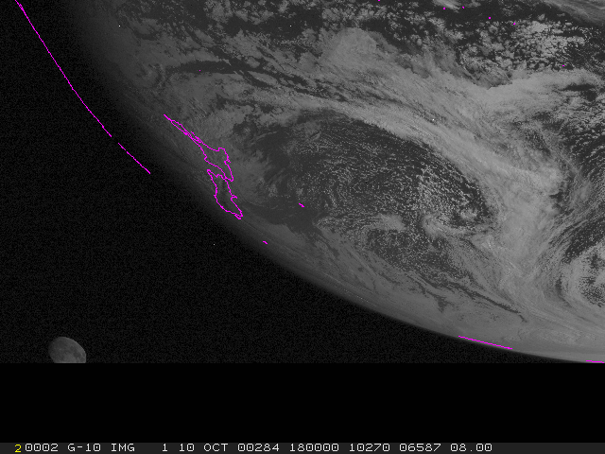
Clipped by edge
Challenging to know the fraction and orientation of the unclipped part

Slide 7
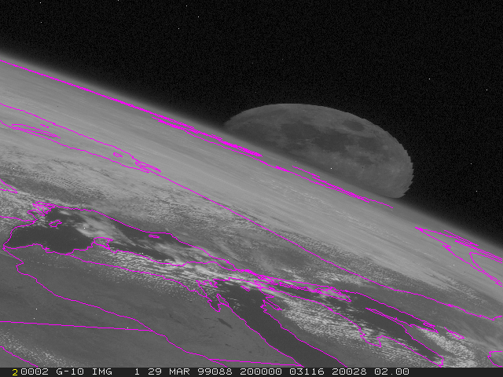
Clipped by the Earth
Little hope to derive lunar irradiance

Slide 8
Unscheduled Data Collection
Predicted gibbous Moon appearance within the GOES FOR (about three times a month on average)
Found 21 suitable observations for GOES-10 in 7.5 years between July 1998 to December 2005.
Five of the 21 cases have a second lunar image within ~ one hour

Slide 9
Scheduled Data Collection
Began in November 2005
One or two scheduled gibbous lunar image every month for each GOES
  Used ~one minute of star view time with negligible impact on navigation

Slide 10
y(t) is the least-squares fit of R(t)

Slide 11
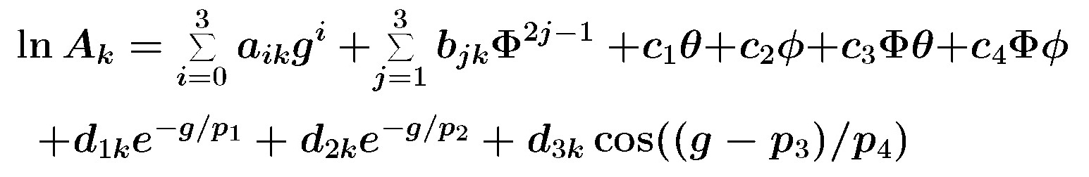
ROLO Irradiance Model
E_{Model} = A Ω_{M} E_{S} / π
E_{Model}: Modeled lunar irradiance

Slide 12
Measured Lunar Irradiance
i: Index of Moon pixel
R_{i}: Radiance from pixel i
ω_{i}: Solid angle subtended by pixel i
Since
So
E_{GOES} = ωS∑_{i}(C^{i}_{R} – C_{S})

Slide 13
Moon Location
Baseline – 400 X 700 pixels containing the Moon
Alternative – fit to ellipse
  Finding the edge
  Least squares fit
  Further adjustment
    Growing
    Fixed mask of ten extra pixels – works best so far

Slide 14
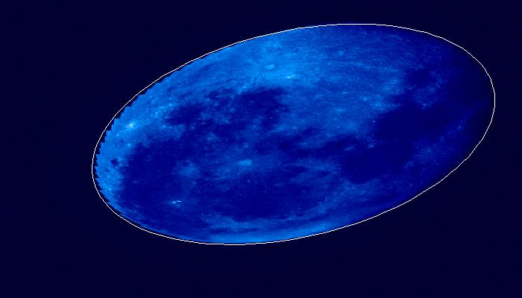
1998_221_210021

Slide 15
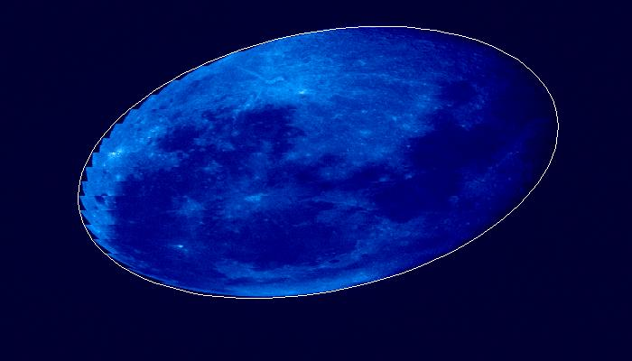
1998_221_220035

Slide 16
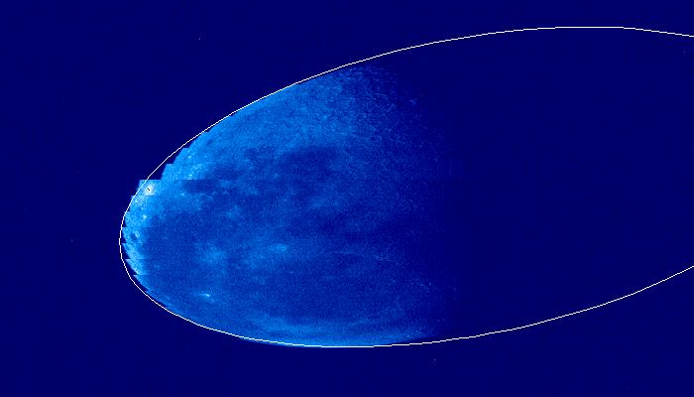
2005_208_013551

Slide 17
Space View
Most critical
  If well known, Moon location becomes less relevant
  If poorly known, best knowledge of Moon location can still lead to error in lunar irradiance
Baseline – Constant of 29
  Drift (between clamps)
  Truncation – half count is 0.4-1.4% of signal (so mode is also inadequate)
Concerns
  Stray light near the Moon edge?
  Striping – space count for individual detector/line

Slide 18
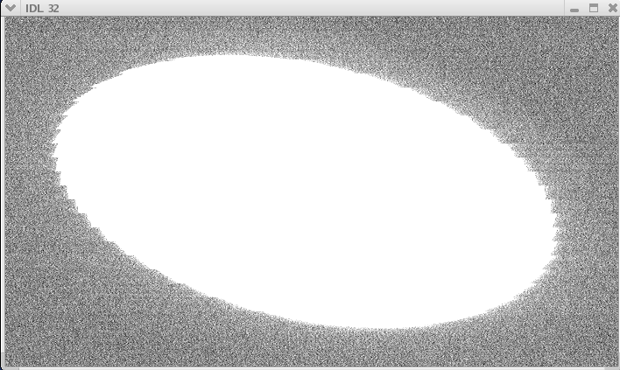
Fussy Moon Edge

Slide 19
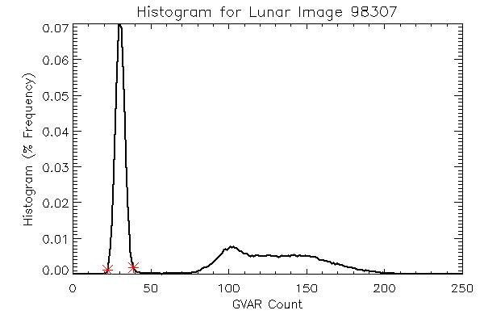
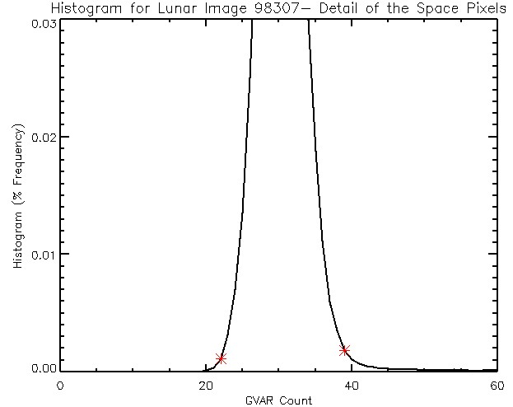
Identification of Space Pixel

Slide 20
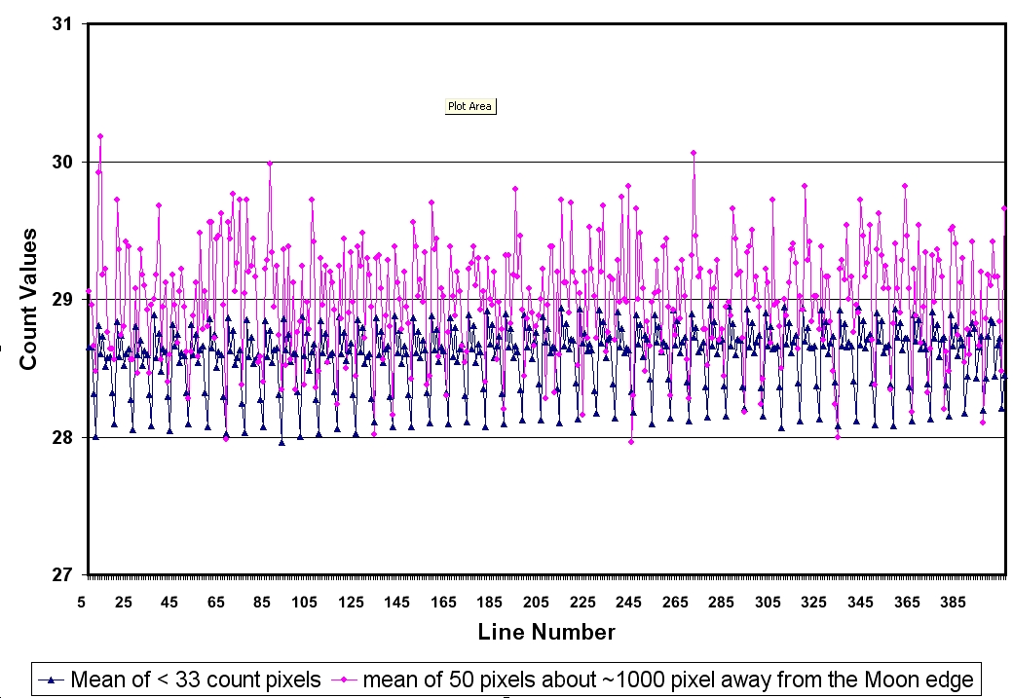
Striping

Slide 21
Result
 |  | Constant | Mode | Selected Mean
All Pixels | A | 1.081 | 1.010 | 1.029
 | β | -0.048 | -0.045 | -0.049
 | SE | 0.038 | 0.042 | 0.030
Growing Moon | A | 1.064 | 1.030 | 1.038
 | β | -0.048 | -0.046 | -0.048
 | SE | 0.033 | 0.033 | 0.030
Masking Moon | A | 1.0494 | 1.0255 | 1.031
 | β | -0.050 | -0.048 | -0.049
 | SE | 0.029 | 0.030 | 0.029

Slide 22
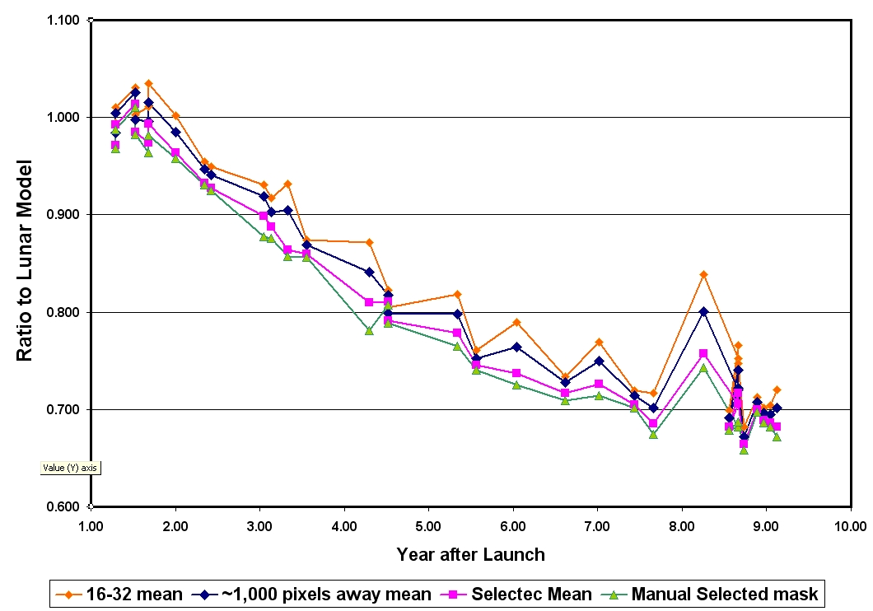
Plots of Result

Slide 23
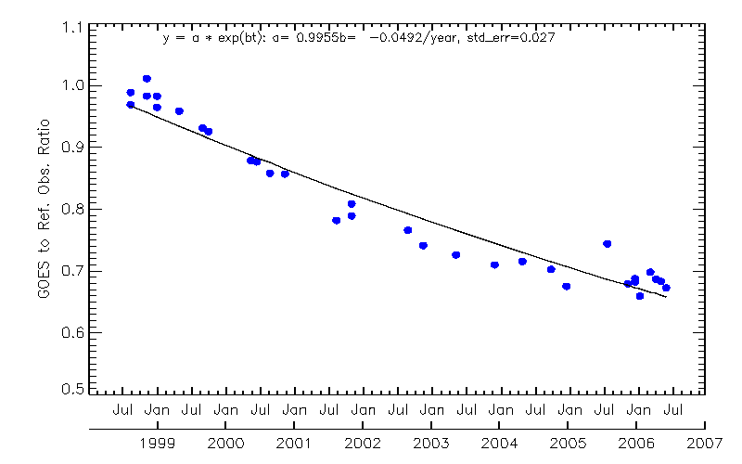
Paired Images

Slide 24
Angle of Incidence Dependent Scan-mirror Reflectance
Separated by about one hour (no instrument degradation)
MIT/LL tested the witness sample
  Consistent with GOES-13/14 measurements (observed irradiance : modeled irradiance).
  Unprecedented moon data collected during the GOES-15 PLT period. Unexpected pattern.
    Earth shine effect?
    Noise drift?

Slide 25
Error Sources
Source of Uncertainties, assuming invariable SRF
  illuminated moon area
    Edge at sub-pixels
  Detector responsivity variations
    Reference detector
  Scan angle effect
    ~2.2% based on MIT Lincoln Lab
  USGS model
    1% for geometric uncertainty
    5-10% for absolute uncertainty
  Others (e.g. straylight/earth shine/?)

Slide 26
Comparison of lunar Calibration vs. other vicarious calibration methods
F.Yu, X. Wu and many other contributors

Slide 27
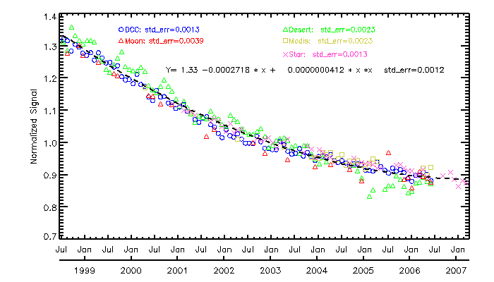

Slide 28
Summary
Lunar calibration provides comparable calibration accuracy with the other methods
To reduce the uncertainty
  Need to characterize the angular dependent scan mirror reflectance
  Accurate computation of space count to derive the lunar irradiance
  Stray-light effect
  Earth shine effect?

