Slide 1
Feasibility of using Deep Convective Clouds to Monitor Performance of the Geostationary Lightning Mapper (GLM)
Dennis Buechler

Slide 2
Monitoring GLM Performance
GLM has no onboard calibration
Use Lightning Imaging Sensor (LIS) observations as proxy data base
Similar design
14 years of data
Lightning detection efficiency depends on background radiance
Background radiance calibration
Monitor background calibration stability

Slide 3
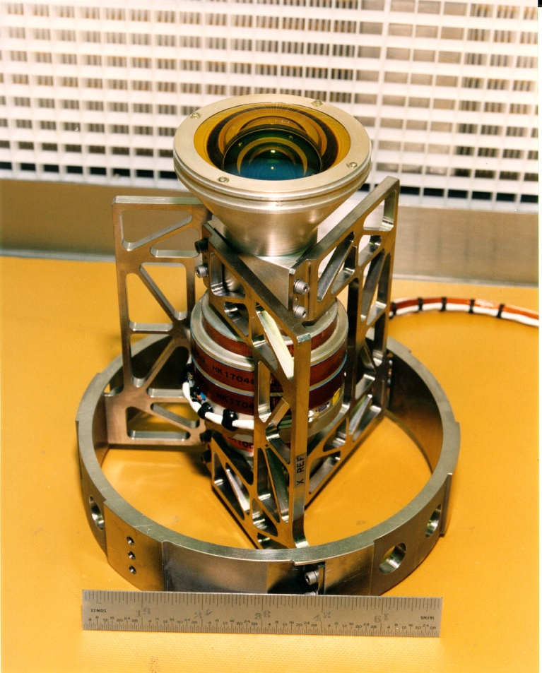
LIS Instrument design
Fast lens, narrowband filter at 777.4 nm
128 x 128 CCD array, 500 fps imaging
Frame-to-frame subtraction isolates lightning transients against bright daytime background
3.3 km nadir to 10 km at corners
Backgrounds ~35 seconds

Slide 4
Deep Convective Cloud Technique (DCCT) Applied to LIS Background Radiances
Purpose: Determine if Deep Convective Cloud Technique (DCCT) can be used as a stable target for monitoring stability of GLM to meet Measurement Precision Requirements

Slide 5
Methodology
For each July and August from 1998 through 2010:
Convert LIS observed counts for each background pixel into radiance values
Get adjusted LIS radiance (ρ)
adjust to SZA of 0° (divide by cosine of SZA)
assume Lambertian surface
Determine coincident LIS and VIRS pixels

Slide 6
Methodology (Cont’d)
Use pixels that meet following criteria:
Tb < 205K
SZA < 40°
VZA < 40°
10° < RAA < 170°
σ/ρ_{i} < .02
No lightning nearby
Assume constant solar radiance throughout the period
Assume random distribution of VZA, RAA, and SZA

Slide 7
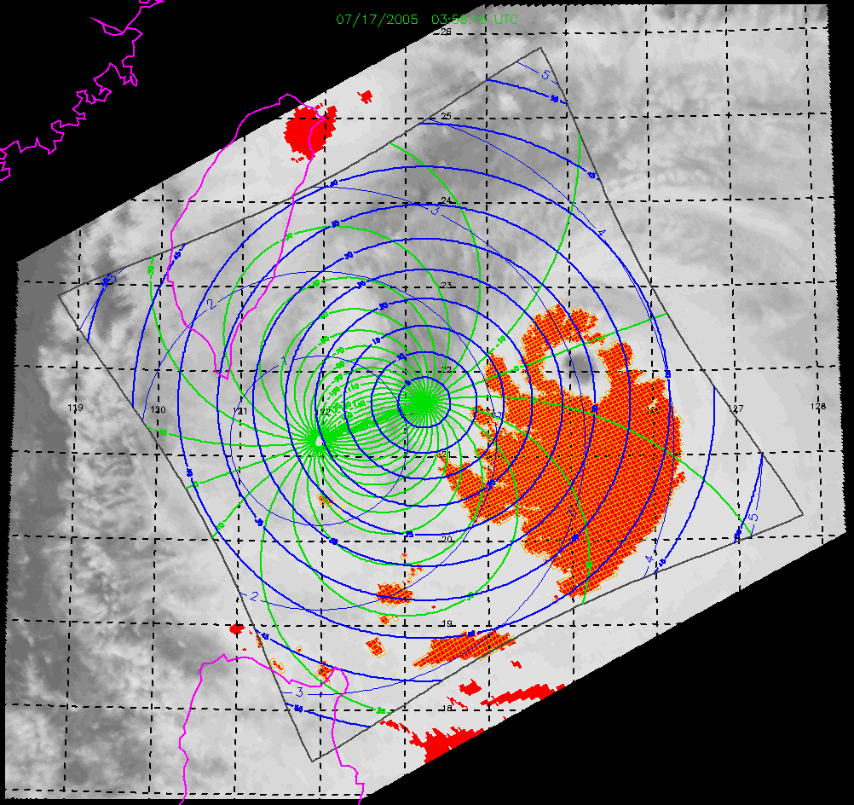
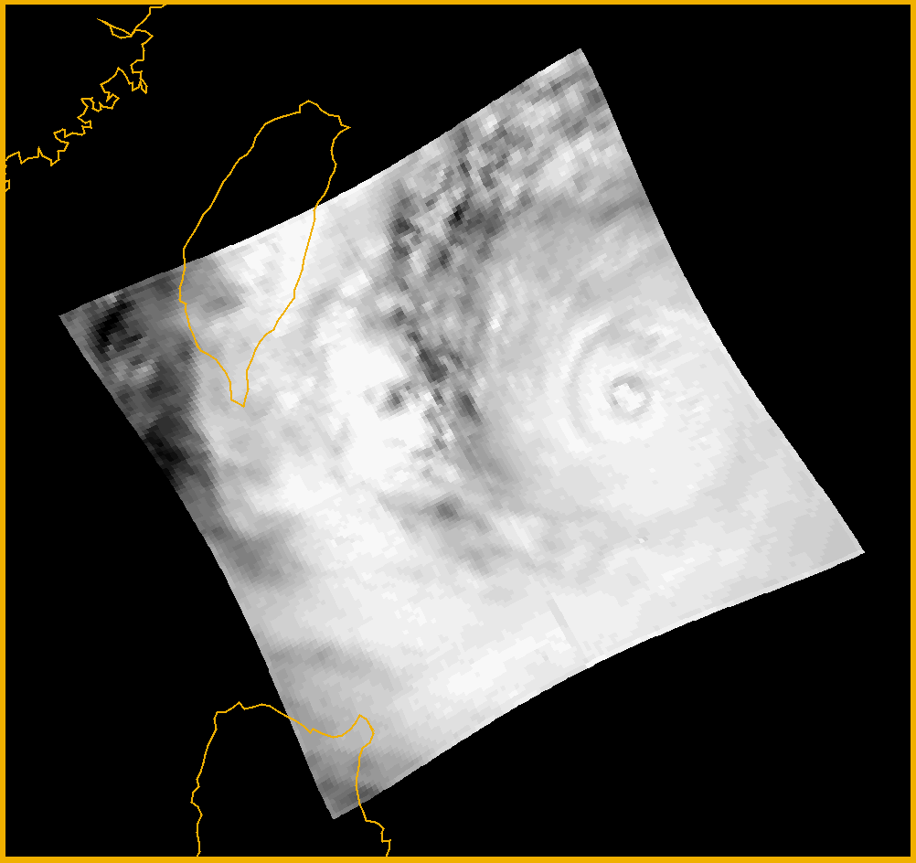
TRMM LIS observations of Deep Convective Clouds
VIRS IR
LIS BG
Super Typhoon Haitang

Slide 8
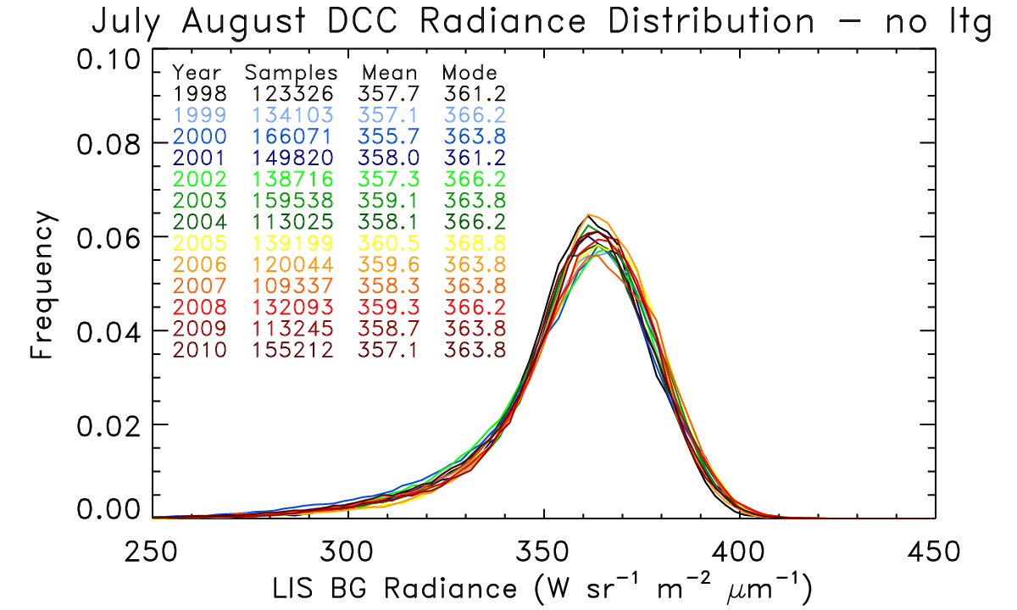
LIS BG DCC Radiance Distribution for July and August (1998-2010)

Slide 9
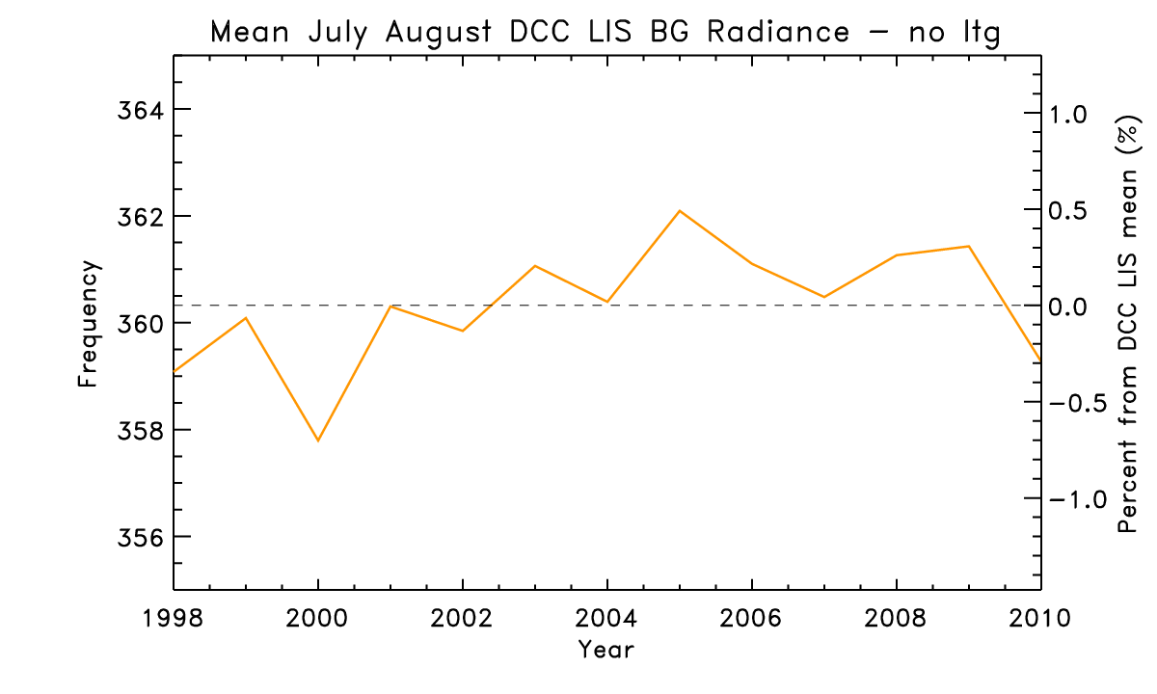
Trend of LIS BG DCC radiances

Slide 10
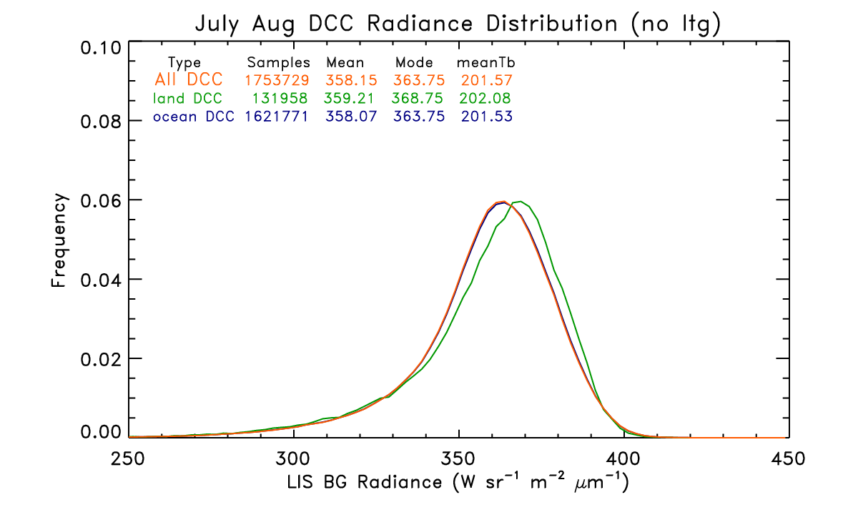
Land/Ocean LIS BG DCC Distribution

Slide 11
DCCT Conclusions
The DCCT method to monitor radiance measurement precision is successfully applied to TRMM LIS and VIRS for the period 1998-2010
The maximum yearly deviation is ~0.6 %
The maximum deviation occurs in 2000
Trend is not evident
Instrument appears stable and well within 5% over its lifetime
The DCCT method appears applicable to monitor GOES-R GLM radiance measurement precision using ABI and GLM
Land pixels appear slightly brighter than ocean pixels

Slide 12
Additional
Develop and apply an angular distribution model
Examine other stable targets for calibration (e.g., deserts, glint)

