Slide 1
GSICS Coordination Center (GCC) Annual Report
Dr. Fuzhong Weng and Dr. Fangfang Yu
Joint GRWG-VII and GDWG-VI Meeting
Beijing, China
March 5, 2012

Slide 2
Outline
Staff change
GCC progress since March 2011
Support to the establishment of GSICS correction algorithm – diurnal calibration variation
GSICS Quarterly
Meeting Support
End-to-end demonstration
Effort on the instrument event log
Near Term 2012 goals

Slide 3
Staff Change in GCC
Dr. Robert Iacovazzi, Jr. left NOAA/NESDIS in August 2011
We greatly appreciate his many contributions to the GSICS in general and to the GCC in particular.
Current GCC staff:
Dr. Fuzhong Weng: Director
Dr. Fangfang Yu: Deputy Director
Dr. Haifeng Qian: Webmaster
Dr. Fred Wu: Other support
Many thanks to the supports from GRWG, GDWG and WMO during the transition period.
Please continue!

Slide 4
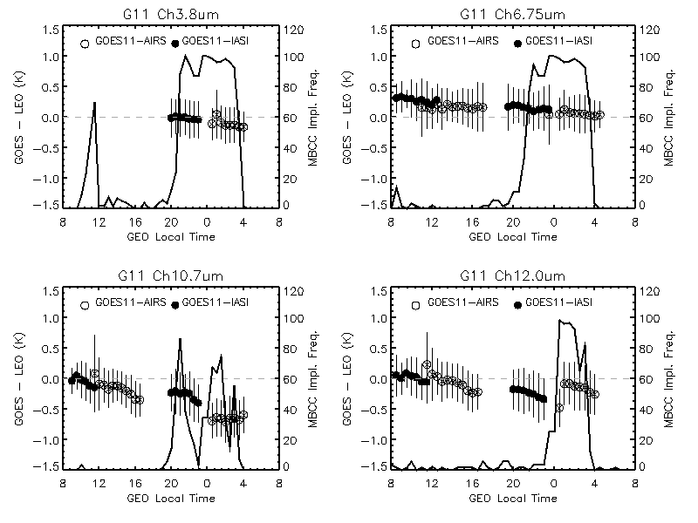
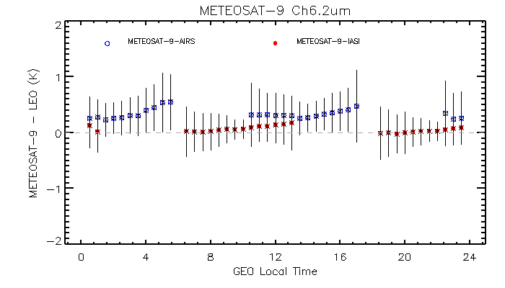
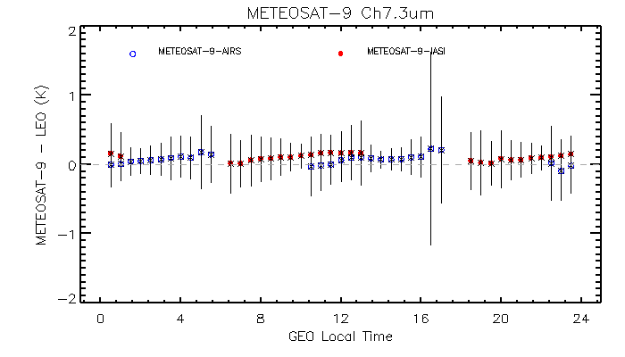
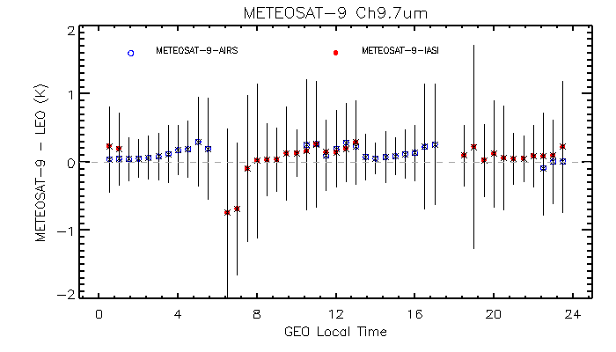
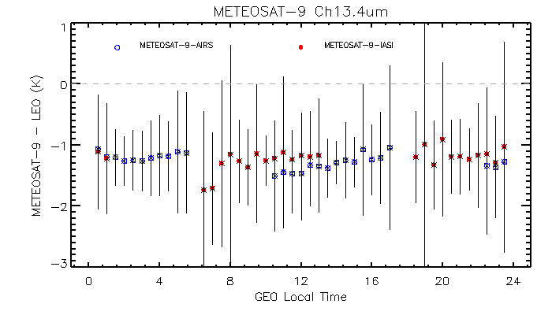
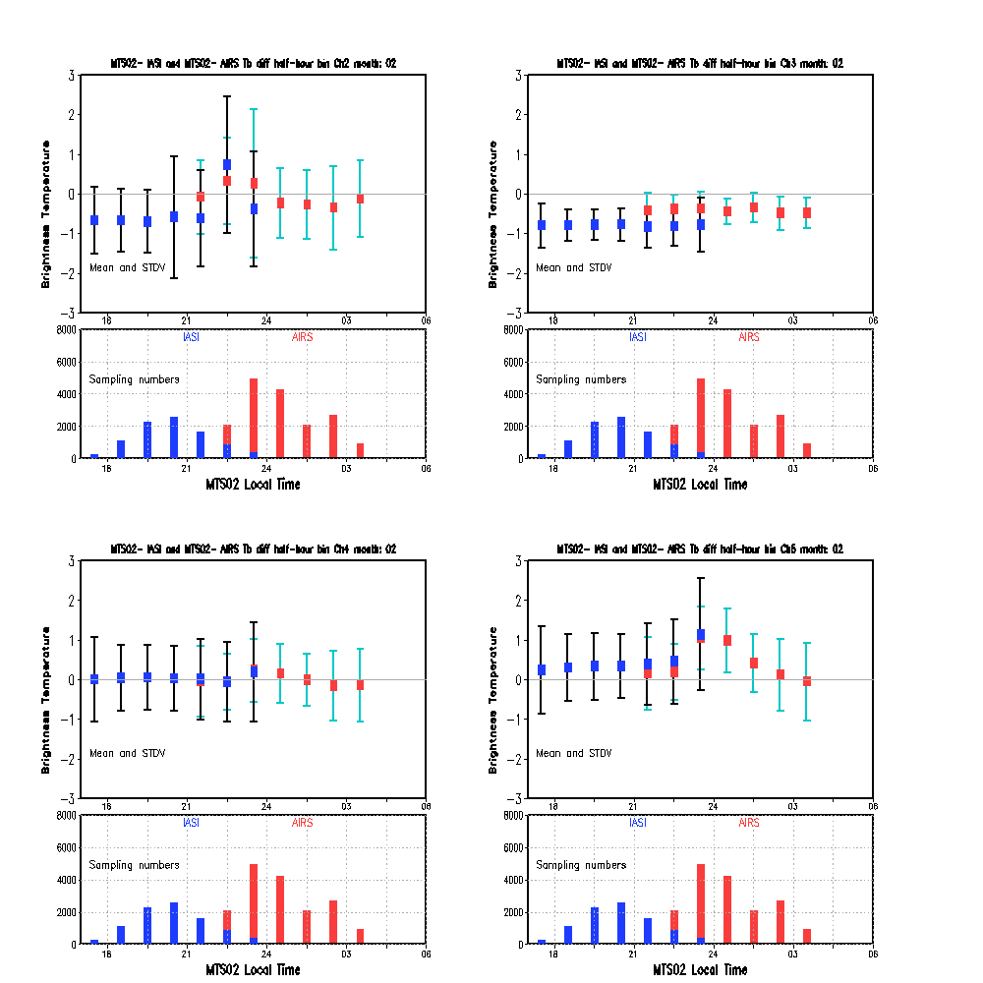
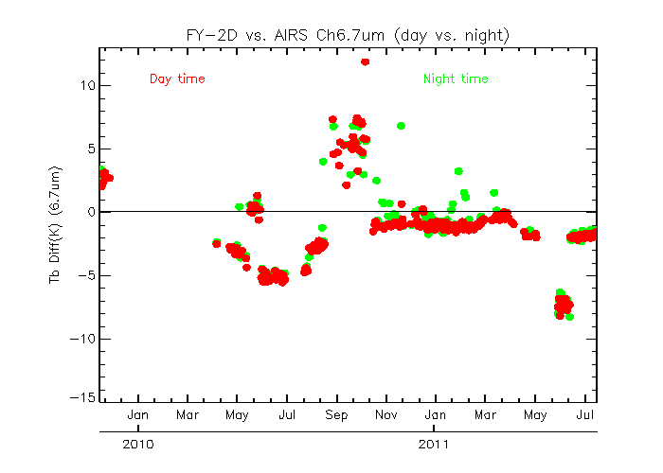
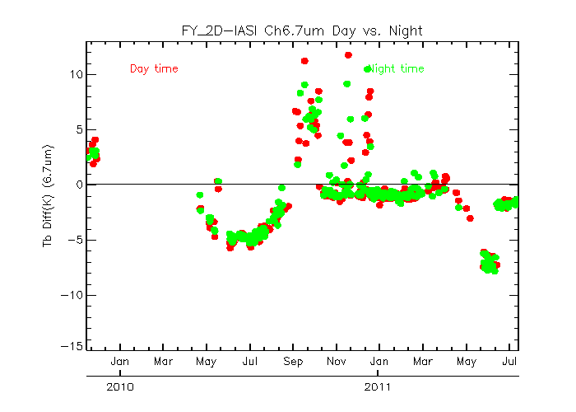
Data Analysis at GCC - Diurnal Calibration Variation
GOES-11
Meteosat-9
MTSAT-2
FY-2D

Slide 5
GSICS Quarterly Newsletter
All GSICS Quarterly Volume 5 Issues are completed
Use the new GSICS mailing system to distribute the GQ!
The edition special issue on the solar reflected channel calibration was sent to 183 email accounts
The online registration form is now available at the GSICS portal (http://gsics.wmo.int/) and GCC website (http://www.star.nesdis.noaa.gov/smcd/GCC/index.php )
Contributors to the successful newsletter: contributing authors, the GQ Editors, Press Correspondents (Tim Hewison [Europe] and Yuan Li [Asia]), and GDWG (Jelenak, Aleksandar), of course. Special thanks also go to Dr. George Ohring for the careful proofreading help.

Slide 6
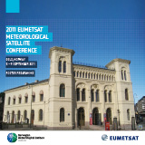
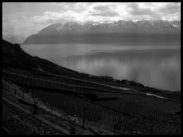
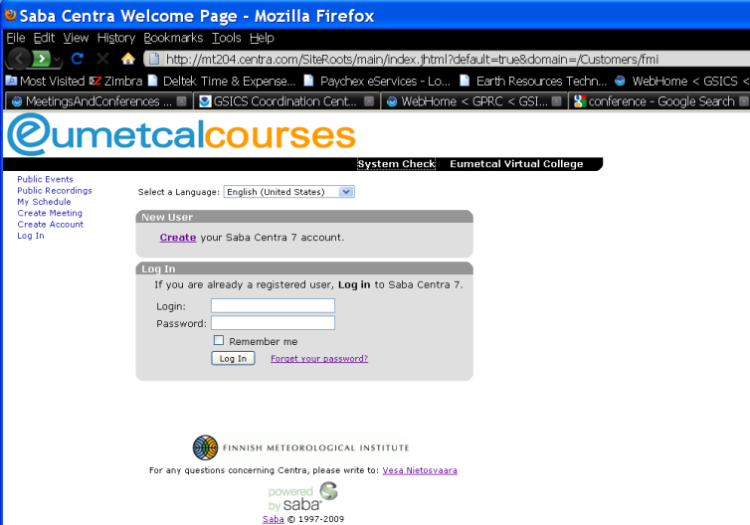
Meeting Support
GSICS Second Users’ Workshop – September, 2011, Olso, Norway, (Brief report to be given in the next presentation).
GSICS Executive Panel 10th Sesssion – June 2011, Geneva, Switzerland
Central web meetings hosted by EUMETSAT

Slide 7
User Interaction
User’s Feedback
Critical and valuable review comments from ISCCP
GCC hosted a telcon to discuss these concerns
Consensually agreed that a central product catalog is needed to direct the users to access products and associated documents
WMO proposed a very good demo version
The central product catalog should be implemented at the GSICS portal and GCC website
Detailed report to be given in the next presentation

Slide 8
GCC Operations Plan Updates: Unfulfilled Actions and Recommendations
GDWG04_07 (Evaluation of WMO GSICS Web Site) All
GDWG04_14 (Product Quality Indicators) GCC-NOAA
GDWG04_13 GRWG05_15 (Gathering Instrument Information )?
GDWG04_11R (Instrument Monitoring Web Site) GCC + GDWG
EP03_06(Presentation about absolute microwave calibration) GCC
EP08_02 (Result display harmonization) JMA + GCC
EP08_12 (Vocabulary and guide on uncertainty) NIST
EP09_01 (ISRO and the GCC to coordinate for the implementation of GEO-to-LEO algorithms by ISRO) ISRO+GCC (?)

Slide 9
GCC Operations Plan Updates: Unfulfilled Actions and Recommendations
EP09_06(Ensure user accessibility to consistent instrument SRFs)GCC+WGCV(?)
GRWG05_08 (Investigation into adding GEO data to SADE database) All GPRCs
GRWG05_10 (SEVIRI Data Transfer) EUMETSAT and CNES
GRWG05_11 (Moon calibration method review) NOAA
GRWG06_23(Update GRWG regarding availability of ER-2 underflight data) GCC
EP10_01(GCC to help IMD obtain GSICS correction ATBD for GEO-LEO channels) GCC + IMD

Slide 10
Instrument Event Log
JOINT06_03: Instrument event log draft template
GCC initialized the effort and evolved two versions of template per feedbacks from each GPRCs.

Slide 11
Instrument Calibration Event Logs for the GEO-LEO IR Inter-Calibration
Front Page
One table per monitored instrument
Instrument (monitored or referenced) | No | Start time | End time | Comment | Type | Related Information
GOES-12 Imager | 1 | 2003/04/01 |  | Operation started |  | http://www.oso.noaa.gov/goesstatus/spacecraftStatusSummary.asp?spacecraft=12
GOES-12 Imager | 2 | 03/21/2007 | 03/23/3007 | Anti-ice Decontamination (uncompleted)
GOES-12 Imager | 3 | 07/02/2007 | 07/04/2007 | Anti-ice decontamination
IASI | 4 | 07/18/2007 |  | IASI Level 1 data operational data formally available |  | http://smsc.cnes.fr/IASI/GP_actualites.htm
GOES-12 Imager | 5 | 12/15/2008 | 01/05/2009 | Stayed as backup and decontamination
GOES-12 Imager | 6 |  |  | Retired from GOES-West and moved to the South American Mission |  | http://www.oso.noaa.gov/goesstatus/spacecraftStatusSummary.asp?spacecraft=12

Slide 12
Near-term 2012 Goals
Resume and Continue to Guide the product acceptance process
GSICS Baseline Algorithm
Continue to coordinate efforts to establish the GSICS baseline algorithm at NOAA GPRC
GSICS Quarterly
Continue to create and distribute this important link to the GSICS community
Update GSICS Operations Plan
Meeting Support
Joint Meeting, QA4EO Workshop(?), GSICS 4rd Users Workshop and GSICS Web Meetings

