Slide 1
NOAA GPRC Report
Fangfang Yu and Fred Wu
05 March 2012

Slide 2
Outline
Operation Status
GEO Imager vs. AIRS/IASI
Bias monitoring Web
Support NOAA’s Satellite Operations
GOES-14/15 PLT
METOP-B AVHRR Re-calibration
GOES-13 Stray Light Correction
Emerging Capacity
NPP
METOP-B

Slide 3
GEO-LEO Retro-Processing
AIRS
IASI
Aug2003
Jun2007
GOES-8
105W
GOES-10
Jun06
GOES-11
Jun06
Jan07
GCC
Jun07
Apr/04
Completed!
Jan07
GOES-12
GCC
Jun07
Aug08
Meteosat-7
GCC
Jan2004
GCC
Meteosat-8
Aug08
Jun2005
MTSAT-1R
GCC
Aug08
Oct2004
FY-2C
GCC
Aug08

Slide 4
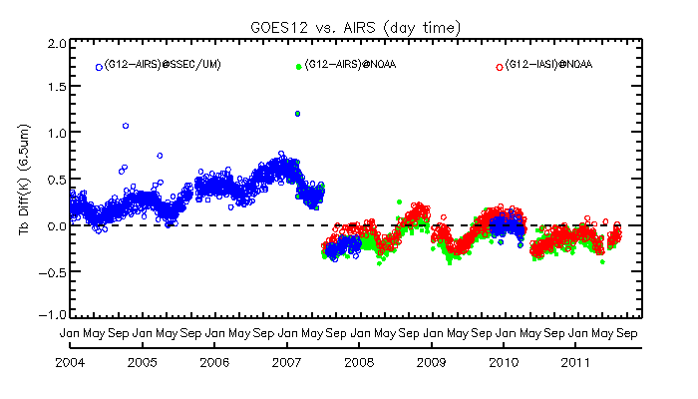
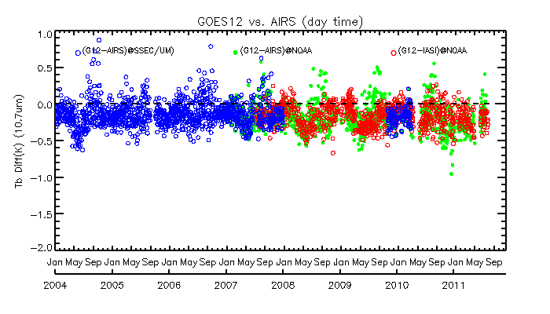
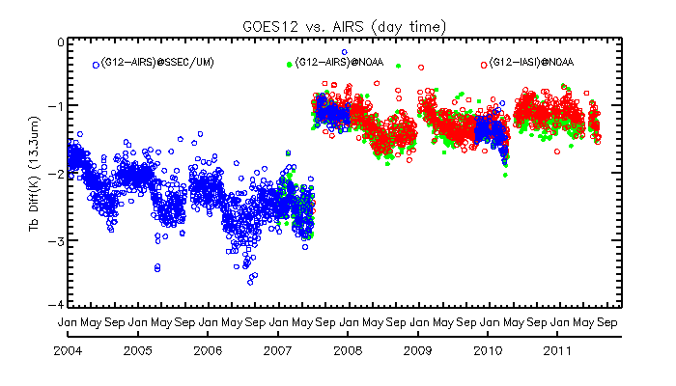
Time-series of mean Tb bias for GOES-12 Imager IR Channels
G12 Ch2 (3.9μm, midnight)
G12 Ch3 (6.5μm, daytime)
G12 Ch4 (10.7μm, daytime)
G12 Ch6 (13.3μm, daytime)

Slide 5
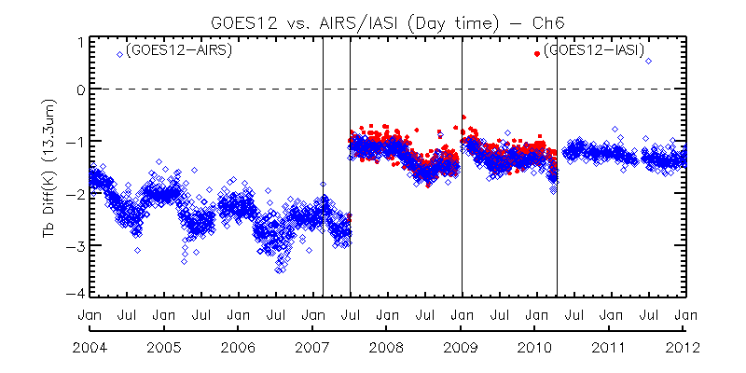
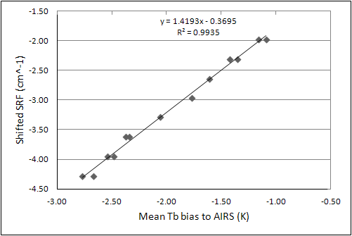
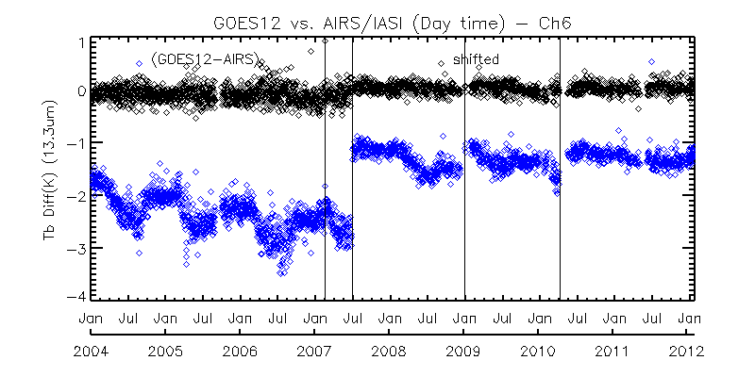
SRF Correction for G12 Imager Ch13.3um during its Mission Life using back-processing + forward-processing data
Mean Tb Bias before SRF Correction
Decontamination Events
Mean Tb Bias after SRF Correction
Relation between the mean Tb bias and the optimal SRF shift
Yu and Wu, 2012, “Correction for GOES Imager spectral response function using GSICS II: Applications ”, submitted to IEEE special issue on the instrument inter-calibration.

Slide 6
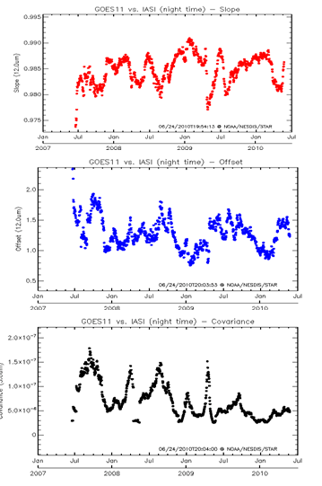
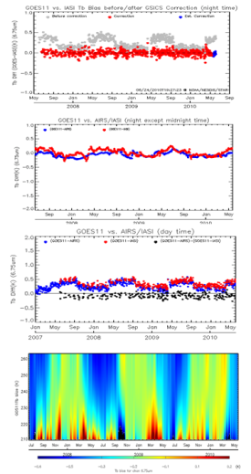
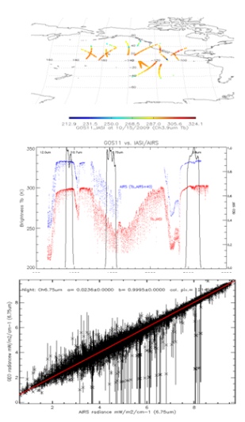
GEO-LEO Inter-Calibration Products
Products download server:
http://gsics.nesdis.noaa.gov:8080/thredds/catalog.html
Near Real-time Correction – update everyday
Re-analysis Correction – updated once per month
New product monitoring wiki-website:
https://gsics.nesdis.noaa.gov/wiki/GPRC/WebHome

Slide 7
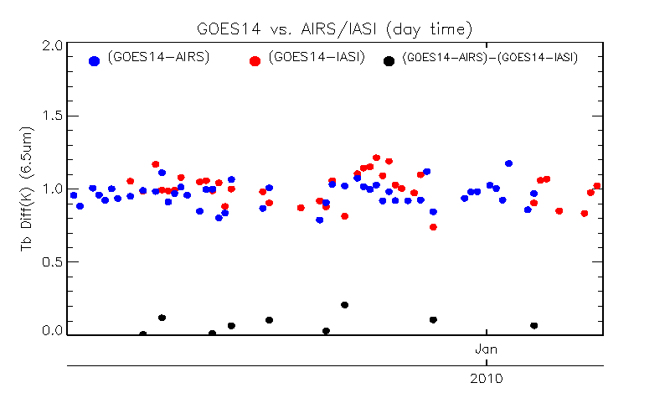
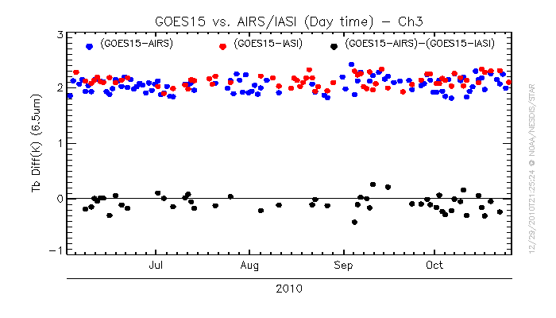
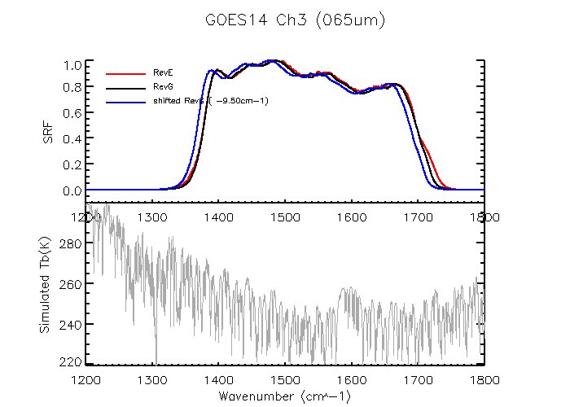
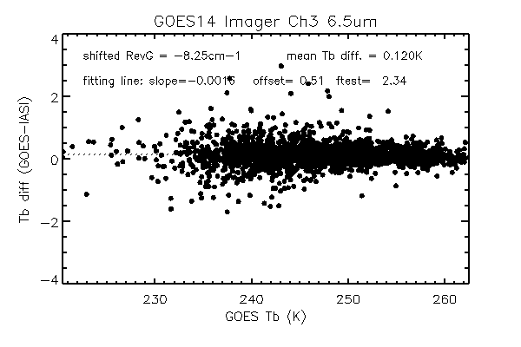
GOES-14/15 PLT Imager Ch3 & Ch 6 SRF
Time-series of Tb bias to AIRS/IASI for GOES-14 Ch3 (left) and GOES-15 Ch3 (right)
Tb bias to IASI with RevE SRF (black) and RevG SRF (red). Left: GOES-14, right: GOES-15
 | Bias with ITT Rev. E (K) | Bias with ITT Rev. H (K) | Bias with NOAA Correction (K) | NOAA Correction (Shift) (cm⁻¹)
GOES-14 Ch. 3 | +0.98 | +0.93 | +0.09 | −8.25
GOES-14 Ch. 6 | -0.48 | -0.22 | -0.06 | -0.25
GOES-15 Ch. 3 | +2.15 | +0.70 | +0.05 | -6.25
GOES-15 Ch. 6 | +0.79 | +0.48 | +0.15 | +0.50

Slide 8
METOP-B AVHRR Re-calibration
A307 was calibrated in June 2002
Re-calibration in Jan 2011 found several issues
NOAA worked with NASA, ITT, and EUMETSAT to resolve the anomalies.
One of the tools was Instrument Performance Monitoring
 | Ch 3B | Ch 4 | Ch5
NOAA-19, last year | +1.6% | -0.3% | -0.0%
METOP-A, last year | +1.3% | +0.8% | +0.3%
METOP-A, since 2006/10/30 | +4.0% | +2.8% | +1.3%

Slide 9
Stray Light

Slide 10
GOES-13 Imager 12/053/04:39 Southern Hemi, Channel 2
Uncorrected for SL
SL Corrected
J. Paul Douglas

Slide 11
GOES-13 Imager 12/053/05:09 Southern Hemi, Channel 2
Uncorrected for SL
SL Corrected
J. Paul Douglas

Slide 12
GOES-13 Imager 12/053/05:39 Southern Hemi, Channel 2
Uncorrected for SL
SL Corrected
An artifact has been introduced
J. Paul Douglas

Slide 13
Artifact in the 5:39 Corrected Frame (0 GVAR count issue can be addressed next release)
J. Paul Douglas

Slide 14
Suomi National Polar-orbiting Partnership Satellite

Slide 15
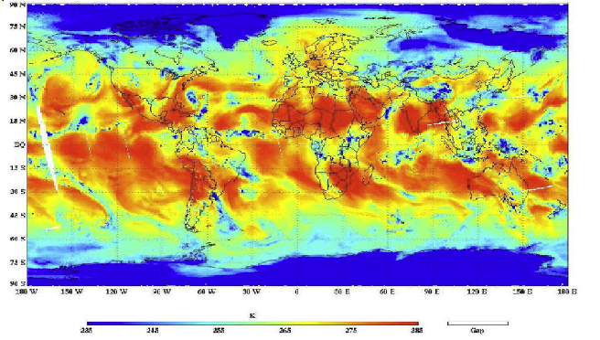
Suomi National Polar-orbiting Partnership Satellite
ATMS SDR Team

Slide 16
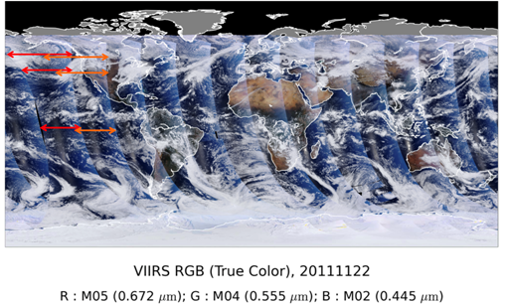
Suomi National Polar-orbiting Partnership Satellite
VIIRS SDR Team

Slide 17
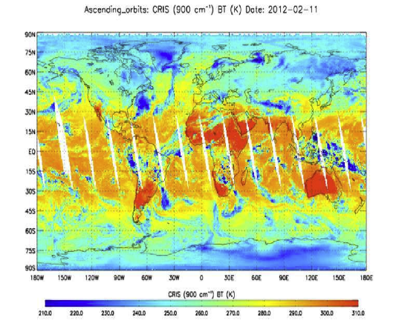
Suomi National Polar-orbiting Partnership Satellite
CrIS SDR Team

Slide 18
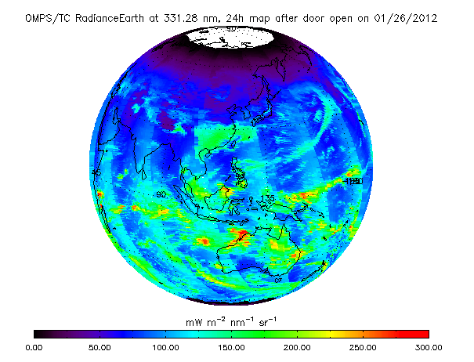
Suomi National Polar-orbiting Partnership Satellite
OMPS SDR Team

Slide 19
Suomi National Polar-orbiting Partnership Satellite
M. Goldberg

Slide 20
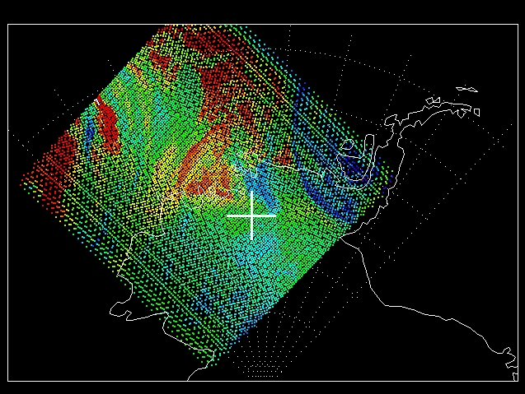
AIRS and CrIS image at 900cm-1
CrIS
02/25/2012, 22:38:02 UTC,
AQUA at (76.71S, 98.17W),
NPP at (76.71S, 98.17W),
0.24 km, 28 second
L. Wang

Slide 21
AIRS CrIS SNO Comparison (740 – 840 cm⁻¹)
Reduced spectral resolution
No missing or bad channels
Agrees well
L. Wang

Slide 22
GOES-13 Imager IR SRF & Simulated AIRS/CrIS/IASI TOA Tb over Clear Tropic Ocean

Slide 23
GOES-13 vs. CrIS Collocation Scenes on 2/24/2012
Collocations range across multiple LEO orbits, ~5-6 hours
Scene Tb range from extremely cold (~210K at Ch10.7um) to very hot (~300K)

Slide 24
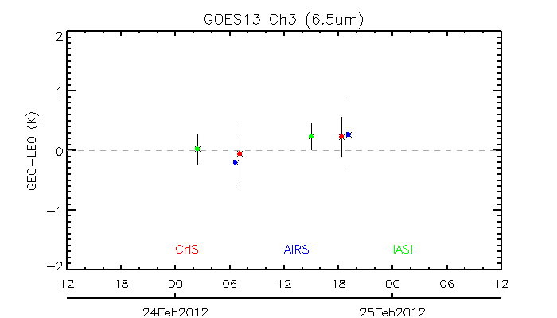
Mean Tb bias (GEO-LEO) vs. median time of the collocated scenes – Ch2 (6.5um)
GOES-13 night-time
GOES-13 day-time
UTC time

Slide 25
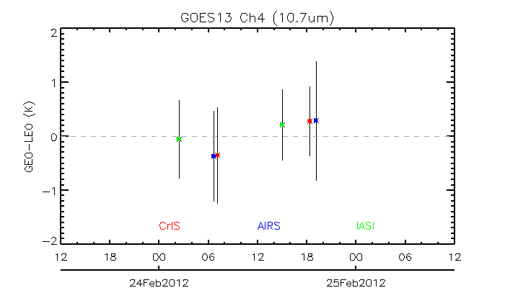
Mean Tb bias (GEO-LEO) vs. median time of the collocated scenes – Ch3 (10.7um)
GOES-13 night-time
GOES-13 day-time
UTC time

Slide 26
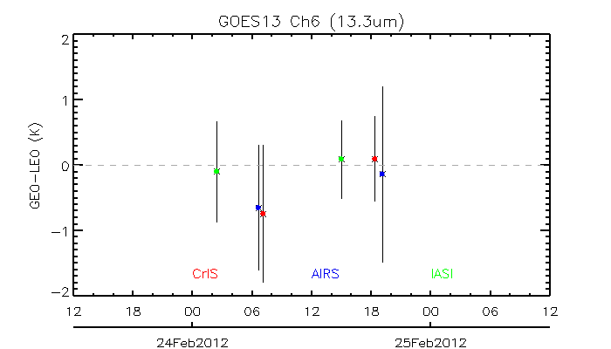
Mean Tb bias (GEO-LEO) vs. median time of the collocated scenes – Ch6 (13.3um)
GOES-13 night-time
GOES-13 day-time
UTC time
Notes:
Possible reasons causing the relatively large Tb bias different at AIRS:
Larger Tb bias uncertainty
Uncertainty of JMA’s gap filling method to fill the bad AIRS detectors
Need more data for further investigation

Slide 27
Mean Tb bias (GEO-LEO) vs. median time of the collocated scenes – Ch6 (13.3um)
GOES-13 night-time
GOES-13 day-time
METOP-A
METOP-b
UTC time
Notes:
Possible reasons causing the relatively large Tb bias different at AIRS:
Larger Tb bias uncertainty
Uncertainty of JMA’s gap filling method to fill the bad AIRS detectors
Need more data for further investigation

Slide 28
Suomi National Polar-orbiting Partnership Satellite
Traditional SNO
SNO_{x} for Aqua & NPP (15 min apart – extended to low latitude)
Also for METOP-A/B?
S. Blonski and C. Cao

Slide 29
Summary
Operation Status
Normal
Support NOAA’s Satellite Operations
Several examples
Emerging Capacity
Expect new challenges and opportunities with NPP and METOP-B

