Slide 1
JMA GPRC report
Arata OKUYAMA
Meteorological Satellite Center,
Japan Meteorological Agency
2012/03/05 GSICS GDWG&GRWG joint meeting in Beijing

Slide 2
Events since the last Joint meeting (1)
Back up operation by MTSAT-1R
August 2011:
The operation of MTSAT-2 had stopped between 3 to 16 August because of ground system malfunction. MTSAT-1R had entered into a backup observation operation in this period.
November to December 2011:
JMA conducted a maintenance of the MTSAT’s ground system. During the system maintenance, 1 November to 26 December, MTSAT-1R was brought back into meteorological observation.
This event is planned every year in same season.
MTSAT-2 IR1(10.8um) TB Bias monitoring

Slide 3
Events since the last Joint meeting (2)
GSICS Correction for MTSAT infrared channels
June 2011:
As a part of the GSICS Procedure for Product Acceptance (GPPA) Demonstration Phase, JMA received review reports. Thanks to this review, so called the “Midnight effect” for MTSAT-2 came out.
Diurnal variation could be implemented and more discussion in GRWG is necessary.

Slide 4
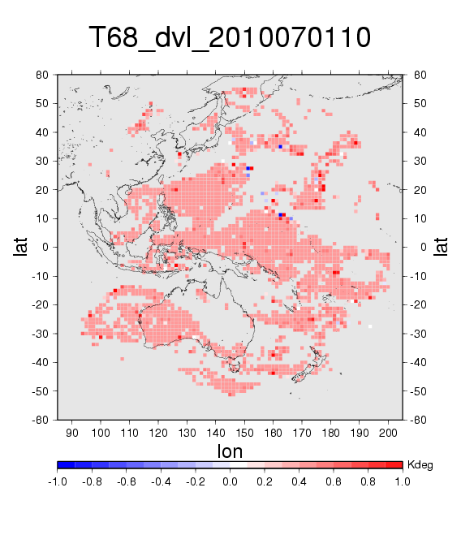
Preliminary Experiment on CSR
Clear Sky Radiance (CSR) data were regenerated by using MTSAT IR GSICS Correction (No tuning for cloud screening parameters was performed)
Regenerated TBs of the MTSAT WV ch. are about 0.5 K higher than original TBs (left chart), that decreases departure between observation and NWP
One month Observing System Experiment shows that number of CSR data assimilated in NWP are increased (right chart)
WV TB differences
w/ and w/o GSICS
Numbers of CSR data assimilated in OSE

Slide 5
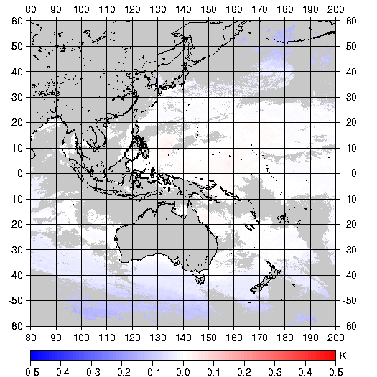
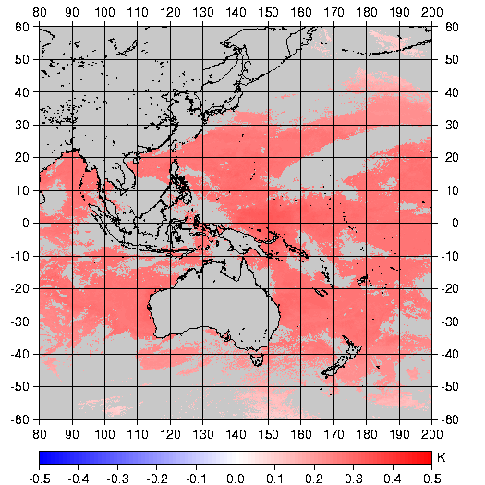
Experiment on SST
MTSAT-2 IR images contain midnight calibration error, which becomes large during eclipse seasons (right charts)
To use GSICS correction, SST parameters should be tuned again. Otherwise, significant biases would be appeared. (bottom chart)
If diurnal bias information is obtained from GSICS, better SST product would be expected
MTSAT 12um – AIRS Asc.(13:30 LST)
GSICS Correction
SST(GSICS) – SST(Original)
MTSAT 12um – AIRS Dec.(01:30 LST)
8 January 2011
1 March 2011
MTSAT 12um – AIRS (All orbits)
Jul 2010
Jun 2011

Slide 6
MTSAT-2 brightness temperature differences
Brightness temperature difference seems to have similar trend on each month and for each channel.
The midnight blackbody calibration correction (MBCC) is active for MTSAT-2 in eclipse season.
3.8um(IR4)
6.8um(IR3)
10.8um(IR1)
12.0um(IR2)
2010
Jul
Aug
Sep
Oct
Nov
MTSAT-2 had no data. MTSAT-1R was operational
Dec
30 minutes mean brightness temperature differences between MTSAT-2 and LEO versus UTC for each MTSAT-2 channel. Vertical lines shows standard error of the brightness temperatures in each 30 mins bin. The red color indicates that differences are with respect to IASI and black color indicates that differences are with respect to AIRS. A vertical black line on 15 UTC means MTSAT-2 midnight.

Slide 7
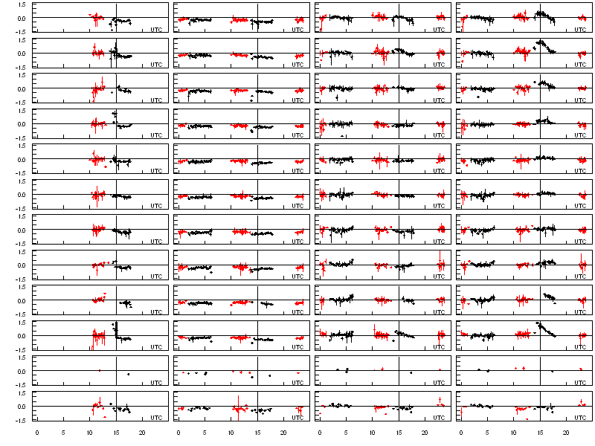
MTSAT-2 brightness temperature differences
3.8um(IR4)
6.8um(IR3)
10.8um(IR1)
12.0um(IR2)
2011
Jan
Feb
Mar
Apr
May
Jun
Jul
Aug
Sep
Oct
Nov
MTSAT-2 had no data. MTSAT-1R was operational
Dec
30 minutes mean brightness temperature differences between MTSAT-2 and LEO versus UTC for each MTSAT-2 channel. Vertical lines shows standard error of the brightness temperatures in each 30 mins bin. The red color indicates that differences are with respect to IASI and black color indicates that differences are with respect to AIRS. A vertical black line on 15 UTC means MTSAT-2 midnight.

Slide 8
Events since the last Joint meeting (3)
NRTC (Near Real Time Correction) product
February 2012:
GSICS NRTC (Near Real Time Correction) product for MTSAT-2 became available on the EUMETSAT THREDDS server.
Reprocess of missed data
January 2012:
Download of IASI data for July and August, 2011 was failed and the data was not used in operation. MTSAT-2 data during this period was reprocessed.
Reprocessed

Slide 9
Other topic (1) Himawari -8/-9 Imager
Advanced Himawari Imager (AHI)
Band | Central Wavelength [μｍ] | Spatial Resolution
1 | 0.43 - 0.48 | 1Km
2 | 0.50 - 0.52 | 1Km
3 | 0.63 - 0.66 | 0.5Km
4 | 0.85 - 0.87 | 1Km
5 | 1.60 - 1.62 | 2Km
6 | 2.25 - 2.27 | 2Km
7 | 3.74 - 3.96 | 2Km
8 | 6.06 - 6.43 | 2Km
9 | 6.89 - 7.01 | 2Km
10 | 7.26 - 7.43 | 2Km
11 | 8.44 - 8.76 | 2Km
12 | 9.54 - 9.72 | 2Km
13 | 10.3 - 10.6 | 2Km
14 | 11.1- 11.3 | 2Km
15 | 12.2 - 12.5 | 2Km
16 | 13.2 - 13.4 | 2Km
Launch of the Himawari-8 is planned in 2014.
Is the GSICS calibration approach available to NIR bands?
●
●
●
NIR
●
●
as of MTSAT-1R/2
●
Band | Central Wavelength [μｍ] | Spatial Resolution
1 | 0.55 – 0.90 | 1Km
2 | 3.50 – 4.00 | 4Km
3 | 6.50- 7.00 | 4Km
4 | 10.3 – 11.3 | 4Km
5 | 11.5 – 12.5 | 4Km
●
●
●
●
●: MSG
●

Slide 10
Other topic (2) Refinement of GMS-5 WV SRF
[Breon,1999] pointed that SRF of the GMS-5 WV channel contains an error.
Erroneous SRF throw off the blackbody calibration.
Corrected calibration tables are computed according to modified SRF by [Breon,1999], and provided to JRA-55 (JMA Re-Analysis) team.
JRA-55 team obtained RTTOV parameters based on the corrected SRF thanks to Dr. Sounders, and performed impact tests.
It looks like absorption lines by water vapor.
response
Wavelength [um]

Slide 11
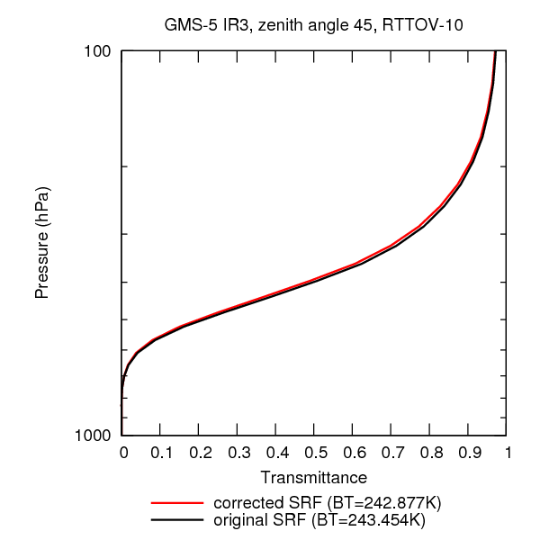
Impact on Transmittance
Transmittance from TOA to ground surface based on the corrected SRF is compared with the original SRF.
The transmittance for the corrected SRF is lower than the one for the original SRF.
Difference of brightness temperature on TOA between corrected and original SRFs is around 0.5K.
Transmittance
RTTOV-10
Mid-latitude
Corrected SRF: BT=242.877K
Original SRF: BT=243.454K
Shinya Kobayashi (CPD/JMA)

Slide 12
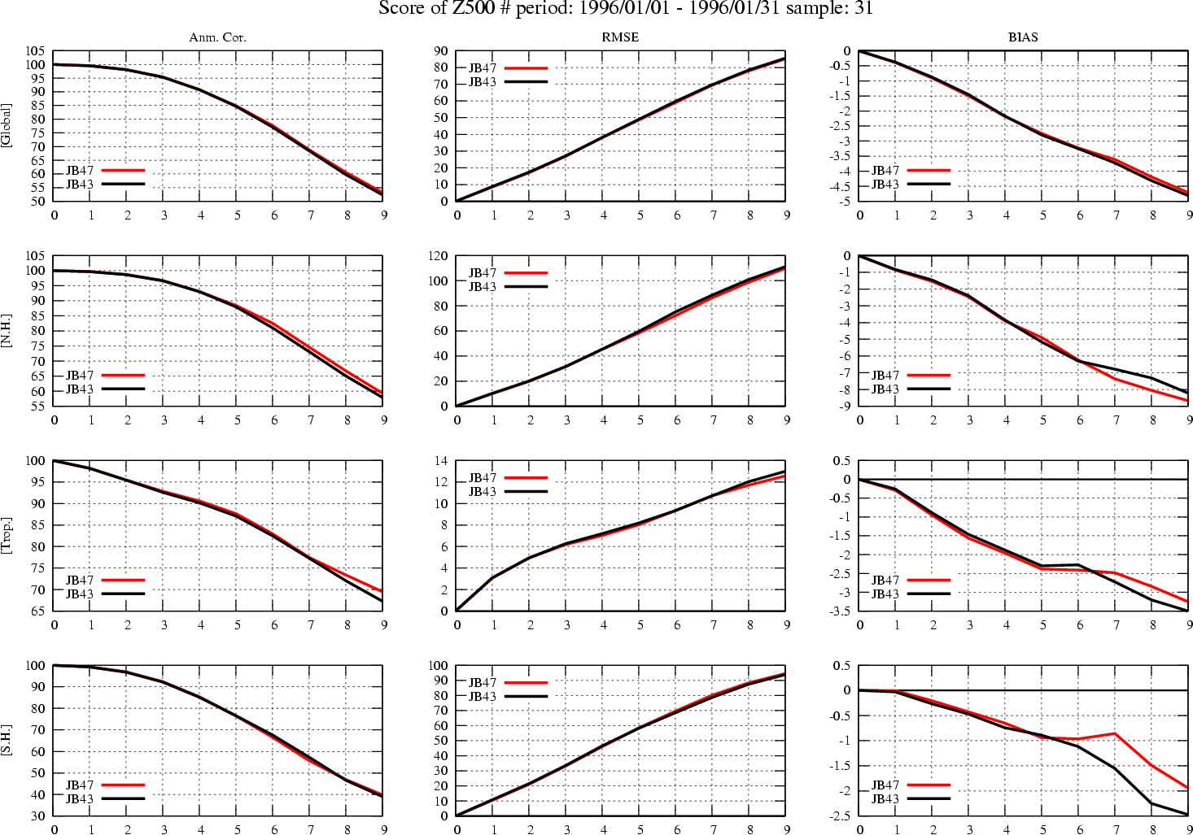
(Just for reference) Jan. 1996 Height of 500hPa Score
Anomaly correlation
RMSE
BIAS
Original SRF，Corrected SRF
Shinya Kobayashi (CPD/JMA)

Slide 13
Summary
Annual back up operation by MTSAT-1R was conducted from November to December, 2011.
“Midnight effect” came out thanks to a report as a part of GPPA.
NRTC product was started to send the THREDDS server in EUMETSAT.
Launch of the Himawari-8 is planned in 2014. One of current issue is NIR channel calibration.
Refined GMS-5 SRF is provided to JMA re-analysis team to use JRA-55.

Slide 14
Thank you!

Slide 15
Back up slides

Slide 16
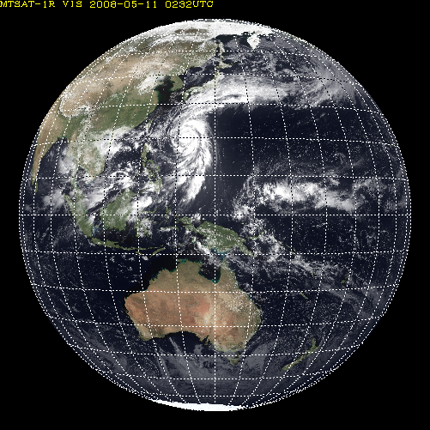
Other topic (1) Himawari -8/-9
AHI Sectored Observations in 10 minutes
Full disk
Interval : 10 minutes (6 times per hour)
23 swath
Region 1 JAPAN (North-East)
Interval : 2.5 minutes (4 times in 10minutes)
Dimension : EW x NS: 2000 x 1000 km
2 swath
Region 1
N-E JAPAN
Region 2
S-W JAPAN
Region 3
Typhoon
Region 2 JAPAN (South-West)
Interval : 2.5 minutes (4 times in 10minutes)
Dimension : EW x NS: 2000 x 1000 km
2 swath
Region 3 Typhoon
Interval : 2.5 minutes (4 times in 10minutes)
Dimension : EW x NS: 1000 x 1000 km
2 swath
Region 5
Land mark
Region 4
Land mark
Region 4 Land mark
Interval : 0.5 minutes (20 times in 10minutes)
Dimension : EW x NS: 1000 x 500 km
1 swath
Region 5 Land mark
Interval : 0.5 minutes (20 times in 10minutes) Dimension : EW x NS: 1000 x 500 km
1 swath

