Slide 1
Joint meeting of GRWG and GDWG
Inter-Calibration of
COMS Infrared and Visible channels
Korea Meteorological Administration
National Meteorological Satellite Center

Slide 2
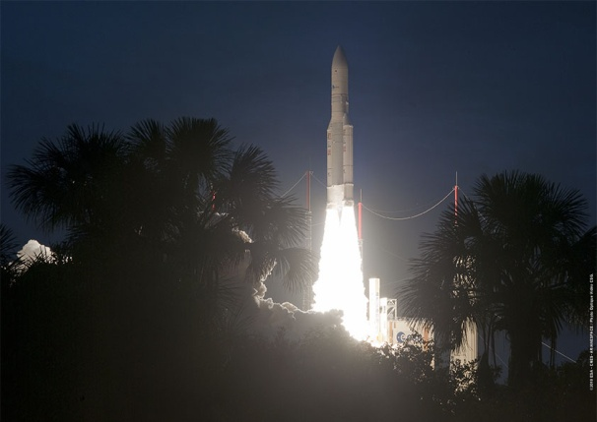
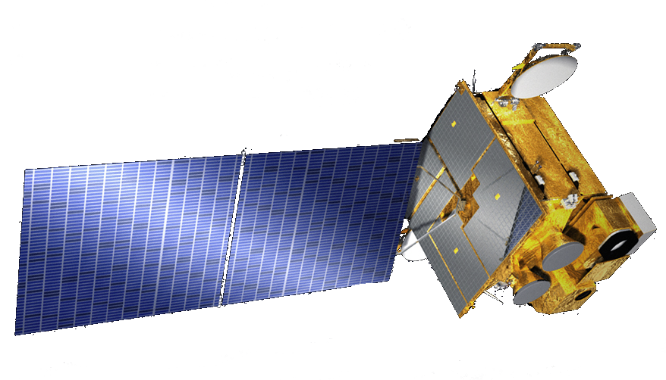
COMS
Communication, Ocean, and Meteorological Satellite (COMS)
8-year program (2003 – 2010)
Launch date : June 26, 2010 (French Guiana Kourou)
Location : 128.2E
Mass : 2,500kg
Design life time : 7 years
Contractor : EADS Astrium (ITT for MI)
S-/L-/Ka-Band Comm
Solar array
channel | Wave length(㎛)
Visible | 0.67
Shortwave IR(IR4) | 3.7
Water Vapor(IR3) | 6.7
IR1 | 10.8
IR2 | 12.0
Meteo Imager
Ocean Color Imager
Bus

Slide 3
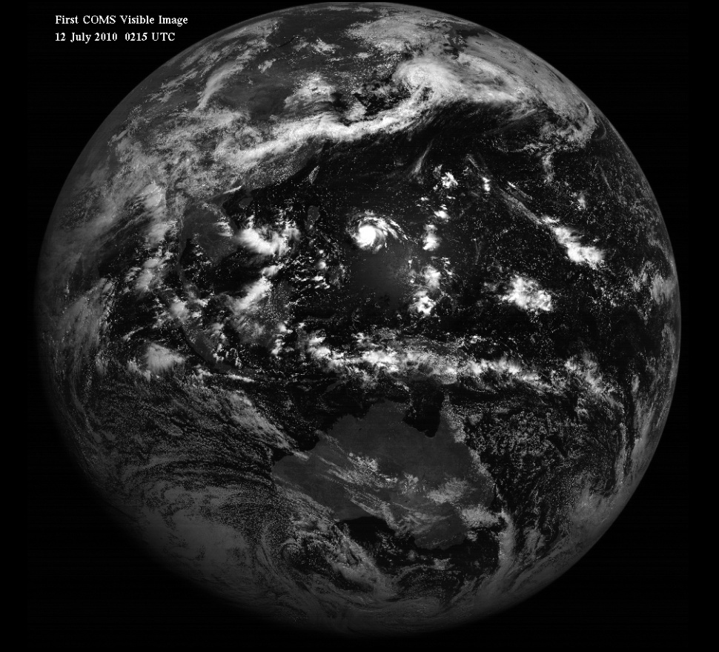
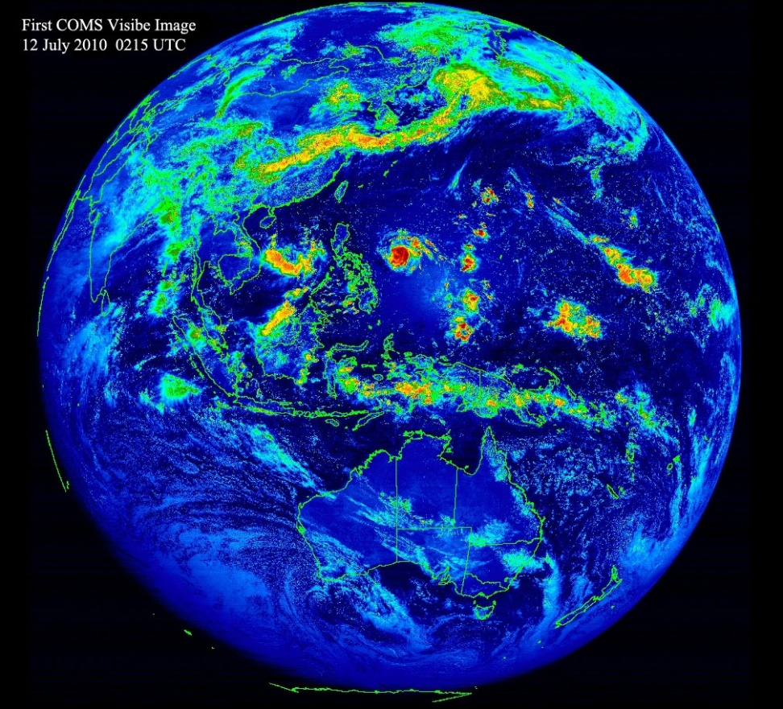
First Visible Image (2010.7.12 1115 KST)

Slide 4
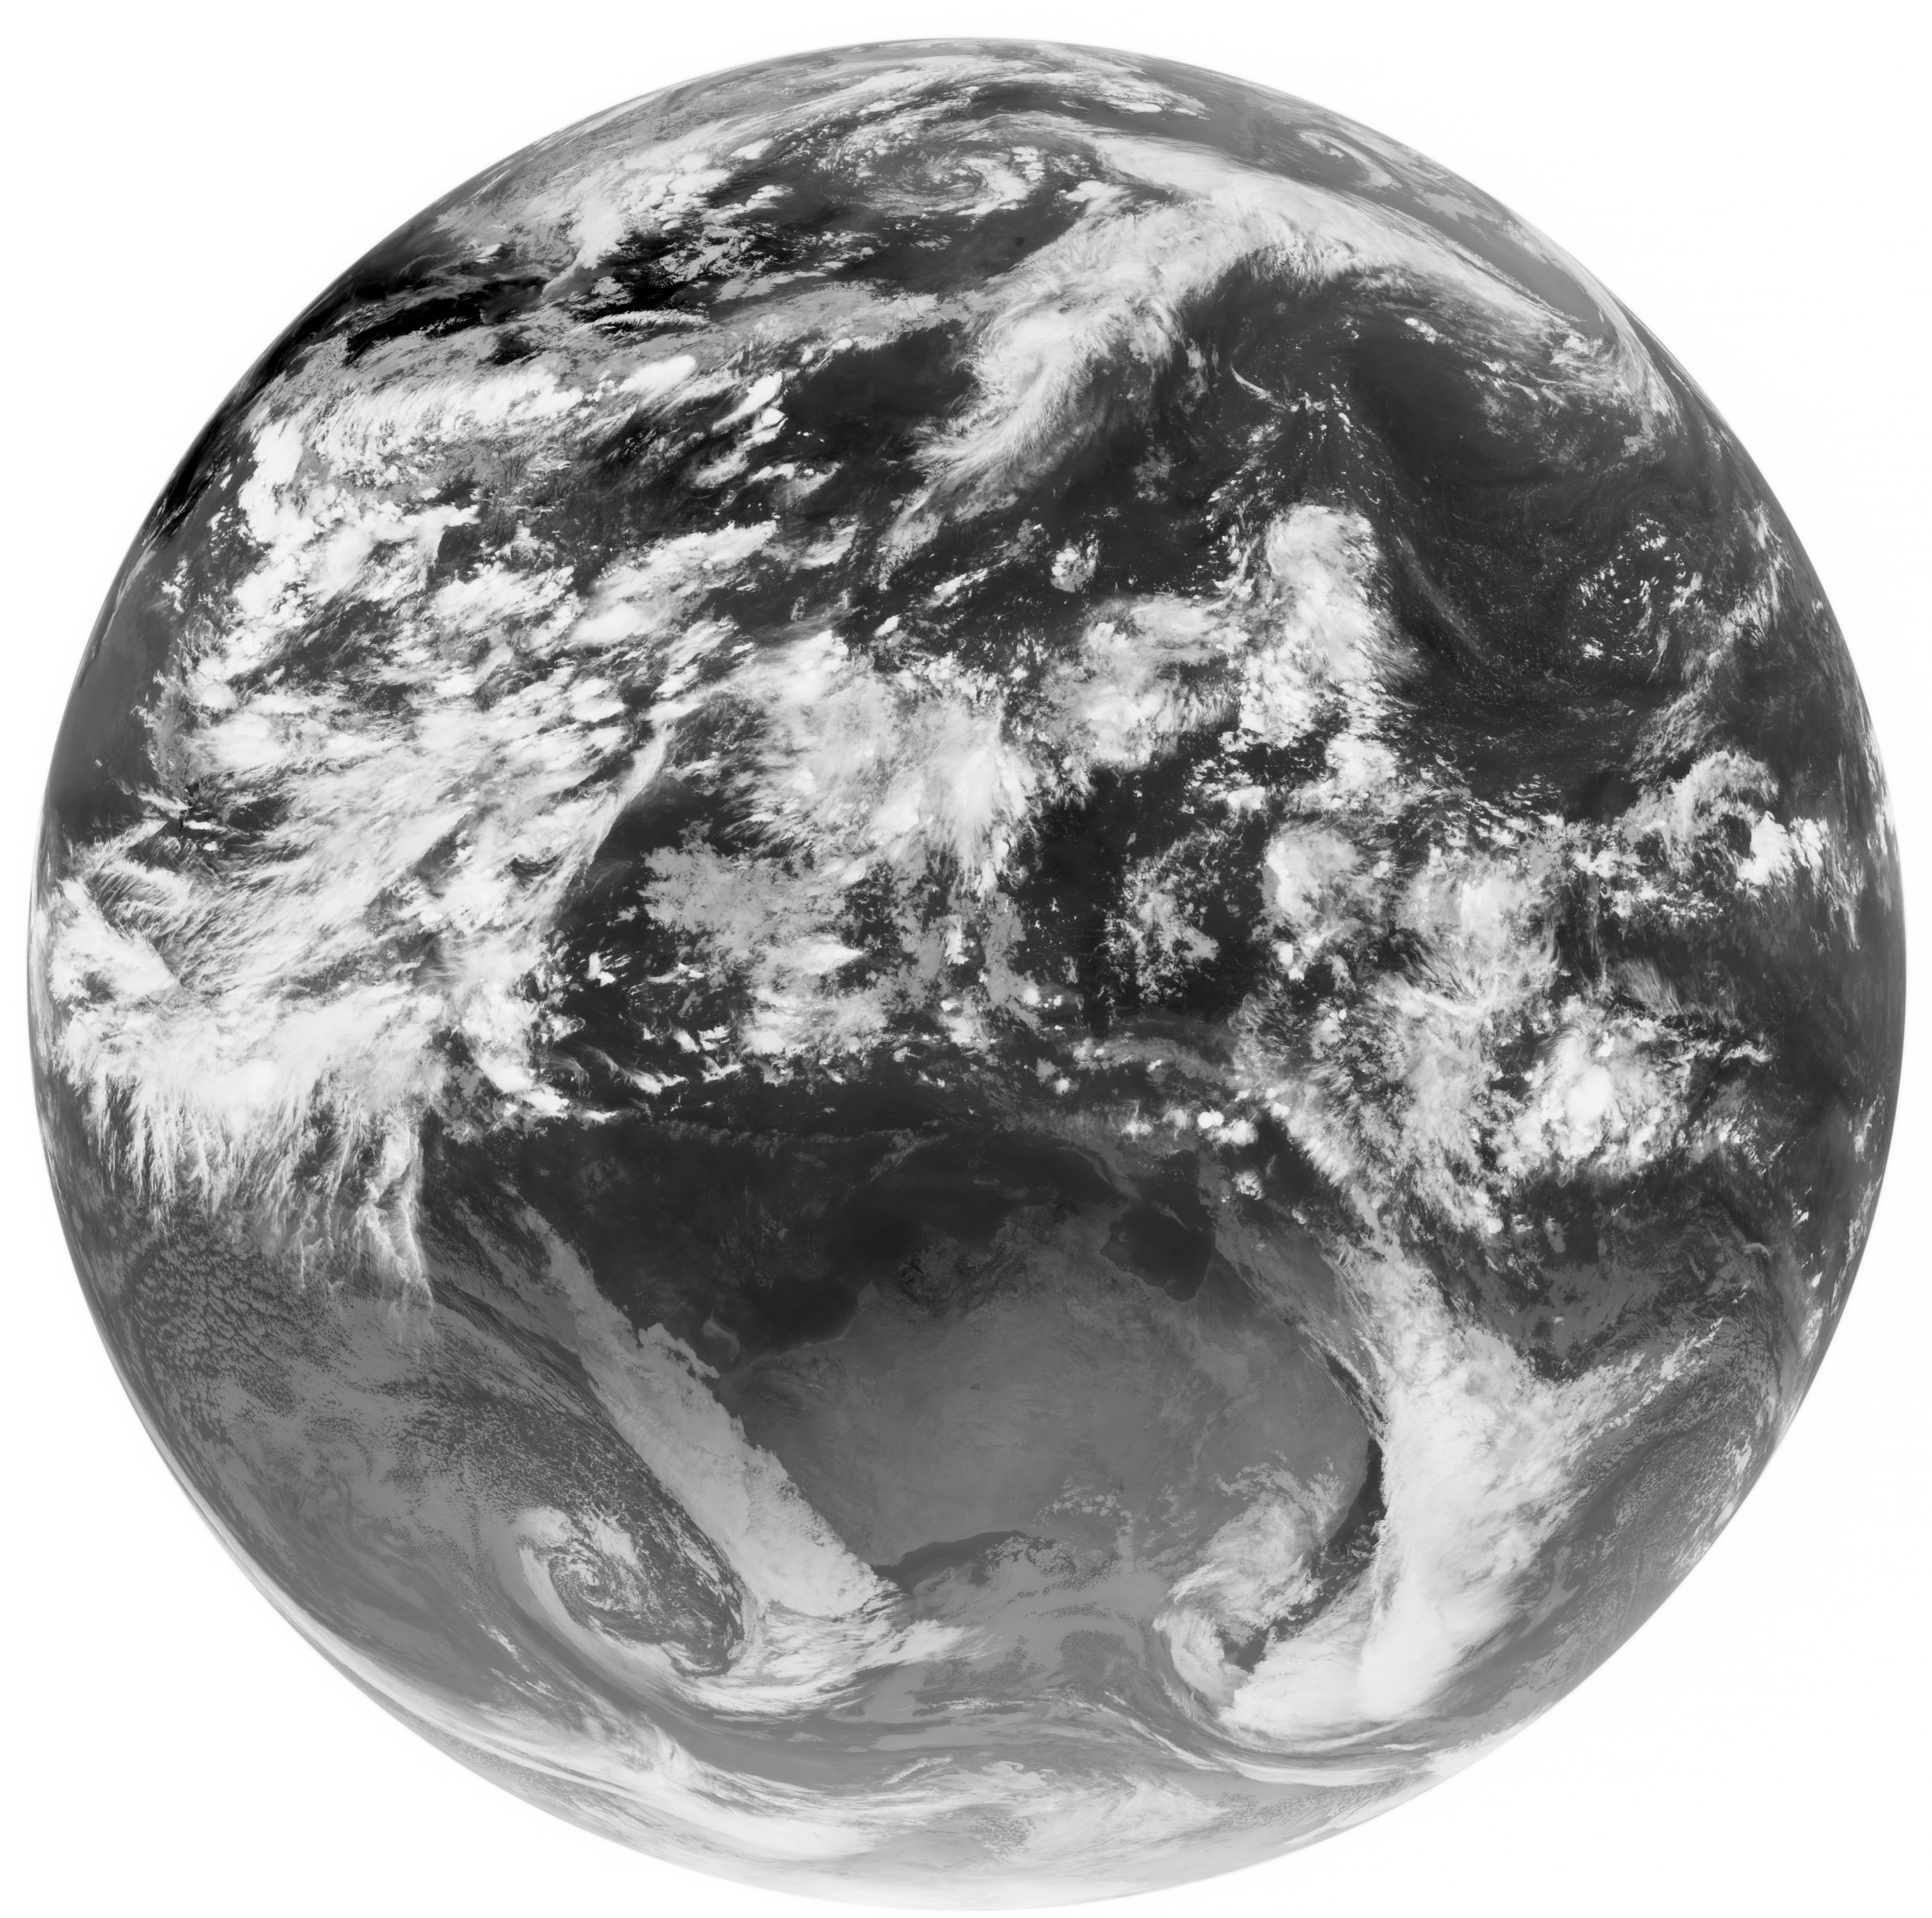
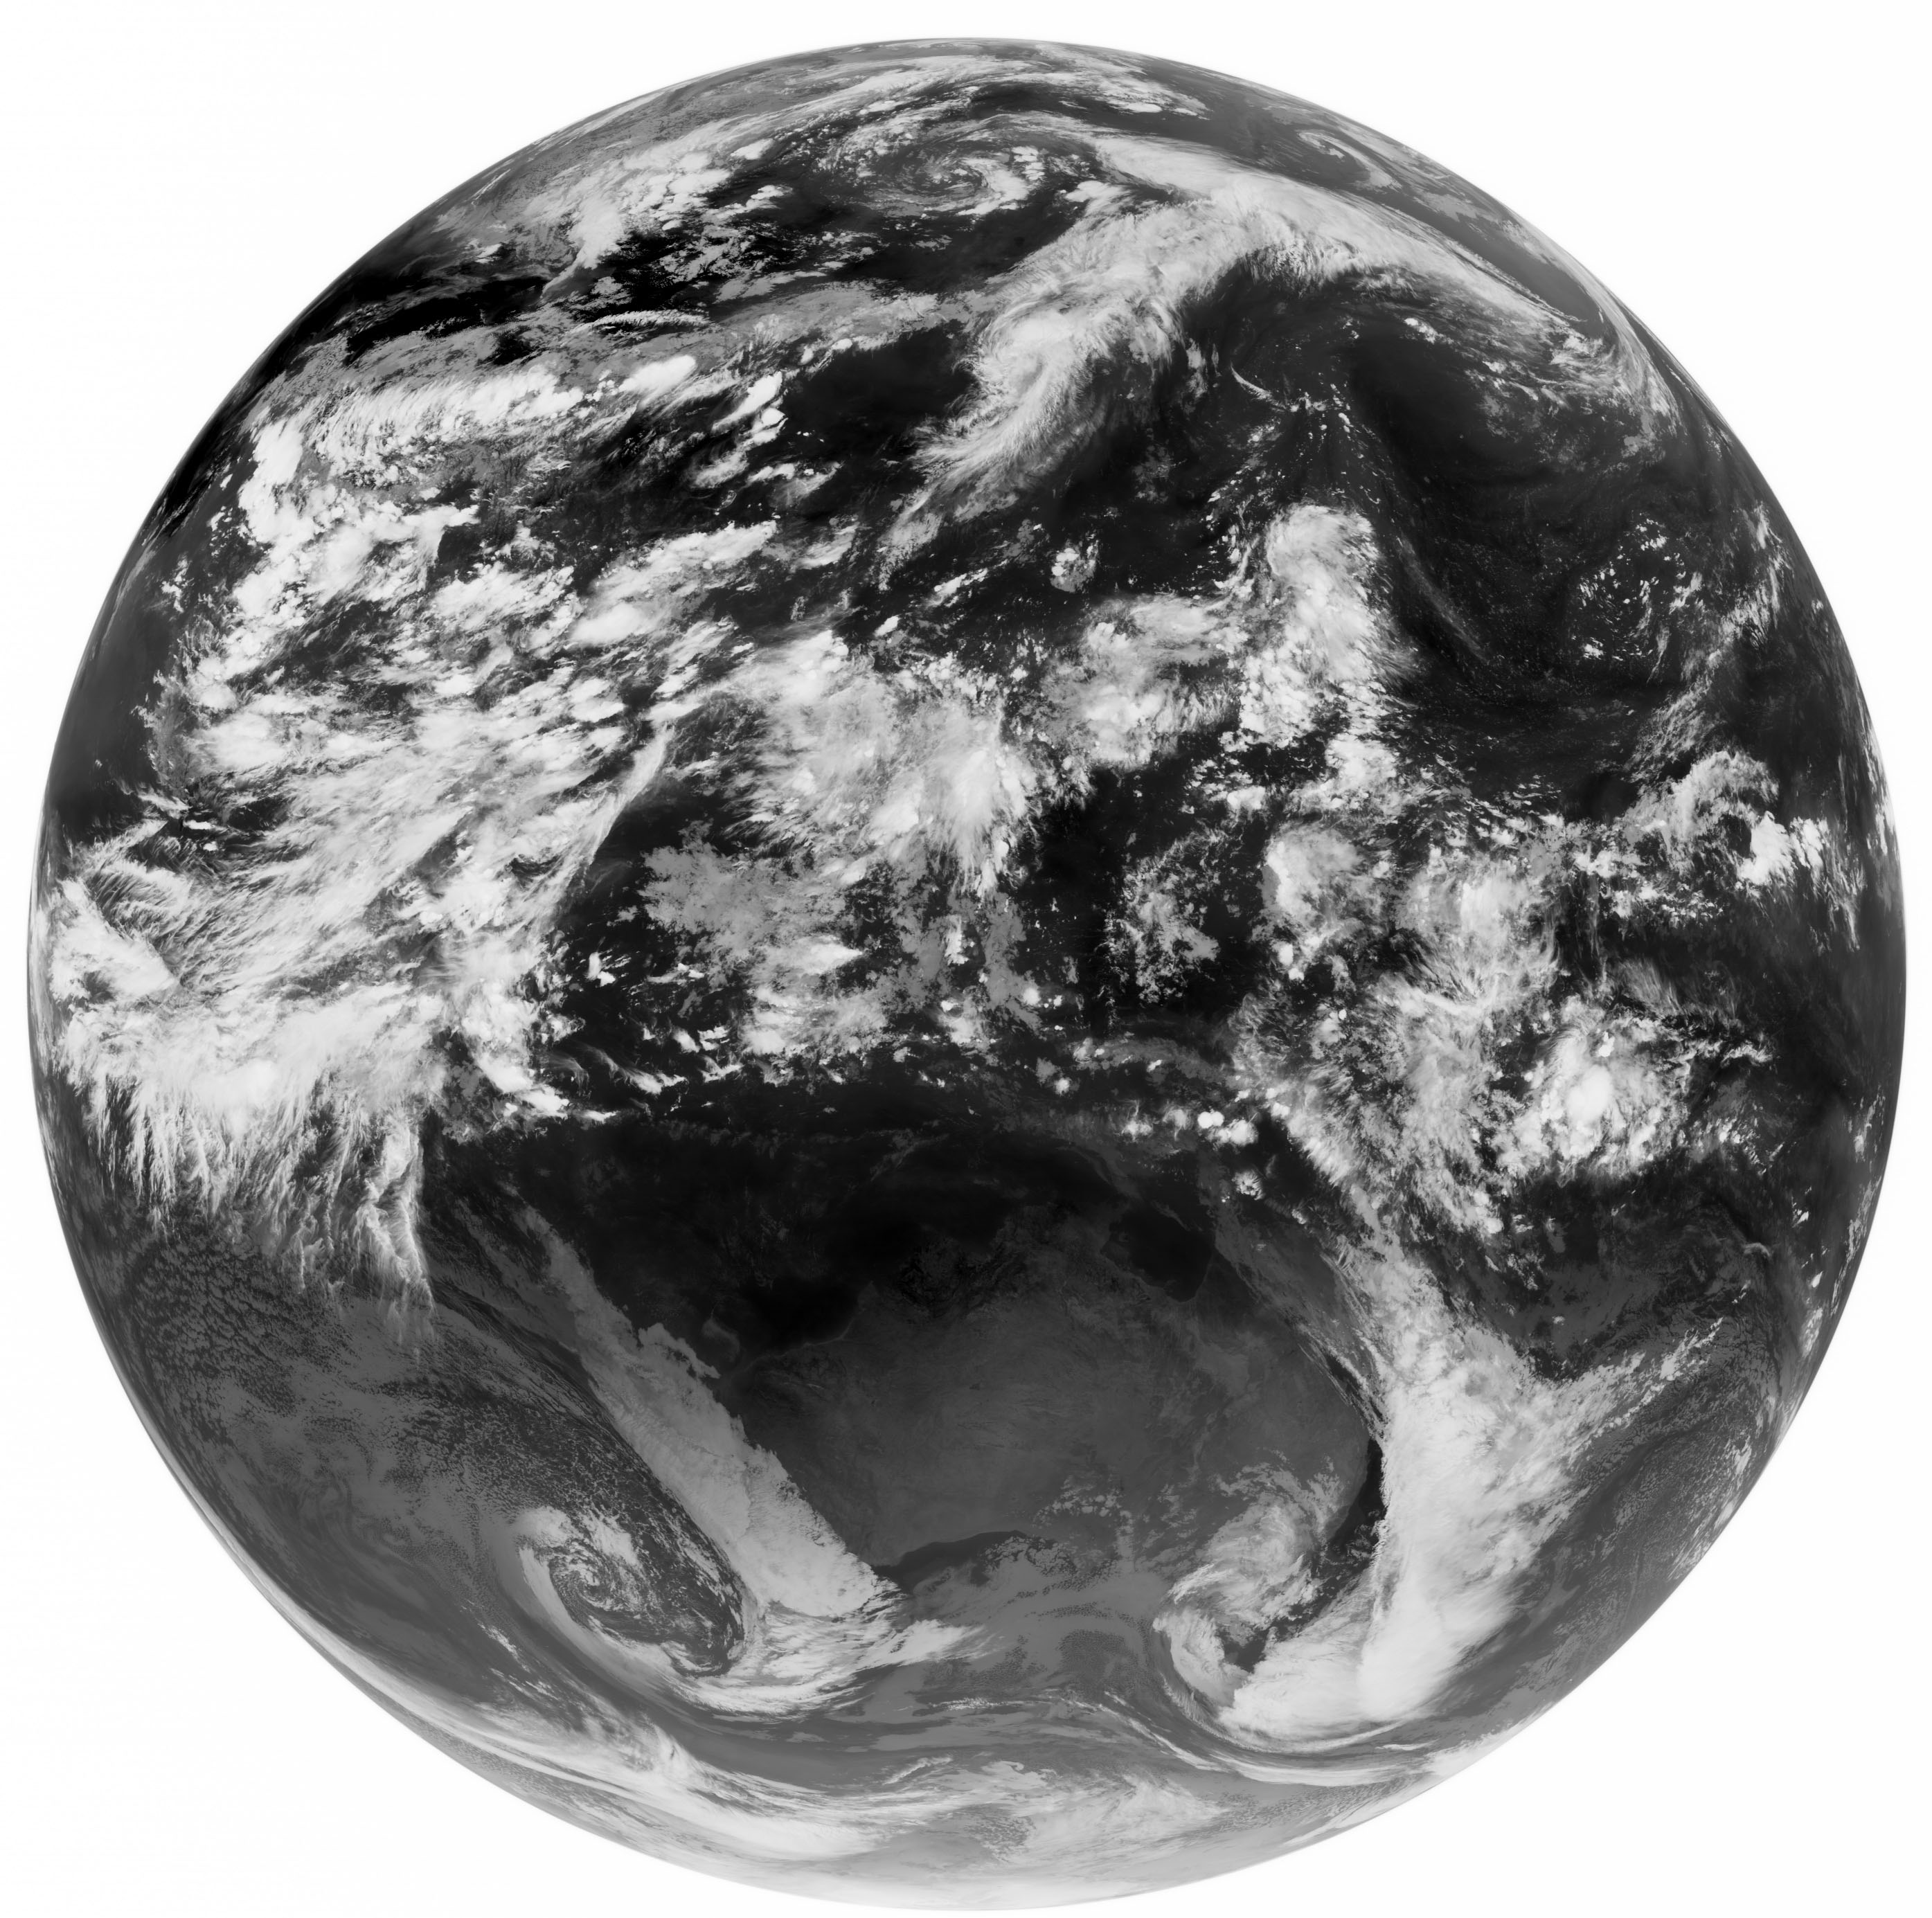
First IR Image (2010.8.11 1914 KST)
IR1 (11μm)
IR2 (12μm)

Slide 5
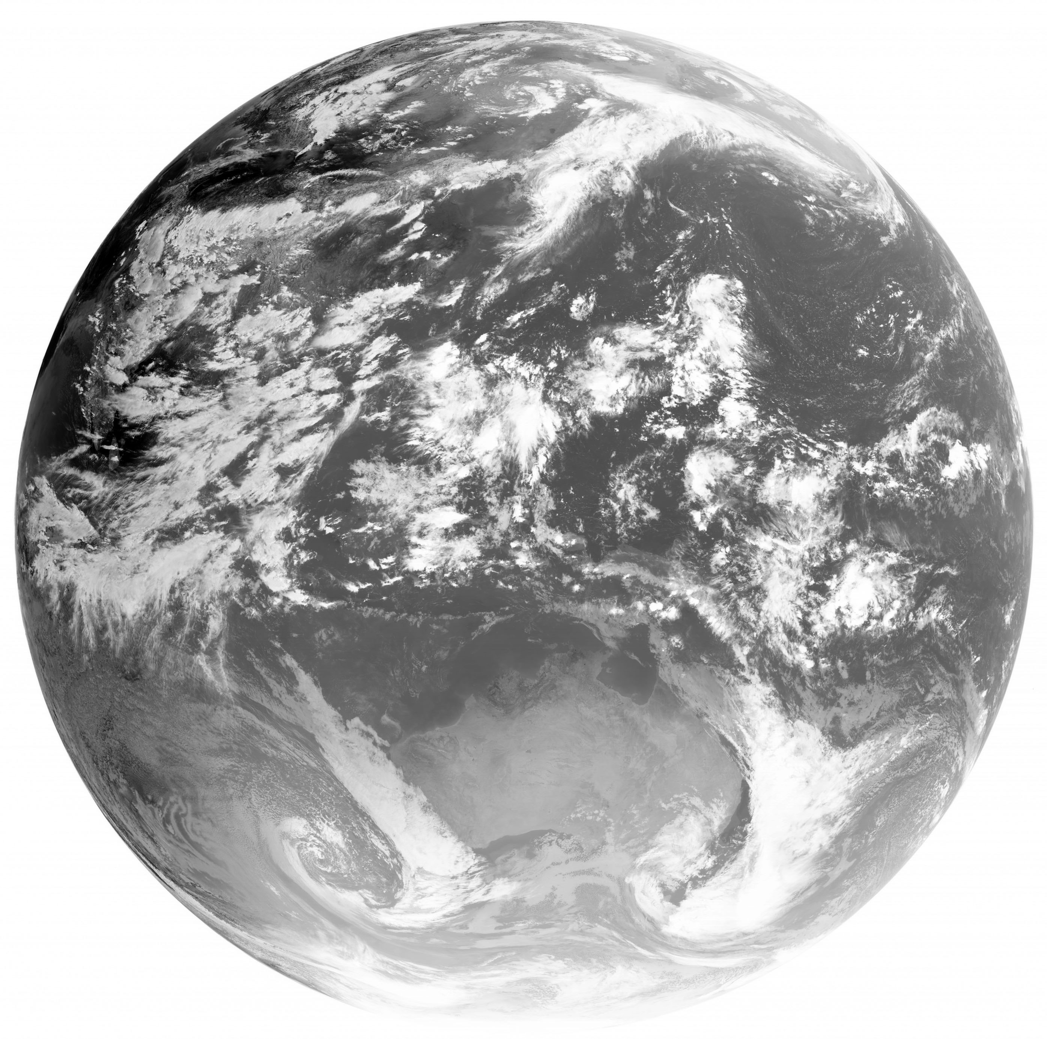
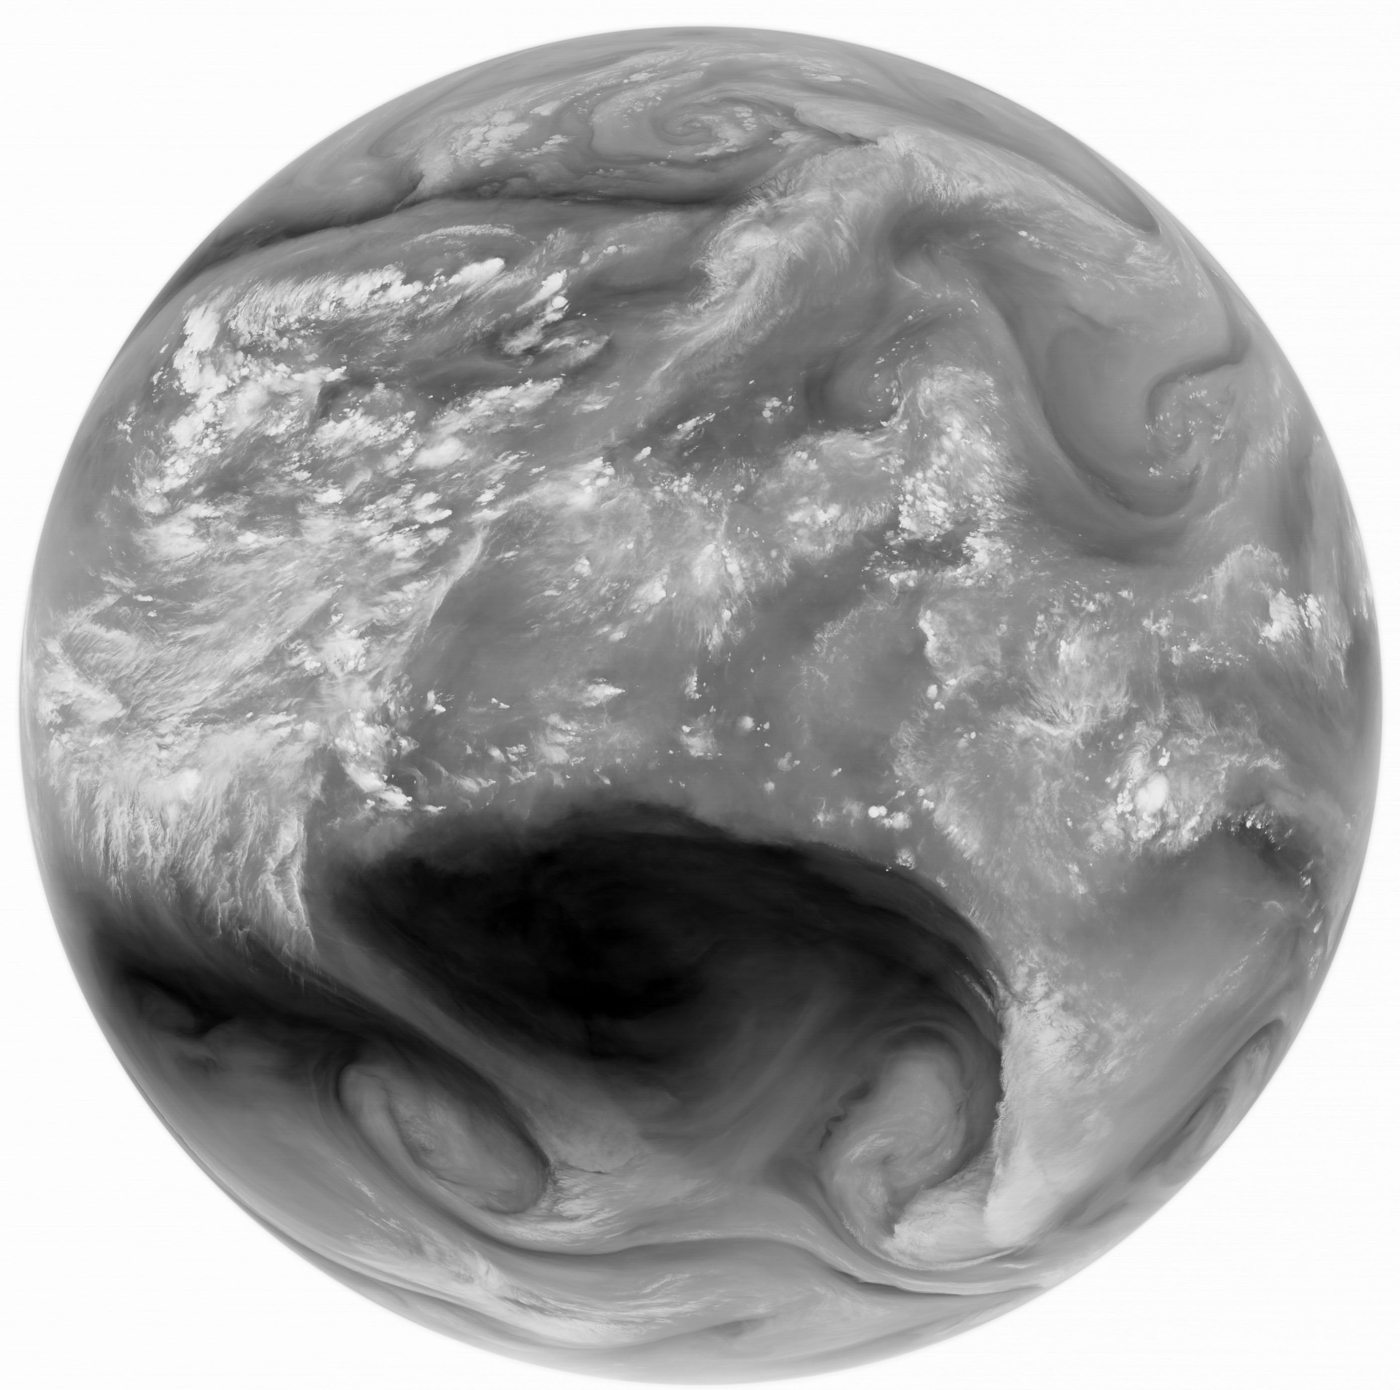
First IR Image (2010.8.11 1914 KST)
SWIR (3.5μm)
WV (6.7μm)

Slide 6
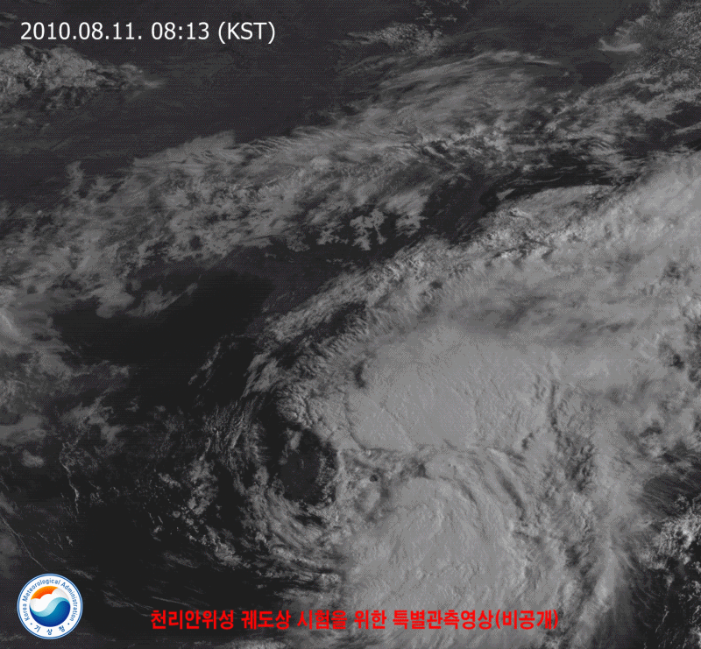
2010 4th Typhoon DENMU

Slide 7
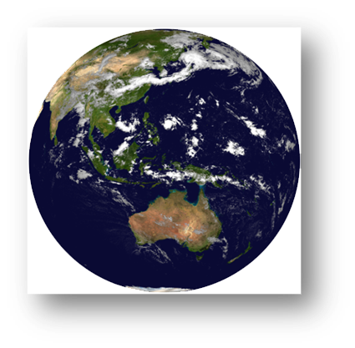
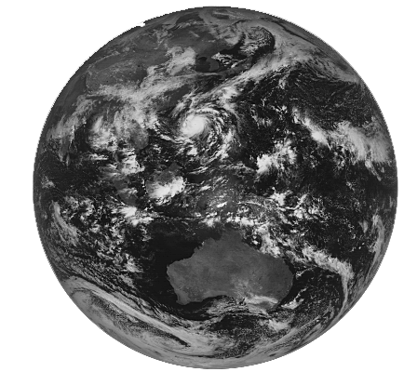
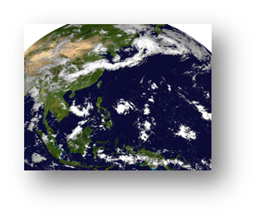
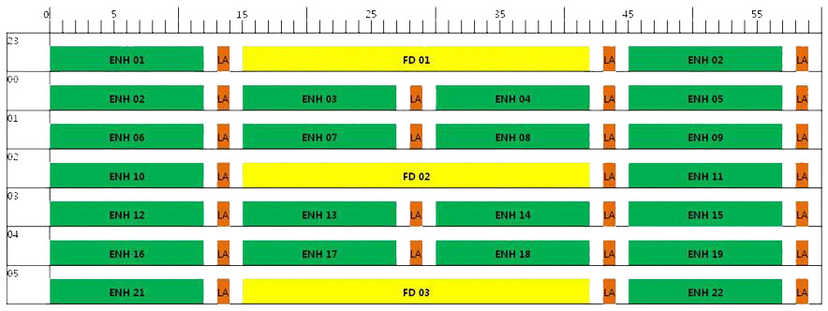
Observation Schedule
FD
ENH
LA
Full Disk : every 3 hr
NH : every 15 min
Korea : ~ 8 min

Slide 8
Previously
IR inter-calibration system for GEO with MODIS
Test using MTSAT-1R data: ~2010
GEO-LEO IR radiation Calibration with AIRS/IASI
MTSAT(both 1R/2) during 2009-2010
COMS (1-Vis, 4-Irs)
10.8, 12.0, 6.7, 3.7
launch date: Jun. 26, 2010
In-orbit test: July 10, 2010 ~ January 2011
Operation: April 2011~
Notes:
This is current GSICS activity of KMA. Implement IR inter-calibration system for COMS with MODIS. Test with MTSAT-1R data instead of COMS. Installation of GSICS GEO-LEO AIRS IR radiation calibration Software. Test with MTSAT-1R data during 2007.

Slide 9
Currently
IR inter-calibration system for COMS with MODIS
Using COMS after 2011
GEO-LEO IR radiation Calibration with AIRS/IASI
COMS after January 2011
VIS vicarious Calibration
Moon Calibration: 2011~
Notes:
This is current GSICS activity of KMA. Implement IR inter-calibration system for COMS with MODIS. Test with MTSAT-1R data instead of COMS. Installation of GSICS GEO-LEO AIRS IR radiation calibration Software. Test with MTSAT-1R data during 2007.

Slide 10
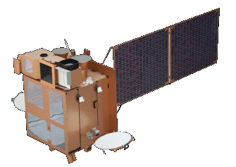
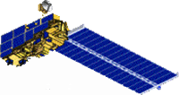
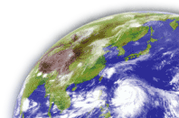
IR Calibration monitoring
Geostationary
Satellite
(COMS)
Polar orbital
Satellite
(AIRS/IASI)
Match-up Conditions
Observation time difference
- Maximum time difference is within 15 min
Target
- Selection clear or homogenous target
Spatial resolution difference
- hyper sounder: 12km, COMS: 4km
- radiances over a box of 3x3 pixels
Viewing angle (VA) difference
- The viewing angle difference changes
the effect of atmosphere
- Data are selected within 50° of satellite viewing angle from nadir (M. König, 1999)
- Maximum viewing angle difference is within 5°

Slide 11
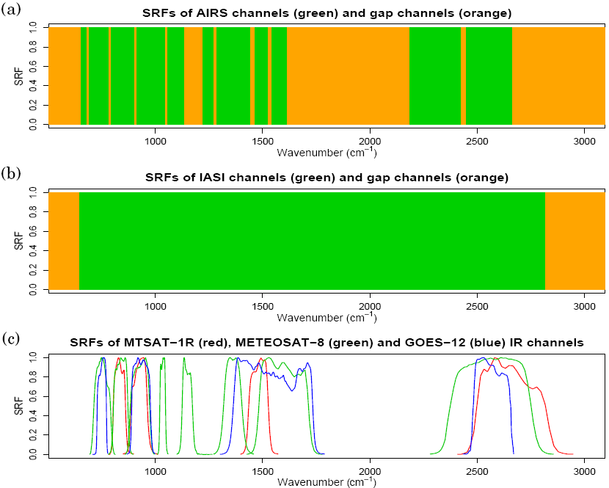
GEO(COMS) vs. LEO(AIRS) IR Calibration
Spectral filling method
Convolution method
Linear interpolation using only US profile
Proposed by NESDIS
Constraint method
Least square method using 8-profile
Proposed by JMA
COLLOCATED IN SPACE
COLLOCATED IN TIME
ALIGNED IN LINE-OF-SIGHT
UNIFORM ENVIRONMENT (9x9 )
LEO: AIRS
Missing channel
NORMAL GEO FOV
LEO: IASI
Valid channel
SPATIAL AVERAGING
SRFs of COMS (red), METEOSAT-8 (green) and GOES-12 (blue) IR channels
GEO: COMS
SPECTRAL FILLING

Slide 12
GEO vs. LEO constraint method(IR Calibration)
AIRS
IASI

Slide 13
TB vs. ΔTB(COMS-AIRS) (IR Calibration)

Slide 14
TB vs. ΔTB(COMS – IASI) (IR Calibration)

Slide 15
Time series of ΔTB (IR Calibration)
Notes:
SWIR 채널에 대한 오차분석은 진행중에 있으나 해결하지 못함. 다방면으로 분석중에 있으며 진행상황에 대해서 지속적으로 보고할 예정임.

Slide 16
KMA/NMSC web

Slide 17
Preliminary Results (IR Calibration)
COMS IR channels have low-bias except IR1
Difference between COMS TB and AIRS/
IASI TB shows positive bias in the cold
scenes while negative bias in the warm
scenes (except IASI IR4)
AIRS comparisons have larger bias and rmse than IASI
Need long-term monitoring

Slide 18
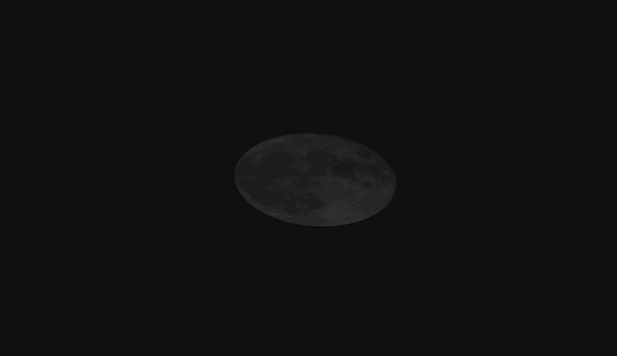
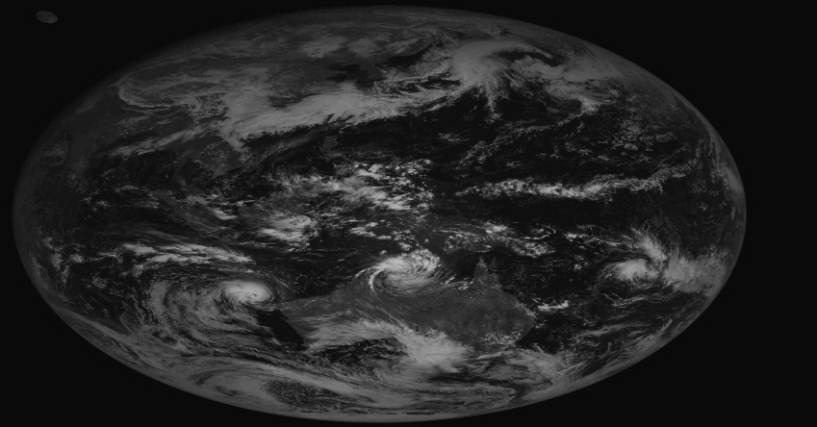
Moon Calibration of COMS visible (1/3)
COMS has observed moon monthly for moon calibration since Feb. 2011.
KMA has used its own Moon Processing system in IMPS(Image Processing Subsystem) for Moon Calibration.
For observing moon, KMA choose two kind of moon observation method by using Local Area Observation for moon and Full disk Observation with moon.

Slide 19
Moon Calibration of COMS visible (2/3)
To measure the total degradation of the instrument visible channel
Comparison between the Moon signal and ROLO model of USGS – as a Function of Phase angle(Sun-Moon-Earth)
Imager Response
Where
is the Moon irradiance as measured by the Imager
is the Moon irradiance computed from the ROLO model,
under the same conditions
All Imager responses are linearly trended over the various Moon images with the ratio $k=\frac{P(t)}{P(t_{0})}$ expressed in percentage.

Slide 20
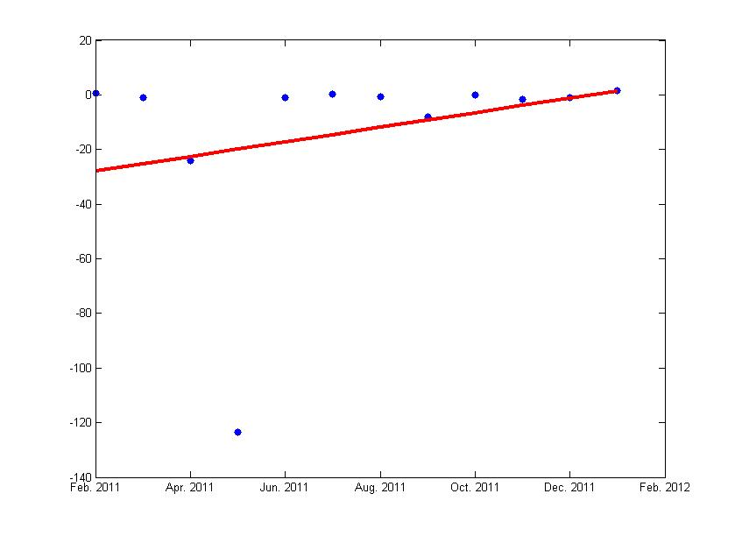
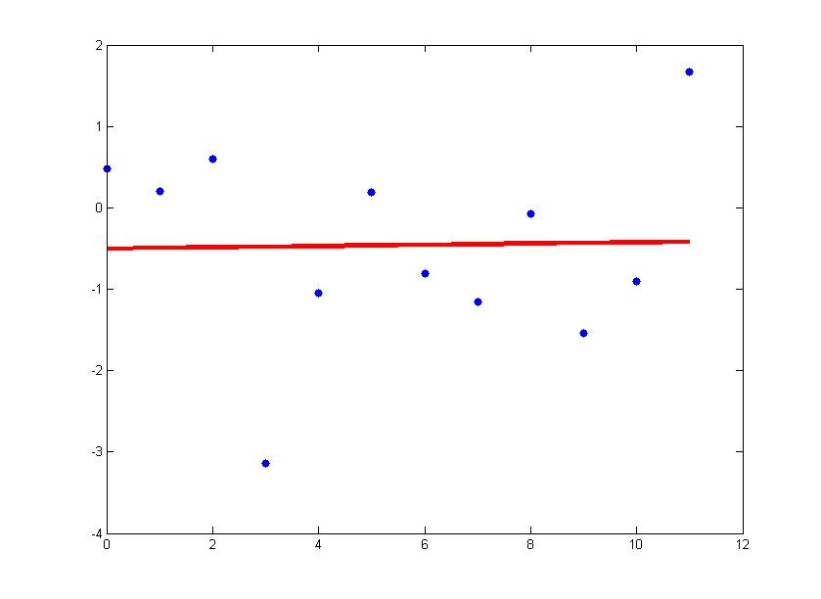
Moon Calibration of COMS visible (3/3)
The results from Feb. 2011 to Jan. 2012.
Maximum absolute accuracy for last 1 year is less than 4%.
Since the rectangle, in which moon irradiance is calculated, can contain earth(red circle), count values of earth part in this rectangle should be replaced space values.
(1-measured/model)×100(%)
TIME(month)
Irradiance with Earth
Irradiance without Earth
1-K on month(%)
1-K on month(%)
y = ax+b
a = 2.6769
b = -27.92045
bias = -13.1976
Rmse = 32.6
y = ax+b
a = 0.0077
b = -0.5024
bias = -0.4602
Rmse = 1.42
TIME(month)
TIME(month)
Notes:
달 관측 분석을 위해서 특정한 크기의 직사각형을 분석하는데 경우에 따라서 달만이 아닌 지구가 이 직사각형속에 포함되는 경우가 있어, 이 경우는 값이 매우 이상한 값으로 나타나기에 지구의 값을 제거하고 우주배경값으로 이를 대신하여 채워서 계산하게 되면 왼쪽 그래프에서 처럼 매우 터무니 없는 값이 오른쪽 그림과 같이 제거 됨.
이렇게 제거를 하고 난 후 ROLO 모델과의 차이는 4% 이내로 정확도를 가지게 됨
전체적으로 2011년동안 달을 이용한 가시채널 검정 결과는 완벽하게 분석이 되지는 않았으나 일정한 경향을 나타내고 있지는 않음. y절편을 0으로 두었을때 기울기가 약 3% 정도로 나타나고 있음. 하지만 오차와의 값이 크게 차이가 나지않아, 이를 가시채널의 센서가 퇴화되었다고 판단하기는 이른 것으로 생각됨.

Slide 21
Any comments or questions?

Slide 22
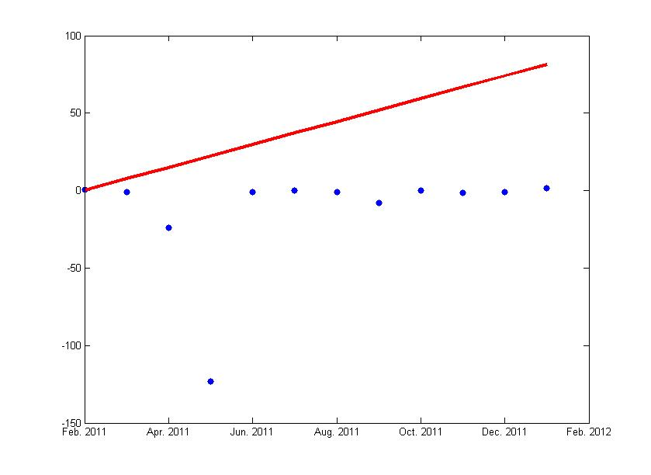
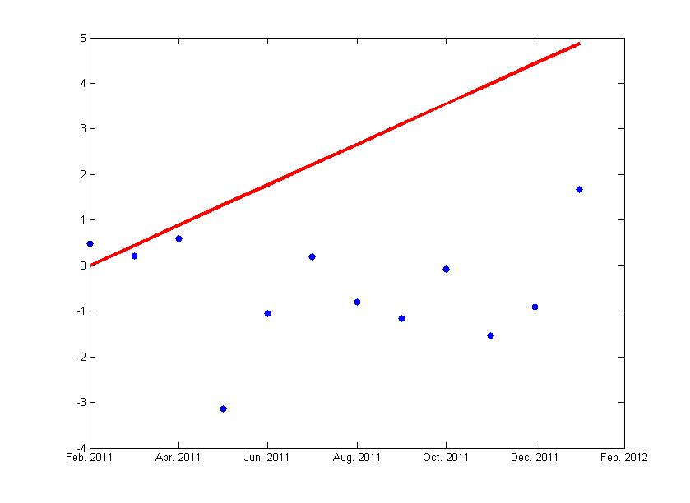
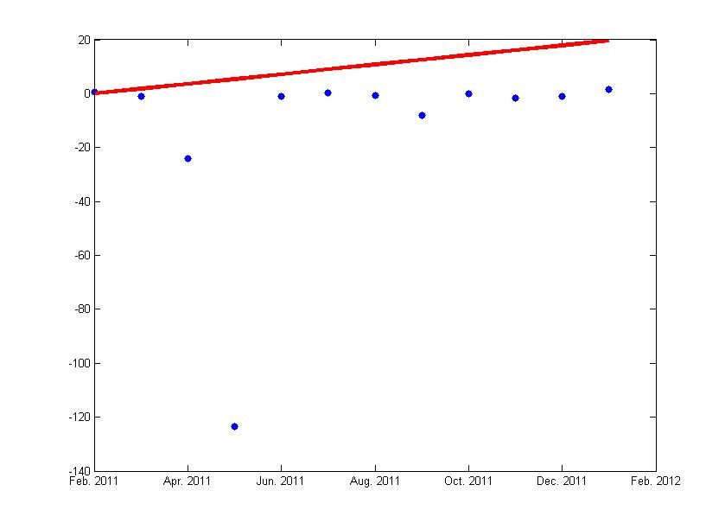
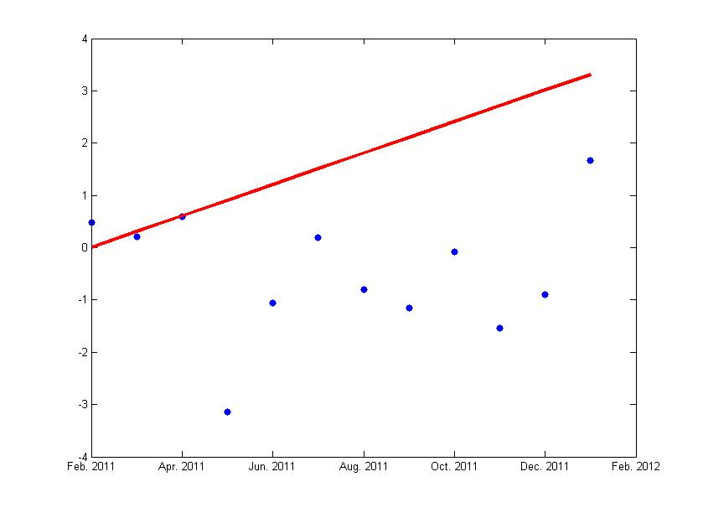
Trends from Feb. 2011 to Jan. 2012.
Irradiance with Earth
Irradiance without Earth
1-K on month(%)
1-K on month(%)
y = ax+b
a = 7.397574212
b = 0
y = ax+b
a = 0.443393249
b = 0
Irradiance with Earth except May 2011 data
Irradiance without Earth except May 2011 data
1-K on month(%)
1-K on month(%)
y = ax+b
a = 1.789828731
b = 0
y = ax+b
a = 0.300893607
b = 0

