Slide 1
Diurnal Calibration Variation of GOES Infrared Channels
Fangfang Yu and Xiangqian Wu

Slide 2
Outline
Issue
Midnight calibration anomaly
Empirical correction algorithm – midnight blackbody calibration correction (MBCC)
MPCC performance: GOES diurnal calibration variation
Time-dependent calibration correction using GSICS

Slide 3
GOES IR Calibration Issue
Midnight calibration anomaly
Expected before GOES-8 was launched
First observed at short-wave channel with the SST temperature at the Gulf of Mexico
Impact on the long-wave channel product was also report
Last 6-8 hours, around the satellite midnight

Slide 4
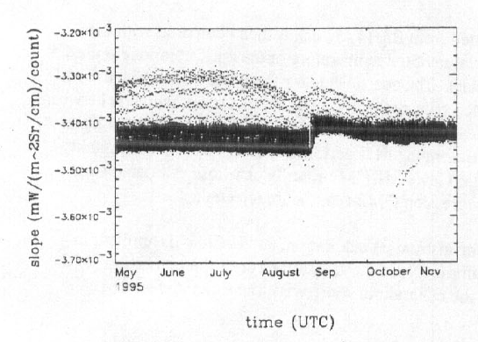
Midnight calibration anomaly and correction
Causes of Midnight calibration anomaly (Johnson and Weinreb, 1996)
Extra radiation reflected by the non-unity emissivity of BB to the detectors, when the instrument is viewing the BB.
Scattered solar radiation contamination at space view
Most pronounced at pre-eclipse and post-eclipse around the equinox.
Empirical correction algorithm: midnight blackbody calibration correction (MBCC) (Johnson et al. 1996, Weinreb and Han 2003)
non-perfect BB effect
Contaminated SPLK effect
Figure. Original calibration slopes of GOES-8 Imager Ch2 (from Johnson et al. 1996)

Slide 5
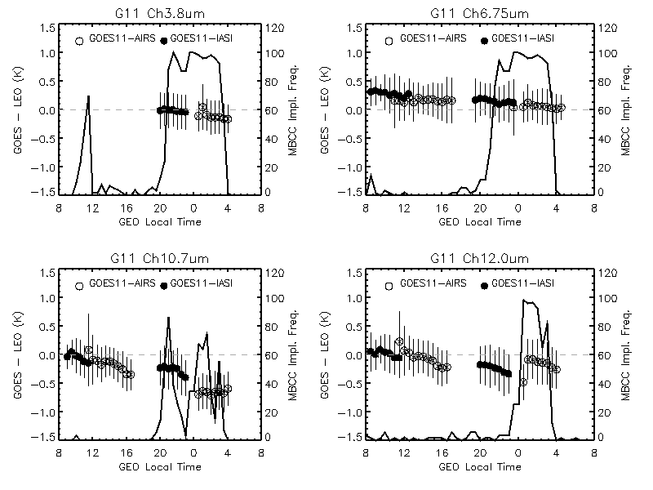
GOES-11 Imager IR Diurnal Cal. Variation
Time dependent Tb bias and the standard deviation (at 30 minute time bin), as well as the frequency of MBCC application in the winter of 2008 (Jan. 1 – March 1).
(Yu et al. ITGRS, 2012, revised)

Slide 6
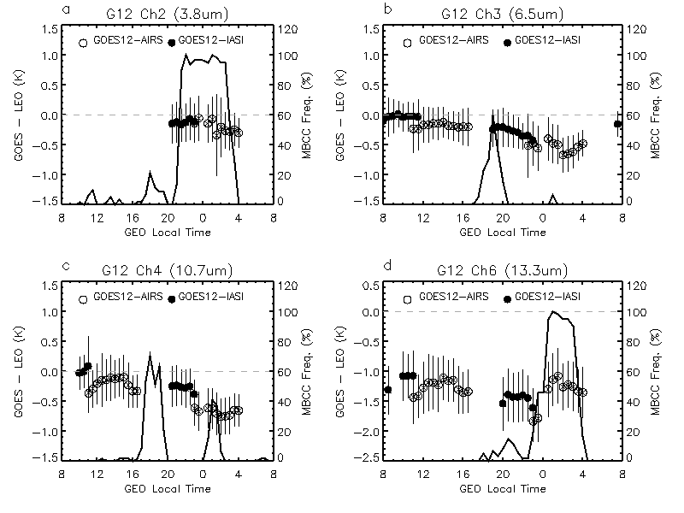
GOES-12 Imager IR Diurnal Cal. Variation
Time dependent Tb bias and the standard deviation (at 30 minute time bin), as well as the frequency of MBCC application in the winter of 2008 (Jan. 1 – March 1).
(Yu et al. ITGRS 2012, revised)

Slide 7
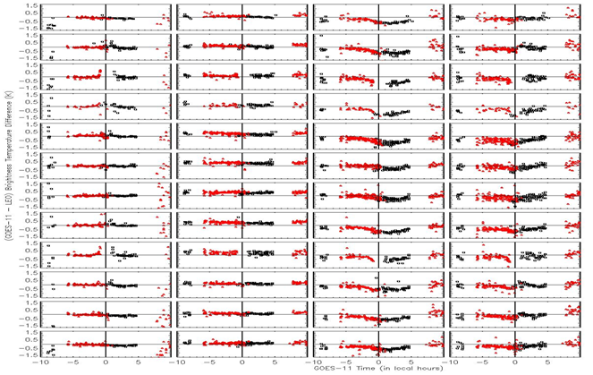
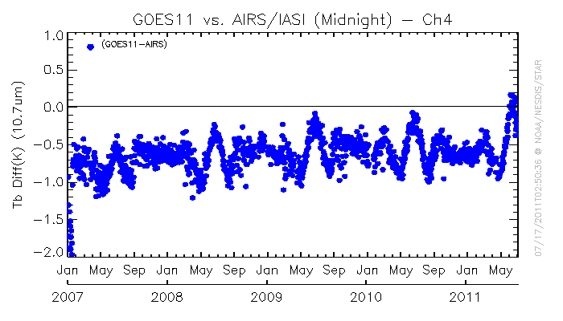
Tb bias to AIRS at satellite midnight
Duration and amplitude vary at different IR channels
Depends on the frequency of MBCC application, which may change with time
May have long-term variation at some IR channels
Time-series of Tb bias to AIRS at midnight time for GOES-11 Ch4
Evaluation of MBCC performance for each channel and in each month for GOES-11

Slide 8
Possible Solutions…
Fundamental correction with physical models
Many benefits with this approach, but may need a relatively long term effort
Time-dependent correction using GSICS

Slide 9
Time-dependent correction using GSICS
Look-up table at each time bin
Large uncertainty for the extreme Tb scenes
Regression correction at time bin
Bias is scene radiance dependent, need sufficient collocated scenes
Delta correction
Difference between the reference instruments, assuming the difference is constant
SNO
Double difference using satellite observation or RTM simulation as the transfer
Time interval
LEO overpass time interval (1 hour) vs. BB calibration time interval (30 minutes).
Varying interval

Slide 10
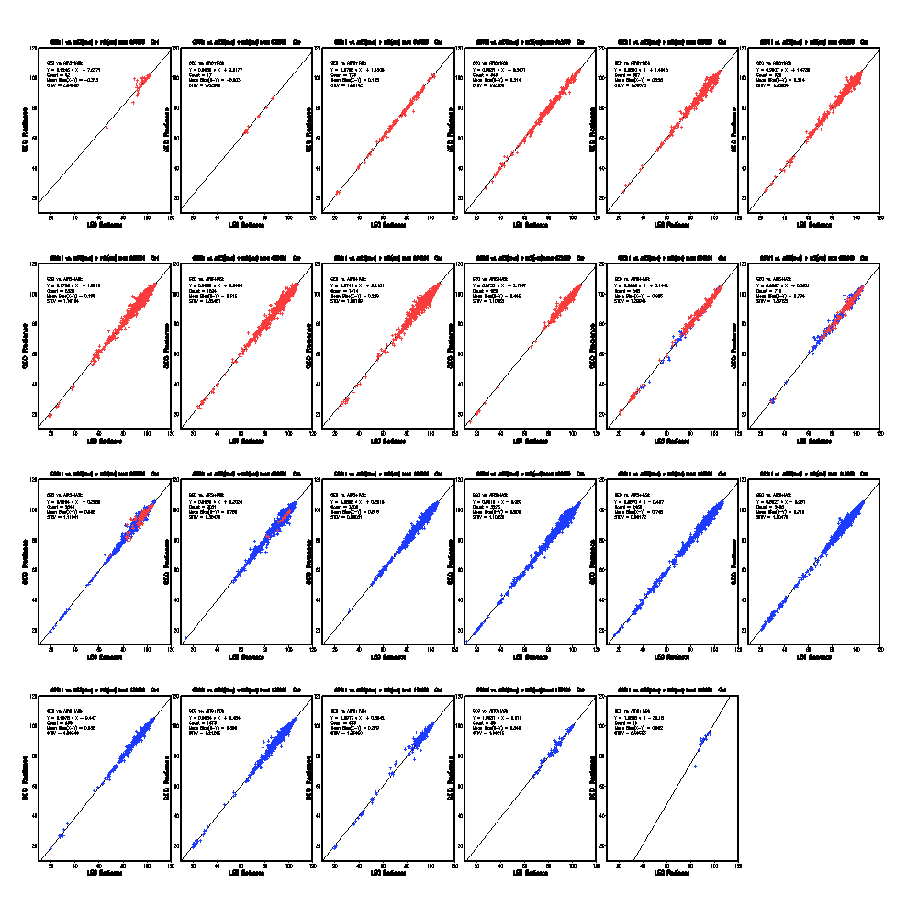
18:00
18:30
19:00
19:30
20:00
20:30
21:00
21:30
22:00
22:30
23:00
23:30
00:00
00:30
01:00
01:30
02:00
02:30
GOES-11 Ch4
03:00
03:30
04:00
04:30
05:00

Slide 11
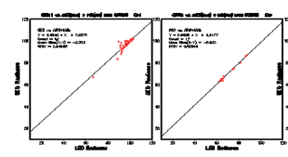
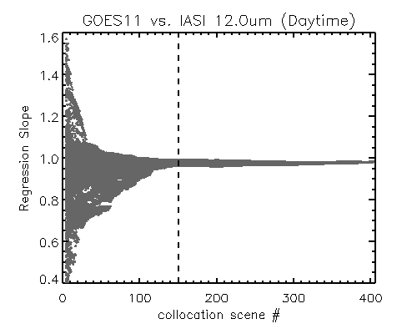
How to handling ….
Insufficient collocated scenes within one-month smoothing window (used for the day-time data correction)
Keep the smoothing period, relax the time interval
Keep the time interval, extend the smoothing period

Slide 12
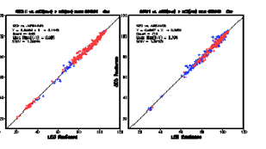
Overlaping period:
use one reference instrument
take advantage of more collocated scenes

