Slide 1
GOES Sounder Infrared Radiometric Calibration Accuracy
Fangfang Yu and Xiangqian Wu
Submitted to the IEEE special issue on instrument inter-calibration

Slide 2
Introduction
The GOES Sounder derived product imagery are important inputs for weather analysis and forecasting.
More than ten GOES Sounder products are identified in a number of numerical weather prediction (NWP) and forecasting applications
clear-sky radiances, temperature and moisture profiles, total precipitable water vapor (TPW) and layer precipitable water, cloud-top retrievals, surface skin temperature, water vapor winds, distribution of atmospheric ozone, and atmospheric stability indices such as convective available potential energy and lifted index(LI)
Accurate weather monitoring and forecasting requires consistent high-quality Sounder radiance.

Slide 3
Objective
To evaluate the GOES Sounder infrared(IR) calibration accuracy using GSICS GEO-LEO inter-calibration algorithm.

Slide 4
Study Period
 | GOES-11 | GOES-12 | GOES-13 | GOES-14 | GOES-15
data period | 10/01/2011-12/01/2011 | 11/01/2009-12/31/2009 | 11/01/2011-12/31/2011 | 12/10/2009- 01/10/2010 | 12/05/2011-02/05/2012
nadir longitude | 135ºW | 75ºW | 75ºW | 104.5ºW | 135ºW

Slide 5
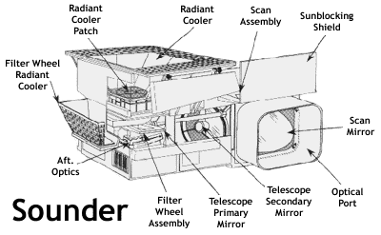
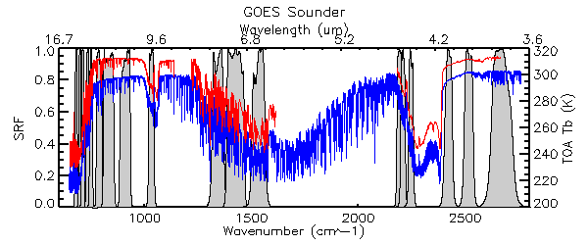
GOES Sounder IR Channel SRFs
long-wave
middle-wave
Short-wave

Slide 6
GOES Sounder Instr. Char.
Detector | Channel Number | Cntr. Wvnum (µm) | IGFOV (µrad) | Purpose
Long-wave (4 detectors per channel) | 1 | 14.71 | 224 (10km at nadir) | Temperature Sounding
 | 2 | 14.37
 |  |  |  | Temperature Soundering
 | 3 | 14.06
 |  |  |  | Temperature Soundering
 | 4 | 13.64
 |  |  |  | Temperature Soundering
 | 5 | 13.37 |  | Temperature Soundering
 | 6 | 12.66 |  | Temperature Soundering
 | 7 | 12.02 |  | Surface Temperature
Mid-wave (4 detectors per channel) | 8 | 11.03 | 224 (10km at nadir) | Surface Temperature
 | 9 | 9.71 |  | Total Ozone
 | 10 | 7.43 |  | Water Vapor
 | 11 | 7.02 |  | Sounding
 | 12 | 6.51 |  | Sounding
Short-wave (4 detectors per channel) | 13 | 4.57 | 224 (10km at nadir) | Temperature Sounding
 | 14 | 4.52 |  | Temperature Sounding
 | 15 | 4.45 |  | Temperature Sounding
 | 16 | 4.13 |  | Temperature Sounding
 | 17 | 3.98 |  | Surface Temperature
 | 18 | 3.74 |  | Surface Temperature
Visible (4 dets) | 19 | 0.67 | 224 (10km at nadir) | Cloud

Slide 7
GEO-LEO Inter-calibration
AIRS
Subset GEO
Subset LEO
IASI
Collocation Criteria:
closest pixel center < 10km
time difference: < 15 minutes
viewing zenith angle difference:
Collocation
SRF Convolution
JMA’s gap filling method used to fill the missing AIRS spectra
Comparison Dataset
Data Analysis

Slide 8
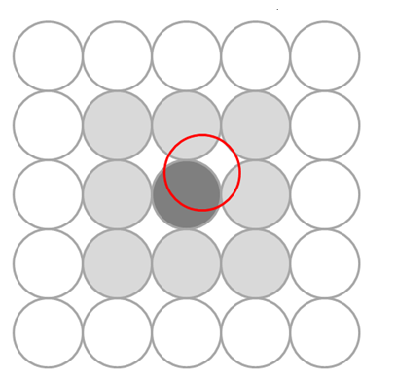
Spatial Collocation
GEO pixels
LEO pixel

Slide 9
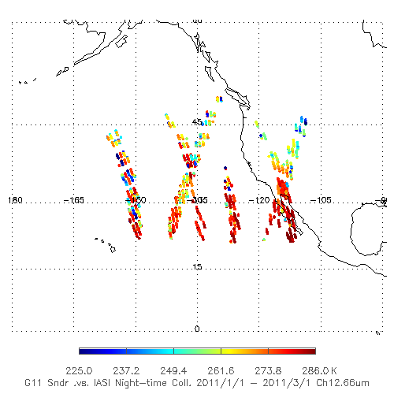
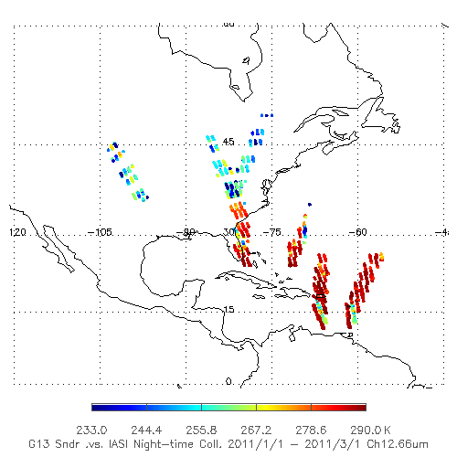
Spatial Distribution
GOES-West (135ºW)
GOES-East (75ºW)

Slide 10
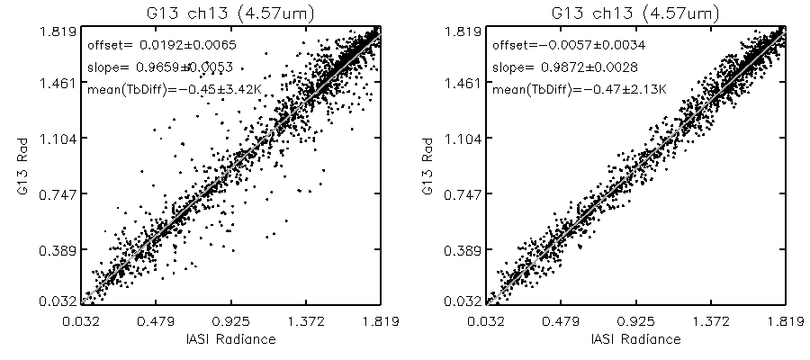
Recursive Filtering to Remove Outliers

Slide 11
Collocation Scene Pixel #
Collocation # between 2011/7/1 – 2011/7/31

Slide 12
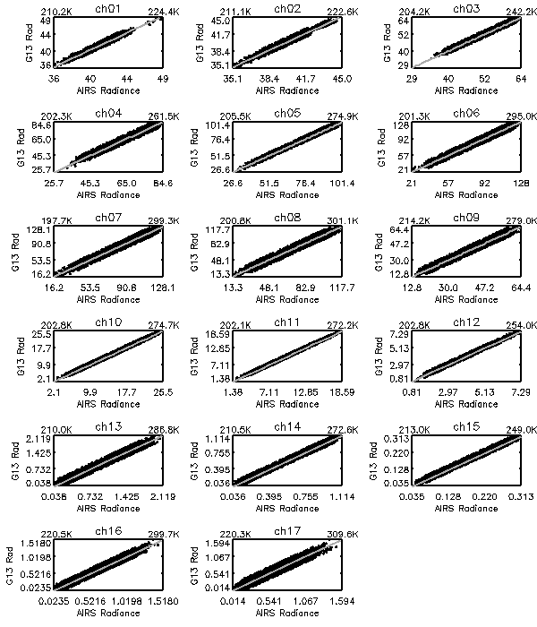
GEO-LEO Radiance Scatter-plot
Linear regression

Slide 13
Scatter-plot of the Tb difference against the measurement time difference (left) and the optical path difference (right) for GOES-13 Sounder Ch4
No significant systematic Tb bias of the collocated scenes

Slide 14
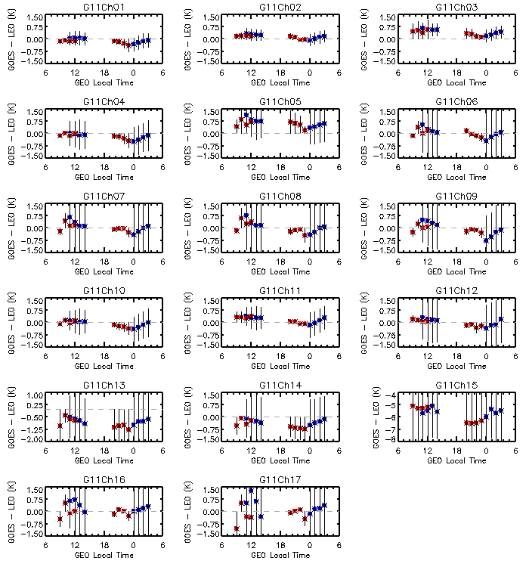
Double Difference to estimate the diurnal cal variation

Slide 15
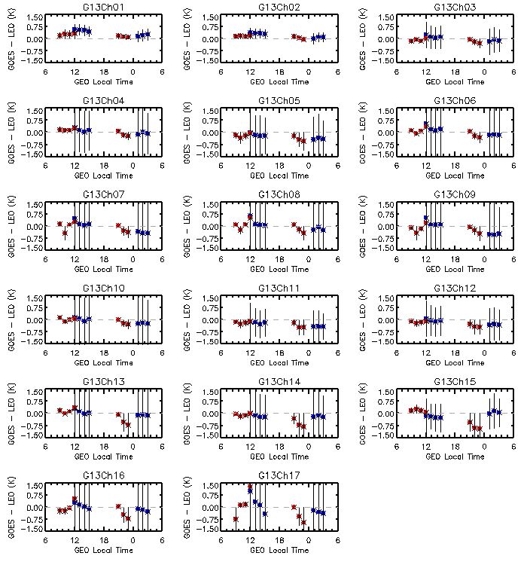
Progressively impact of midnight effect is apparent before satellite midnight.
Tb bias to AIRS is very consistent at night time
SW channels have the strongest midnight effect

Slide 16
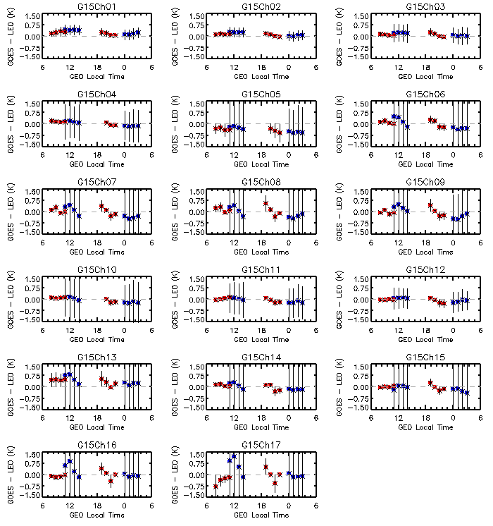

Slide 17
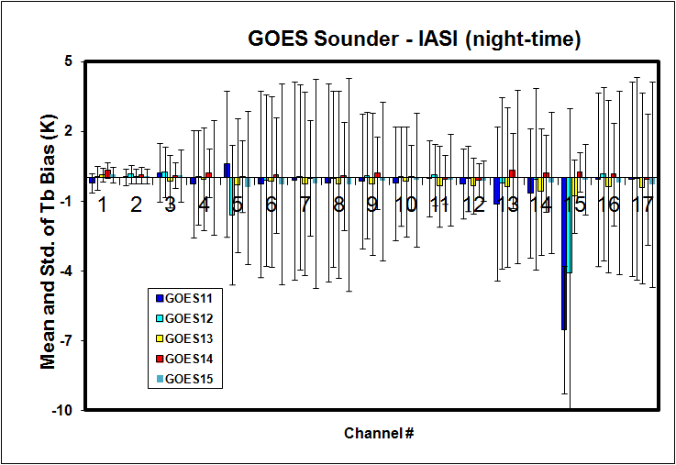
Mean and standard deviation of GOES-11/12/13/14/15 Sounder Tb bias, referenced to night-time IASI data

Slide 18
Conclusions
The impact of the midnight effect varies greatly at different satellites
May not apparent at some channels/satellite
The detector position at the filter wheel also affects the midnight effect.
Outside the midnight effect window, the Sounder IR channel data are in general well calibrated, except for G11 Ch15, G12 Ch5 and G12 Ch15.

