Slide 1
Vicarious Radiometric Calibration of IR Channels in CMA
Yong Zhang,
Xiuqing Hu, Zhiguo Rong, Zhaojun Zheng, Min Min, Na Xu, Ling Sun, Yuan Li, Jingjing Liu, Lijun Zhang
National Satellite Meteorological Center, China Meteorological Administration

Slide 2
Outline
Introduction of China Radiometric Calibration Sites (CRCS)
Calibration activities at Lake Qinghai
Calibration activities at Dunhuang Gobi
Vicarious calibration of IR channels with NCEP and sea buoy data
Re-calibration of FY-2 Data Archived at CIMSS/SSEC

Slide 3
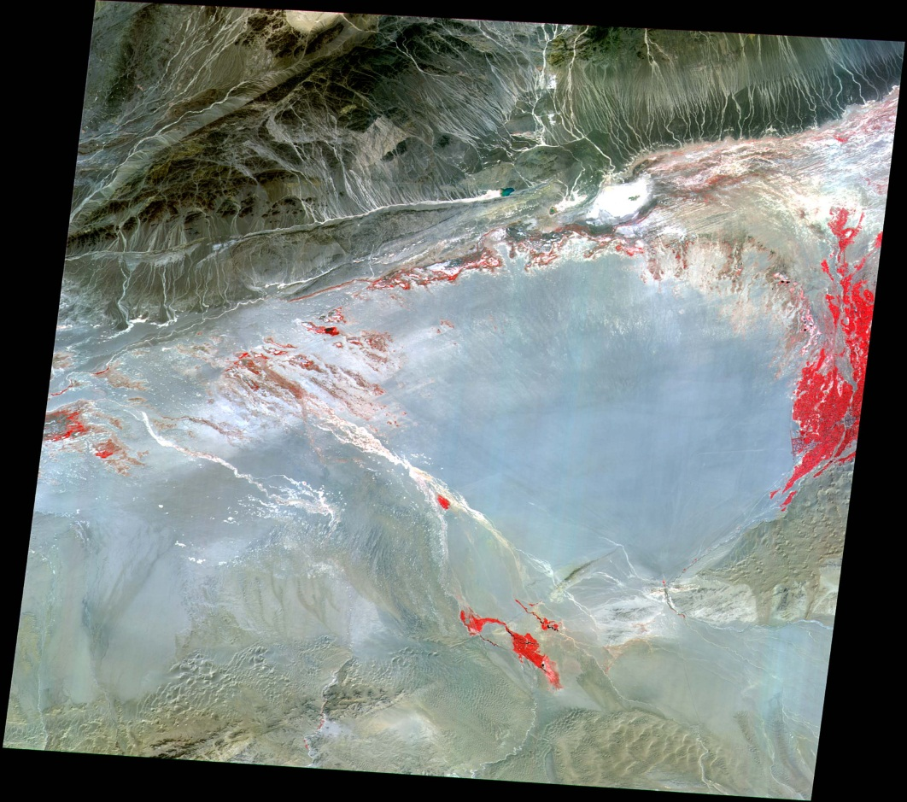
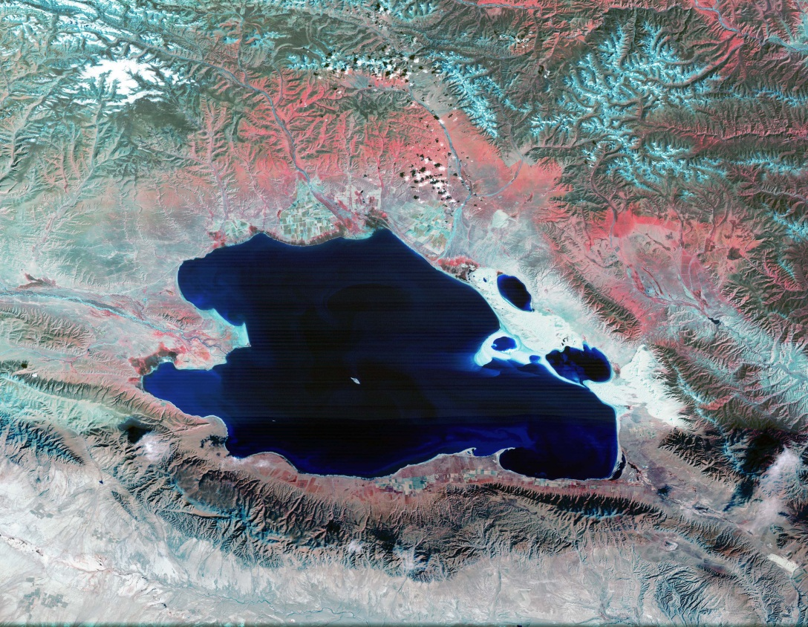
Introduction of China Radiometric Calibration Sites (CRCS)
Lake Qinghai Site: Lake Qinghai is the largest saline of China and located in the northeast of Tibet Plateau. Lake Qinghai (36°45N, 100°20E) is located 150km from Xining City, capital of Qinghai Province. Its total area is 4473 km² and the perimeter is 360km The elevation of the water surface is 3196 m and the cubage of the lake is 105 Gm³. It is a good place for IR bands’ calibrating.
Dunhuang Site: Located at 40°08N and 94°40E. Gobi surface is combined with sandy soil and gravels, the mean diameter of the gravels is from 2cm to 5cm.The atmospheric conditions are dry and clean. It is a very good radiometric calibration site for satellites.

Slide 4
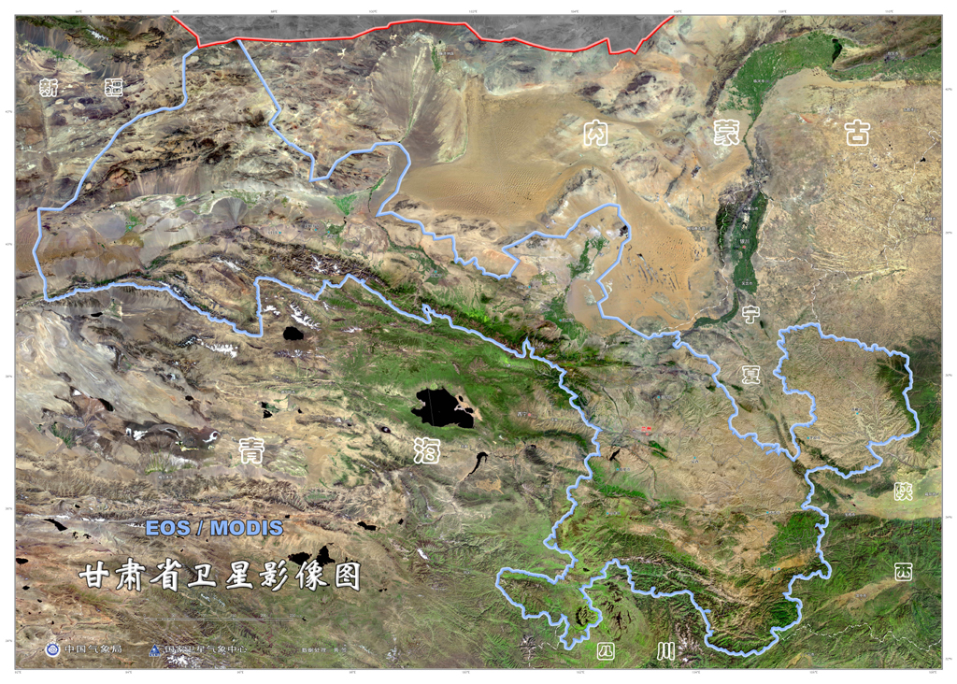
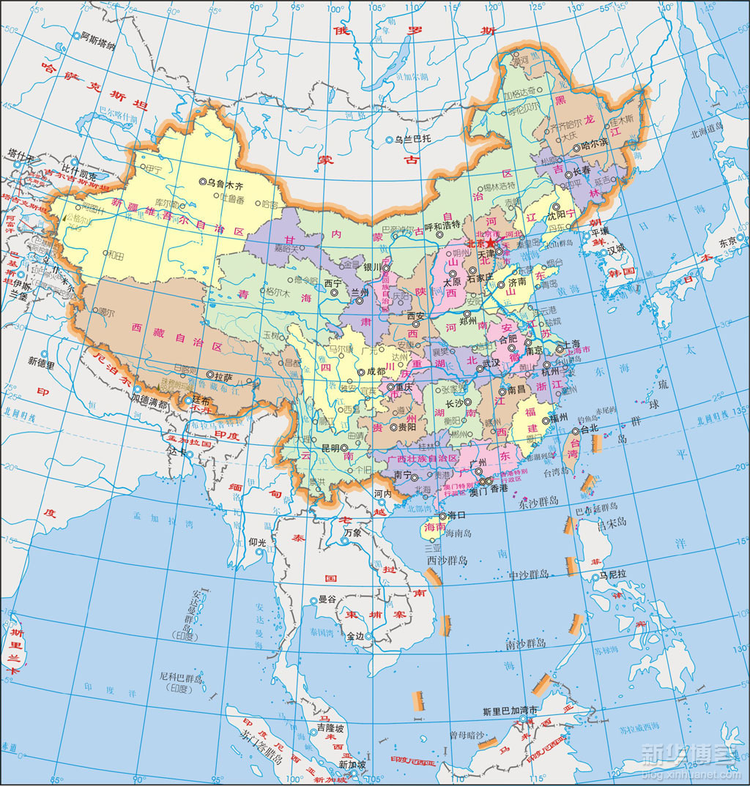
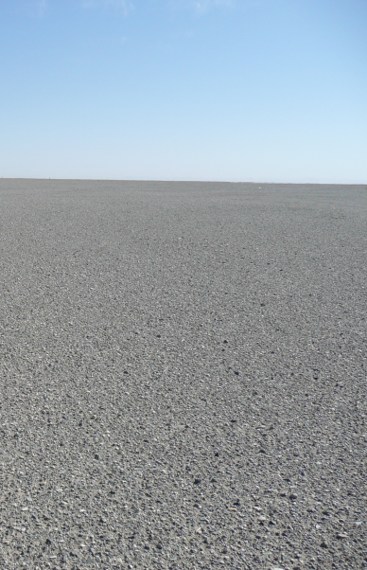
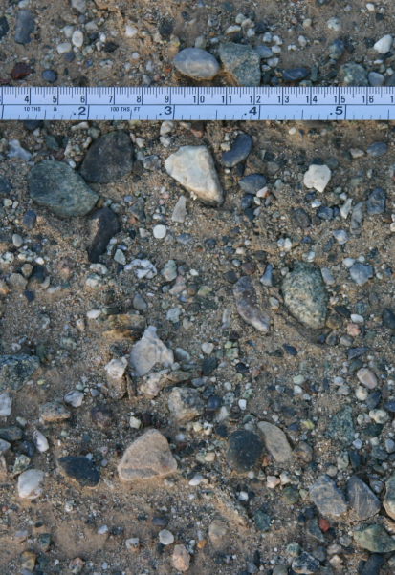
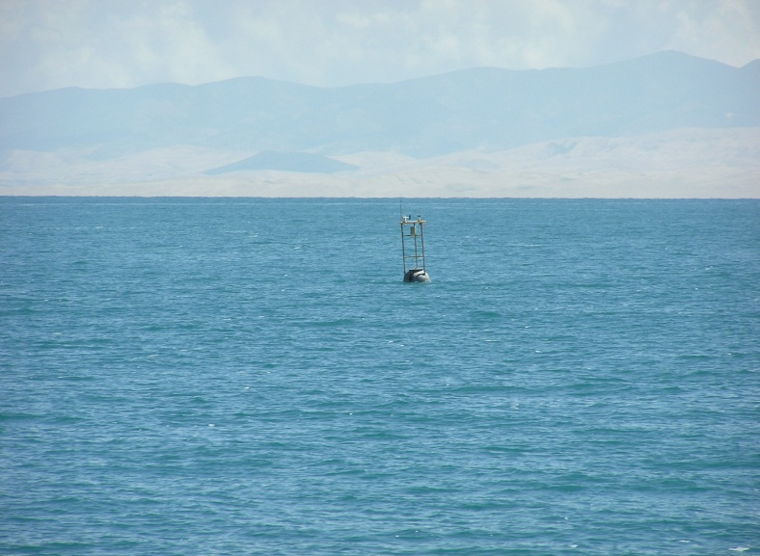
Dunhuang Gobi
Lake Qinghai

Slide 5
Instruments of CRCS
There are 4 categories, more than 50 sets instruments of CRCS:
  Instruments for CRCS primary calibrating lab
  Instruments for CRCS secondary calibrating lab
  Instruments for measuring radiometric characteristics of ground objects and atmosphere
  Instruments for collecting weather and environmental parameters

Slide 6
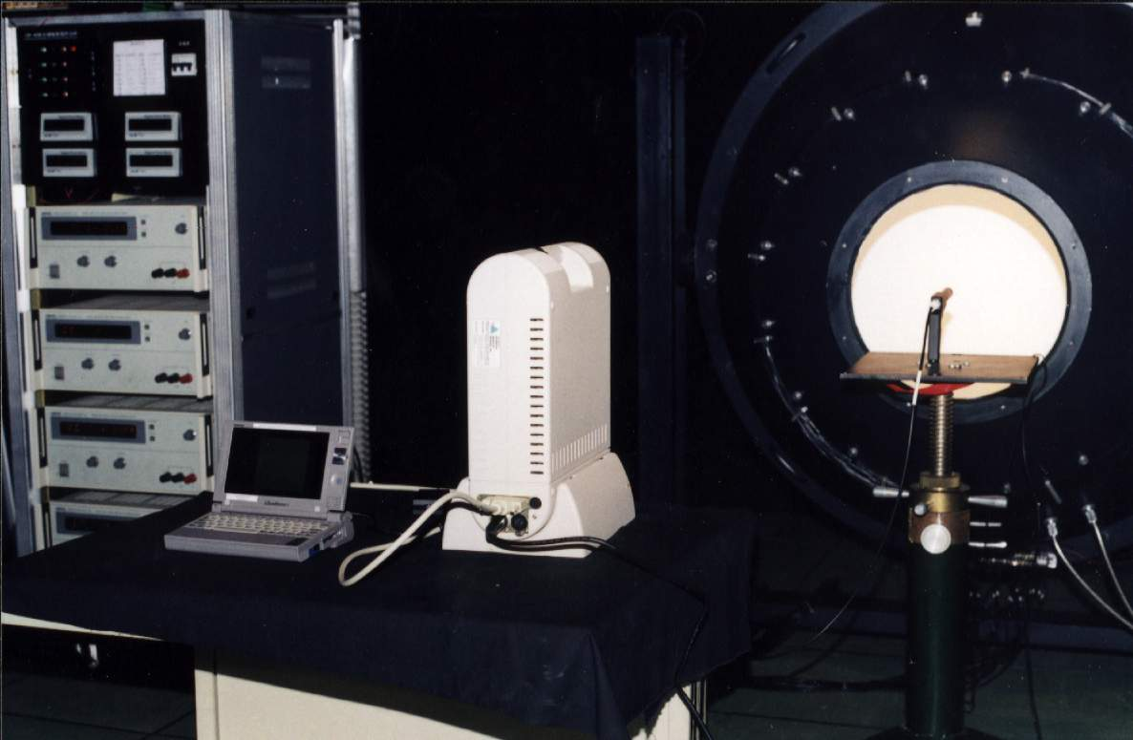
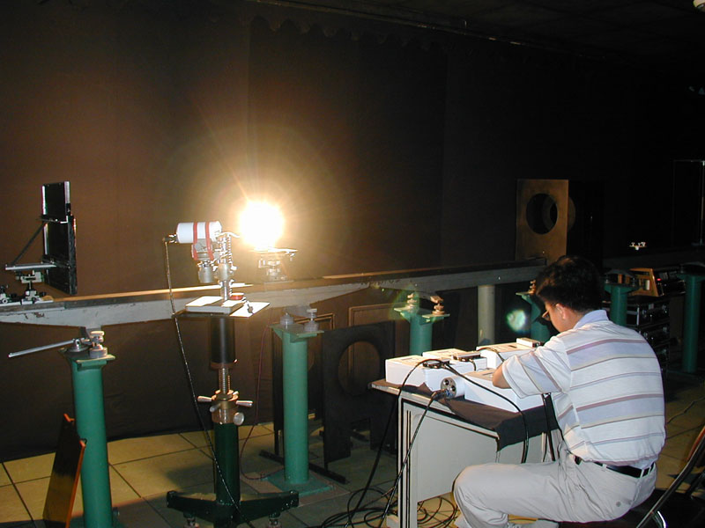
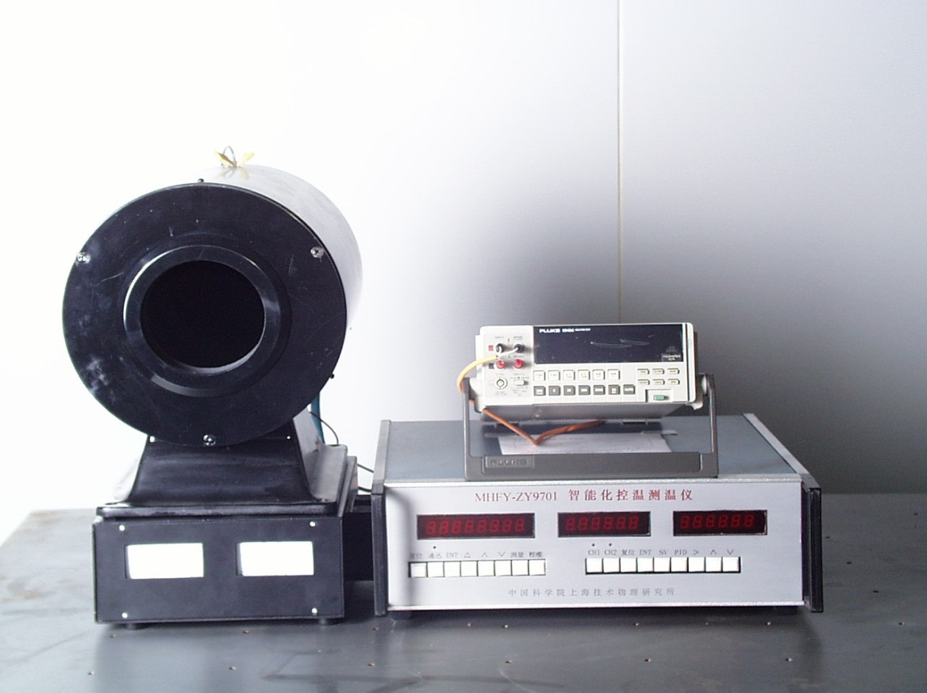
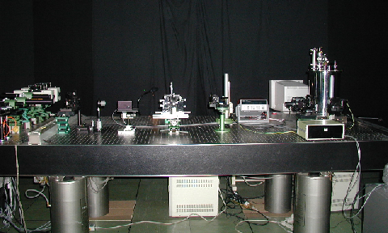
General-Purpose Optical Bench
Integrating sphere
Standard lamp
Blackbody

Slide 7
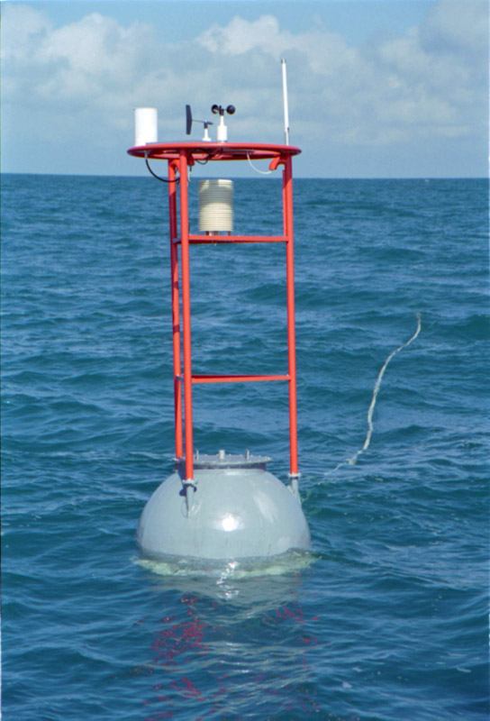
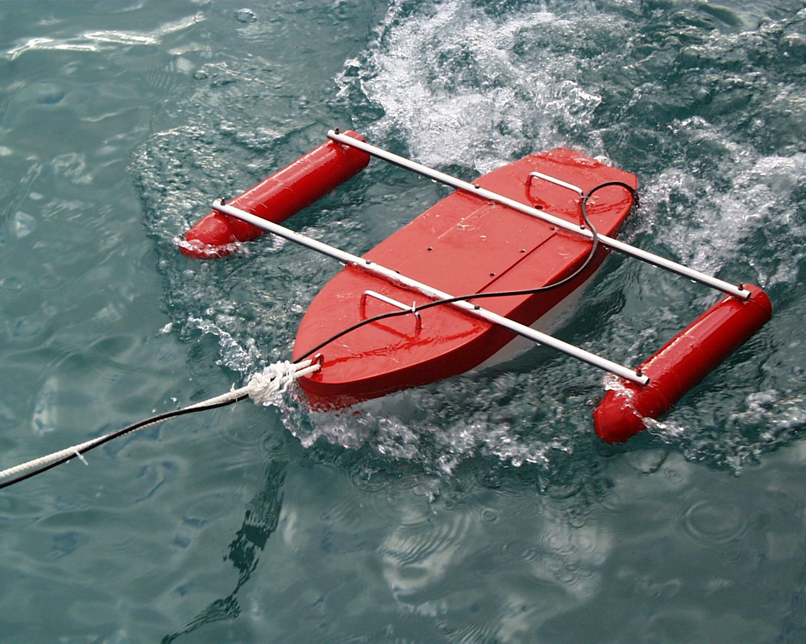
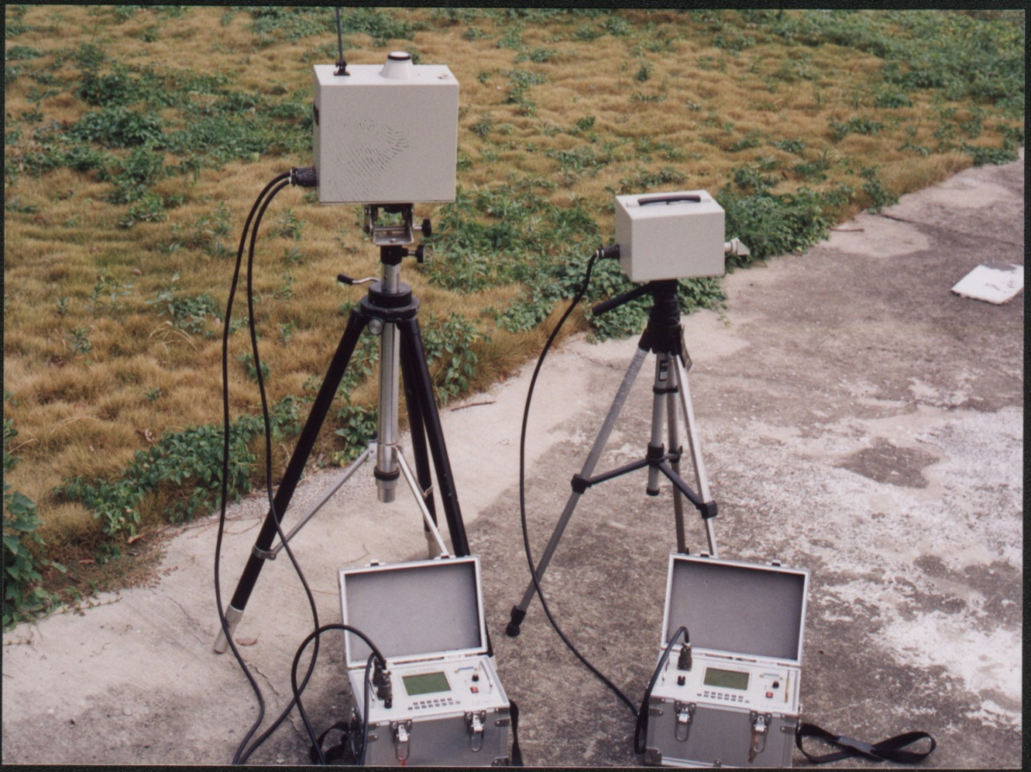
Water thermometer
Water buoy
IR981(left) VIR981(right)

Slide 8
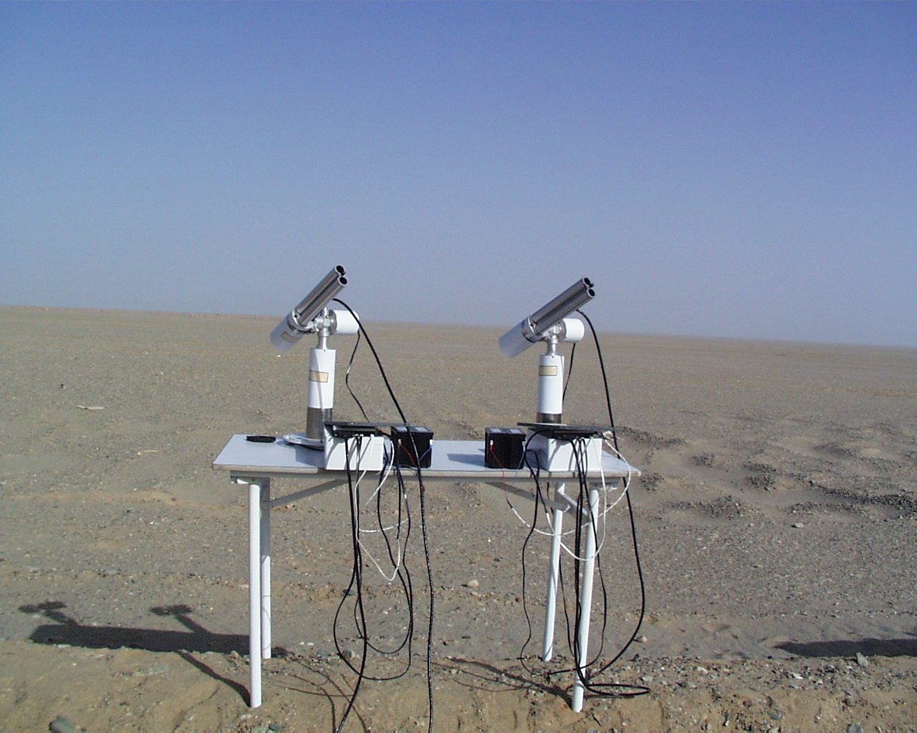
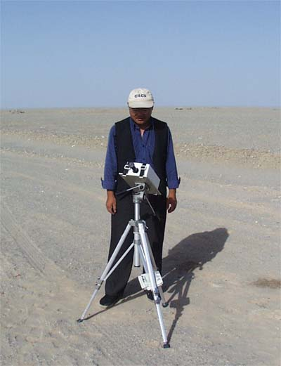
CE318, CE317 radiometers

Slide 9
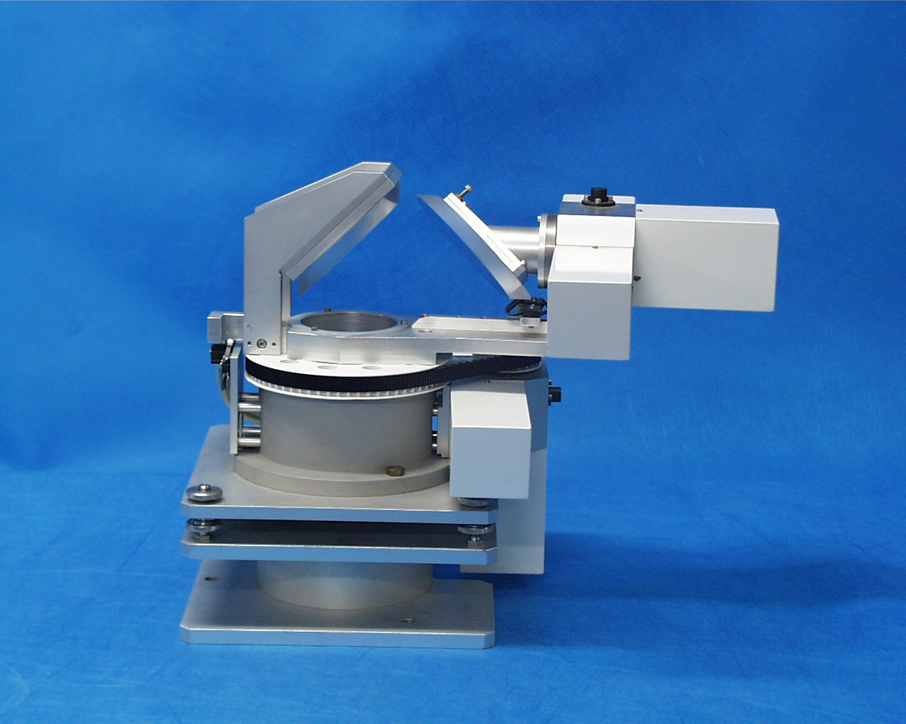
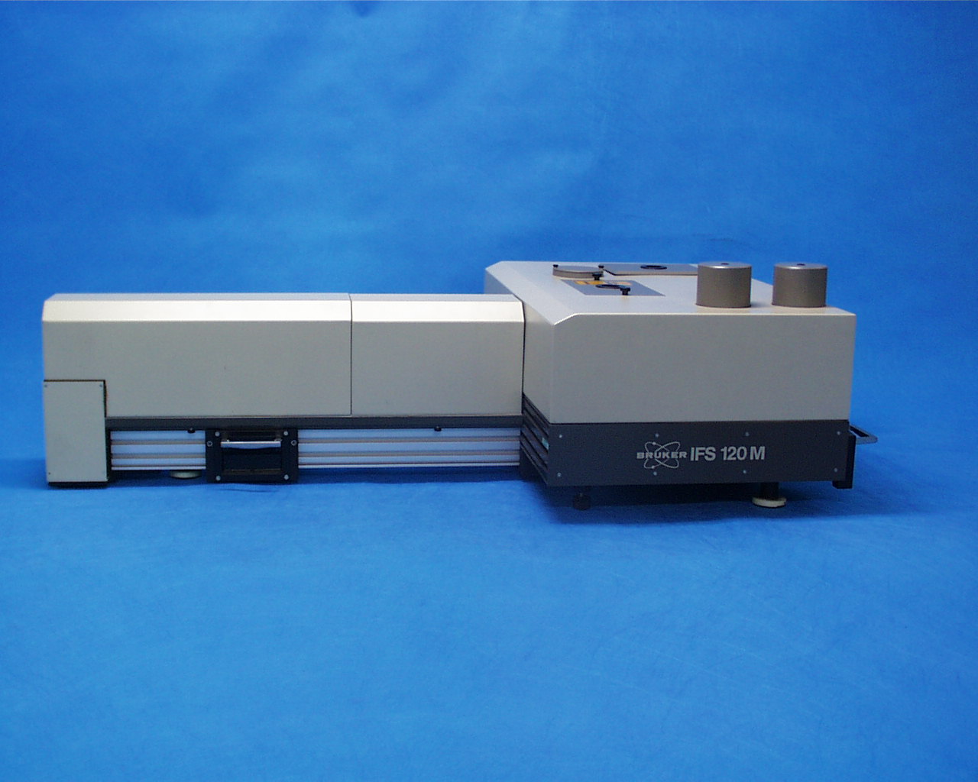
IFS120M Fourier transform infrared spectrometer
BROKER
0.4—16.6μm
Spectral resolution: 0.008cm⁻¹

Slide 10
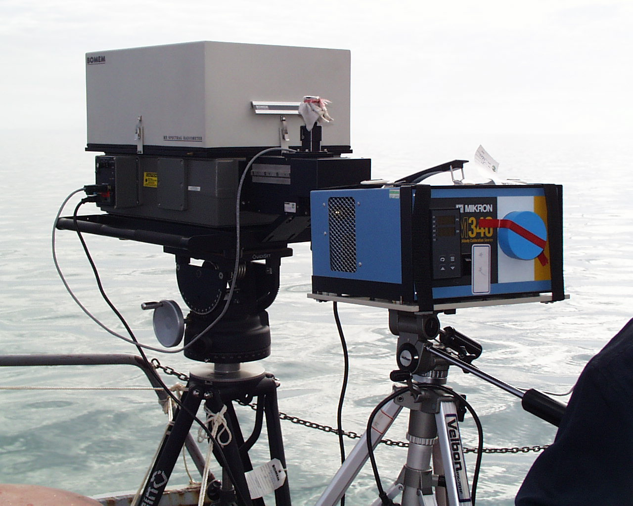
BOMEN MR-154 thermal infrared radiometer
（0.70—19.5μm，spectral resolution: 1 cm⁻¹，FOV: 10°）

Slide 11
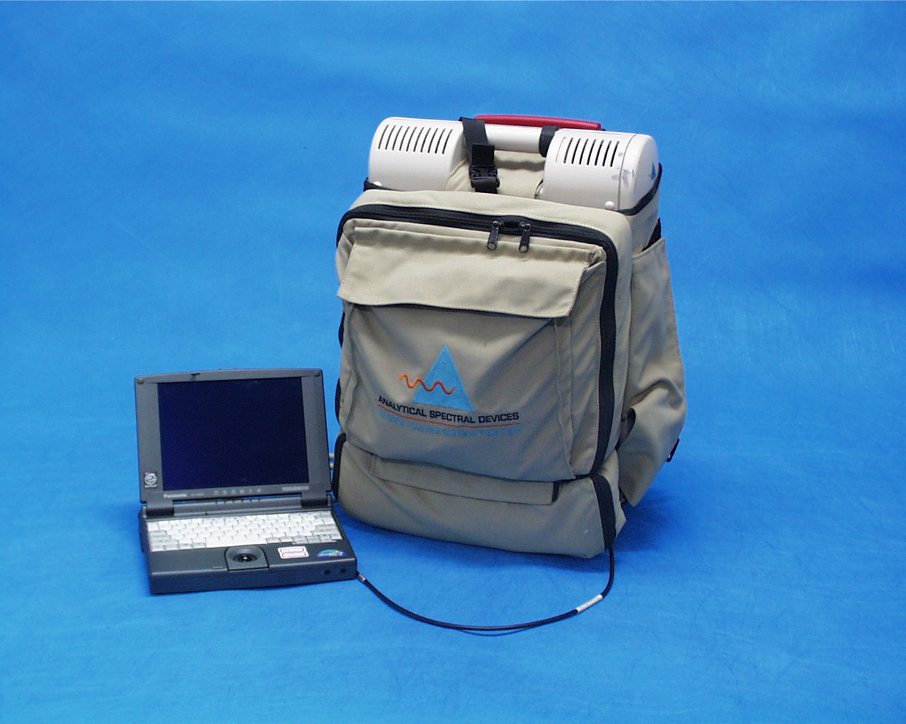
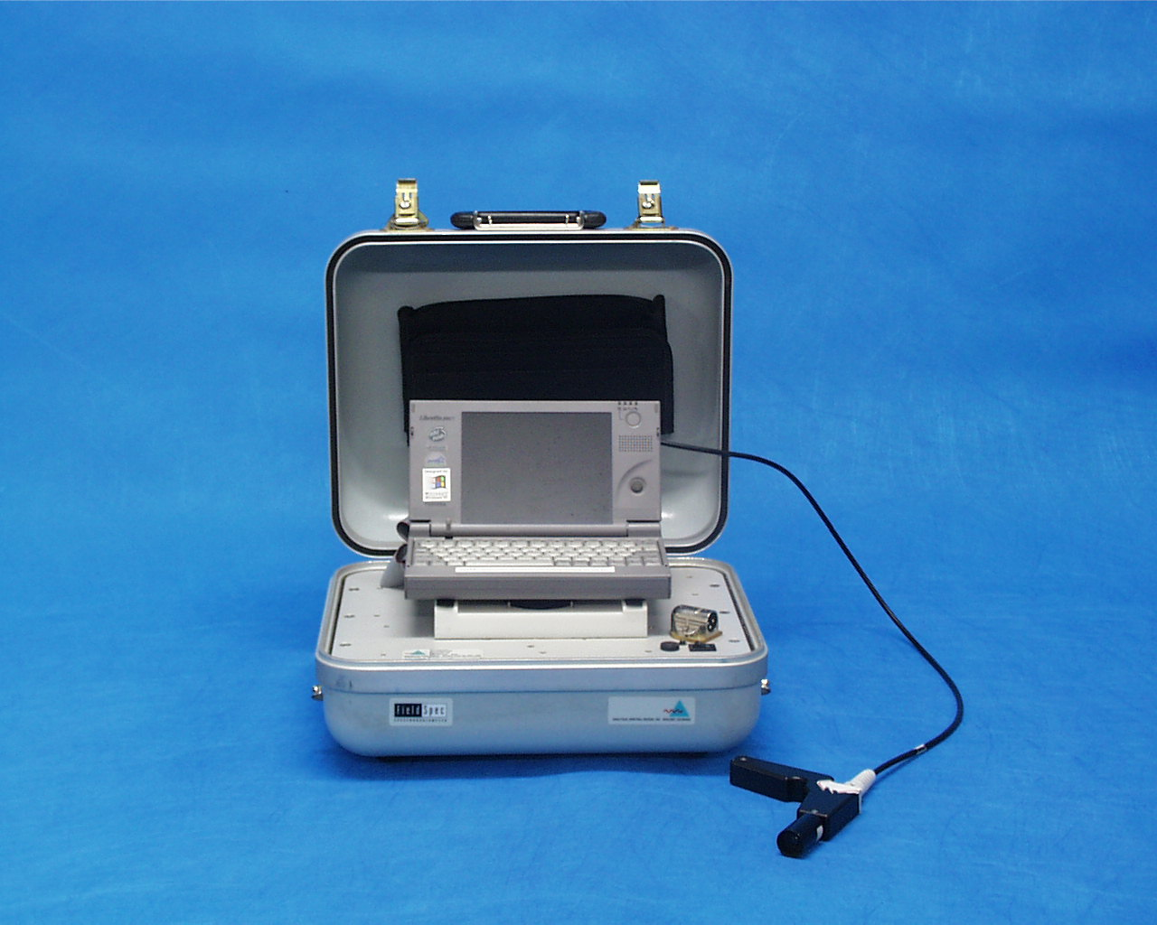
ASD FR field spectrometers

Slide 12
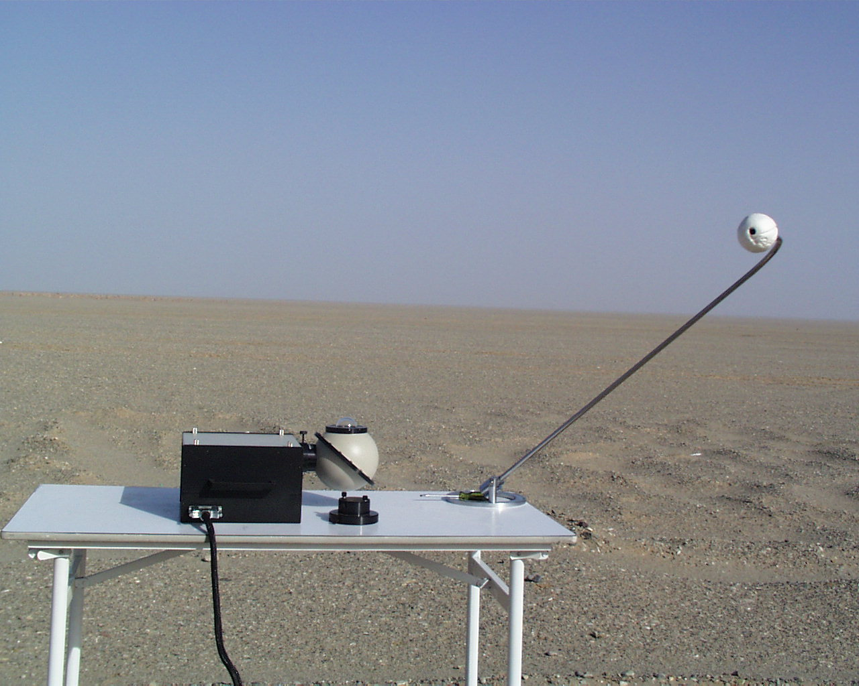
OL 756 Portable UV-VIS Spectroradiometer

Slide 13
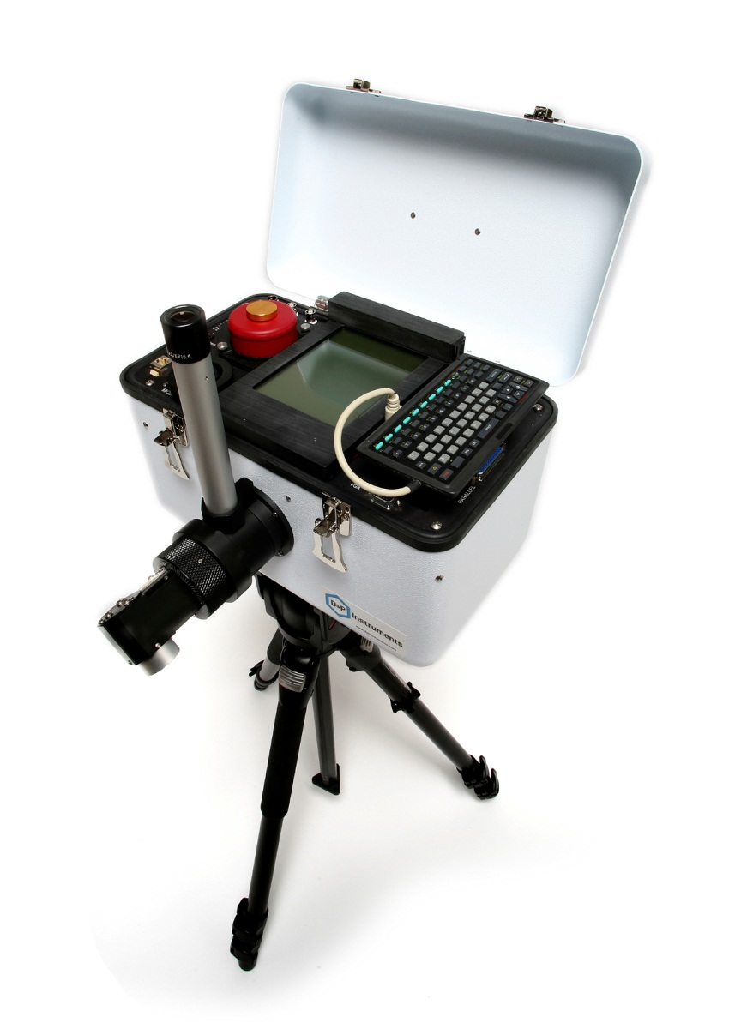
102F portable FTIR spectrometer

Slide 14
Outline
Introduction of China Radiometric Calibration Sites (CRCS)
Calibration activities at Lake Qinghai
Calibration activities at Dunhuang Gobi
Vicarious calibration of IR channels with NCEP and sea buoy data
Re-calibration of FY-2 Data Archived at CIMSS/SSEC

Slide 15
Calibration activities at Lake Qinghai
Field experimentations of remote sensors’ in-orbit calibrations
  From 1994 to 2011, almost every year field experimentations at Lake Qinghai to calibrate the mainstream thermal remote sensors were carried out.
  FY-1C/D, FY-2C/D/E/F, FY-3A/B, CBERS-02A/B/C, HY-1/2A, HJ-1A/B, NOAA AVHRR, TERRA/AQUA MODIS et al. thermal infrared channels were calibrated with Lake Qinghai Site.

Slide 16
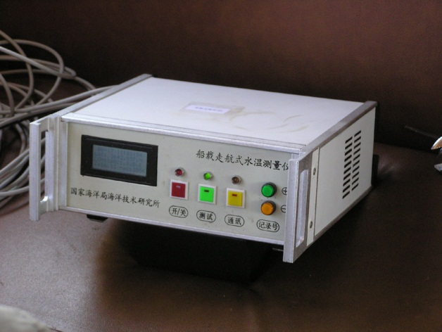
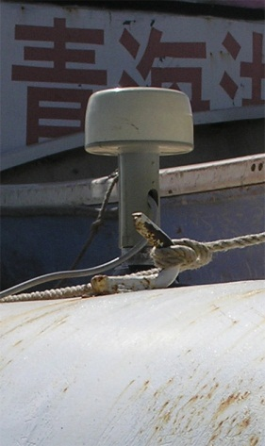
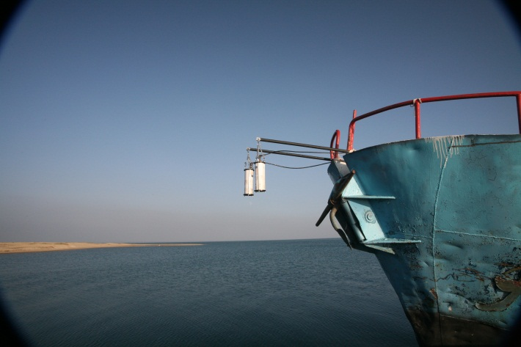
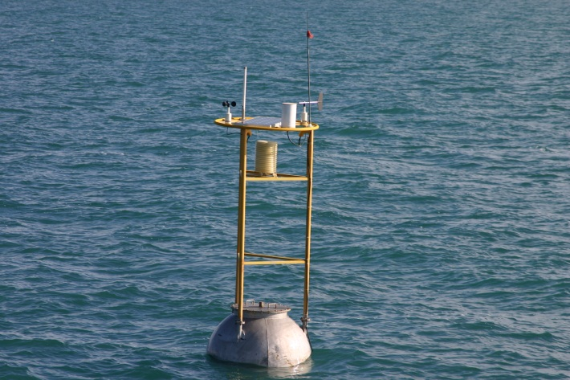
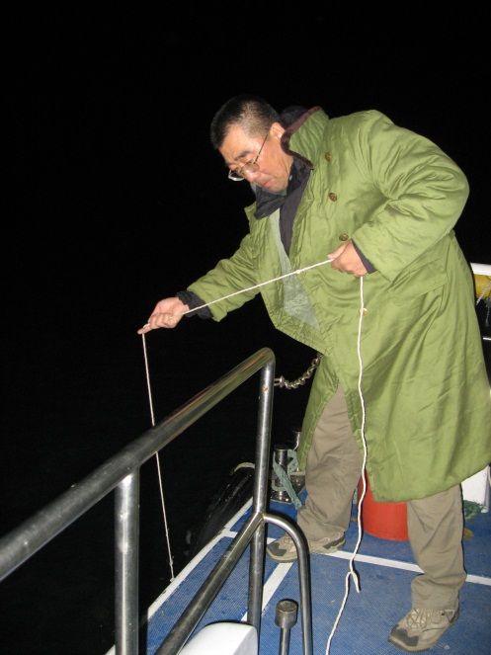
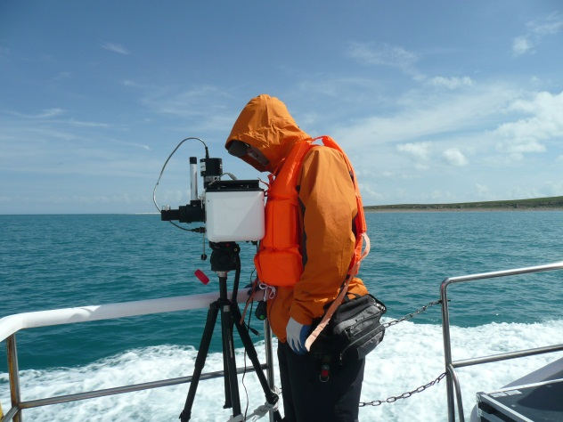
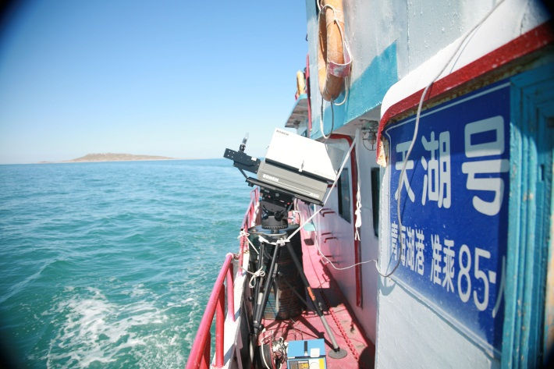
Measurements of water surface temperature and radiance

Slide 17
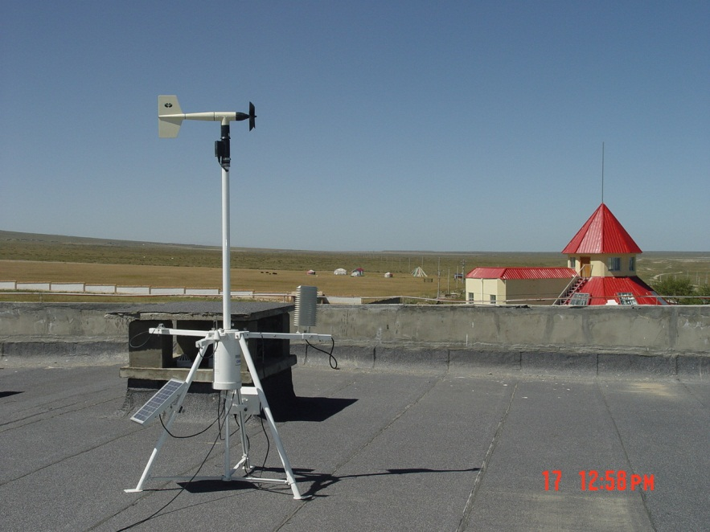
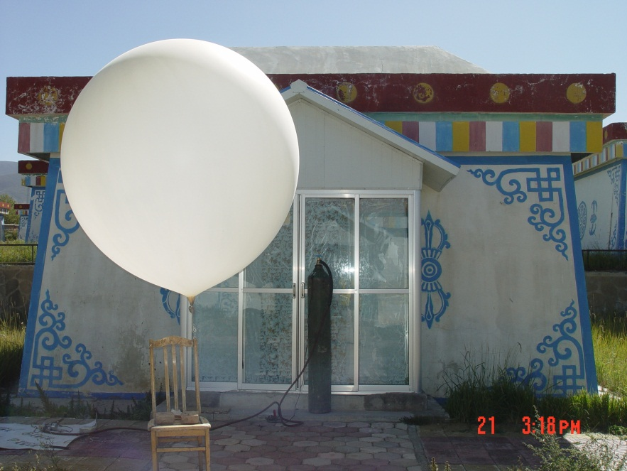
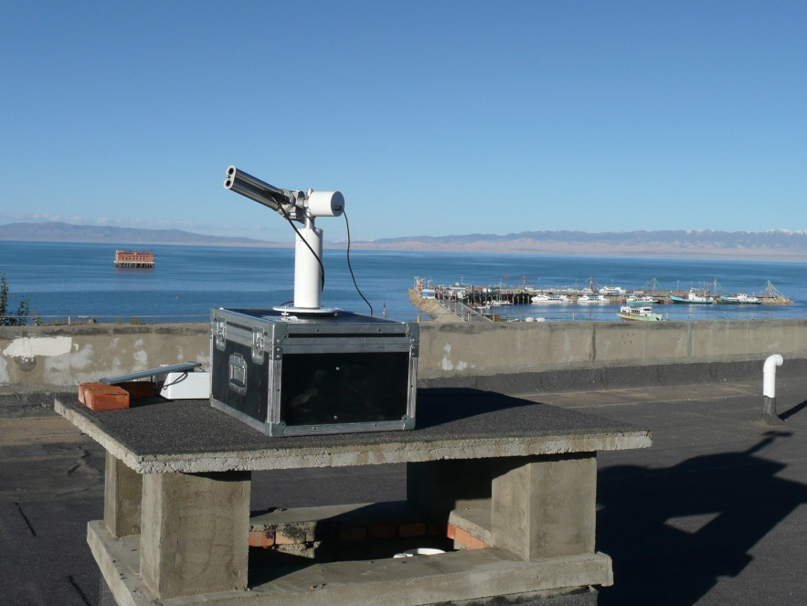
Measurements of atmospheric and environmental parameters

Slide 18
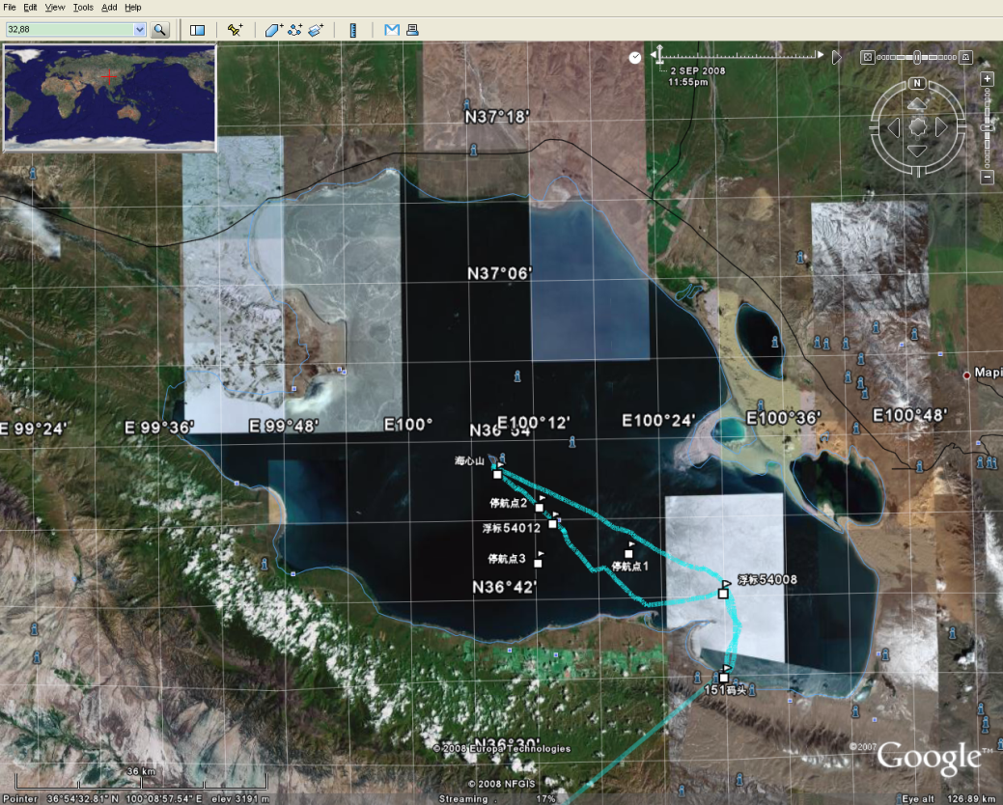
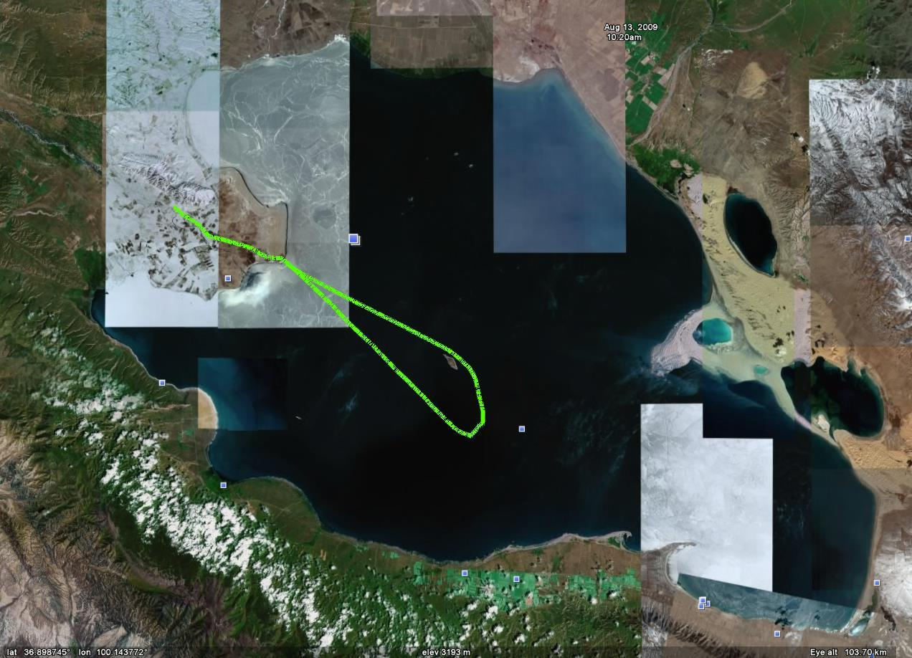
GPS records of the ship movements during experimentations
CRCS 2008
CRCS 2009

Slide 19
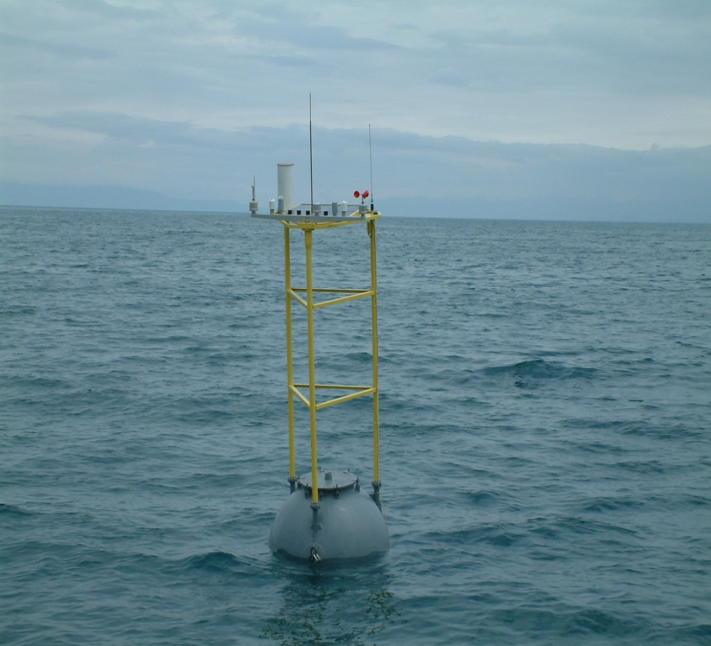
Buoys' measurements of water surface temperature
Use the data from 2 buoys deployed at Lake Qinghai and MODIS data to analysis the infrared feature of water surface.
In 2001, 2002, 2003, 2004, 2005, 2008, 2009, 2010 and 2011, the water surface data were collected every 3 hours from May to October.

Slide 20
Data collected by buoys
5 parameters of atmosphere boundary layer: wind speed, wind direction, atmospheric temperature, relative humidity and pressure;
2 hydrologic parameters: water surface temperature and water salinity;
3 ancillary data: latitude, longitude and battery voltage.

Slide 21
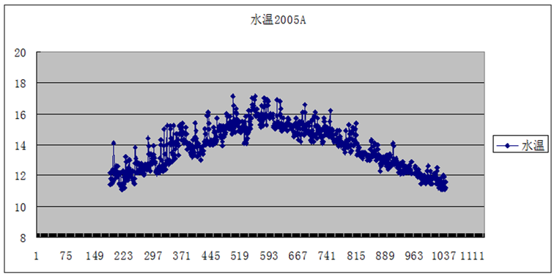
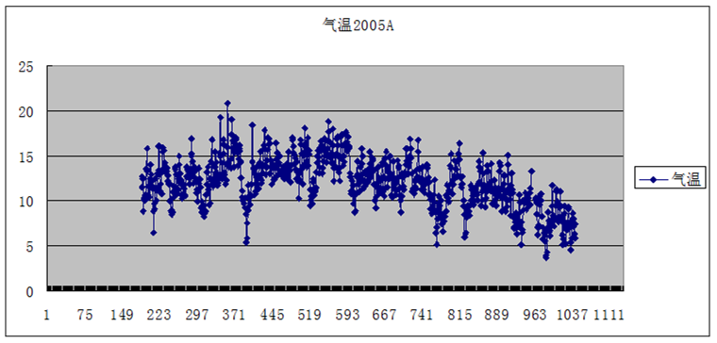
2005 every 3 hours
Water temperatures
Degree C
01-Jun 15-Aug 31-Oct
Boundary layer temperatures
Degree C

Slide 22
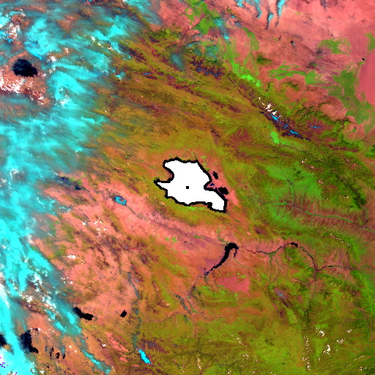
Satellite data
TERRA/MODIS L1B 1KM data of May 1st to Oct. 31st in each year from 2001 to 2008 were collected.

Slide 23
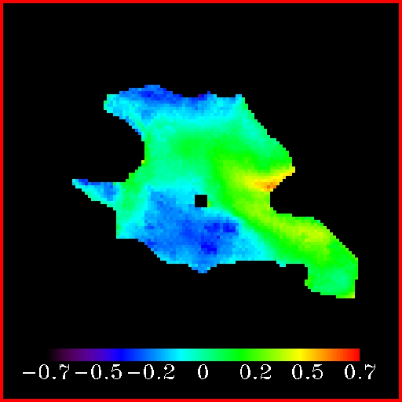
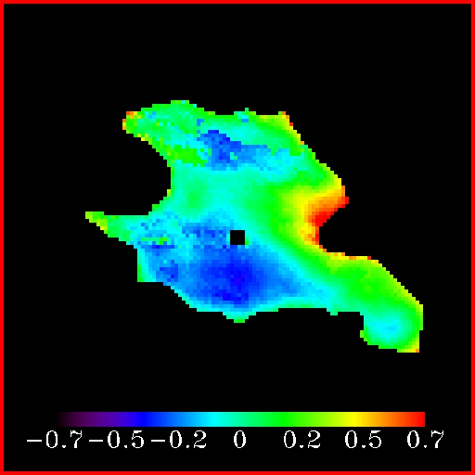
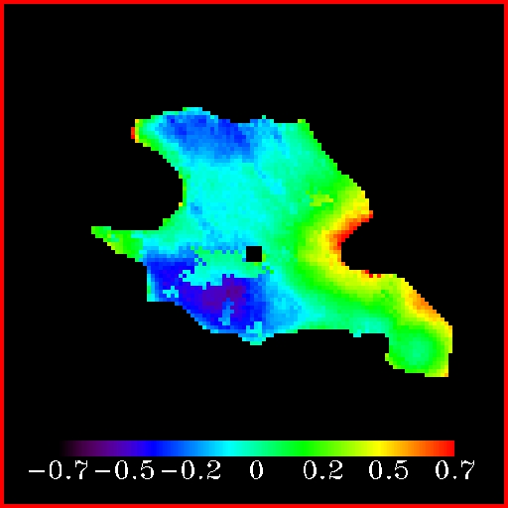
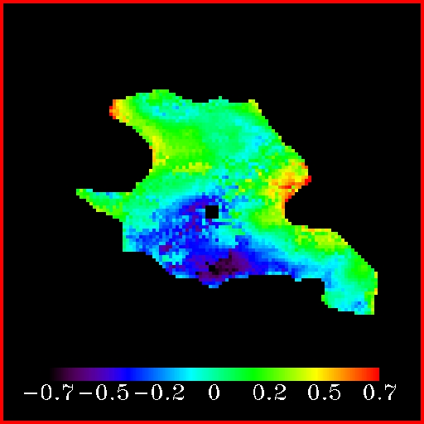
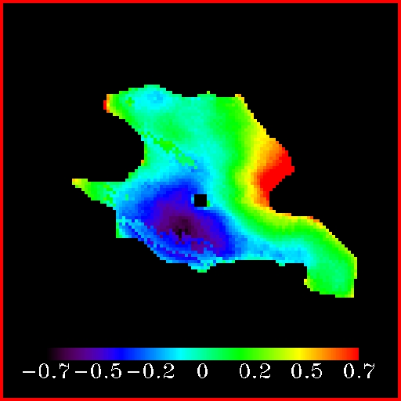
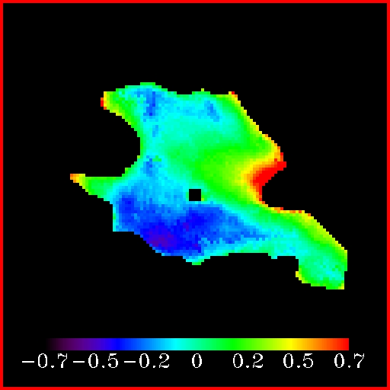
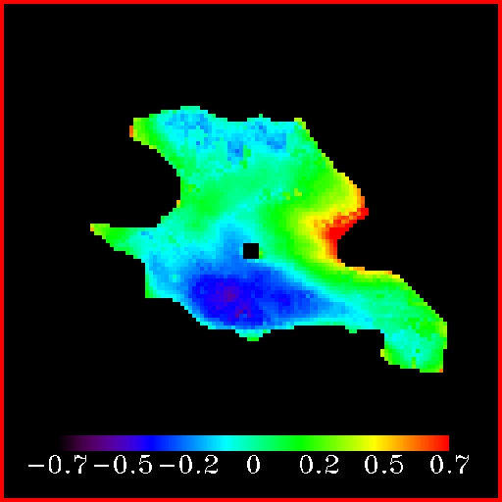
Water surface temperature daily departures’ annual mean (from May to October) value of 2002~2008
2002
2003
2004
2005
2006
2007
2008
The Joint Meeting of GSICS 7th Research Working Group and 6th Data Working Group, 5-9 March 2012, Beijing, China
Notes:
5-10月期间，东北部浅水区及西北两角端水表温度偏高，最大偏差为0.7度；西南部深水区及北部近岸处水表温度偏低，最大偏差为-0.6度。二郎剑到海心山连线两侧，存在一个明显的水表温度梯度。

Slide 24
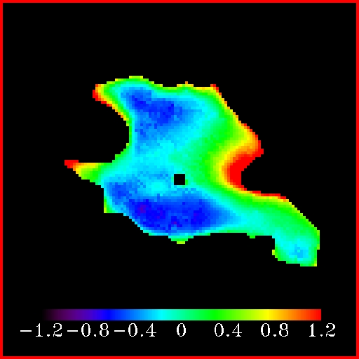
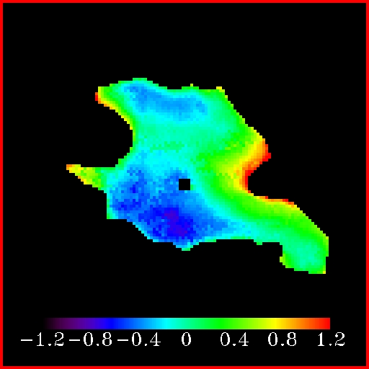
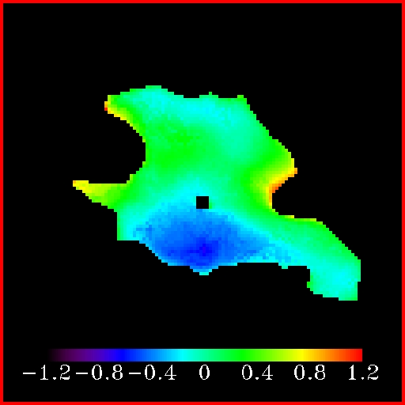
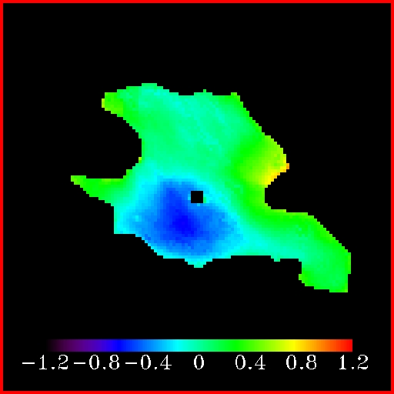


Water surface temperature daily departures’ monthly mean values from May to October of 2002~2008
May
Jun
Jul
Aug
Sep
Oct
The Joint Meeting of GSICS 7th Research Working Group and 6th Data Working Group, 5-9 March 2012, Beijing, China
Notes:
9月湖面温差相对较小；5-6月期间，东北部浅水区及西北两角端水表温度上升快，而10月份，这两个地方水表温度下降快。

Slide 25
2002
The Joint Meeting of GSICS 7th Research Working Group and 6th Data Working Group, 5-9 March 2012, Beijing, China

Slide 26
2003
The Joint Meeting of GSICS 7th Research Working Group and 6th Data Working Group, 5-9 March 2012, Beijing, China

Slide 27
2004
The Joint Meeting of GSICS 7th Research Working Group and 6th Data Working Group, 5-9 March 2012, Beijing, China

Slide 28
2005
The Joint Meeting of GSICS 7th Research Working Group and 6th Data Working Group, 5-9 March 2012, Beijing, China

Slide 29
2008
The Joint Meeting of GSICS 7th Research Working Group and 6th Data Working Group, 5-9 March 2012, Beijing, China

Slide 30
Evaluation for radiometric calibration of infrared band of FY-3A MERSI using CRCS
Compairs the brightness temperatures observed by infrared band of FY-3A MERSI using on-board radiometric calibration coefficients with that simulated basing on surface observation data.
The primary surface data have been collected from the simultaneous observation in Qinghai Lake site in 2008, 2009 and 2010, and buoy data in 2008 and 2009.
The Joint Meeting of GSICS 7th Research Working Group and 6th Data Working Group, 5-9 March 2012, Beijing, China

Slide 31
Seven groups of available field measurements at Lake Qinghai in three years
Date | Satellite passing time | Satellite zenith angle | Orbit | Mersi TOA BT | Modtran simulated TOA BT | Difference (K)
2008-09-03 | 22:52 | 16.90° | Night | 286.07 | 283.88 | 2.19
2008-09-07 | 11:56 | 1.10° | Day | 286.31 | 283.73 | 2.58
2008-09-08 | 11:37 | 28.97° | Day | 285.73 | 283.57 | 2.16
2009-08-13 | 12:10 | 10.97° | Day | 287.32 | 285.54 | 1.78
2009-08-19 | 11:57 | 10.77° | Day | 285.85 | 281.97 | 3.88
2010-08-13 | 12:45 | 21.28° | Day | 301.69 | 300.50 | 1.19
2010-08-24 | 12:35 | 10.71° | Day | 315.25 | 314.21 | 1.04
The Joint Meeting of GSICS 7th Research Working Group and 6th Data Working Group, 5-9 March 2012, Beijing, China

Slide 32
Eighteen groups of available buoy measurements at Qinghai Lake in 2008 and 2009.
Date | Satellite passing time | Satellite zenith angle | Orbit | Mersi TOA BT | Modtran simulated TOA BT | Difference (K)
2008-07-17 | 22:50 | 12.17° | Night | 283.87 | 283.82 | 0.05
2008-08-06 | 11:55 | 6.24° | Day | 283.20 | 283.08 | 0.12
2008-08-06 | 23:15 | 26.57° | Night | 279.42 | 282.25 | -2.83
2008-08-11 | 23:15 | 26.98° | Night | 281.41 | 281.69 | -0.28
2008-08-17 | 23:10 | 15.93° | Night | 278.76 | 282.18 | -3.42
2008-08-18 | 22:50 | 15.83° | Night | 280.46 | 282.55 | -2.09
2008-09-07 | 11:50 | 3.16° | Night | 281.61 | 280.68 | 0.93
2008-09-13 | 11:40 | 18.47° | Day | 281.76 | 281.22 | 0.54
2009-06-16 | 23:20 | 18.20° | Night | 279.61 | 280.12 | -0.51
2009-06-27 | 11:50 | 14.30° | Day | 283.06 | 281.53 | 1.53
2009-07-08 | 23:05 | 4.86° | Night | 278.68 | 281.63 | -2.95
2009-07-13 | 11:50 | 15.84° | Day | 282.21 | 282.73 | -0.52
2009-08-03 | 11:55 | 7.55° | Day | 285.83 | 282.44 | 3.39
2009-09-20 | 11:55 | 12.33° | Day | 284.34 | 282.86 | 1.48
2009-10-01 | 11:45 | 23.33° | Day | 281.83 | 280.84 | 0.99
2009-10-04 | 12:25 | 27.77° | Day | 285.74 | 282.17 | 3.57
2009-10-10 | 12:10 | 6.96° | Day | 282.15 | 279.66 | 2.49
2009-10-16 | 12:05 | 6.47° | Day | 282.28 | 280.61 | 1.67

Slide 33
Results
It is found that the brightness temperatures observed by medium resolution spectral imager (MERSI) sensor are 1.72±1.18 K systematically higher than the simulated results using surface observation data, which is mainly attributed to the variations of emissivity of on-board blackbody without calibration.
The Joint Meeting of GSICS 7th Research Working Group and 6th Data Working Group, 5-9 March 2012, Beijing, China

Slide 34
Outline
Introduction of China Radiometric Calibration Sites (CRCS)
Calibration activities at Lake Qinghai
Calibration activities at Dunhuang Gobi
Vicarious calibration of IR channels with NCEP and sea buoy data
Re-calibration of FY-2 Data Archived at CIMSS/SSEC

Slide 35

Calibration activities at Dunhuang Gobi for IR channels
Automatic measurement system of Gobi temperatures
The Joint Meeting of GSICS 7th Research Working Group and 6th Data Working Group, 5-9 March 2012, Beijing, China

Slide 36

Automatic measurement system (Station A)
The Joint Meeting of GSICS 7th Research Working Group and 6th Data Working Group, 5-9 March 2012, Beijing, China

Slide 37
Data collecting
Station A: wind speed, wind direction, atmosphere temperature at 10 meters height; Gobi temperature profile: 0cm, 5cm, 10cm, 15cm, 20cm, 40cm, 80cm, 160cm and 320cm.
Station B: Gobi temperature profile: 0cm, 5cm, 10cm, 15cm, 20cm, 40cm, 80cm, 160cm and 320cm.
Stations C, D and E: Gobi temperature profile: 0cm, 5cm, 10cm, 15cm, 20cm, 40cm, 80cm and 160cm.
The Joint Meeting of GSICS 7th Research Working Group and 6th Data Working Group, 5-9 March 2012, Beijing, China

Slide 38


Surface temperature from May 2009 to Sep. 2010, every hour
The Joint Meeting of GSICS 7th Research Working Group and 6th Data Working Group, 5-9 March 2012, Beijing, China

Slide 39


Emissivity measurement at Dunhuang Gobi
The Joint Meeting of GSICS 7th Research Working Group and 6th Data Working Group, 5-9 March 2012, Beijing, China

Slide 40

Operational calibration testing at Dunhuang Gobi for IR bands
The Joint Meeting of GSICS 7th Research Working Group and 6th Data Working Group, 5-9 March 2012, Beijing, China

Slide 41
Outline
Introduction of China Radiometric Calibration Sites (CRCS)
Calibration activities at Lake Qinghai
Calibration activities at Dunhuang Gobi
Vicarious calibration of IR channels with NCEP and sea buoy data
Re-calibration of FY-2 Data Archived at CIMSS/SSEC

Slide 43
T_{max}=307.35K
T_{min}=271.35K

Slide 44
Method
Collocating satellite clear pixels’ data and buoy data : obtain sea surface temperatures, buoy latitude and longitude, satellite image pixels’ digital numbers;
Collecting NCEP data from the collocated pixels;
Use MODTRAN to simulating the TOA brightness temperatures from buoy temperatures and atmospheric profiles.

Slide 45


Comparing the satellite observations and simulated TOA BT of FY-3A MERSI

Slide 46
Outline
Introduction of China Radiometric Calibration Sites (CRCS)
Calibration activities at Lake Qinghai
Calibration activities at Dunhuang Gobi
Vicarious calibration of IR channels with NCEP and sea buoy data
Re-calibration of FY-2 Data Archived at CIMSS/SSEC

Slide 47

FY-2 data archived at CIMSS/SSEC

Slide 48
AIRS data archived at CIMSS/SSEC, UW-Madison
Year | Dates Archived | Data products | Data version
2003 | 01/01/2003~10/29/2003 11/19/2003~12/31/2003 | L1B AIRS geolocated radiance | Collection 5
2004 | 01/01/2004~12/31/2004 | L1B AIRS geolocated radiance | Collection 5
2005 | 01/01/2005~12/31/2005 | L1B AIRS geolocated radiance | Collection 5
2006 | 01/01/2006~12/31/2006 | L1B AIRS geolocated radiance | Collection 5
2007 | 01/01/2007~06/28/2007 | L1B AIRS geolocated radiance | Collection 5
2008 | 07/18/2008~12/31/2008 | L1B AIRS geolocated radiance | Collection 5
2009 | 01/01/2009~10/31/2009 | L1B AIRS geolocated radiance | Collection 5
2010 | 07/01/2010~08/23/2010 | L1B AIRS geolocated radiance | Collection 5
The Joint Meeting of GSICS 7th Research Working Group and 6th Data Working Group, 5-9 March 2012, Beijing, China

Slide 49

Methodology
Step1:Data clipping
Step2:Spatial and temporal collocation
Step3:Alignment in viewing geometry
Step4:Collocation observations quality control
Step5:Spectral matching
FY-2C/D/E’s spectral response functions (SRFs) and a sample AIRS observation, where blue lines are the SRFs of FY-2C, red lines are the SRFs of FY-2D, green lines are the SRFs of FY-2E, and grey dots are the sample AIRS spectrum.

Slide 50
Results
In this study, all the matched data pairs of FY-2C/D/E and AIRS archived at UW/SSEC/CIMSS were processed and compared. There were 1200, 519 and 54 days with collocated data pairs for AIRS and FY-2C/D/E respectively. Following the ATBD of the inter-calibration algorithm of GSICS, the collocated data pairs of FY-2C/D/E were archived in netcdf files named as AIRS_FY2X_YYYYDDD.nc; each day has a single file including day and night collocated data pairs.

Slide 51

Selected Case Comparisons
Five consecutive day samples ending on days 2008257 (Sep. 13th, 2008), 2009183 (July 2nd, 2009) and 2010187 (July 6th, 2010) were selected arbitrarily as a sample of the calibration inter-comparison between AIRS simulated brightness temperatures (BTs) and FY-2C/D/E operational calibration BTs at 3.8, 6.8, 11 and 12µm channels.

Slide 52



Comparisons between FY-2C/D/E operationally calibrated BTs (x-axis) and AIRS simulated BTs (y-axis) of all channels from a five consecutive day samples, where red dots are daytime and blue dots are nighttime.

Slide 53

RMSE and BIAS between AIRS simulated and operational calibration BTs from five consecutive day samples ending on Sep. 13th, 2008, July 2nd, 2009 and July 6th, 2010 FY-2C/D/E respectively.

Slide 54

FY-2C/D/E and AIRS simulated BT differences, expressed in histograms, are presented here with a bin size of 0.1K.

Slide 55
Longer Term Analysis
All the data of FY-2C/D/E and AIRS archived at CIMSS/SSEC UW-Madison are collocated and processed, and the results are shown in following figures:

Slide 56
FY-2C

Slide 57
FY-2D

Slide 58
FY-2E

Slide 59
The mean and standard deviation about the GEO – LEO brightness temperature differences of all infrared channels of FY-2C/D/E for the time periods of all the matched data pairs
Satellites |  | FY-2C Collocated samples for day: 309110 Collocated samples for night: 253980 |  |  |  | FY-2D Collocated samples for day: 127257 Collocated samples for night: 111987 |  |  |  | FY-2E Collocated samples for day: 12360 Collocated samples for night: 10189
Channels |  | 3.8µm | 6.8 µm | 11 µm | 12 µm | 3.8µm | 6.8 µm | 11 µm | 12 µm | 3.8µm | 6.8 µm | 11 µm | 12 µm
Day | Mean diff BT (K) | -0.08 | -1.92 | -0.07 | 0.28 | -0.68 | -1.65 | 0.66 | 1.43 | 1.96 | -0.48 | 1.10 | 2.34
 | STD. diff BT (K) | 2.49 | 3.29 | 2.03 | 1.75 | 3.51 | 2.70 | 2.16 | 3.22 | 1.36 | 1.42 | 1.97 | 2.24
Night | Mean diff BT (K) | 4.76 | -1.43 | -0.59 | -0.03 | 5.63 | -1.03 | 0.64 | 1.73 | 6.18 | 0.25 | 1.26 | 2.84
 | STD. diff BT (K) | 9.82 | 3.21 | 2.37 | 6.39 | 10.83 | 2.94 | 2.23 | 3.49 | 8.29 | 2.02 | 1.80 | 2.09

Slide 60
Conclusions and discussions
The current operational calibrations for FY-2C/D/E do not compare favorably based on the FY-AIRS inter-calibration results. The future operational calibration of FY-2D and E could be revised using GSICS corrections calculated from the inter-calibration with AIRS. The historical FY-2C/D/E data could be re-calibrated with the GSICS intercalibration algorithm.
In the future, for batch 03 satellites of the FY-2 series (FY-2F and FY-2G), the GSICS inter-calibration algorithm has been planned for implementation instead of the current operational inter-calibration with NOAA AVHRR and HIRS.
Some research efforts on using onboard blackbody data and GSICS together to calibrate current and future FY-2 satellites are also underway.

Slide 61
Thanks for your attentions!
zhangyong@cma.gov.cn

