Slide 1
GOES-East DCC analysis
Fangfang Yu, Xiangqian Wu and Haifeng Qian
GSICS Annual Meeting in Beijing, 2012

Slide 2
GOES Imager 4KM data
Lat = [-25., 25.]
Lon = [nadir_lon – 30, nadir_lon + 30.]
Time duration = [1:30pm LST – 2.0, 1:30pm LST + 2.0]
Subset GOES data
SZN < 50
VZN < 50
Tb4 < 215K
STDV(Tb4) < 10K
STDV(Refl) < 5%
Potential DCC identification
Archived variables in the intermediate products
Time titude
Longitude
Solar zenith angle
Solar azimuth angle
Satellite viewing zenith angle
Satellite viewing azimuth angle
Raw count for the solar reflected channel(s)
Radiance for the IR channels
Standard deviation of the reflectance (3x3 pixels window)
Standard deviation of the Tb (3x3 pixels window)
Data Analysis

Slide 3
Sensitivity Analysis
Monthly DCC pixel
SCIAMACHY
GOME
Spectral Conversion
BRDF, SRF dependent?
ADM Correction
Mode/Median
Binsize?
PDF
Gain

Slide 4
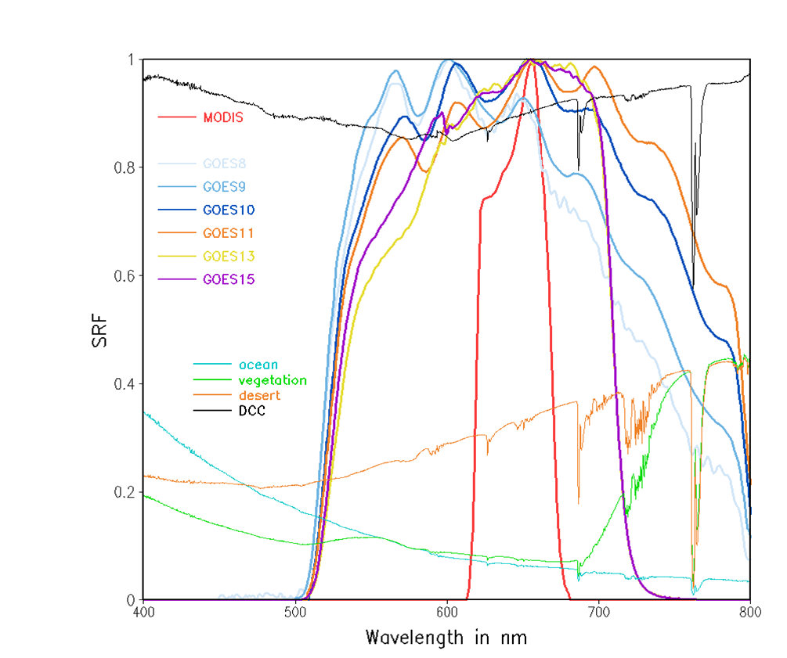
GOES Imager SRF
GOME DCC Reflectance
MODIS SRF

Slide 5
SBAF
SCIAMACY = 0.998, STDV=0.25%
GOME = 0.994, STDV=0.27%
Diff =0.4%

Slide 6
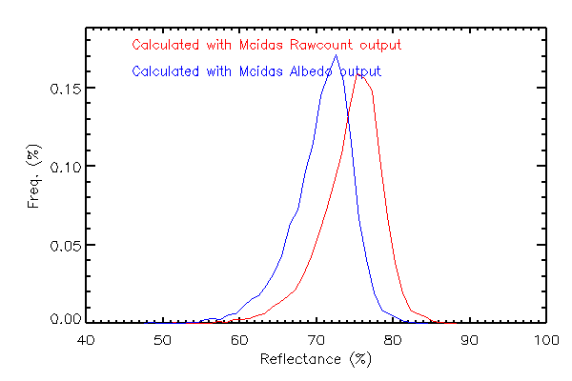
Reflectance Difference from Mcidas Raw vs. Albedo Outputs
Both reflectances are normalized with solar zenith angle and sun-earth distance
Possible cause of the difference might come from the mcidas conversion from raw count to pre-launch radiance/reflectance
Message home: when using the mcidas-x function to read the SRF-dependent variables (e.g., albedo and Tb ), be sure that the Mcidas version installed at the computers are most recently updated!
Notes:
Message home: be aware of the mcidas-x Version! Updated SRFs, pre-launch cal. Coefficients?

Slide 7
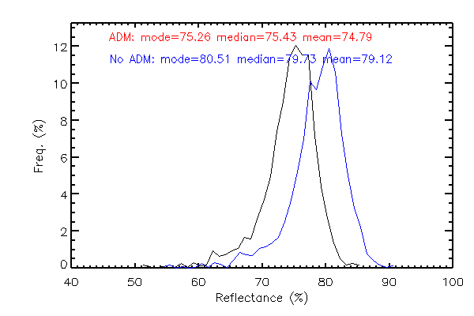
DCC PDF ADM vs. NO ADM

Slide 8
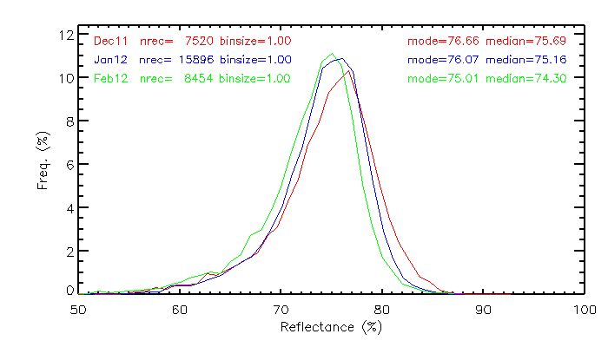
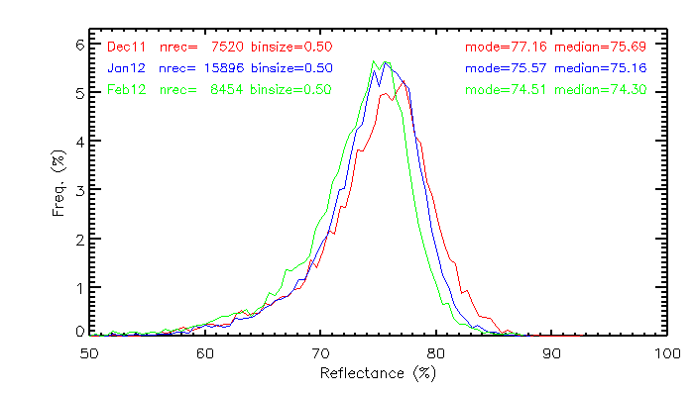
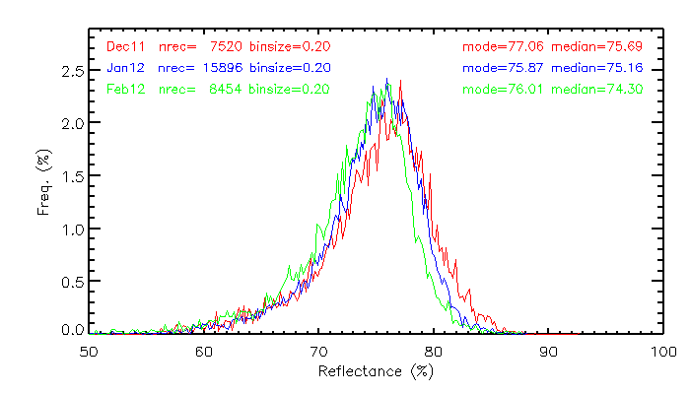
Bin size, Median vs. Mode?
Binsize = 1.0%
Binsize = 0.5%
Binsize = 0.2%
Baseline algorithm:
SZN < 40
VZN < 40
Latitude = [-20, + 20.]
Longitude = [nadir_lon – 20., nadir_lon + 20.]
Tb4 < 205K + 1.15K
STDV(Tb4) < 1K
STDV(Refl) < 3%

Slide 9
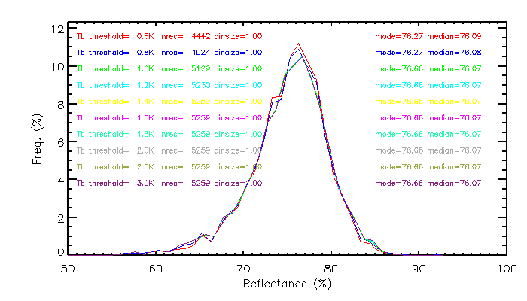
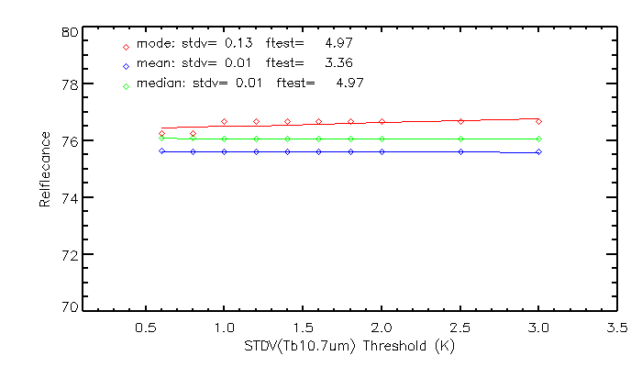
Sensitivity to STDV(Tb10.7um) – Dec11
Binsize=1.0, stdv(refl)<3%
Tb4 < 205K

Slide 10
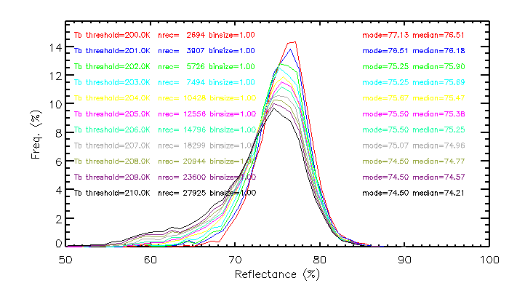
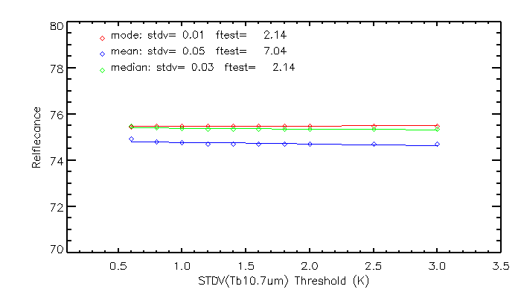
Sensitivity to STDV(Tb10.7um) – Jan12
Binsize=1.0, stdv(refl)<3%
Tb(10.7um)<205 + 1.15K

Slide 11
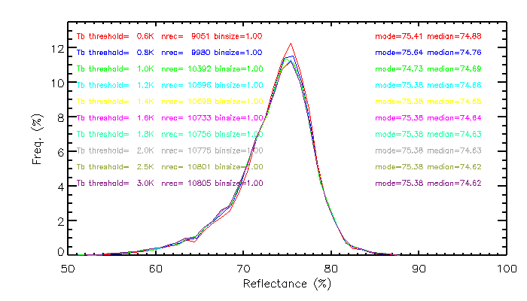
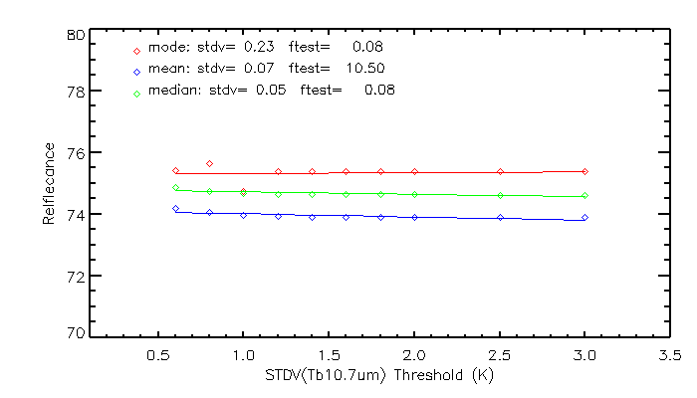
Sensitivity to STDV(Tb4) - Feb12
Binsize=1.0, stdv(refl)<3%
Tb(10.7um)<205+1.15K
Notes:
DCC reflectance (Mode) looks stable with stdv(Tb4)>1.0

Slide 12
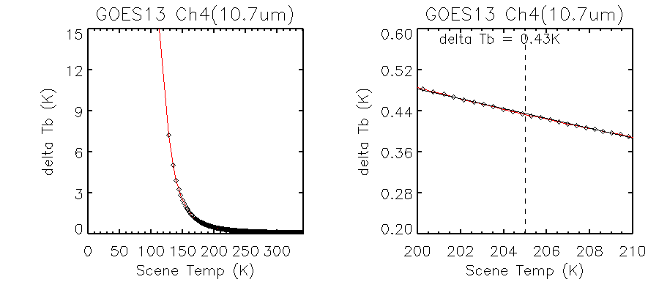
Sensitivity of GOES GVAR Radiance Count
Change in Tb / GVAR Count

Slide 13
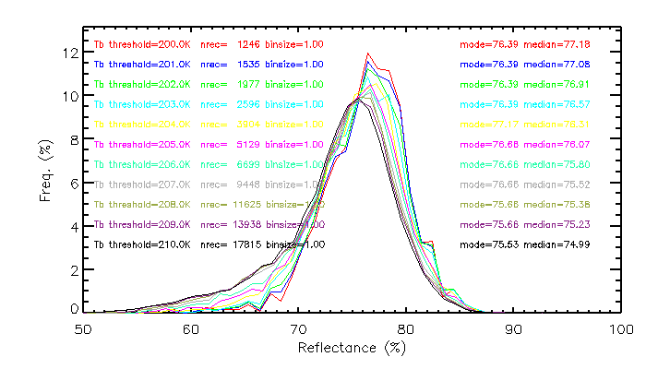
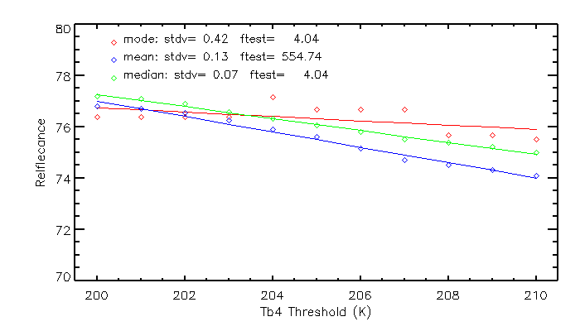
Sensitivity to Tb(10.7um) threshold – Dec11
Binsize=1.0, stdv(refl)<3%
Stdv(Tb10.7um)<1K

Slide 14
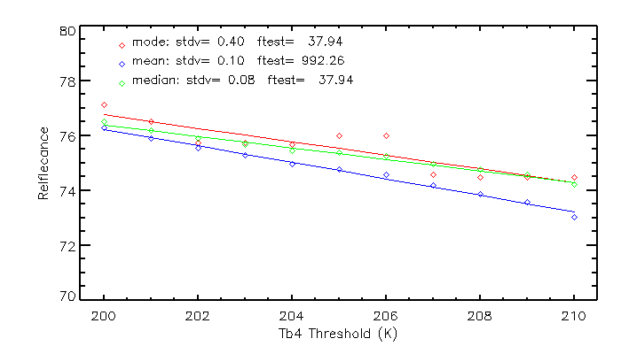
Sensitivity to Tb(10.7um) threshold – Jan12
Binsize=1.0, stdv(refl)<3%
Stdv(Tb10.7um)<1K
Notes:
Binsize can affect the fitting function uncertainty

Slide 15
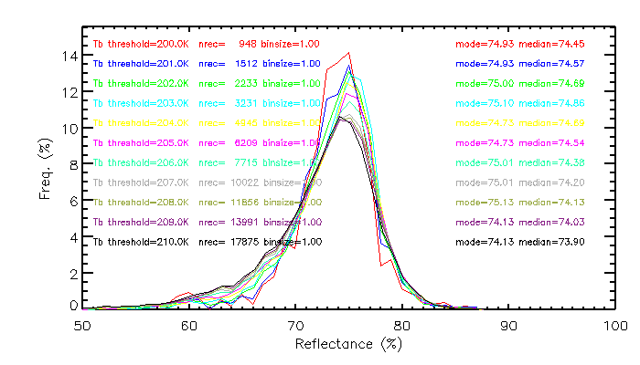
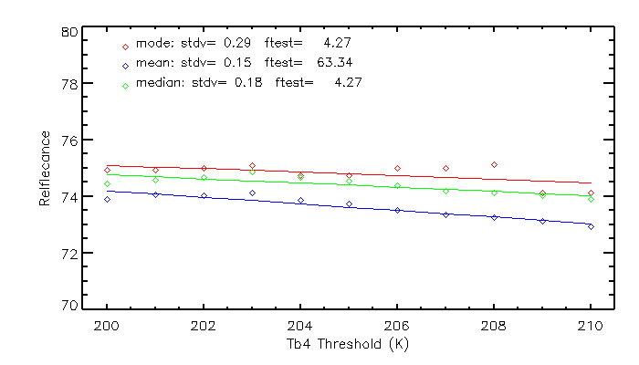
Sensitivity to Tb4 threshold – Feb12
Binsize=1.0, stdv(refl)<3%
Stdv(Tb10.7um)<1K
Notes:
Median refl seems provide more accurate relative calibration accuracy

Slide 16
Conclusions
Progressive decreasing of DCC reflectance can be observed with mode reflectance (binsize=1.0%) and median reflectance
Bin size may affect the uncertainty of the gain trending
median reflectance is irrelevant to the bin-size and more consistent at stdv(Tb10.7um)
While mode/median reflectance might be sensitive to the Tb(10.7um) thresholds, mode has larger stdv and median is more sensitive to the threshold.
When using mode reflectance, we need to consider the impact of instrument noise at cold scenes
For the 10-bit GOES instrument, it is recommended to slightly relax the criteria of Stdv(Tb10.7) (eg. =1.5K)

Slide 17
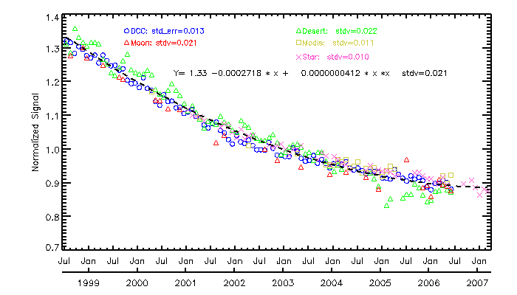
Preliminary Results – Comparison of the Vicarious Calibration Methods
GOES-10 Imager Visible Channel

Slide 18
Backup Slides

Slide 19
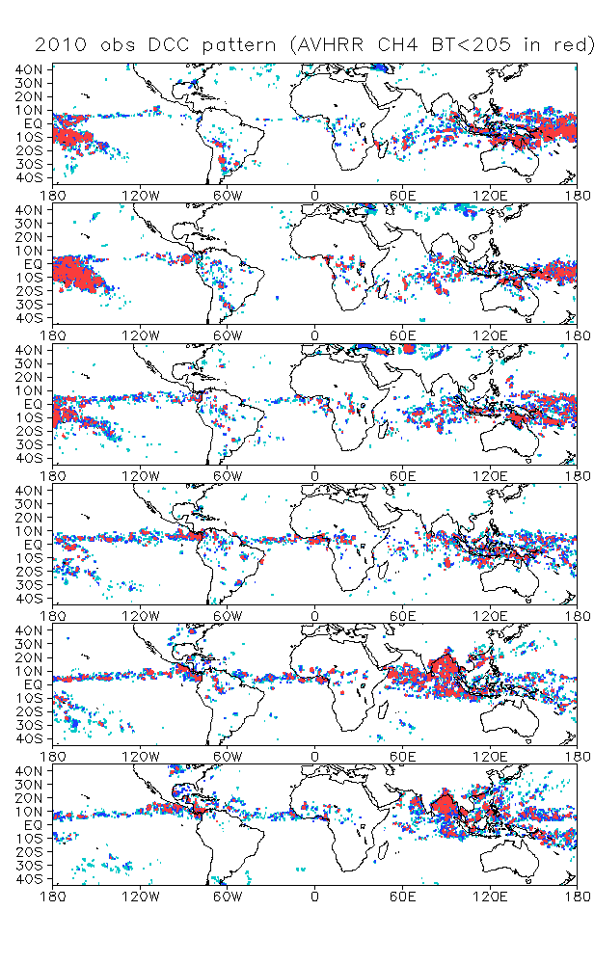
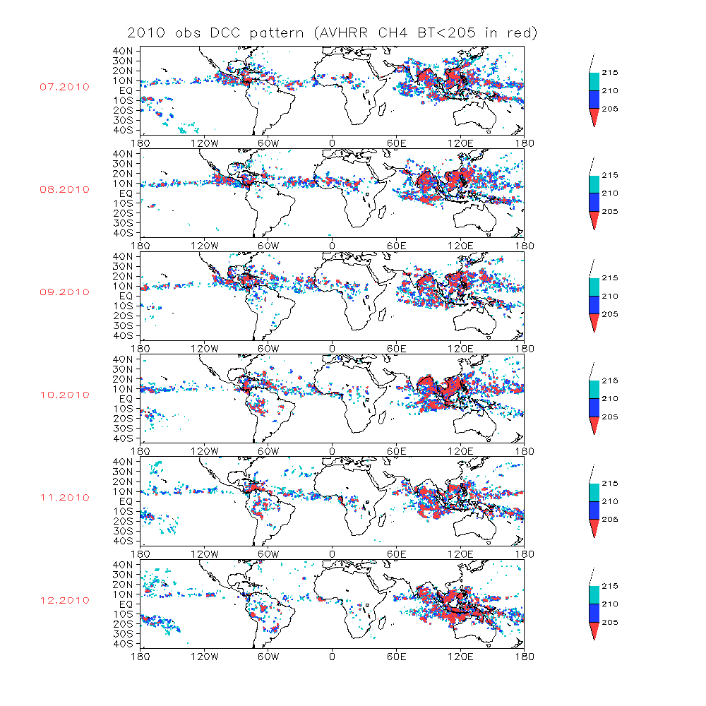
MTSAT-2
Feb
Mar
Sep
Apr
Oct
May
Nov
Jun
Dec

