Slide 1
Visible channel Calibration approach for the baseline algorithm
Japan Meteorological Agency
Meteorological Satellite Center
Yuki Kosaka
Notes:
My name is Yuki Kosaka.
I’ll introduce our visible channel calibration approach for the baseline algorithm.

Slide 2
Methodology
Vicarious calibration
  Rebuilds calibration table by referring radiative transfer calculation
Target selection
  Adopt following targets to cover wide range of brightness to obtain reliable regression line
    Cloud-free ocean, Cloud-free land, Liquid cloud, DCC
Radiative transfer calculation
  RSTAR (Nakajima and Tanaka [1986,1988])
  Input data is independent from GEO data
Notes:
For visible channel calibration, we have developed a vicarious calibration method which rebuilds calibration table by referring radiative transfer calculation.
Detailed process is as follows.
Following four targets are adopted to cover wide range of brightness to obtain reliable regression line.
And as for radiative transfer model, RSTAR which has been developed by University of Tokyo is employed
Input data of RT is independent from GEO data.

Slide 3
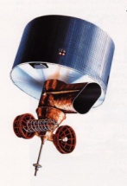


Cloud-Free Ocean Target
Target selection
  Cloud-free and spatially uniform sea
    Standard deviation of DN is small
    TBB(10.8um) > 273K
  Geometrical condition
    Sun zenith angle, satellite zenith angle < 60°
    Exclude near sunglint area
  Aerosol optical thickness is thin (< 0.3)
  Sea surface wind speed is low (< 7m/s)
Aerosol
Wind speed
Item | Input parameters to RSTAR
Geometrical condition | Solar zenith and azimuth angle Satellite zenith and azimuth angle Visible channel sensor
Atmospheric profile | Pressure, temperature, and moisture (JCDAS)
Surface condition | Sea surface wind speed (JCDAS)
Atmospheric gas Aerosols | Column ozone amount (Earth Prove/TOMS) Aerosol optical parameters (Terra/MODIS L1B)
Notes:
For ocean target, cloud-free and spatially uniform area is selected using visible and IR observation.
And conditions where RSTAR can hardly simulate are excluded.
Input parameters are retrieved from such data as MODIS, JCDAS.

Slide 4

DCC Target
Target selection
  Spatially uniform ice cloud top
    Standard deviation of DN is small
    TBB(10.8um) < 205K
  Geometrical condition
    Sun zenith angle, satellite zenith angle are < 60°
    Exclude near sunglint area
  Cloud optical thickness is adequately large (> 150)
  Adopt hexagonal column for ice crystal shape based on Yang et al(2000)
DCC
Wind speed
Item | Input parameters to RSTAR
Geometrical condition | Solar zenith and azimuth angle Satellite zenith and azimuth angle Visible channel sensor
Atmospheric profile | Pressure, temperature, and moisture (JCDAS) Cloud optical depth (Terra/MODIS L1B)
Surface condition | Sea surface wind speed (JCDAS)
Atmospheric gas Aerosols | Column ozone amount (Earth Prove/TOMS)
Notes:
For DCC target, spatially uniform ice cloud top is selected by using visible and IR observation.
Also, only targets which cloud optical thickness is adequately large are adopted to minimize RT calculation error.
As for ice crystal shape, hexagonal column based on Yang et al(2000) is adopted.

Slide 5
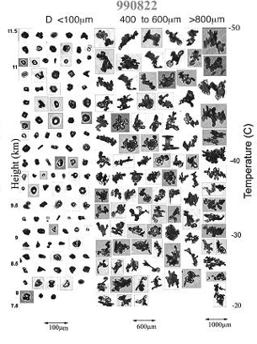
Minimize Influence of Ice Crystal Shape Uncertainty
  Influence of non-spherical shape crystals was minimized in RT radiance simulation
  Large uncertainty in RT radiance calculation is caused by the difference of hexagonal and spherical shape particle phase function
  We introduce the geometrical condition, where difference between phase function of hexagonal shape and that of spherical one is small, to minimize error
Example of crystal shape (Heymsfield, 2002)
Height
Particle size
Notes:
In DCC RT calculation, there was one problem.
Large uncertainty in RT radiance calculation exists which caused by the difference of hexagonal and spherical shape particle phase function.
We introduce the geometrical condition, where difference between phase function of hexagonal shape and that of spherical one is small ,to minimize error.

Slide 6
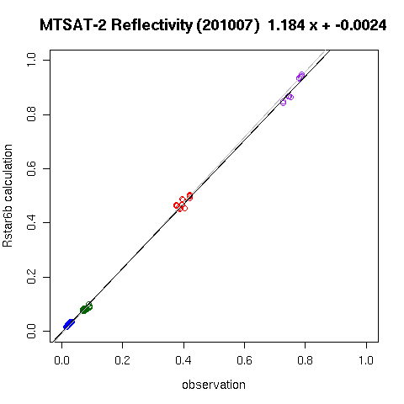
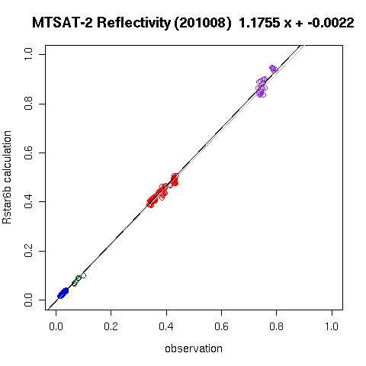
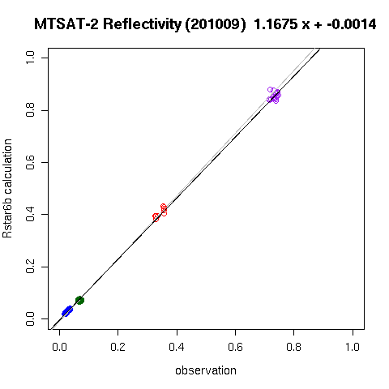
Calibration result
RT Calculation
July,
2010
August, 2010
September, 2010
DCC
Liquid Cloud
Land
Ocean
Observation
Calibration result of MTSAT-2
  Calculation of four targets looks consistent
Notes:
These are the calibration result of MTSAT-2.
Calculation of four targets looks consistent.

Slide 7
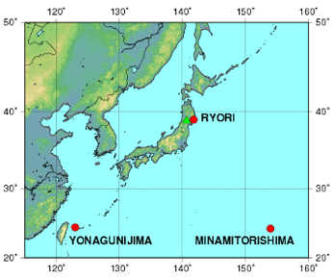
Validation
Aerosol Optical Thickness（September, 2010）
New Table
Retrieved from Satellite
Original Table
Ground Observation
Ground observation sites of JMA
Compare AOT retrieved from satellite observation to ground observation
Underestimation of aerosol optical thickness is improved
Notes:
Calibration accuracy was also validated by comparing aerosol optical thickness retrieved from satellite observation to ground observation.
Ground observation sites of JMA were used for this process.
It is confirmed that underestimation of AOT is improved by using new calibration table.

Slide 8
Plan of Reprocessing Past Satellites
Background
  Calibration of past satellites data is required for climatological use
Problem
  Developed calibration method can’t be applied before 2000, because MODIS data isn’t exist
Plan
  For ocean target, find conditions where aerosol optical thickness is small
  For DCC target, find conditions where optical parameter uncertainty is small
Notes:
Next I explain our plan of reprocessing past satellites.
Calibration of past satellites data is mainly required for climatological use.
But our calibration method can’t be applied before 2000, because MODIS data isn’t exist.
Therefore we are planning to develop calibration method for that period.
Our current plan is to find conditions where RT calculation error caused by input parameter uncertainty is small.

Slide 9
Global Composite Imagery
Application of visible channel calibration technique
Notes:
I have just explained our calibration method and result.
Next I introduce an application of our calibration technique, that is global composite imagery.

Slide 10
Objectives
Background
  For climate investigation and research, globally observed satellite data is necessary
  Global historical satellite dataset which has homogeneous quality is required
Problem
  Data quality is different among satellites
  Sensitivity of satellite sensor degrades
Objectives
  Establish visible channel calibration technique which contributes climate investigation and research
10
Notes:
For climate investigation and research, globally observed satellite data is necessary.
And global historical satellite dataset which has homogeneous quality is required.
But there is problem that data quality is difference among satellites and sensitivity of satellite sensor degrades.
Then, we developed a calibration technique which contributes to make such datasets.

Slide 11
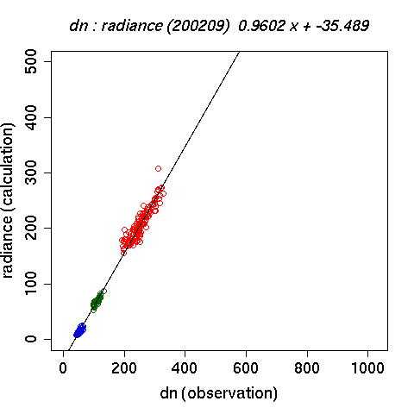
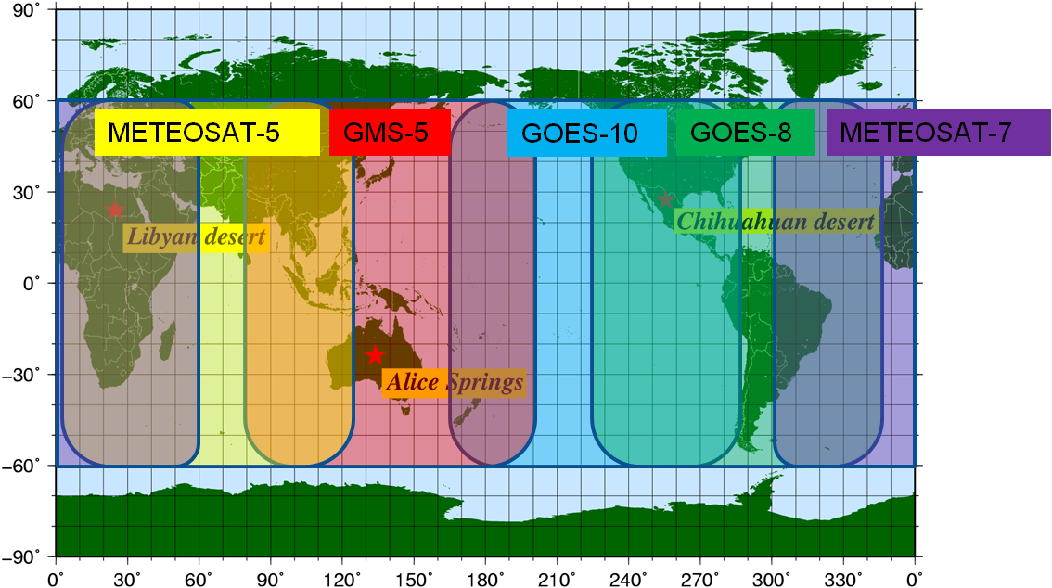
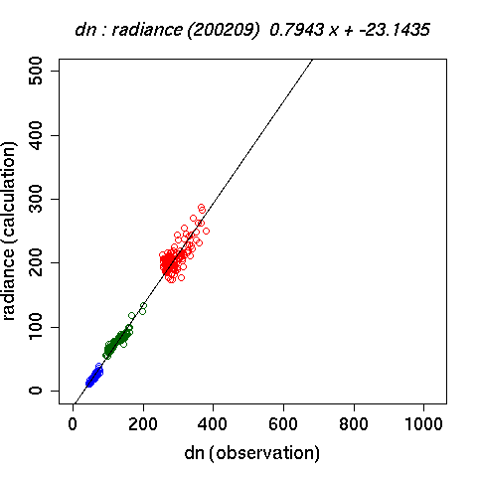
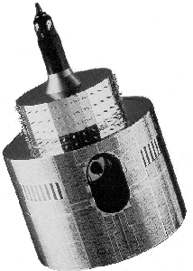
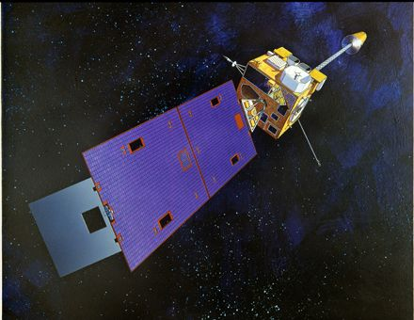
Calibration Result
GOES-8
September 2002
Meteosat-7
Radiance(W/m²/sr/μm)
Liquid Cloud
Land
Ocean
DN
GOES-10
Meteosat-5
Apply developed calibration technique to GOES, Meteosat
  Calibration result of each satellite looks fine
11
Notes:
To obtain global composite imagery, several geostationary satellites are required.
we use these five satellites, for example.
Then our calibration technique was applied for each satellite.
Here’s the result.
It seems that calibration result of each satellite looks fine.

Slide 12
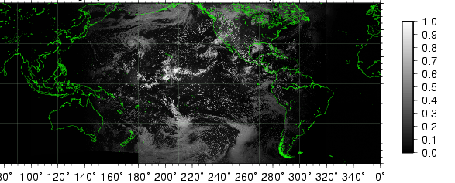
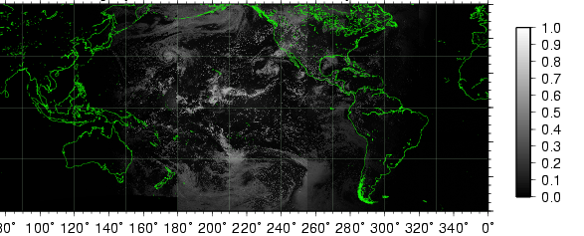
Example of Global Composite Imagery
  Visible vicarious calibration is examined to GMS-5 and GOES-10(W) and -8(W)
  Composite image shows discontinuity reduced
  The composite data is expected to be used for climate study
New Calibration Table
GMS-5
GOES-10
GOES-8
Original Calibration Table
GMS-5
GOES-10
GOES-8
Discontinuity
Notes:
Global composite imagery was also made experimentally.
These images are the ones using original calibration table and new one, respectively.
In this case, there is two discontinuity, here and here.
It is found that the image using new table shows discontinuity reduced.

Slide 13
Brush Up of Target Selection
Problem
  Calibration coefficient time sequence has fluctuation
Purpose
  optimize target selection to improve calibration accuracy
Method
  Brush up target selection of liquid cloud
Notes:
Although our calibration almost performed well, there was a little problem.
This is an example of calibration coefficient time sequence.
A little fluctuation can be found in this figure.
To mitigate this, we optimized target selection.
Because it is found that calculation of liquid cloud is more unstable than that of other targets, we brushed up target selection of this.

Slide 14
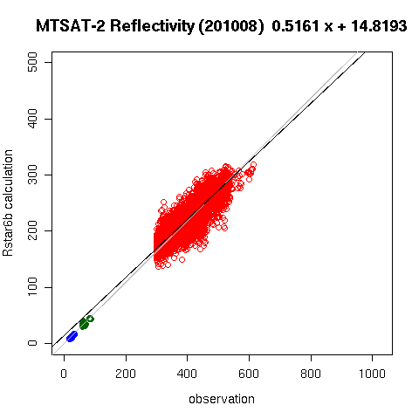
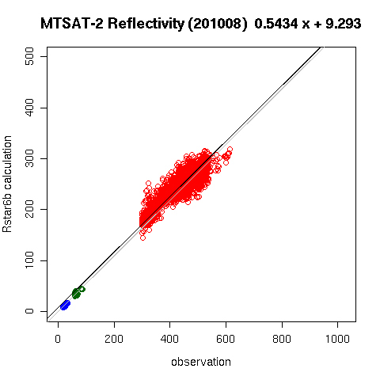
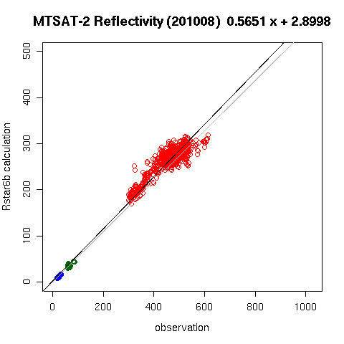
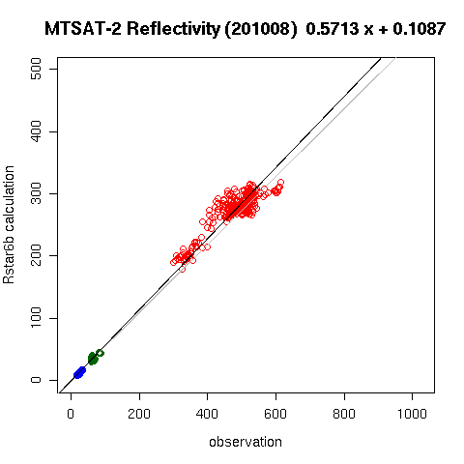
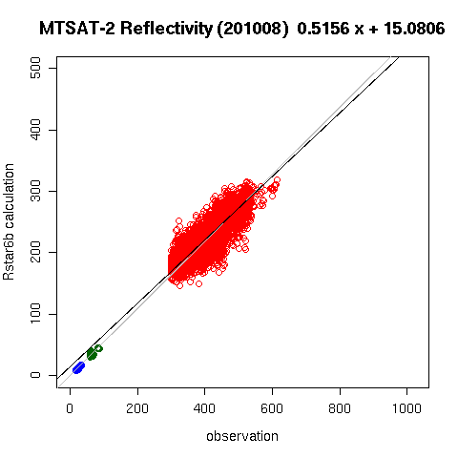

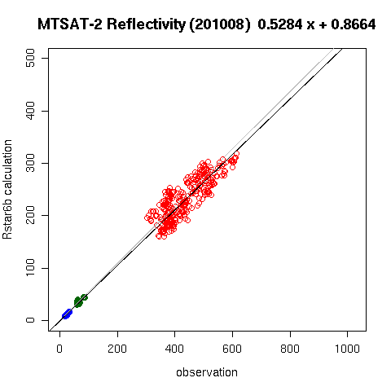
Investigate liquid cloud target
Sensitivity of cloud optical thickness (τ)
τ >10
τ >20
τ >30
τ >40
Threshold becomes strict
Sensitivity of sun zenith angle(SNZ)
SNZ>10
SNZ>20
SNZ>30
SNZ>40
Investigate standard deviation of liquid cloud sample when threshold of each parameter changes
Notes:
For target selection of liquid cloud, several parameters, such as cloud optical thickness, zenith angles, are used as threshold.
We investigated which parameter is important for target selection.
For more detail, we took standard deviation of liquid cloud sample when threshold of one parameter changes.
Because threshold of other parameters were fixed while this process, sensitivity of one parameter can be known.

Slide 15
Sensitivity by each parameter
Scattering of sample reduced
Threshold becomes strict
Calibration accuracy improves when spatial uniformity of target(“σ_{DN}”) becomes small
Notes:
These are the results.
Each figure shows how standard deviation changes when threshold of each parameter becomes strict.
It is found that it decreases remarkably when threshold of σ_{DN} becomes strict.
Then it can be say that this parameter, which means spatial uniformity of target, is the most important for calibration accuracy.
We modified each parameter’s threshold based on this result.

Slide 16
Time sequence of calibration coefficients
Calibration coefficients become more stable
16
Notes:
These are the results of GOES-8 and GOES-10 calibration.
It is confirmed that calibration coefficients become more stable by this modification.

Slide 17
Smoothing of Time Sequence
Introduce mathematical smoothing process
Method
  Based on Phillips(1962), Twomey(1963)
  Assume calculated time sequence (g) has some error, and real one (f) is smooth
  Calculate function “f” by Lagrange multipliers method which minimizes following expression
g
f
Lagrangian multiplier
“f” is smooth function
Magnitude of ε
Notes:
Regarding stability of time sequence, we are investigating to introduce a mathematical smoothing process.
This method is based on Phillips and Twomey, so please refer these documents for more detail.
It assumes calculated time sequence has some error, and ideal one is smooth.
Then calculate ideal time sequence “f” by Lagrange multipliers method which minimizes following expression.

Slide 18
Meteosat-5 SRF Problem
SRF of Meteosat-5 is unreliable (GOVAERTS.Y.M, 1999)
  pre-launch measurement technique was not very accurate
  More consistent result was obtained by substituting Meteosat-5 SRF by Meteosat-7 one
Investigate impact of SRF substitution
  Apply to our visible channel calibration process
Meteosat-5
Meteosat-7
Notes:
Next, I talk about Meteosat-5’s spectral response function problem.
According to this document, SRF of Meteosat-5 is unreliable.
Specifically, pre-launch measurement technique at that time was not very accurate, and more consistent result was obtained by substituting Meteosat-5 SRF by Meteosat-7 one.
So we also investigated impact of this substitution by applying to our visible channel calibration process.

Slide 19
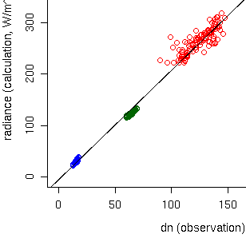
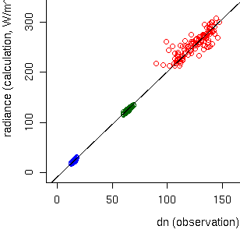
Calibration Result
Using Meteosat-5 SRF
January, 2002
Using Meteosat-7 SRF
RT Calculation
RT Calculation
Liquid Cloud
Land
Ocean
Observation
Observation
More consistent result is obtained by using Meteosat-7 SRF
Notes:
There are the calibration results.
Left figure is original result, and right one is the result of using Meteosat-7 SRF.
In the left figure, There is a little inconsistency between land target calculation and those of ocean and liquid cloud ones.
But this inconsistency can not be seen in the right figure, which is same result as previous report.

Slide 20

Summary
JMA has developed visible channel vicarious calibration technique using radiative transfer model
  JMA would like to compare our method with the Dave’s result to support DCC technique
Global composite imagery is one of the application of calibration technique
Calibration method for Pre-MODIS period is current issue
Notes:
Finally, I summarize.
JMA has developed visible channel vicarious calibration technique using radiative transfer model.
JMA would like to compare our method with the Dave’s result to support DCC technique.
Global composite imagery is one of the application of calibration technique, and it performs well.
And calibration method for Pre-MODIS period is current issue.
Thank you for your attention.

Slide 21
Backup

Slide 22
Cloud-Free Land Target
Target selection
  Cloud-free and spatially uniform land
    Desert
    Standard deviation of DN is small
    TBB(10.8um) > 273K
  Geometrical condition
    Sun zenith angle, satellite zenith angle are < 60°
    Exclude near sunglint area
  Aerosol optical depth < 0.3
Aerosol
Item | Input parameters of RSTAR
Geometrical condition | Solar zenith and azimuth angle Satellite zenith and azimuth angle Visible channel sensor
Atmospheric profile | Pressure, temperature, and moisture (JCDAS)
Surface condition | Surface albedo (Terra/MODIS BRDF)
Atmospheric gas Aerosols | Column ozone amount (Earth Prove/TOMS) Aerosol optical parameters (monthly climatic value)
BRDF

Slide 23
Liquid Cloud Target
Target selection
  Spatially uniform cloud top
    Standard deviation of DN is small
    TBB(10.8um) > 273K
  Geometrical condition
    Sun zenith angle, satellite zenith angle are < 60°
    Exclude near sunglint area
  10 < Cloud optical depth < 40
Liquid Cloud
Wind speed
Item | Input parameters of RSTAR
Geometrical condition | Solar zenith and azimuth angle Satellite zenith and azimuth angle Visible channel sensor
Atmospheric profile | Pressure, temperature, and moisture (JCDAS) Cloud optical depth (Terra/MODIS L1B)
Surface condition | Sea surface wind speed (JCDAS)
Atmospheric gas Aerosols | Column ozone amount (Earth Prove/TOMS)

Slide 24
“ RSTAR” – Radiative Transfer Code
Developed by Dr. NAKAJIMA’s Lab. (AORI, Univ. of Tokyo)
  Algorithm is based on Nakajima and Tanaka [1986,1988]
  http://www.ccsr.u-tokyo.ac.jp/~clastr/
General package for simulating radiation fields
  k - distribution method
  HITRAN2004 database
  Wavelengths between 0.2μm to 200μm
  Absorption and scattering schemes
  Parallel atmosphere divided into sub-layers
Input
Sun and view angles
Sensor's response function
Atmosphere profile
Surface condition
Output
Radiance, irradiance
24
Notes:
24

Slide 25
Time sequence of calibration coefficients
Monthly and seasonal changes of calibration coefficients exist.

Slide 26
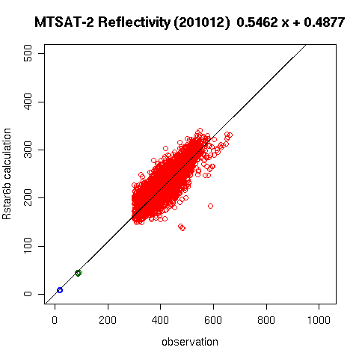
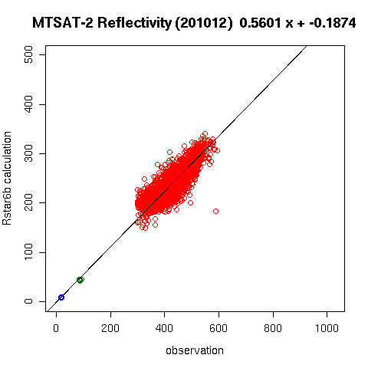

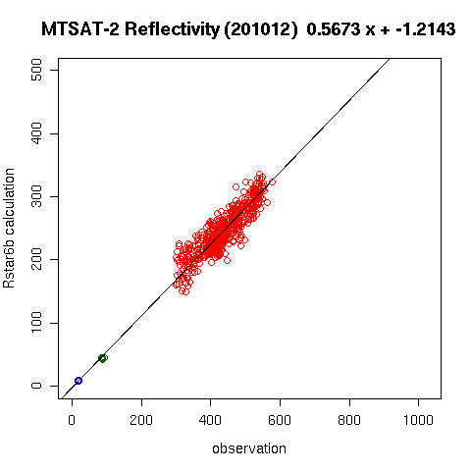
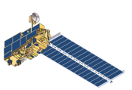
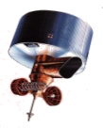
Introduce new parameter
X<=180
X<=90
X<=60
X<=45
Threshold becomes strict
Δφ
Threshold becomes strict
calibration accuracy improves when “Difference of Azimuth Angles” (Δφ) becomes small

Slide 27
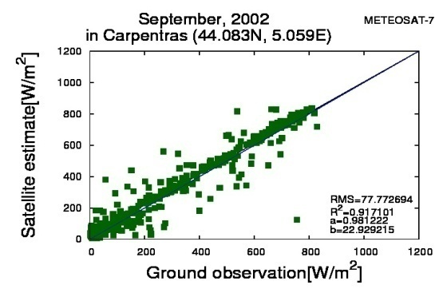
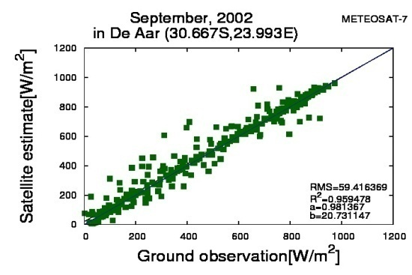
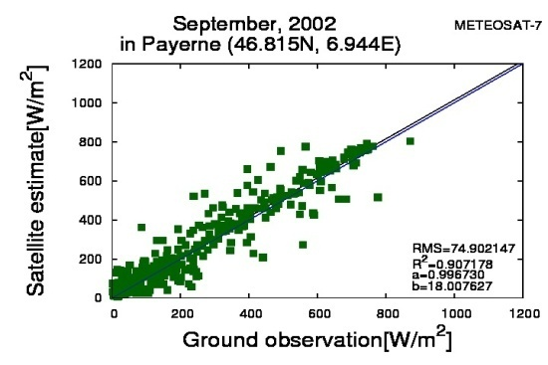
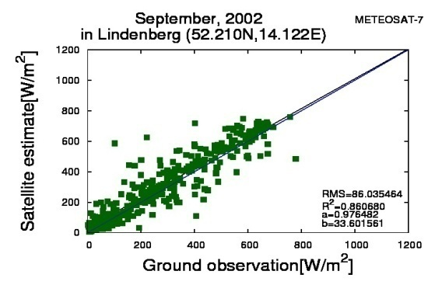
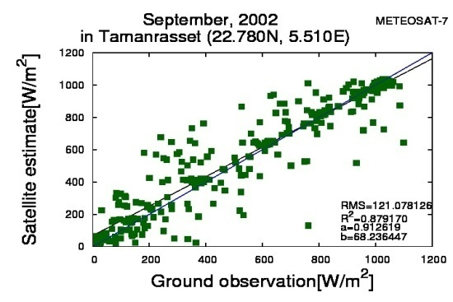
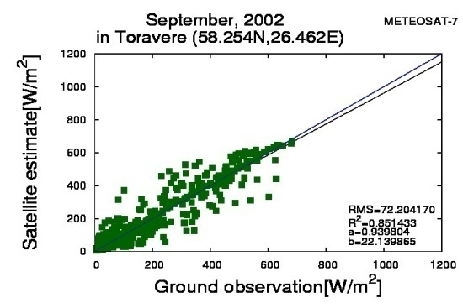
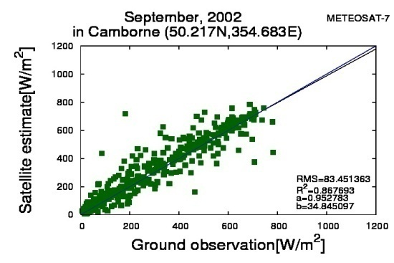
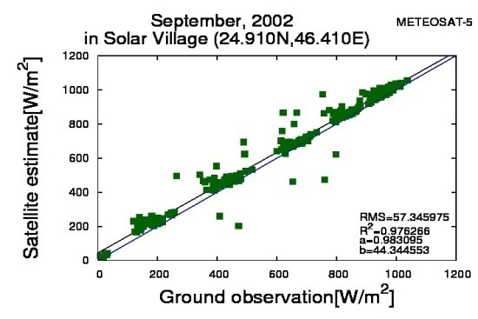
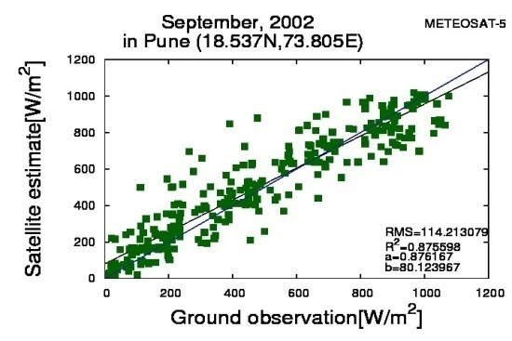
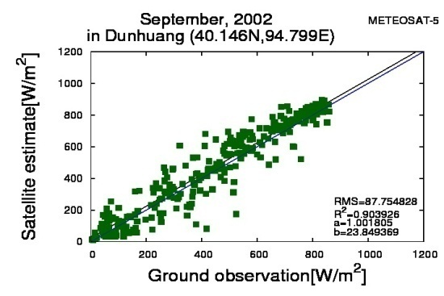
・METEOSAT-7(322.5E~31.5E)
Carpentras
De Aar
Payerne
Lindenberg
Tamanrasset
Toravere
Camborne
・METEOSAT-5(31.5E~101.5E)
Solar Village Pune Dunhuang

Slide 28
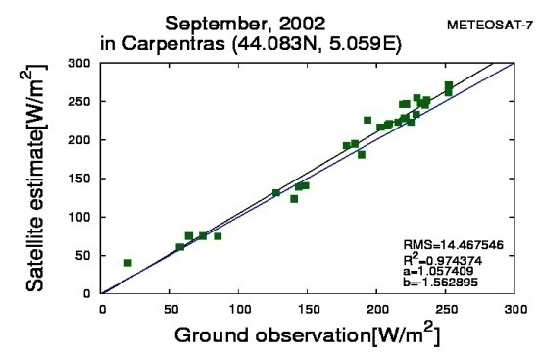
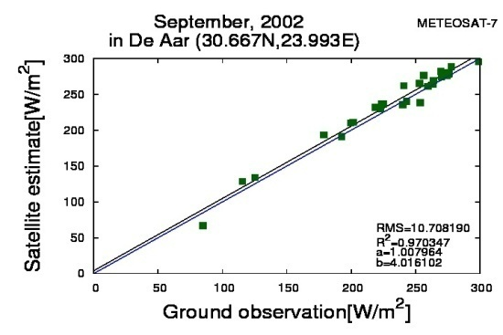
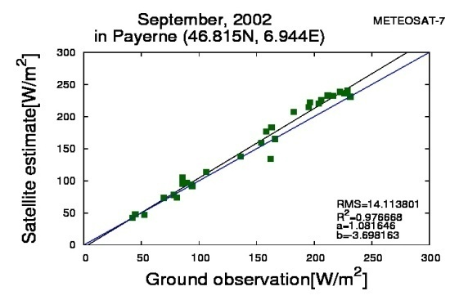
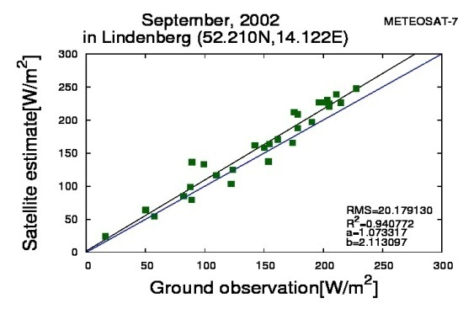
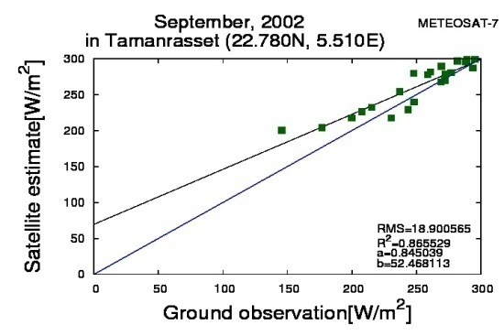
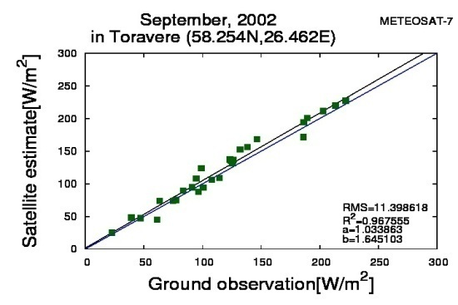
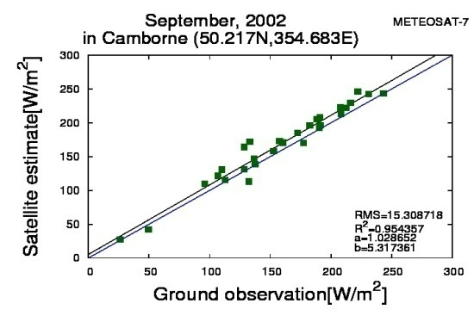
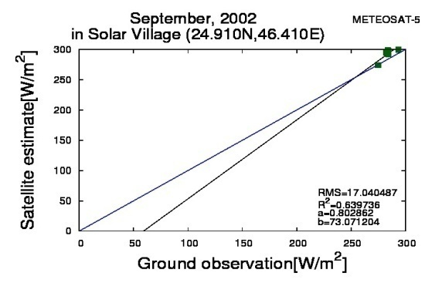
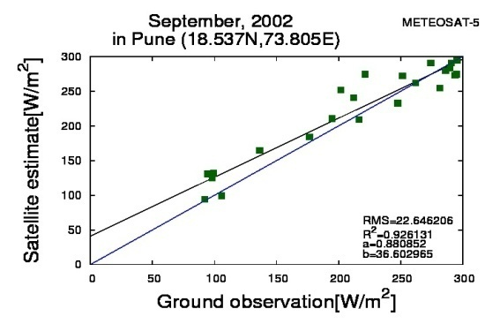
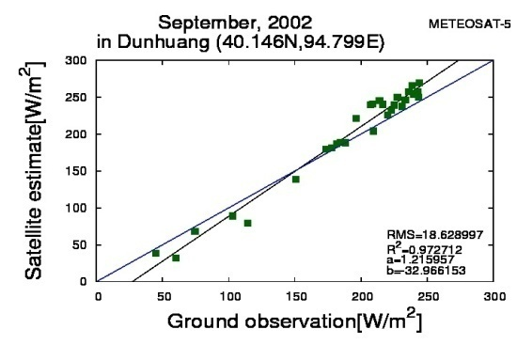
・METEOSAT-7(322.5E~31.5E)
Carpentras
De Aar
Payerne
Lindenberg
Tamanrasset
Toravere
Camborne
・METEOSAT-5(31.5E~101.5E)
Solar Village Pune Dunhuang

Slide 29
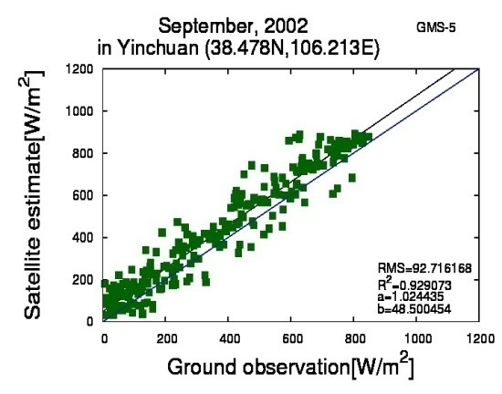
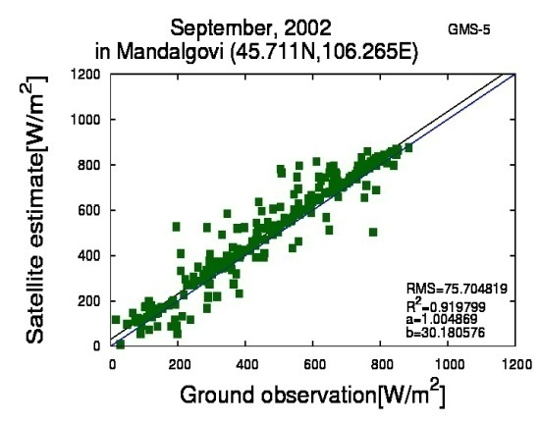
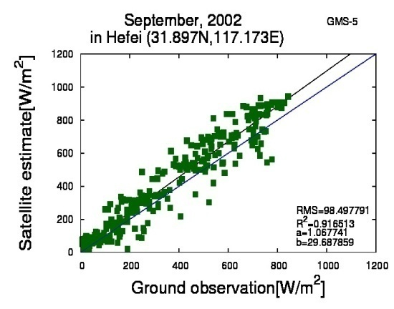
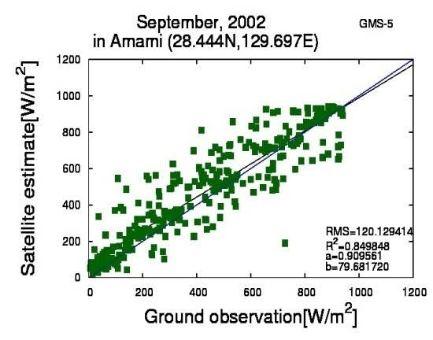








・GMS5(101.5E~182.5E)
Yinchuan
Mandalgovi
Hefei
Amami
Chiba
Tateno
Alice Springs
Darwin
Momote
Nauru Island
Kwajalein
Lauder

Slide 30












・GMS5(101.5E~182.5E)
Yinchuan
Mandalgovi
Hefei
Amami
Chiba
Tateno
Alice Springs
Darwin
Momote
Nauru Island
Kwajalein
Lauder

Slide 31












・GOES-8(225E~345E)
Regina
Billings
S.Great Plaints
Goodwin Creek
Bondville
Rock Springs
Chesapeake Light
Bermuda
・GOES-10(165E~285E)
Desert Rock
Boulder(BOS)
Fort Peck
Boulder(BOU)

Slide 32












・GOES-8(225E~345E)
Regina
Billings
S.Great Plaints
Goodwin Creek
Bondville
Rock Springs
Chesapeake Light
Bermuda
・GOES-10(165E~285E)
Desert Rock
Boulder(BOS)
Fort Peck
Boulder(BOU)

