Slide 1

Lunar calibration trial in JMA
Arata OKUYAMA
Meteorological Satellite Center,
Japan Meteorological Agency
2012/03/07 GSICS GDWG&GRWG joint meeting in Beijing

Slide 2
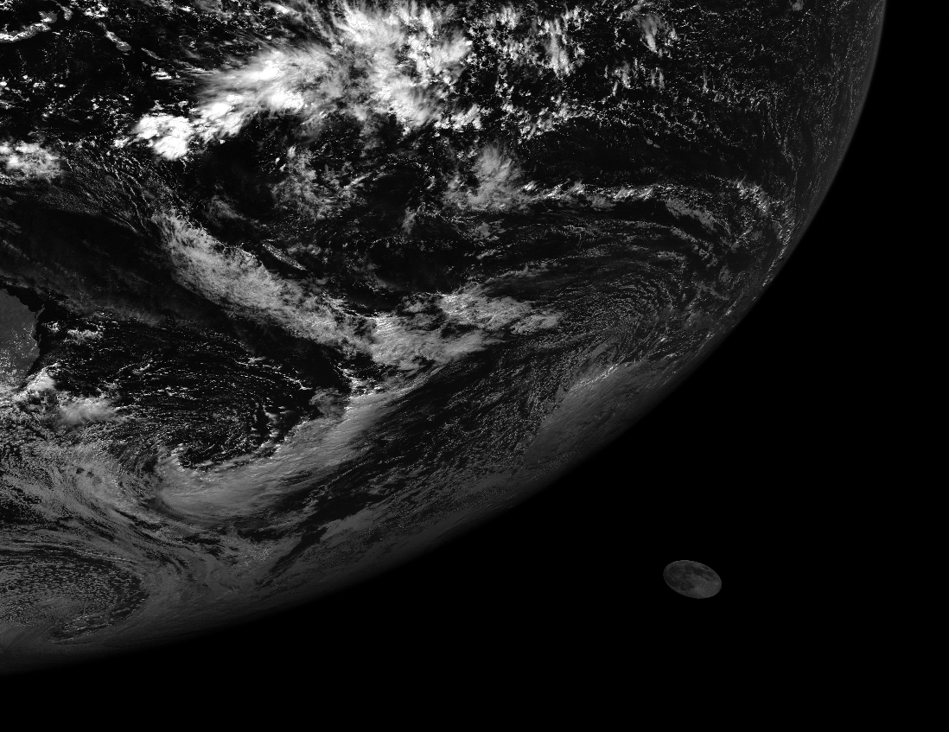
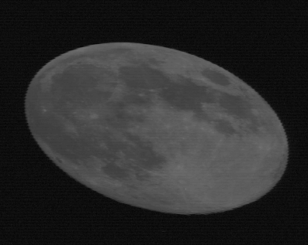
GMS-5 Lunar calibration trial
GMS-5 captures moon images in full disk observations. (10 times per year or so)
Moon irradiance of GMS-5 VIS is compared with the ROLO model irradiance calculated by Dr. Tom Stone in USGS.

Slide 3
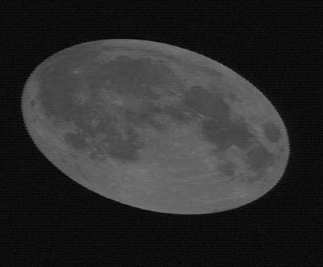
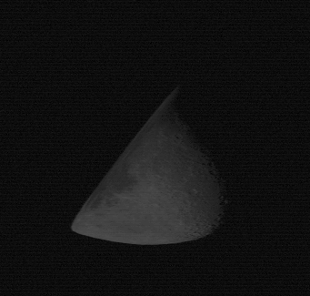
GMS-5 Lunar calibration trial (cont.)
Calibration coefficients, ROLO/GMS-5, is consistent with the coefficients by the vicarious calibration approach.
Small phase angle is preferable, but good sample is very limited.
Phase angle < 25[deg]

Slide 4
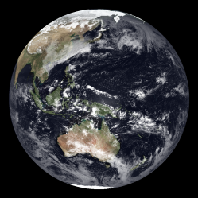
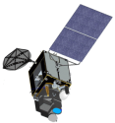
Feasibility of the Lunar calibration for JMA
MTSAT-1R
  can not capture moon images because of its scan pattern.
MTSAT-2
  can take the same approach as GMS-5.
Himawari-8/-9
  have a plan of lunar observation to support solar channel calibration.
It would be much appreciated if ROLO lunar data for Himawari-8/-9 and GMS-1 to -4 could be available.
MTSAT-1R scan concept

Slide 5

Thank you!

