Slide 1
Consideration on IR inter-calibration for historical GEOs
Yoshihiko Tahara
Meteorological Satellite Center
Japan Meteorological Agency

Slide 2
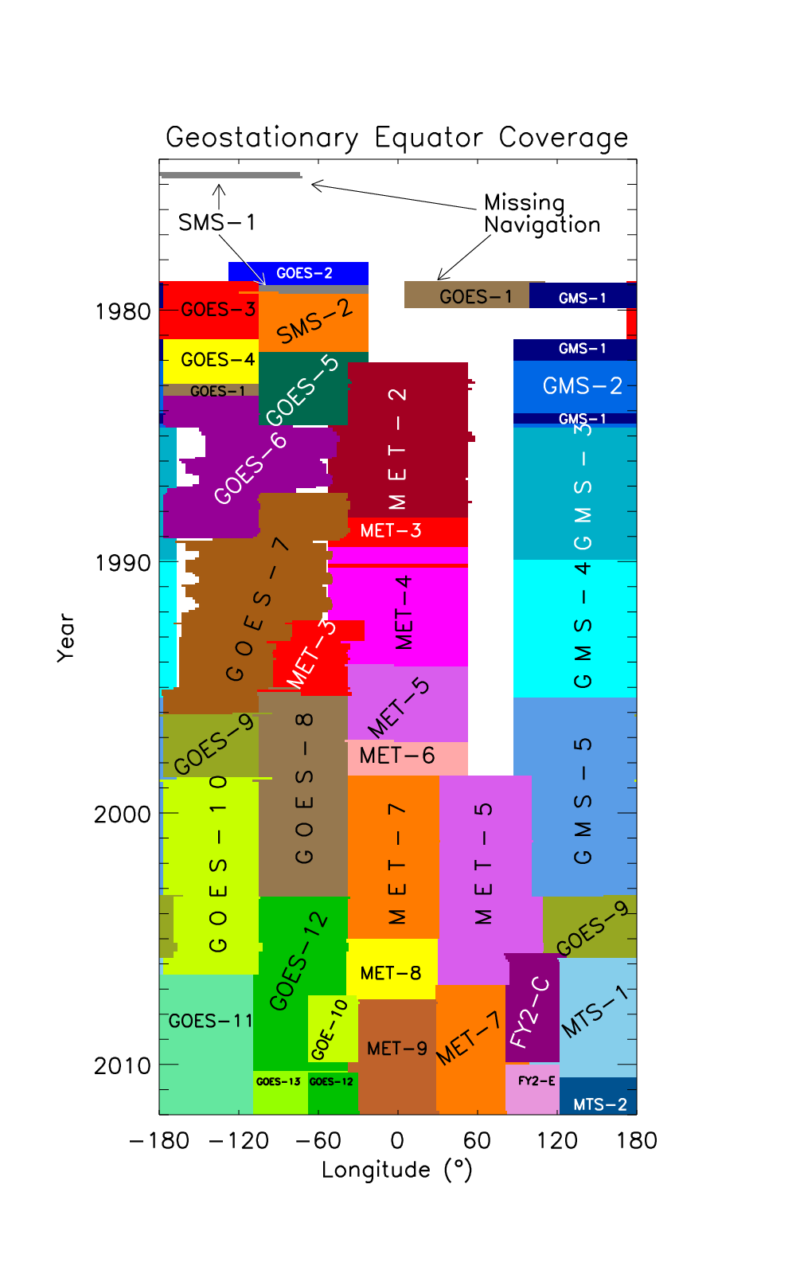
Considering…
Comparison with HIRS and AVHRR is one of approaches for historical GEO IR inter-calibration
GSICS baseline algorithm should be applicable for a number of historical GEOs
Fig: Satellites used for the ISCCP climate data record. (Courtesy of Ken Knapp, NOAA-NCDC)

Slide 3
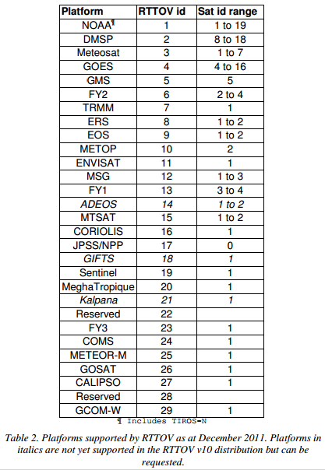
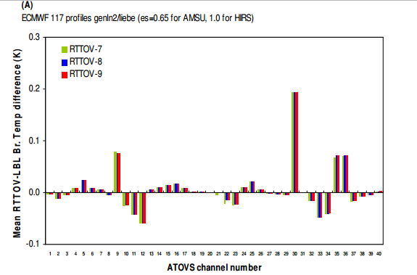
Considering Tim & Rob’s Method reported in the Web meeting on January 17
Basically, the method seems good
Necessary for spatial and temporal collocation conditions like GEO-AIRS/IASI comparison
Homogeneity & environment checks
Necessary for other spectral compensation approach than using RTTOV
RTTOV only supports the platforms listed on the right at this moment
RTTOV contains some biases comparing with Line-by-Line

Slide 4
Considering Spectral Compensation
Use of high spectral resolution Line-by-Line radiance dataset for a set of model profiles
Applicable for any IR channels, only SRFs needed
No biases between a fast RT and LBL
Ask help to fast RT communities
RTTOV and CRTM developers must have such dataset or code to create the dataset for the training of the RT models.
Recommendation from GSICS to ITSC?

