Slide 1
Update on the GSICS Procedure for Product Acceptance (GPPA)
GCC
04/17/2012

Slide 2
Outline
Review of the GPPA
Current status of GPPA
Impediments to Pre-Operational Phase
Discussion of potential solution to impediments

Slide 3
Fundamental Capabilities of GPPA
GPPA was originally developed by Dr. Bob Iacovazzi, following the QA4EO guidelines
The GPPA is the GSICS:
Product developers pathway to obtain a “Stamp of Approval” for a potential product
Data users window to GSICS product quality and “fitness for purpose”
Governing body reference for judging GSICS product fitness
The GPPA defines and documents:
Scope of product within the GSICS product portfolio – correction of level1b data
Theoretical basis, traceability, and implementation and distribution strategy
Product quality (uncertainty, quality indicators, data user’s guide, etc)
The GSICS Product Acceptance Form (GPAF) is available at GSICS wiki
https://gsics.nesdis.noaa.gov/wiki/Development/GppaWorkflow

Slide 4
Four Product Phases
Submission Phase
Demonstration Phase
Pre-operational Phase
Operational Phase

Slide 5
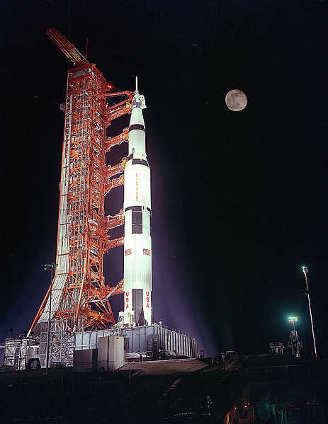
GPPA: Submission Phase
Phase Progress:
GSICS Product Acceptance Form (GPAF) is satisfactory,
Sample data files conform to GSICS file and parameter naming and format standards,
Verified to be within GSICS scope, and
Theoretical basis is understood at a high-level.
Documents & Data to GCC:
GPAF sections that detail product name, POC, brief description, and relevance to GSICS.
Preliminary version of the product algorithm theoretical basis document (ATBD)
Sample product files that adhere to GSICS file and parameter naming conventions
Reviewers: GSICS Product Acceptance Team (GPAT)
Maximum Time Period: 90 Days

Slide 6
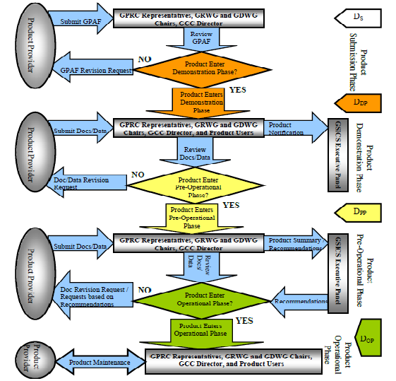

Slide 7
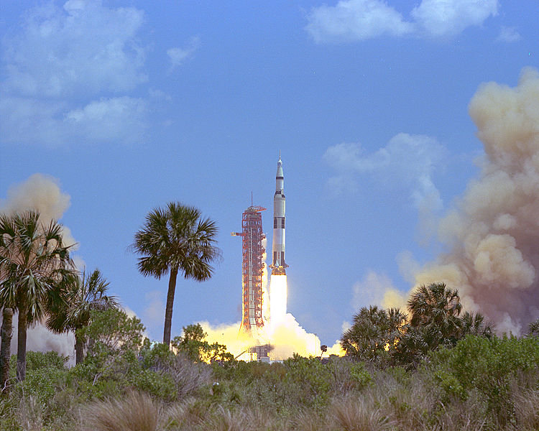
GPPA: Demonstration Phase
Phase progress:
Founding concepts, supporting models and measurements, and implementation are documented and fully understood,
Traceability to community reference standard is documented,
Quality Indicator is documented and well-defined,
Tested and reviewed by potential product users, and
Data released to GSICS members and potential users.
Documents & Data to GCC:
Routine product upload to a GSICS data server and agree on file retention policy.
Baseline versions of four documents critical to product quality assurance –
Algorithm Theoretical Basis Document,
Document describing product traceability to standards
Product supporting radiative transfer model and cal/val supporting measurements description
Product quality indicator description and justification
Reviewers: GPAT & potential product users
Maximum Time Period: 365 Days
Notes:
1. ATBD, data usability and format should be reviewed at least one outsider of the GSICS community, while the product supporting RTM and cal/val measurement descriptions can be reviewed by GPAT only. That is right?
2. What should be accounted as product quality indicator? Missing data? Product uncertainty?
3.

Slide 9
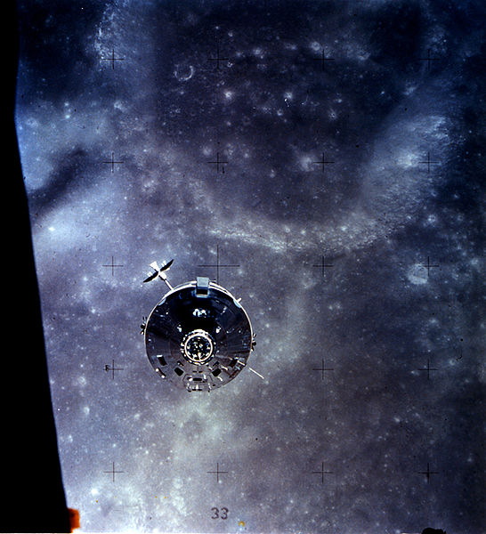
GPPA: Pre-operational Phase
Phase progress:
Generation, distribution, version control and archive strategies are fully documented and implemented.
Users’ Guide with clear implementation instructions made available to data users,
Data released to public with disclaimer.
Documents associated with product data stewardship in an operational environment to GCC:
product version control plan,
operations and distribution plan, and
data user's guide
Reviewers: GPAT & GSICS Executive Panel (EP)
Maximum Time Period: 180 Days

Slide 11
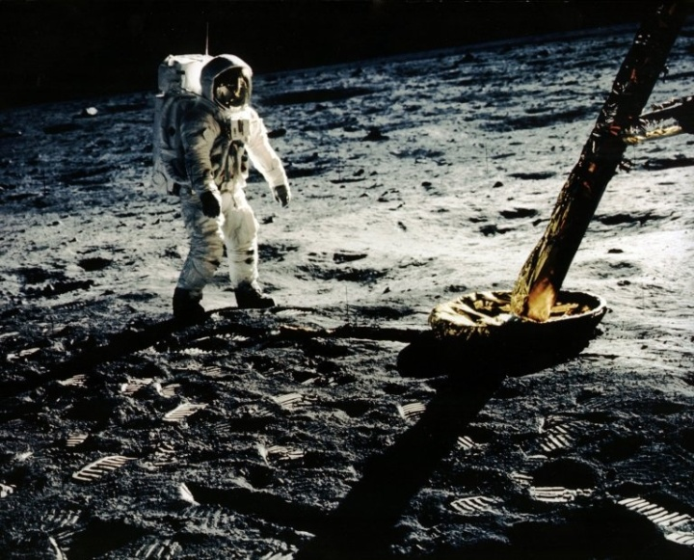
GPPA: Operational Phase
Goal:
Product is fully accepted by GSICS Executive Panel (EP) and maintained within GSICS and distributed to the public.
Maximum Time Period: Periodic Reviews
Milestones: The following are made available by the product provider to the GCC and the GPAT for periodic inspection and review
Product logs and usage reports
Updated documentation/software as necessary

Slide 13
Current GPPA Status
Five Potential Products in Demonstration Phase and one in potential Submission Phase
GSICS Correction for EUMETSAT SEVIRI IR Channels based on IASI
GSICS Correction for GOES Imager IR Channels based on AIRS and IASI
GSICS Correction for MTSAT Imager IR Channels based on AIRS and IASI
Patmos-X AVHRR solar reflective channel corrections based on MODIS
NOAA MSU/AMSU/SSU inter-calibration
GSICS Correction for GOES Sounder IR Channels based on AIRS and IASI (not submitted the GPAF yet)

Slide 14
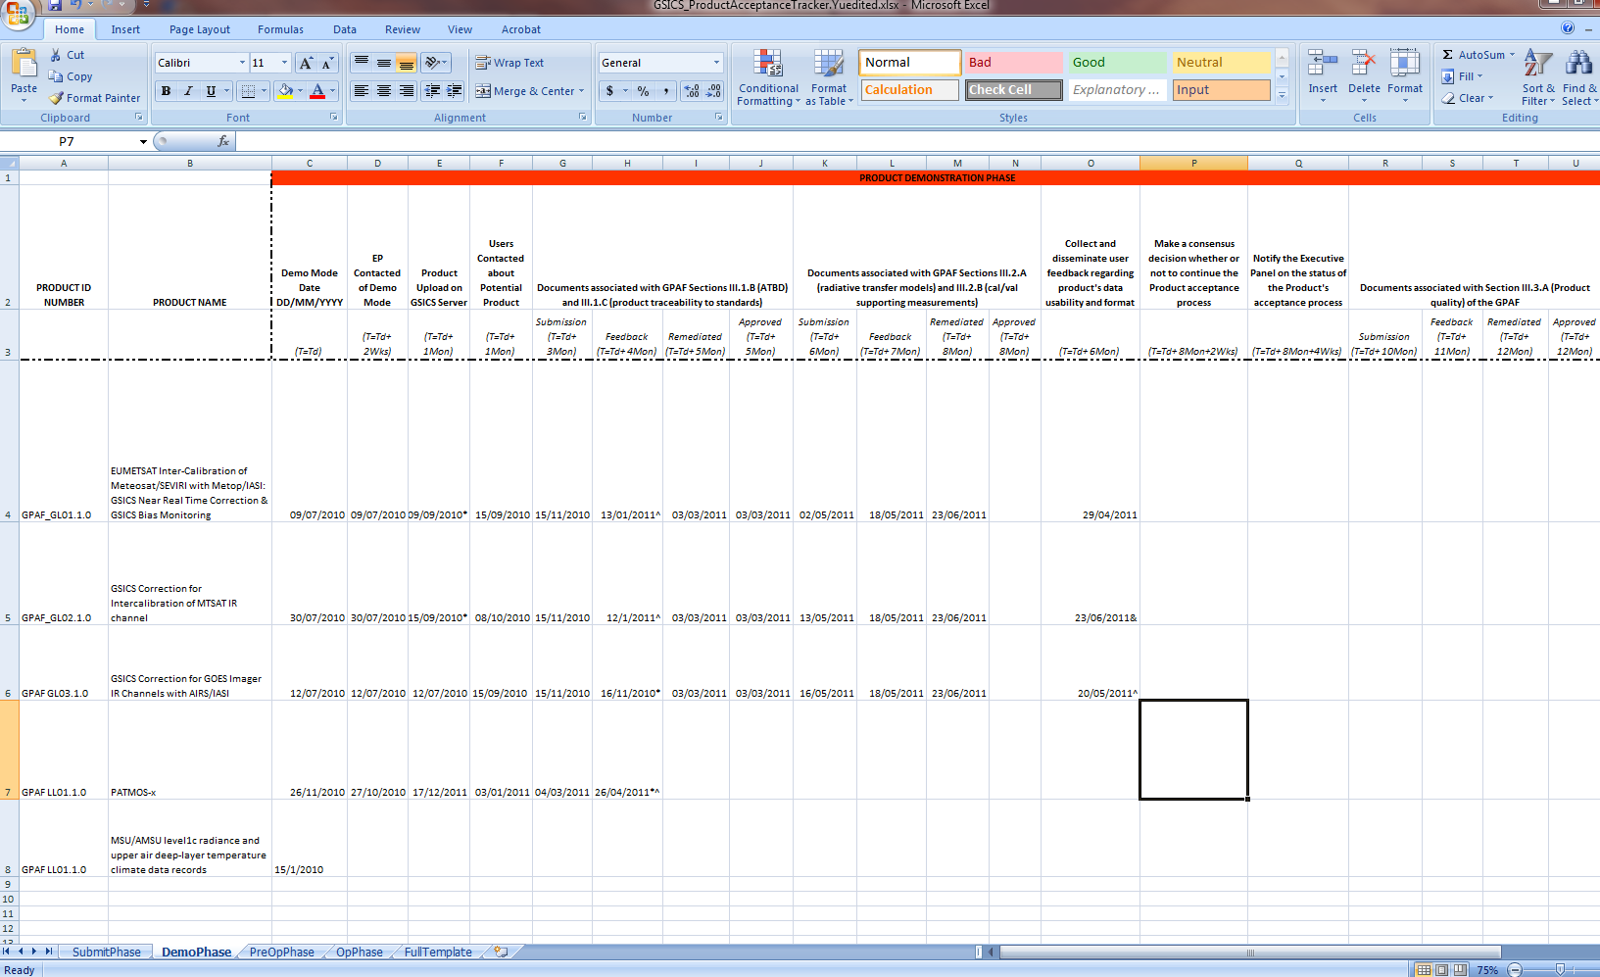
Current GPPA Status
Feedback from GSICS Product Acceptance Team is overdue

Slide 15
GPPA: Road to Pre-Operational Phase
Examine the submitted documents (ATBD and product traceability to standards)
Who: GPAT and product users
Due: One month after GCC received the documents
Remediate any document issues according to the GPAT and user feedback
Who: Product provider, GCC Director
Due: One month after receiving GPAT feedback
Complete documents associated with GPAF Sections III.2.A (radiative transfer models) and III.2.B (cal/val supporting measurements)
Who: Product provider
Due: Six months after entering the Demonstration phase
Collect and disseminate user feedback regarding product's data usability and format
Who: Product users, GCC Director
Due: Six months after entering the Demonstration phase
Examine the submitted documents (radiative transfer models and cal/val supporting measurements).
Who: GPAT
Due: One month after GCC received the documents
Remediate any document or data issues according to the GPAT and user feedback
Who: Product provider, GCC Director
Due: One month after receiving GPAT feedback

Slide 16
GPPA: Road to Pre-Operational Phase
Examine the submitted documents (ATBD and product traceability to standards)
Who: GPAT and product users
Due: One month after GCC received the documents
Remediate any document issues according to the GPAT and user feedback
Who: Product provider, GCC Director
Due: One month after receiving GPAT feedback
Complete documents associated with GPAF Sections III.2.A (radiative transfer models) and III.2.B (cal/val supporting measurements)
Who: Product provider
Due: Six months after entering the Demonstration phase
Collect and disseminate user feedback regarding product's data usability and format
Who: Product users, GCC Director
Due: Six months after entering the Demonstration phase
Examine the submitted documents (radiative transfer models and cal/val supporting measurements).
Who: GPAT
Due: One month after GCC received the documents
Remediate any document or data issues according to the GPAT and user feedback
Who: Product provider, GCC Director
Due: One month after receiving GPAT feedback

Slide 17
GPPA: Road to Pre-Operational Phase
Examine the submitted documents (ATBD and product traceability to standards)
Who: GPAT and product users
Due: One month after GCC received the documents
Remediate any document issues according to the GPAT and user feedback
Who: Product provider, GCC Director
Due: One month after receiving GPAT feedback
Complete documents associated with GPAF Sections III.2.A (radiative transfer models) and III.2.B (cal/val supporting measurements)
Who: Product provider
Due: Six months after entering the Demonstration phase
Collect and disseminate user feedback regarding product's data usability and format
Who: Product users, GCC Director
Due: Six months after entering the Demonstration phase
Examine the submitted documents (radiative transfer models and cal/val supporting measurements).
Who: GPAT
Due: One month after GCC received the documents
Remediate any document or data issues according to the GPAT and user feedback
Who: Product provider, GCC Director
Due: One month after receiving GPAT feedback

Slide 18
GPPA: Road to Pre-Operational Phase
Examine the submitted documents (ATBD and product traceability to standards)
Who: GPAT and product users
Due: One month after GCC received the documents
Remediate any document issues according to the GPAT and user feedback
Who: Product provider, GCC Director
Due: One month after receiving GPAT feedback
Complete documents associated with GPAF Sections III.2.A (radiative transfer models) and III.2.B (cal/val supporting measurements)
Who: Product provider
Due: Six months after entering the Demonstration phase
Collect and disseminate user feedback regarding product's data usability and format
Who: Product users, GCC Director
Due: Six months after entering the Demonstration phase
Examine the submitted documents (radiative transfer models and cal/val supporting measurements).
Who: GPAT
Due: One month after GCC received the documents
Remediate any document or data issues according to the GPAT and user feedback
Who: Product provider, GCC Director
Due: One month after receiving GPAT feedback

Slide 19
Impediments to Pre-Operational Phase
EUMETSAT Meteosat/SEVIRI GEO-LEO IR product
Two positive reviews from the product users on the ATBD, data usability and reliability
Waiting for the consensus decision from GPAT
NOAA GOES Imager GEO-LEO IR product
Need the traceability/uncertainty analysis documentation
Limited feedback from the users on the data availability/format.
Have the problem to get the feedbacks from the product users outside the GSICS developing community
JMA MTSAT Imager GEO-LEO IR product
Need the traceability /uncertainty analysis documentation
So far have two reviewers’ comments on the ATBD and data usability and reliability.

Slide 20
Impediments to Pre-Operational Phase
NOAA AVHRR PATMOS-X
Peer reviews on the ATBD and uncertainty analysis completed
Yet no feedback from the product provides on the review comments
No feedback from the users on the data usability, format, and reliability part yet.
NOAA MSU/AMSU Level1C product
Journal publications of ATBD and uncertainty analysis
Limited feedback from GPAT on the GPAF.
No feedback from the users on the data usability, format, and reliability part yet.

Slide 21
Potential Solutions
Some of the issues may be solved as the GCC resumes its normal function
Remind or resend the GPAF to GPAT
Volunteer from the product users to review the documents and data usability and dissemination
Strongly encourage the peer-review paper publications for the ATBD and the product quality analysis
It takes time to get published in a journal and some ATBD may not be suitable for the journal publication.
Call for volunteering in the GSICS users’ workshop
Any other options?
Other issues?

