Slide 1
GSICS DCC telecon
Oct 30, 2012
NASA-Langley
David Doelling, Dan Morstad, Ben Scarino, Sebastien Wagner

Slide 2
Background
DCC are bright, tropopause level clouds, solar diffusers, near the equator, offering the brightest earth invariant targets
Very little water vapor absorption above tropopause
Predictable and nearly Lambertion BRDF, when used as a large ensemble
Little inter-annual and seasonal natural variability
Found over all GEO domains with slight spatial brightness variations
Diurnal variations found over land
Use Aqua-MODIS Collection-6 as calibration reference
Aqua-MODIS more stable than Terra-MODIS
Use same identification and BRDF for both GEO and Aqua-MODIS to ensure proper calibration transfer
Nearly spectrally flat, but use SCIAMACHY pseudo radiance for spectral band adjustment factor

Slide 3
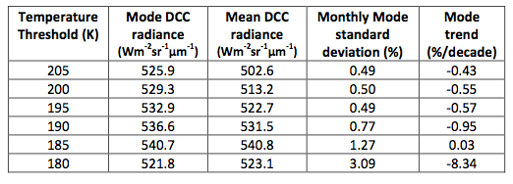
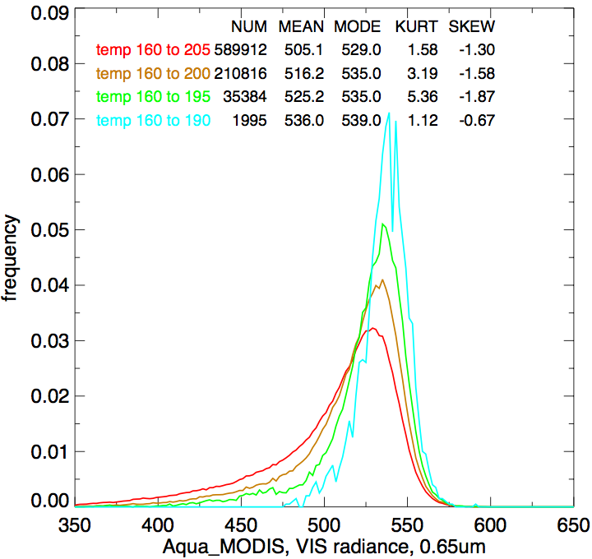
IR Temperature Threshold for DCC Identification
August 2004
Month # Mean Mode Kurtosis Skewness
• 2%, 0.6% increase in the mean, mode PDF Rad_{AC} with each 5° decrease
• 64%, 94%, 99.7% data reduction between 205°K and 200°K, 195°K, 190°K
• Sufficient samples with IR threshold between 205°K and 195°K
• Use 205°K for baseline

Slide 4
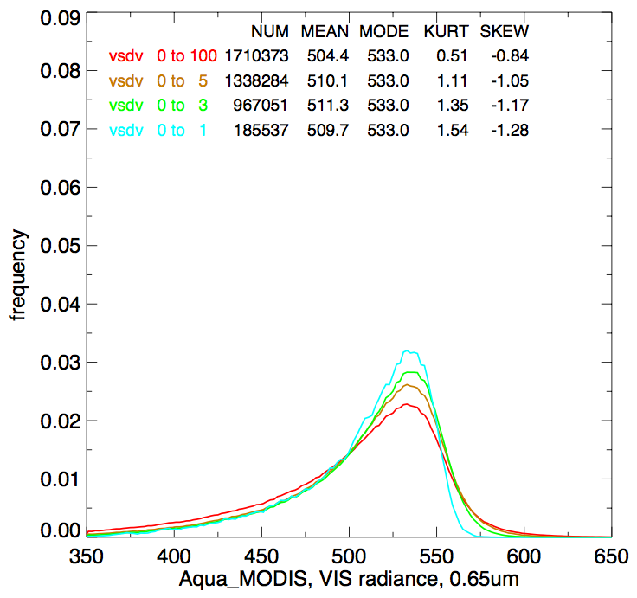
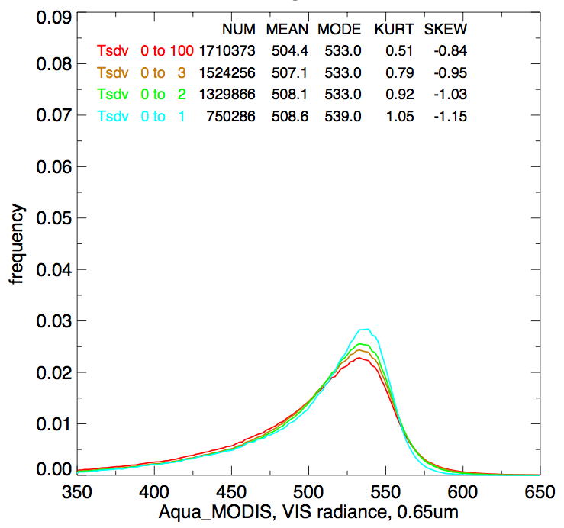
Spatial Thresholds for DCC Identification
Month # Mean Mode Kurtosis Skewness
Month # Mean Mode Kurtosis Skewness
sVIS, August 2004
sIR, August 2004
• 1.6%, 0.4% increase in the mean, mode PDF Rad_{AC} with visible spatial
• 0.8%, 0.6% increase in the mean, mode PDF Rad_{AC} with IR spatial
• 56% data reduction when applying both spatial thresholds
• If there are too few samples this criteria can be eliminated

Slide 5
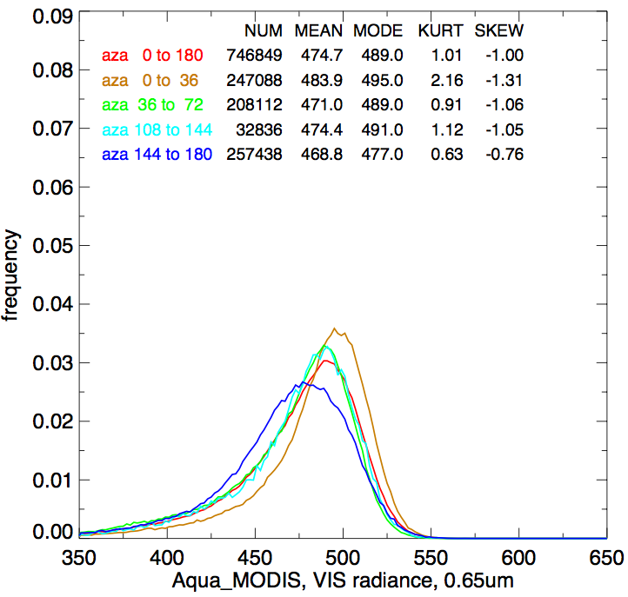
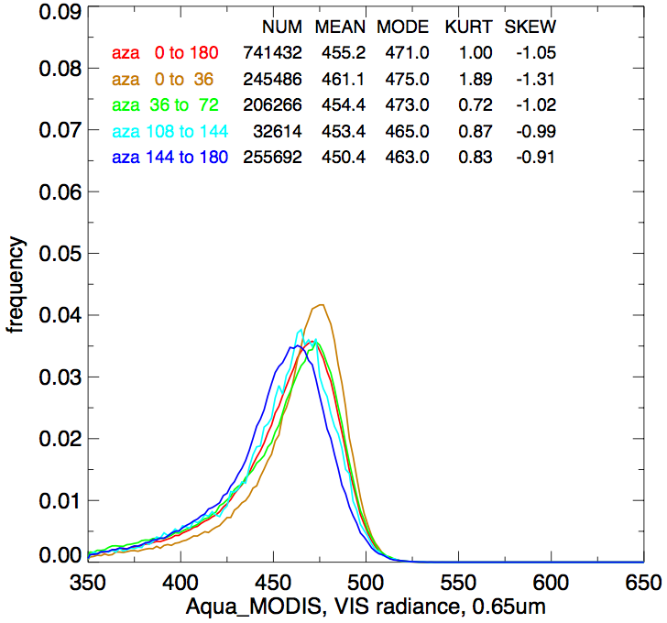
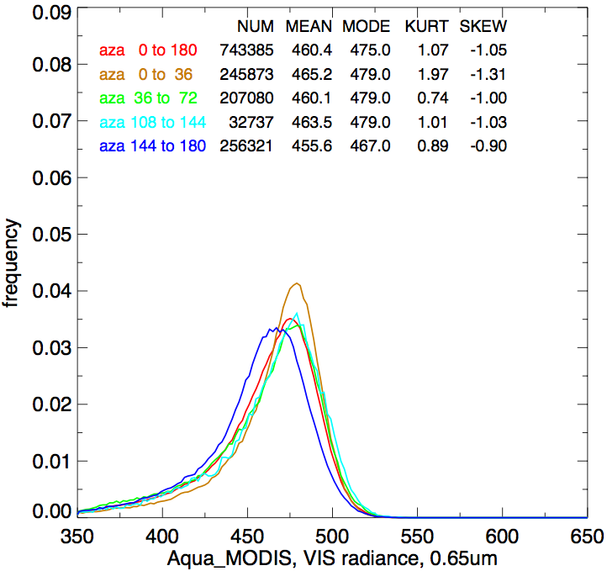
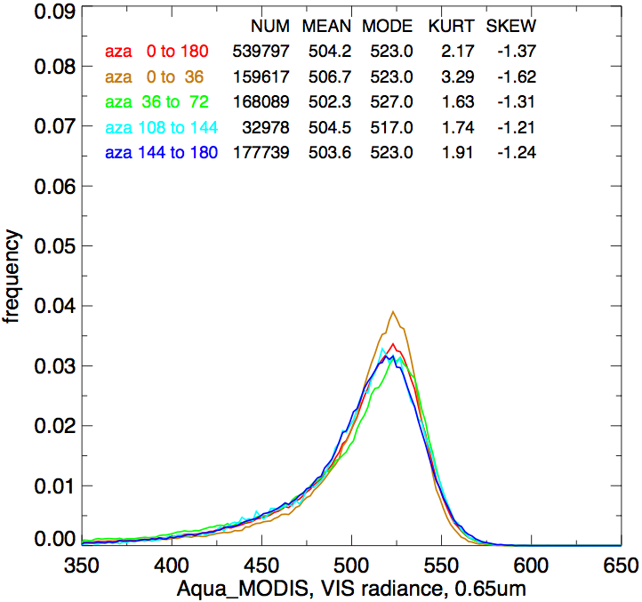
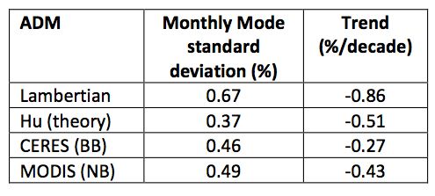
DCC ADMs
No BRDF Model
Hu Model
CERES - Broadband
MODIS based
• The DCC ADM is nearly isotropic within 40° SZA and VZA
• Seasonal spatial distributions in DCC reflectance and seasonal angular sampling variations should be annually repeatable in sun-synch and GEO orbits
• Use either Hu or MODIS

Slide 6
Implementation
Step #1: Identify GEO DCC pixels on a monthly basis
The DCC thresholds were designed to match the Aqua sampling time and domain
Not necessary to actually coincidently match Aqua DCC (DCC ray-matching)
Step #2: Convert CNT_{DCC} to overhead sun CNT_{DCCsz=0°}
Use Hu DCC bidirectional model
Step #3: Determine mode of CNT_{DCCsz=0°}
Need to empirically determine count increment
Step #4: Solve for gain, based on Aqua DCC radiance, which is spectrally adjusted to the GEO SRF
Aqua MODIS is the calibration reference
Assume a temporal degradation function and solve for the coefficients
Step #5: Derive the calibration uncertainty
Based on Aqua-MODIS calibration uncertainty, SBAF correction uncertainty, trend standard error

Slide 7
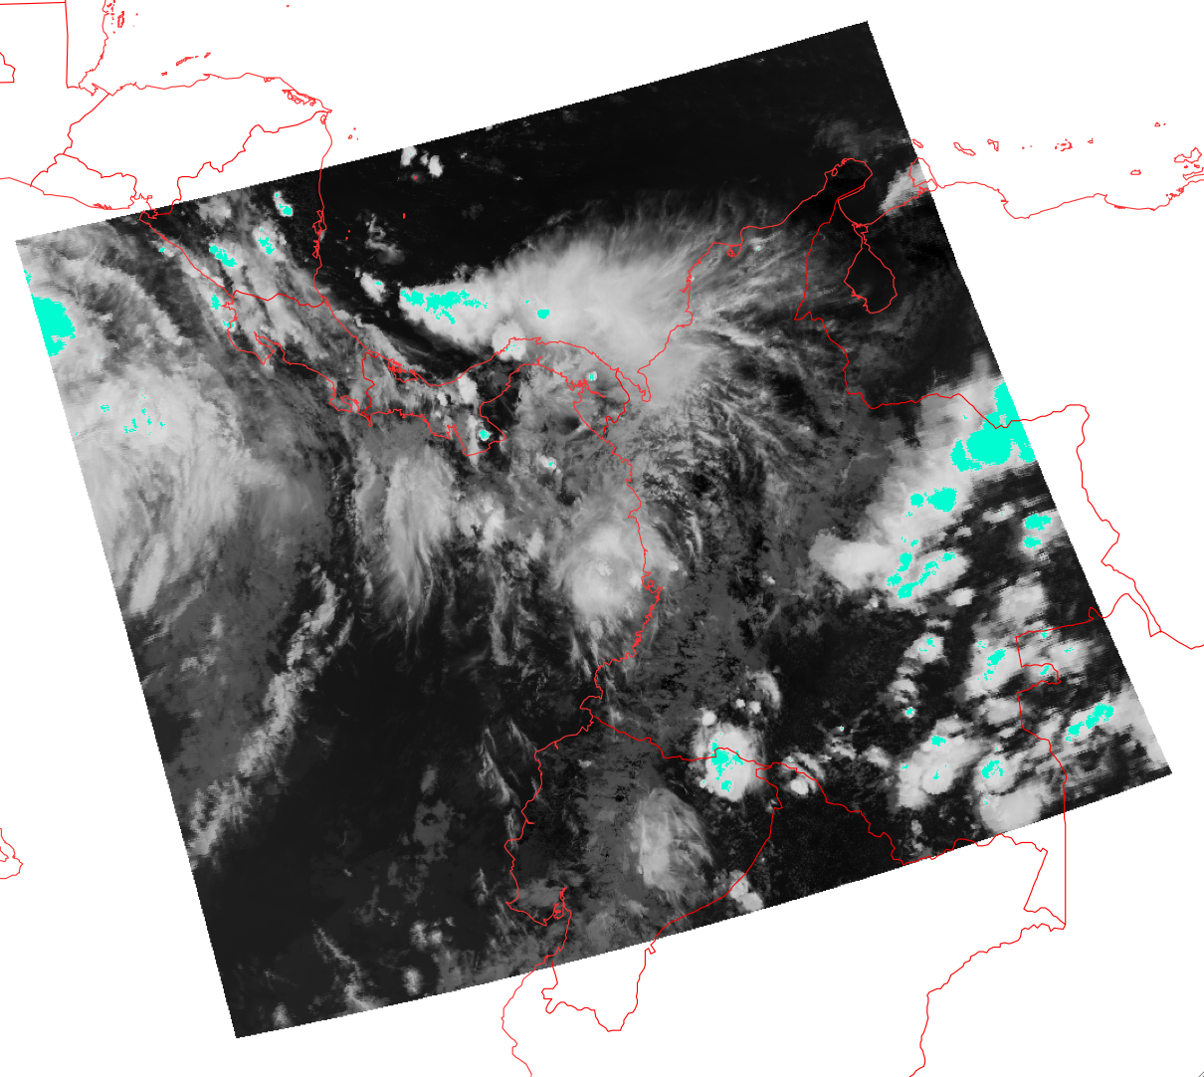
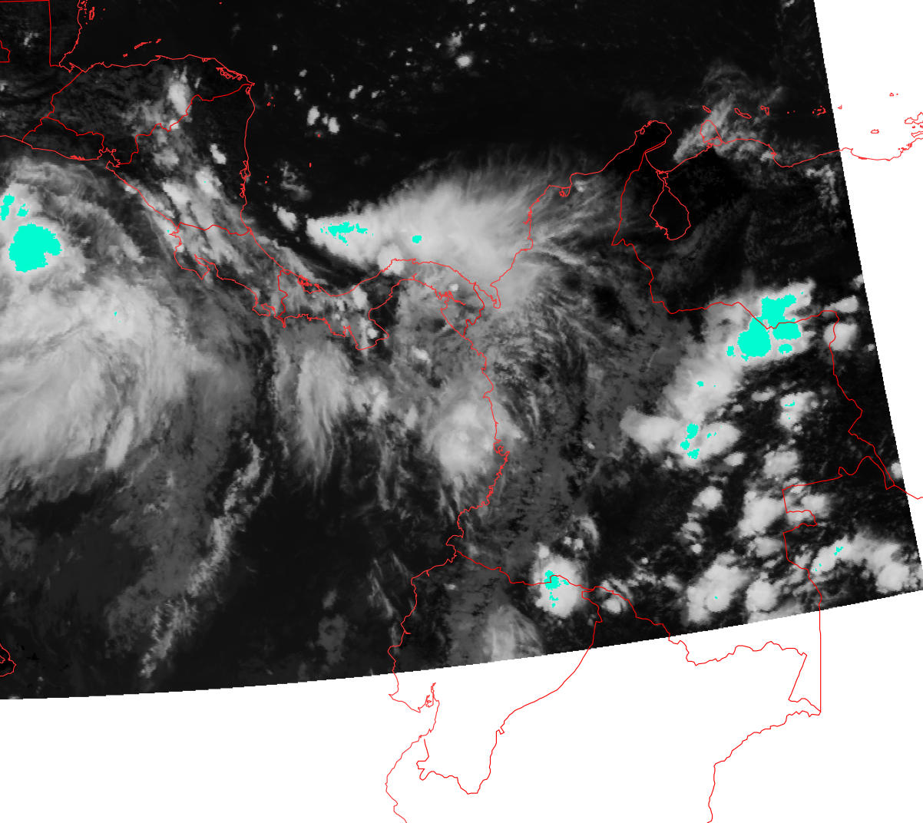
Step 1: Identify DCC
Aqua-MODIS DCC, coincident with GOES-13
GOES-13 DCC
T_{MODIS}<205°K in cyan
T_{GOES13}<206.5°K in cyan
• To illustrate that same DCC cells are being captured in both Aqua and GEO
• Loop through all lines and pixels over GEO DCC domain to capture all DCC pixels

Slide 8
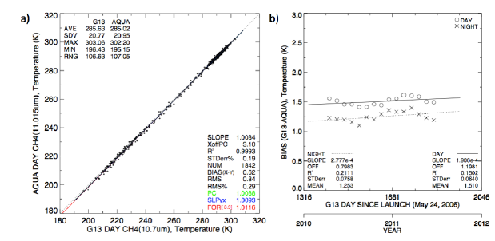
Identify DCC pixels
Try to match the Aqua identified DCCs in order to use the Aqua MODIS DCC radiance
Cycle through the images during the specified GMT range using all days of the month
Restrict the pixel selection by spatial domain, 20°N to 20°S and specified longitude, include both ocean and land
BT_{11µm} < 205°K – (T_{bias})
σ BT_{11µm} < 1°K
σ CNT/CNT < 3%
SZA<40°, VZA<40°
T_{Aqua} = slope*T_{GEO}- offset
T_{GEO} = [T_{aqua} (205°K)+offset]/slope
T_{bias} = T_{GEO}-T_{Aqua}
DCC pixel
Standard deviation based on all 9 pixels

Slide 9
DCC domain selection table
 | long_{SAT} (°) | long_{MIN}(°) | long_{MAX}(°) | GMT_{MIN}(hour) | GMT_{MAX} (hour) | T_{(GEO)} (K°)
FY2-D | 86 | 66 | 106 | 4:31 | 8:31 | varies
FY2-E | 105 | 85 | 125 | 4:31 | 8:31 | varies
GOES-11 | -135 | -155 | -115 | 20:00 | 22:30 | 206.6
GOES-13 | -75 | -110 | -55 | 17:15 | 19:45 | 206.5
MET-7 | 57 | 37 | 77 | 7:00 | 9:30 | 203.6
MET-9 | 0 | -20 | 20 | 11:15 | 13:15 | 205.4
MTSAT-2 | 145 | 125 | 165 | ~1:30 | ~3:30 | 205.2

Slide 10
Step 2: Convert DCC counts to overhead sun
For each month save the DCC identified pixels
CNT, sza, vza, raz, BT_{11µm} ,σ BT_{11µm},σ CNT, …
Usually 100K to 1000K pixels saved per month
Convert the DCC counts to overhead sun
Use Hu DCC BDRF model
Set up a frequency histogram using suggested count increment (P_{del})
Determine mode of histogram using bin with the most counts
This is the monthly CNT_{nadir}

Slide 11
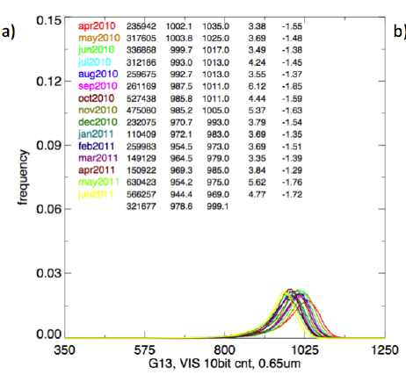
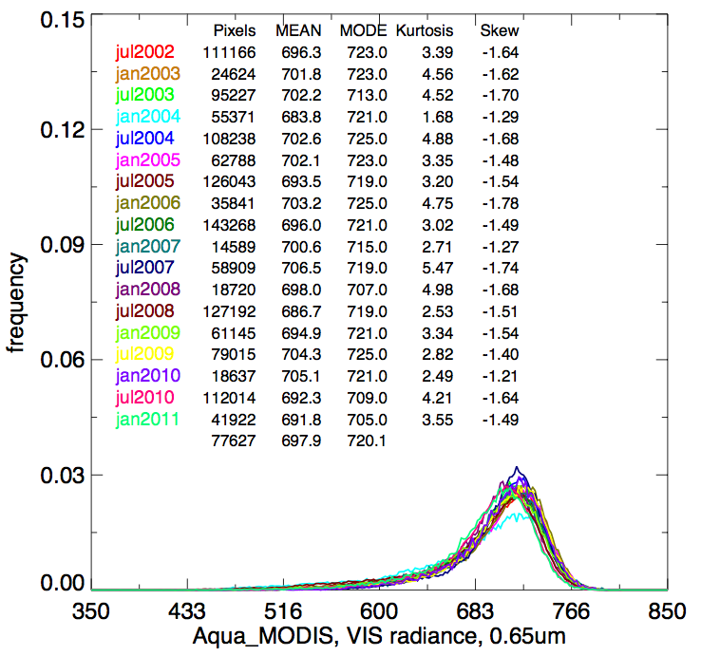
Step 3: Find mode of DCC nadir radiance over month
Aqua-MODIS over GEO domain
GOES-13 over GEO domain
Use CERES BRDF for both GEO and Aqua-MODIS DCC radiances to derive DCC nadir radiance and GEO count (count unit proportional to radiance)

Slide 12
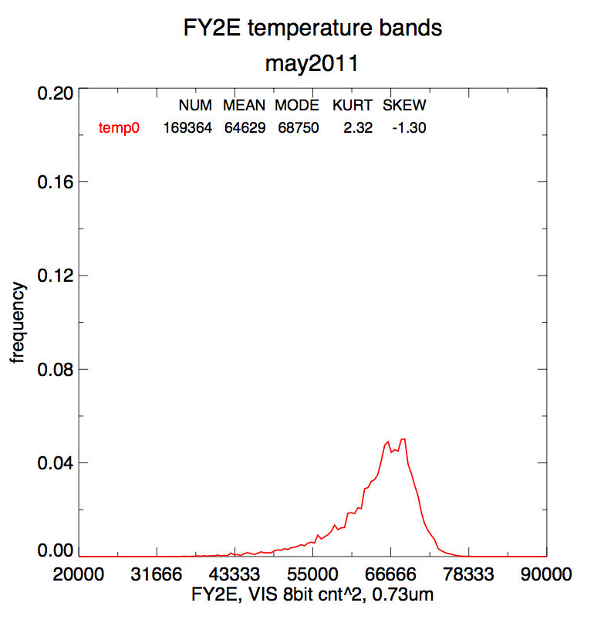
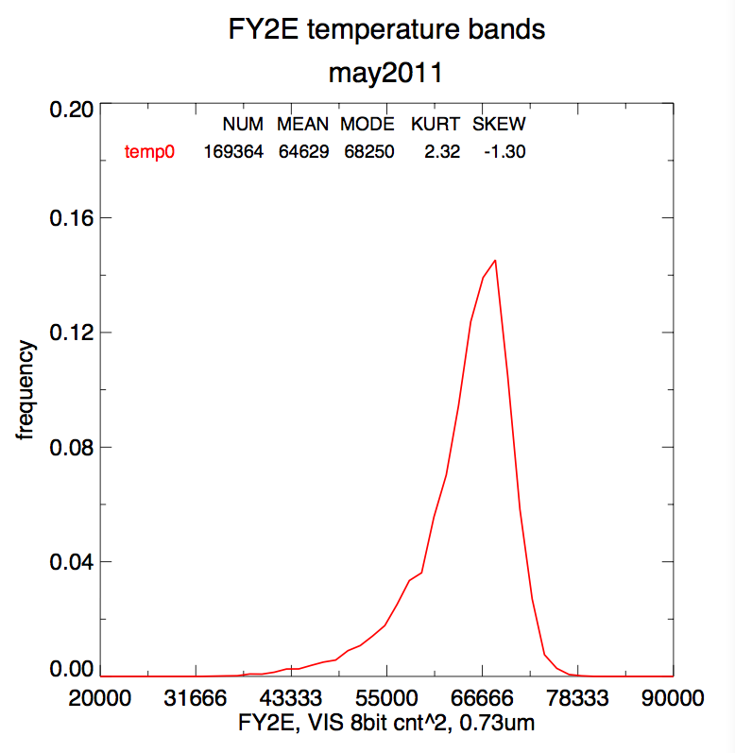
Example of P_{del} increments
P_{del} too small (500)
P_{del} =1500

Slide 13
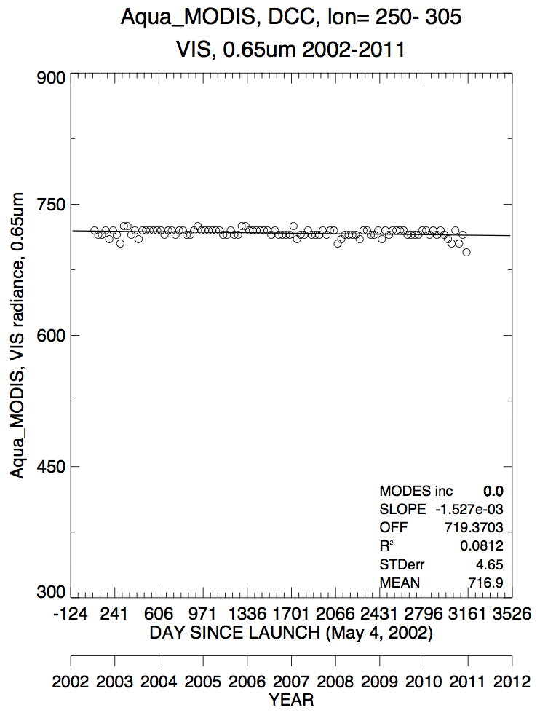
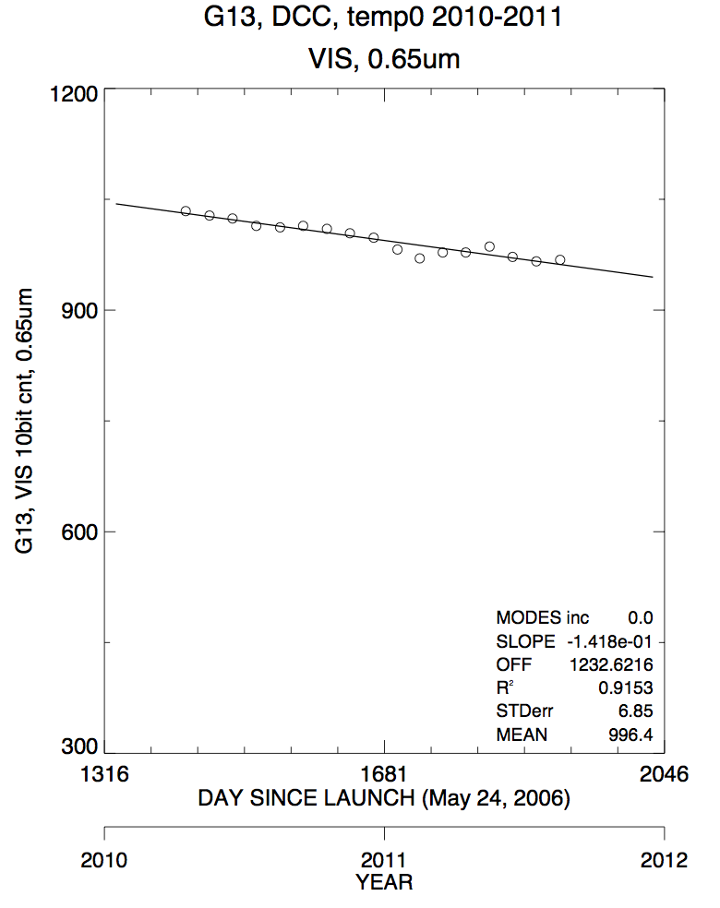
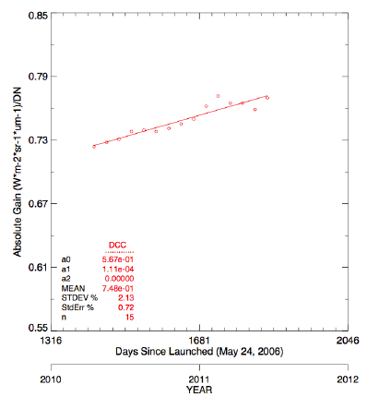
Step 4: Use Aqua DCC radiance to derive GEO gain
Aqua Rad_{nadir}
G-13 CNT_{nadir}
G-13 gains
• The gain is factor needed to produce the Aqua DCC radiance with the GEO DCC nadir count
• The Aqua Rad_{nadir} has no seasonal cycle but is dependent on MODIS stability. Jack claims that the MODIS calibration is best known in the first 3-years after launch.
• Use a 3-year or lifetime mean Aqua Rad_{nadir} to base GEO gain on

Slide 14
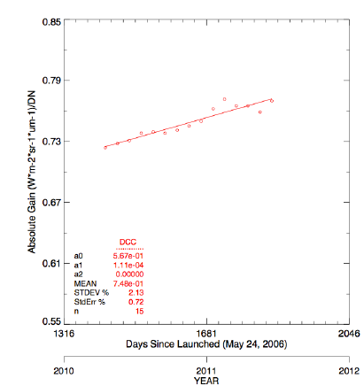
Solve for monthly gain
GOES-13 monthly CNT_{nadir}(mode)
GOES-13 Monthly Gains
DCC does have natural variability, assume linear temporal degradation function and solve for the coefficients
Standard error about degradation function is the uncertainty due to DCC natural variability

Slide 15
Aqua calibration transfer
When using an Apriori DCC model
• Calibration transfer assumes that the same DCC are captured between Aqua and GEO
• Not necessarily the same angular matches
• Need to validate by using DCC ray-matching
When using an Aqua-MODIS collection 6 DCC BRDF model
• Calibration transfer assumes that the GEO count in a angular bin should equal the Aqua BRDF model radiance
• Only angles that are used in the Aqua BRDF model are used
• Need to build over each GEO domain with first 3-years of data
• Need to validate by using DCC ray-matching

Slide 16
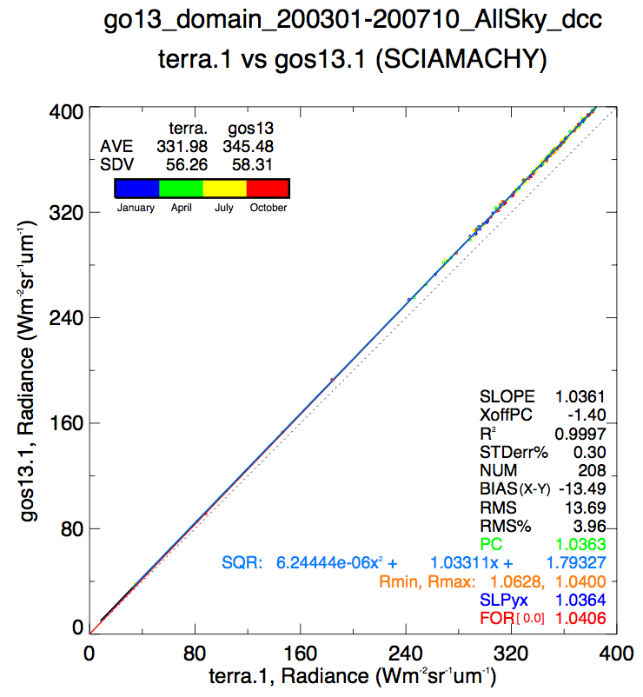
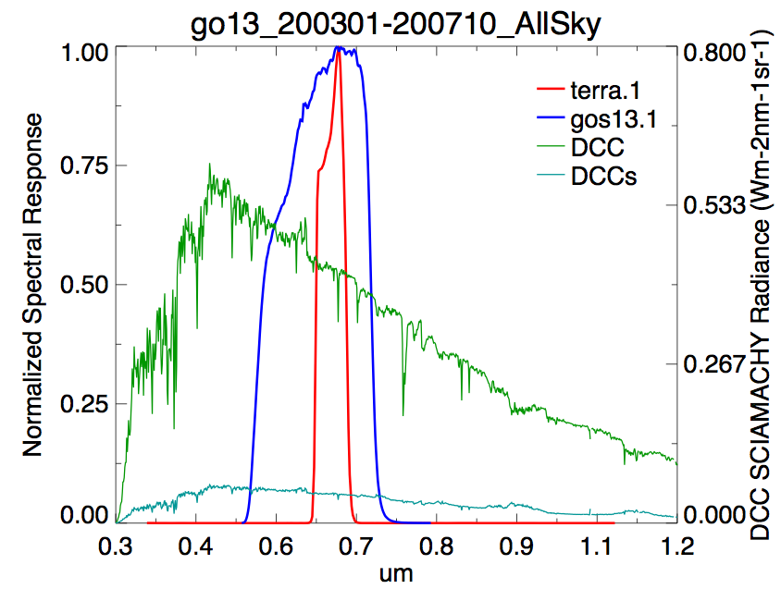
Use SCIAMACHY to spectrally adjust the Aqua radiance to GEO
• SCIAMACHY is a hyper-spectral imager designed for trace gas studies
• SCIAMACHY calibration is stable against MODIS
• Derive the GEO and Aqua-MODIS pseudo radiance based on convolved SCIAMACHY hyper-spectral radiances and derive the spectral band adjustment factor
• The adjustment factor is nearly linear across the radiance dynamic range

Slide 17
DCC selection table
 | Pdel cnts | Aqua DCC radiance Wm⁻²sr⁻¹µm⁻¹ | Aqua DCC radiance*SBAF Wm⁻²sr⁻¹µm⁻¹
FY2-D | 1300. | -------- | -------
FY2-E | 1500. | 712.3 | 609.5
GOES-11 | 5. | 717.5 | 701.9
GOES-13 | 2. | 716.9 | 746.0
MET-7 | 2. | 714.8 | 624.7
MET-9 | 2. | 718.1 | 730.8
MTSAT-2 | 5. | 713.2 | 668.7
The Aqua DCC radiance is within 0.8% across all GEOs
The 10-year Aqua DCC monthly radiance trend is between -0.5% to -1.0% across all GEOs and the standard error is between 0.6% and 1.2% validating that both DCC and Aqua are stable

Slide 18
Derive GEO gain uncertainty
GEO (%) | Aqua-MODIS absolute calibration* | SBAF | Trend | Total Uncertainty
FY2-D | 1.64 | 0.47 | 1.2 | 2.1
FY2-E | 1.64 | 0.86 | 1.1 | 2.2
GOES-11 | 1.64 | 0.40 | 0.9 | 1.9
GOES-13 | 1.64 | 0.30 | 0.7 | 1.8
MET-7 | 1.64 | 0.69 | 1.0 | 2.1
MET-9 | 1.64 | 0.08 | 0.7 | 1.8
MTSAT-2 | 1.64 | 0.68 | 0.7 | 1.9
• Trend is based on the standard error from monthly gains provides the DCC natural variability over the GEO domain
• Aqua-MODIS absolute calibration uncertainty
Based Xiong et al during GSICS 2011 annual meeting 1.64%

Slide 19
Suggested Way Forward
Work with Sebastien to settle on a baseline algorithm
Obtain the Met-9 gain using Hu DCC BRDF, MODIS DCC BRDF, and ray-matching to determine uncertainty in the Aqua-MODIS calibration transfer using DCC
Hopefully in a month or two finalize method with Sebastien

