Slide 1
Characterization of Sonoran Desert for GOES Imager Visible Vicarious Calibration - Some Early Results and lessons learned
Fangfang Yu, Xiangqian Wu and Haifeng Qian

Slide 2
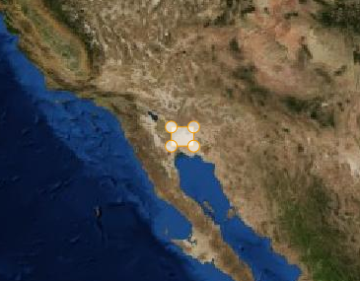
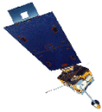
Sonoran Desert
The only desert that can be observed by both GOES-West (135W) and GOES-East (75W)
Served as the operational calibration target for GOES-8 and 10 Imager visible channels
http://www.oso.noaa.gov/goes/goes-calibration/vicarious-calibration.htm
The operational target switched to Terra MODIS in 2004
http://www.star.nesdis.noaa.gov/smcd/spb/fwu/homepage/GOES_Imager_Vis_OpCal.php
ENSO effect
Revisit the Sonoran desert calibration in 2012 for the GSICS project
Traceable to Aqua MODIS C6
Combined method

Slide 3
Challenges
Target characterizations for trending purpose; predictable and traceable to Aqua MODIS C6 data
Spatial – spatial distribution observed by the instrument; fixed boundary vs. moving boundary
Temporal - diurnal/seasonal/long-term observations
Spectral – hyper-spectral data for the SBAF
Directional – BRDF model/measurements
Image processing – determine the reflectance/radiance/irradiance to represent the target
Target reflectance, traceable to Aqua MODIS C6
Spectral band adjustment factor (SBAF)
Bidirectional reflectance distribution faction (BRDF)
Degradation function

Slide 4
Sonoran Desert
Operational calibration for GOES-8/10 Imager visible channels
34.0N, 114.1W (Rao, 2001, http://www.oso.noaa.gov/goes/goes-calibration/vicarious-calibration.htm)
GOES-R ABI risk-reduce project
32.0N, 114.39W, ROI: 20kmx20km (Uprety and Cao, 2012, JARS)
MODIS vicarious calibration project
32.25N, 114.65W, ROI:15kmx15km (Angal et al. 2010, JARS)

Slide 5
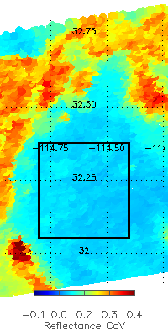
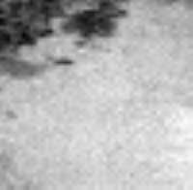
Sonoran Desert
MODIS image: 50x50km
[32.05N-32.37N, 114.4W-114.8W]
Seasonal variability
[32.05N-32.65N, 114.4W-114.8W]
25 pixels
Subset data available since 1998
GOES image
50x49 pixels

Slide 6
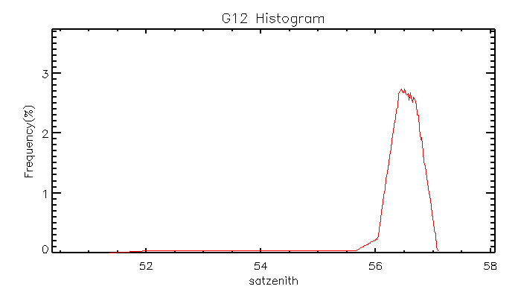
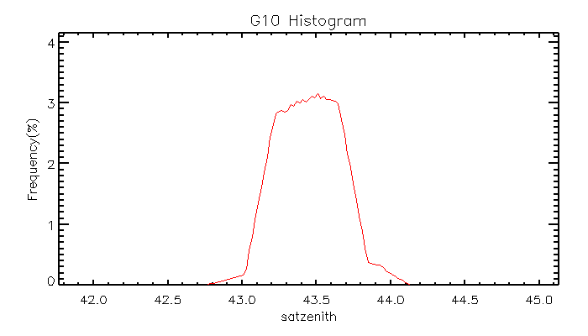
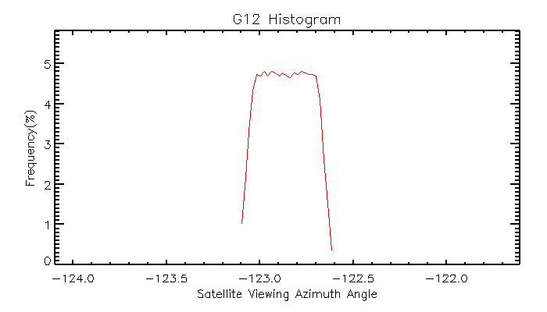
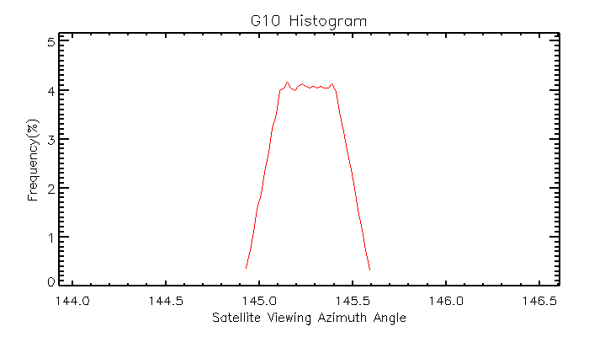
Viewing Geometry - GOES
GOES-East
GOES-West

Slide 7
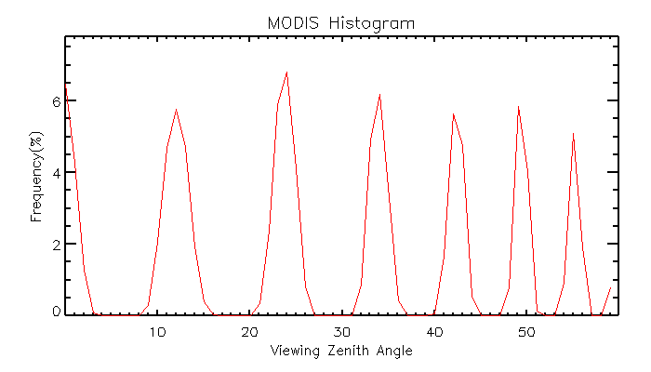
Viewing Geometry – Aqua MODIS

Slide 8
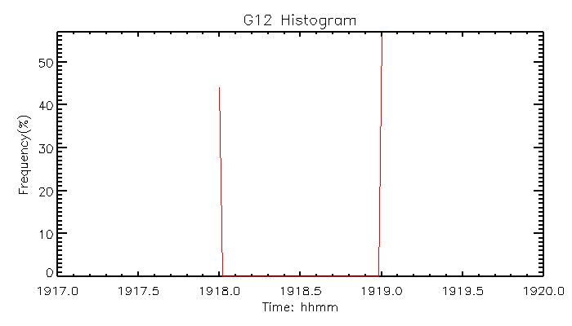
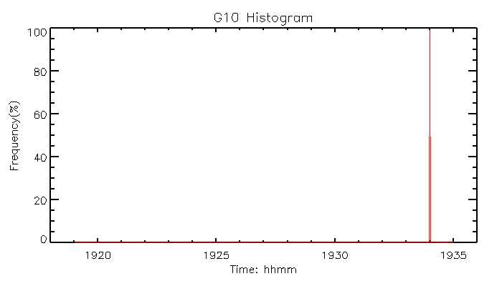
Observation Time Difference
GOES-West
GOES-East
> 1 hour observation time difference

Slide 9
Ray-matching method?
Cannot apply strict ray-matching threshold for the collocations
Small viewing zenith angle difference
1-2 hours difference -> large solar zenith angle difference
Azimuth angle difference can be relatively small at GOES-East, yet relative viewing azimuth angle ~60º at GOES-West
BRDF correction

Slide 10
Screening of Vegetation and Cloud contaminated pixels
Yu and Wu, 2008, JTECH

Slide 11
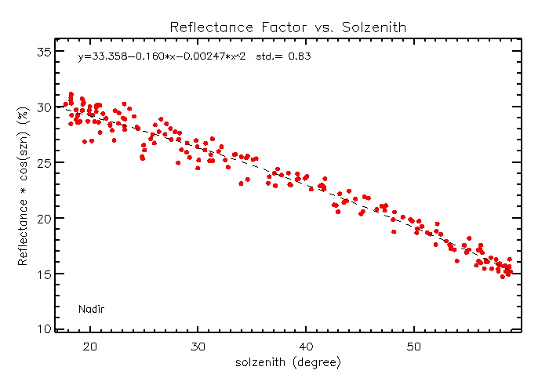
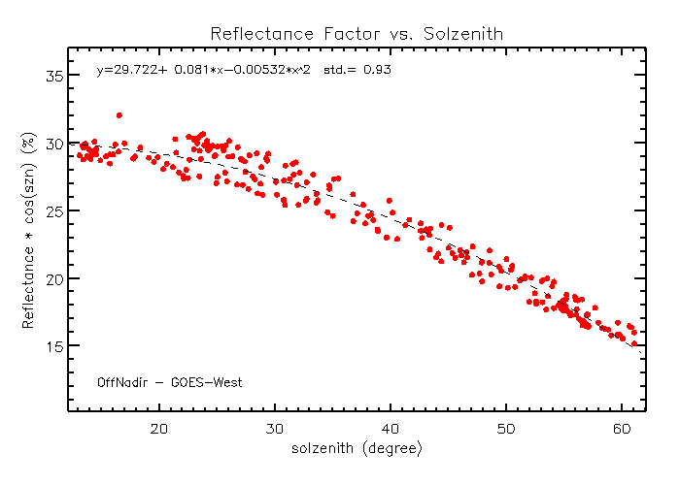
BRDF Correction – Impact of SZN

Slide 12
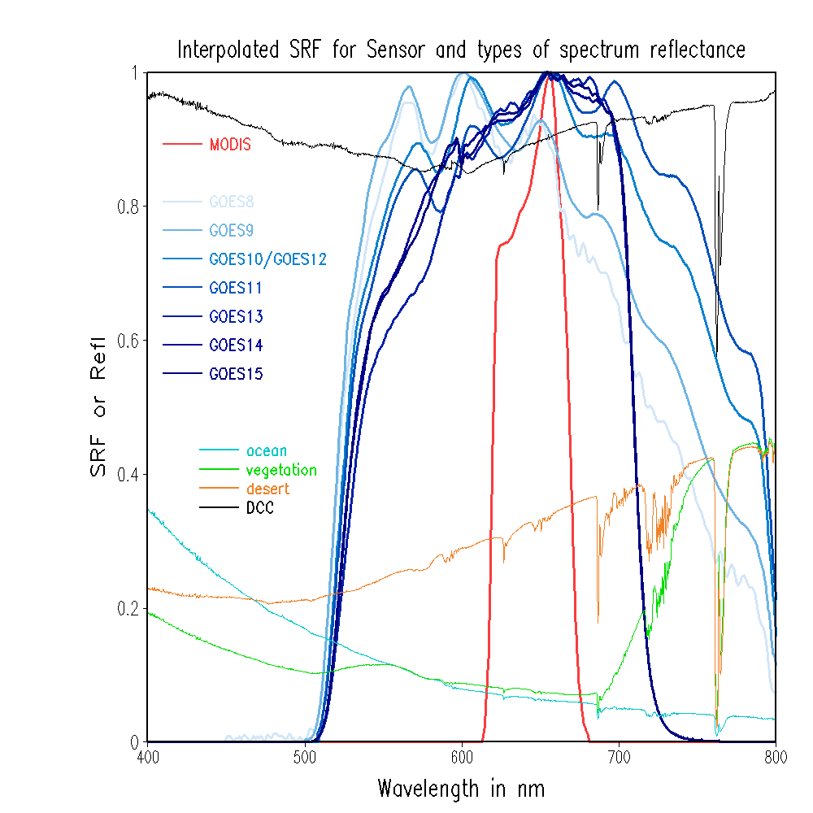
GOES Imager Visible SRFs and Atm. Trans.

Slide 13
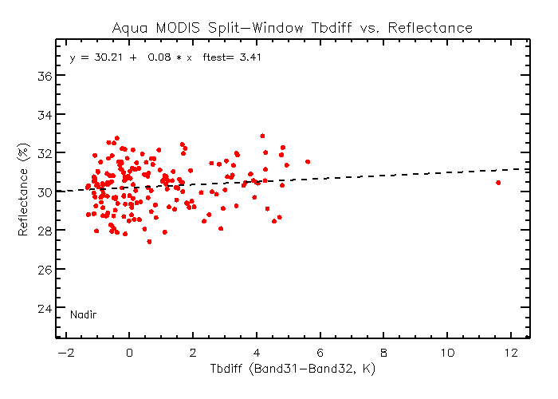
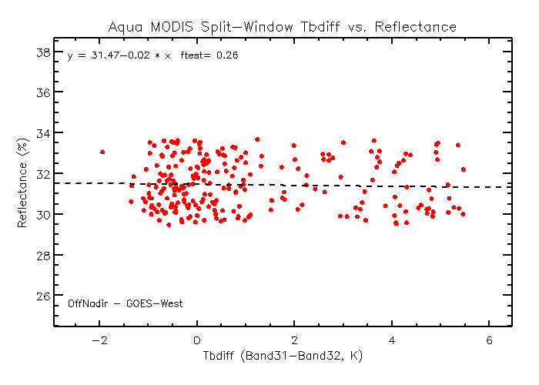
Sensitivity to Dynamic Atmospheric Components

Slide 14
Seasonal Variation
Aqua MODIS C6 in 2008

Slide 15
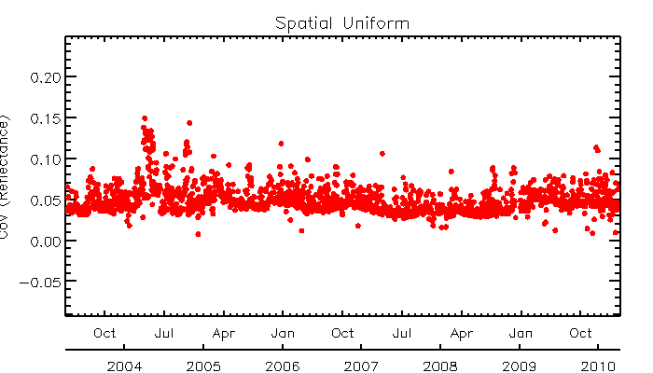
Spatial Uniformity
GOES-10
GOES-12
Wet year
?
Cause of sudden change of surface spatial heterogeneity in late 2002, instrument, desert surface or atm. change?

Slide 16
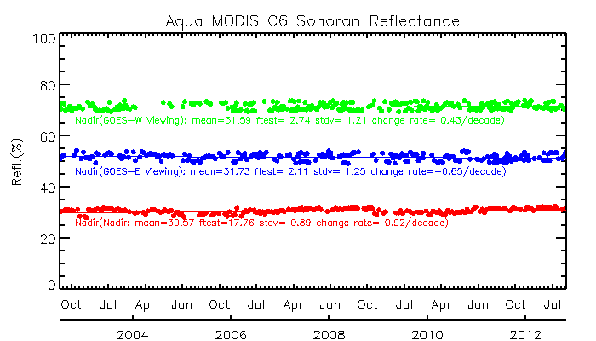
Long-term stability
Before BRDF correction
After BRDF correction

Slide 17
GOES Imager Visible SRFs and Atm. Trans.

Slide 18
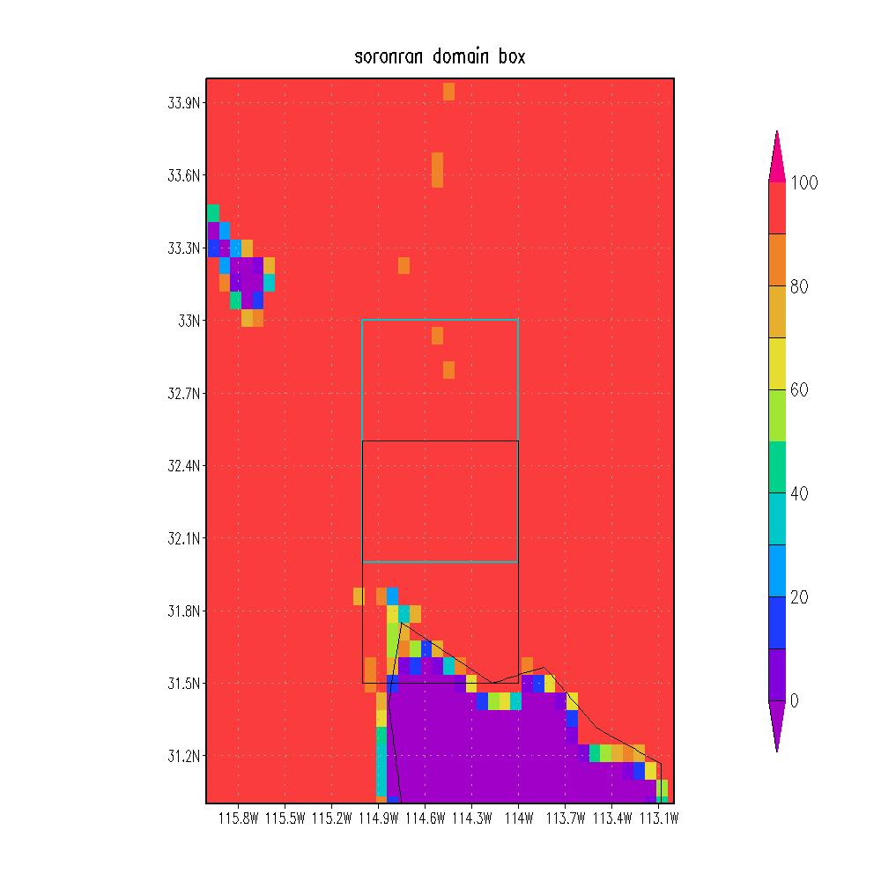
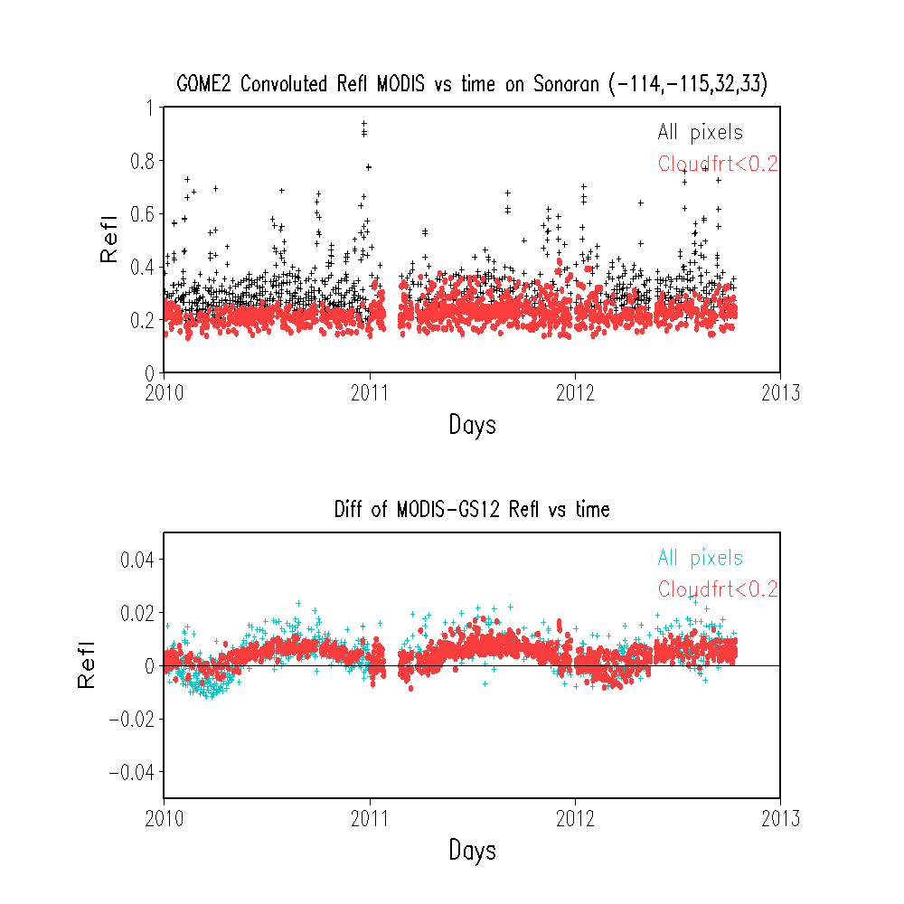
GOME and SCIAMACHY are not appropriate to generate SBAF at the Sonoran Desert
now working with the Hyperion data

Slide 19
Summary
Use of the sub-area [32.05-32.37N, 114.4-114.8W] as the reference
Low seasonal variation, avoid of vegeted pixels
Sonoran desert (sub-area) is long-term stable
Sudden change of spatial uniformity pattern can be found in 2002.
Root cause unknown
Hyperion data should be used to generate the spectral band adjustment factor
An accurate BRDF model is needed to account for the impact of different viewing geometry.

