Slide 1
Extraction of Moon “imagettes” from MSG data
Current Status
Bartolomeo Viticchiè, Tim Hewison, and Sebastien Wagner

Slide 2
Briefly on the Extraction Procedure
Download Level 1.5 Header and Trailer (e.g., on a monthly base)
Check the availability of the Moon in Level 1.0 data by using the Level 1.5 Header and send the order of Level 1.0 data for the cases in which the Moon is available in the FOR (hereafter “Moon cases”; cannot exclude the presence of the Sun).
Pre-extraction Phase (via info available in the HEADER)
  Check on the quality of the Level 1.0 data in each channel
  Check on the availability of the Moon (to handle “Sun cases”)
Location of the Moon within the SEVIRI Level 1.0 low-res Images
  Re-alignment of the Earth Image (correction for the satellite jitter)
  Location of the SSP using horizon detection
  Location of the Moon with respect to the Earth:
    Check on the position of the Moon in the FOR (to handle partial occultation due to the Earth, stray-light effect when too close to the Earth limb, and Moon not completely in the FOR)
  Extraction
    Location of the Moon within the SEVIRI Level 1.0 HRVIS Images
Re-alignment of the Moon images (correction for the relative motion Moon-MSGs)
Conversion from Level 1.0 DC to Level 1.5 Radiances (.sav files + .gif images)
.sav files used to produce binary files for Tom Stone (.ps plots)

Slide 3
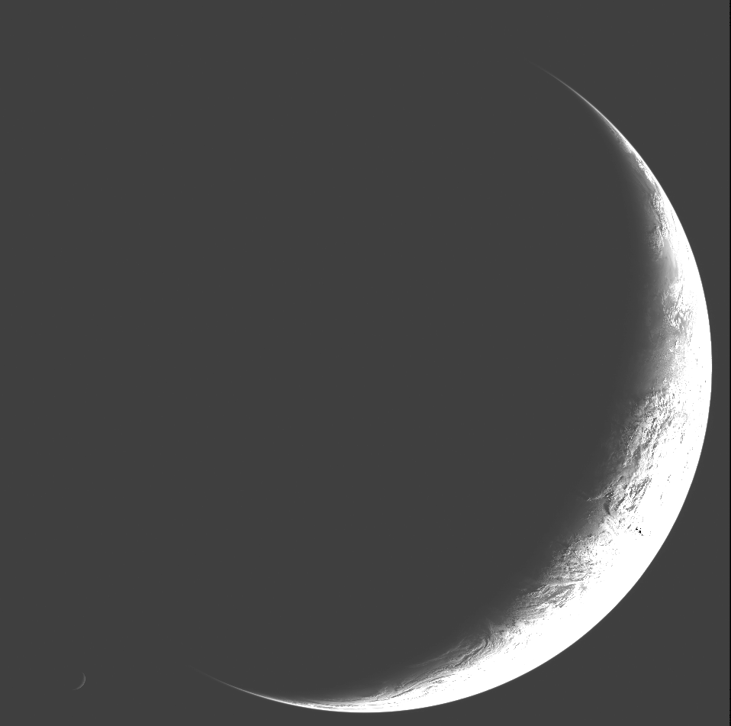
Moon extraction: an example [MSG1 200501140330]
MSG1/SEVIRI VIS 06 data clipped between [min(Image), max(Image)/5]
Moon available and in a good position

Slide 4
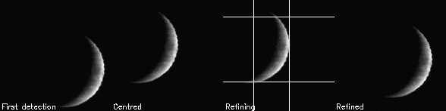
Moon extraction: an example [MSG1 200501140330]
MSG1/SEVIRI VIS 06 Moon “imagette” extraction procedure (after Moon re-alignment)
1
2
3
4
First detection
via Chebyshev polynomials

Slide 5
Moon extraction: an example [MSG1 200501140330]
MSG1/SEVIRI VIS 06 Moon “imagette” extraction procedure (after Moon re-alignment)
1
2
3
4
First detection
via Chebyshev polynomials

Slide 6
Moon extraction: an example [MSG1 200501140330]
MSG1/SEVIRI VIS 06 Moon “imagette” extraction procedure (after Moon re-alignment)
1
2
3
4
First detection
via Chebyshev polynomials
Centering
based on the barycentre of illuminated portion

Slide 7
Moon extraction: an example [MSG1 200501140330]
MSG1/SEVIRI VIS 06 Moon “imagette” extraction procedure (after Moon re-alignment)
1
2
3
4
First detection
via Chebyshev polynomials
Centering
based on the barycentre of illuminated portion
Refining
based on the illumination properties
the less the Moon is illuminated the more the barycentre gets close to the Moon edge

Slide 8
Moon extraction: an example [MSG1 200501140330]
MSG1/SEVIRI VIS 06 Moon “imagette” extraction procedure (after Moon re-alignment)
1
2
3
4
First detection
via Chebyshev polynomials
Centering
based on the barycentre of illuminated portion
Refining
based on the illumination properties
the less the Moon is illuminated the more the barycentre gets close to the Moon edge
Refined centering
so to have the complete Moon in the imagette

Slide 9
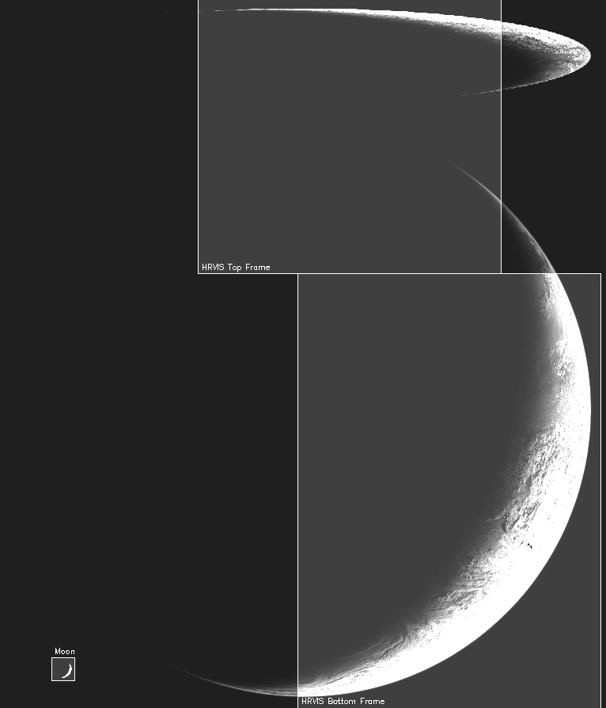
Moon extraction: an example [MSG1 200501140330]
HRVIS frames and Moon “imagette” on MSG1/SEVIRI VIS 06 data clipped between [min(Image), max(Image)/5]
By using the information available in the header we can evaluate whether the Moon is in the available in the HRVIS

Slide 10
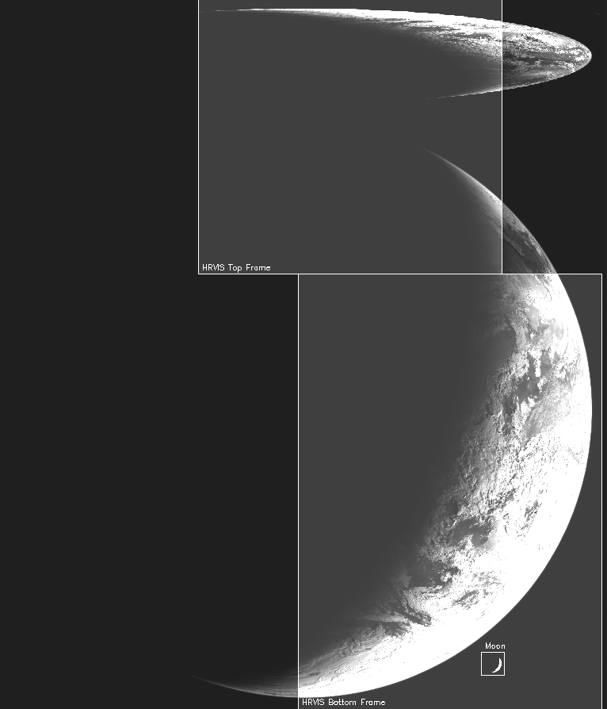
Moon extraction: an example [MSG1 200501140430]
HRVIS frames and Moon “imagette” on MSG1/SEVIRI VIS 06 data clipped between [min(Image), max(Image)/5]
By using the information available in the header we can evaluate whether the Moon is in the available in the HRVIS
ONE HOUR LATER THE MOON IS AVAILABLE IN THE HRVIS BOTTOM FRAME!

Slide 11
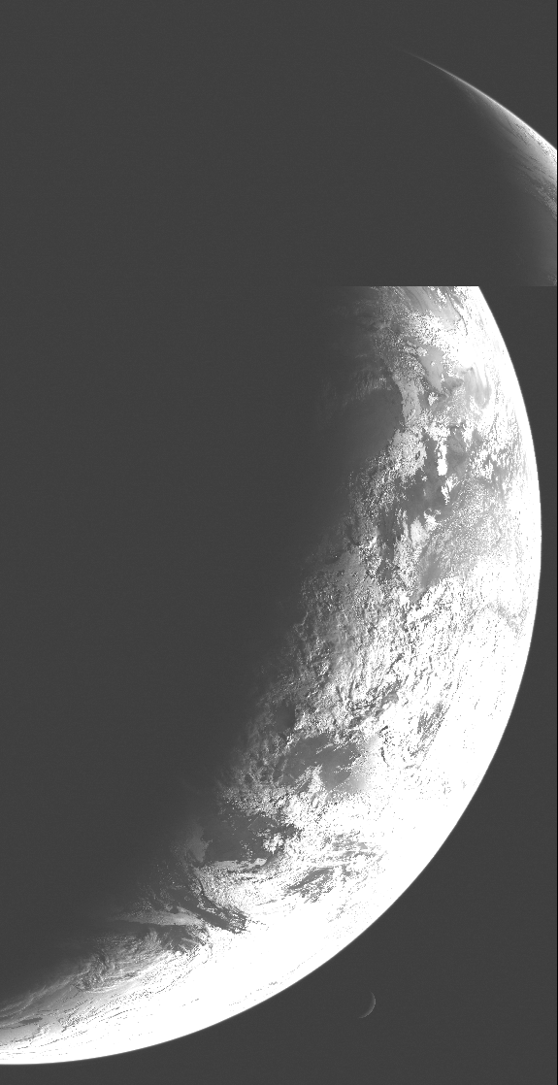
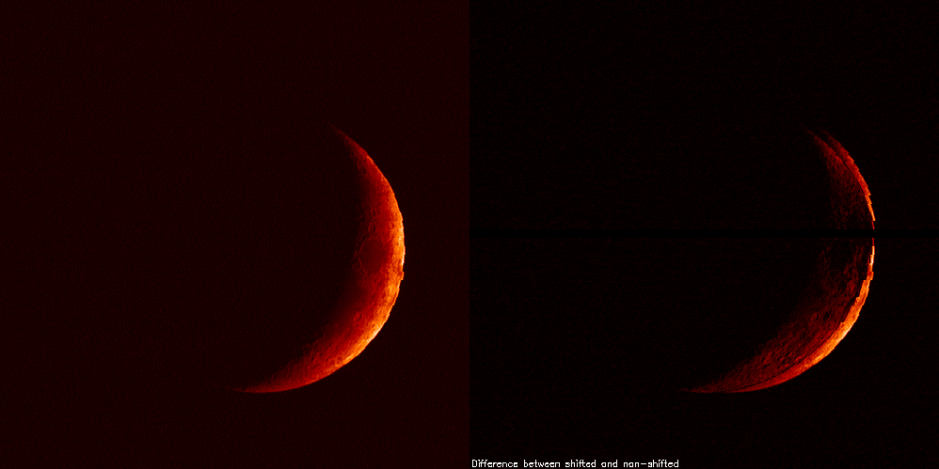
Moon extraction: an example [MSG1 200501140430]
MSG1/SEVIRI HRVIS Moon “imagette” (after Moon re-alignment)
Effect of the re-alignment for the relative motion between the Moon and MSG1
MSG1/SEVIRI HRVIS data clipped between [min(Image),max(Image)/5]

Slide 12
Moon extraction: an example [MSG1 200501140430]
MSG1/SEVIRI HRVIS Moon “imagette” (after Moon re-alignment)
Effect of the re-alignment for the relative motion between the Moon and MSG1

Slide 13
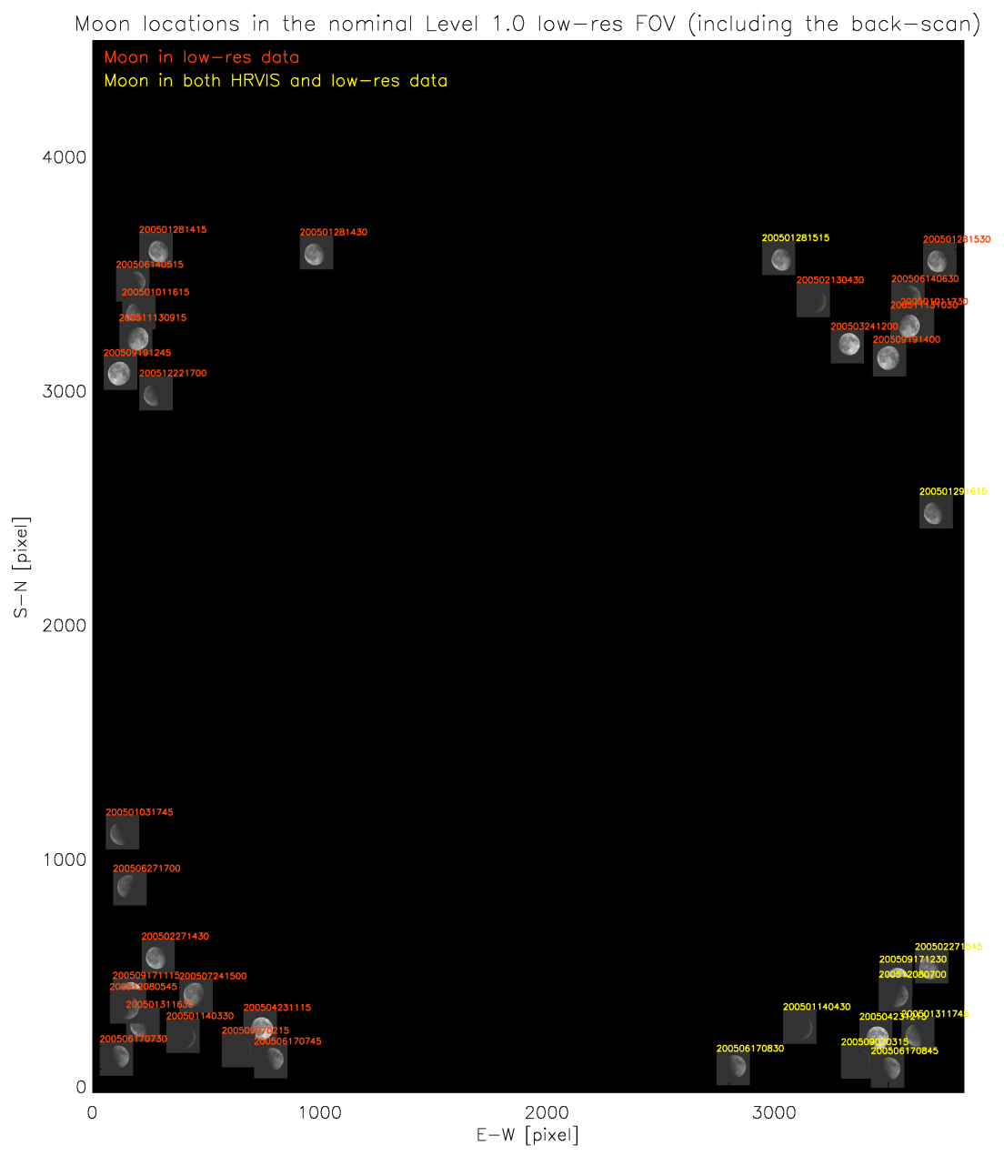
Moon in 2005 for MSG1

Slide 14
Moon in 2005 for MSG1
Fixed HRVIS bottom frame

Slide 15
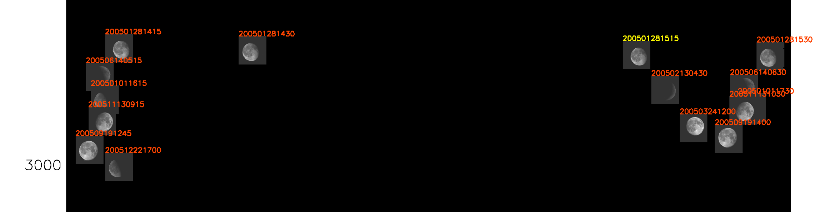
Moon in 2005 for MSG1
MSG1/SEVIRI HRVIS Moons (North hemisphere)

Slide 16
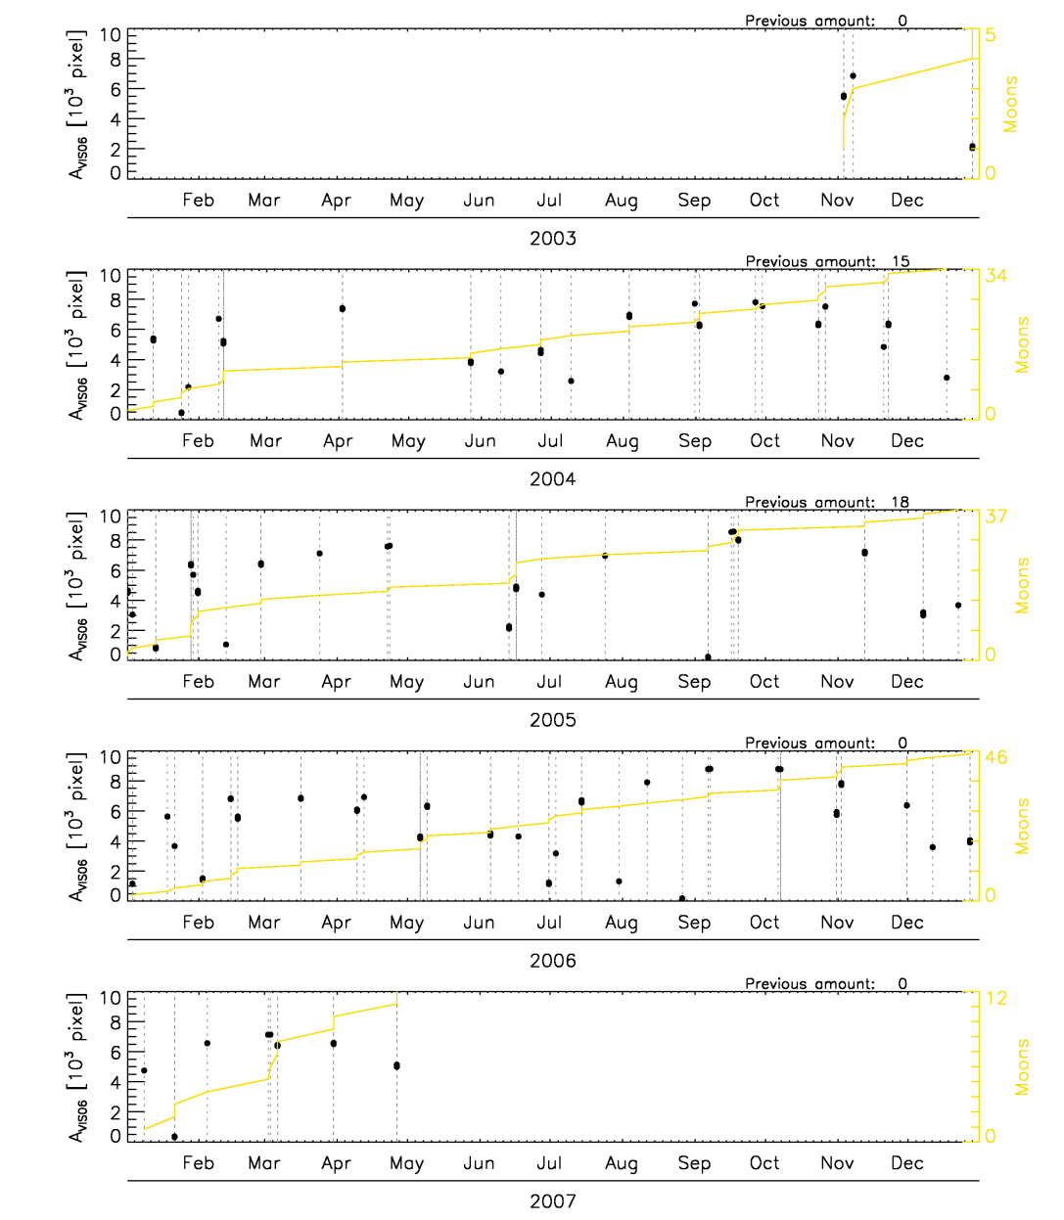
Moon in MSG1 low-res
MSG1/SEVIRI VIS06 Moon’s area as a function of the Julian day of extraction
Cumulative number of Moon

Slide 17
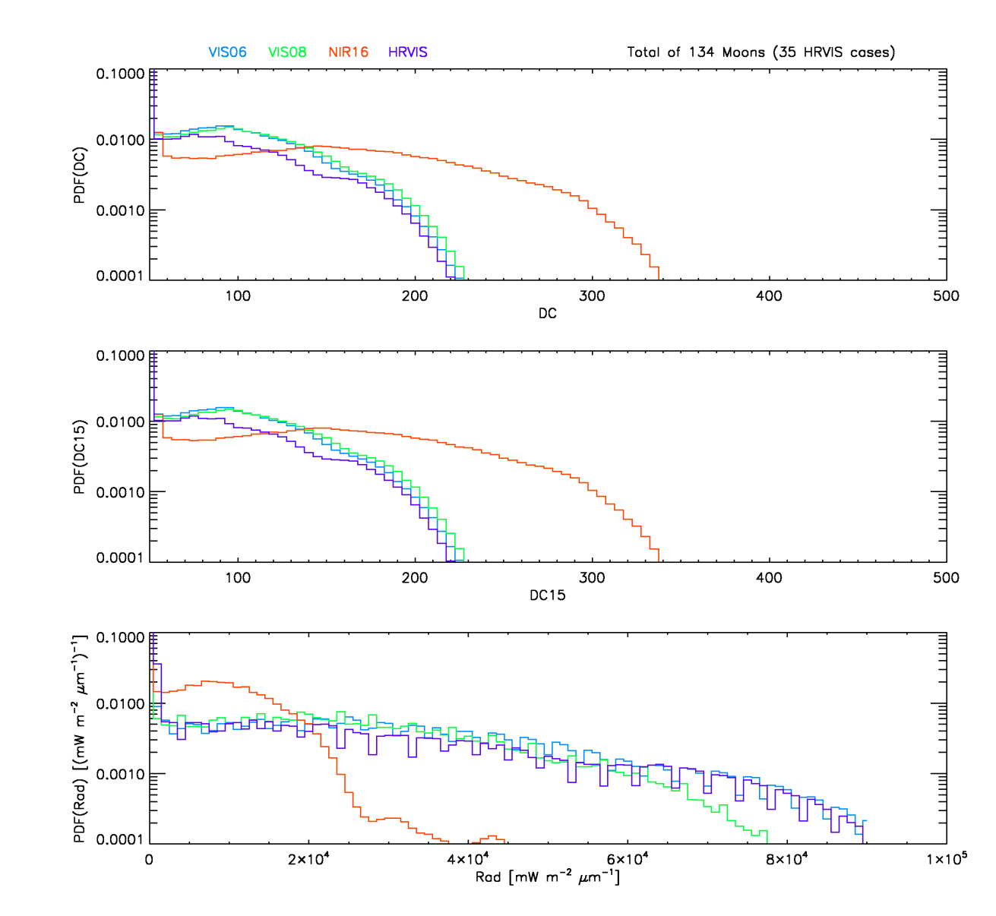
Moon in MSG1 low-res
MSG1/SEVIRI PDFs for Level 1.0 DC, Level 1.5 DC, and Level 1.5 Radiances

Slide 18
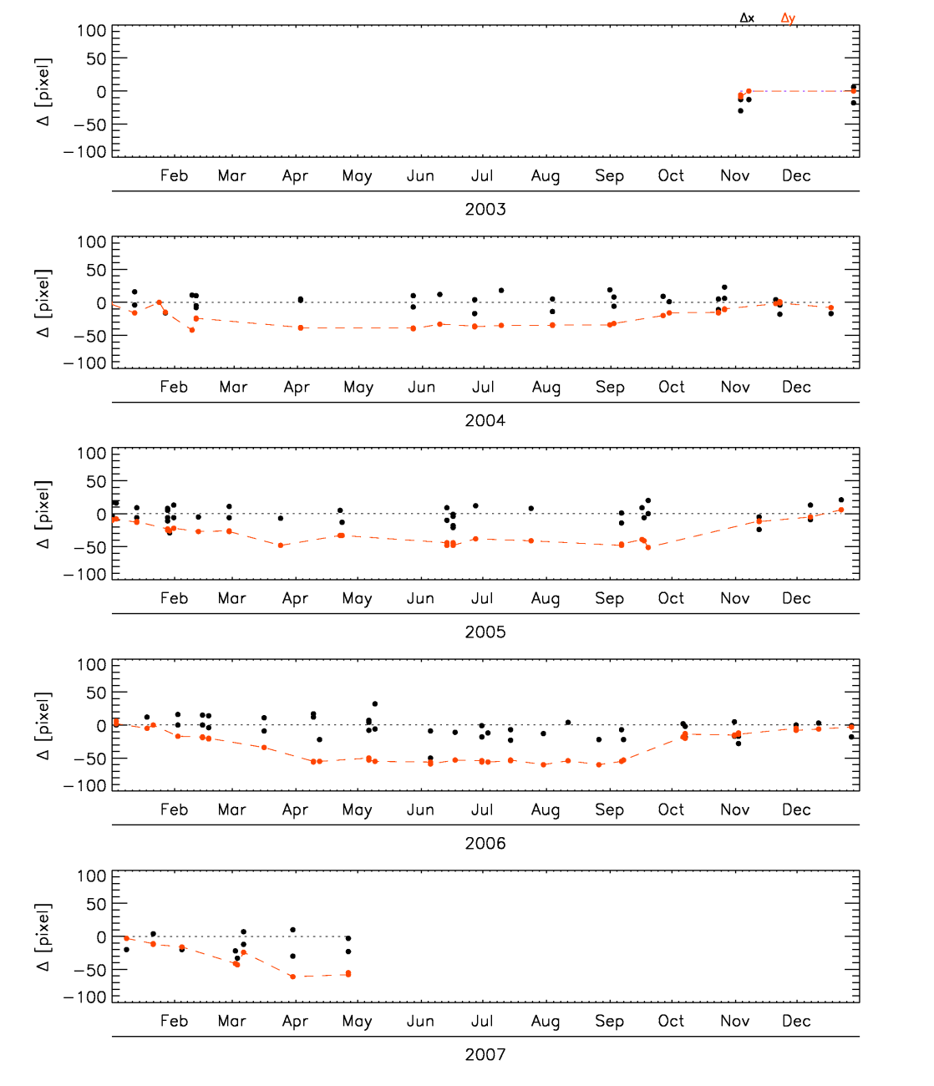
Moon in MSG1 low-res
Navigation error evaluated as the difference between the position of “imagettes” centre at the first detection and at the end of the refining

Slide 19
Moon in MSG1 low-res
Navigation error evaluated as the difference between the position of “imagettes”’ centre at the first detection and at the end of the refining

Slide 20
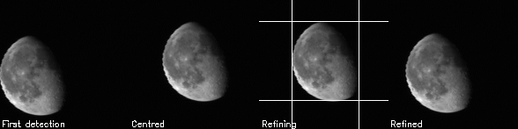
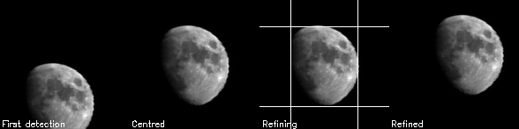
Moon in MSG1 low-res
Navigation error evaluated as the difference between the position of “imagettes”’ centre at the first detection and at the end of the refining

Slide 21
Summary
Extraction procedure improved to take into account low illumination cases
Extraction procedure improved to perform the extraction of HRVIS “imagettes”
Moon’s “imagettes” available for the MSG1 in (standard) low-res mode
  134 in low-res (previously extracted 33)
  35 in HRVIS (previously not extracted)
The new procedure is currently applied to MSG3 data
Monitoring tools developed (navigation problems pointed out)
Currently on-going:
Extraction of MSG1 RSS (development of a brand new procedure)
Extraction of MSG2 low-res (currently building up the archive)
Monitoring tool for detectors’ performances

Slide 22
MSG1 detectors’ behaviour
SEVIRI Focal Plane

Slide 23
MSG1 detectors’ behaviour
Each swath is composed by three lines of detectors in low-res and nine lines in HRVIS; we expect each detector to contribute in the same way
SEVIRI Focal Plane

Slide 24
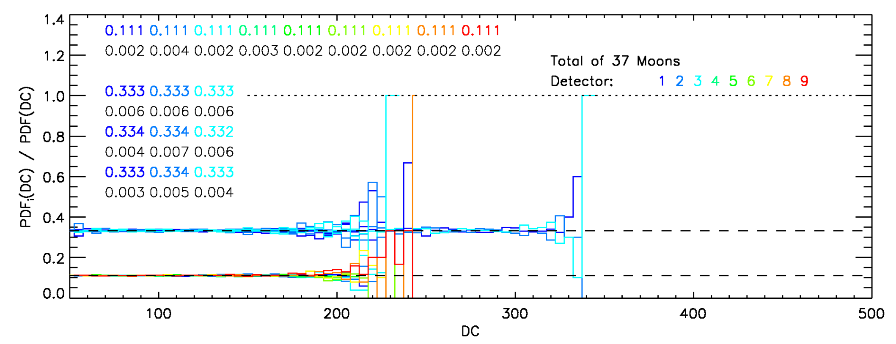
MSG1 detectors’ behaviour in 2005
Contribution of each detector to the channel’s statistics:
for each low-res detector the contribution is expected to be 1/3 while for each HRVIS detector the contribution is expected to be 1/9

Slide 25
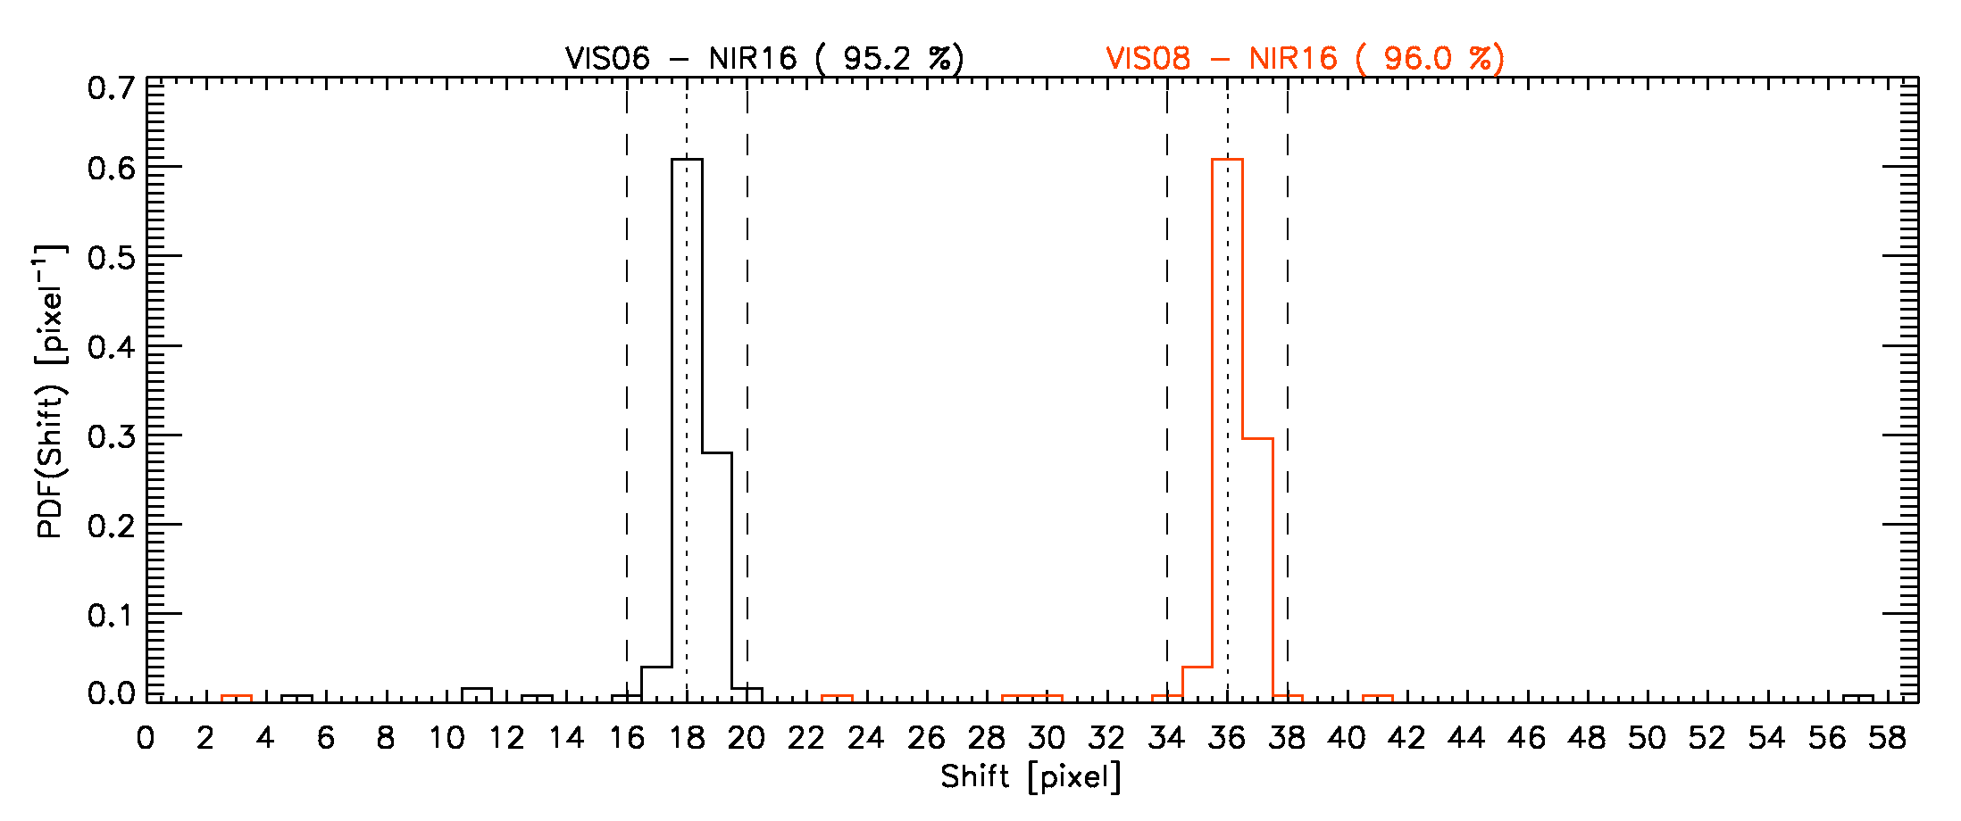
MSG1 detectors’ positions
Distance between the channels in the focal plane as derived from the position of the Moon “imagette” in the channels

