Slide 1
Suomi NPP science validation and contribution to GSICS
Mitch Goldberg
JPSS Program Scientist
GSICS Exec. Panel Chair

Slide 2
Suomi NPP Mission Objectives
Provide quality data to meet scientific requirements for continuity of a group of NASA Earth Observing System (EOS) observations,
Provide a pre-operational demonstration and validation risk reduction for the Joint Polar Satellite System (JPSS),
Provide Suomi NPP sensor data and data products to support NOAA’s operational missions.

Slide 3
Suomi NPP Level 1- EOS Continuity
Provide quality data to meet scientific requirements for continuity of a group of NASA Earth Observing System (EOS) observations,
The Suomi NPP Science Team is focused on supporting work to ensure the continuity of scientific data records started in the EOS era.
The Suomi NPP Science Team prepared discipline-based assessments.
  -- VIIRS Cloud/Aerosol/Atmosphere -- Ozone
  -- VIIRS Land -- Sounder
  -- VIIRS Ocean -- Calibration
Science Team is now providing initial assessment reports ( December 2012 - April 2013).
  Initial Assessment provided at Jan. 2013 ST meeting: NPP can provide the data needed to continue EOS observations. Current NPP operations including calibration maneuvers need to continue.

Slide 4
JPSS Overview
JPSS consists of five satellites (Suomi NPP, JPSS-1, JPSS-2, FF-1, FF-2), ground system and operations through 2028
  JPSS mission is to provide global imagery and atmospheric measurements using polar-orbiting satellites
JPSS is a partnership between NOAA and NASA
  NOAA has final decision authority and is responsible for overall program commitment
  NASA is the acquisition agent for the flight system (satellite, instruments and launch vehicle), ground system, leads program systems engineering, and program safety and mission assurance
  NOAA is responsible for operations, science, data exploitation and archiving, infrastructure

Slide 5
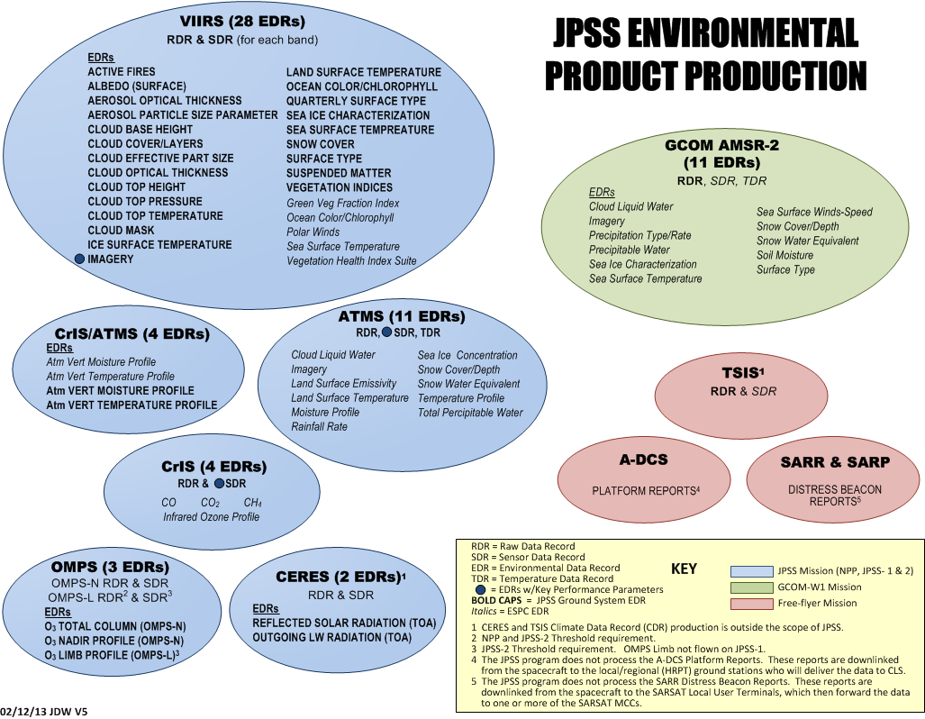

Slide 6
JPSS Ground System Evolution and NPP – On Orbit Mission Phases
NPP LRD
NPP EOL
Transition to Routine Ops
Risk Reduction Phase
Intensive Calibration/Validation
Add GCOM-W1 IDPS ingest
Operations
Block 1.5
IDPS H/W Technology Refresh
IDPS S/W port to Linux
Multi Mission support to:
NPP
GCOM
DMSP
POES
Coriolis
Metops
Commissioning
Intensive Cal/Val Period
De-Commissioning
Block 1.2.1
Develop, T&E Block 2.0
Launch
L+3 mos
L+7 mos
L+15 mos
L+24 mos
L+30 mos
L+5 yrs
Commissioning
LEO
S/C Activation
Instrument Activation
Sat Maneuver Verification
Sat On-orbit Perf Evaluation
Risk Reduction
Fixes / Enhancements
Intensive Cal/Val
Algorithm Fixes
Cal / Characterization Maneuvers
Operations Team Integration
CGS Performance Tuning
CGS Performance Eval
Tech Refresh
Security Updates
Separate Operating Environs
Operations
Nominal Operations
Security Monitoring / Maintenance
Ops Sustainment
Long Term Monitoring & Trending
Routine Cal Updates
Periodic Cal Maneuvers
De-commissioning
Sat Health & Propellant
Monitoring
De-orbit Planning / Script
Controlled De-orbit

Slide 7
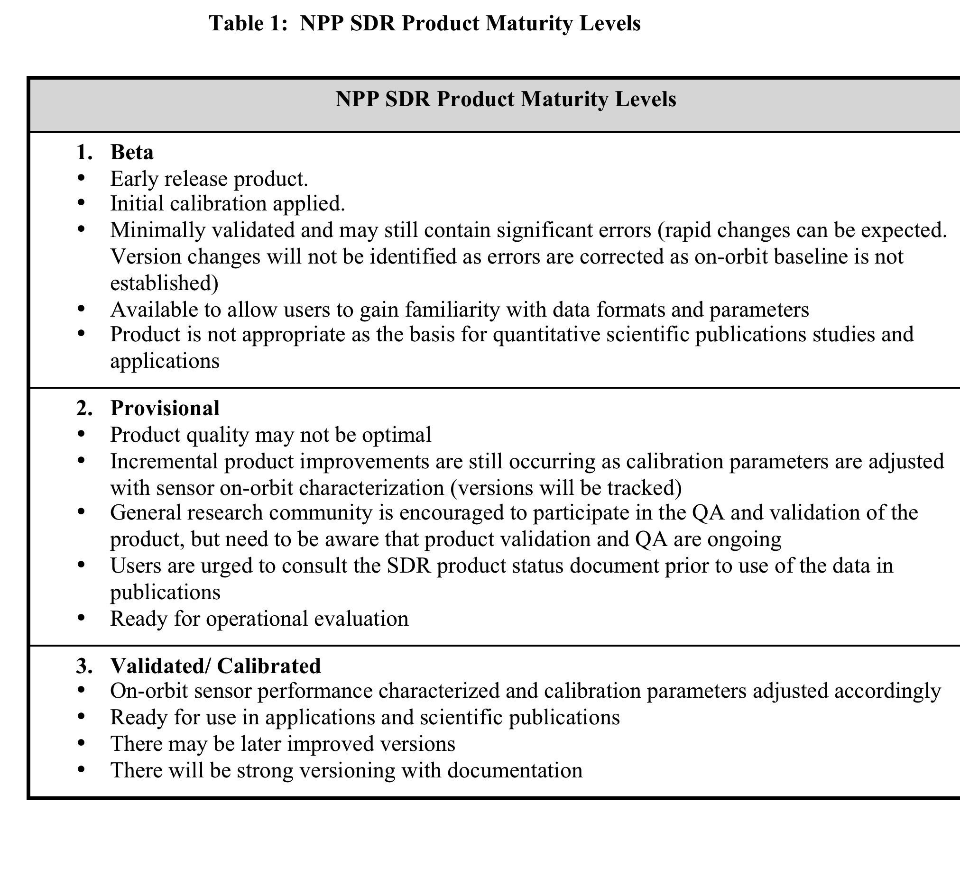
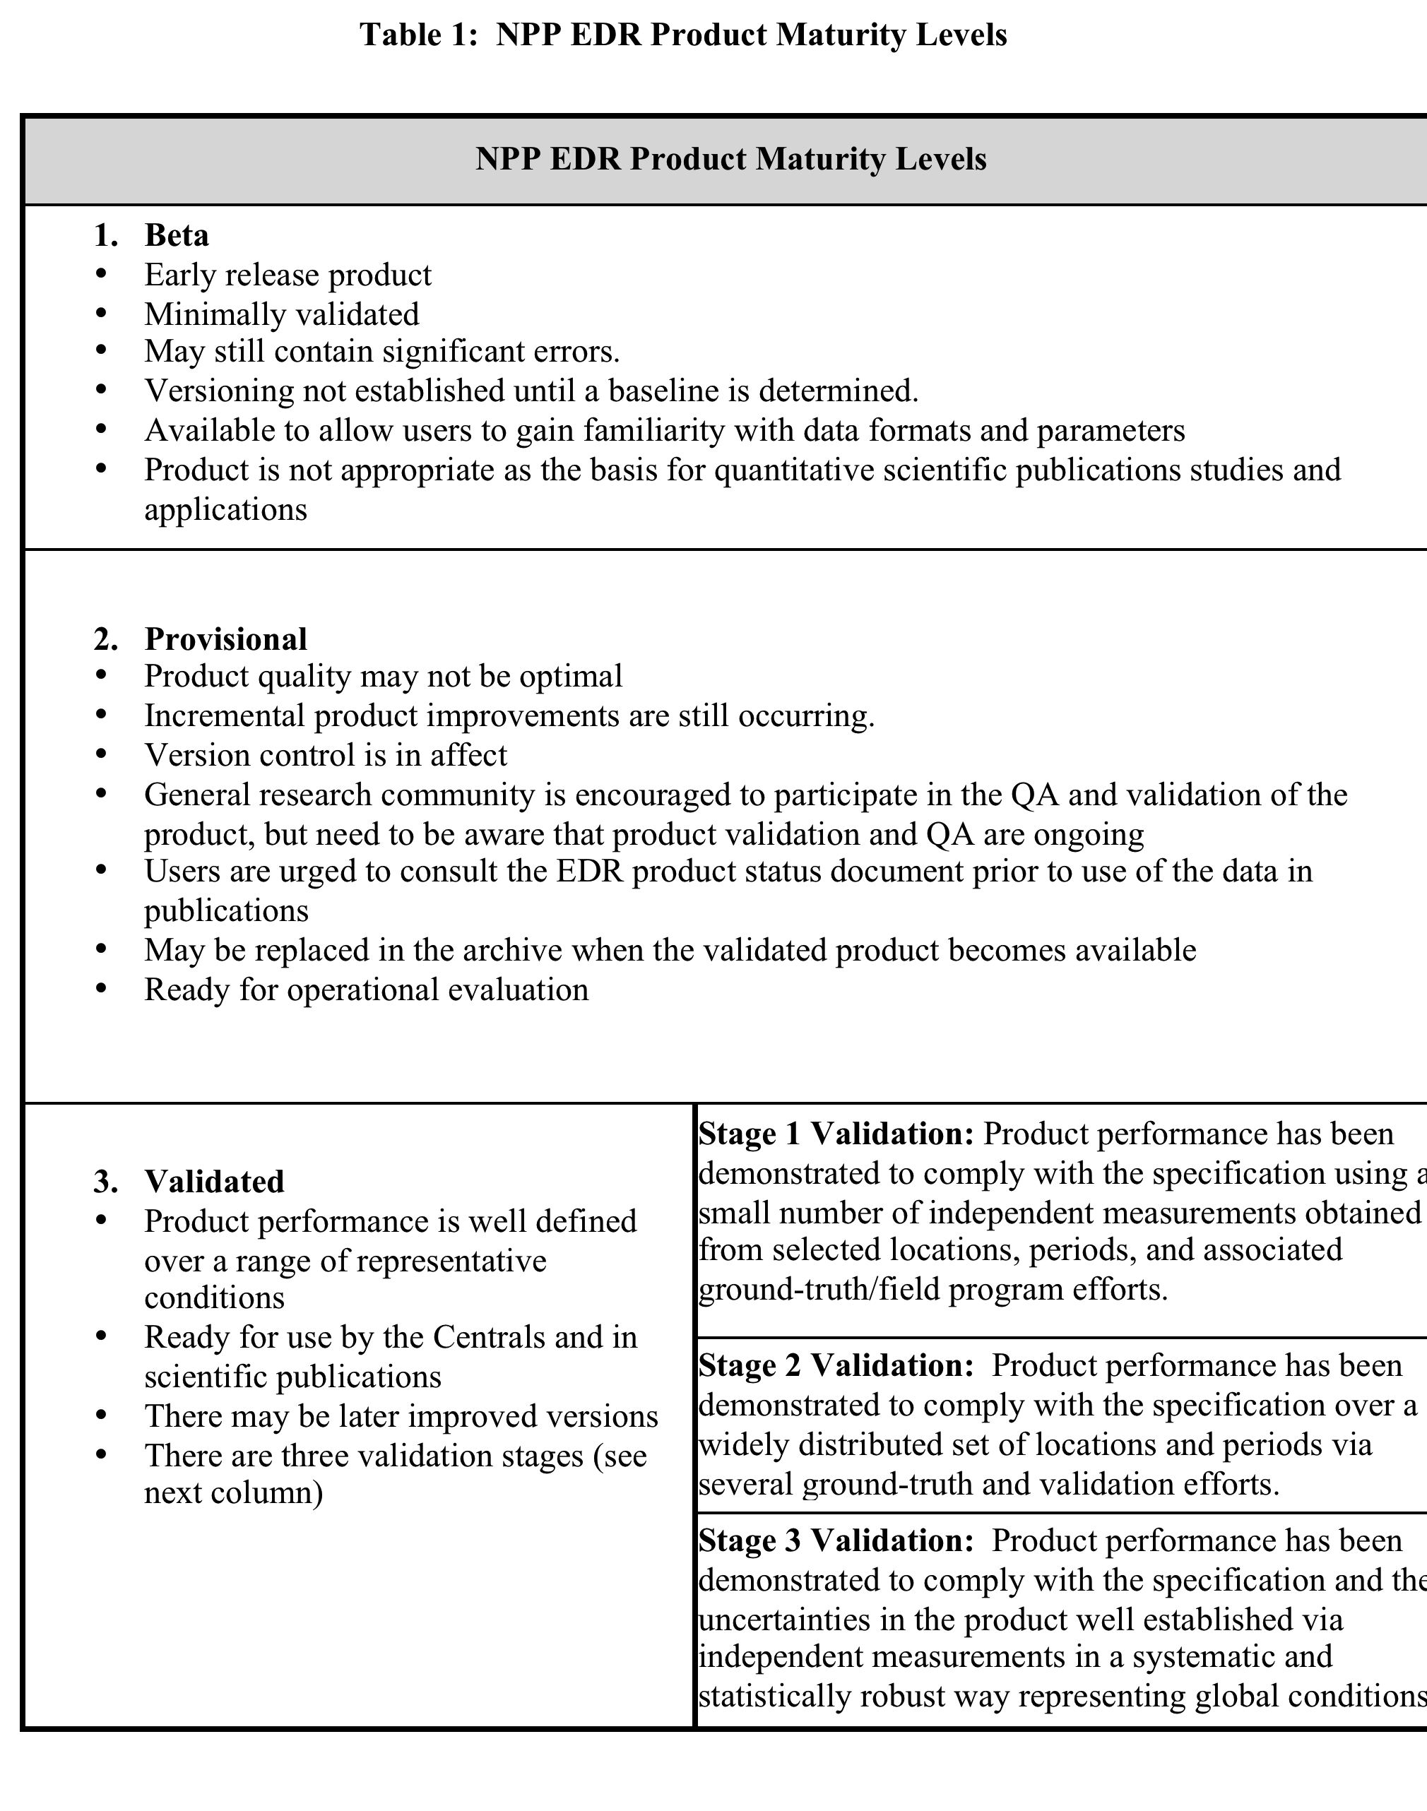
SDR and EDR Maturity Levels

Slide 8
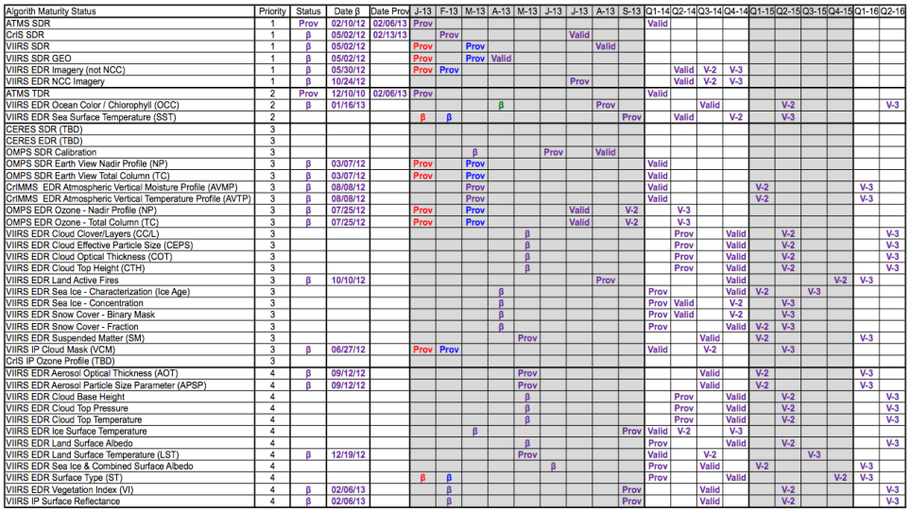
Note: Dates are indicative of AERB approval
Legend
Purple Text – Date Unchanged
Blue Text – Date Is
Red Text – Date Was
Green Text – Ahead of Schedule
VIIRS SDR, VIIRS SDR GEO and OMPS SDR
Awaiting required documentation from Teams
Expect VIRRS SST and VIIRS Surface Type to be boarded at AERB FEB 2013
CrIMSS EDR, VIIRS Imagery EDR, VIIRS Cloud Mask IP, OMPS EDRs
Prov Maturity Status Review held JAN 2013
Board recommended each product for Provisional status and expect to be boarded at AERB FEB 2013

Slide 9
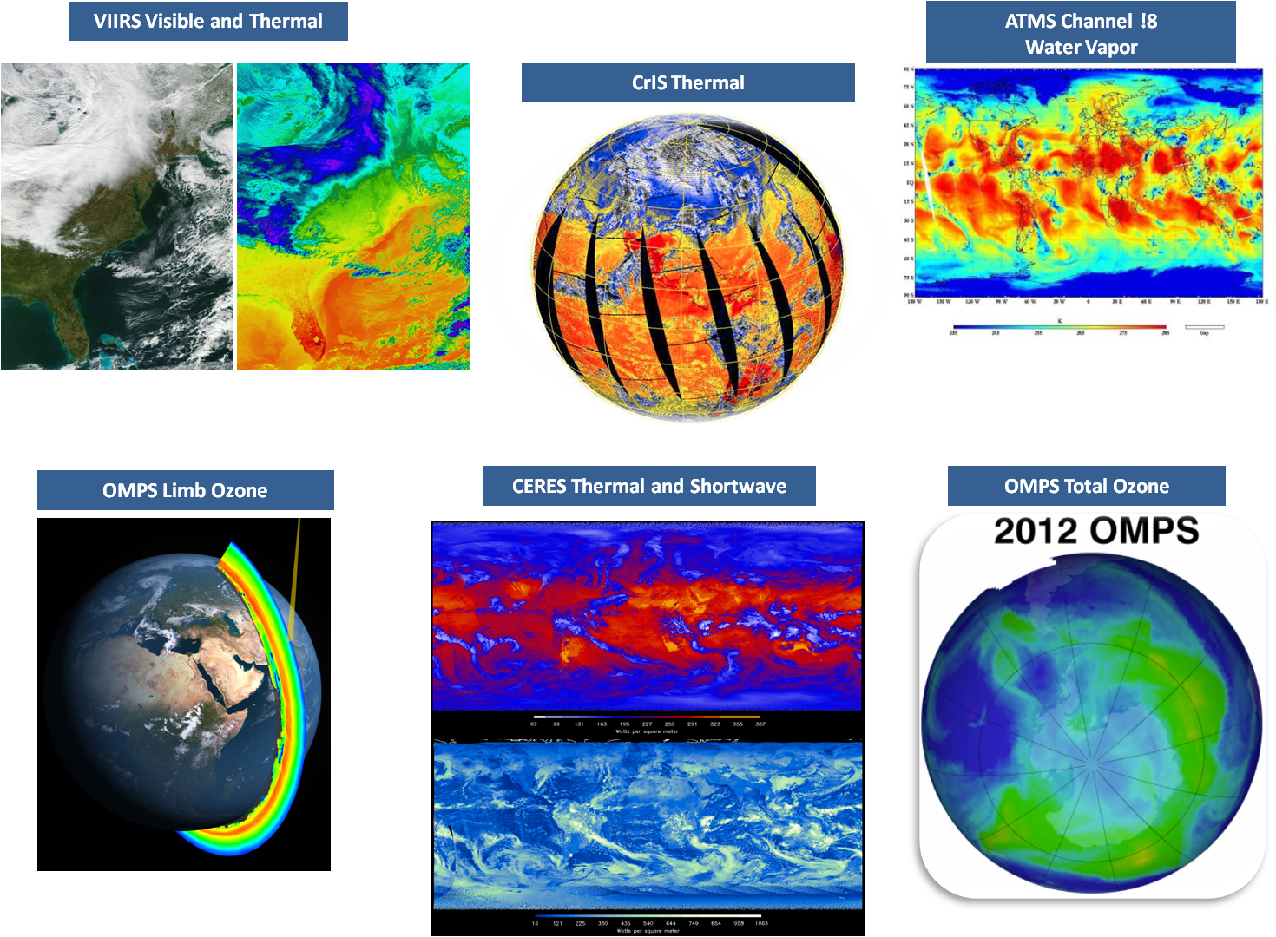
NPP First Light

Slide 10
Suomi NPP Data Product Status
Beta: worth looking at,
known errors
Provisional: most major errors fixed,
minor errors identified, needs characterization time
Validated: data characterized over a wide range of geophysical conditions
Operational: NOAA Service starts to use data in operational forecasts and warnings.
Instrument SDRs publically released
  VIIRS Provisional
  CrIS Provisional
  ATMS Provisional Operational at NWS
  OMPS Nadir Beta (Provisional)
  OMPS Limb released at GSFC
  CERES released at LaRC
EDRs
  Cloud Mask: Provisional
  Imagery: Provisional
  Temperature and Moisture Profiles: Provisional
  Ozone Beta/Provisional
  Land Vegetation Index, Surface Reflectance: Beta
  Ocean Color, Sea Aurfance: Beta
  Aerosol: Beta

Slide 11
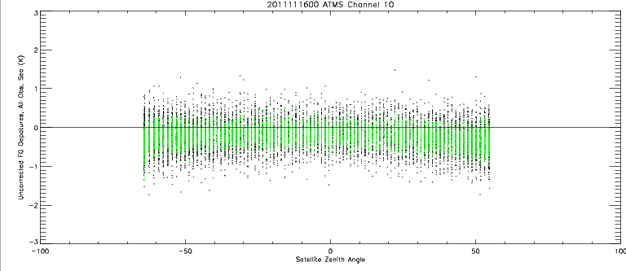
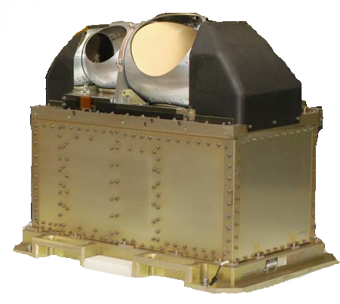
Advanced Technology Microwave Sounder
AMSU-A vs ATMS Stats
Departure; All Obs over Sea (K)
Satellite Zenith Angle (degrees)
ATMS Data used in operationally
in NWS forecasts.

Slide 12
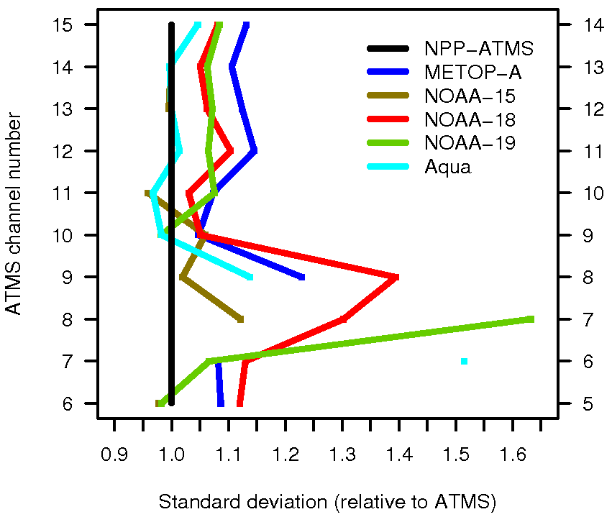
ATMS: Comparison to AMSU-As
(for ATMS 3x3)
→ After averaging, ATMS noise performance at least as good as AMSU-A.
AMSU-A channel number
Standard deviation of observation – background
(normalised by ATMS)

Slide 13
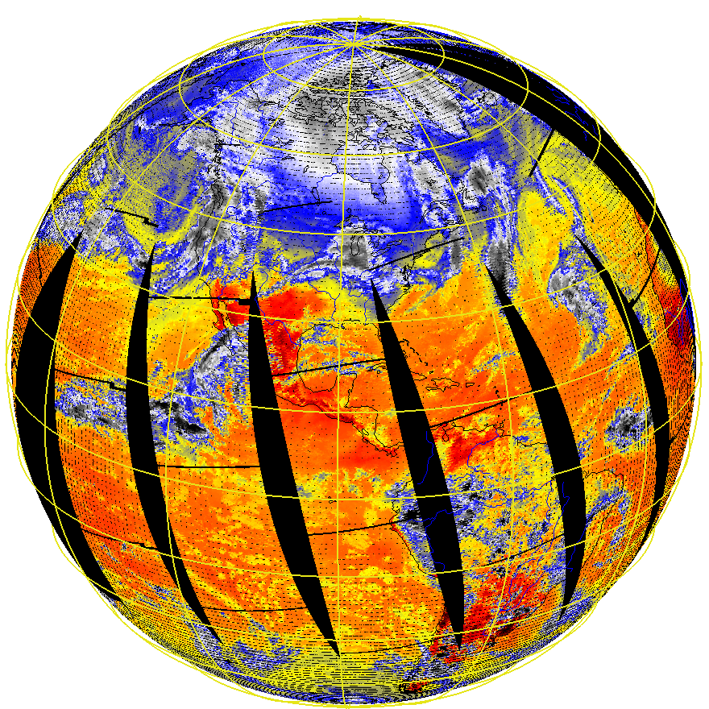
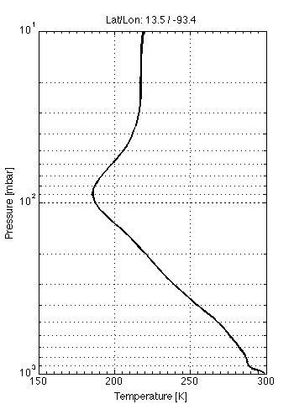
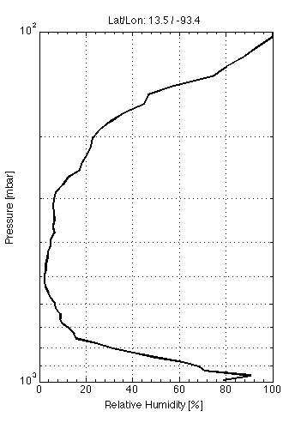
CrIS Data and Retrievals for 20 Jan 2012
CrIS
Temperature
CrIS
Humidity
Notes:
On behalf of the NPP/JPSS NOAA Cal/Val team, the first global dataset from CrIS was produced on Jan 20, 2012. Attached are four figures. The first is imagery from a single CrIS channel out of more than the 3000 channels that CrIS can generate. Each channel is sensitive to a different part of the atmosphere as well as the surface. The channel shown in this figure is a “window” channel at 900 cm-1 wavenumber (or 11.1 microns) and is very sensitive to the Earth’s surface and clouds. The second figure in the lower left is the spectrum of the myriad of CrIS channels in temperature units. The spectrum is used to derive the vertical temperature and moisture (humidity) information needed by the National Weather Service to forecast weather, both calm and severe, up to 5 to 7 days in advance. The figures to the right show the first temperature and humidity soundings generated by CrIS using a research algorithm developed by Dr. Bill Smith Sr.. It is fitting that Bill provided the first sounding, since Bill was a long-time friend and colleague of Professor Vern Soumi. Bill started his career at NOAA in 1965 and is a pioneer in the profiling of the atmosphere from Earth remote sensing satellites and continues to remain very active in the sounding research community.

Slide 14
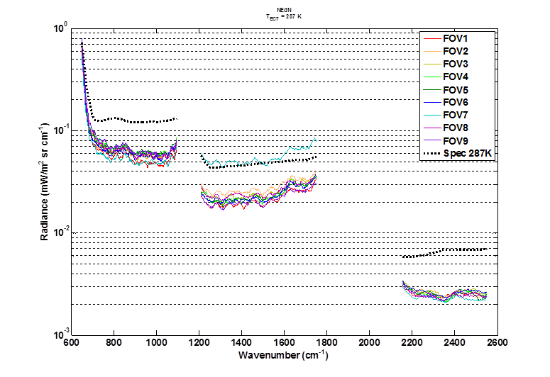
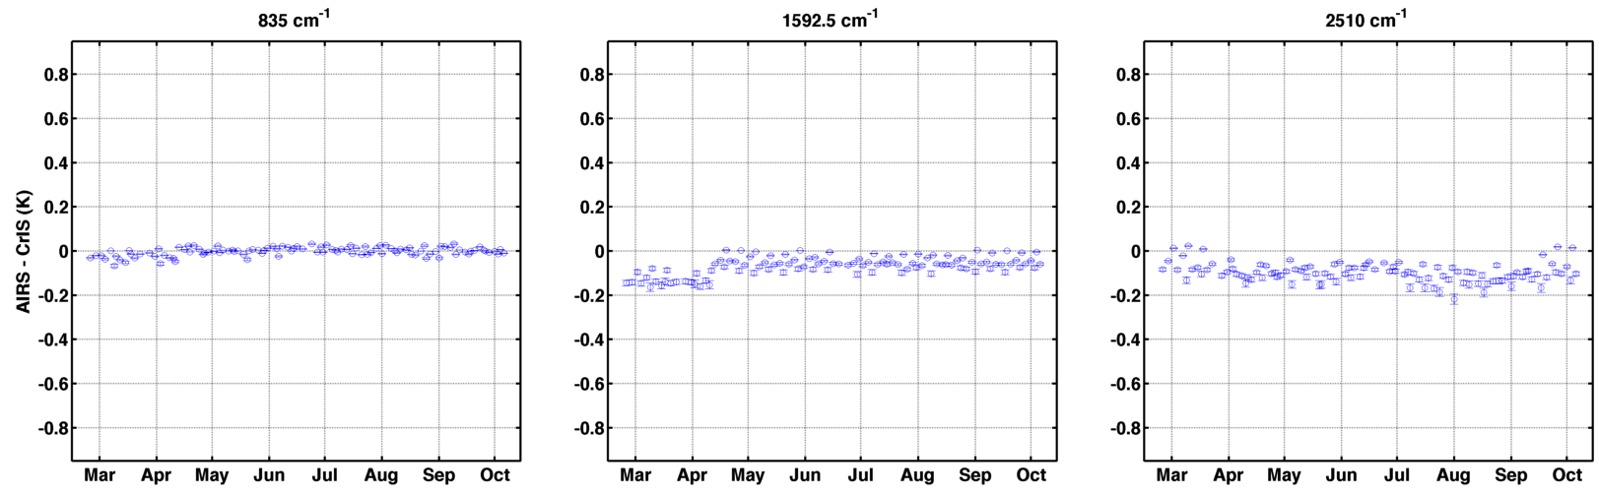
CrIS Radiances meet Noise requirements
NEdN
The noise levels are much better than the specification
Esplin USU/SDL
CrIS vs AIRS differences at the 0.1K level
835 cm⁻¹
1592.5 cm⁻¹
2510 cm⁻¹
0.2K
-0.2K
Req: 1.3K
Req: 1.6K
Req: 2.2K
CrIS vAIRS Work done by Dave Tobin UW/SSEC

Slide 15
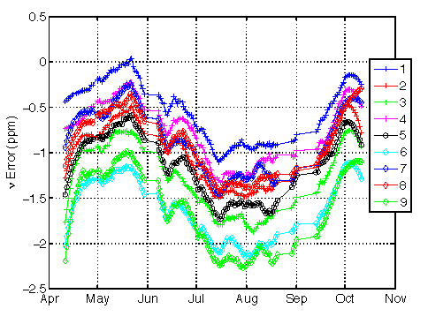
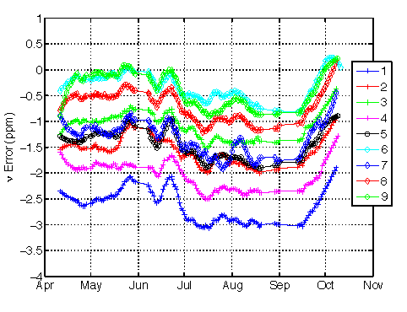
Spectral Uncertainty
Spectral shifts assessed with RTM
Inter-FOV spectral shifts relative to FOV5 derived from correlation analysis
Longwave band
Longwave band, 730-740 cm⁻¹
ppm
Midwave band, 1350-1380 cm⁻¹
Midwave band
ppm
Shortwave band, 2200-2250 cm⁻¹
LW & MW band frequency uncertainty < 3 ppm (specification 10 ppm)
SW band frequency uncertainty relative to FOV5 < 3 ppm

Slide 16
Radiometric Uncertainty Assessment
CrIS/VIIRS (M13 4um) comparisons
Difference is less than 0.2 K

Slide 17
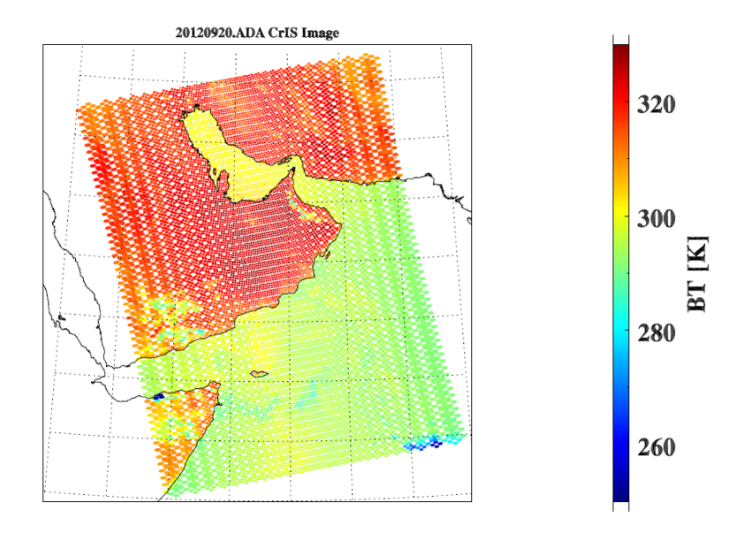
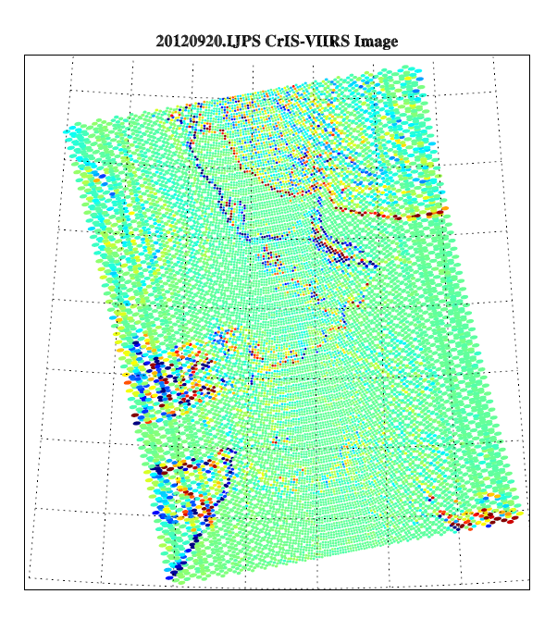
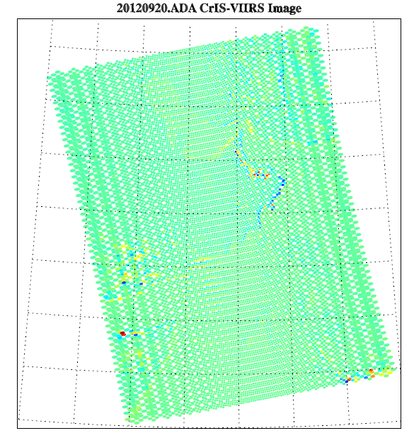
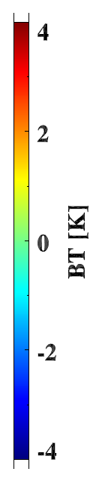
Co-located VIIRS IR data are used to estimate the CrIS geolocation uncertainty
A coding error was found that caused the geolocation error
Geolocation Uncertainty Assessed with VIIRS
VIIRS geolocation uncertainty
 | Bias (m) | RMSE (m)
Track | -21 | 80
Scan | -8 | 64
Geolocation uncertainty within 30º scan angles < 1 km (specification 1.5 km)
IDPS MX6.2
4.5 km geolocation error error
IDPS MX6.3
CrIS image
CrIS - VIIRS
Image differences (CrIS – VIIRS) before and after a coding error fix

Slide 18
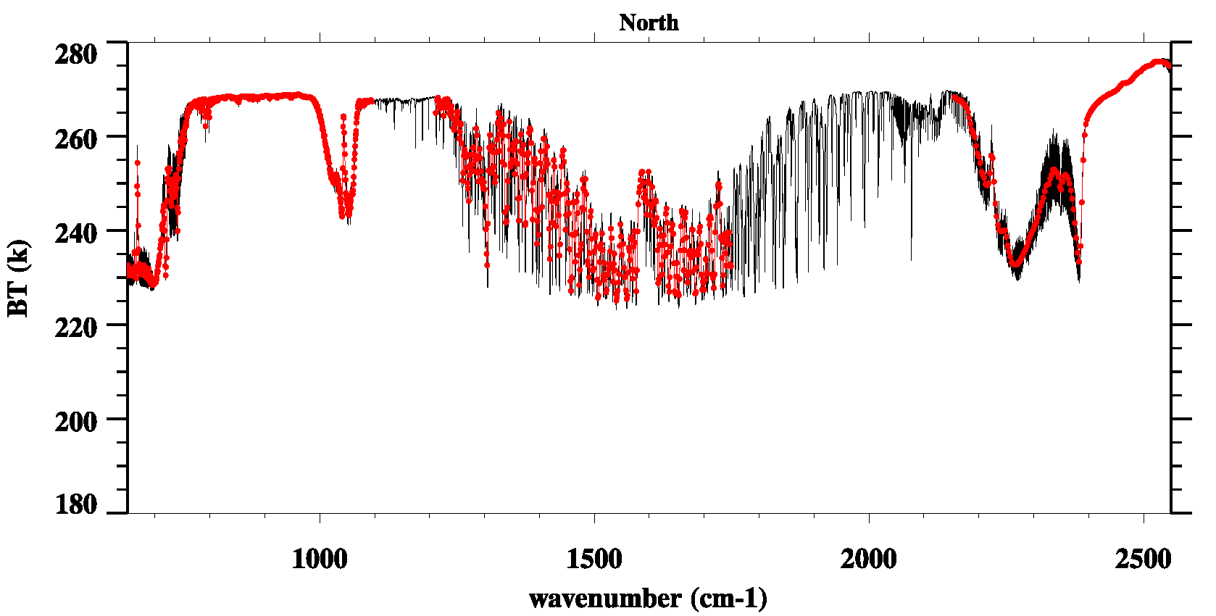
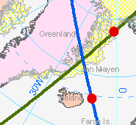
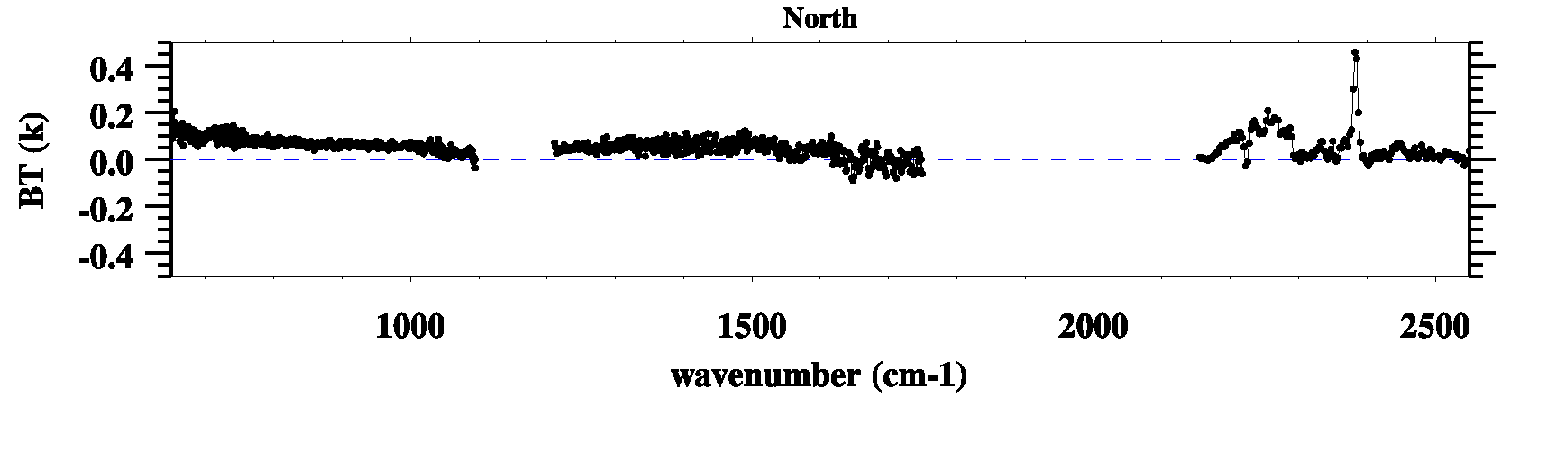
: Inter-Sensor Comparison
CrIS vs. IASI at SNOs
IASI
CrIS
Total of 852 SNO Pairs
411 North Pole
441 South Pole
CrIS - IASI
CrIS and IASI have an agreement of 0.2K or better for all 3 bands.

Slide 19
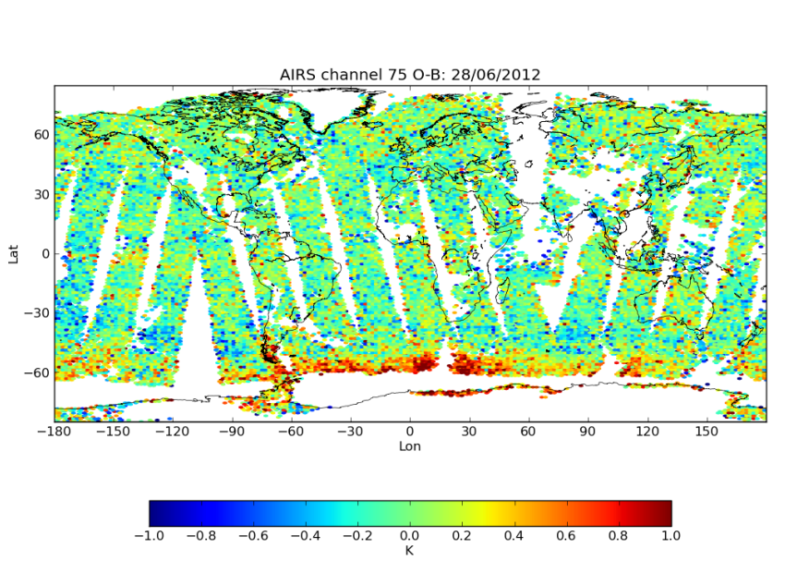
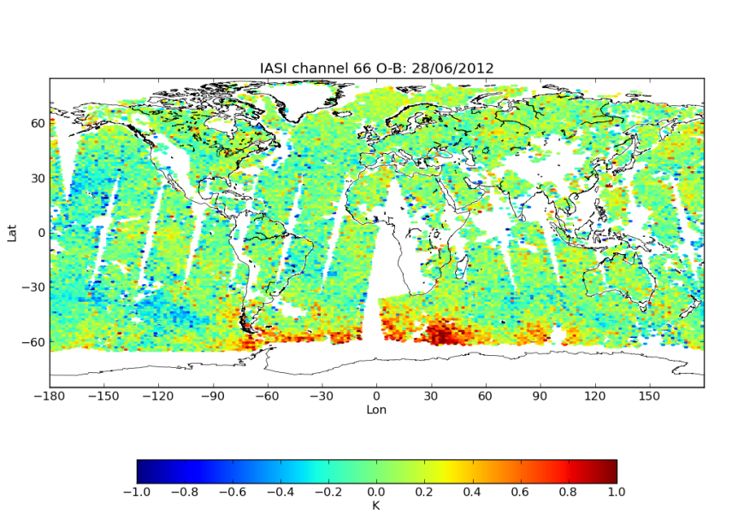
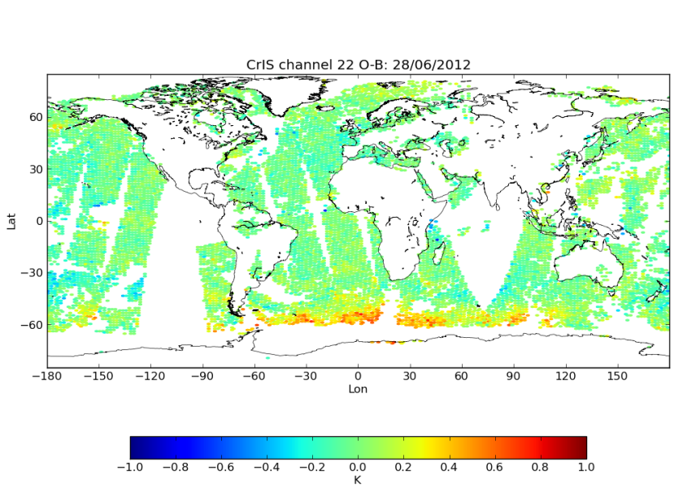
CrIS data Quality:
O-B for AIRS / IASI / CrIS
AIRS
IASI
-1.0K
1.0K
CrIS
Select some ‘clean’ channels with similar weighting functions, e.g.,
  CrIS-22 (700 cm⁻¹)
  IASI-66 (700.25 cm⁻¹)
  AIRS-75 (698.82 cm⁻¹)
Weighting functions peak at ~14km.
Illustrates excellent radiometric performance of CrIS

Slide 20
CrIS Summary
CrIS SDR has reached the Provisional maturity level
All critical DRs and document issues have been addressed
A number of CalVal and software issues have been identified and will be addressed for the Validated product
Calibration type | Meet Specification
 | LW band | MW band | SW band
NEdN | ✓ | ✓ | ✓
Radiometric calibration | ✓ | ✓ | ✓
Spectral calibration | ✓ | ✓ | ✓*
Geolocation | ✓** | ✓** | ✓**
* Relative to FOV5
** Within 30º scan angles

Slide 21
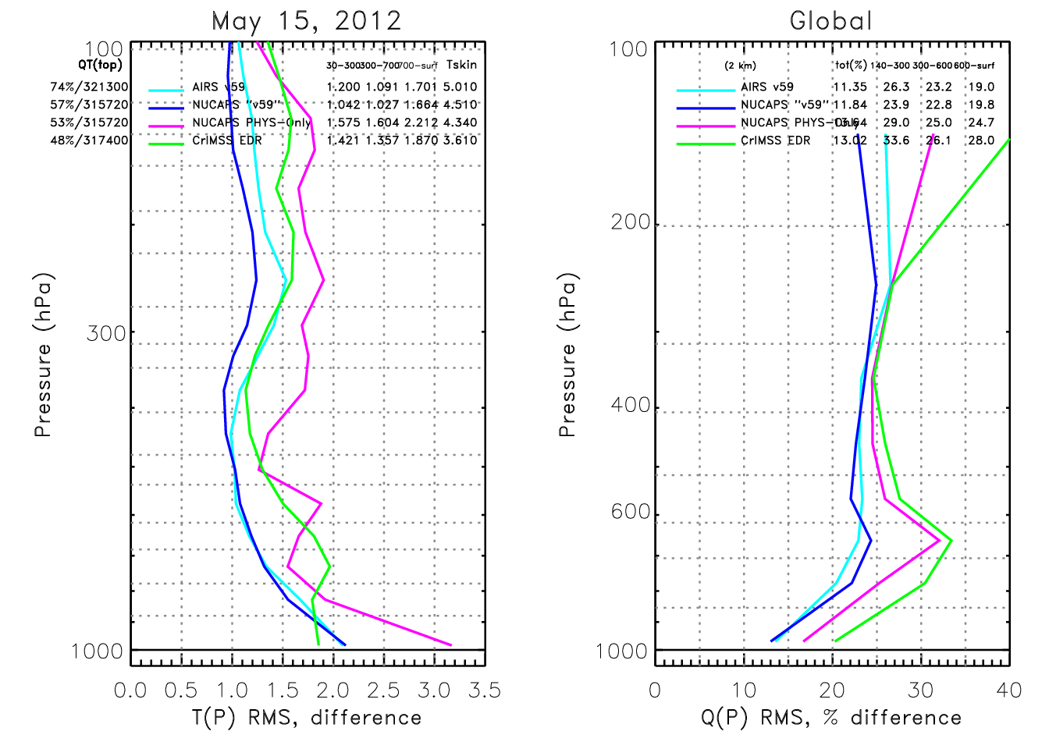
Comparison of CrIMSS-EDR, NUCAPS, AIRS
AIRS/AMSU v5.9 (CYAN) is AIRS v5 with correction for instrument changes.
NUCAPS “v5.9” uses CrIS/ATMS and the same spectroscopy and retrieval methodology as AIRS v5.9.
NUCAPS PHYS-only has no statistical operators
CrIMSS-EDR (GREEN) results have all changes installed (it is an emulation of Mx7.1 (May 2013) system).
Statistics for May 15, 2012 focus day in which Aqua and NPP orbits has high coincidence.
NUCAPS -PHYS(Magenta) and CrIMSS EDR (GREEN) have similar yield and performance
AIRS v5.9 and NUCAPS statistics are remarkably close
  However, yield of NUCAPS is significant lower

Slide 22
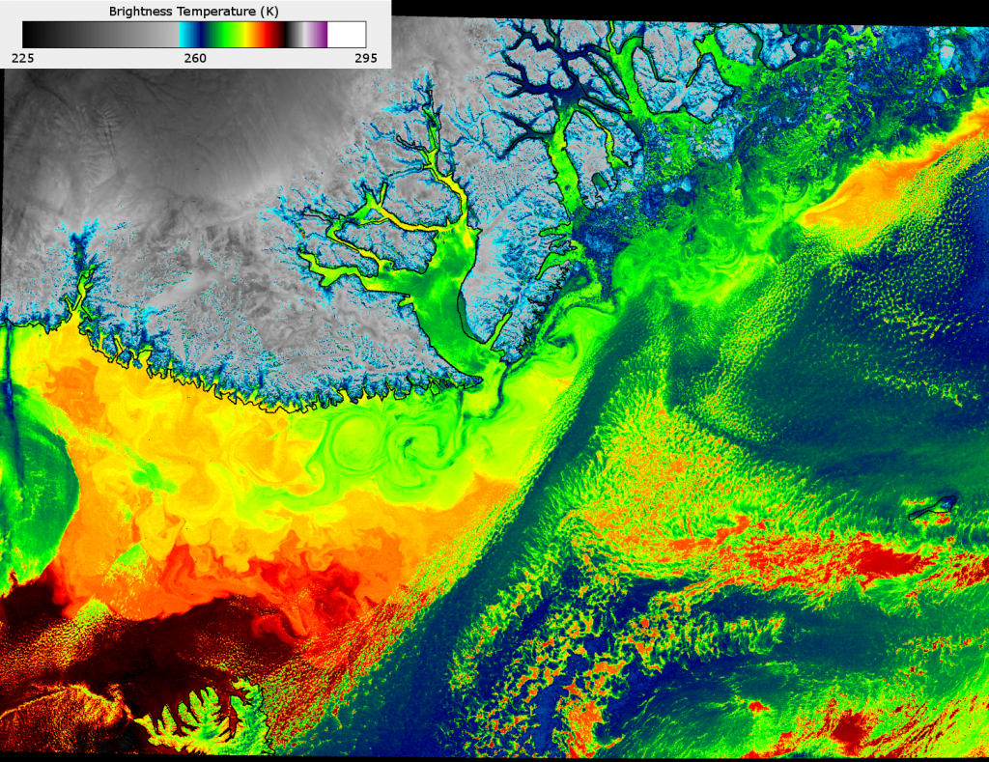
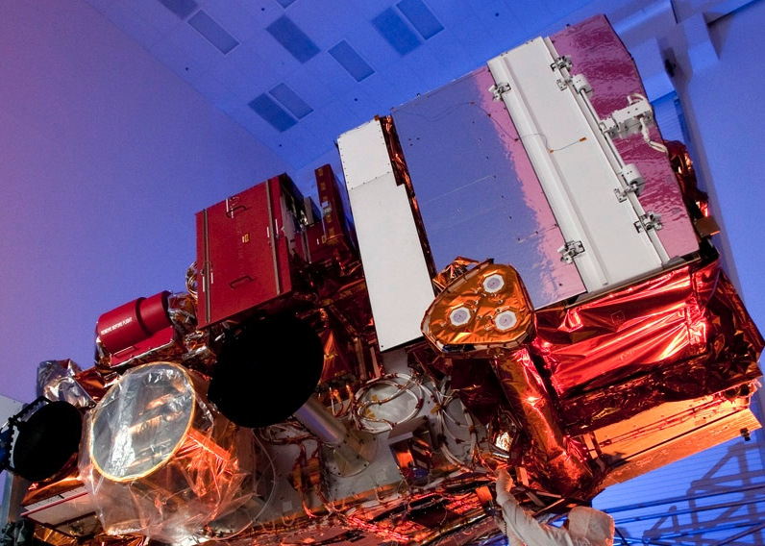
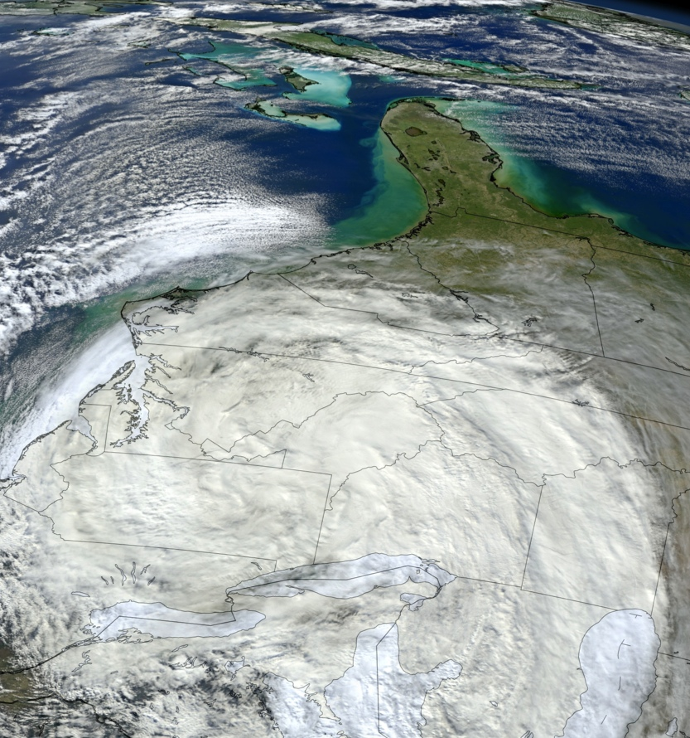
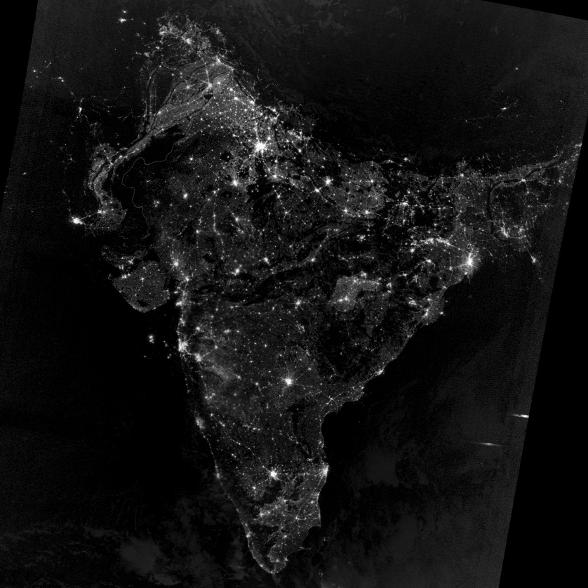
VIIRS
16 bands at 750m, 5 bands at 325m, DNB
Greenland SST IR
VIIRS
India DNB
SS Sandy Visible

Slide 23
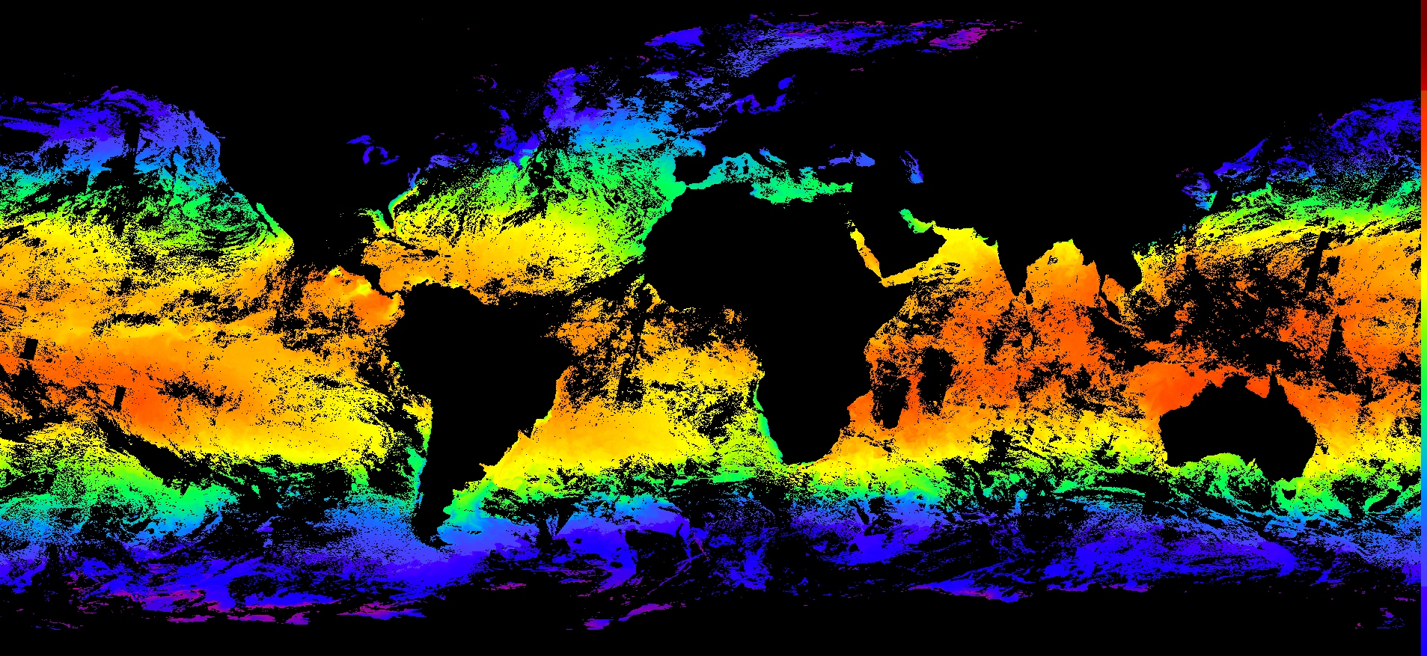
VIIRS SDR Thermal Bands : SST
  Night time SST from U Miami RSAS Evans/Minnett

Slide 24
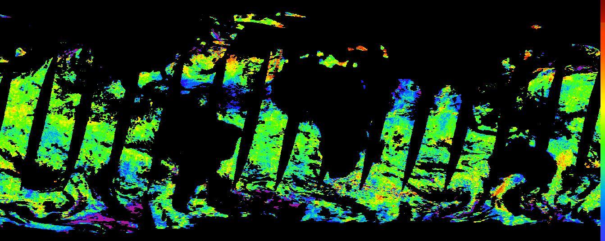
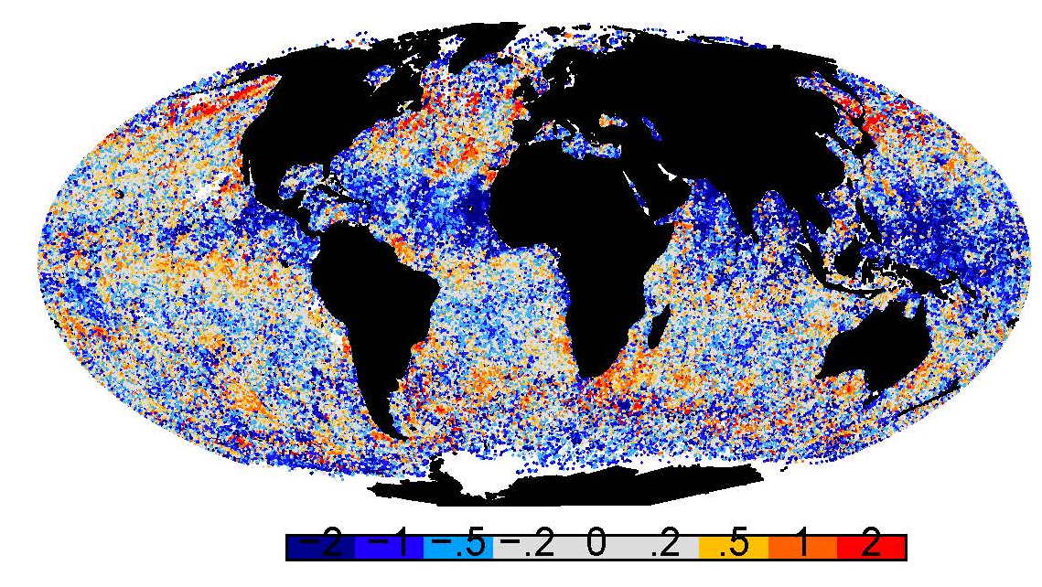
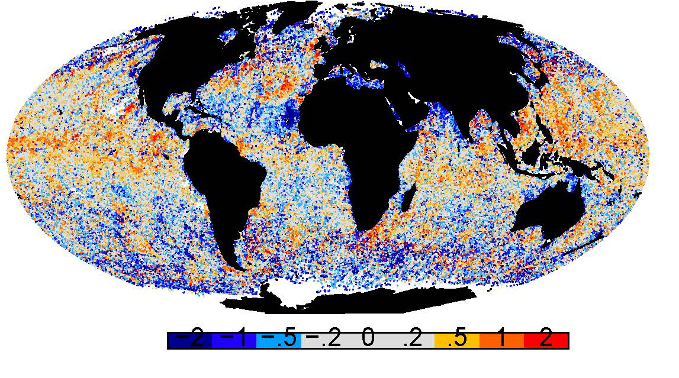
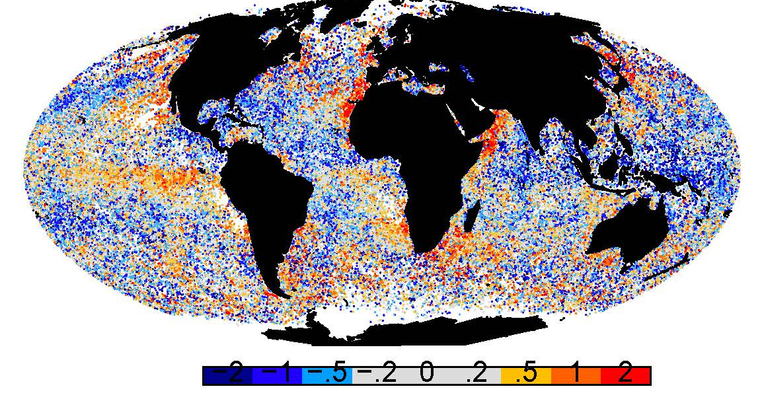
VIIRS infrared vs WindSat microwave SSTs
VIIRS SST3b – WindSat data day 2012225
Miami cloud mask QL=0
VIIRS SSTs – WindSat subset matchups cumulative April through Sept 2012
IDPS v5.3 SST2b – SST WindSat
IDPS v5.3 SST3b – SST WindSat
MIA Beta SST4 – SST WindSat

Slide 25
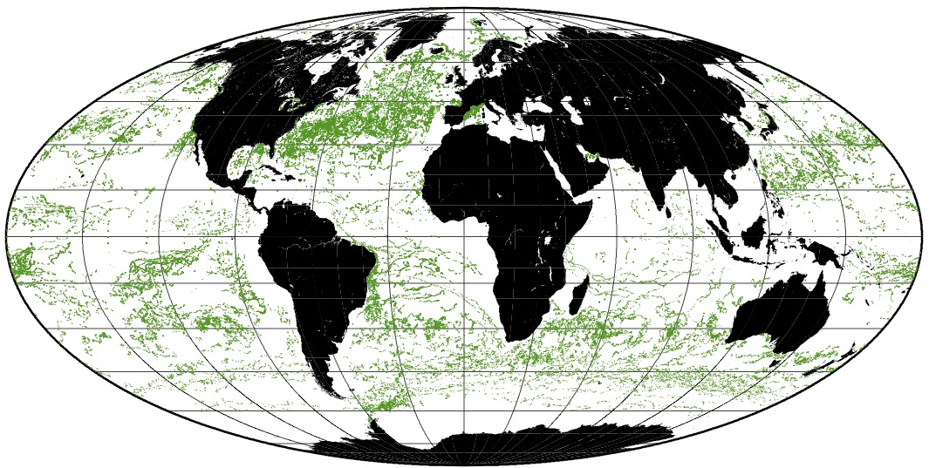
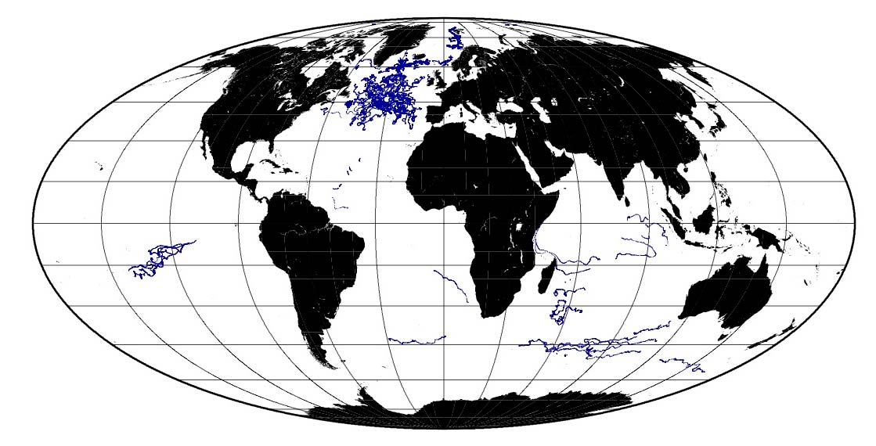
Distributions of VIIRS -buoy matchups
Distribution of VIIRS-buoy matchups. Buoy data from iQUAM – in situ Quality Monitor (http://www.star.nesdis.noaa.gov/sod/sst/iquam/)
In response to requests from GHRSST, new generations of drifters are being developed and deployed, ultimately to have accuracies of 0.01K (Currently ~0.25K)

Slide 26
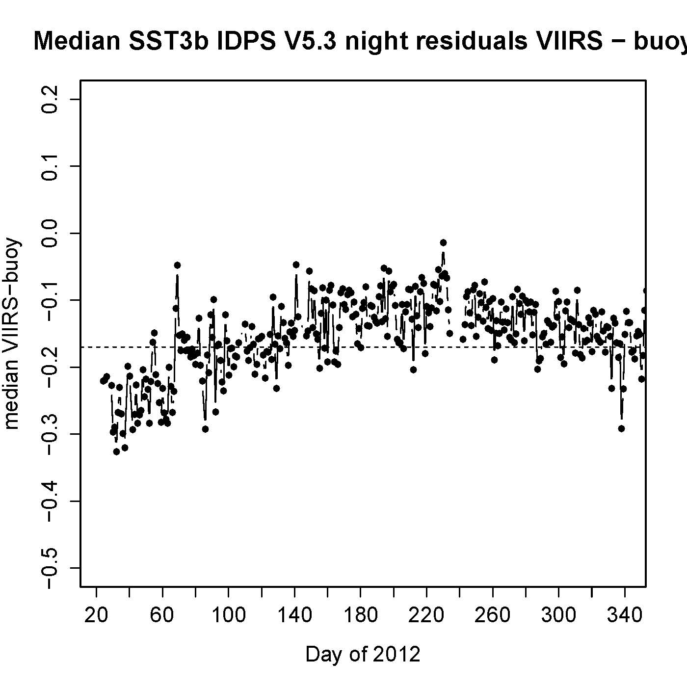
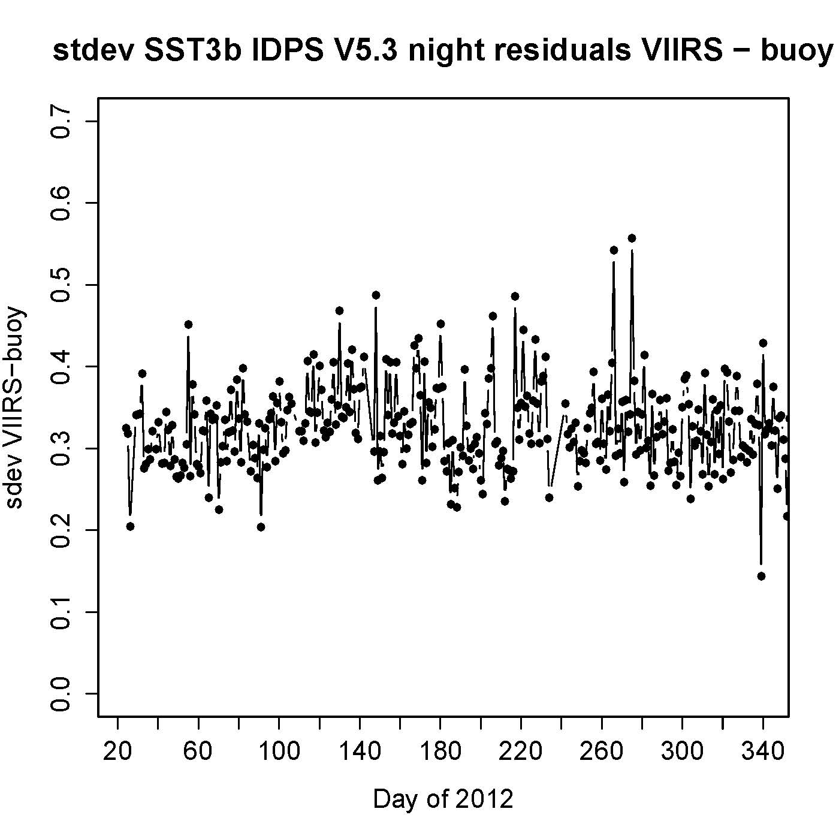
Summary of accuracies – IDPS algorithm
Spec: 0.2K
Spec: 0.6K
IDPS atmospheric correction algorithms with Miami Decision Tree cloud screening.
Comparisons with drifting buoys.
Shift in offset in median errors in March caused by SDR change in brightness temperature computation (red line).
Standard deviations are very respectable, and indicate VIIRS is capable of producing climate quality data.

Slide 27

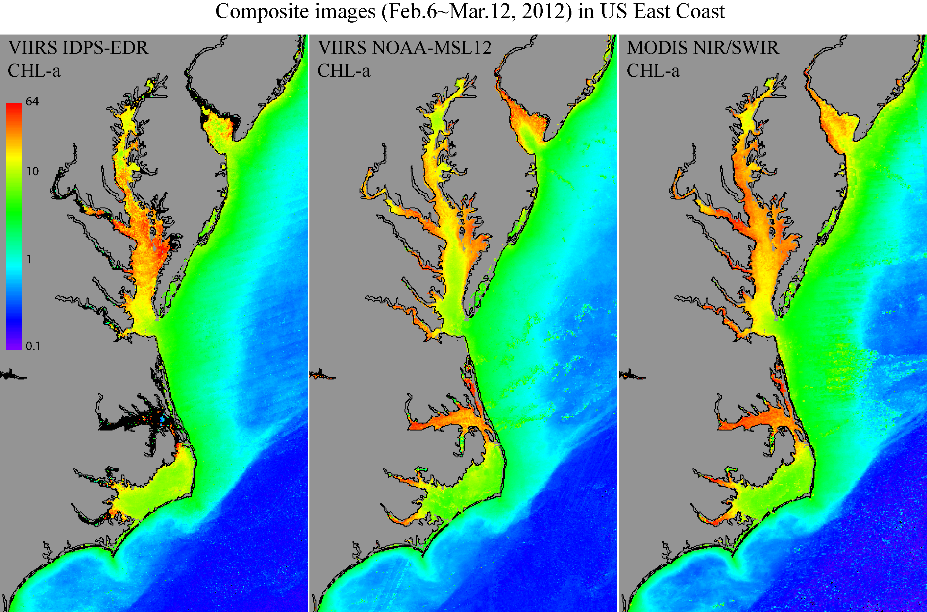
VIIRS Reflected Solar VisNIR:
VIIRS Chlorophyll-a Data

Slide 28
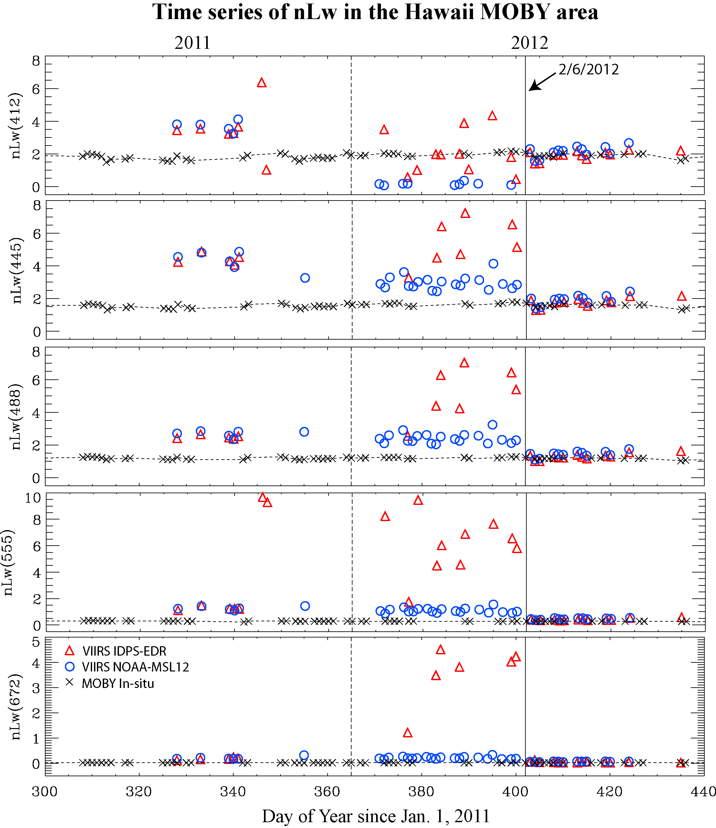
VIIRS vs. MOBY In Situ
412
445
488
555
672
VIIRS OC data compared with the MOBY in situ data, showing that SDR data since 2/6/2012 are good and reasonable, before that SDR date were poor/not reliable.
VIIRS ocean color products are good and reasonable from 2/6/2012.
Vicarious calibration is needed and will further improve ocean color products.
Data from M. Wang
MOBY PI: Ken Voss

Slide 29
VIIRS Geolocation Summary
Residuals | Error | After error correction
Track mean | -25 m | 0 m
Scan mean | -11 m | 1 m
Track RMSE | 75 m | 70 m
Scan RMSE | 63 m | 61 m
Note: 75 m is 20% of an I-band 375m pixel
Nadir equivalent accuracy (RMSE – Root Mean Square Error)
296 data-days, average of 135 CP residuals per day (after filtering)
After VIIRS I/M-band LUT update on Feb. 23, 2012
Excludes switch to Scan Control Electronics (SCE) A-side (Nov. 22 to Dec. 11, 2012)
Mapping Uncertainty requirement 1km

Slide 30
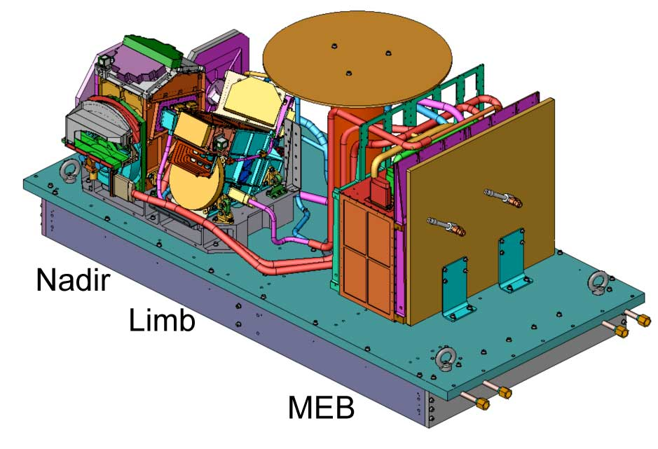
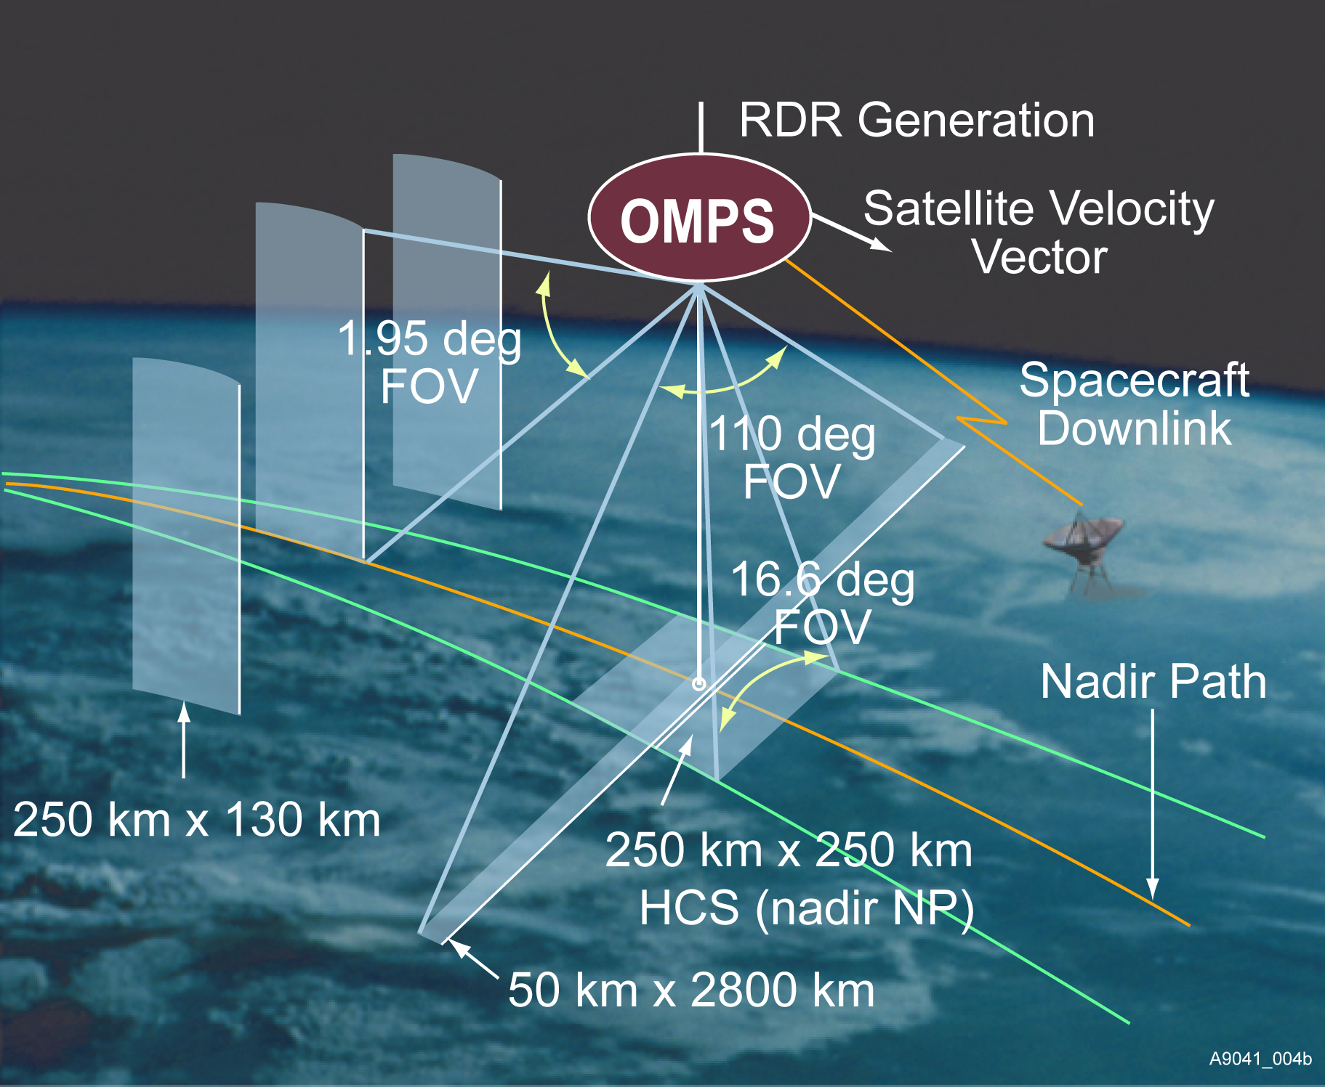
OMPS Instrument
Ozone Mapper Profiler Suite
Global and daily monitoring of three dimensional distribution of ozone and other constituents
Nadir Mapper
Grating spectrometer, 2-D CCD
110 deg. cross track, 300 to 380 nm spectral, 1.1nm FWHM bandpass
Nadir Profiler
Grating spectrometer, 2-D CCD
Nadir view, 250 km cross track, 270 to 310 nm spectral, 1.1 nm FWHM bandpass
Limb Profiler
Notes:
Updated schematic from Scott Asbury.
Some changes in numbers (2.23 degrees to 1.9 degrees) and position of components.
Old instrument picture.
Heritage instruments are providing product development, and algorithm and application testing.
For example, SAGE III limb measurements pointing
For example, OMI Products into assimilation systems
CCD Charge-Coupled Device
TOMS Total Ozone Mapping Spectrometer
SBUV Solar Backscatter Ultraviolet instrument
GOME Global Ozone Monitoring Experiment
OMI Ozone Monitoring Instrument
SCIAMACHY SCanning Imaging Absorption spectroMeter for Atmospheric CartograpHY
SOLSE Shuttle Ozone Limb Sounding Experiment
LORE Limb Ozone Retrieval Experiment
OSIRIS Optical Spectrograph and InfraRed Imager System
SAGE Stratospheric Aerosol and Gas Experiment
OMPS` Ozone Mapping and Profiler Suite

Slide 31
Instrument Performance – NM
Requirement | Specification/Prediction Value | On-Orbit Performance
Non-linearity | < 2% full well | < 0.46%
Non-linearity Knowledge | < 0.5% | ~0.1%
On-orbit Wavelength Calibration | < 0.01 nm | average ~0.01 nm RMS
Stray Light NM Out-of-Band + Out-of-Field Response | ≤ 2 | average ~± 2%
Intra-Orbit Wavelength Stability | <0.02 nm | < 0.013 nm
SNR | >1000 | > 1000 from SV and EV
Inter-Orbital Thermal Wavelength Shift | <0.02 nm | <0.013 nm
CCD Read Noise | <60 –e RMS | < 25 –e RMS
Detector Gain | >46 | ~42
Absolute Irradiance Calibration Accuracy | < 7% | 5%
Absolute Radiance Calibration Accuracy | < 8% | < 5%

Slide 32
Instrument Performance – NP
Requirement | Specification/Prediction Value | On-Orbit Performance
Non-linearity | < 2% full well | < 0.46%
Non-linearity Knowledge | < 0.5% | ~0.1%
On-orbit Wavelength Calibration | < 0.01 nm
Stray Light NM Out-of-Band + Out-of-Field Response | ≤ 2 | average ~± 2%
Intra-Orbit Wavelength Stability | <0.02 nm | < 0.013 nm
SNR | >1000 | > 1000 from SV and EV
Inter-Orbital Thermal Wavelength Shift | <0.02 nm | <0.013 nm
CCD Read Noise | <60 –e RMS | < 25 –e RMS
Detector Gain | >43 | ~45
Absolute Irradiance Calibration Accuracy | < 7% | 1~10% , average: ~7%
Absolute Radiance Calibration Accuracy | < 8% | < 5%

Slide 33
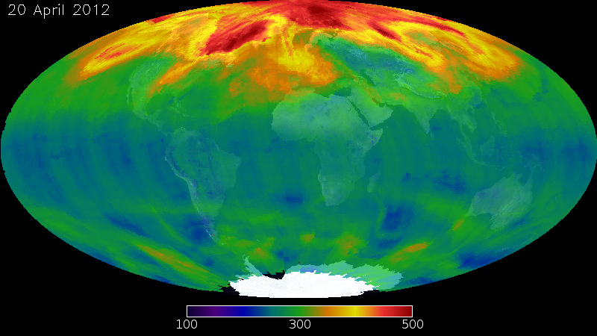
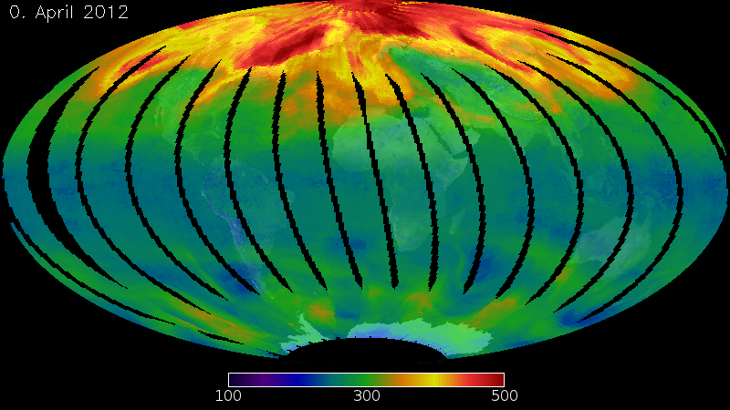
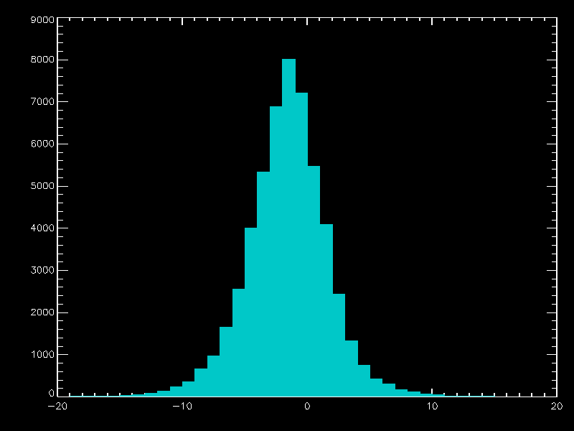
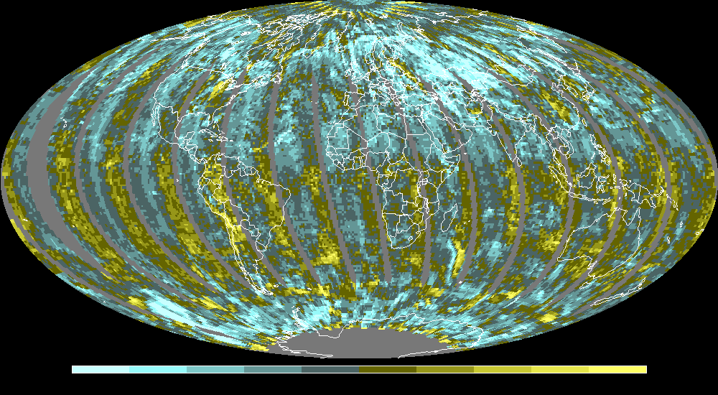
Comparison of IDPS IP to OMI
20 April 2012
IDPS IP
OMI EDR
Mean = -1.6%
StDev = 3.3%
8000
Number of Measurements
4000
0
-10
-8
-6
-4
-2
0
2
4
6
8
10
-20 -10 0 10 20
Percent
Percent
Notes:
Standard deviation 11% to 3%

Slide 34
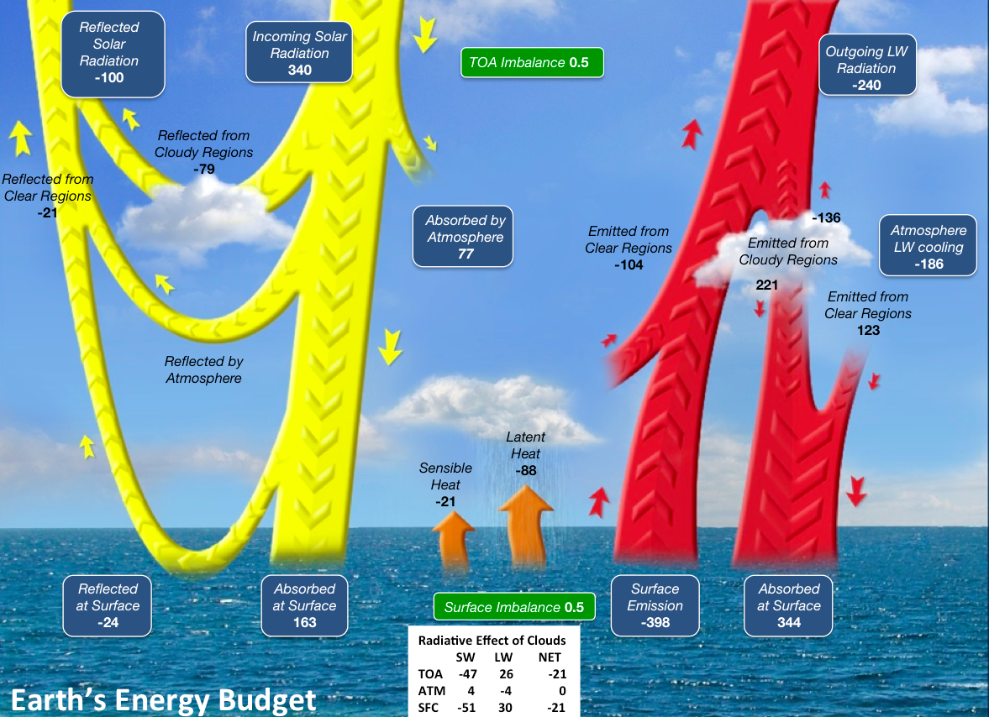
CERES: Earth’s Energy Budget (Wm⁻²)
The radiative imbalance between the surface and atmosphere determines how much energy is available to drive the hydrological cycle and the exchange of sensible heat between the surface and atmosphere.

Slide 35
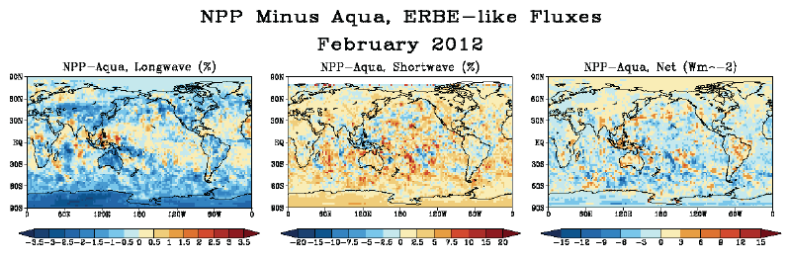
CERES FM5 (NPP) – Aqua ERBE-Like
TOA Flux Comparisons
CERES NPP higher than Aqua in SW (2%), lower in LW (-0.5%).
R² > 0.998 for all TOA fluxes.

Slide 36
Can we use Suomi NPP for GSICS
Yes!
We will see CrIS vs AIRS vs IASI agreements are generally within 0.2 K.
VIIRS – is performing very well . Comparison with MODIS and CrIS is generally very good.

Slide 37


Questions?

