Slide 1
GOES-R Program Cal/Val Annual GSICS GRWG & GDWG Meeting March 4, 2013
Bob Iacovazzi, Jr.
GOES-R Program Systems Engineering (PSE) Cal/Val Lead
Notes:
To-Do:

Slide 2
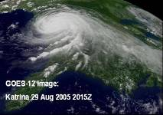
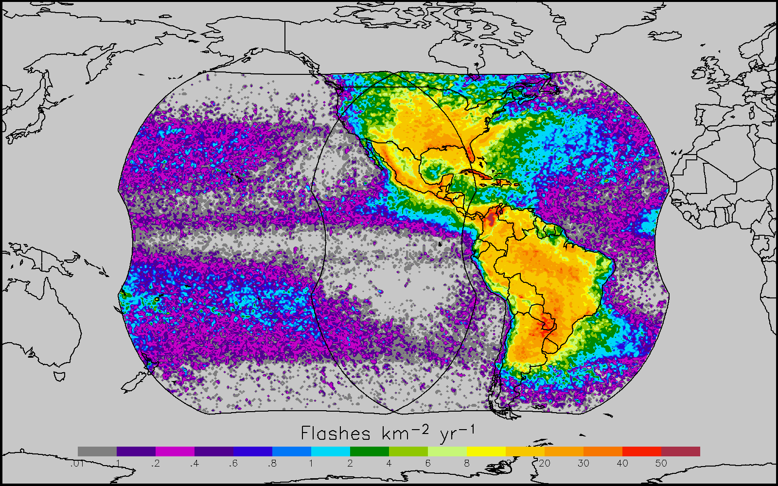
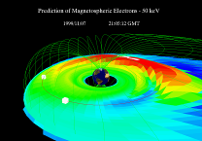
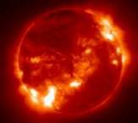
Instrument Overview
GOES-R supports NOAA mission to provide forecasts and warnings for the United States, its territories, and adjacent waters for the protection of life and property and the enhancement of the national economy.
GOES-R is the next generation of GOES satellites that will provide a major improvement in quality, quantity, and timeliness of data collected.
Earth Pointing
In-Situ
Sun Pointing
Spare
Visual & IR Imagery
Lightning Mapping
Space Weather Monitoring
Solar Imaging
Advanced Baseline Imager (ABI)
Geostationary Lightning Mapper (GLM)
Space Environment in-Situ Sensor Suite (SEISS)
Magnetometer
Solar Ultra-Violet Imager (SUVI)
Extreme UV/X-Ray Irradiance Sensors (EXIS)
New and improved capabilities for:
increased lead times for severe weather warnings
better storm tracking capabilities
solar, space weather, and climate analyses
advanced products for aviation, transportation, commerce
Notes:
To-Do:

Slide 3
GOES-R Data and Product Overview
GOES-R Products
GOES-R Raw Data Throughput
Radiances* | Cloud and Moisture Imagery (KPP)
Solar Imagery: X-ray* | Rainfall Rate / QPE
Energetic Heavy Ions* | Legacy Vertical Moisture Profile
Magnetospheric Electrons and Protons: Low Energy* | Legacy Vertical Temperature Profile
Magnetospheric Electrons and Protons: Medium and High Energy* | Derived Stability Indices
Solar and Galactic Protons* | Total Precipitable Water
Geomagnetic Field* | Clear Sky Masks
Solar Flux: EUV* | Downward Shortwave Rad.: Surface
Solar Flux: X-Ray* | Fire / Hot Spot Characterization
Lightning Det: Events, Groups, Flashes* | Land Surface (Skin) Temperature
Aerosol Detection (including Smoke & Dust) | Sea Surface Temperature (skin)
Aerosol Optical Depth | Reflected Shortwave Rad.: TOA
Volcanic Ash: Detection & Height | Snow Cover
Cloud Optical Depth | Derived Motion Winds
Cloud Particle Size Distribution | Hurricane Intensity
Cloud Top Phase | Cloud Top Pressure
Cloud Top Height | Cloud Top Temperature
ABI | GLM
SEISS | EXIS
SUVI | Magnetometer
 | * Included in GRB
Fill Packets
L1b
Space Wx
Mbps
GLM
ABI
ABI provides 3x spectral, 4x coverage, and 5x temporal resolution of current imager
GOES-R product requirements drive instrument performance requirements, which often are the same as, or more strict than, heritage GOES.
L2+ Products are remainder outside of oval
Notes:
To-Do:

Slide 4
Importance of Calibration & Validation
Calibration: The process to determine factors for converting and correcting raw detector measurements into science data units (e.g., radiance) with the specified level of accuracy.
Calibration is applied to GOES-R raw instrument data to transform them into L1b measurements … the fundamental building blocks for all L2+ products.
Validation: The process of determining that the deliverable item satisfies its intended use in its intended environment.
Validation provides user confidence that GOES-R data can be used for their intended purpose, e.g., weather forecasting or numerical weather prediction.
GOES-R cal/val requirements are integrated into mission requirements!
Notes:
To-Do:

Slide 5
GOES-R Cal/Val Scope
Pre-launch calibration/L1B validation
Observe, and validate results of, pre-launch instrument-level calibration tests
Evaluate instrument performance risks and waiver requests
Provide subject matter expert (SME) review of L1b algorithm design and implementation
Develop Cal/Val related Post-Launch Test (PLT) planning
Develop tools for post-launch validation and anomaly resolution of L1b science data quality
Validate expected results from pre-launch system level testing of L1b algorithm using synthetic L0 data
Analyze PLT cal/val data results and provide SME support of science data anomaly resolution
Coordinate cal/val activities through PLT and Handover
Prepare NOAA satellite calibration scientists and engineers for monitoring, analyzing and maintaining GOES-R series instrument calibration and product integrity after Handover
GOES-R cal/val enhances understanding of data quality, and encourages “Day-1” operational readiness and long-term user confidence.
Notes:
To-Do:

Slide 6
GOES-R Cal/Val Collaborators
Collaborator | Main Responsibilities | Cal | L1b Prod Val | L2+ Prod Val
Flight Project | Oversee SC/Instr. Design, Fabr., Integ., and Test | ✓ | ✓
SC/Instr Vendors | SC/Instr. Design, Fabr., Integ., and Test | ✓ | ✓
Ground Segment (GS) Project | Oversee GS Design, Fabr., Integ., and Test | ✓ | ✓ | ✓
GS Vendor | GS Design, Fabr., Integ., and Test | ✓ | ✓ | ✓
Mission Ops Support Team | Gov’t SC/Instr/GS Test | ✓ | ✓ | ✓
Data Ops Support Team | Gov’t GS Test | ✓ | ✓ | ✓
Cal Working Group (CWG) | PSE Technical Support to GOES-R Instr. Cal & L1b Val | ✓ | ✓
Algorithm Working Group (AWG) | L2+ Product Dev and V&V |  |  | ✓
NESDIS Office of Satellite and Product Operations (OSPO) | Ops Support to Cal/Val | ✓ | ✓ | ✓
All Collaborators participate in the Cal Coordination Team to manage GOES-R cal/val activities.
Notes:
To-Do:

Slide 7
GOES-R Cal/Val Organization
GOES-R Program Manager
Ground Segment Project (GSP)
Manager
Program Systems Engineering Lead
Instr./L1b Verification
GOES-R Chief Scientist
L1b Science Validation
Flight Project (FP) Manager
GSP Prod and Algorithm Lead
GSP L1b Integ. Project Team
GSP Data Ops Support Team (DOST)
Gov’t GS Tests
Cal Working Group
Cal/Val Technical
Cal Coordination Team
Cal/Val Management
FP Mission Ops Support Team (MOST)
Gov’t Satellite Tests
FP
Instr. Managers
Instr. Vendors
GS Vendor
Algorithm Working Group - L2+ Product Cal/Val Technical
Cal/Val Collaborators
Notes:
To-Do:

Slide 8
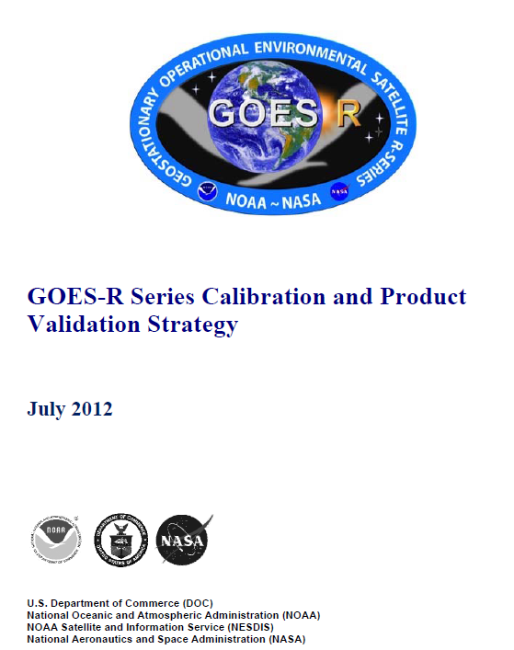
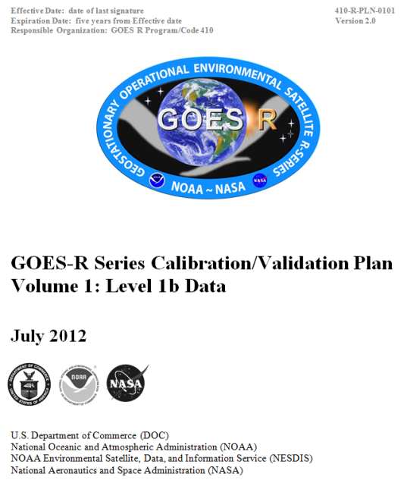
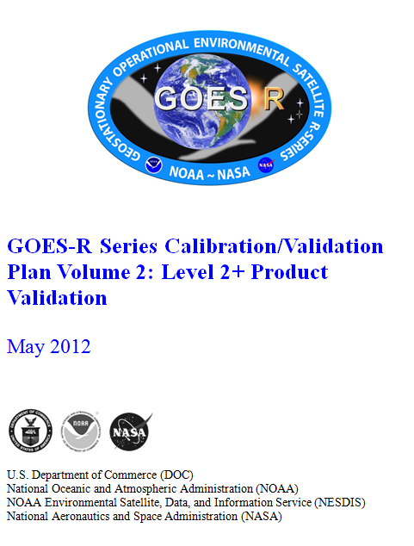
GOES-R Program Cal/Val Documents
Calibration and Product Validation Strategy
Cal/Val Plan Vol. 1: L1b Data
Cal/Val Plan Vol 2: L2+ Product Val
Scope, Organizations & Working Groups, Roles & Responsibilities, Resources, and Schedules
Cal/Val Methods and Processes
All documents at CDR-level - Scope defined, technical methods mature, organizational role and responsibilities and processes defined, resources allocated, and schedules defined.
Notes:
To-Do:

Slide 9
GOES-R Cal/Val Resources
Resource | Pre-Launch | Post-Launch Testing | Mission Operations
Data and Tools
Cal/Val, L0, L1b Data Archive/Storage | ✓ | ✓ | ✓
Models/Analysis Tools | ✓ | ✓ | ✓
GOES-R Portal and Web Sites | ✓ | ✓ | ✓
Facilities and Equipment
Vendor Offices, Manufacturing Centers, Test Labs/Equipment | ✓ | ✓
NIST Test Labs/Equipment | ✓
NASA Offices & Test Labs/Equipment | ✓ | ✓
NOAA Offices | ✓ | ✓ | ✓
Independent Test Facilities (e.g., Mass General Hospital) | ✓
Field Campaign Assets (e.g. SURFRAD, ARM) | ✓ | ✓ | ✓
Notes:
To-Do:

Slide 10
GOES-R Cal/Val Current Status/Updates
Instrument testing support:
Attending instrument Pre-Environmental Review and Pre-ship Review meetings
Cal-related testing activities:
Observing select ABI, SEISS, and EXIS testing
Analyzing vendor CDRL074 test results
Resolving discrepancies found in CDRL074 test results with respect to analysis performed by the vendor
Supporting L1b Algorithm and Instrument Cal Data Implementation
Preparations for Post-Launch Testing (PLT):
Creating “deep-dive” cal/val analysis tools
Assessing MSFC, NGDC, and STAR agency computing infrastructure needed to support post-launch GOES-R cal/val
Developing cal-related PLT Short Forms in collaboration with the MOST
Preparations for pre-launch system-level testing and PLT
Developing a GOES-R Cal/Val CONOPS, based on Harris GS design presentations and program-level cal/val plans
Developing a GOES-R Cal/Val OPSCON that describes processes needed to assess and maintain product integrity
Creating a cal-related PLT implementation tracking spreadsheet, based on GOES-R Cal/Val Plan Volume 1: L1b Data
Notes:
To-Do:

Slide 11
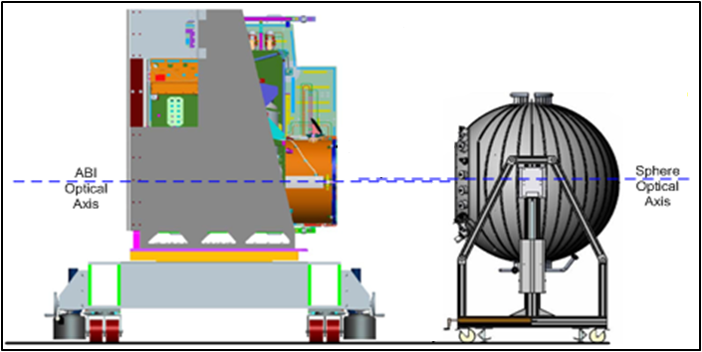
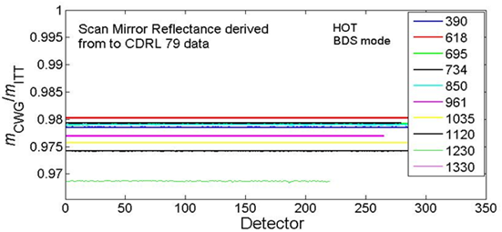
Instr Cal and Cal Test Report Review: ABI
CWG conducted detailed data analysis on pre-launch tests for proto-type model (PTM)
Reflective and emissive channel calibration
Coherent noise
Irradiance calibration
MTF-Focus-Registration
Exelis
CWG
Emissive (top) and Reflective (bottom) channel calibration test arrangement
Coherent noise test results
Anomalies caused by not using actual scan mirror reflectance value
Government analysis of vendor cal testing reports scrutinizes reproducibility of results and provides valuable feedback to the testing process.
Emissive (left) and reflective (right) channel calibration test results - ratio of CWG to Exelis cal coefficient

Slide 12
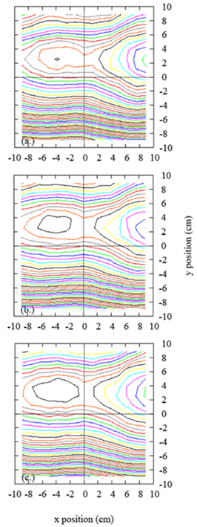
Instr Cal and Cal Test Report Review: NIST support for ABI and EXIS
Witness filter characterization (ongoing)
Reflective channel radiance scale validation via visible transfer radiometer (VXR) (planning)
FEL-based irradiance scale validation: uniformity test (completed)
Spectral response and irradiance characterization via SIRCUS (completed for PTM)
Characterization of external blackbody via thermal transfer radiometer (TXR) (completed)
EXIS testing at Synchrotron Ultraviolet Radiation Facillity-III (ongoing)
0.1% contours
Spatial uniformity setup
Traveling SIRCUS (Spectral Irradiance and Radiance Responsivity Calibration Using Uniform Sources)
Spatial uniformity results at three distances, z.
NIST testing provides independent validation of instrument performance and in some cases traceability to international standards.

Slide 13
Cal/Val Roadmap to Launch
Continue …
Cal testing and test report review and analysis
Ensuring proper implementation of L1b algorithms, Instrument Cal Data and operational monitoring
Creating “deep-dive” cal/val tools
Coordinating cal/val efforts between projects and with external operational cal/val support agencies
Cal/Val Related Post-Launch Test (PLT) Preparations
PLT detailed test planning will continue with CWG participation
Pre-launch System-level Testing Activities
Ensure ability to process data that have been collected during End-to-End Test III
Ensure correct cal parameter files are verified and are in place
Inspect and analyze data associated with instrument testing
Test out functionality of L1b “deep-dive” tools
Notes:
To-Do:

Slide 14
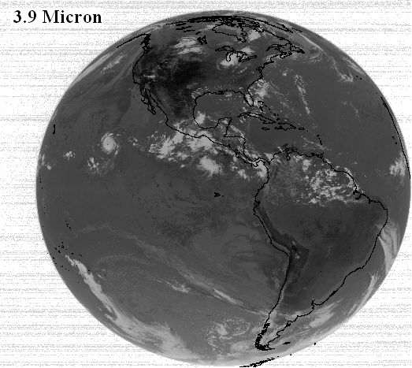
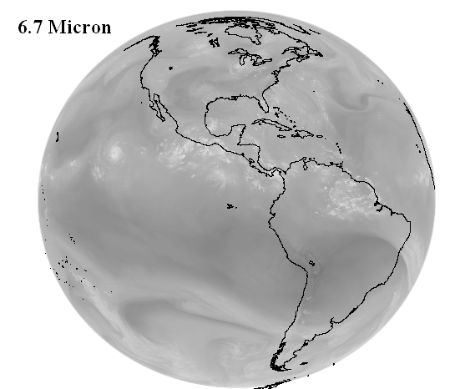
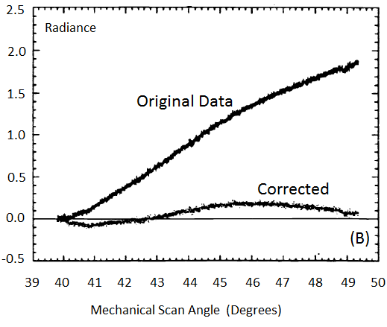
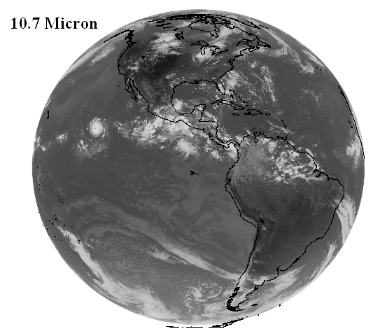
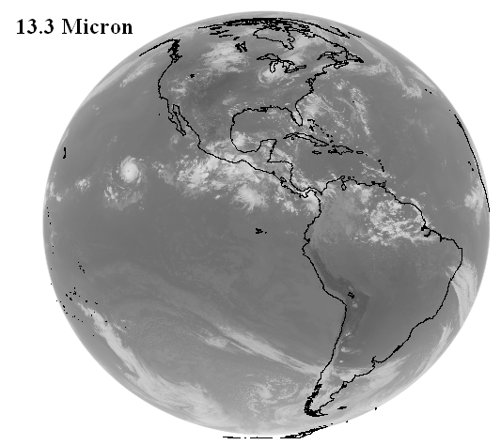
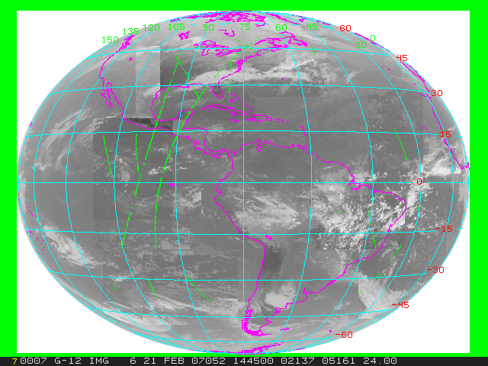
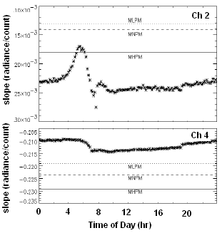
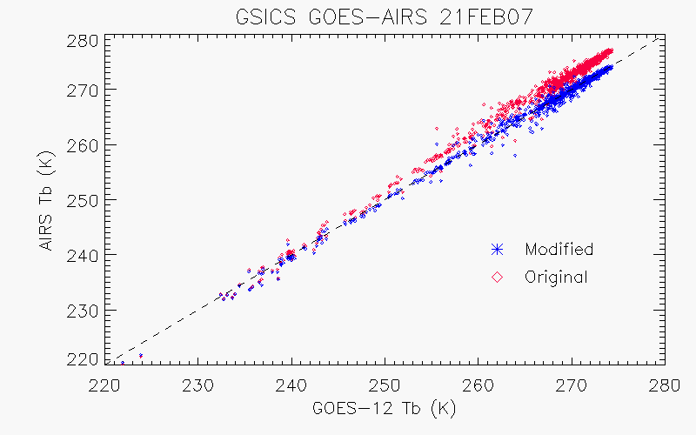
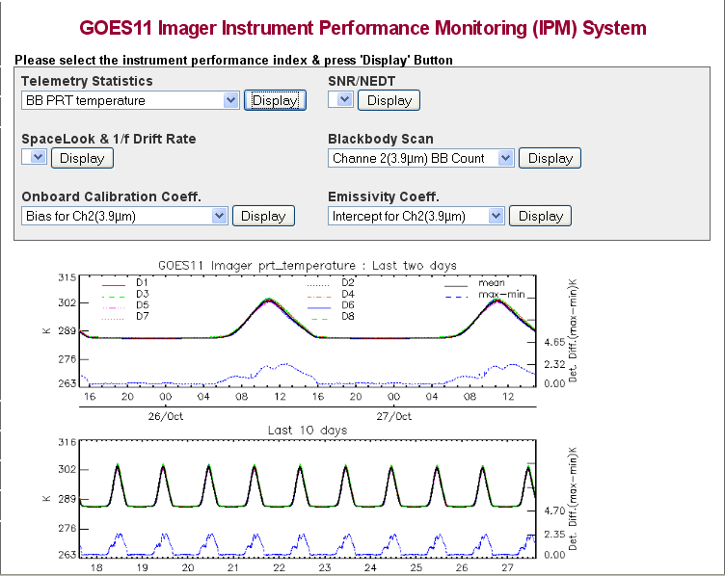
Post-launch Testing On-orbit Checkout
KPP product quality evaluation
Calibration input parameter evaluation
Radiance [mW/(m^2-sr-cm^-1)]
GOES-10 Ch. 4A Corrected and uncorrected Radiance vs. scan angle. (Beaucom et al., Proceedings of SPIE, 1999)
GOES-13 Hemispheric Image Tiles
On-board calibration system evaluation
Instrument Noise, Blackbody Temp and Cal Slope Monitoring
LEO Hyperspectral Sounder vs. GEO Inter-comparison (Courtesy of Wu et al.)
Notes:
To-Do:

Slide 15
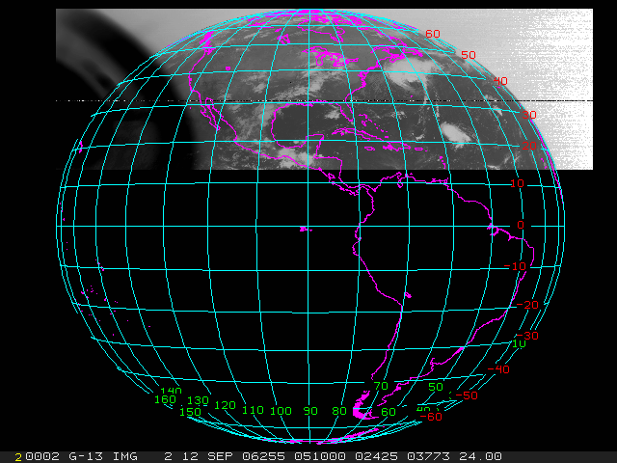
Post-launch Anomaly Resolution
Stray Light
GOES-13 Eclipse Season Stray Light
Strongly coordinated efforts between Cal Collaborators will be essential to success of post-launch instrument and L1b performance anomaly resolution efforts.
GOES-13 Eclipse Season Stray Light Before Fix (Top) and After Fix (Bottom) (Courtesy of J. Paul Douglas, OSPO)

Slide 16
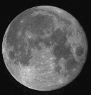
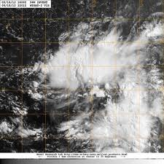
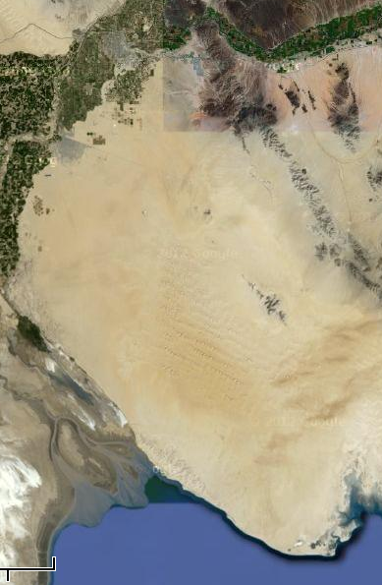
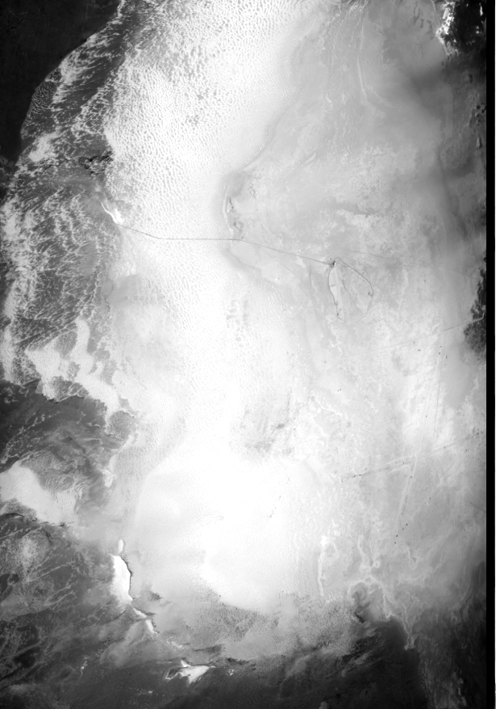
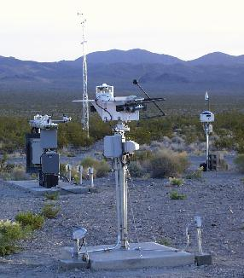
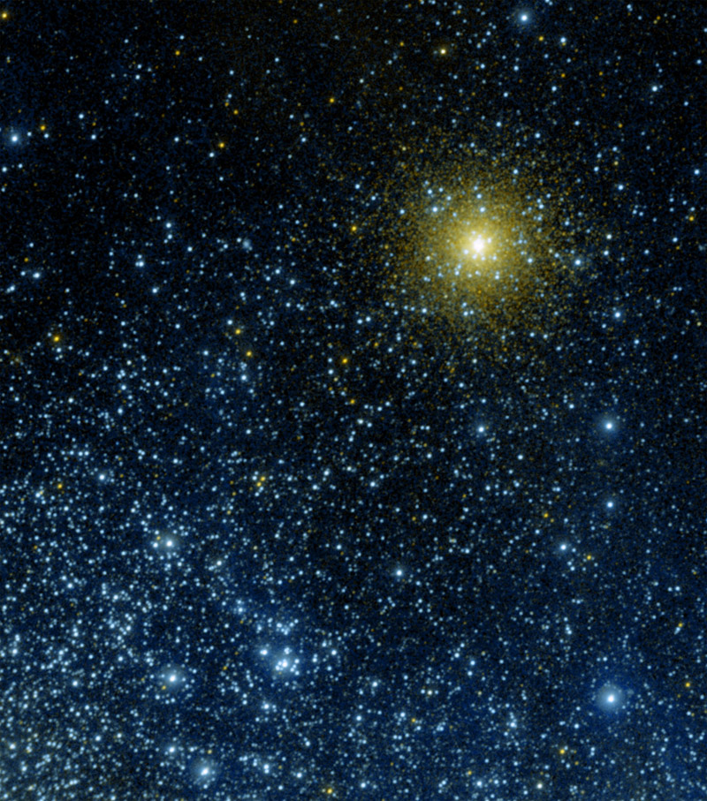
Post-Launch Testing Environmental Calibration Initialization
Activity near the end of PLT for L1b validation and creating a “state-of-the-cal” snapshot for long-term calibration trending
Vicarious Calibration
Satellite Inter-Calibration
Moon ABI Radiometric Cal, MTF and Band-to-band Registration
Deep Convective Clouds ABI and GLM Radiometric Cal
GEO-LEO ABI and GLM Radiometric Cal and INR
Sonora Desert
White Sands Missile Range
ARM and SURFRAD
GEO-GEO ABI and GLM Radiometric Cal and INR
Stars ABI Radiometric Cal
Desert and Instrumented Sites ABI Radiometric Cal

Slide 17
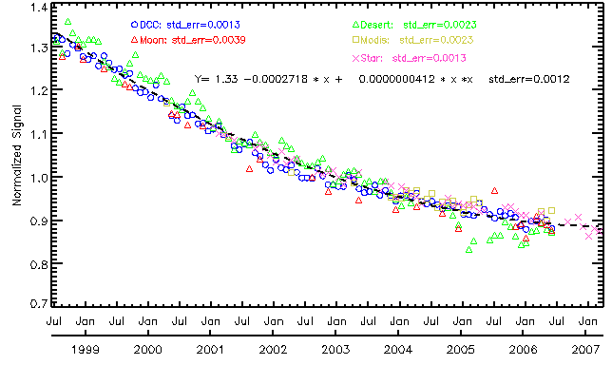
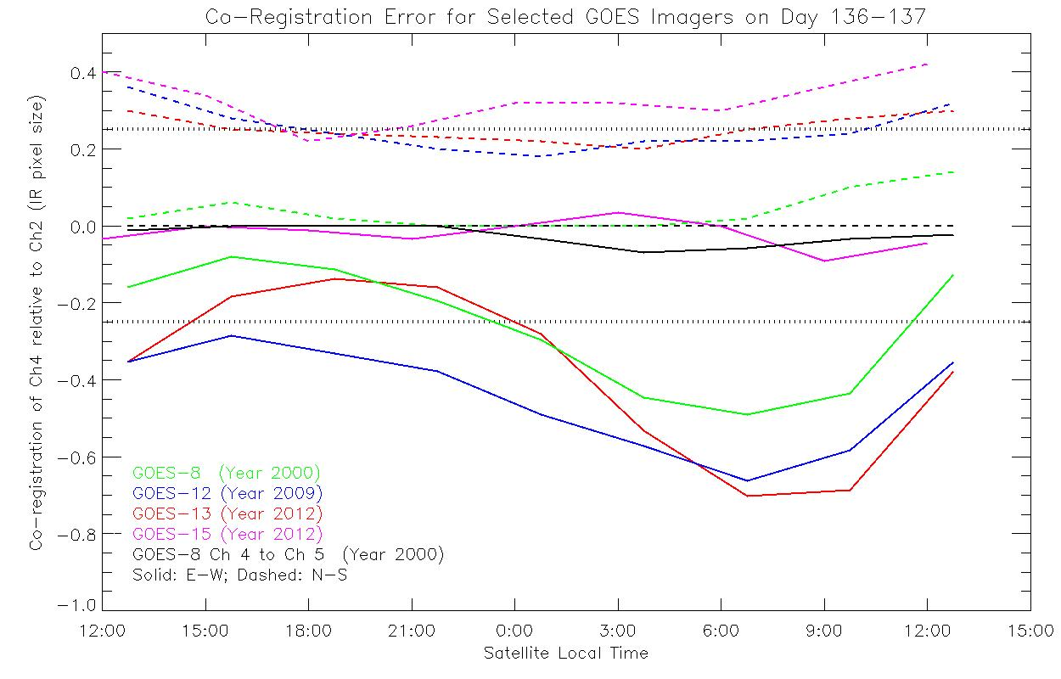
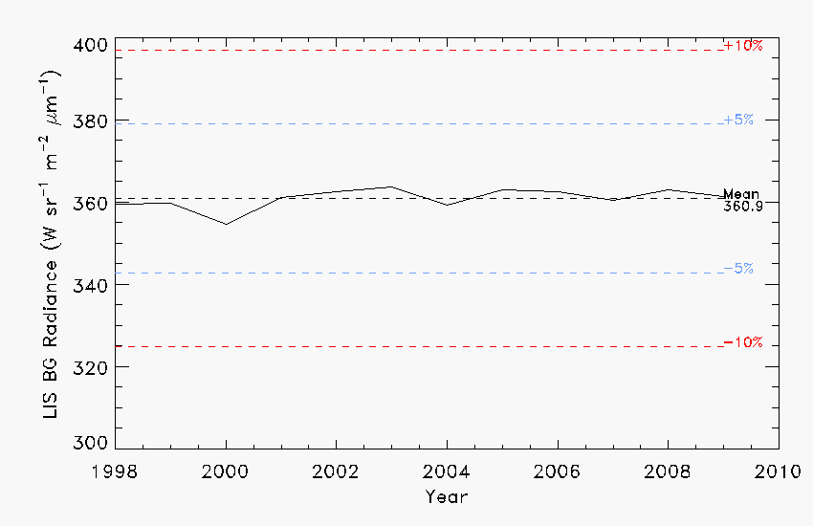
Mission-life sensor parameter and derived product trending
Application of ABI Long-term Radiometric Performance tool to GOES-10. (Wu et al., GSICS Monthly Web Seminar, Dec. 2011, https://gsics.nesdis.noaa.gov/wiki/ Development/20111213)
GOES-10
Application of ABI Co-Registration Validation tool to the GOES Imager. (Grotenhuis, Proc. SPIE 8510, 85101T 2012.)
Tropical Rainfall Measurement Mission Lightning Imaging Sensor (LIS)
Cal activities required during GOES-R acquisition enables long-term monitoring, analysis and maintenance of GOES-R product quality after Handover.
Application of GLM Long-term Radiometric Performance tool to LIS (Buechler et al., Atmos. Res., 2012)

Slide 18
Summary
GOES-R has a comprehensive cal/val program to ensure product integrity
Cal/Val Strategy
Cal/Val Plans
Cal/Val CONOPS&OPSCON
GOES-R leveraging diverse complementary technical capabilities and resources
Provide life cycle cal/val support for a successful GOES-R program
Notes:
To-Do:

Slide 19
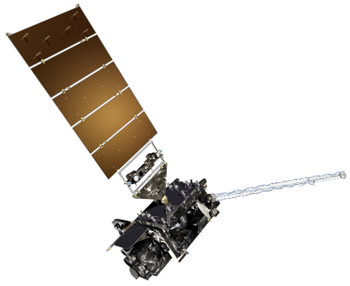
GOES-R Pre-Launch Milestones
 | 2010 | 2011 | 2012 | 2013 | 2014 | 2015
Program/System
Flight Segment
Ground Segment
System Design Review complete
Mission PDR Part I
Launch Readiness Oct. 2015
Mission PDR Part II
Mission CDR
Spacecraft
S/C PDR complete
S/C SDR complete
S/C CDR
ABI Delivery
Instruments
ABI Delta CDR complete
EXIS Delivery
GLM Delivery
All instruments have passed CDR
MAG Delivery
SEISS Delivery
SUVI Delivery
Core GS PDR completed
Core GS CDR
RBU/NSOF/WCDAS installation
Antenna System CDR
Antenna System PDR completed
GS Project PDR complete
WCDAS complete
ESPDS CDR
RBU complete
100 % delivery of baseline product algorithms
CLASS CDR
NSOF complete
GS Project CDR
Development Integration and Testing
Notes:
To-Do:

