Slide 1
S-NPP VIIRS Performance and SDR Data Quality
Changyong Cao (NOAA STAR)
Jack Xiong (NASA GSFC)

Slide 2
Acknowledgements
  VIIRS SDR Team Members
  NOAA/NESDIS/STAR
  The Aerospace Corporation
  NASA/VCST
  University of Wisconsin
  MIT Lincoln Laboratory
  Raytheon
  NGAS
  DPA/ADP
  NCEP Users
  NSOF
  EDR/SDR
  CLASS
  JPSS
  NJO

Slide 3
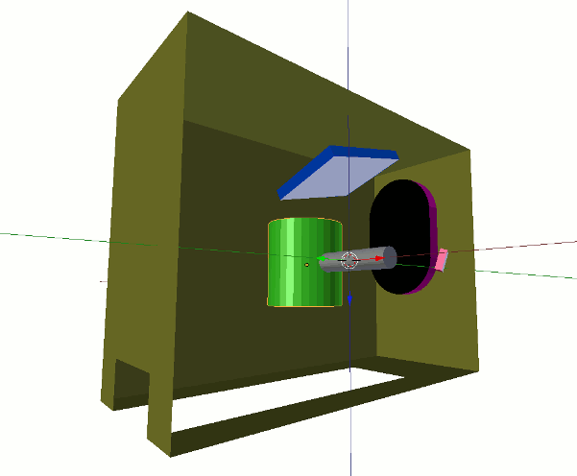
The VIIRS Instrument
Courtesy of D. Pogo
Significance of VIIRS:
MODIS
AVHRR
SeaWiFS/MERIS
OLS
Source: VIIRS SDR User’s Guide https://cs.star.nesdis.noaa.gov/NCC/VIIRS

Slide 4
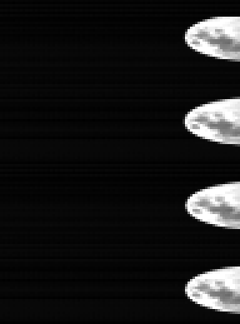
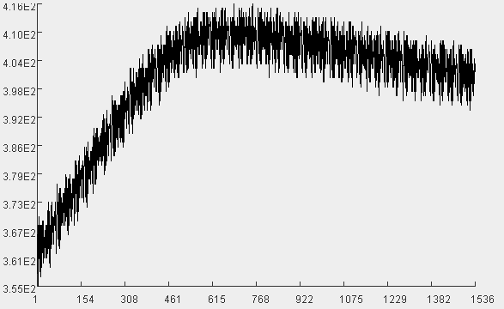
VIIRS Onboard Calibration Comparisons
VIIRS | MODIS | AVHRR
Rotating telescope w/ half angle mirror | Paddle Mirror (large RVS effect) | 45 deg mirror (image pixel rotation at high scan angles)
V-Grooved Blackbody | V-Grooved Blackbody | Honeycomb Blackbody
Space view | Space view | Space view
Solar diffuser + screen (VISNIR+DNB) | Solar diffuser +screen+door (VISNIR) | Vicarious (desert)
Solar diffuser stability monitor | Solar diffuser stability monitor | -
Lunar cal | Lunar cal | -
None | SRCA | None
VIIRS solar diffuser view
I2 band
Source: VIIRS SDR User’s Guide (v1.01)
https://cs.star.nesdis.noaa.gov/NCC/VIIRS
VIIRS
Moon in space view I2 band
4

Slide 5
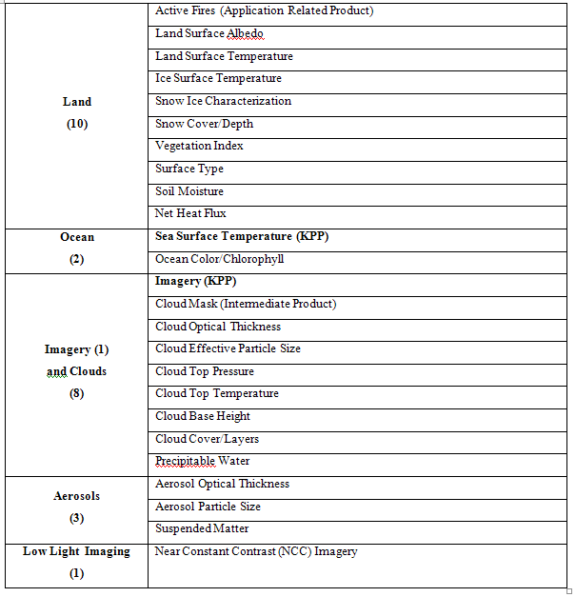
Environmental Data Products (EDRs)
Derived from VIIRS SDRs
*

Slide 6
Comparison of MODIS & VIIRS Bands
MODIS |  | VIIRS
Band | λ (nm) | λ (nm) | Band
1 | 620 – 670 | 600 - 680 | I-1
2 | 841 – 876 | 846 - 885 | I-2
3 | 459 - 479
4 | 545 - 565 | 545 - 565 | M-4
5 | 1230 - 1250 | 1230 - 1250 | M-8
6 | 1628 - 1652 | 1580 - 1670 | M-10
 |  | 1580 - 1640 | I-3
7 | 2105 - 2155 | 2225 - 2275 | M-11
8 | 405 – 420 | 402 - 422 | M-1
9 | 438 – 448 | 436 - 454 | M-2
10 | 483 – 493 | 478 - 498 | M-3
11 | 526 - 536
12 | 546 – 556
13 | 662 - 672 | 662 - 682 | M-5
14 | 673 - 683
15 | 743 – 753 | 749 - 754 | M-6
16 | 862 - 877 | 846 - 885 | M-7
17 | 890 - 920
18 | 931 - 941
19 | 915 - 965
MODIS |  | VIIRS
Band | λ (µm) | λ (µm) | Band
20 | 3.660 - 3.880 | 3.598 - 3.791 | M-12
 |  | 3.550 - 3.930 | I-4
21 | 3.929 - 3.989
22 | 3.940 - 4.001
23 | 4.020 - 4.080 | 3.973 - 4.128 | M-13
24 | 4.433 - 4.498
25 | 4.482 - 4.549
26 | 1.360 - 1.390 | 1.371 - 1.386 | M-9
27 | 6.535 - 6.895
28 | 7.175 - 7.475
29 | 8.400- 8.700 | 8.400 - 8.700 | M-14
30 | 9.580 - 9.880
31 | 10.780 - 11.280 | 10.263 - 11.263 | M-15
 |  | 10.500 - 12.400 | I-5
32 | 11.770 - 12.270 | 11.538 - 12.488 | M16
33 | 13.185 - 13.485
34 | 13.485 - 13.785
35 | 13.785 - 14.085
36 | 14.085 - 14.385
MODIS Bands 1-2 are 250 m at Nadir
MODIS Bands 3-7 are 500 m at Nadir
MODIS Bands 8-36 are 1,000 m at Nadir
VIIRS Bands I1-I5 are 375 m at Nadir
VIIRS Bands M-1-M-16 are 750 m at Nadir

Slide 7
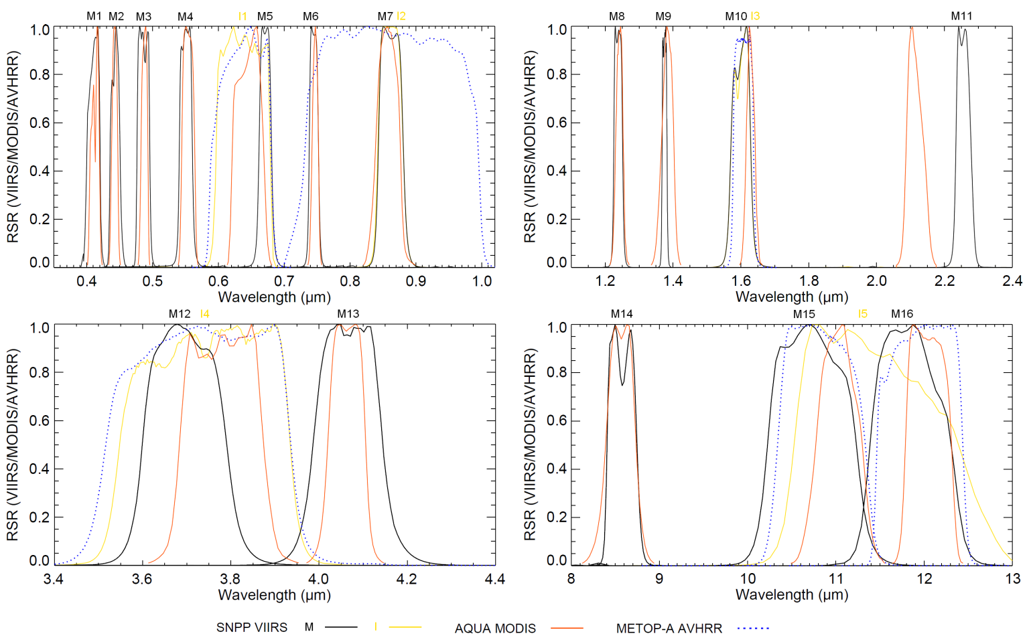
VIIRS, AVHRR, and MODIS Spectral Response Comparisons

Slide 8
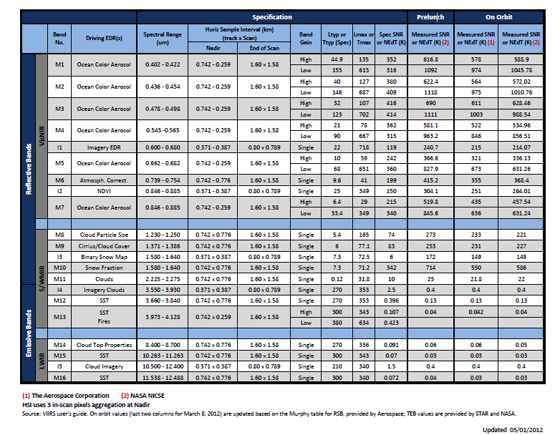
VIIRS Sensor Data Records (SDRs)
SDRs = L1B = calibrated, geolocated radiance, reflectance and brightness temperature
22 types of SDRs
  16 moderate resolution radiometric (M-bands),
    11 Reflective Solar Bands (RSB)
    5 Thermal Emissive Bands (TEB)
  5 imaging (I-bands),
    3 RSB; 2 TEB
  1 Day Night Band (DNB) imaging, broadband
6 non-gridded geolocation products
  DNB, IMG, IMG terrain corrected, MOD, MOD terrain corrected, MOD unaggregated
2 gridded geolocation products
  MOD, IMG

Slide 9
Cal/Val to Ensure Product Maturity
Beta (L+150)
  Early release product, initial calibration applied, minimally validated and may still contain significant errors
  Available to allow users to gain familiarity with data formats and parameters
  Product is not appropriate as the basis for quantitative scientific publications studies and applications
Provisional (Beta+2mo)
  Product quality may not be optimal
  Incremental product improvements are still occurring as calibration parameters are adjusted with sensor on-orbit characterization
  General research community is encouraged to participate in the QA and validation of the product, but need to be aware that product validation and QA are ongoing
  Users are urged to contact NPP Cal/Val Team representatives prior to use of the data in publications
Validated/Calibrated (L+20mo)
  On-orbit sensor performance characterized and calibration parameters adjusted accordingly
  Ready for use by the Centrals, and in scientific publications
  There may be later improved versions
  VIIRS 58 Cal/Val tasks
Functional Performance &
Format Evaluation (7)
Calibration System
Evaluation (7)
Image Quality Evaluation (4)
Radiometric Evaluation (24)
Geometric Evaluation (9)
Performance and Telemetry
Trending (7)
VIIRS SDR team Weekly telecons, reports, technical tagup, SDR/EDR interactions, blogs, and wiki.

Slide 10
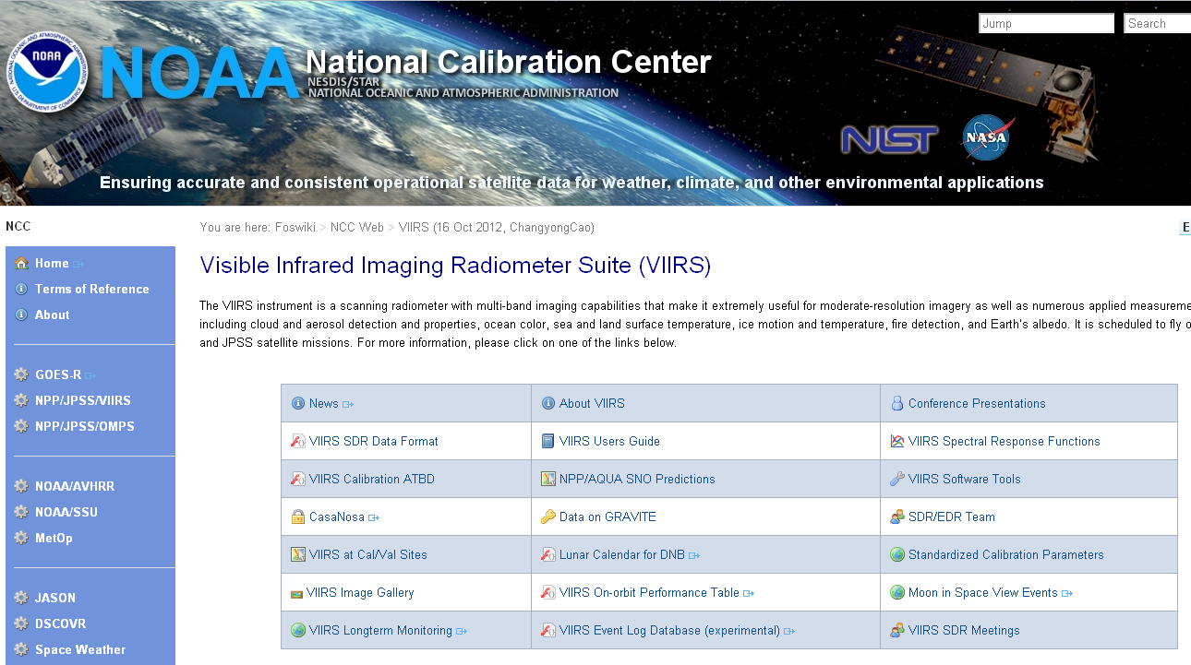
VIIRS SDR Data Access and Calibration Knowledge Base
The VIIRS SDR team developed the Calibration Knowledge base and made available on the website at https://cs.star.nesdis.noaa.gov/NCC/VIIRS with a wealth of information including user’s guide, relative spectral response, SNO predictions, image gallery, conference presentations, etc.
The VIIRS SDR User’s Guide is being actively maintained and updated (Version 1.1 as of Feb. 2013).
VIIRS publication database added recently
VIIRS SDR data is now open to the public on the NOAA CLASS archive at http://www.class.noaa.gov

Slide 11
RSB Radiometric Performance
May 2012
average
SNR performance is exceeding requirements for all bands

Slide 12
TEB Radiometric Performance
average
NEdT performance is exceeding requirements for all bands

Slide 13
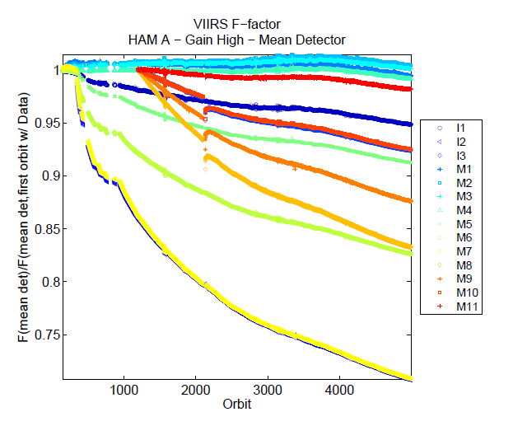
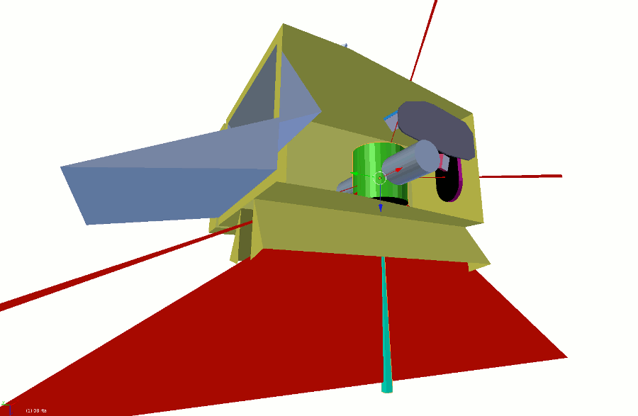
VIIRS Rotating Telescope Assembly (RTA)
Mirror Degradation
VIIRS RTA mirror degradation continues as predicted (currently about ~30% in the 0.86um bands)
Root cause of the degradation is traced to Tungsten/Tungsten oxide contamination of the RTA mirrors in the manufacturing process prelaunch
The impact of the responsivity degradation is mitigated through weekly calibration updates
The remaining effect of the degradation is decreased signal to noise ratio, and small spectral change, although the impacts to products are still negligible
0.86um bands
VIIRS RTA mirror degradation since launch
Solar diffuser
BB view
The VIIRS RTA degradation is quantified by its response to the onboard solar diffuser
SV
Earth view

Slide 14
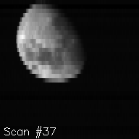
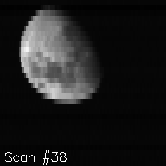
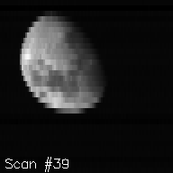
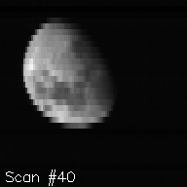
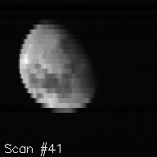
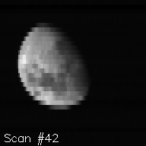
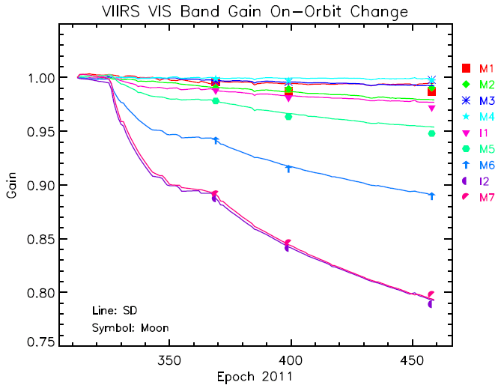
Roll Maneuvers - Lunar Calibration
VIIRS lunar observations have been made via SC roll maneuvers; different roll angles used
to keep lunar phase angles to within a small range
Examples of band I1 lunar images from 6 consecutive scans (Jan 4, 2012)
Corrections for lunar view geometry differences applied using the ROLO model (USGS)
Lunar observations are used to track VIS/NIR calibration stability
Lunar Cal generally agrees with SD Cal
Difference to be expected as a result of mirror deg. impact on sensor RSR
Notes:
Lunar observations are used to track, independent of SD calibration, on-orbit changes in RSB response.

Slide 15
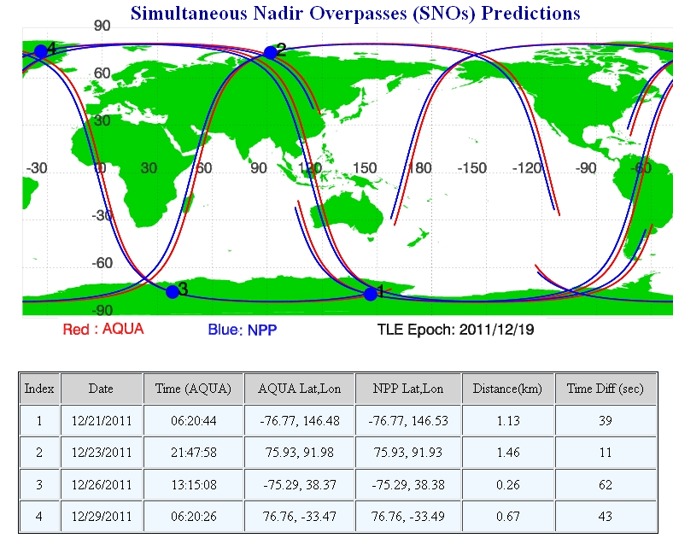
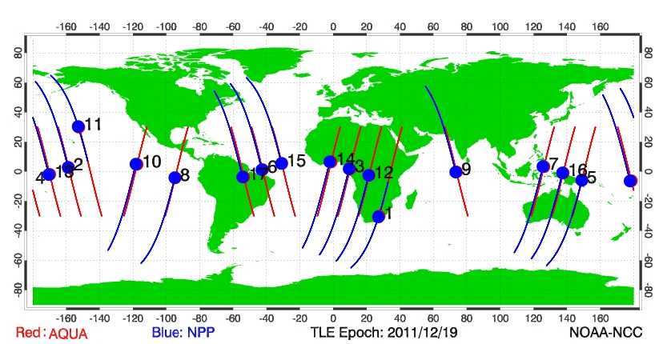
SNO and SNO extension to the Low Latitudes (SNOx) - Aqua/MODIS vs. SNPP/VIIRS
 | SNO | SNOx
Time diff | 30 sec | ~10 mins
Nadir distance | < 10 km | ~100 km
Location | Polar regions | Low latitudes
Surface | Snow/ice/ tundra | Ocean, desert, forest, etc.
Uncertainty factors | High solar zenith angle (sza), ozone, ground truth | Sun glint, clouds, atmosphere, sza diff
Use for inter-comparisons | Radiometric, Spectral | Radiometric, Geospatial, RVS, spectral
SNO (Simultaneous Nadir Overpass)
Seoul
SNOx = SNO extension to low latitudes
Taiwan
Hong Kong
Hong Kong
Macau
Shanghai
The SNO/SNOx as well as daily SNPP orbital predictions are available at: https://cs.star.nesdis.noaa.gov/NCC/SNOPredictions

Slide 16
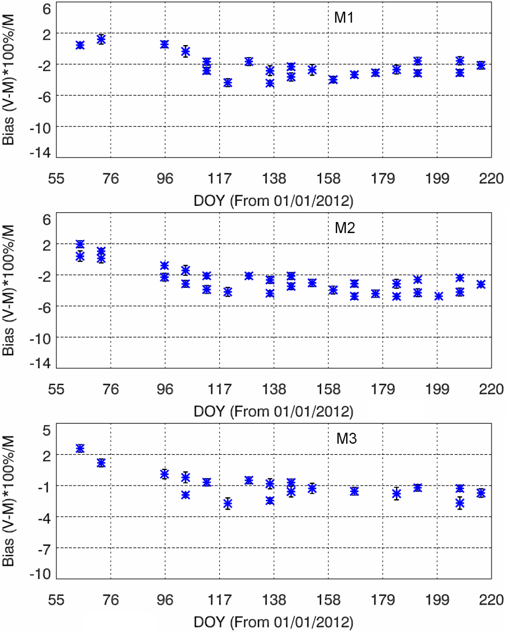
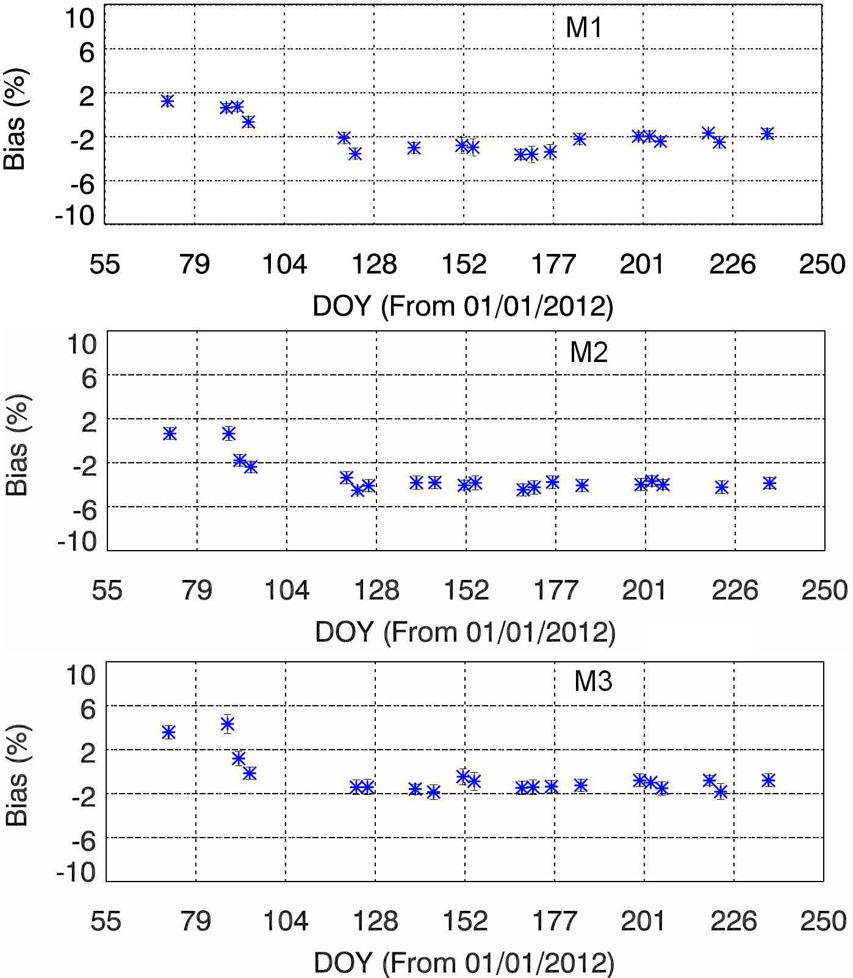
VIIRS Bias Time Series Using SNO-x
Desert
Ocean Surface
VIIRS bias relative to MODIS decreased by 4% during early April.
The decreasing bias trend is consistent at both ocean surface and Desert.

Slide 17
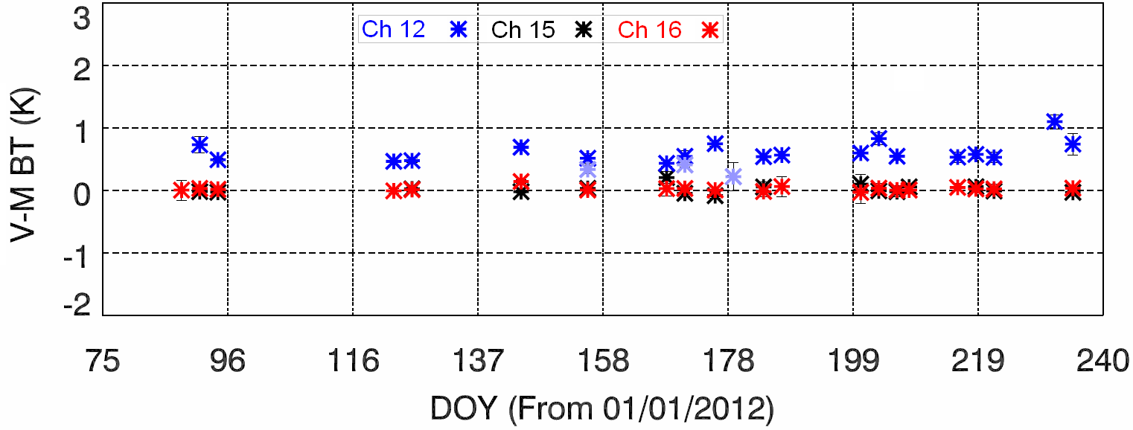
TEB band Biases at SNOx

Slide 18
VIIRS Geospatial Performance
Geolocation ~80 m or ¼ I-band pixel
Band to band co-registration:
  I-bands 2x2 pixels nested into 1 M-band pixel
  80% overlap in both scan and track direction
MTF
  Preliminary evaluation show good performance based on lunar and Lake Pontchartrain Bridge
More details can be found in Wolfe et al. 2012, SPIE paper

Slide 19
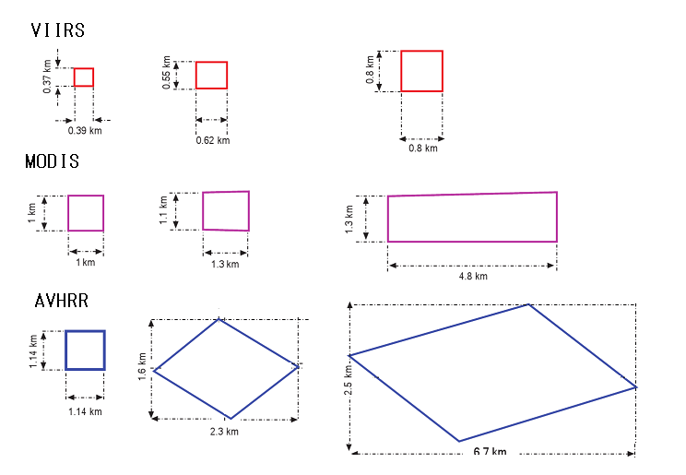
VIIRS excellent scan geometry and controlled pixel growth off-nadir
2km

Slide 20
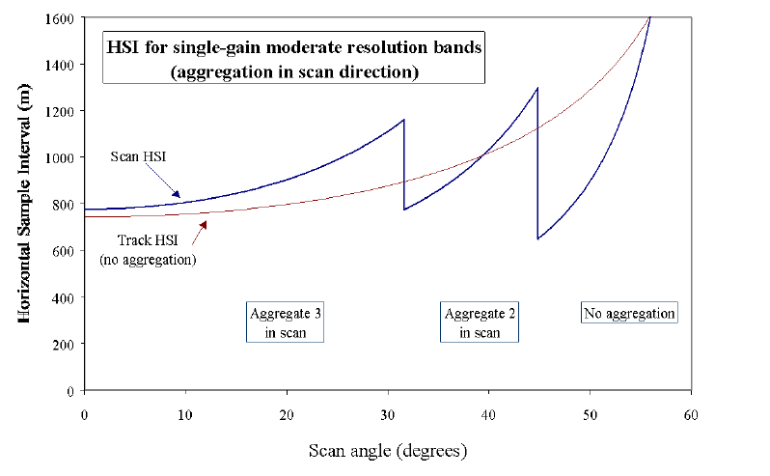
Control Pixel Size Growth Off-Nadir

Slide 21
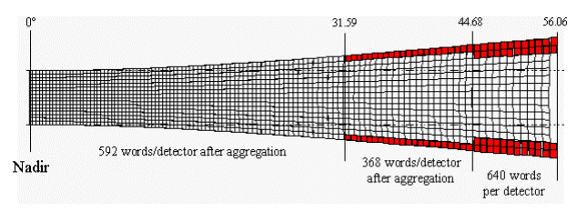
VIIRS Bow-tie Deletion and Aggregation
Source: VIIRS geolocation ATBD

Slide 22
VIIRS Swath Width 3000km with no Gap between Orbits

Slide 23
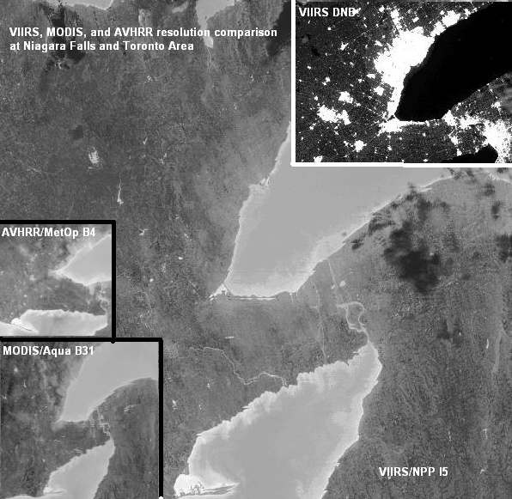
VIIRS infrared and DNB imagery enable regional and metropolitan area night time monitoring
VIIRS infrared imagery with spatial resolution 375m significantly outperforms similar bands of MODIS and AVHRR(1 km)
The finer resolution of VIIRS enables environmental monitoring in regional and greater metropolitan areas especially at night
Example shows night time imagery of the Niagara Falls region in the 12um band, with urban areas being warmer than surrounding regions
City night lights (upper right inset) not only shows the urban development, but may also allow monitoring of power outages
Toronto
Niagara Falls

Slide 24
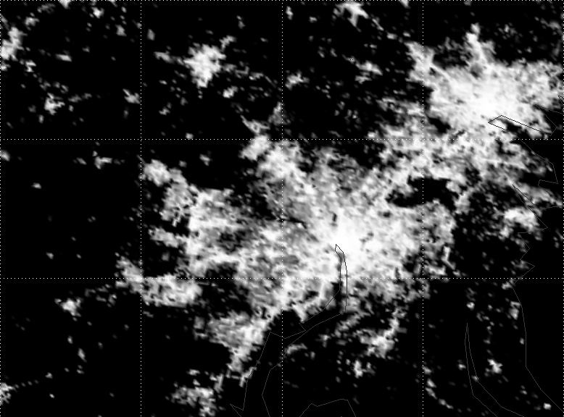
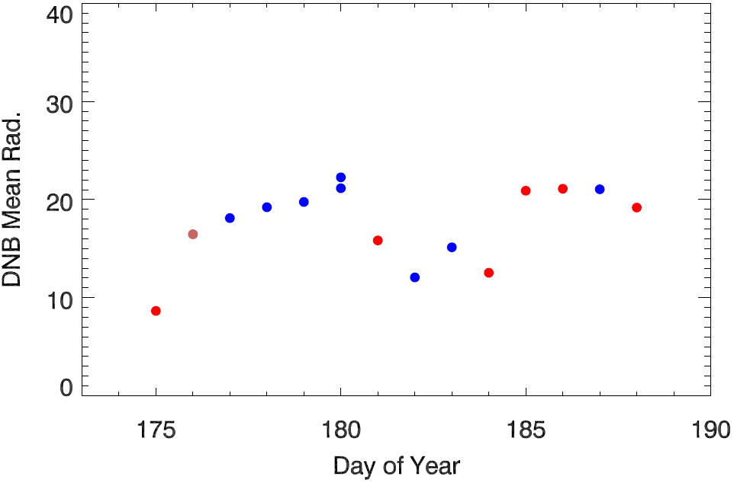
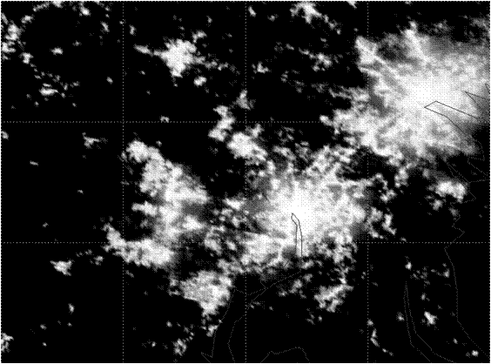
Power Outage Detection
Despite the straylight effect, the Day/Night Band has been used to detect a major power outages in the Washington, DC on the night of the Direcho storm on June 29, 2012.
An analysis of the data after the storm showed that most areas had power restored within 3 days.
Blue: mostly clear sky
Red: Cloudy
ROI: (101 by 71 pixels)
~ 64 km × 64 km
06/29
07/06
07/02
06/23
06/30
VIIRS DNB of the Washington/Baltimore area on June 26th (top)and June 30th.
The suburbs west of DC and Baltimore, in particular show dark areas.
VIIRS DNB radiance time series before and after the power outage (6/29) shows that most of the power was restored in three days.

Slide 25
Challenges and Way Forward
Instrument responsivity degradation
Early VIIRS SDR data and reprocessing
DNB straylight mitigation
Further investigation on striping
Instrument and spacecraft maneuver
A-side vs. B-side
Other issues
Transition to operations
J1, J2 and beyond

Slide 26
Summary
VIIRS Geolocation – Excellent (Provisional)
VIIRS Radiometry (provisional)
  Extensive pre-launch test program provided highly accurate calibration onorbit
  SNR performance is consistent with pre-launch measurements and complies with requirements
  Data quality is comparable or better than that of MODIS
  RSB throughput degradation is being monitored and its effect mitigated
  DNB images are excellent except in regions affected by stray light
VIIRS Spectral – Provisional (modulated RSR available for user evaluation)
New VIIRS capabilities will lead to more novel applications
Reference:
  Cao, C., F. Deluccia, X. Xiong, R. Wolfe, and F. Weng, Early On-orbit Performance of the Visible Infrared Imaging Radiometer Suite (VIIRS) onboard the Suomi National Polar-orbiting Partnership (S-NPP) Satellite, TGRS, 2013, In press.

Slide 27
Backup slidles

Slide 28
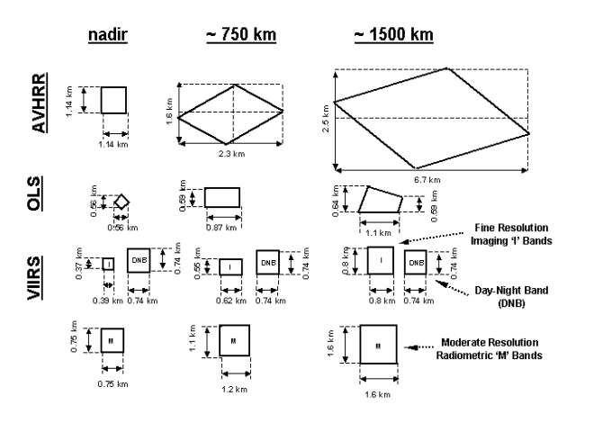
VIIRS Geometric Characteristics
Source: VIIRS geolocation ATBD

