Slide 1
Suomi NPP CrIS
Operational Status and SDR Data Quality
Denis Tremblay, Yong Han, Dan Mooney, Hank Revercomb, Deron Scott, Larrabee Strow, Degui Gu, Joe Predina
GSICS Annual Meeting
Williamsburg, VA, USA, March 2013

Slide 2
Outlines
CrIS Measurement Characteristics
Post-launch calibration
  Radiometric calibration
  Spectral calibration
  Geo-location calibration
  Instrument and SDR stability monitoring
CrIS Inter-Sensor Comparison
  Covered by the following talk
Summary

Slide 3
Team Members
Affiliation | Lead | Team members
NOAA/STAR | Yong Han (Team lead) | Denis Tremblay, Xin Jin, Likun Wang, Yong Chen
NASA | Dave Johnson
MIT | Dan Mooney
University of Wisconsin | Hank Revercomb | Dave Tobin, Daniel DeSlover, Lori Borg, Bob Knuteson
SDL, Utah State University | Deron Scott | Mark Esplin, Validimir Zavyalov, Gail Bingham
Exelis | Joe Predina | Lawrence Suwinski, Mike Cromp
UMBC | Larrabee Strow | Howard Motteler, Paul Schou, Scott Hannon
NGAS | Degui Gu | Lihong Wang, Denise Hagan, Chunming Wang
Raytheon | Wael Ibrahim | Tim Gardner
Team members include government, academia, and private sector.

Slide 4
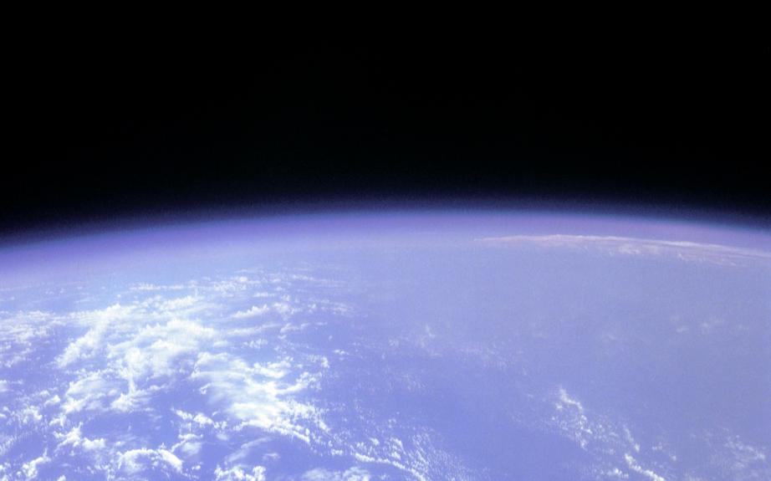

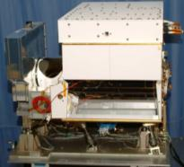
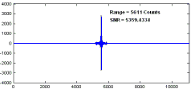

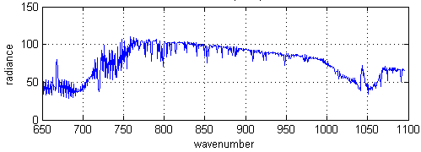
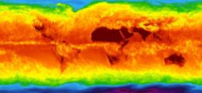
CrIS Operational Concept
CrIS on NPP
RDR = Raw Data Record
SDR = Sensor Data Record
EDR = Environmental Data Record
±50°
Cross track Scans
Downlink
RDRs
RDRs
Decode Spacecraft Data
30 Earth Scenes
Interferograms
Ground Station
SDRs
2,200 km Swath
CrIS SDR Algorithm
Calibrated / Geolocated Spectra
3x3 Array of CrIS FOVs (Each at
14-km Diameter)
EDRs
Co-Located ATMS SDRs
NWP, EDR Applications
Global Temperature, Moisture, Pressure Profiles
From Exelis

Slide 5
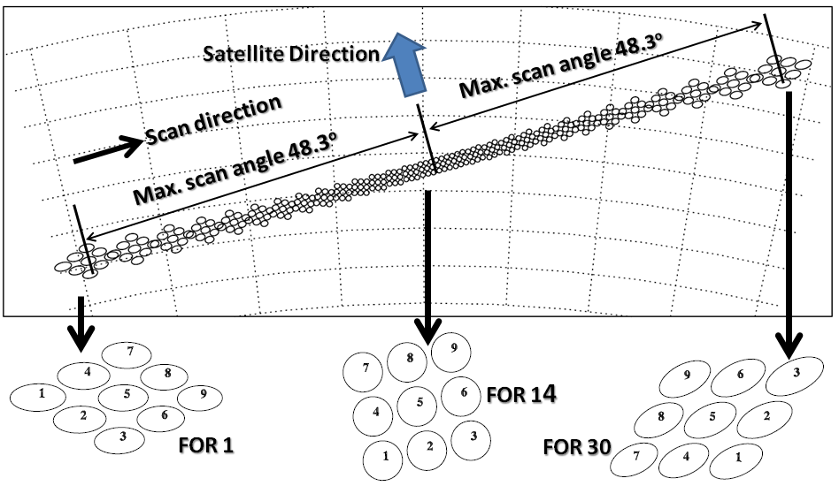
CrIS Scan Pattern
North
(~50km, nadir)
FOV – Field OF View
FOR – Field OF Regard
FOV (14km, nadir)
Swath is 2200 Km (FOR1 to FOR 30).
CrIS acquires 1 scan line every 8 seconds.
CrIS measures 8.7 million spectra per day.

Slide 6
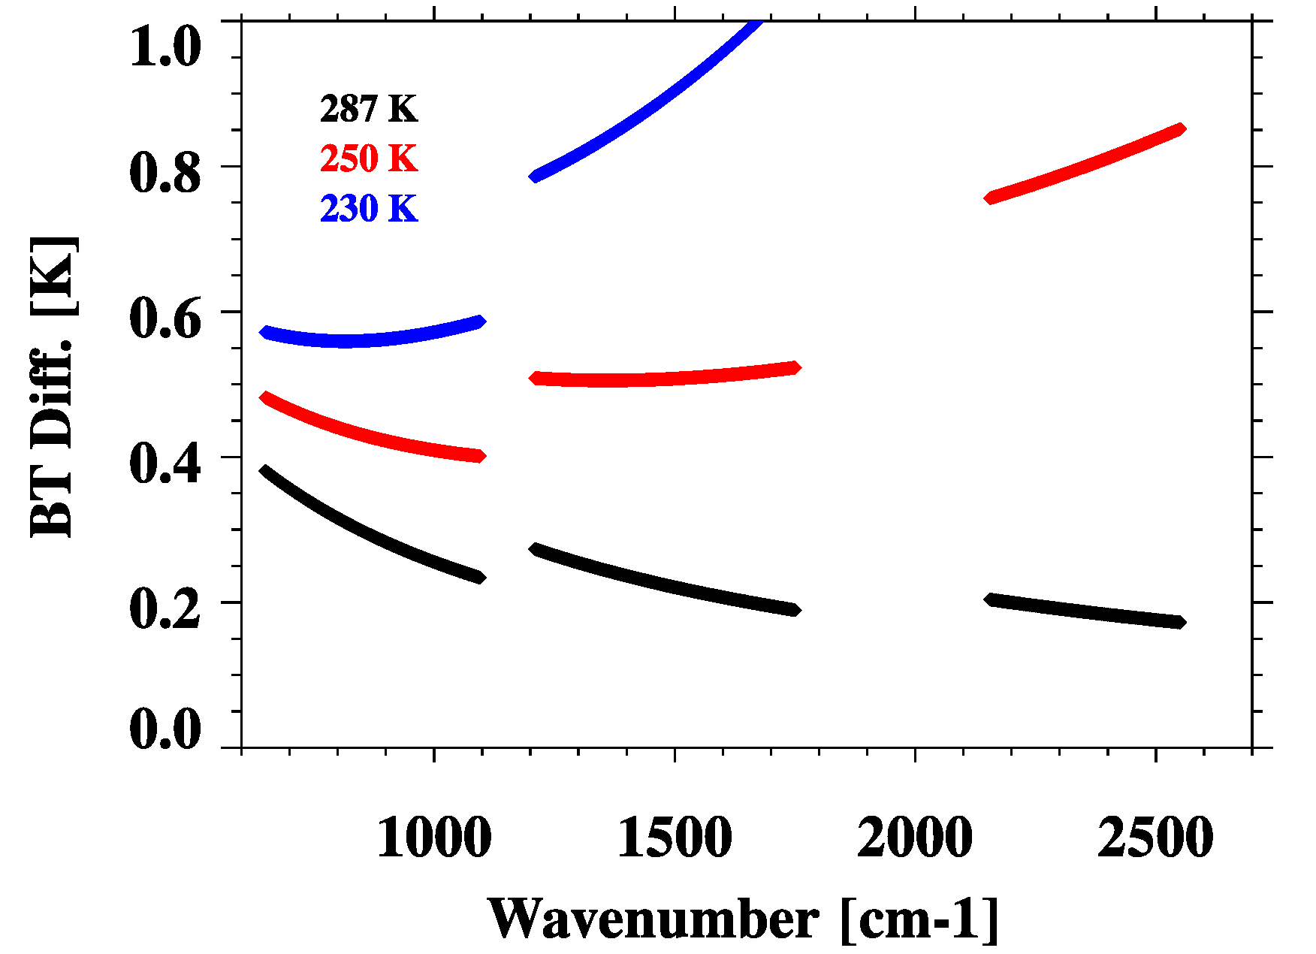
NPP CrIS Sensor Data Record
Calibration Uncertainty Specifications
SDR Calibration Uncertainty
Band | Spectral range (cm⁻¹) | N. of chan. | Resolution (cm⁻¹) | FORs per Scan | FOVs per FOR | NEdN @287K BB mW/m²/sr/ cm⁻¹ | Radiometric Uncertainty @287K BB (%) | Spectral (chan center) uncertainty ppm | Geolocation uncertainty km
LW | 650-1095 | 713 | 0.625 | 30 | 9 | 0.14 | 0.45 | 10 | 1.5
MW | 1210-1750 | 433 | 1.25 | 30 | 9 | 0.06 | 0.58 | 10 | 1.5
SW | 2155-2550 | 159 | 2.5 | 30 | 9 | 0.007 | 0.77 | 10 | 1.5
Radiometric uncertainty specification converted to that expressed in brightness temperature
NEdT, ⁰K
From Vladimir Zavyalov of SDL

Slide 7
CrIS Cal/Val Milestones
January 18th 2012: CrIS was powered up; team started instrument checkout and optimization.
February 8th : Engineering packet v32 was uploaded (PGA setting and bit trim mask updates).
February 22nd : Full spectral resolution RDRs (0.8 cm maxOPD for all bands) were collected.
April 11th : Engineering packet v33 was uploaded (spectral calibration parameters, nonlinearity coefficients and ICT emissivity table updates).
April 18th: A new FIR digital filter was uploaded to replace the corrupted one.
May 15th : CrIS SDR product reached Beta maturity level .
October 15th : CrIS Gelocation errors are fixed
October 23rd , CrIS SDR Provisional Review
February 13th , 2012 CrIS SDR Provisional Declaration
Radiometric
Spectral
Spatial

Slide 8
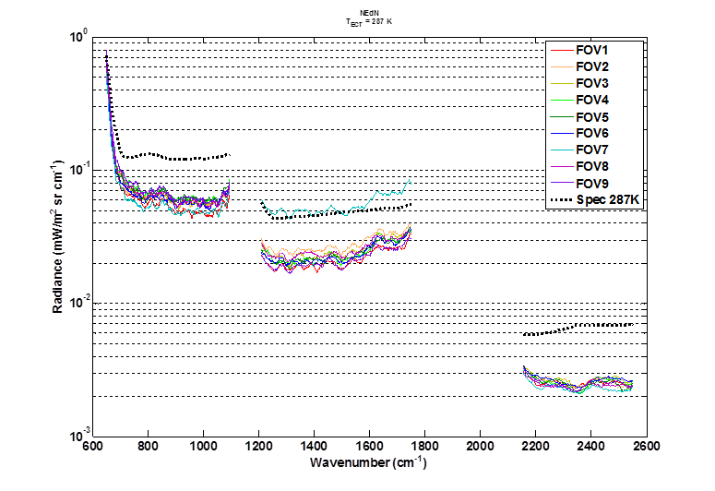
Instrument Noise
Overall Performance
NEdN at selected wavenumber ranges
The large NEdN at MW FOV 7 is a known issue before NPP launch
The noise levels are much better than the specification

Slide 9
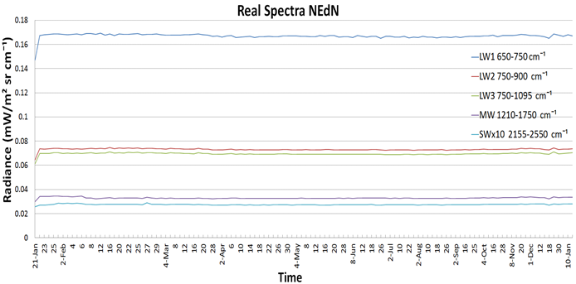
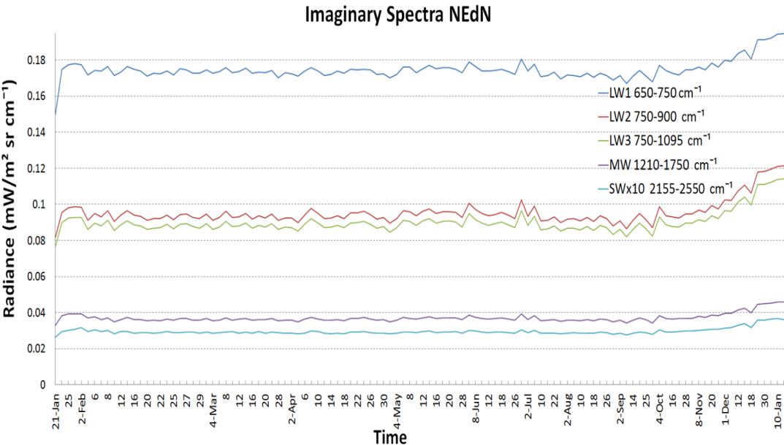
Instrument Noise
NEdN Trend
Deep Space Derived Average NEdN
Real spectra NEdN
Imaginary spectra NEdN
From SDL
NEdN is very stable in real part of the DS spectra over all spectral bands ( CrIS SDR)
NEdN is increasing in the imaginary part of the DS spectra over all spectral bands (~30-40%)
NEdN was averaged over all FOVs and over spectral regions:
LWIR: 650-750 ; 750-900; and 750-195 cm⁻¹
MWIR: Entire band 1210-175 cm⁻¹
SWIR: Entire band 2155-2550 cm⁻¹

Slide 10
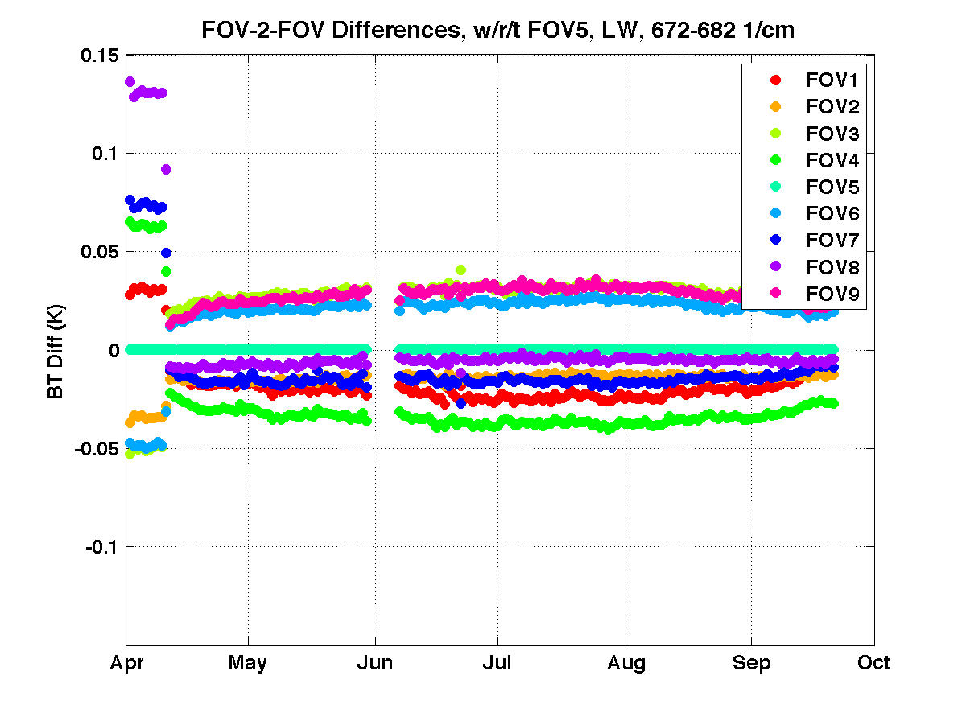
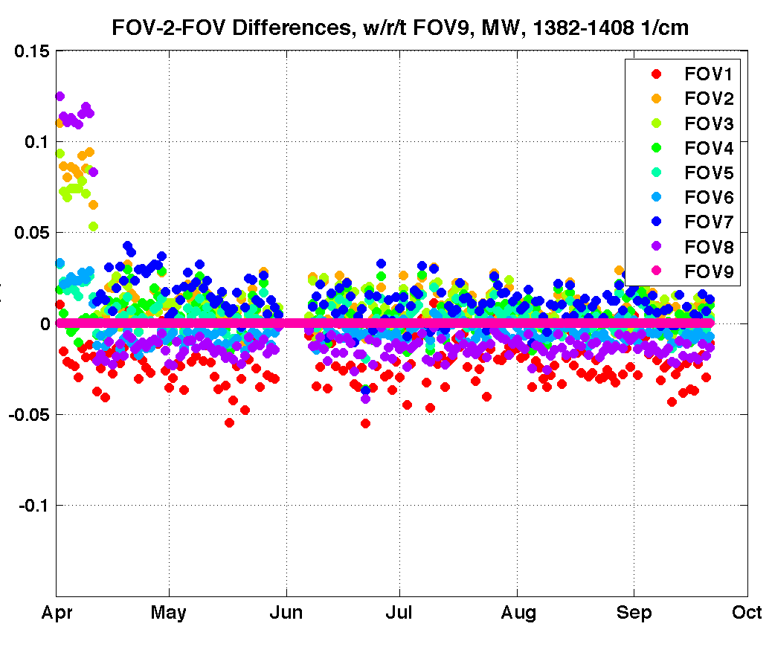
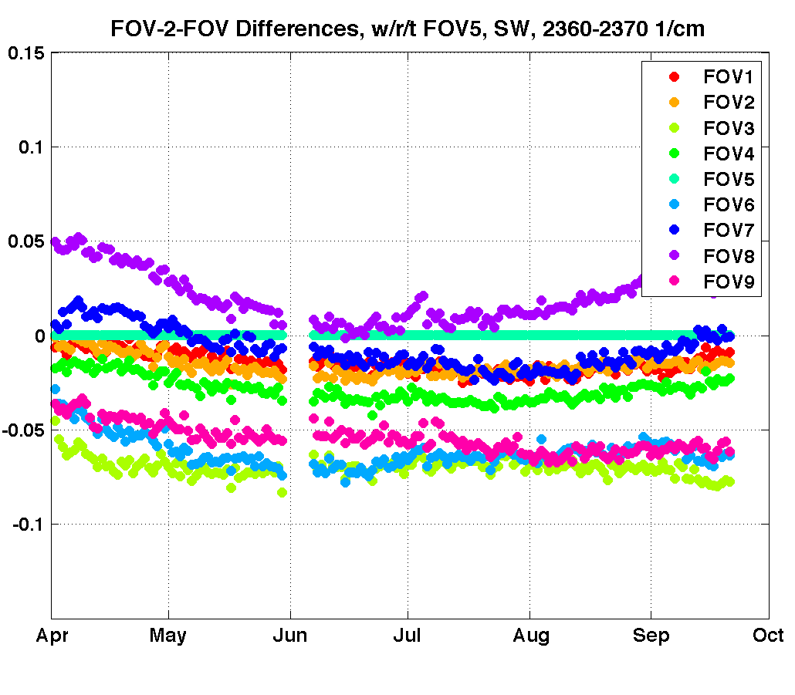
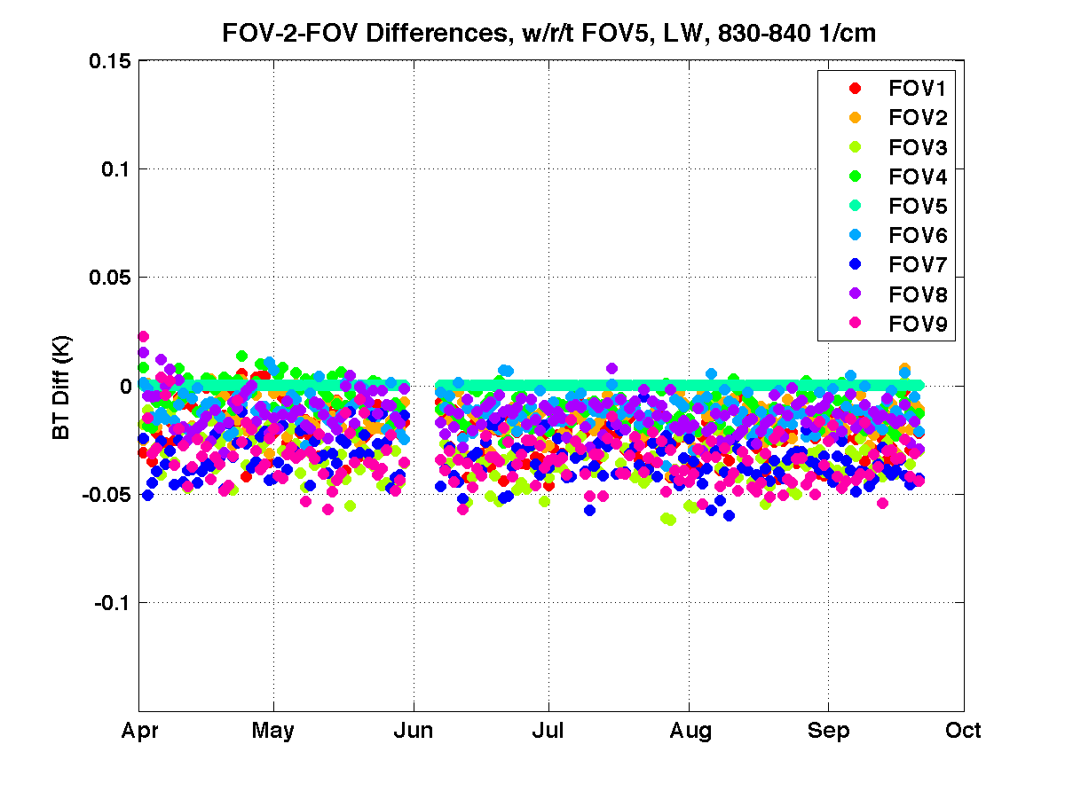
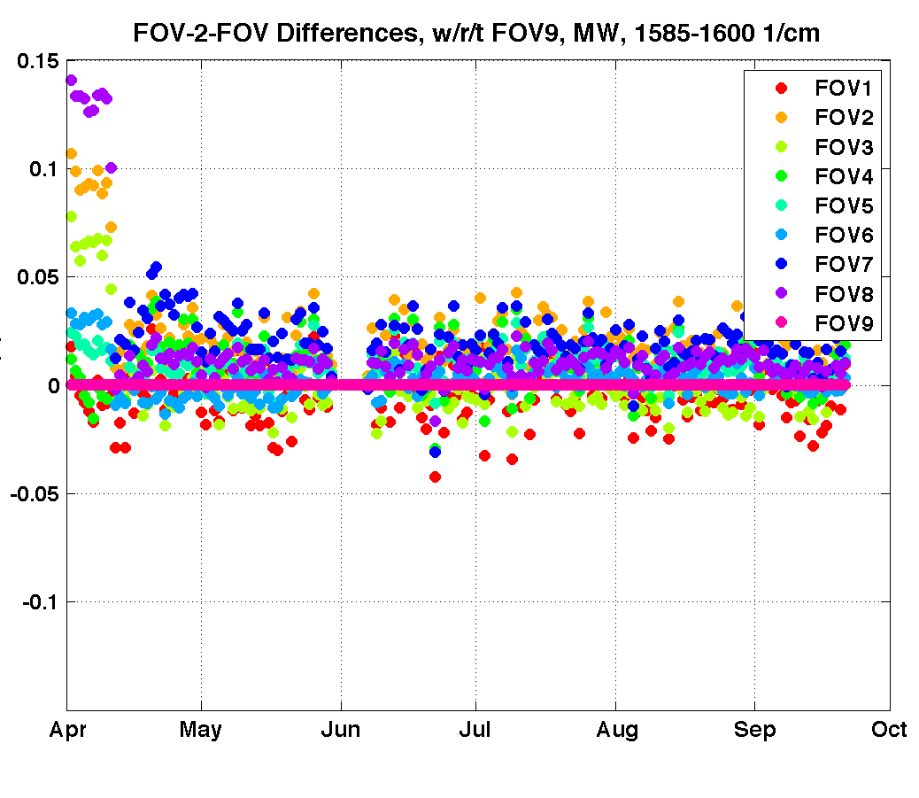
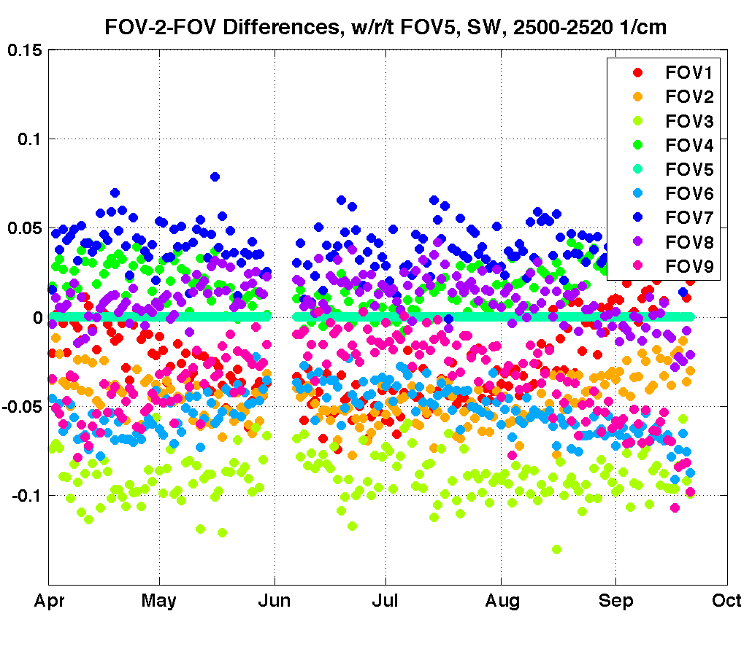
Radiometric Uncertainty Assessment
Inter-FOV difference
LW, 672-682 cm⁻¹, wrt FOV5
MW, 1382-1408 cm⁻¹, wrt FOV9
SW, 2360-2390 cm⁻¹, wrt FOV5
0.1
BT Diff (K)
-0.1
LW, 830-840 cm⁻¹, wrt FOV5
MW, 1585-1600 cm⁻¹, wrt FOV9
SW, 2500-2520 cm⁻¹, wrt FOV5
0.1
BT Diff (K)
-0.1
From UW
FOV-2-FOV differences are less than 0.04 K for LW and MW and less than 0.1 K for SW

Slide 11
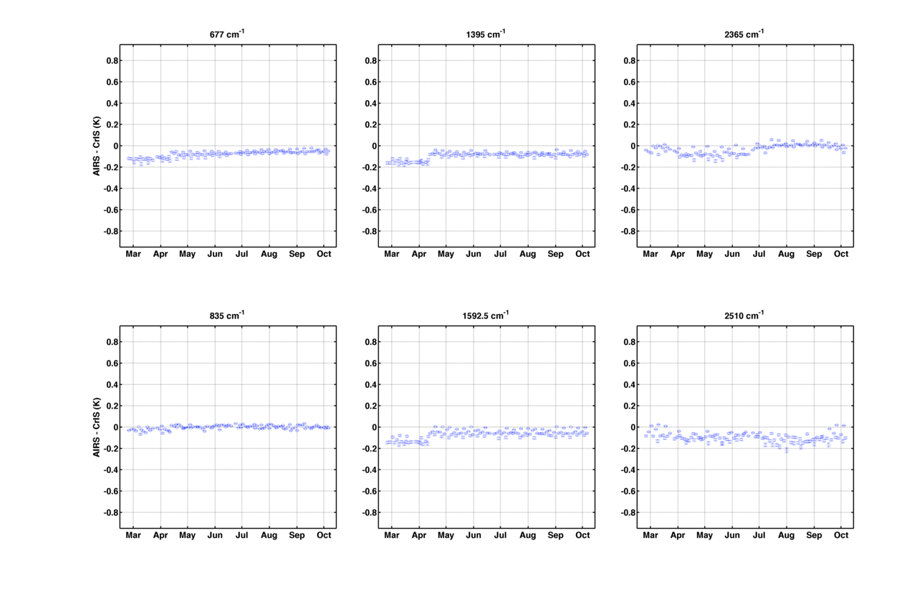
Radiometric Uncertainty Assessment
Daily Mean CrIS-AIRS Differences
v33
upload
Mar
Oct
Mar
Oct
Mar
Oct
Mar
Mar
Oct
Mar
Oct
Stable difference ~0.1 K
From UW

Slide 12
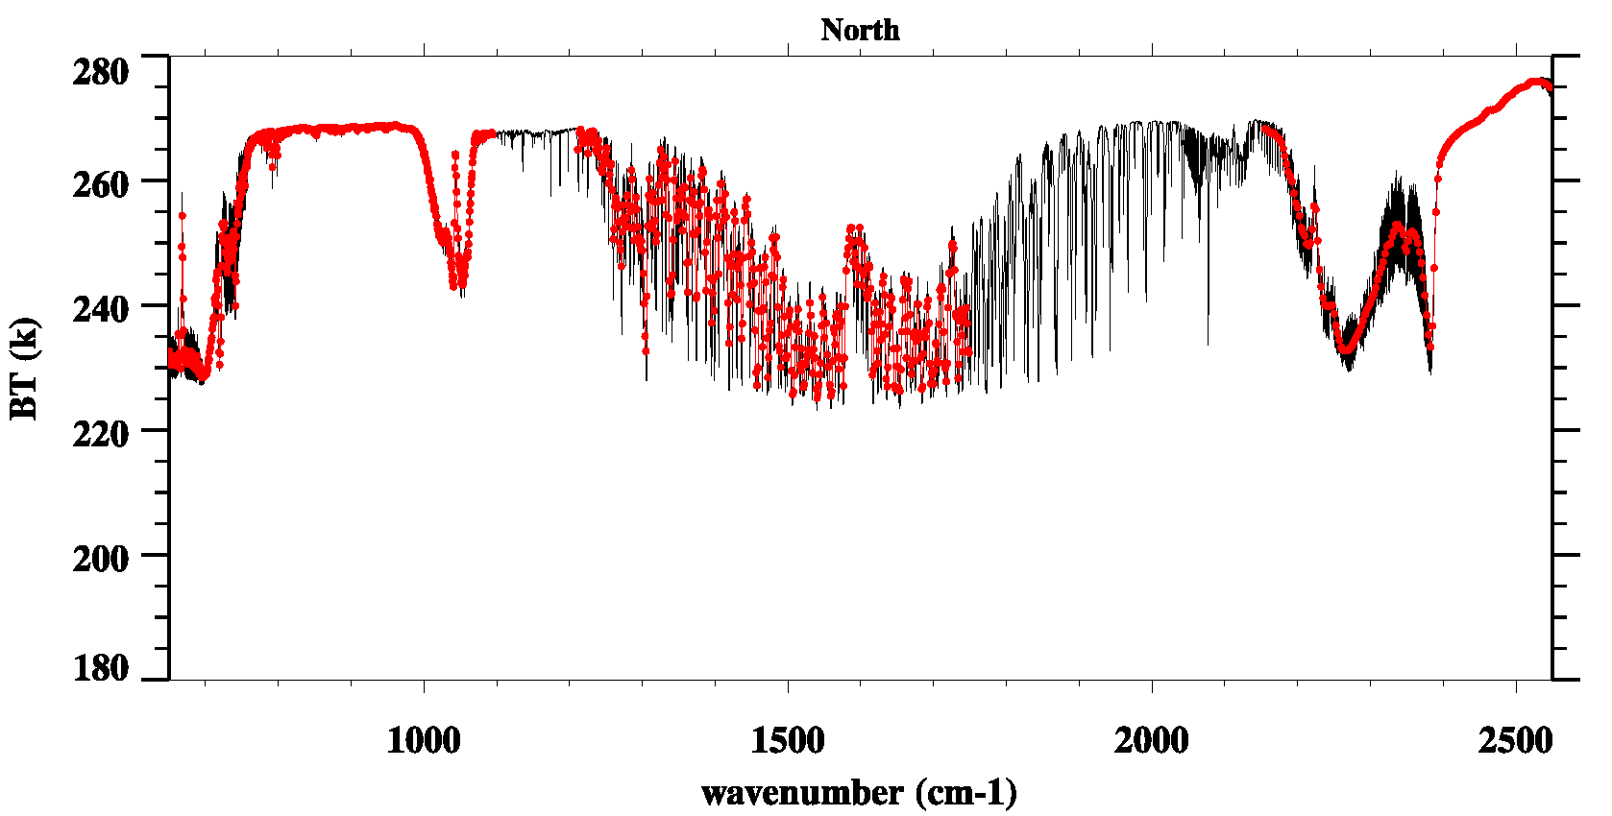
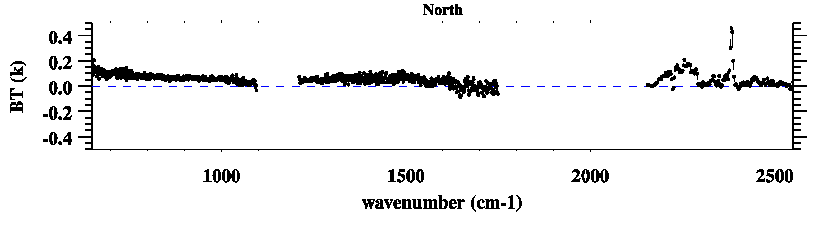
Radiometric Uncertainty Assessment
CrIS-IASI SNO (North Pole)
CrIS
IASI
CrIS - IASI
Sample size = 411
CrIS-IASI difference is ~ 0.2 K

Slide 13
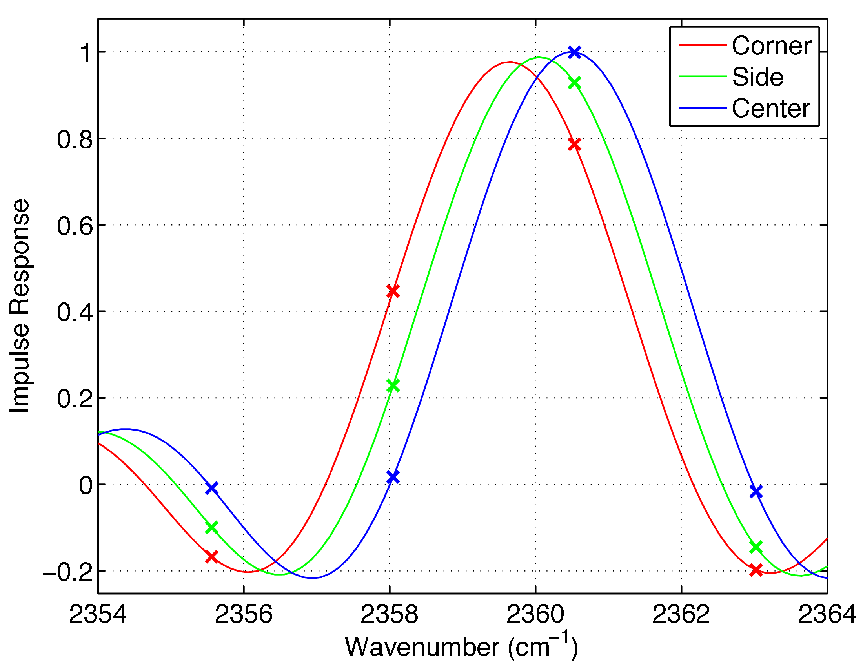
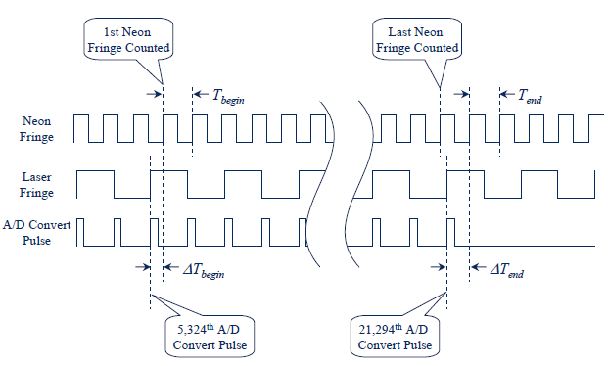
CrIS Spectral Calibration
3x3 Array of CrIS FOVs
(Each at 14-km Diameter at Nadir)
Neon and laser fringes are counted and rationed to
Transfer neon line knowledge to metrology laser
Before ILS correction, all spectra are shifted to the left
  - Center : 16 ppm; Side : 282 ppm; Corner : 399 ppm
Onboard neon lamp provides long-term spectral calibration references for CrIS

Slide 14
CrIS Spectral Calibration
Assessment using CRTM
CMO Update
Measured laser wavelength is very stable after launch, except to bit lock events ; the CMO was re-calculate when wavelength drift exceeds the threshold.
CRTM assessment results exactly follow the laser wavelength trend.

Slide 15
Spectral Calibration
Overall Accuracy with respect to CRTM
Cross-correlation Method under Clear Sky between Observation and CRTM Calculation
LWIR
MWIR
FOV spectral calibration is consistent with 1 ppm.
Spectral calibration with respect to CRTM is 3 and 4 ppm for LWIR and MWIR respectively (meet requirement of < 10 ppm).

Slide 16
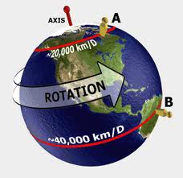
Spectral Shift Caused by Earth-rotation Doppler Effect
Spectral Calibration
Doppler Effects in CrIS SDR data
Doppler shift:
ν : channel frequency; Ω: Earth angular velocity
R_{s}: Distance of the satellite from the center of the Earth
i : Inclination of the orbit; λ: Latitude
Ф: Scan angle
FOR15 relative to FOR16
Satellite orbit
FOR1 frequency shift relative to FOR30
FOR1 relative to FOR30
The Earth-rotation Doppler effect can cause a channel frequency bias up to 1.3 ppm, and Very stable CrIS performance allows detection of very small frequency shifts

Slide 17
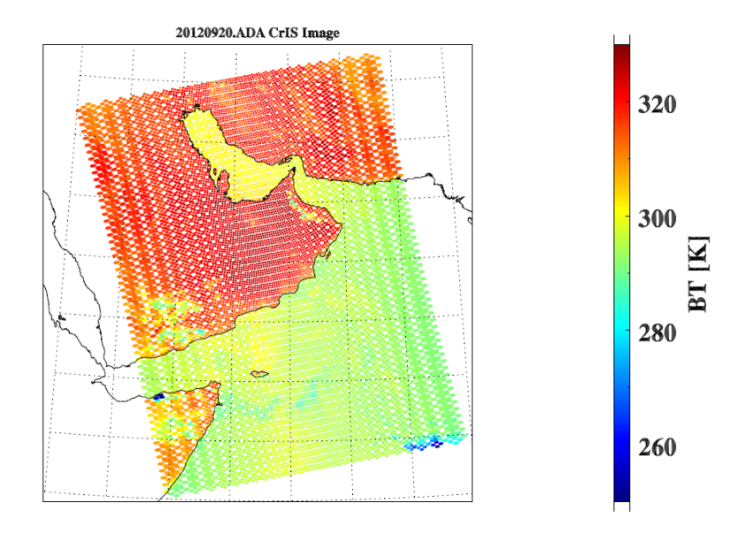
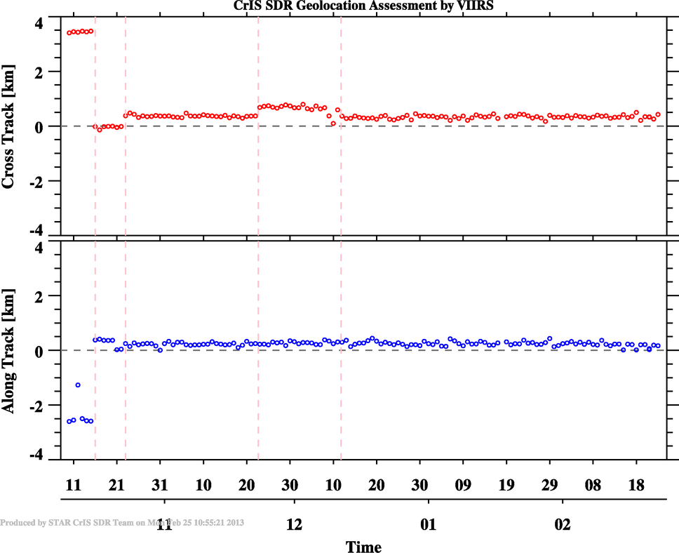
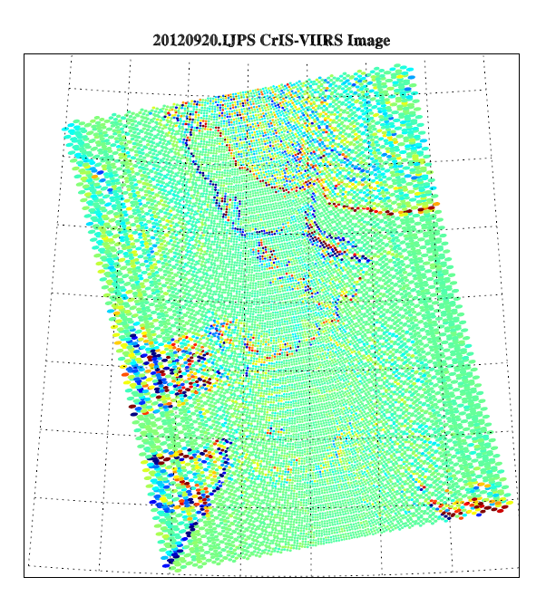
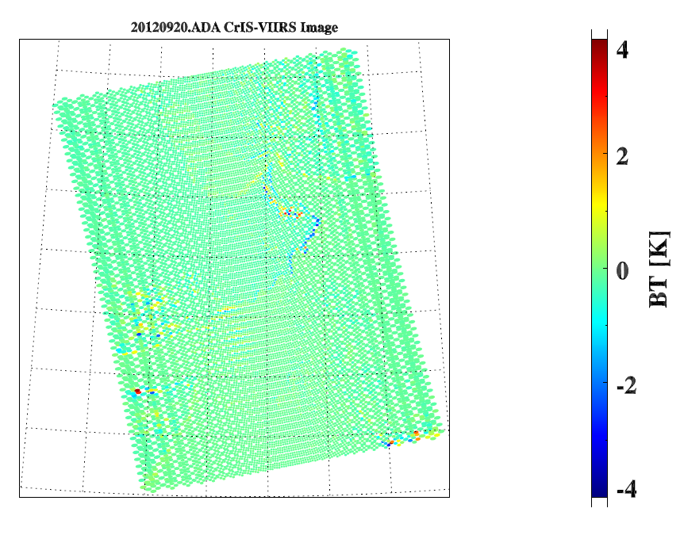
Geolocation Assessment
M6.3x released, code bugs were fixed
EP V35 Upload
VIIRS Geolocation errors
CrIS-VIIRS
Without correction
- Geolocation source code has been fixed and implemented in MX6.3 (10/16/2012).
Geolocation accuracy is: Cross Track: 0.281 ± 0.110 km
          Along Track: 0.276 ± 0.162 km (WRT VIIRS)
With correction

Slide 18
CrIS Overall Performance
 | Method | Result | Requirement | Meet Req.
Radiometric Assessment | SNO CrIS vs AIRS/IASI Double difference GEO | SNO match 0.4K or better DD match 0.2K or better 0.3K or better | 0.45% LW 0.58% MW 0.77% SW at 287K BB. | Yes
Radiometric Assessment | Double Difference | 0.2K or better | Same as above | Yes
Radiometric Assessment | GEO vs LEO | 0.3K or better | Same as above | Yes
Spectral Calibration | Using CRTM | 3 ppm LW 4-5 ppm MW | < 10 ppm | Yes
Geolocation Accuracy | CrIS vs VIIRS | 1.0 Km accuracy | 1.5 Km | Yes
Noise | ICT/DS |  |  | Yes, except MW-FOV7 (has waiver)

Slide 19
Summary
CrIS has excellent performance since launch and meets or exceeds requirements:
  Radiometric accuracy
  Spectral calibration
  Geolocation
  Noise
Provisional maturity level was declared on Feb. 13th 2013.
CrIS radiance is ready for assimilation by NWP.
Issues under investigation:
  Bias at the cold scenes
  Ringing related to sweep direction

Slide 20
Backup

