Slide 1
Inter-Sensor Comparison for Soumi NPP CrIS
Likun Wang¹, Yong Han^{2*}, Denis Tremblay³, Fuzhong Weng², and Mitch Goldberg⁴
1. CICS/ESSIC/University of Maryland, College Park, MD; wlikun@umd.edu
2. NOAA/NESDIS/STAR, College Park, MD
3. Earth Resources Technology, Inc., Laurel, MD
4. NOAA/NESDIS/JPSS Program Office, Greenbelt, MD
* CrIS SDR Team Lead
GSICS GRWG+GDWG Annual Meeting, 4-8 March 2013,Williamsburg, VA

Slide 2
Motivation
Hyperspectral IR sounders have served as benchmark measurements for the GSICS community.
Polar orbiting sensor: HIRS, AVHRR, AATSR
Geostationary : Imagers and Sounders
With more hyperspectral IR sounders on-orbit, are there any radiometric and spectral differences among them?
Now: AIRS →Metop-A/IASI → NPP/CrIS → Metop-B/IASI
Future: JPSS-1/CrIS and MetOp-C/IASI ….
If so, we need to understand the root causes of the differences based on sensor physics.
Benefit for each sensor’s calibration
Basis for climate data records

Slide 3
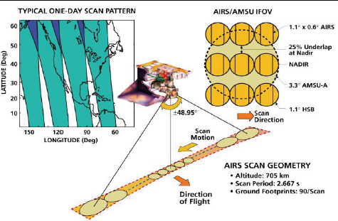
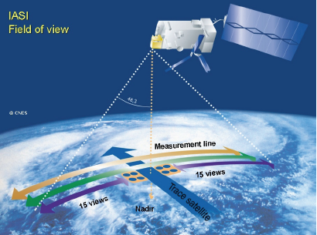
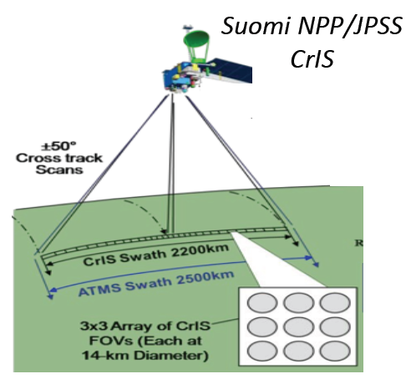
Instrument and Spectral Characteristics
Spectral Coverage and Resolution of
AIRS, IASI, and CrIS
From Hank Revercomb

Slide 4
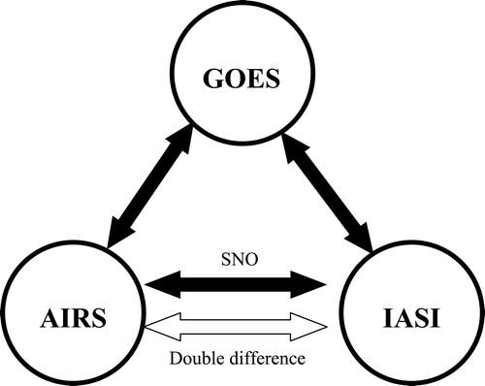
Approach
Direct comparison
CrIS versus IASI/AIRS
Indirect comparison:
Through the third sensor, CrIS-VIIRS versus IASI-VIIRS
Objectives
Reduce uncertainties caused by the methodology
Identify the differences at the sensor calibration level
Understanding the root causes of these differences
VIIRS
CrIS

Slide 5
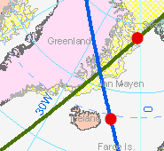
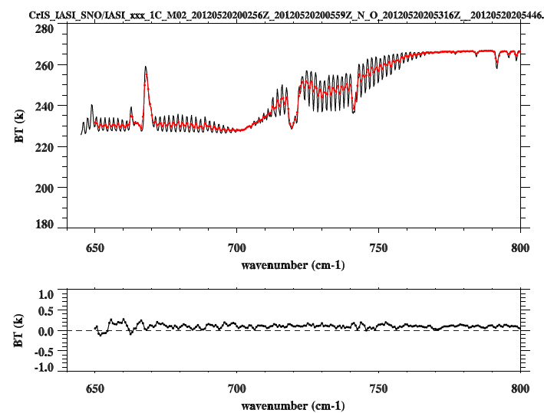
Simultaneous Nadir Overpass (SNO) from 10/22-10/24 and 12/10-12/14: a total of 125 cases
CrIS
Time Difference: <= 120 Sec
Pixel distance difference: <=(12+14)/4.0 km = 6.5 km
Angle Difference: ABS(cos(a1)/cos(a2)-1) <= 0.01
IASI
All data are from IDPS.
Only nadir and uniform scenes were selected.
Using the same collocation algorithms to collocate CrIS/IASI with VIIRS.

Slide 6
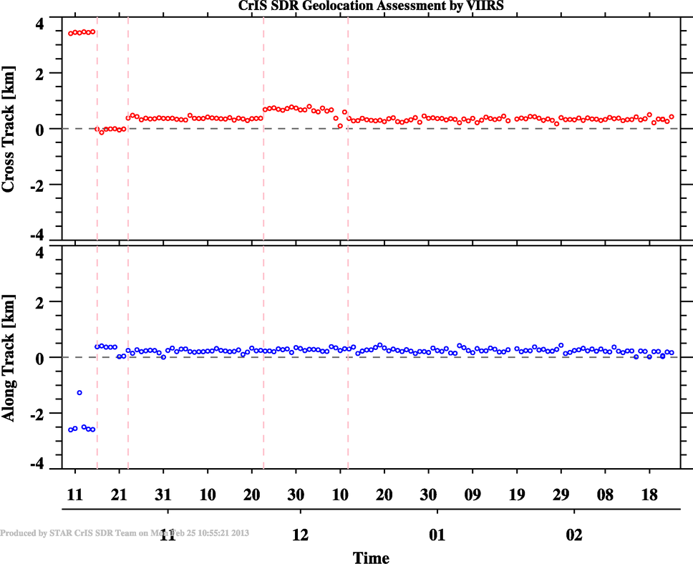
Accurately computing FOV Shape
Satellite Direction
VIIRS Scan Direction
CrIS Scan Direction
M6.3x released, code bugs were fixed
The method based on the algorithm
can detect the VIIRS geolocation errors
EP V35 Upload
VIIRS Geolocation errors

Slide 7
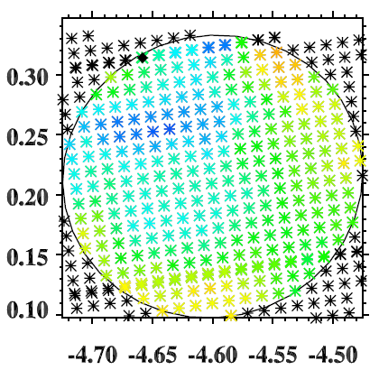
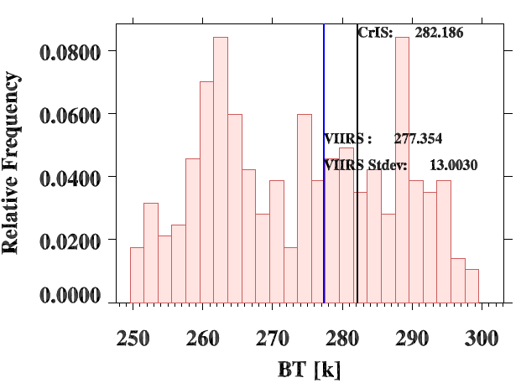
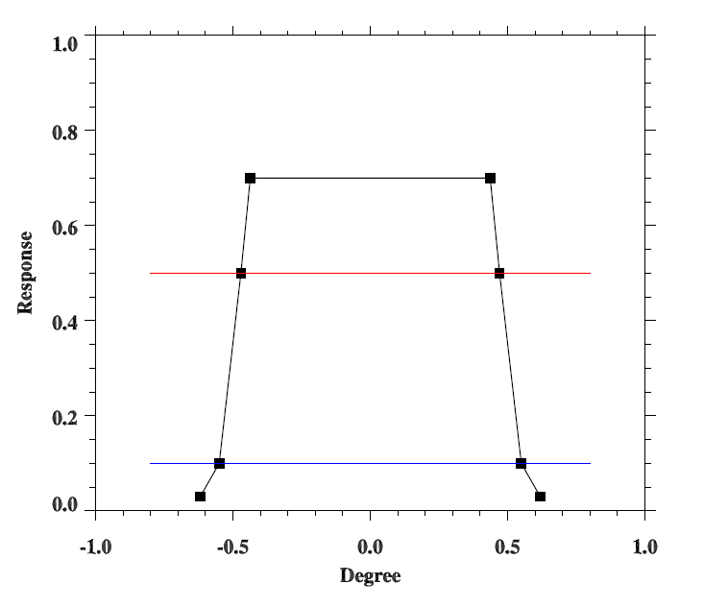
Collocate VIIRS with CrIS/IASI
VIIRS Pixels
CrIS FOV footprint
CrIS/IASI FOV Spatial Response
50%
Histogram of VIIRS M16 radiances in CrIS FOV

Slide 8
Scene Uniformity Effects

Slide 9
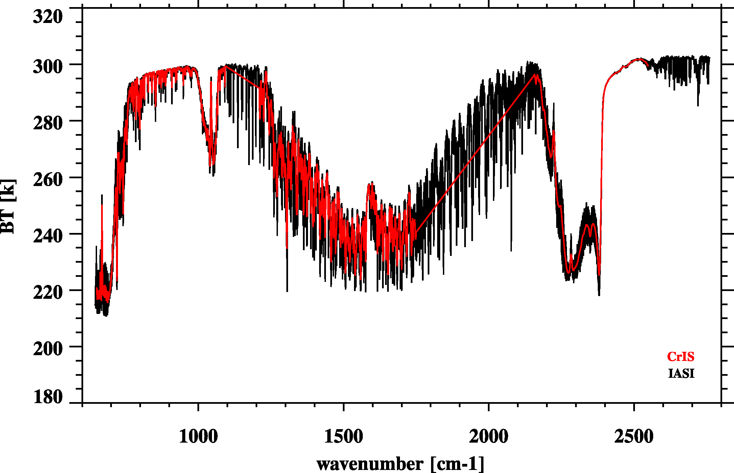
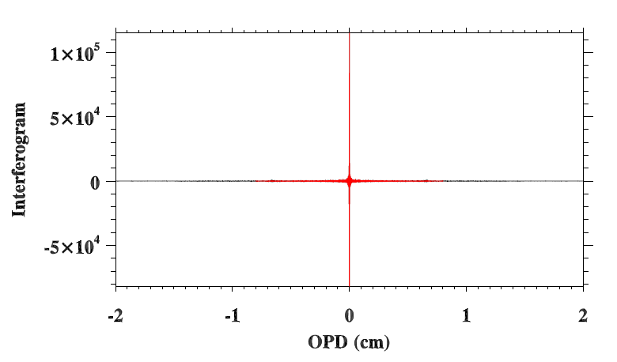
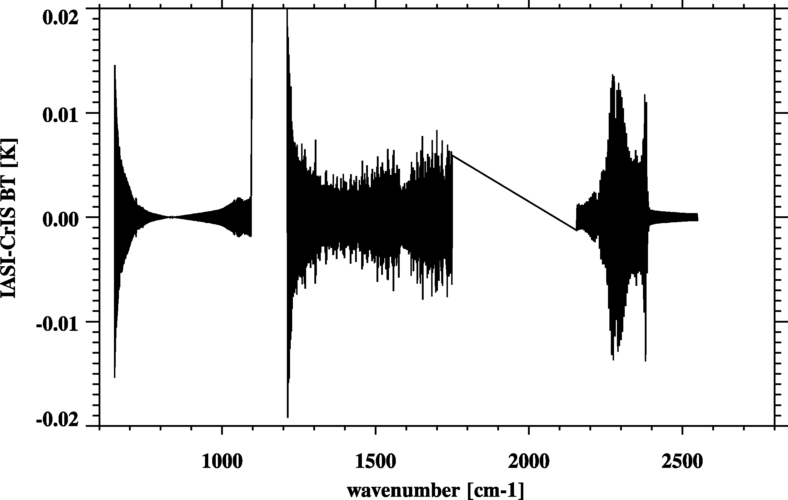
Resample IASI to CrIS
Fourier Transform
De-Apodization
2) Truncation
3) Apodization
CrIS – IASI
Re-sampling error very small
Inverse Fourier Transform

Slide 10
SNO Spectra: 770 Pairs
Average Spectra
North (339)
South (431)

Slide 11
CrIS vs. IASI: CrIS Band 1
North Pole
South Pole
CrIS
IASI
CrIS-IASI
At band 1, CrIS is slightly warmer than IASI.
CrIS-IASI BT differences show the slope feature and BT differences decrease with wavenumbers.

Slide 12
CrIS vs. IASI: CrIS Band 2
North Pole
South Pole
CrIS
IASI
CrIS-IASI
For band 2 at water vapor absorption region, CrIS and IASI are well consistent and the BT difference is less than 0.1 K.

Slide 13
CrIS vs. IASI: CrIS Band 3
North Pole
South Pole
CrIS
IASI
CrIS-IASI
At band 3, CrIS is warmer than IASI .
BT differences are large at the spectral transition region (~2380 cm-1)

Slide 14
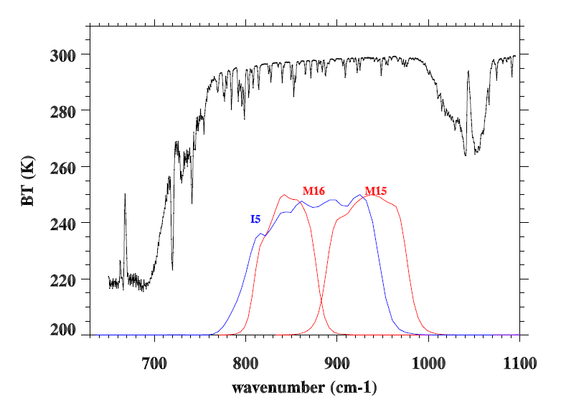
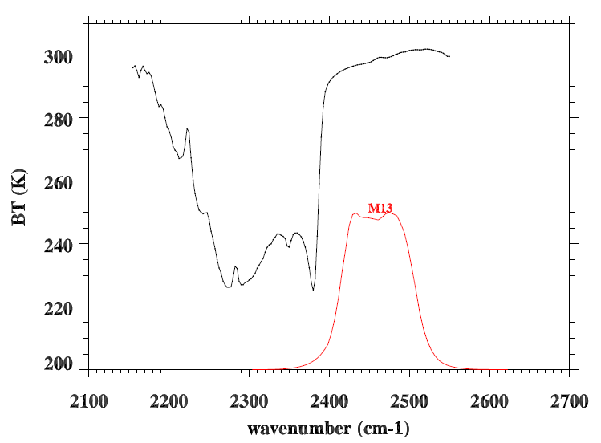
How about CrIS/IASI versus VIIRS?
CrIS/IASI spectra are overlapped with VIIRS SRFs for M13, M15, and M16, and I5
12.0 µm
10.8 µm
4.05 µm

Slide 15
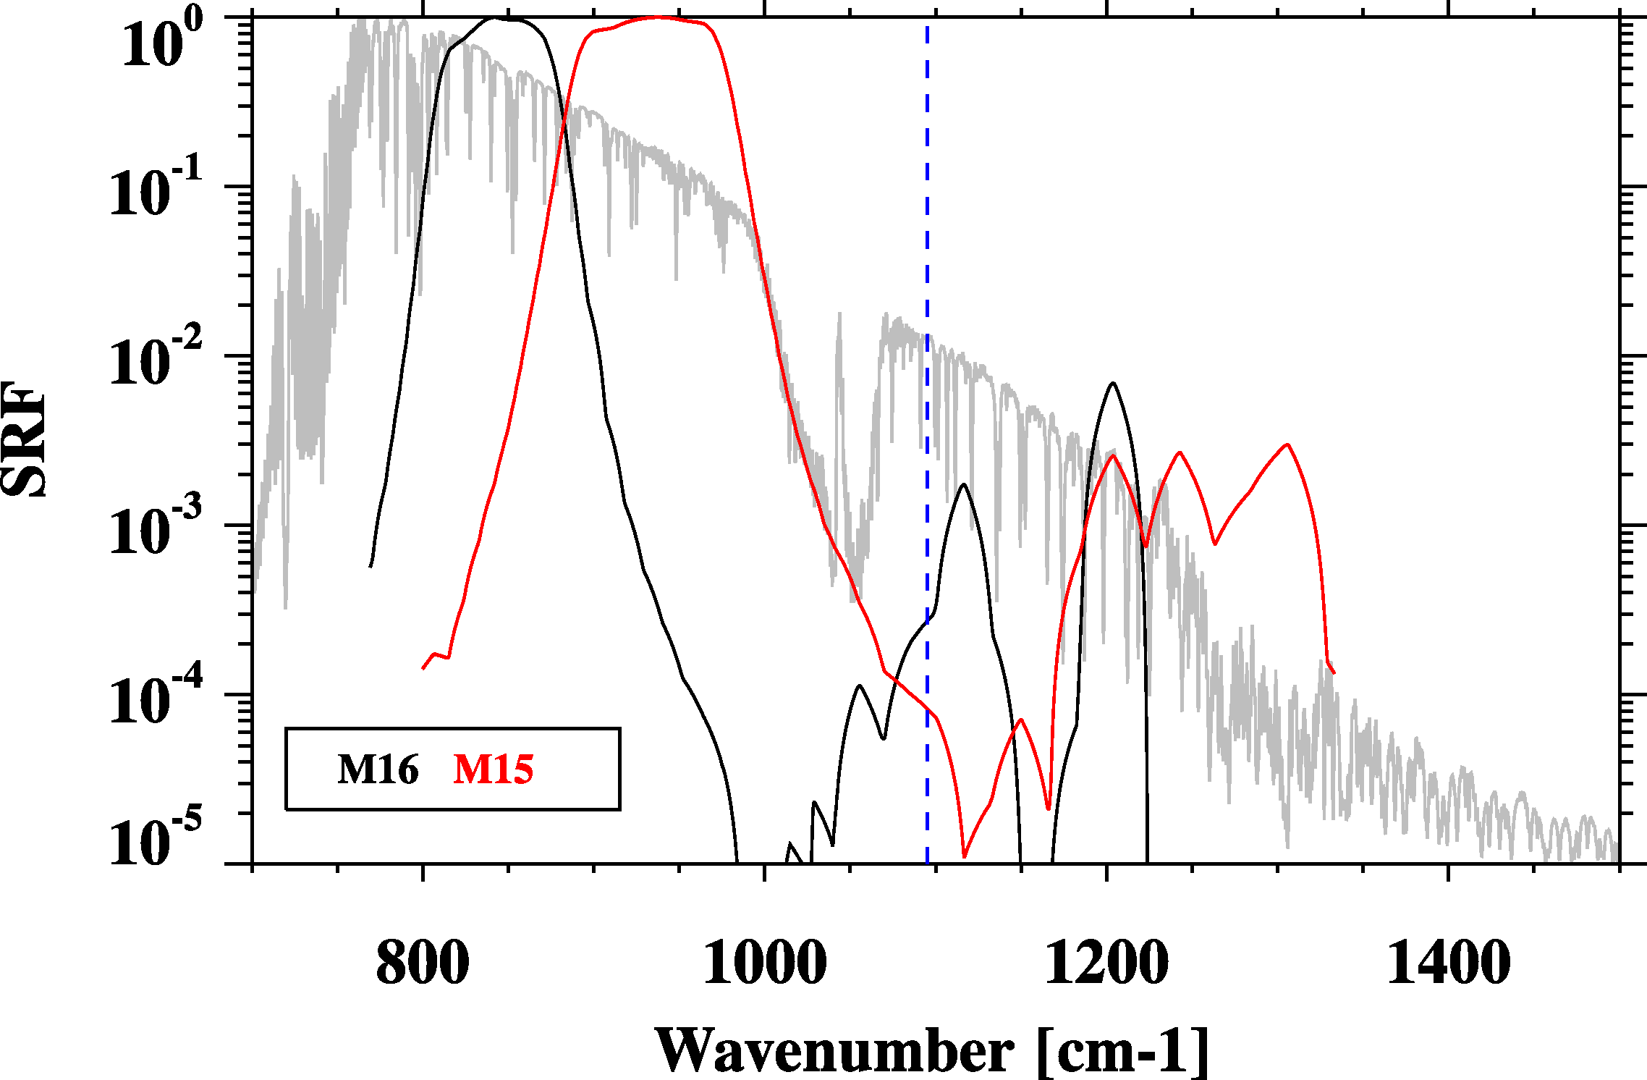
Be careful for out-of-band response!
CrIS Band 1 end point
Center wavenumber and band correction coefficients are calculated using the above SRFs.

Slide 16
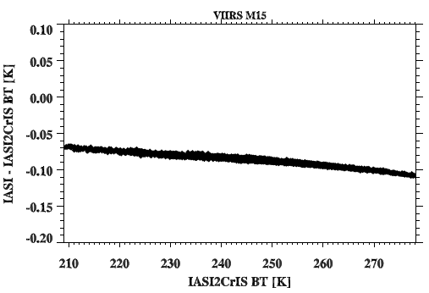
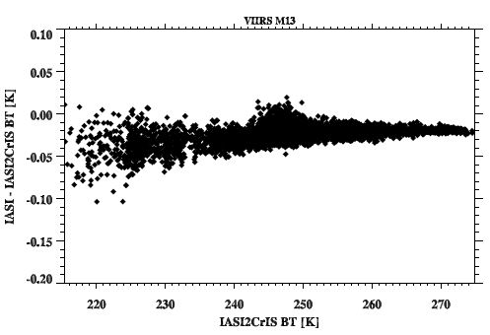
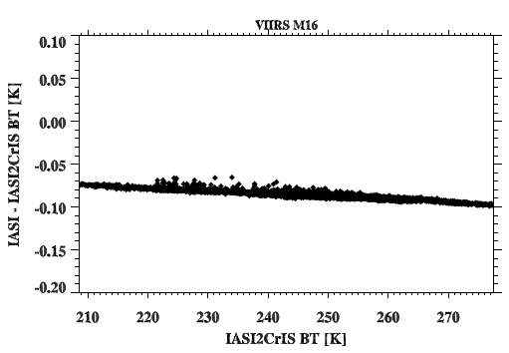
OOB effects in BTs
IASI-IASI2CrIS vs. IASI2CrIS
M15
M15
M13
M16
M16
This relationship is used to compensate
CrIS convolution results.

Slide 17
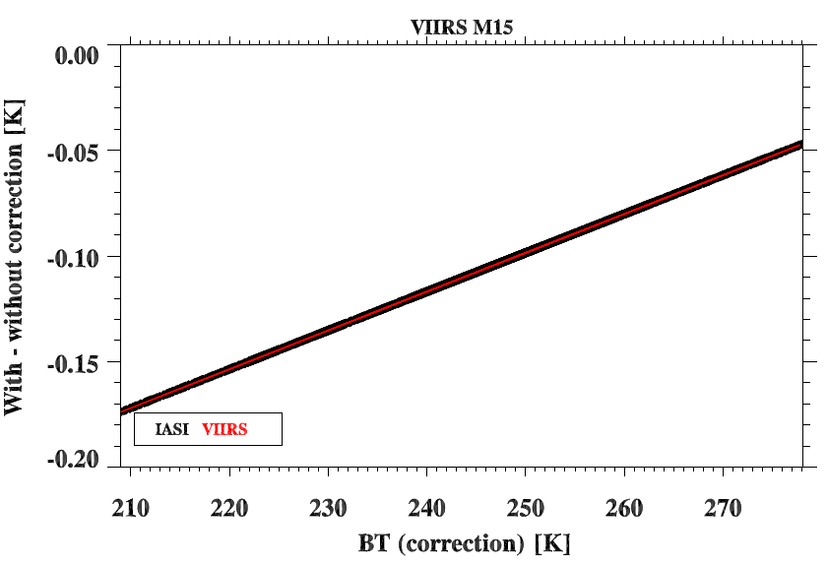
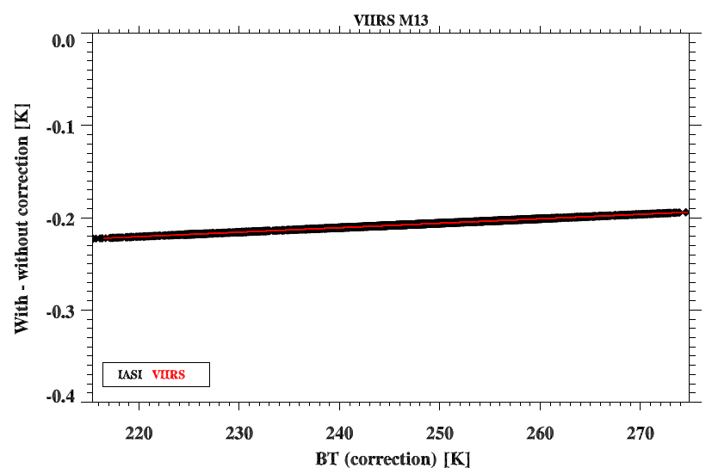
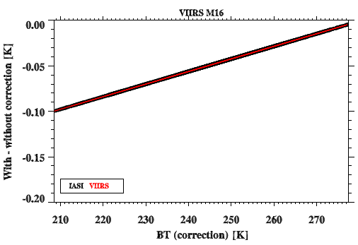
Band Correction
M15
M13
From VIIRS radiances to BTs
Unit: [wm-2 sr-1 μm-1]
From CrIS/IASI radiances to BTs
Unit: [mw m-2 sr-1 cm-1]
Band correction at a BT domain should give identical values.
M16

Slide 18
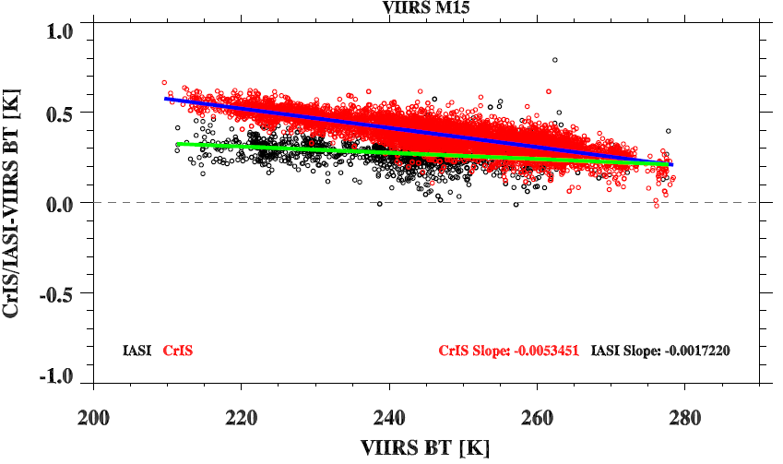
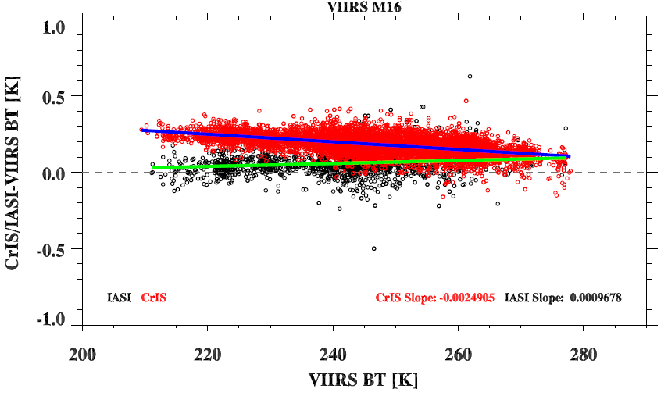
CrIS/IASI versus VIIRS
CrIS is warmer than all sensors; CrIS-VIIRS at Band 15 has larger scene-dependence than M16
IASI seems close to VIIRS and does not show scene dependence features.
Using VIIRS as a reference, CrIS is warmer than IASI , especially for cold scenes.
M15
M16
Notes:
CrIS is warmer than all the sensors, Band 15 have more large scene-dependence than M16
IASI seems close to VIIRS and doesn’t show scene dependence bias.
CrIS and IASI

Slide 19
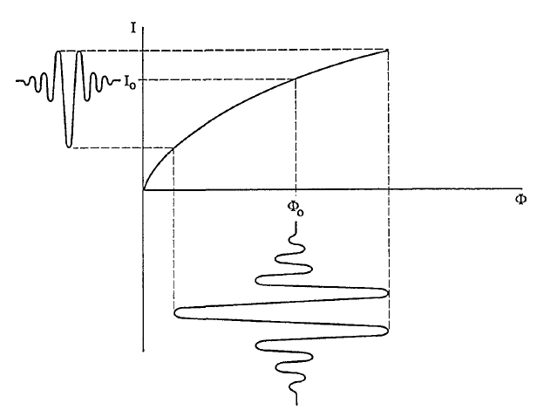
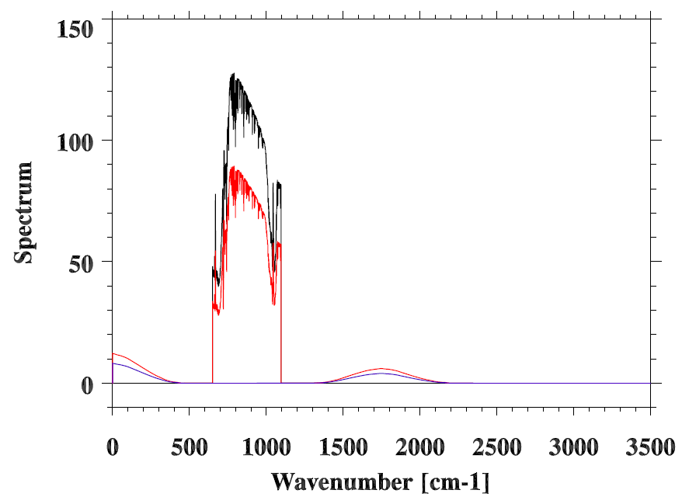
For a non-linear detector
F(Ifg1): linear response
measured dc signal.
F(Ifg2): non-linear response
F(Ifg3): convolution term
Flux
Hypothetical detector-response curve exhibiting nonlinearity. The horizontal axis represents the absolute magnitude of the photon flux and the vertical axis represents the measured dc signal.
Non-linearity responses in spectral domain.
From Abrams et al. 1994

Slide 20
Non-linearity Values (a2) from TVAC, DM, and Earth Scenes
3x3 Array of CrIS FOVs
(Each at 14-km Diameter at Nadir)
From UW
Different from Band 2, a2 values are close to each other in band 1 and it is not easy to
find a reference FOV.

Slide 21
a2 Sensitivity Study How do CrIS-VIIRS patterns change with a2?
M15
a2
Changed a2 values
M16

Slide 22
a2 Sensitivity Study How do CrIS-IASI patterns change with a2?
2012/12/12-14 SNO cases South Pole
CrIS
IASI
a2
Changed a2 values

Slide 23
Conclusion Remarks
Inter-comparison of CrIS with IASI indicate that the consistency between CrIS and IASI is around 0.1-0.2 K at most spectral regions.
Given current consistency level (0.1-0.2K), it is very hard to find the root causes of the differences. However, in order to generate long-term climate data records, some issues still need further investigation:
CrIS is warmer than IASI at the longwave band, especially for cold scenes
CrIS-VIIRS scene-dependent features at M15
Spectral inconsistency for shortwave sharp transition regions between CrIS and IASI
Looking forward: we really need MetOp-B IASI data to join in inter-comparison, which will facilitate the diagnosis.

Slide 24
Thank you

Slide 25
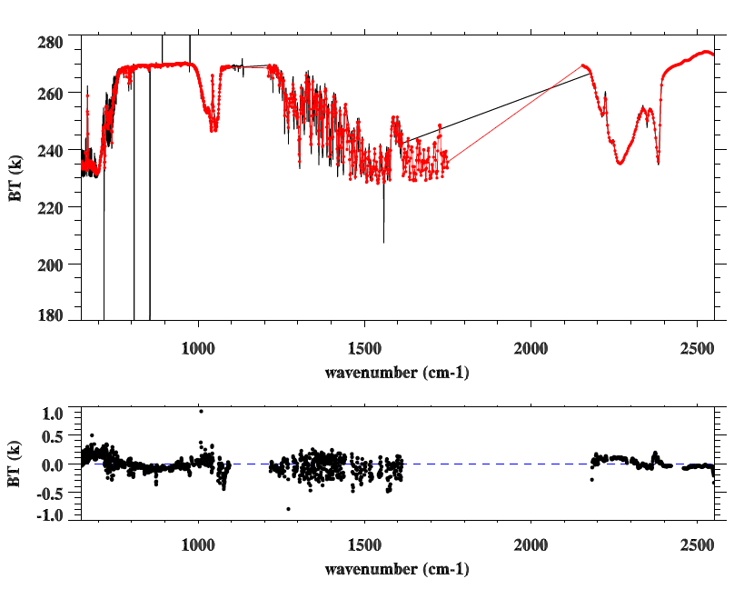
AIRS vs. CrIS
: North Pole SNOs
CrIS
AIRS
CrIS-AIRS

