Slide 1


MODIS and VIIRS Reflective Solar Bands Calibration Methodologies and
Performance Comparison
X. Xiong¹, J. Butler¹, J. Sun², A. Angal³, J. Fulbright², N. Lei²,
J. McIntire², and H. Oudrari²
1. NASA/GSFC, Greenbelt, MD 20771, USA
2. Sigma Space Co., Lanham, MD 20706, USA
3. SSAI, Lanham, MD 20706, USA
2013 GSICS Annual Meeting-Williamsburg, VA, March 4-8, 2013
1

Slide 2
Acknowledgements
MODIS Characterization Support Team (MCST)
VIIRS Characterization Support Team (VCST)
S-NPP/JPSS VIIRS SDR Team
  NOAA
  Aerospace Corp
  NASA
  Univ. of Wisconsin
  …
2

Slide 3
Outline
Background
  Instrument and On-board Calibrators
Reflective Solar Bands On-orbit Calibration
  Solar Calibration
  Lunar Calibration
On-orbit Performance
Summary
3

Slide 4
Background
Moderate Resolution Imaging Spectroradiometer (MODIS)
  Key instruments for NASA EOS Terra (L: 1999 ) and Aqua (L: 2002)
  20 reflective solar bands (RSB) and 16 thermal emissive bands (TEB)
  Spectral wavelengths: 0.4-14.5 μm
  Spatial resolution: 250 m (2 bands), 500 m (5 bands), and 1 km (29 bands)
  40+ science data products
Visible/Infrared Imager Radiometer Suite (VIIRS)
  Key instruments for SNPP (L: 2011) and JPSS (J1 L: 2016?)
  14 reflective solar bands (RSB), 7 thermal emissive bands (TEB), and 1 day night band (DNB)
  Spectral wavelengths: 0.4-12.4 μm
  Spatial resolution: 375 m for I bands and 750 m for M bands
  22 EDRs
VIIRS was designed and built with strong MODIS heritage and lessons

Slide 5
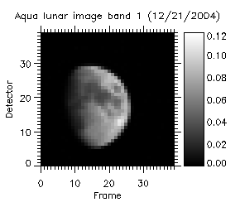
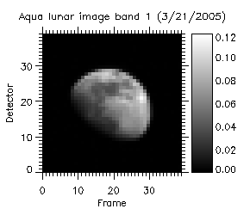
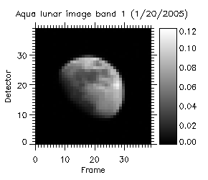
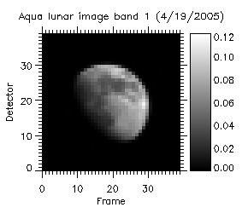


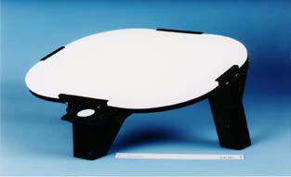
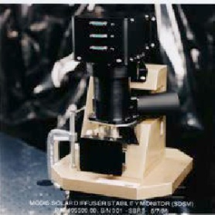
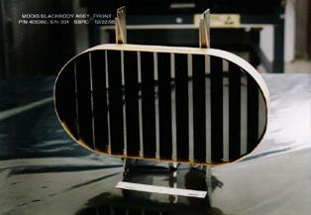
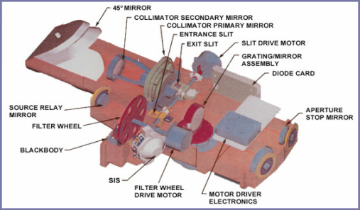
MODIS On-board Calibrators
Aqua MODIS B1 Lunar Images
SD SDSM BB SRCA
5
Notes:
Calibration Coefficients and Noise Characterization

Slide 6
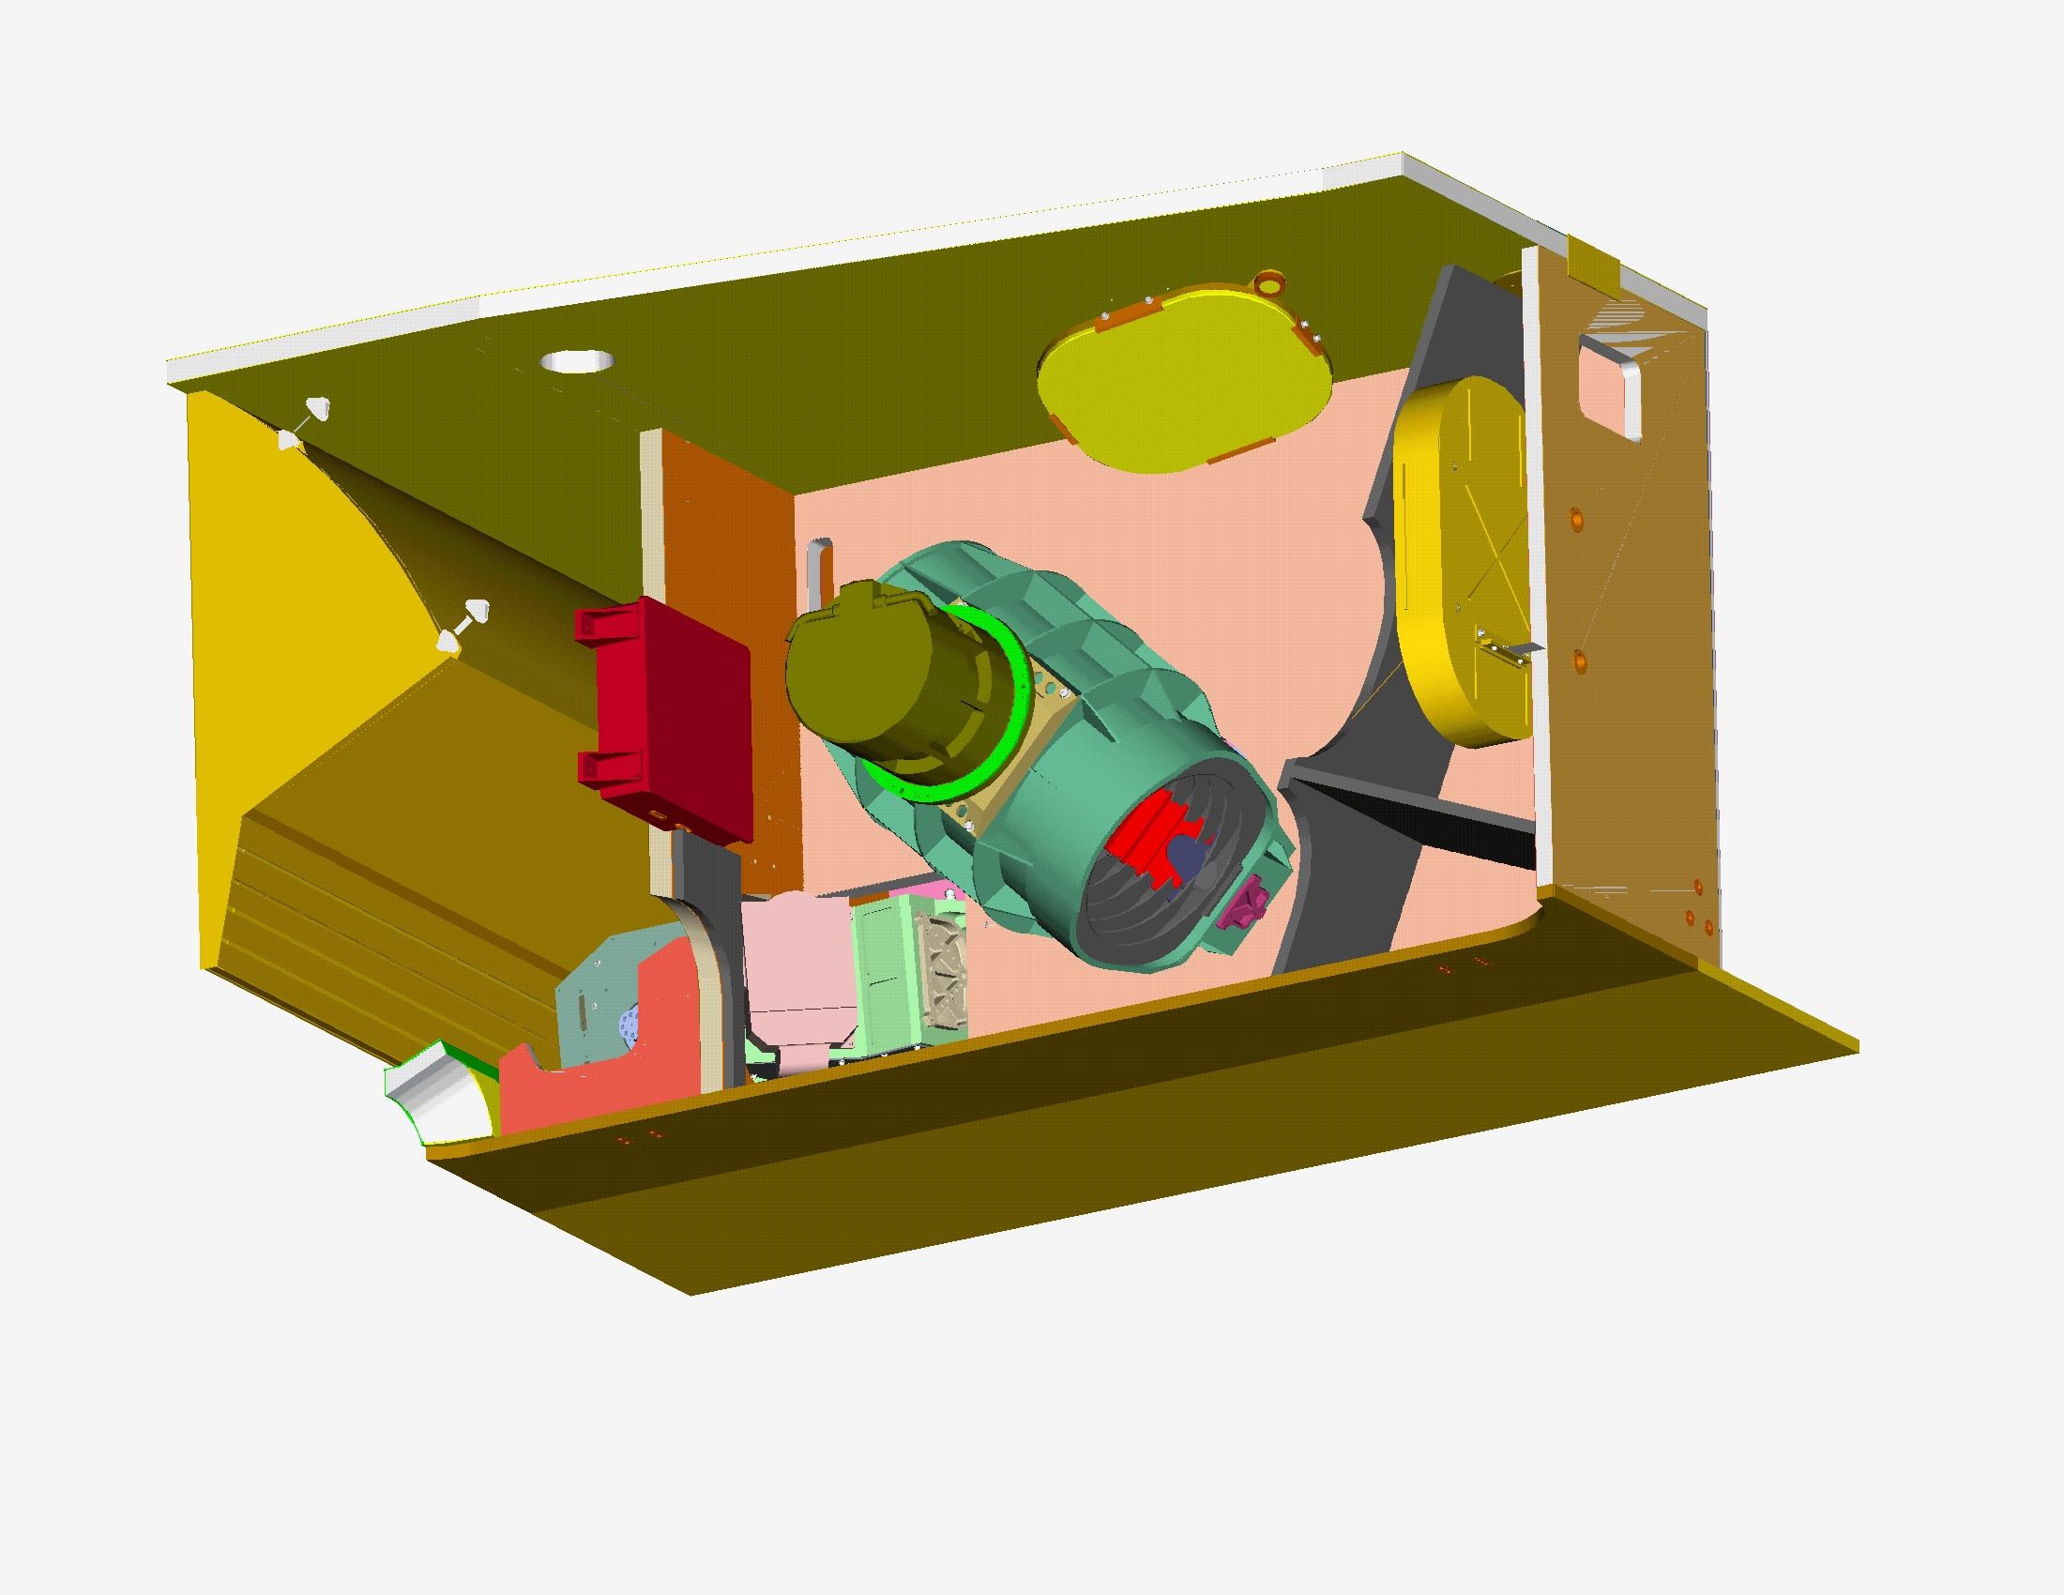
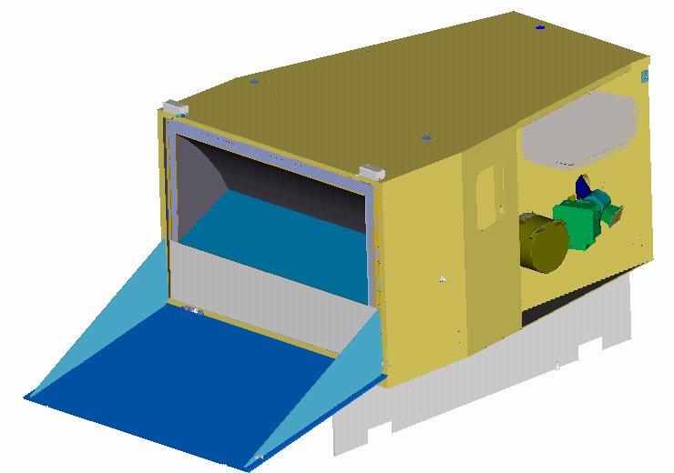
VIIRS On-board Calibrators (MODIS Heritage)
Blackbody
Solar Diffuser with Fixed Screen
Extended SV Port
Rotating Telescope Aft Optics and HAM
Solar Diffuser Stability Monitor
S-NPP VIIRS I1 Lunar Images
No SRCA for VIIRS
6
Notes:
Calibration Coefficients and Noise Characterization

Slide 7
Reflective Solar Bands On-orbit Calibration
Solar Calibration
  MODIS: Regularly scheduled SD/SDSM observations (SD door opens only during SD/SDSM calibration)
  VIIRS: SD calibration performed each orbit (no SD door), SDSM currently operated on a daily basis
Lunar Calibration
  Regularly scheduled at nearly the same phase angle
  Observed through SV port via SC maneuvers (roll)
7

Slide 8

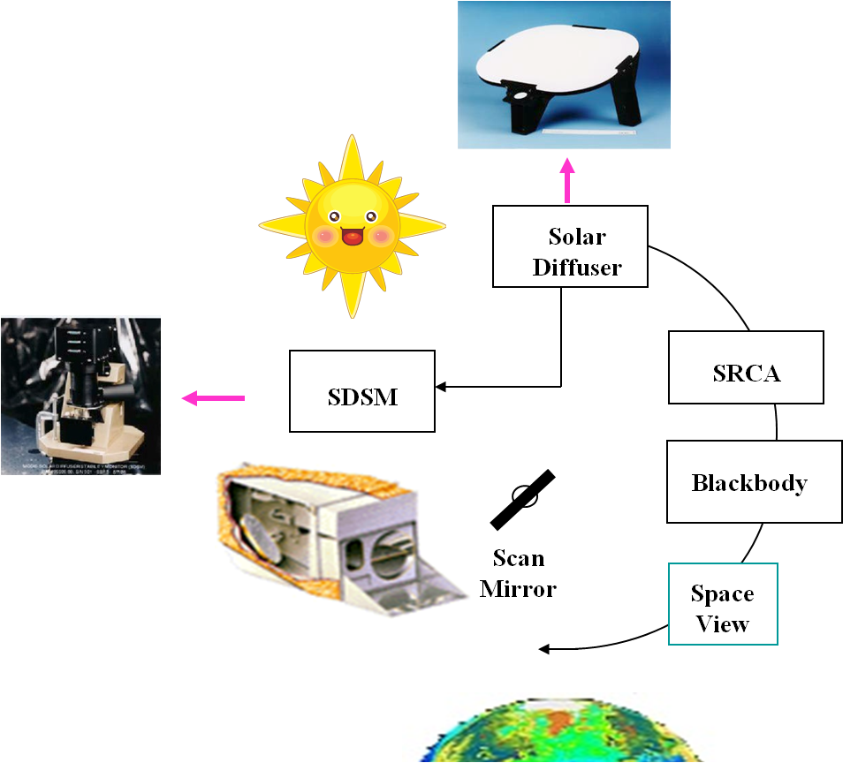
MODIS RSB Calibration (SD/SDSM)
EV Reflectance Factor:
Δ_{SD}: SD degradation factor
Γ_{SD}: SD screen vignetting function
d: Earth-Sun distance
dn*: Corrected digital number
dc: Digital count of SDSM
8

Slide 9
VIIRS RSB On-orbit Calibration (SD/SDSM)
RSB Calibration: F and H Factors
The dn and dc are VIIRS and SDSM detector “corrected” responses
9

Slide 10

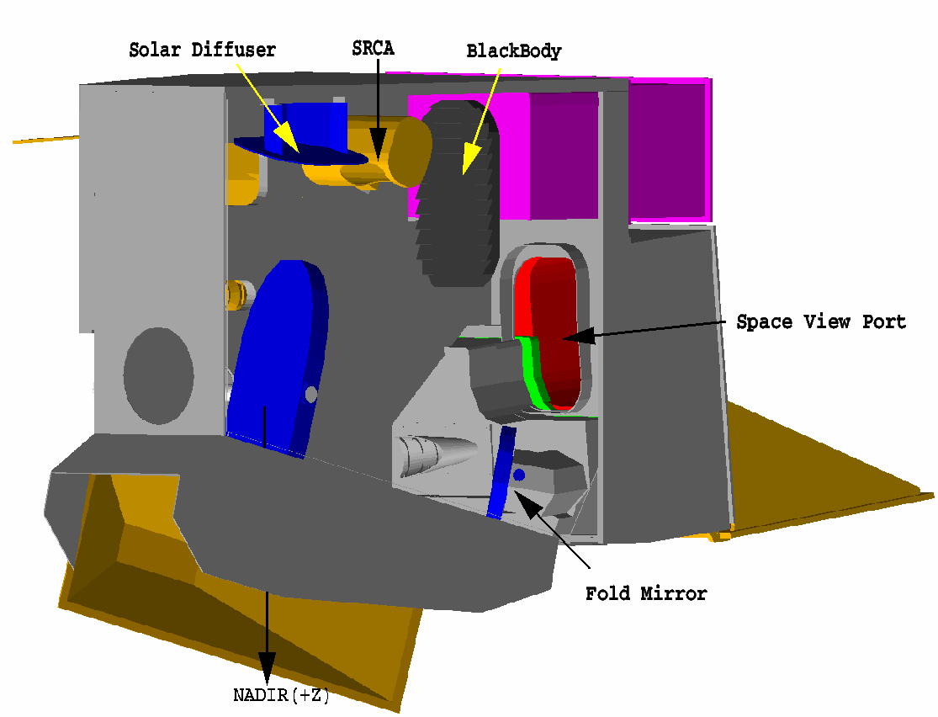
MODIS RSB Calibration (Moon)
gain ∝ 1/m₁
Geometric Factors
MODIS SD and lunar observations are made at different scan angles
10

Slide 11
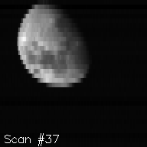
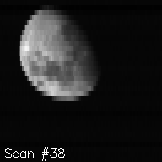
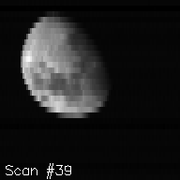
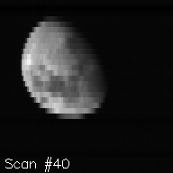
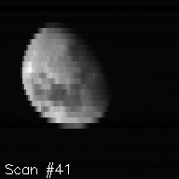
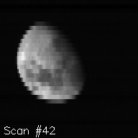
VIIRS RSB Calibration (Moon)
Integrated lunar irradiance (or radiance) from sensor observations
  B: Band; M: HAM side; G: Gain stage; d: Detector; s: Sub-frame;
  dn: Background subtracted response
  c₀, c₁, and c₂: calibration coefficients
Relative lunar F-factor
  J_{Model}(B) from USGS ROLO model
SD F-factor
Examples of band I1 lunar images (Jan 4, 2012 )
11

Slide 12
On-orbit Performance
RSB On-orbit Performance
  Aqua MOIDS and S-NPP VIIRS
OBC On-orbit Performance
  SD Degradation
  SDSM (not included here)
12

Slide 13
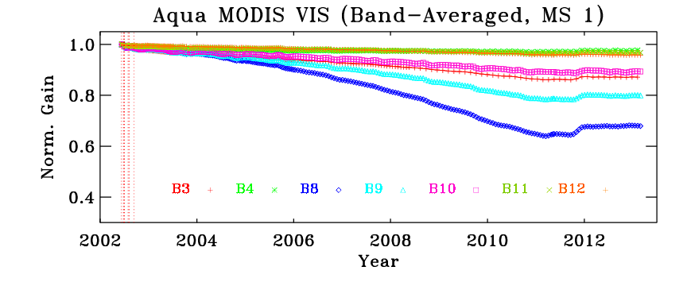
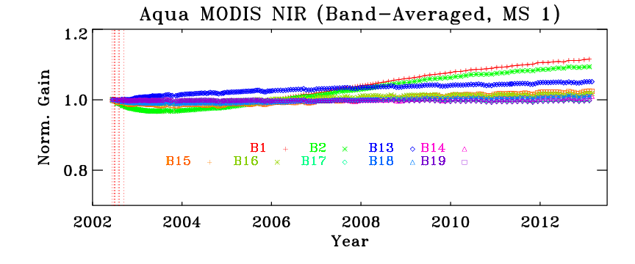
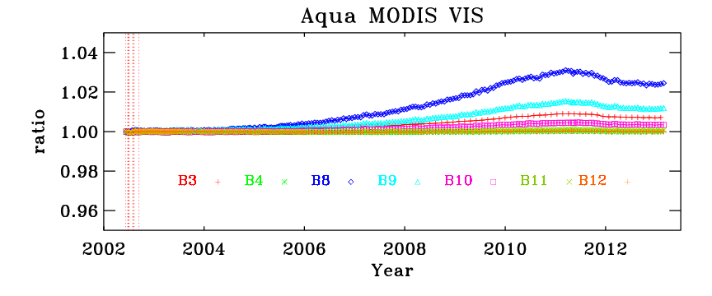
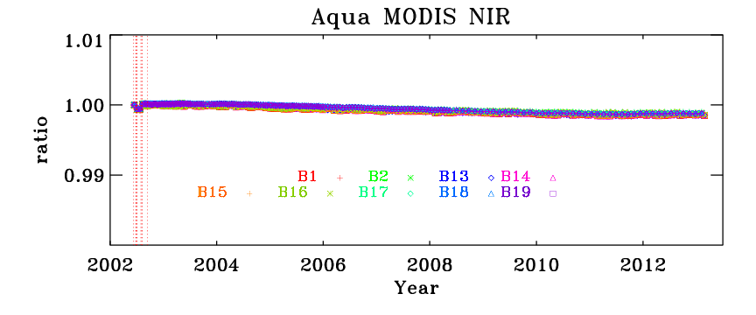
MODIS RSB On-orbit Performance
VIS bands
NIR bands
SD
MS Ratio
Noticeable Mirror Side Dependence in VIS
13

Slide 14
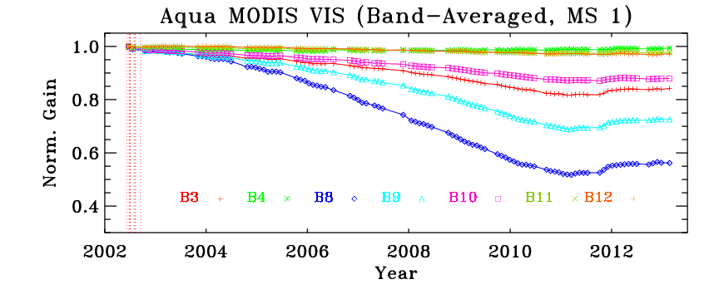
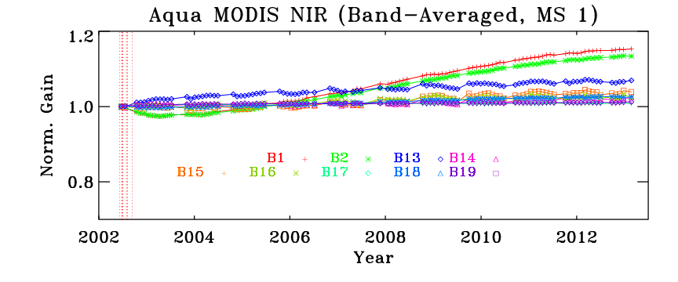
MODIS RSB On-orbit Performance
VIS bands
NIR bands
SD
Moon
Large Changes in Short Wavelength VIS Bands
Strong Mirror AOI Dependence in VIS
14

Slide 15
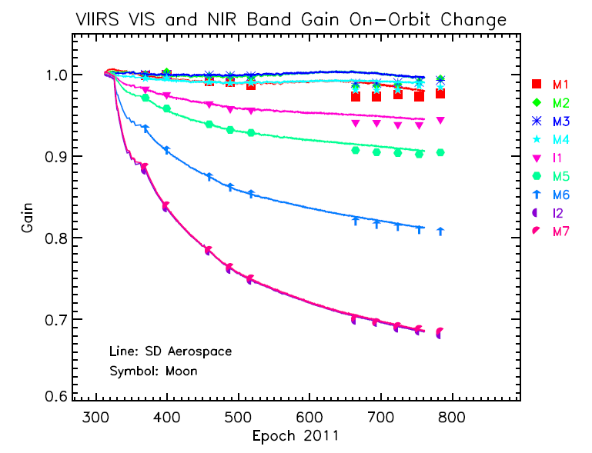
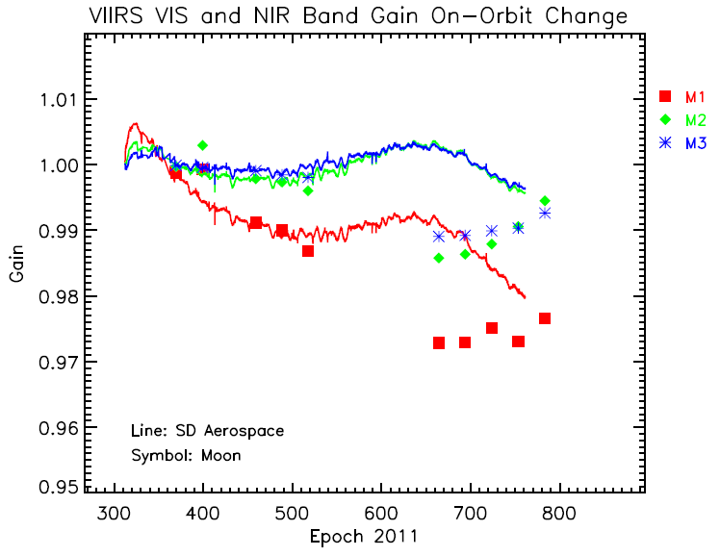
VIIRS RSB On-orbit Performance
Normalized SD calibration gains (1/F-factors) – “Aerospace”
Normalized lunar calibration gains (normalized to 4/2/2012 lunar observation)
Noticeable SD and Lunar Calibration Difference in VIS (at the same AOI)
Little Change for HAM Side and AOI Dependence
15

Slide 16
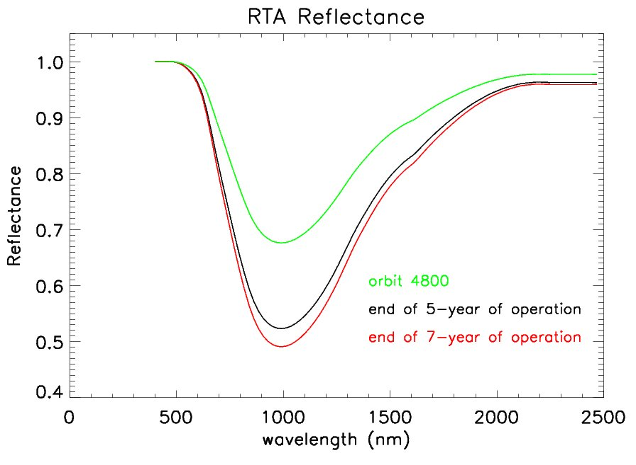
VIIRS RSB On-orbit Performance
Mirror Degradation Impact On Calibration
Modulated Sensor RSR
Ongoing Effort for Future Improvement: Modulate RSR in SDR Calibration
16

Slide 17
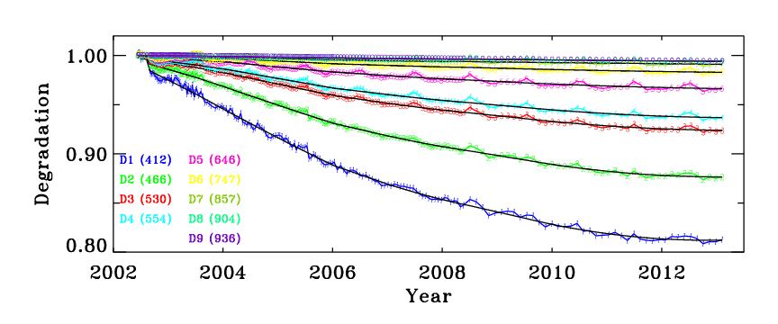
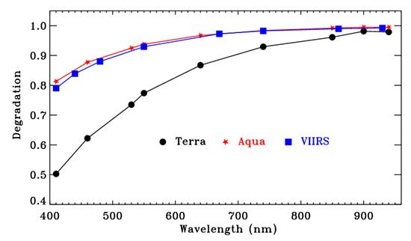
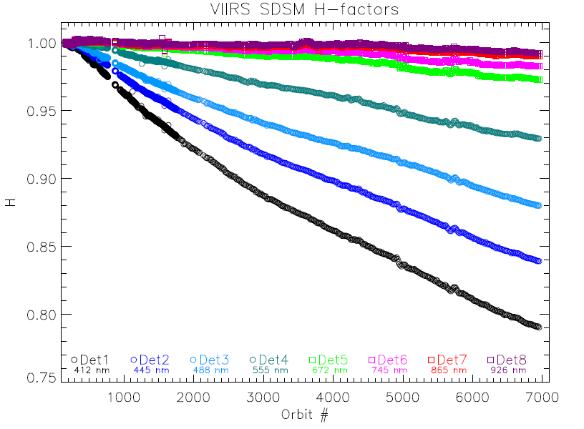
SD On-orbit Degradation
Aqua MODIS
SD On-orbit Degradation Tracked by On-board SDSM
S-NPP VIIRS
VIIRS has no SD door:
Large degradation in SD BRF
17

Slide 18
On-orbit Calibration Strategy and Effort
Mirror side and AOI depend calibration
Frequent calibration LUT updates
  Sensor and SD degradation
  Change in sensor RVS (MODIS)
Dedicated calibration effort
  Degradation modeling and impact analysis
  Mitigation strategy for future improvement
    Modulated RSR
18

Slide 19
Summary
Both MODIS and VIIRS RSB are well calibrated (joint effort by a gov-led SDR team), meeting specified sensor design requirements
  Similar calibration methodologies (different calibration frequency)
  Similar SDSM performance
  Similar SD degradation (larger at shorter wavelengths)
  Large response changes in VIS bands for MODIS
  Large response changes in NIR (and SWIR) for S-NPP VIIRS
Effort for future improvements
  VIIRS mirror degradation impact (modulated RSR)
  Larger SD degradation impact (reflected solar spectra)
  SDSM detector OOB response
19

Slide 20
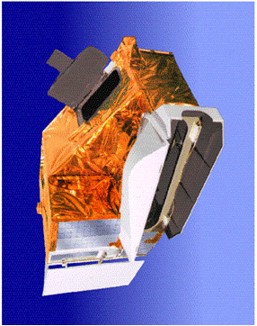
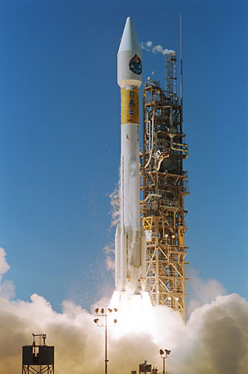
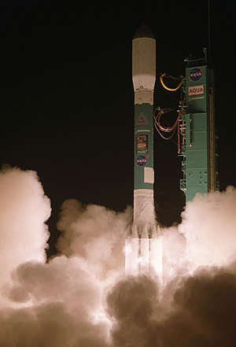
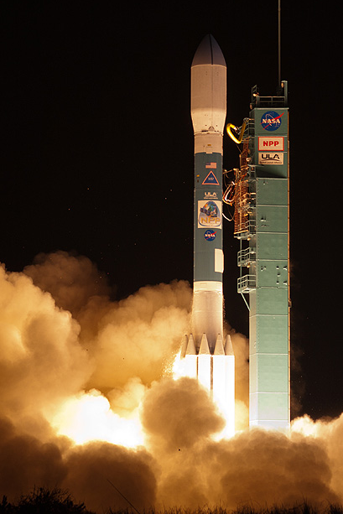
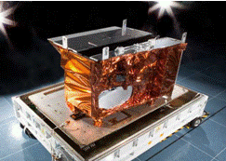
MODIS and VIIRS
MODIS on Both Terra and Aqua
  Terra: Dec. 18, 1999 – Present (12+ years)
  Aqua: May 04, 2002 – Present (10+ years)
VIIRS on S-NPP and JPSS
  S-NPP: Oct. 28, 2011 – Present (~ 1 year)
  JPSS-1: Launch in 2016
MODIS
Terra
Aqua
SNPP
VIIRS
Applications: 40+ data products from MODIS and 22 EDR from VIIRS

